Slide 1


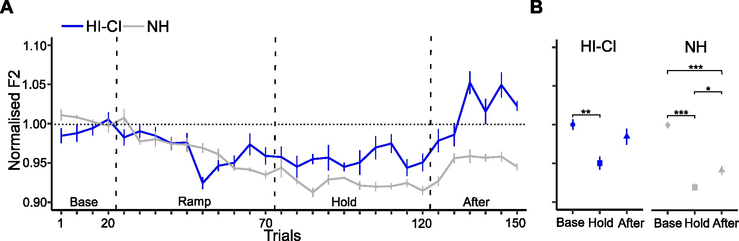
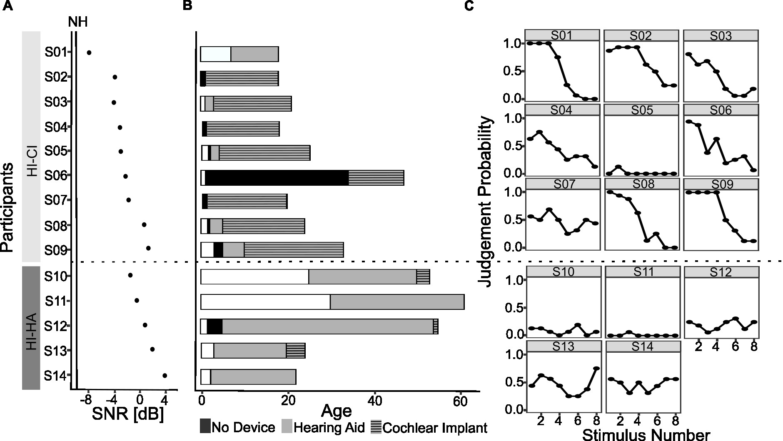


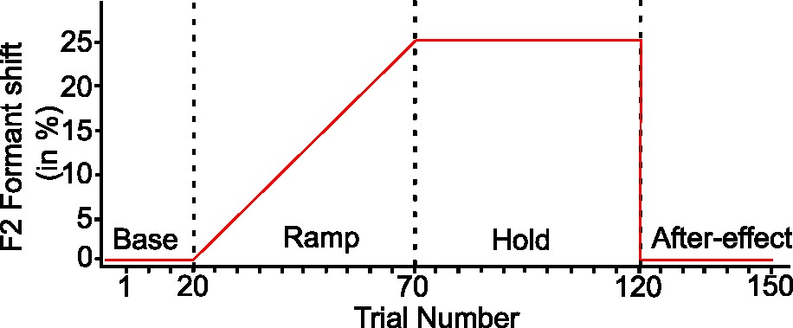
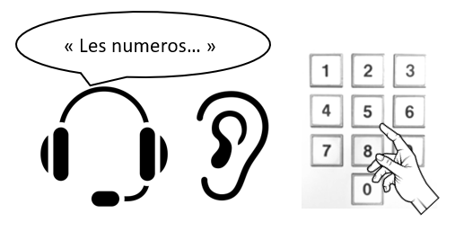
Speech sensorimotor adaptation in individuals with hearing-impairment
Monica Ashokumar¹, Jean-Luc Schwartz¹, Takayuki Ito¹
¹Univ. Grenoble Alpes, CNRS, Grenoble INP, GIPSA-lab, Grenoble, France
Introduction
Results
Auditory feedback is important for learning and maintaining speech production.
When a produced vowel sound is played back with altered formants, speakers adapt their production in the direction opposite to the imposed formant change.
We assessed whether hearing-impaired (HI) individuals using hearing aids (HA) and/or cochlear implants (CI) showed speech sensorimotor adaptation based on altered auditory feedback task and how their adaptation is related to their hearing ability and profile.
NH adapted [F(2, 26) = 54.9, p < 0.001]
HI-CI: long-term CI users (≥13 years), low hearing thresholds, able to identify the vowels.
adapted [F(2, 16) = 5.3, p < 0.05]
HI-HA: long-term HA users (> 16 years), high hearing thresholds, difficult to identify the vowels.
not adapted [F(2, 8) = 0.3, p = 0.7]
Methods
French native speakers: 14 NH, 14 HI
Hearing Thresholds
Hearing Profile
Vowel Identification Test
Altered Auditory feedback task
Participants repeated “deux”(/dø/) 150 times.
F2 was changed over the course of the training.
Compared normalized F2 between Base, Hold and After-effect phases.
Deux
Produced
Playback
Discussion
Audapter: F2 Change
+ 70dB noise
Formant change over the course of the training
HI-CI group showed sensorimotor adaptation, but HI-HA did not. This can be consistent with the general idea that CI can provide acoustic characteristics more in detail than HA.
Although HI-HA group includes CI users with relatively short period, they did not show adaptation as HI-CI. Certain period of CI experience may be required to use such detailed acoustic information adequately.
HI-CI returned F2 over the baseline at the end of aftereffect phase, while NH returned F2 up to the half point between Baseline and Hold. Adapted sensorimotor representation may different between NH and HI-CI.
Hearing ability and profile
Hearing threshold in noise: to detect three digits in noise
Hearing profile: Questionnaire
Vowel identification: to identify if presented vowel is /e/ or /ø/
/e/ or /ø/?
Acknowledgements: We would like to thank Marie-Joe Kfoury, team in CCP and ULB for help with HI participant recruitment.
This project has received funding from the European Union’s Horizon 2020 research and innovation programme under the Marie Sklodowska-Curie Grant Agreement No 860755 and by National Institute on Deafness and Other Communication Disorders Grant R01-DC017439.

