Slide 1
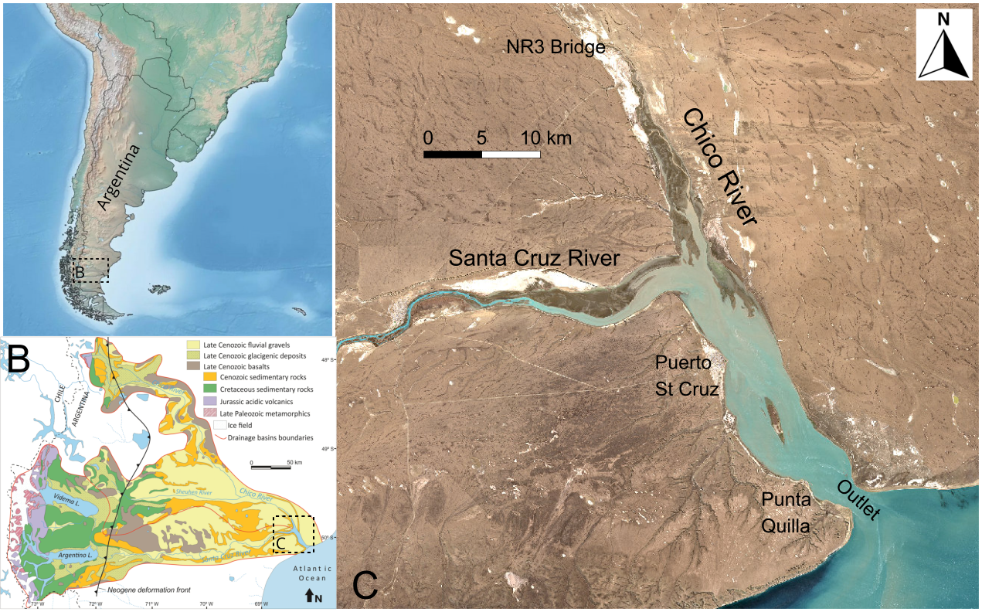
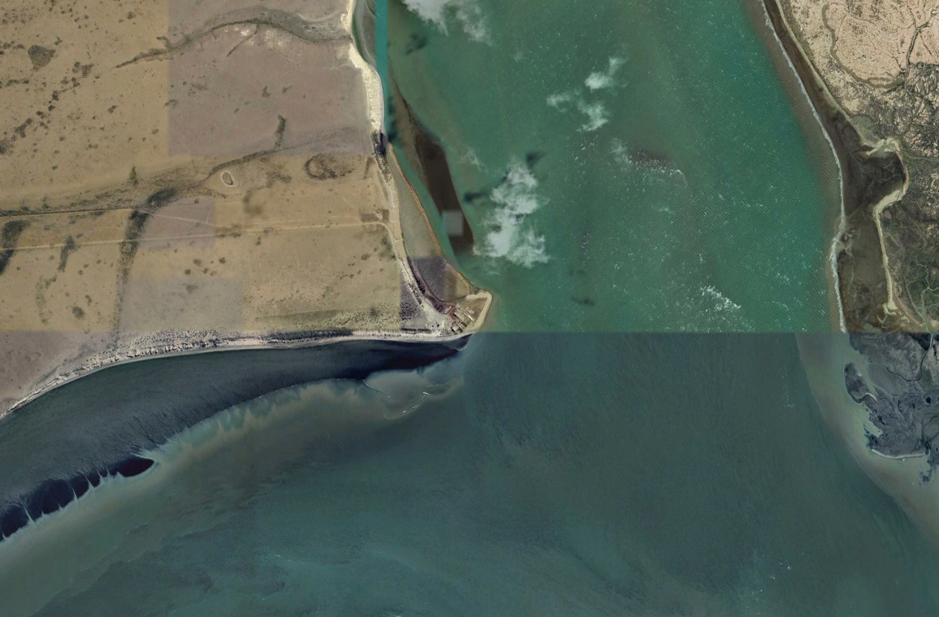
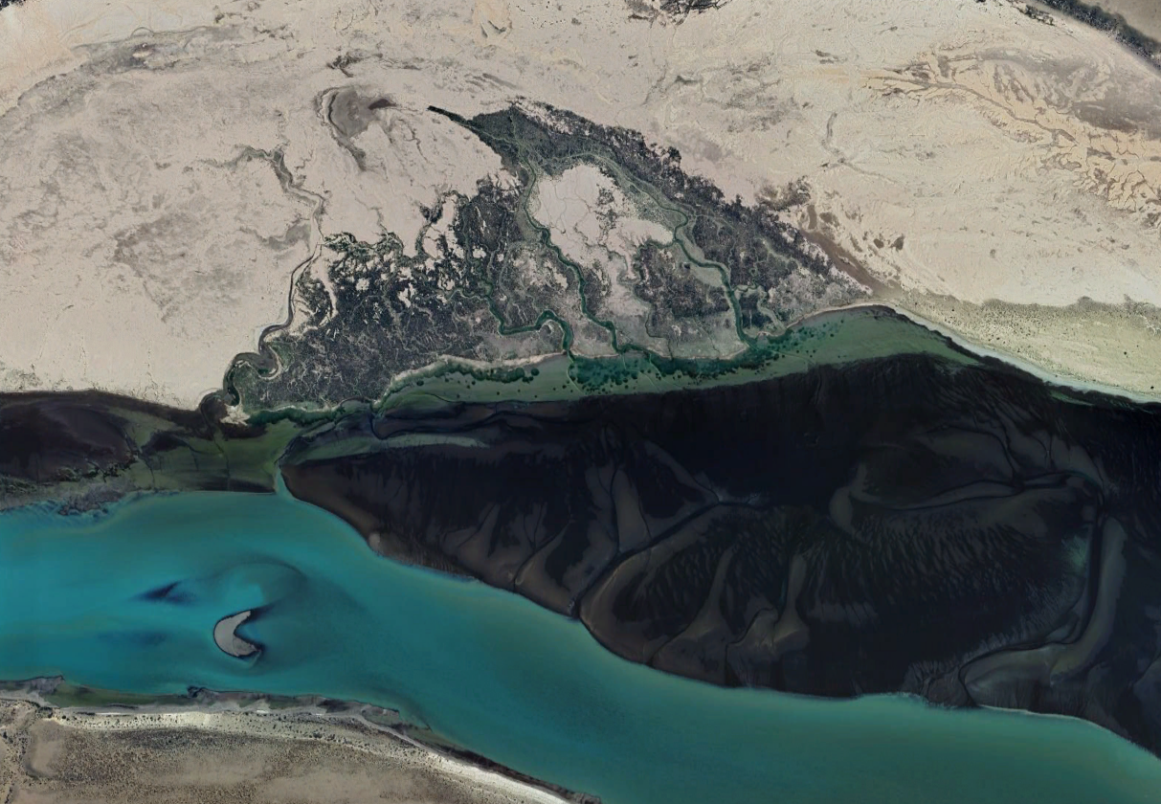
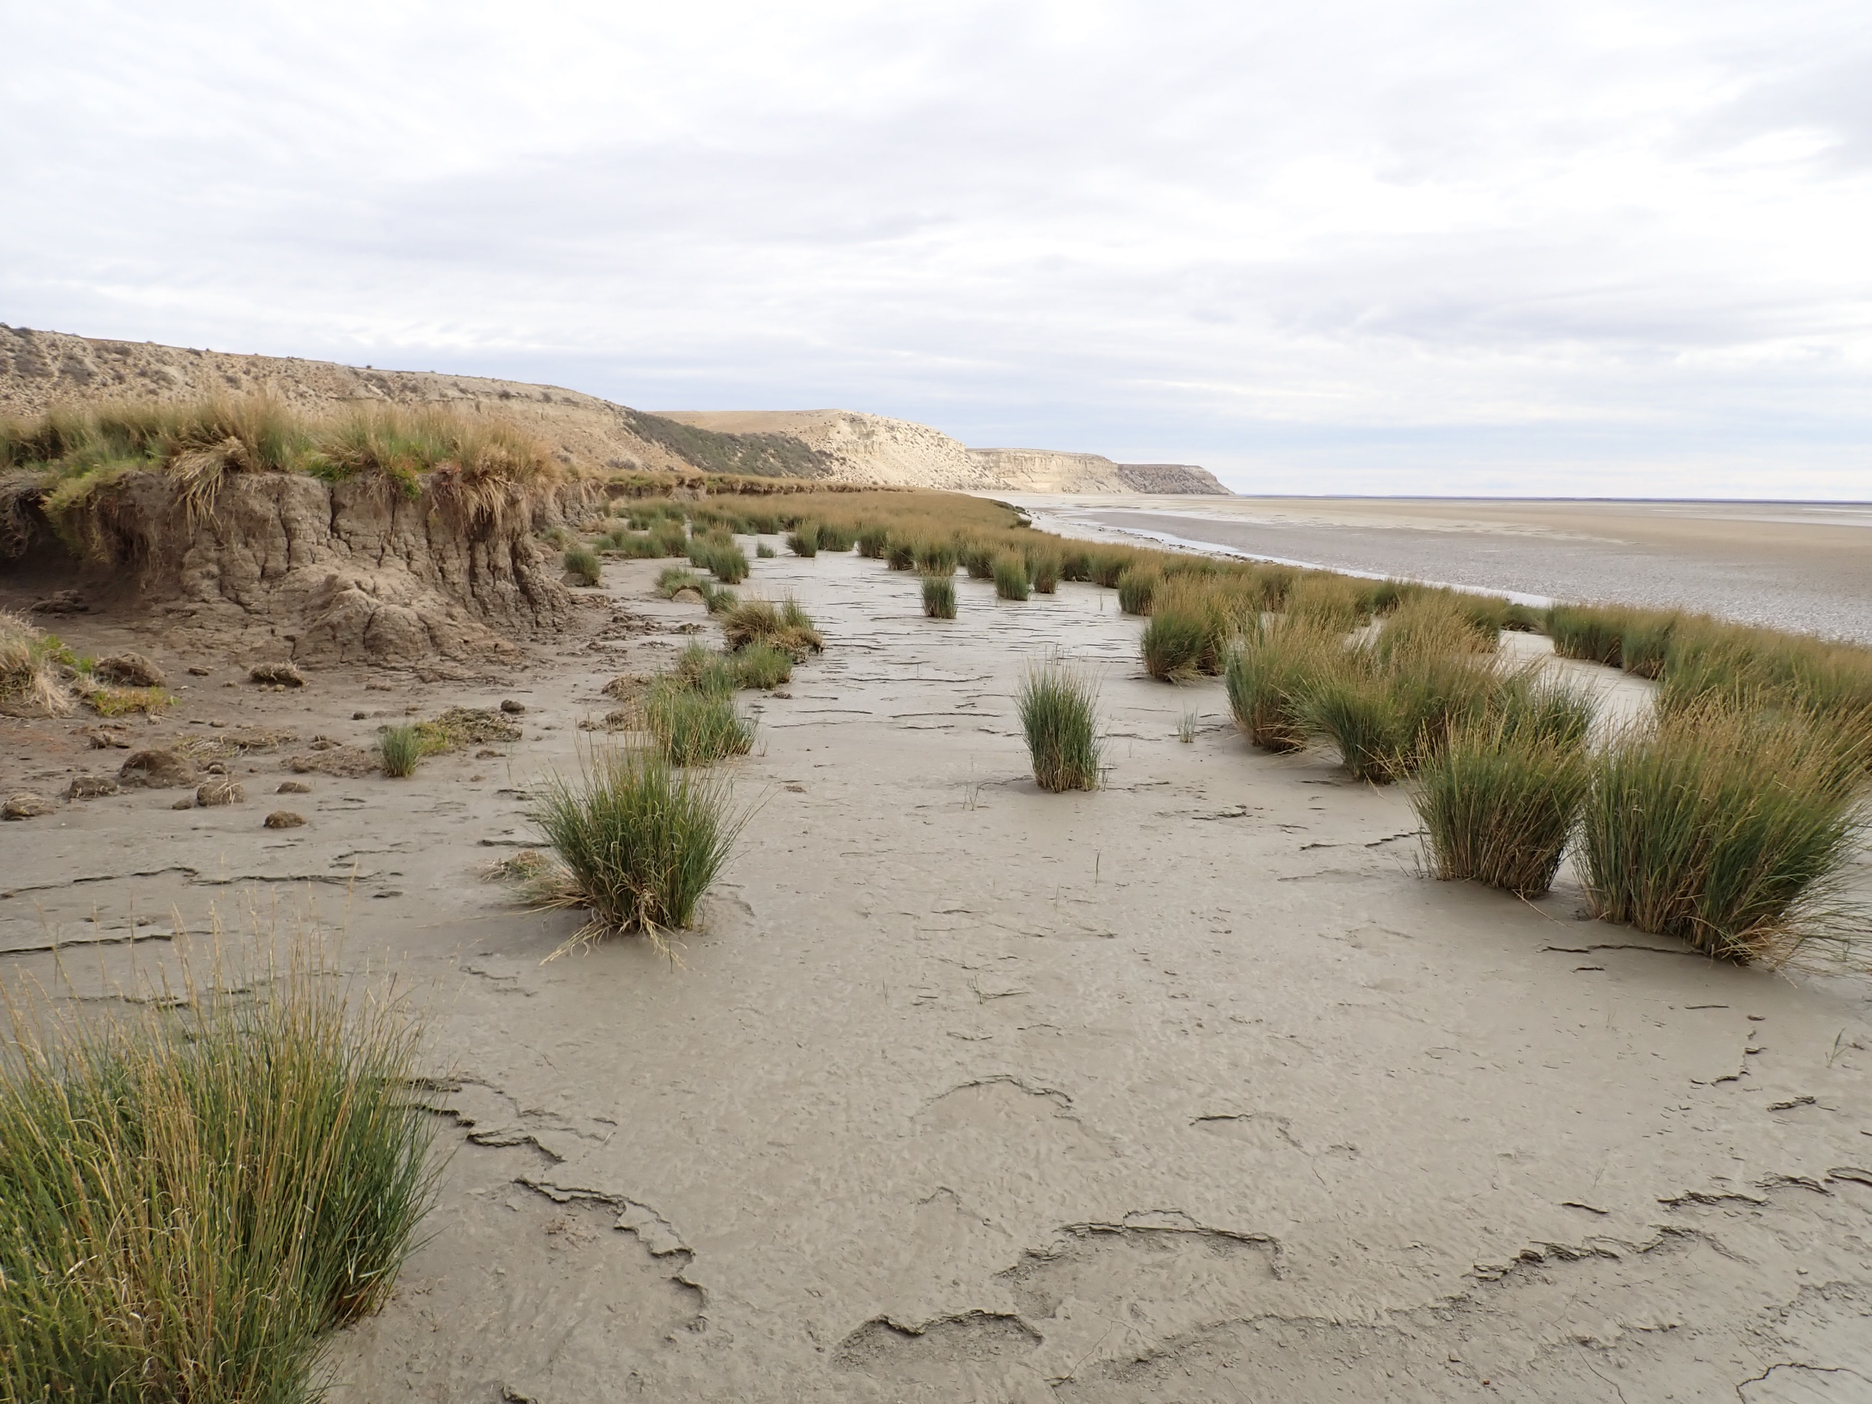
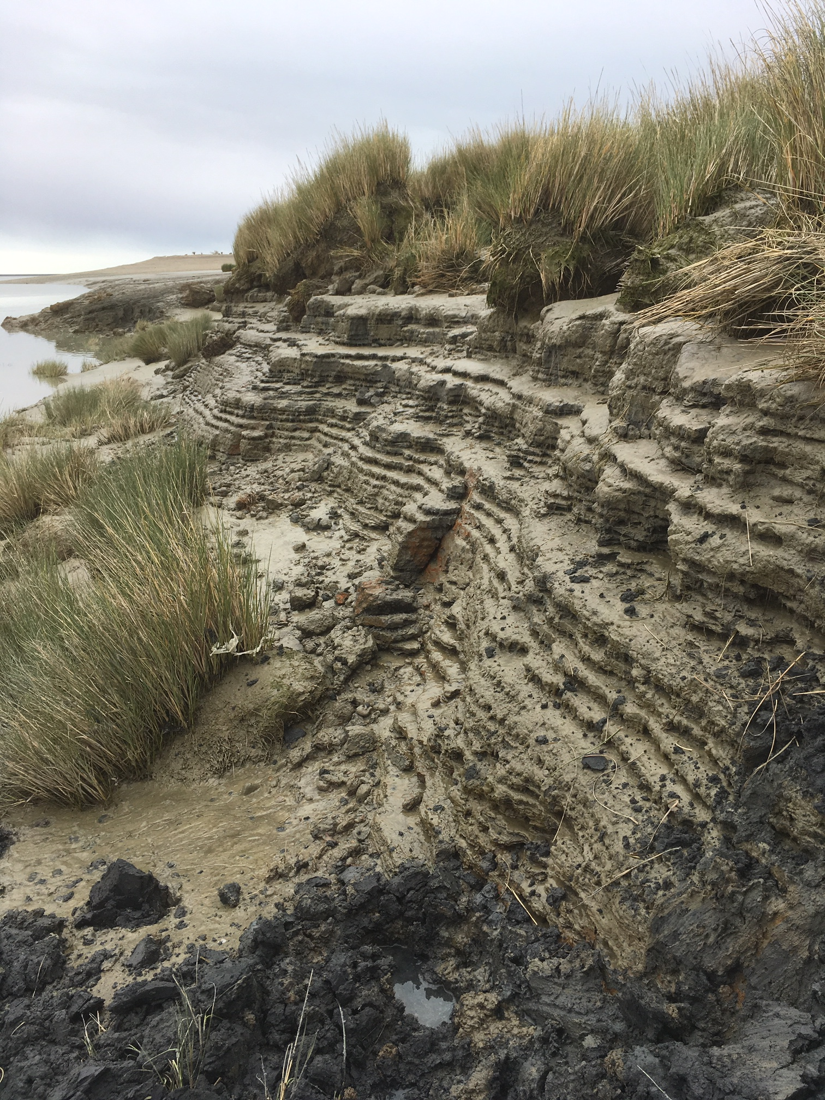
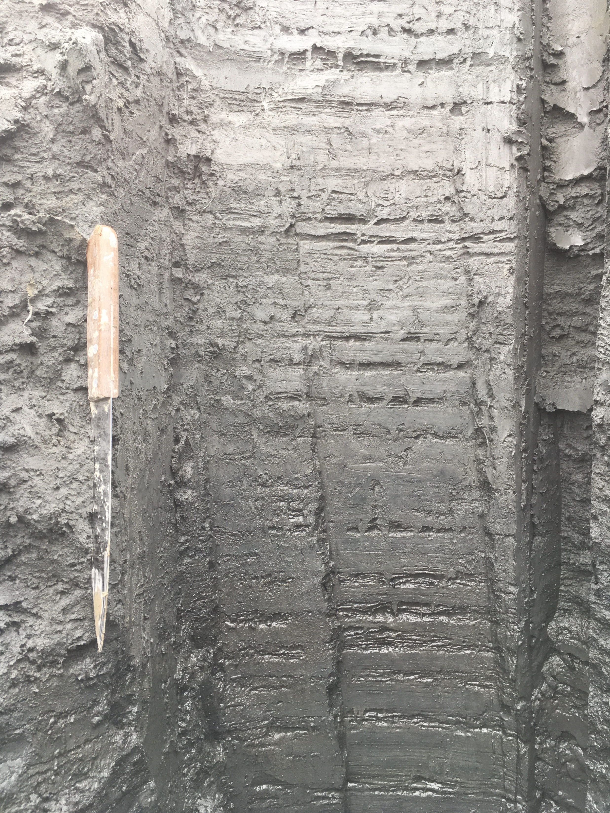
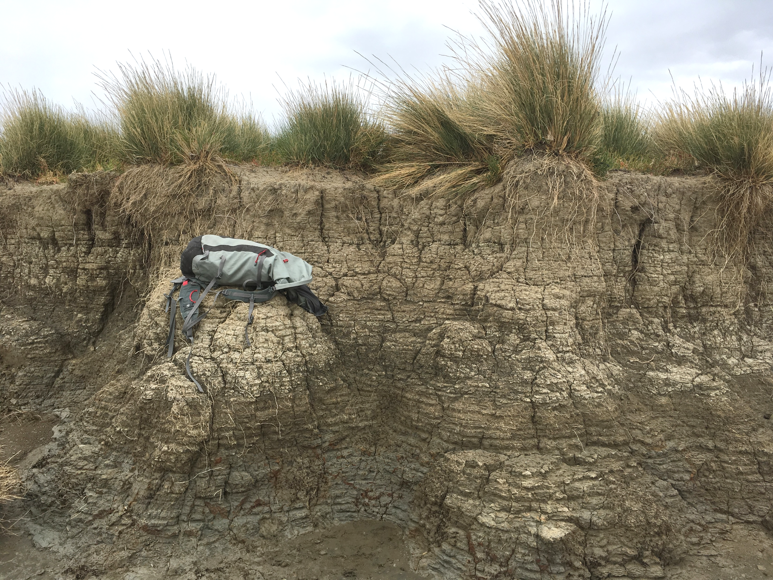
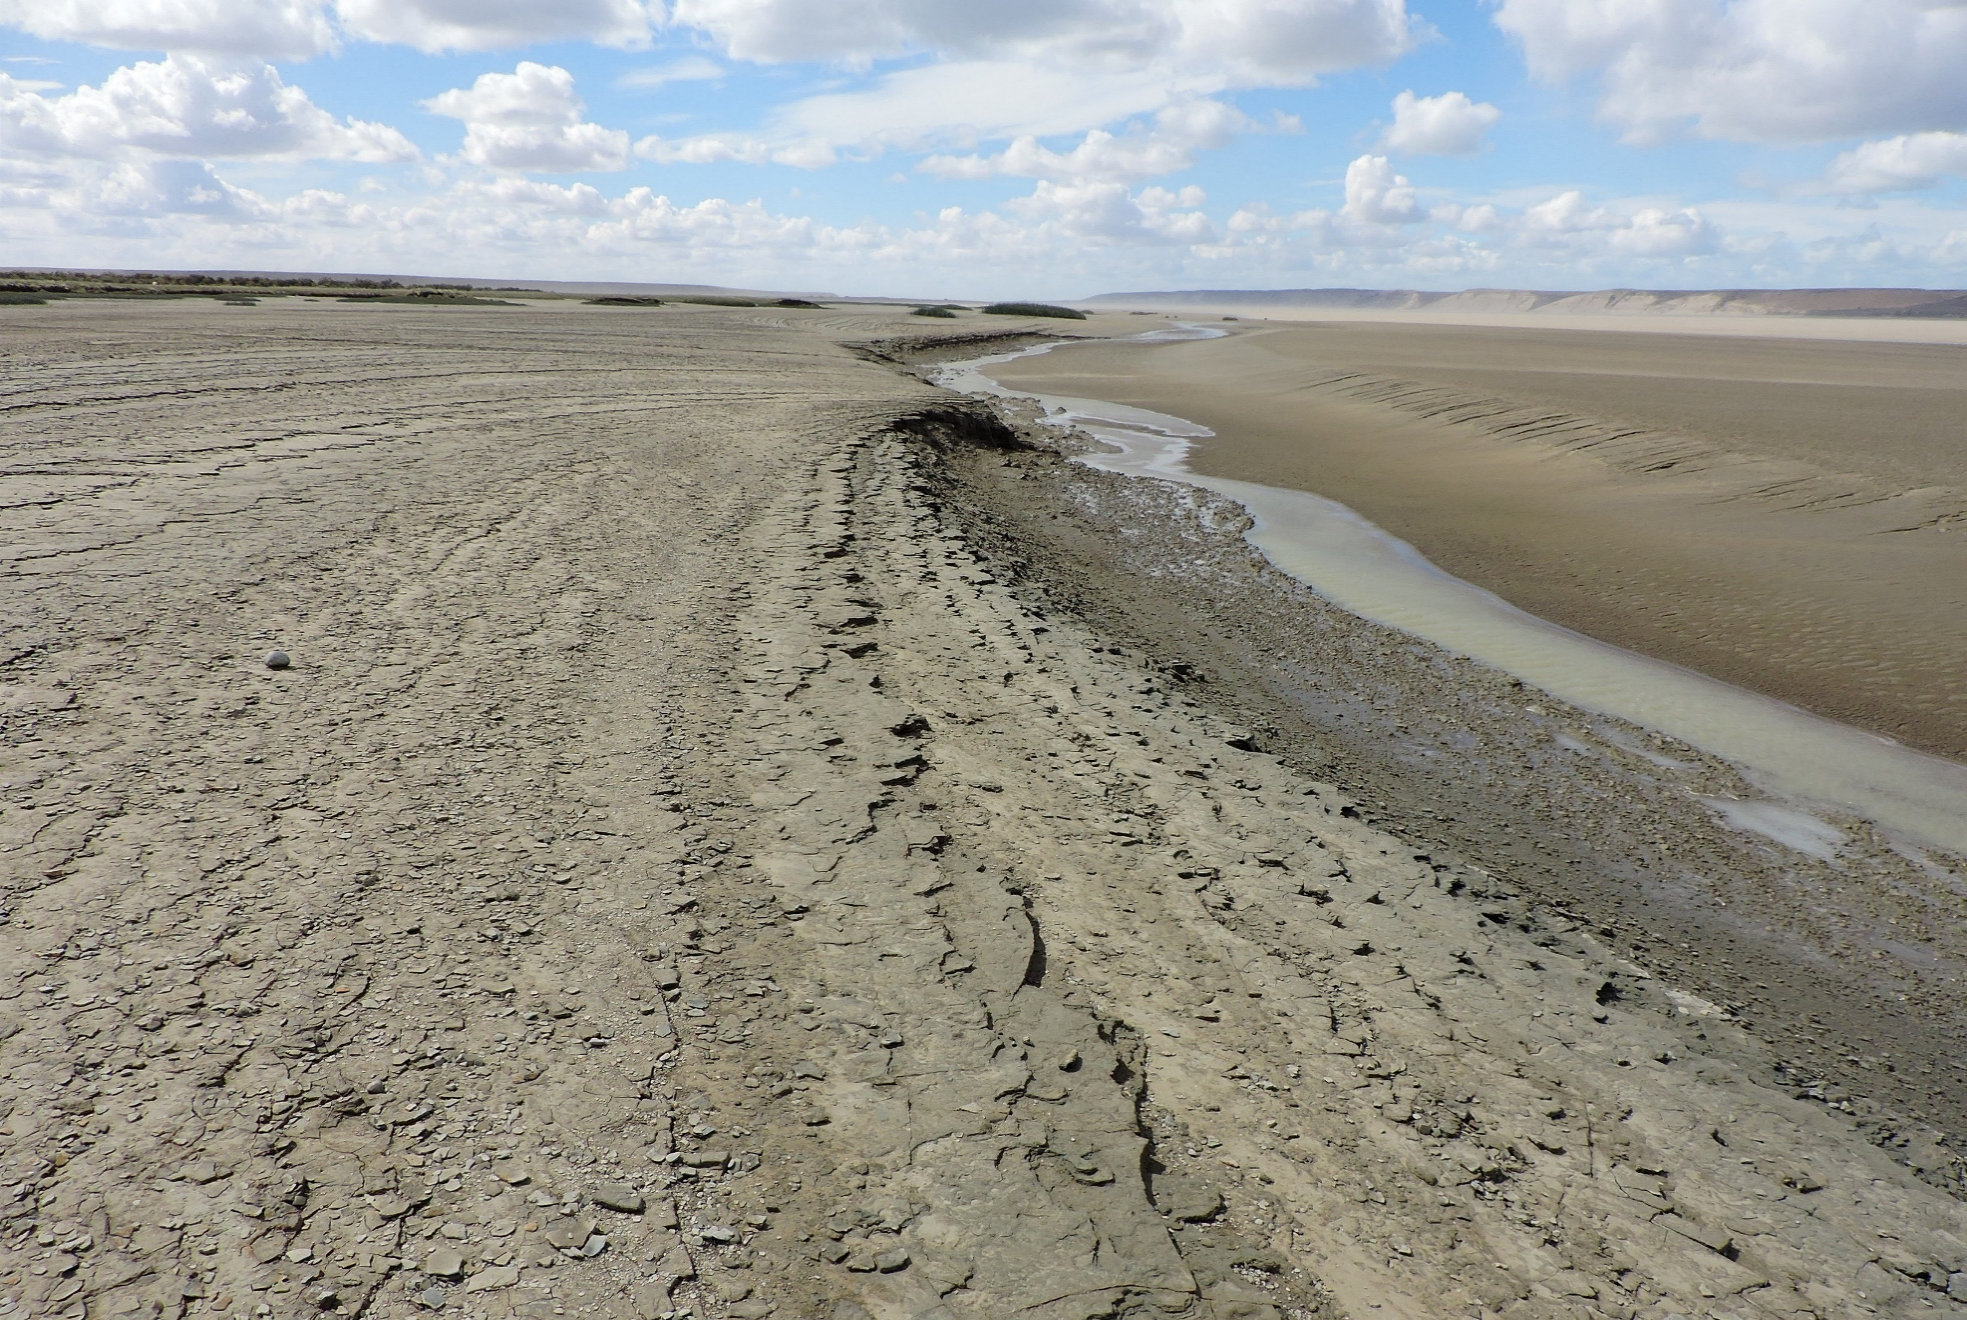
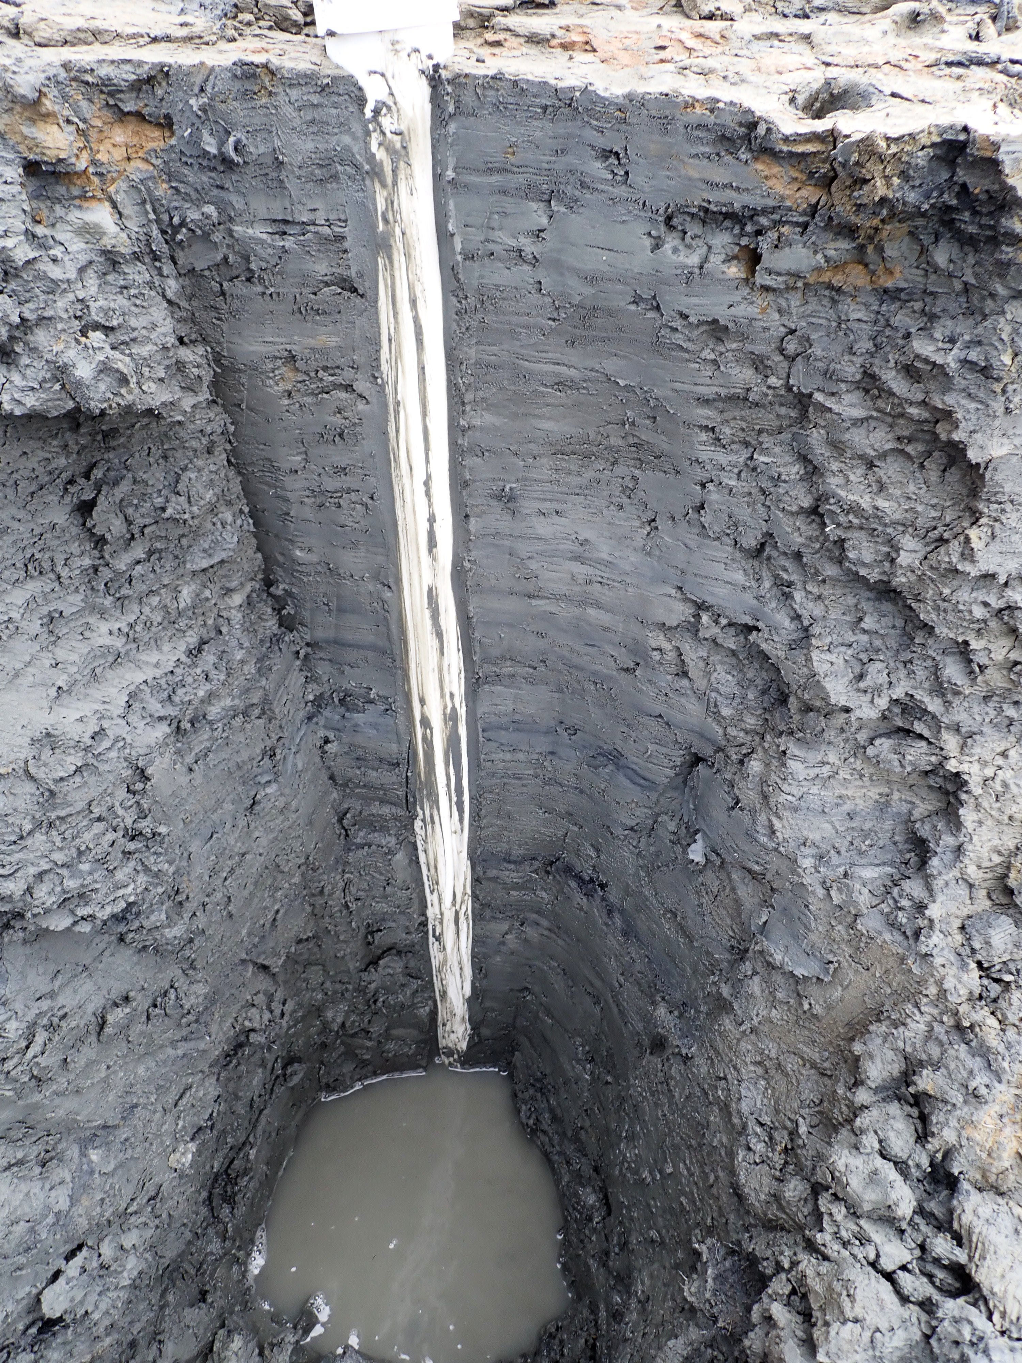
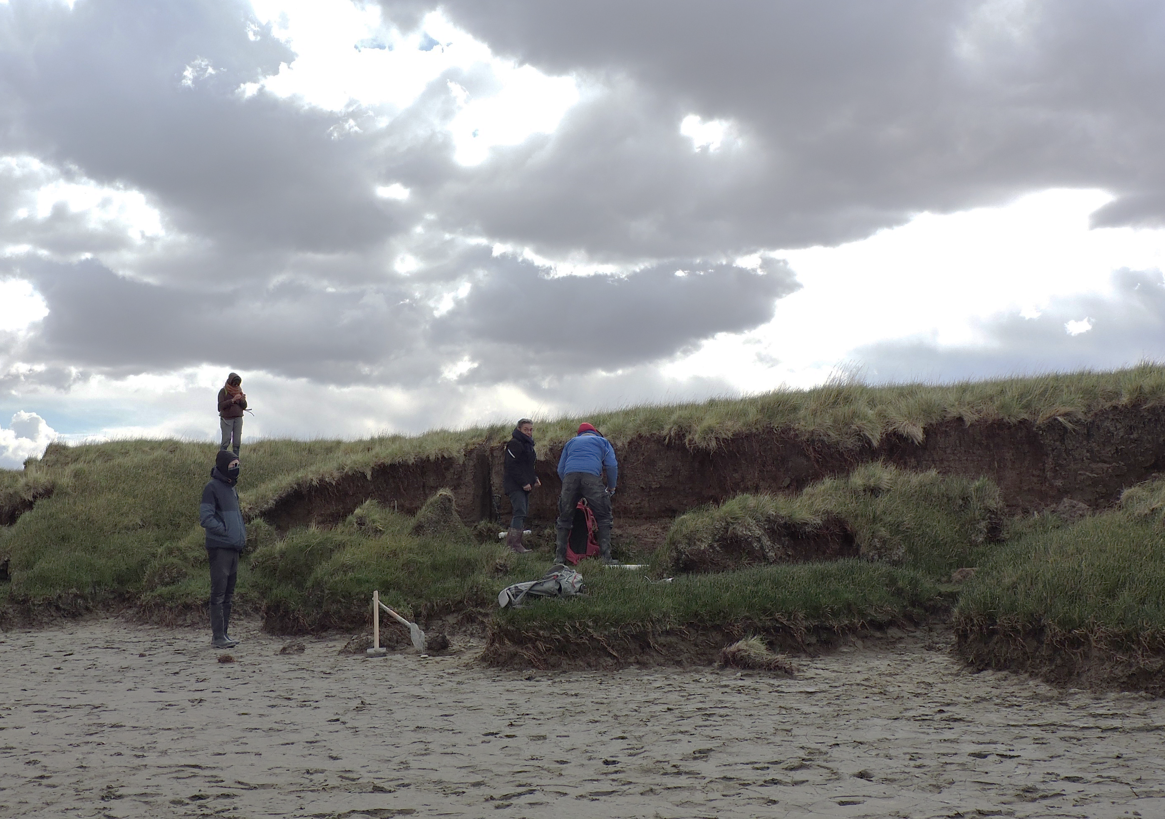
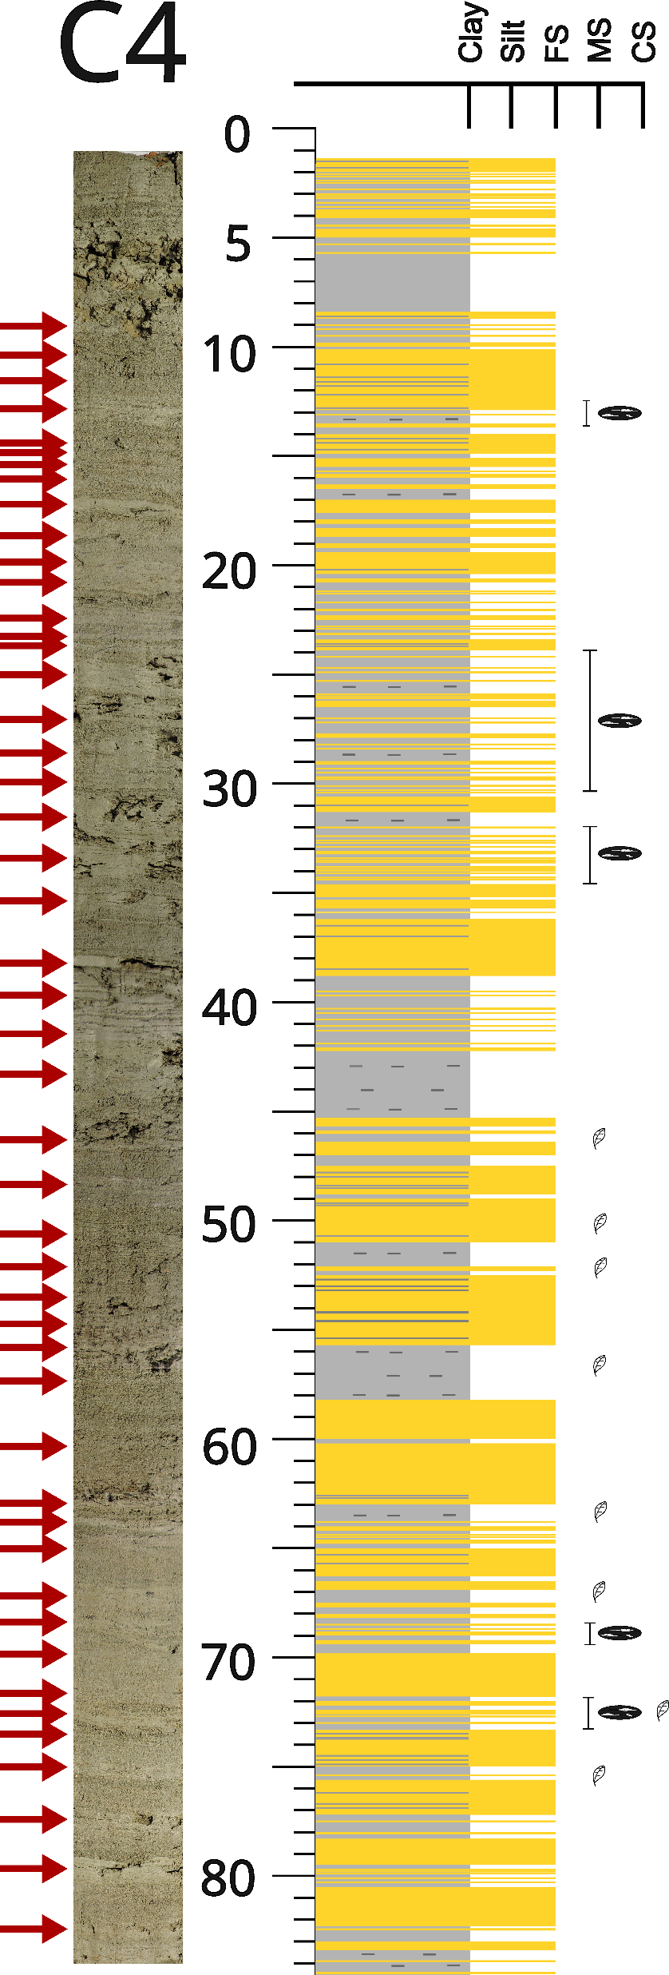
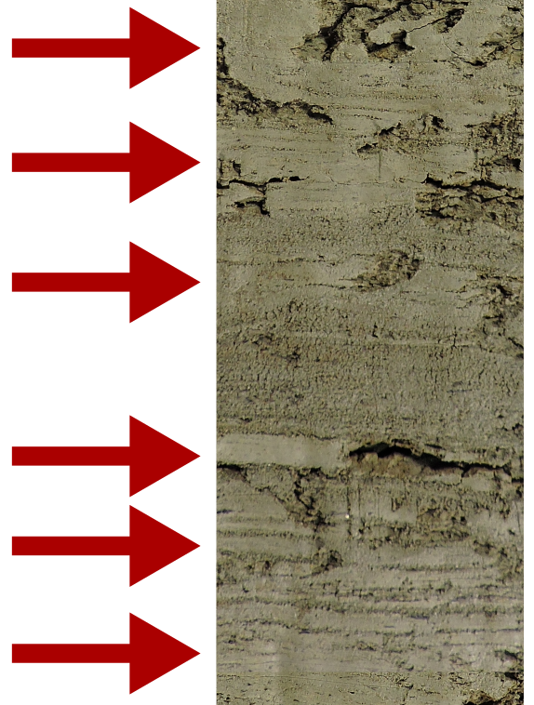
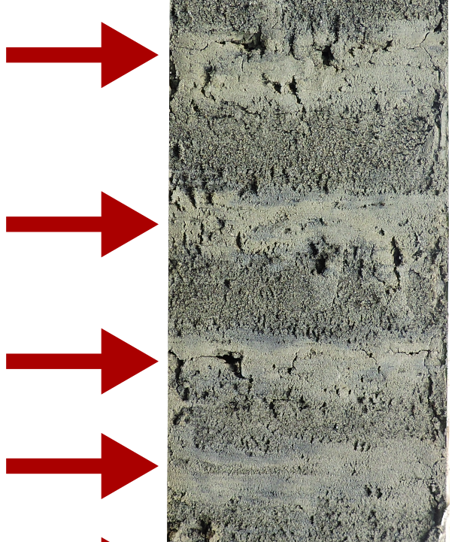
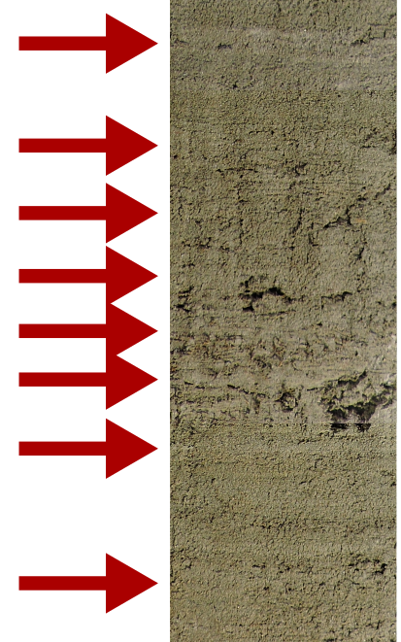
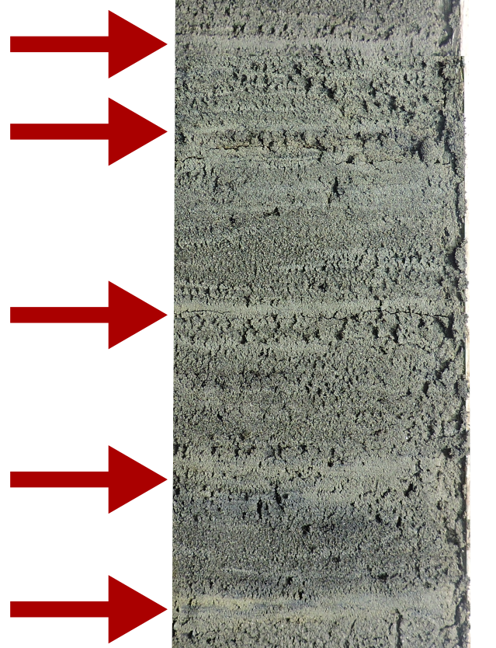
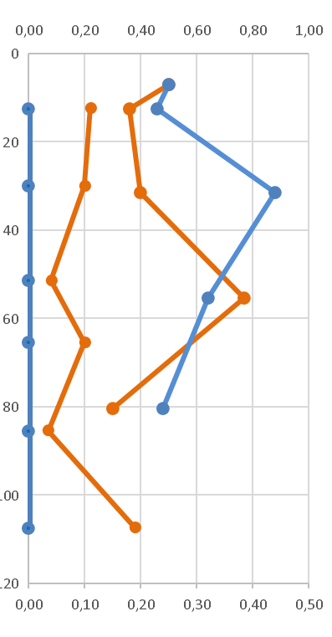
Rhythmites preserved into intertidal flat successions
of the hypertidal Santa Cruz – Chico River estuary
(Southern Patagonia, Argentina)
Thibaud Lortie¹, José I. Cuitiño², Bernadette Tessier¹, Jean-Yves Reynaud³, Roberto A. Scasso⁴,
Sebastián M. Richiano², Léo Pancrazzi¹, Michel Condomines⁵, Laurent Dezileau¹, Malala Lekander⁶
Introduction
Within tide-dominated estuaries, upper intertidal sediment successions frequently contain well-preserved tidal rhythmites, basically recording semi-diurnal to neap-spring-neap cycles, eventually annual cycles in the uppermost part of the successions, and that provide valuable information on hydrosedimentary processes and sedimentation rates.
Study site
Short sediment cores were retrieved from the hypertidal (12 m tidal range) Santa Cruz-Chico River (SC-CR) ria-type estuary (Southern Patagonia, Argentina, Fig. 1). Tidal dynamics are dominant along the Chico river arm, the fluvial discharge of which is low. In contrast, the water discharge of the Santa Cruz River is much higher so that the influence of tidal dynamics drops down at about 20 km upstream. Extensive sandy to muddy tidal flats develop along the edges of the outer portion of the two arms.
C1
D
Cored successions
The cores studied (C1 & C4) were collected into upper intertidal sediment successions that appear along secondary tidal channel cutbanks. Core C1 (114 cm) were retrieved at the mouth of the tide-dominated Chico River arm (Fig. 1D), core C4 (85 cm) at about 14 km upstream of the mouth of the tide-influenced Santa Cruz arm (Fig. 1E). They both reveal well-developed rhythmic layering, resembling tidal rhythmites (Fig. 2). Above tidal flat succession, salt marsh sequences display as well rhythmic bedding, the origin of which is probably annual (Fig. 2).
Figure 1
C4
Salt marsh succession
with annual rhythmites
Core C1
E
Upper tidal flat
succession
Upper intertidal rhythmite description
Cores C1 and C4 both show sand-dominated beds alternating with mud-dominated beds (mdb, red arrows on Fig. 3 & 4). Thickness of «mdb-to-mdb» packages ranges from a few mm to a few cm. Some of the packages clearly contain sand-mud couplets, of varying thickness and shape (location: light blue rectangles). These packages are typical tidal rhythmites recording neap-spring-neap (semi-lunar) cycles. Other packages do not clearly show sand-mud couplets, mdb look amalgamated. Such packages are well expressed in C1 (Fig. 3). In C4, mdb are locally poorly discernible (Fig. 4).
Figure 2
Core C4
Salt marsh succession
with annual rhythmites
Upper tidal flat
succession
Figure 5
Rhythmite thickness measurements
Assuming that all mdb-to-mdb packages could represent the record of semi-lunar cycles, their thicknesses have been measured along both cores (blue histograms on Fig. 3 & 4).
Present-day Tides (2021-2024)
Punta Quilla
(Argentina Hydrograph Navy Service)
Core C1
Figure 3
7
202
4
Results
Thickness evolution of mdb-to-mdb packages show a cyclic pattern (smoothed red curve on Fig. 3 & 4) with successive thickening and thinning.
The cyclic pattern is especially well expres-sed on core C1 (Fig. 3), with an average number of 7 mdb-to-mdb packages per cycle. Along core C4 a cyclic evolution is barely detected (Fig. 4). Cycles contain between 4 and 9 packages.
Core C4
cm
28
cm
45
27
6
7
40
26
40
9
35
20
35
8
8
4
30
25
19
30
2023
5
25
24
18
25
6
10
9
20
20
20
5
15
19
7
9
Package numbers
7
10
18
14
15
2022
5
17
0
10
20
30
40
1
16
13
10
7
9
Package thickness (mm)
15
12
Figure 4
14
11
5
8
Package numbers
9
2021
mud dominated beds (mdb)
1
40
30
20
10
0
Core sections with obvious neap-spring-neap packages
(red arrows around neap periods)
Package thickness (mm)
8
210Pbex (dpm/g)
Very high sedimentation rates are confirmed by 210Pbex measurements. 137Cs data highlight that the successions have deposited at least a few decades ago, i.e. > 50 years at least, C4 being probably younger (Fig. 6).
spring
neap
Figure 6
Interpretation - Discussion
The elevation of the 2 sites is about 10-10,5 m above lowest tide level, meaning that only spring tides can reach them.
Present-day high tide level variations (Fig. 5) show typical semi-annual cycles (equinox-solstice-equinox), comprising ca. 12 semi-lunar cycles. Above an elevation of 10 m (purple curve Fig. 5), less than 10 spring tide periods in average, in some case only 7, over 12, are effective.
Based on the comparison with present-day tidal data, all mdb-to-mdb packages in core C1 are inferred to be semi-lunar cycles, and the lower cyclicity semi-annual. Within the 3-year record
13
12
11
10
9
8
7
High tide elevation (m)
contained into C1, semi-lunar cycles with amalgamated mdb typify only a part (half) of years 2 and 3. Their occurrence could thus be of seasonal origin (fluvial fine-grained sed. discharge > tidal dynamics ?).
The signal in core C4 is more difficult to decipher. The site is exposed to waves and eolian sand supply induced by permanent westerlies, and is influenced by the highly fluctuating fluvial discharge and levels of the Santa Cruz river. C4 probably features a very disturbed tidal signal.
Core C4
Conclusion
Upper tidal flat successions preserved into the internal domain of the hypertidal SC-CR estuary record tidal cyclicities, modulated (C1) to highly disturbed (C4) by
Core C1
137Cs (mBq/g)
seasonally changing hydro-sedimentary conditions according to tidal flat exposure. 137Cs data suggest that the studied tidal flats are in course of abandonment, maybe due to the regional uplift context.
1 Normandie Univ, UNICAEN, UNIROUEN, CNRS, M2C, Caen, France; 2 Inst. Patagónico de Geología y Paleontología (CONICET-CENPAT), Puerto Madryn, Chubut, Argentina; 3 Univ. Lille, UMR CNRS LOG, Villeneuve d'Ascq, France;
4 IGEBA CONICET, Dpt Ciencias Geológicas, Universidad de Buenos Aires, Buenos Aires, Argentina; 5 Geosciences Montpellier, CNRS-Univ. Montpellier, Montpellier, France; 6 Marcelo T. de Alvear 175, Rio Grande, Tierra del Fuego, Argentina

