Slide 1
COVID-19 protective behavior among French high school students
Jérémy Castéra, Magali Coupaud, Claire Coiffard Marre, Corine Jegou, Hélène Cheneval-Armand, Alice Delserieys Pedregosa.
ADEF, Aix-Marseille University.
Contact : jeremy.castera@univ-amu.fr
Notes:
Good morning erveryone,
First of all I would like to say that I am very glad being back in the city where I did my PhD, forteen years ago. Ok sorry for this nostalgic time. Today I am gonna talk about covid-nineteen protective behaviour among French secondary school students. This work has been done 5 of my colleagues from the same Lab of Aix-Marseille University. We started this research during the very first lockdown.

Slide 2
Introduction and context
COVID-19 pandemic in France during the first wave of infections
lockdown period: 17th March 2020 to 11th of May 2020
Schools : closed mid-March, 2020, slow reopening after mid-May, 2020
Government Communication: Shift from reassurance to alarm; compared to a war context with the objective of encouraging the population to adopt protective behavior
Information Spread: Focus on lockdown measures rather than scientific information (Schück et al. 2021)
Issues: teenagers mental well-being strongly affected and less inclined to adopt protective behavior (Pagnini et al., 2020)
Notes:
Some words about the context. The context is very important in any research study, I have to say this time it even more true. So the first lockdown happened in France from mid march to mid may. At the same time all the schools were closed. With few exceptions some schools welcoming children of healthcare workers.
During this period, the French government communication was sometimes reassuring and sometimes alarming, Probably the best example was about masks, not necessary in February and mandatory In July in public places. This kind of decision was usualy taken without any explanation. I mean, Media Rarely highlighted how the Scientific Knowledge about covid-19 pandemic was Open to Revision in Light of New scientific evidence. But of course the government objective was to encourage population to adopt protective behavior.
We have found as well in the literature that the teenage population was the most affected in terms of mental well-being due to the lockdown and about adoption of protective behavior.
Le 28 février, le Dr Bruce Aylward, qui a dirigé une mission conjointe de l'OMS et de la Chine qui est parvenue « à changer le cours de l’épidémie et à éviter des dizaines, voire des centaines de milliers de cas de Covid-19 »55, a publié un rapport qui détaille notamment les méthodes déployées en Chine dont le port de masques obligatoire

Slide 3
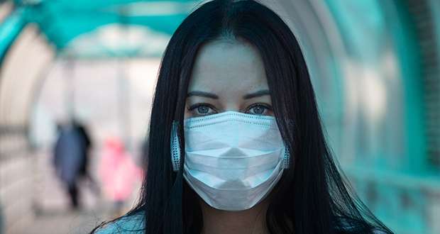
Introduction and context
COVID-19 pandemic in France during the first wave of infections
lockdown period: 17th March 2020 to 11th of May 2020
Schools : closed mid-March, 2020, slow reopening after mid-May, 2020
Government Communication: Shift from reassurance to alarm; compared to a war context with the objective of encouraging the population to adopt protective behavior
Information Spread: Focus on lockdown measures rather than scientific information (Schück et al. 2021)
Issues: teenagers mental well-being strongly affected and less inclined to adopt protective behavior (Pagnini et al., 2020)
Before july 2020, not necessary
Notes:
Some words about the context. If the context is very important in any research study, I would say that in this case it is even more. So the first lockdown happened in France from mid march to mid may. At the same time all the schools were closed. With few exceptions some schools welcoming children of healthcare workers.
During this period, the French government communication was sometimes reassuring and sometimes alarming, probably the best example was about masks, not necessary in February and mandatory In July in public places, without or very rarely explanation why such decisions. Media Rarely highlighted how the Scientific Knowledge about covid-19 pandemic was Open to Revision in Light of New evidence. Of course the government objective was to encourage population to adopt protective behavior.
We have found as well in the literature that the teenage population was the most affected in terms of mental well-being du to the lockdown and about adoption of protective behavior.
Le 28 février, le Dr Bruce Aylward, qui a dirigé une mission conjointe de l'OMS et de la Chine qui est parvenue « à changer le cours de l’épidémie et à éviter des dizaines, voire des centaines de milliers de cas de Covid-19 »55, a publié un rapport qui détaille notamment les méthodes déployées en Chine dont le port de masques obligatoire

Slide 4
Introduction and context
COVID-19 pandemic in France during the first wave of infections
lockdown period: 17th March 2020 to 11th of May 2020
Schools : closed mid-March, 2020, slow reopening after mid-May, 2020
Government Communication: Shift from reassurance to alarm; compared to a war context with the objective of encouraging the population to adopt protective behavior
Information Spread: Focus on lockdown measures rather than scientific information (Schück et al. 2021)
Issues: teenagers mental well-being strongly affected and less inclined to adopt protective behavior (Pagnini et al., 2020)
After july 2020, mandatory in public spaces
Notes:
Some words about the context. If the context is very important in any research study, I would say that in this case it is even more. So the first lockdown happened in France from mid march to mid may. At the same time all the schools were closed. With few exceptions some schools welcoming children of healthcare workers.
During this period, the French government communication was sometimes reassuring and sometimes alarming, probably the best example was about masks, not necessary in February and mandatory In July in public places, without or very rarely explanation why such decisions. Media Rarely highlighted how the Scientific Knowledge about covid-19 pandemic was Open to Revision in Light of New evidence. Of course the government objective was to encourage population to adopt protective behavior.
We have found as well in the literature that the teenage population was the most affected in terms of mental well-being du to the lockdown and about adoption of protective behavior.
Le 28 février, le Dr Bruce Aylward, qui a dirigé une mission conjointe de l'OMS et de la Chine qui est parvenue « à changer le cours de l’épidémie et à éviter des dizaines, voire des centaines de milliers de cas de Covid-19 »55, a publié un rapport qui détaille notamment les méthodes déployées en Chine dont le port de masques obligatoire

Slide 5
Aims of the study
Explores the different predictors of protective behavior of French secondary school students during the first COVID-19 pandemic.
Relationships has been drawn between the perceived knowledge, perceived severity, interest in science and protective behaviour.
Notes:
So as science educators and science eduction researchers; with my colleagues, we wanted to contribute in understing how we can help young students to adopt protective behavior. That is why the main objective of this is to understand a bit more some predictors which can be important in the adoption of protective behavior. Based on the literature we found some good candidates as predictors: the perceived knowledge, the perceived severity and interest in science.

Slide 6
Protective Behavior
Defined in three “types” (Jørgensen et al . 2021):
Preventive behavior: broadly in the hygiene dimension (e.g., handwashing, wearing masks)
Avoidance behavior: referring to social distancing (e.g., stay at home, avoid crowded places)
management behavior: such as taking medication or monitoring heath
Many studies investigated protective behavior as a unique dimension (or failed to identify those three clear independent dimensions)
Interest in Science
Reflects the cognitive potential of a student for achievement in the science field
Interest in science may positively impact behaviors such as science engagement and knowledge (e.g., Bathgate & Schunn, 2016) and even for decision making skills (Sadler & Dawson, 2012)
Notes:
So, what is protective behaviour, Jorgensen defines protective behaviour as 3 types :
Preventive behavior: broadly in the hygiene dimension (e.g., handwashing, wearing masks)
Avoidance behavior: referring to social distancing (e.g., stay at home, avoid crowded places)
management behavior: such as taking medication or monitoring heath
However such multidimensional approach of protective behavior has been rarely identified in the literature. In most of the papers we have read the protective behaviour was investigated as unique dimension, I mean without distinction between preventive, avoidance and management behaviour.
So, One potential predictor could be the science interest, which reflects the cognitive potential of a student for achievement in the science field. Why making the hypothesis that science interest may influence protective behavior? It is because we know from the literature that science interest may impact science engagement, knowledge and even decision making skills.

Slide 7
Perceived Severity
Definition: The negative consequences an individual associates with Covid-19
Important predictor for protective behavior (Anaki & Sergay, 2021)
Important predictor of staying at home (avoidance behaviour; Irigoyen-Camacho et al., 2020)
Perceived Knowledge
Definition: one's self-assessment or feeling of knowing
Important predictor for vaccine intention (preventive behavior) and perception of severity ( Faasse & Newby, 2020)
Notes:
Another potential candidate impacting protective beahvior is the Perceived severity. the Perceived severity is the perception of the negative consequences an individual associates with Covid-19. It seems to be one of the most Important predictors especially considering avoidance behavior like staying at home
Perceived Knowledge
The last candidate is the perceived knowledge . It is the self-assessment or feeling of knowing. Previous studies have shown how it can be an important predictor for vaccine intention ( wihich is a preventive behavior) and perception of severity.

Slide 8
The two main research questions
1 – To what extent 1-factor model of protective behavior fits with our sample of French secondary school students?
2 – What are the interrelations between perceived knowledge, perceived severity, protective behavior, and interest in science, including the impact of some demographic variables?
H1: The severity perception of COVID-19 would be positively predicted by perceived knowledge about COVID-19 (Faasse & Newby, 2020).
H2: Protective behaviors would be positively predicted by perceived knowledge about COVID-19 (Faasse & Newby, 2020).
H3: Protective behaviors would be positively predicted by perceived severity (Anaki & Sergay, 2021)
H4: Perceived knowledge would be positively predicted by interest in science (Bathgate & Schunn, 2016).
H5 Protective behaviors would be positively predicted by interest in science (Yacoubian, 2018)
H6: Demographic variables, such as age, infection by COVID-19, and knowing people who had and were infected with COVID-19 would predict protective behaviour (Wolfe et al., 2021; Le Vigouroux et al. 2021…)
Notes:
Based on this literature review and context, we can formulate 2 main research questions:
1 – To what extent 1-factor model of protective behavior fits with our sample of French secondary school students? Or is there any subfactors?
2 – What are the interrelations between perceived knowledge, perceived severity, interest in science and protective behavior, and including the impact of some demographic variables?
Every relationship tested is formulated with an hypothesis….. for instance, The severity perception of COVID-19 would be positively predicted by perceived knowledge about COVID-19 for H1.
Or H2: Protective behaviorswould be positively predicted by perceived knowledge about COVID-19
Since I have only fifteen minutes I am going to discuss just some of them.

Slide 9
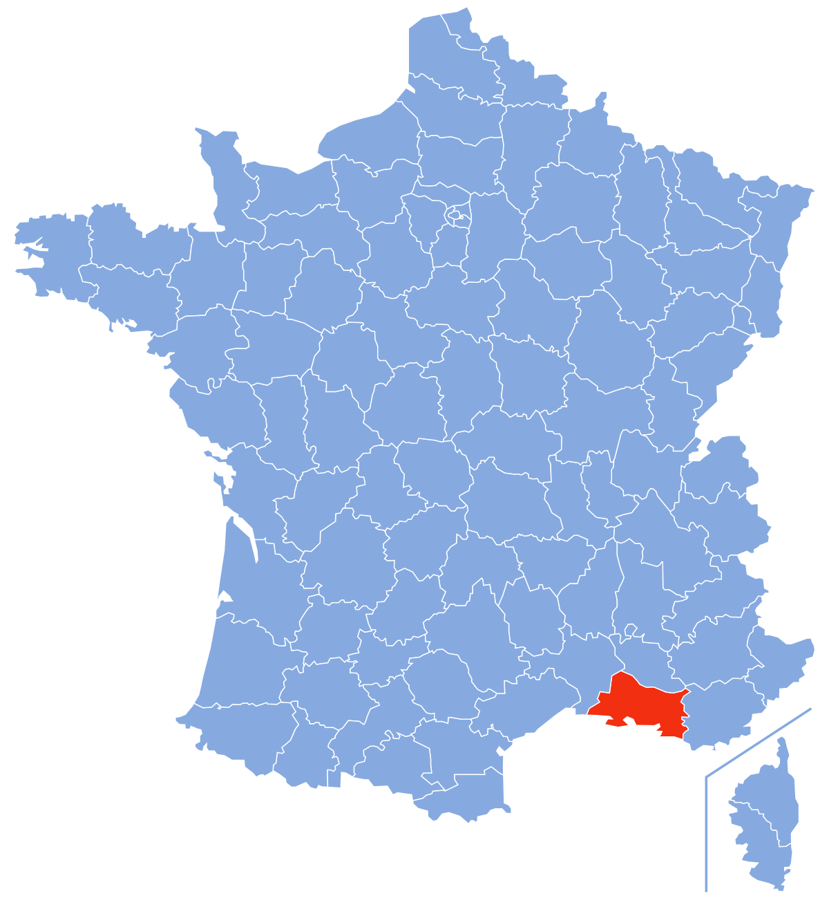
Methodology
Participants
Secondary school students (16 to 18 years old students)
Sphinx software and filled in online during learning sessions between 19/05/2020 and 15/06/2020
N = 691
From the region of Marseille
Notes:
Let’s have a quickly talk about the methodology:
we collected data from a sample composed by almost seven hundred secondary school students. The data were collected based on an oline questionnaire between mid-may to mid-june 2020. We sampled in the region of Marseille.

Slide 10
Methodology
Instruments
Perceived knowledge, perceived severity, and protective behavior (Yang et al. 2020)
Interest in science (PISA, 2015).
Protective behavior
Avoidance behavior
Je reste à la maison autant que possible | I stay at home as much as possible
Preventive behavior
Je porte un masque | I wear a face mask.
Management behavior
Je surveille de près ma santé | I monitor my health closely
Perceived severity
Je pense que les séquelles dues au coronavirus sont importantes. | I think the after-effects of the coronavirus are significant.
Perceived knowledge
Je connais bien les causes de la maladie | I am familiar with the causes of the disease
Interest in Science
Je trouve amusant d’apprendre les sciences | I find it fun to learn about science
Examples of items for each dimension
Notes:
We used a questionnaire adapted from already existing instruments.
it is a likert scale questionnaire, and the final questionnaire contains 25 items.
Just few exemples of questions at least one per factor. You can see the French version of the item on your left and englih translation on you right.
So for the protective behavior and the potential subfactors…

Slide 11
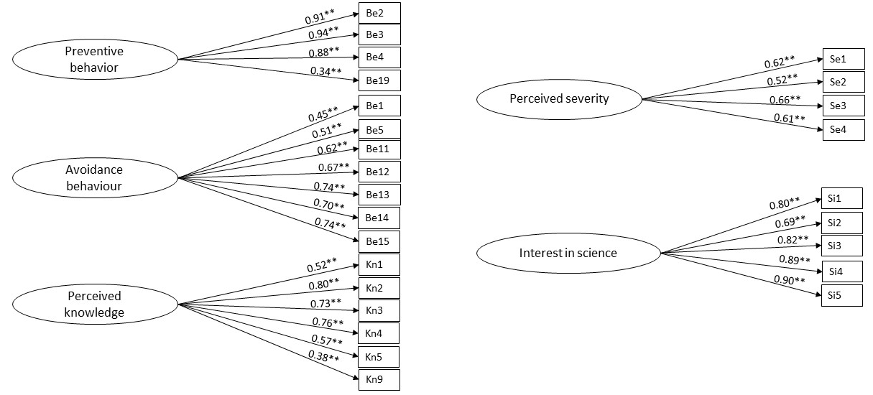
Results
EFA (exploratory factor analysis) was performed to investigate the model structure and dropped the irrelevant items (all the items about management behavior).
CFA (confirmatory factor analysis)
Goodness of fit indices : χ2/df = 2.77, RMSEA = 0.072, SRMR = 0.018, CFI = 0.992)
Notes:
Ok some results… we splitted randomly our sample in two equal sub_samples EFA was performed on the first subsample to investigate the model structure and dropped irrelevant items. And with the CFA we confirmed the model. The results show that there are 5 independent factors, without surprise as factors we have perceived severity, perceived knowledge and interest in science appearing as independent factors. However, The protective behavior is separated in 2 independent factors: preventive and avoidance behaviour since all the items about management behaviour were dropped.

Slide 12
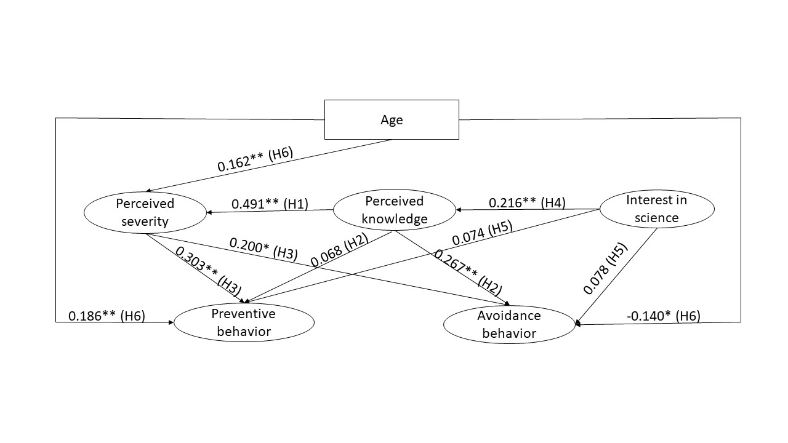
Results
SEM (Structural equation modelling)
Validated model with standardized path coefficients (p-value < 0.05*; p-value < 0.01**) Goodness of fit indices χ2/df = 1.789, RMSEA = 0.048, SRMR = 0.057, CFI = 0.931
Notes:
Once the model confirmed, the idea is to test the links between the tested factors (we call that structural eution modelling). The time is running out I am just going to highlight just two of the results: you can notice the positive impact of perceived knowledge on avoidance behaviour and not on preventive behavior. That s support at least partly what Justin Dillon said yesterday about the lack of knowledge of the lay public about adopting preventive behaviour.
The second one is the significant influence of perceived severity on preventive and avoidance behavior.

Slide 13
Discussion
Recommendation for future study analysing student protective behavior:
Protective behaviors have to be analyzed as at least two independent sub-factors (confirming rare studies considering subfactors e.g., Jørgensen et al., 2021).
Perceived knowledge doesn't predict preventive behavior rather than avoidance behavior
That students perceived as “contradictions” in media/government about preventive behavior probably induced this result (rather than the tentativeness in science).
Perceived severity predicts preventive and avoidance behavior:
Should biology education increase the perceived severity ? “mental well-being strongly affected” (Pagnini et al., 2020)
New opportunity to learn NOS (tentativeness of scientific knowledge, role of error in scientific research, role of debate in the development of science, ethic in Science…García-Carmona, 2021, Reiss 2020).
“Scientific progress as reflected in reports and public debate during the COVID-19 pandemic offers vivid examples of teachable aspects of the nature of science.” (Shi, 2022 : Nature Human Behaviour)
Notes:
Short discussions about those specific results:
At first a kind of recommendation: If the objective is to analyse protective behavior, it is going to be recommended to consider the subfactors of protective behaviour . in our case preventive and avoidance are two independent factors that we have to consider
The second point is about the Students or even the lay public who perceived the information given by the government as contradictions rather than the tentativeness in Science. The exemple with the masks is very typical and explain probably the lack of connection between perceived knowledge and preventive behavior.
As we have seen in our results perceived severity predicts preventive and avoidance behaviour. So the question is should biology education increase the perceived severity? I would say probably not, since the teenage population is already sensitive in terms of well being. We thing that reinforcing knowledge especially knowledge about NOS would be a better idea. But I am waiting for your opinion. I would even finish on this recent citation coming from shi in the journal : human nature behaviour: Scientific progress as reflected in reports and public debate during the COVID-19 pandemic offers vivid examples of teachable aspects of the nature of science”

Slide 14
Thank you for your attention
For more information:
Recently published in Public and One Health:
Castéra, J., Coupaud, M., Coiffard Marre, C., Jegou, H., Cheneval-Armand, H. and Delserieys-Pedregosa, A., (2024). COVID-19 protective behavior When science interest and knowledge matter. Journal of Global, Public and One Health, 2024, ⟨10.61034/JGPOH-2024-9⟩.
Notes:
If you want to know more about this paper, it has been very recently published in public health journal which is full open access.

