Slide 1
Evaluating Action Competence and Environmental Values Among Student Teachers: Impact of Training Programs Addressing Sustainable Development Goals
Jérémy Castéra, Eva Nyberg, Corinne Jegou, Claire Coiffard Marre, Cecile Redondo
Aix Marseille Université, ADEF, Marseille, France
Dept. of Pedagogical, Curricular and Professional Studies, University of Gothenburg, Gothenburg, Sweden
Contact : jeremy.castera@univ-amu.fr
Notes:
Bonjour a toutes et tous,je suis jérémy castera je suis en didactique des sciences, et meme plutôt en biologie. Je suis de l’université d’aix marseille. C’est un titres très general et fianlement c’est un pretexte pour vous parler d’etudes passée, presentes et futures autour de 2 concepts importants: valeurs environmentales et des competence en action. Si on devait lier ce recherche à un champs disciplinaire je parlerais de rcherche en psychologie envornmentale.

Slide 2
Introduction and context
Paper under review in Australian Journal of Environmental Education
Starting point for a much more wider project : TEACOSSE (TEAcher COmpetence for Sustainability and Environmental Education) funding by UNI-T
A group of researchers mainly from Aix-Marseille University
Collaborative work with a colleague from Sweden Eva Nyberg University of Gothenburg (Action Competence)
Notes:
Actuelement et en particuleir les resutats presenté à la fin ont été soumis australian journal of EE, pratiquement six mois on attend le premier retour des reviwers. Ce sont des données préliminaires, qui doivent nouriir TEACOSEE ui est financé par un projet européen UNI-T
Groupe de chercheur princpalement de Marseille mais une chercheuse Suédoise qui travail avec nous qui a apporté ce concept de compétenc en action.

Slide 3
State of the art and theoretical background
Environmental values, the 2-MEV Model (Bogner & Wiseman, 2006):
The 2-MEV (two Major Environmental values) model is based on two independent value-based dimensions (constructs validated empirically) representing anthropocentric (Utilization: U) and ecocentric-biocentric (Preservation: P) concerns (Bogner & Wiseman, 2006).
Preservation
Utilisation
NEP model unidimensionel: Dunlap et., 2000
Notes:
Le tout the New Ecological Paradigm (NEP) scale’s unidimensional construct
Bogner donne un definition très pragmatique des valeurs, il dit que se sont des facteur d’odre superieurs base sur des groups d’items qui chacun test une attitude. Pour le dire autrementles valueurs sont formée par un groupe d’attitudes elle memes tétsées par des items

Slide 4
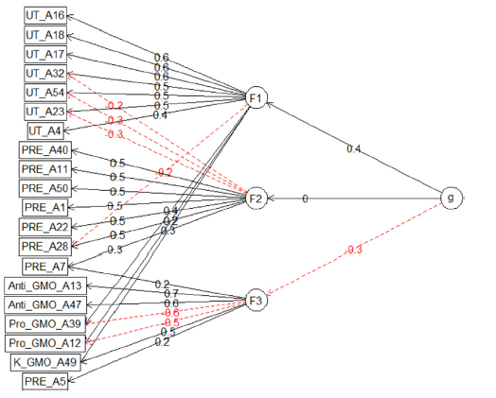
State of the art and theoretical background
The 2-MEV Model (Bogner & Wiseman, 2006):
The 2-MEV (two Major Environmental values) model is based on two independent value-based dimensions (constructs validated empirically) representing anthropocentric (Utilization: U) and ecocentric-biocentric (Preservation: P) concerns (Bogner & Wiseman, 2006).
Pro-Preservation
Pro-Utilisation
2 independent factors, 2-MEV : Bogner & Wiseman, 2006.
HFA: 2 basic orthogonal factors for the 2-MEV (N= 10651) + a factor about GMO (Castéra, Clément, Munoz & Bogner, 2018)
Notes:
The 2-Major Environmental Values
Robuste testé dans plus dans 30 pays adult enfants….

Slide 5
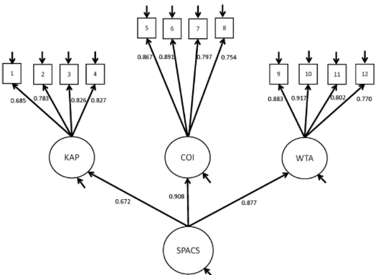
State of the art and theoretical background
Action competence (Olsson et al., 2020, Sass et al.,2020):
The overall will, confidence, and knowhow to bring about sustainability transformations
3 main components:
- Knowledge of Action Possibilities (KAP)
- Confidence in One’s own Influence (COI)
- Willingness to act (WTA).
Self-Perceived Action Competence for Sustainability Model (SPACS) Designed and validated with secondary school students
Notes:
défini comme la volonté globale, la confiance et le savoir-faire nécessaires pour provoquer des transformations durables (Sass et al. Citation2020).

Slide 6
State of the art and theoretical background
Connections between Action competence and value?
It has often been assumed that values are the basis for forming an action competent person (e.g., Chong & Cheah, 2009, Mauer & Bogner, 2020, etc.)
Research questions
(1)To what extent can the SPACS-Q and the 2-MEV be used to analyse action competence and environmental values in a sample of French primary school student teachers?
(2) What are the links between self-perceived action competence for sustainability and environmental values?
(3) Does age and training in sustainability issues influence attitudes related to self perceived action competence?
Notes:
Chong & Cheah, 2009 showed the link between Values Skills and knowledge with vlues as umbrella for devolling competencies
Mauer and Bogner Strong link beten environmental values and general ecological behaviour.
1) Dans quelle mesure le spacs et le 2MEV penvent etre ultilisés pour analyser un echantillon de d’etudiant pour devenir enseigant en France
2) Dans quelle mesure les valeurs peuvent etre des preducteurs au compétences
3) Variables exogene age et si ils on eut des formation sur le developpement durable

Slide 7
methodology
SPACS: 12 items
I know how one should take action together with others in order to contribute to sustainable societal development.
Questionnaire (exemples of items)
I believe I can influence global sustainable development through my actions
I want to engage in changing society towards sustainable development.
2-MEV (15 items):
Preservation : Industrial smoke from chimneys makes me angry
Utilisation : Our planet has unlimited natural resources
Notes:
Je sais comment agir ensemble pour contribuer au developpement durable
Je crois que je peux influencer le développement durable par mes actions au niveau mondial je veux m'engager dans une société qui évolue vers un développement durable.
La fumée industrielle des cheminées me met en colère
Notre planète possède des ressources naturelles illimitées

Slide 8
methodology
Participants:
- 236 primary school student teachers in the last year of their master’s degree studies
- Data were collected anonymously between April 2022 and June 2022 using Sphinx Software
Analyses (Lavaan and Psych packages in R software):
Confirmatory factor analysis -> fitting of the model (RQ1)
Structural equation model -> links between values and action competence (RQ2) & influence of age and training in Sustainability (RQ3)

Slide 9
Results & discussion
CFA
Relationship between observed variables and their latent constructs = confirmation of 5-factor model (RQ1)
Notes:
Relative chi-square value was acceptable (χ2/df = 1.89; less than 5). Indicators indicated good fit: RMSEA = 0.061 and SRMR = 0.074. CFI is a bit below what Bentler (1990) considers a good fit indice (CFI>0.9); however, since our baseline model’s RMSEA is below 0.158 (our baseline model RMSEA = 0.141), the CFI may not be very informative (Kenny, Kaniskan, & McCoach, 2015).

Slide 10
Results & discussion
RQ2: Confirmation of relationships but only regarding the factor Preservation in the environmental values
-> promoting action competence would be most efficient if educational content focused on supporting preservation of the environment rather than promoting abstaining from exploitative use of the environment (education for “Hope” better than education by fear).
RQ3 : No impact of training in sustainable program followed (declarative basis) and small impact of age (more confident)
-> consider action competence in not suffisant in tearcher training programs

Slide 11
Implications
Funded by the UNI-T project (ERASMUS+) new analyses are engaged:
Using a much more appropriate tool for the evaluation of professional action competence of teachers (Sass, 2022: PACesd)
Test the impact of training programs in ESD (pre-post and control group)
In different contexts : France, Italy, Greece.
Notes:
ERIDOB
climate change hope scale

Slide 12
Thank you for your attention

Slide 13
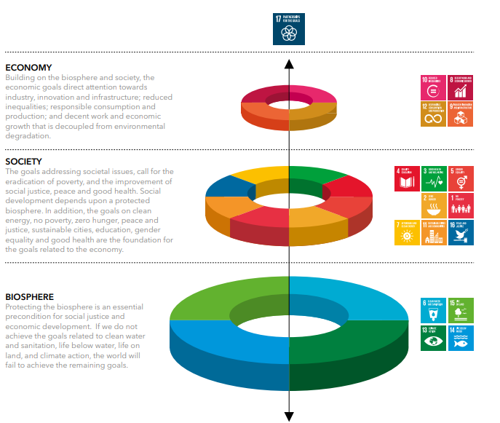
Pretlove & Blaziak, 2018
Notes:
pret

