Slide 1





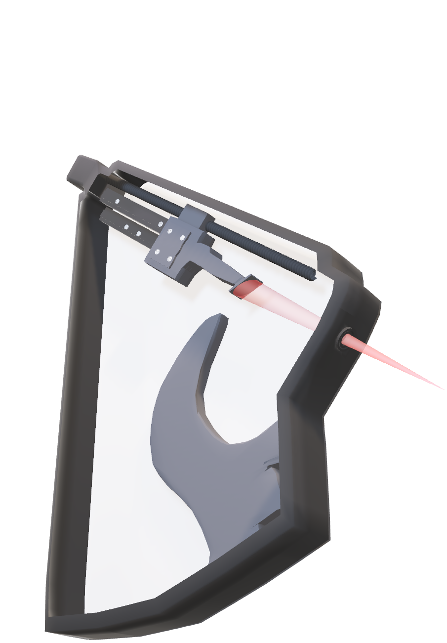
High-resolution x-ray emission spectrometry and quantification in the Li K spectral range with a reflection zone plate spectrometer
Khalil HASSEBI
Laboratoire de Chimie Physique-Matière et Rayonnement (LCPMR)
Sorbonne University
Paris, France
Under the supervision of:
Dr. Philippe JONNARD
Dr. Nicolas RIVIDI
Dr. Anne VERLAGUET

Slide 2
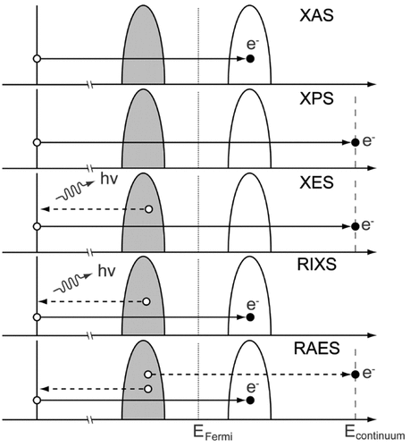

X-ray emission spectroscopy
The X-ray emission spectrum is generated by bombarding the sample with electrons or by absorption of a photon.
These X-rays/electrons ionize inner-shell electrons, which then decay by emitting X-ray photons.
These emitted X-rays have energies that correspond to the energy differences between the two electronic states. (core -> core or valence -> core)
→ X-ray emission spectroscopy (XES) provides a means of probing the partially occupied density of electronic states
VB
Ionization
(electron bombardment)
Core states
VB
XES a powerful technique since the physical and chemical properties of matter depend on these distributions.
→ Chemical state (how each element is chemically combined in the sample...)
X-ray Photon
→ Element-specific information
Notes:
As the title indicates the main phenomenon we are interested in is the XES, this phenomenon occurs when a beam of electrons interacts with matter leading to the ionization of the inner-shell electrons, which then decay by emitting x-ray photons, these emitted x-rays have energies that correspond to the energy differences between the two electronic states involved in the transition. (core -> core or valence -> core).
This gives the XES the ability to the probe the partially occupied density of states where other techniques such as XAS probes the unoccupied density of states..
This make XES a powerful technique since the physical and chemical properties of matter depend on these distribution. Making it capable of giving element specific information but also information about the chemical state of the atoms.

Slide 3

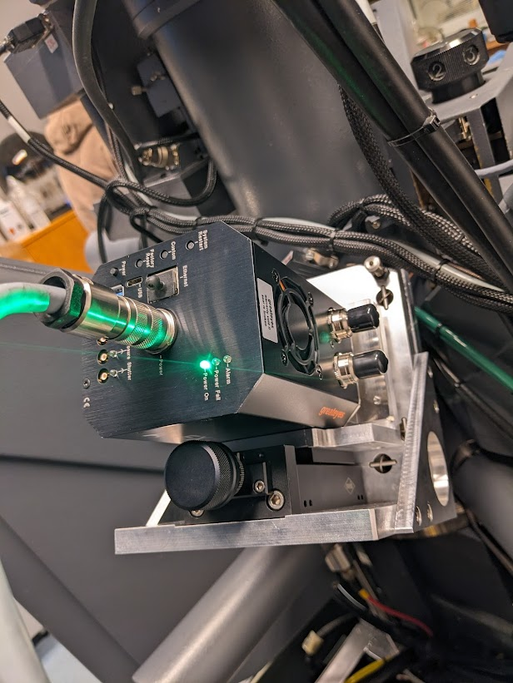
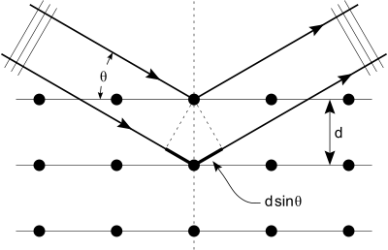
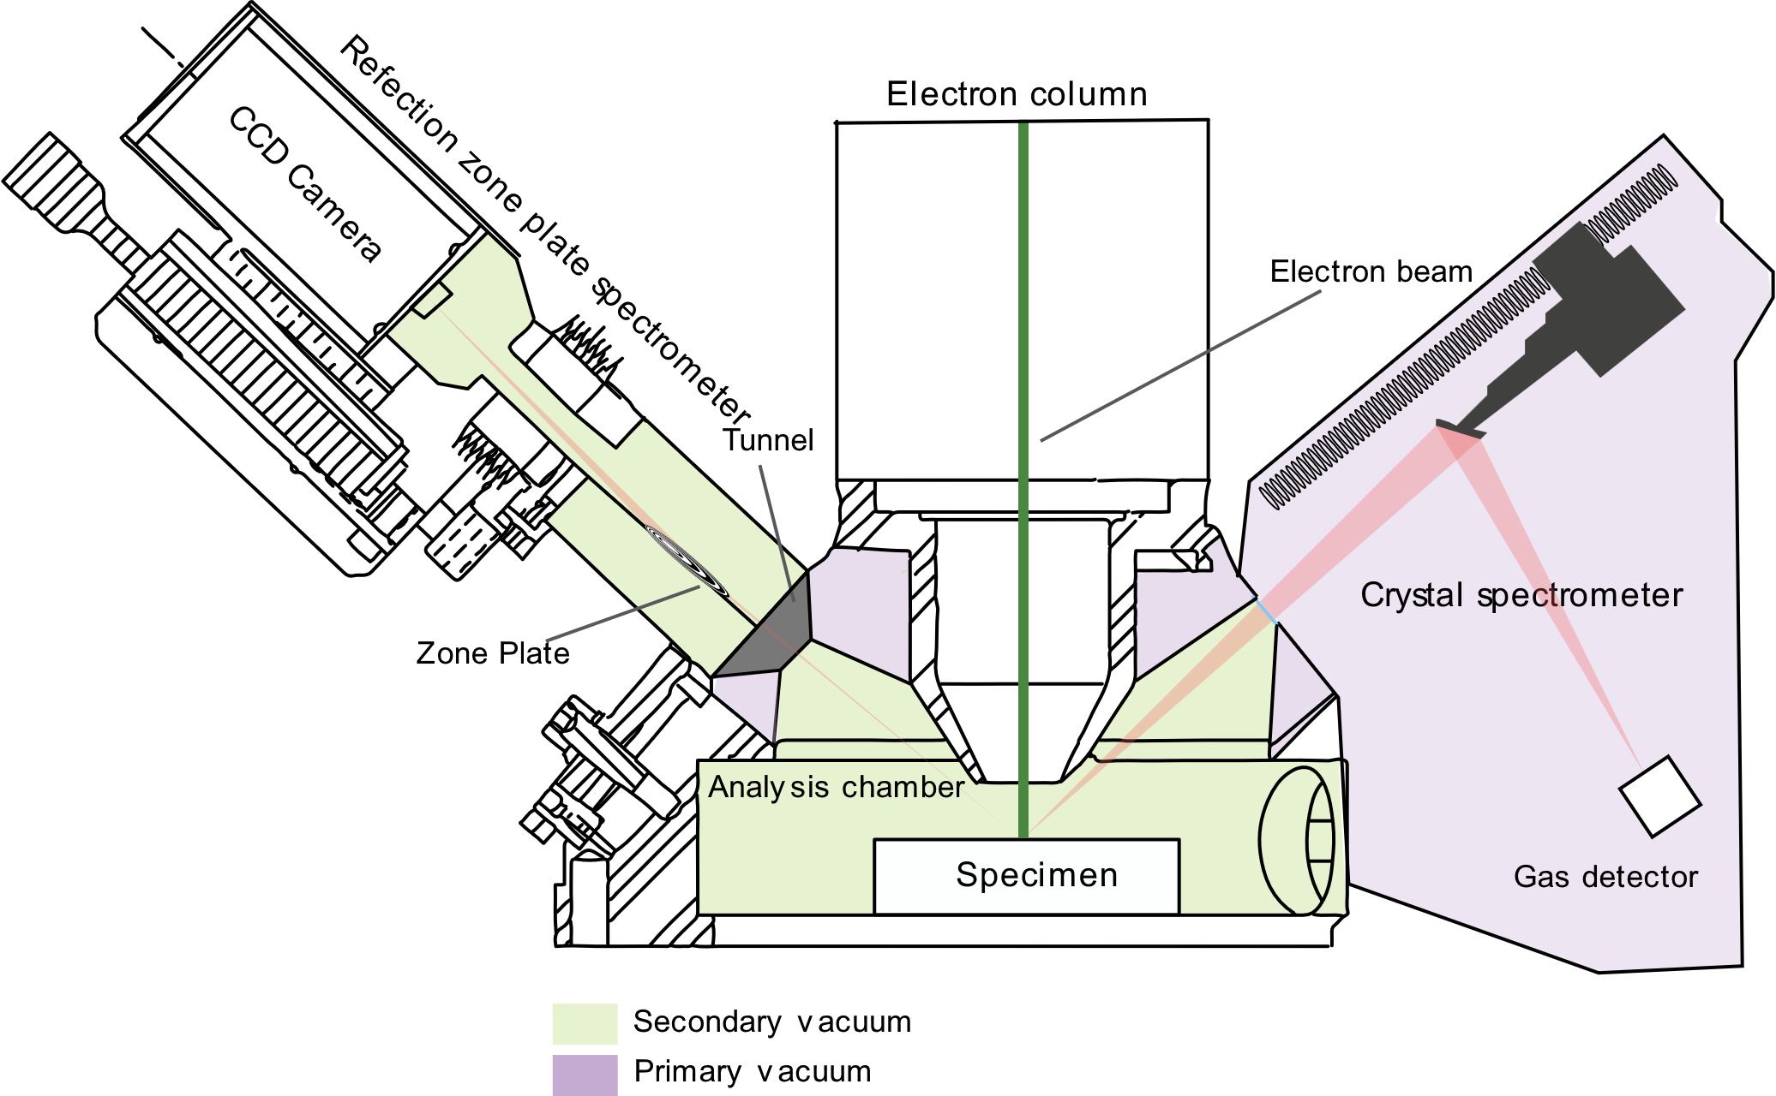
Wavelength Dispersive Spectrometer
Reflection Zone Plate
spectrometer
2dsin(θ) = nλ
α
β
Mechanical scanning (Rowland mount)
High efficiency
Resolution: few eV (for multilayers in soft x-ray range)
d(cosα−cosβ)= nλ
Simultaneous (VLS)
Efficiency 10-25%
Resolution: < 1 eV
RZP
WDSX02 - NOB
Crystal / Multilayer
40 eV
120 eV
150 eV
Few keV
Notes:
The instrument that allows us to acquire the XES spectra is the EPMA which is similar to a SEM but equipped with WDS which disperse/diffract x-rays based on their wavelength respecting Bragg’s law or grating law. The second spectrometer we have equipped our instrument with is a newly developed and special type of grating with laminar grooves with varied line spacing.
I have listed here somme of the differences between the two spectra, for instance, the multilayer/crystal there is a scanning mechanism while in the RZP there is no moving parts thanks the to the VLS, in terms of resolution multilayers have a resolution of few eVs while the RZP have a higher resolution (less than 1 eV).
The range convered by the RZP spectrometer we posses is from about 40 eV to 120 eV while higher energies can be covered by multilayers/crystals.

Slide 4
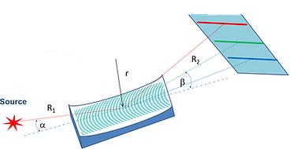
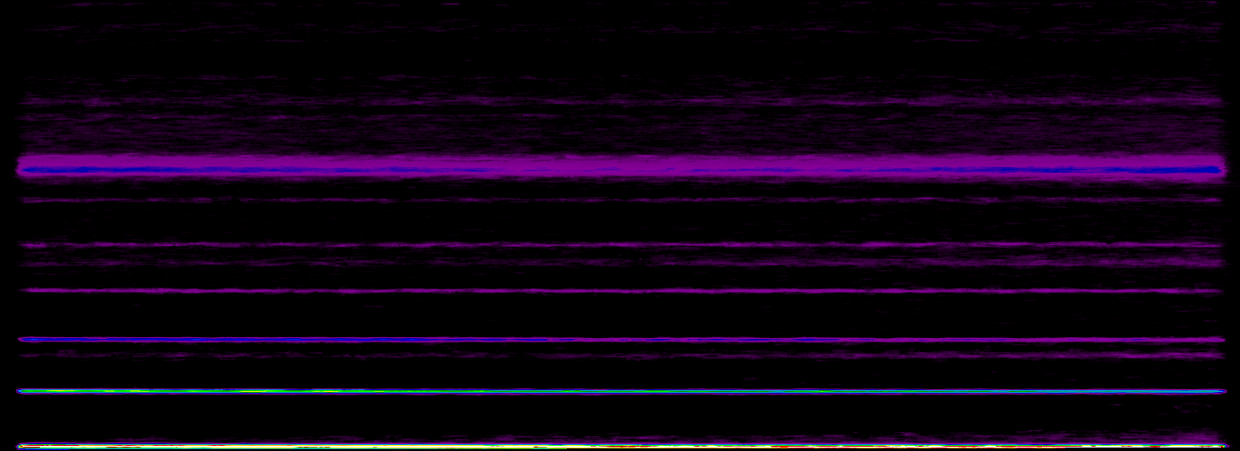
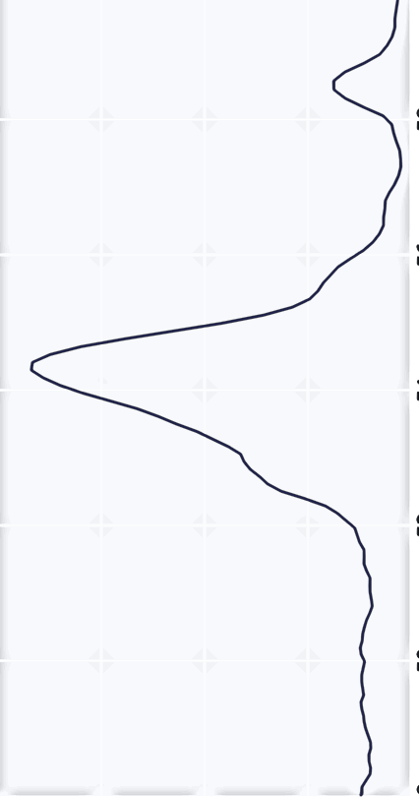
RZP:
CCD Camera
RZP
Concentric rings
Varied line spacing
188.46 l/mm
CCD Image of Li metal
2048 px
Dispersion
Direction -
Energy (eV)
515 px
Notes:
So after being diffracted by the RZP the polychromatic x-ray beam is separated into different monochromatic ones and detected using a CCD camera.
The images obtained are like the one presented here and to obtain the final spectrum we sum over the horizontal axis like you see in the animation to obtain the final spectrum.

Slide 5

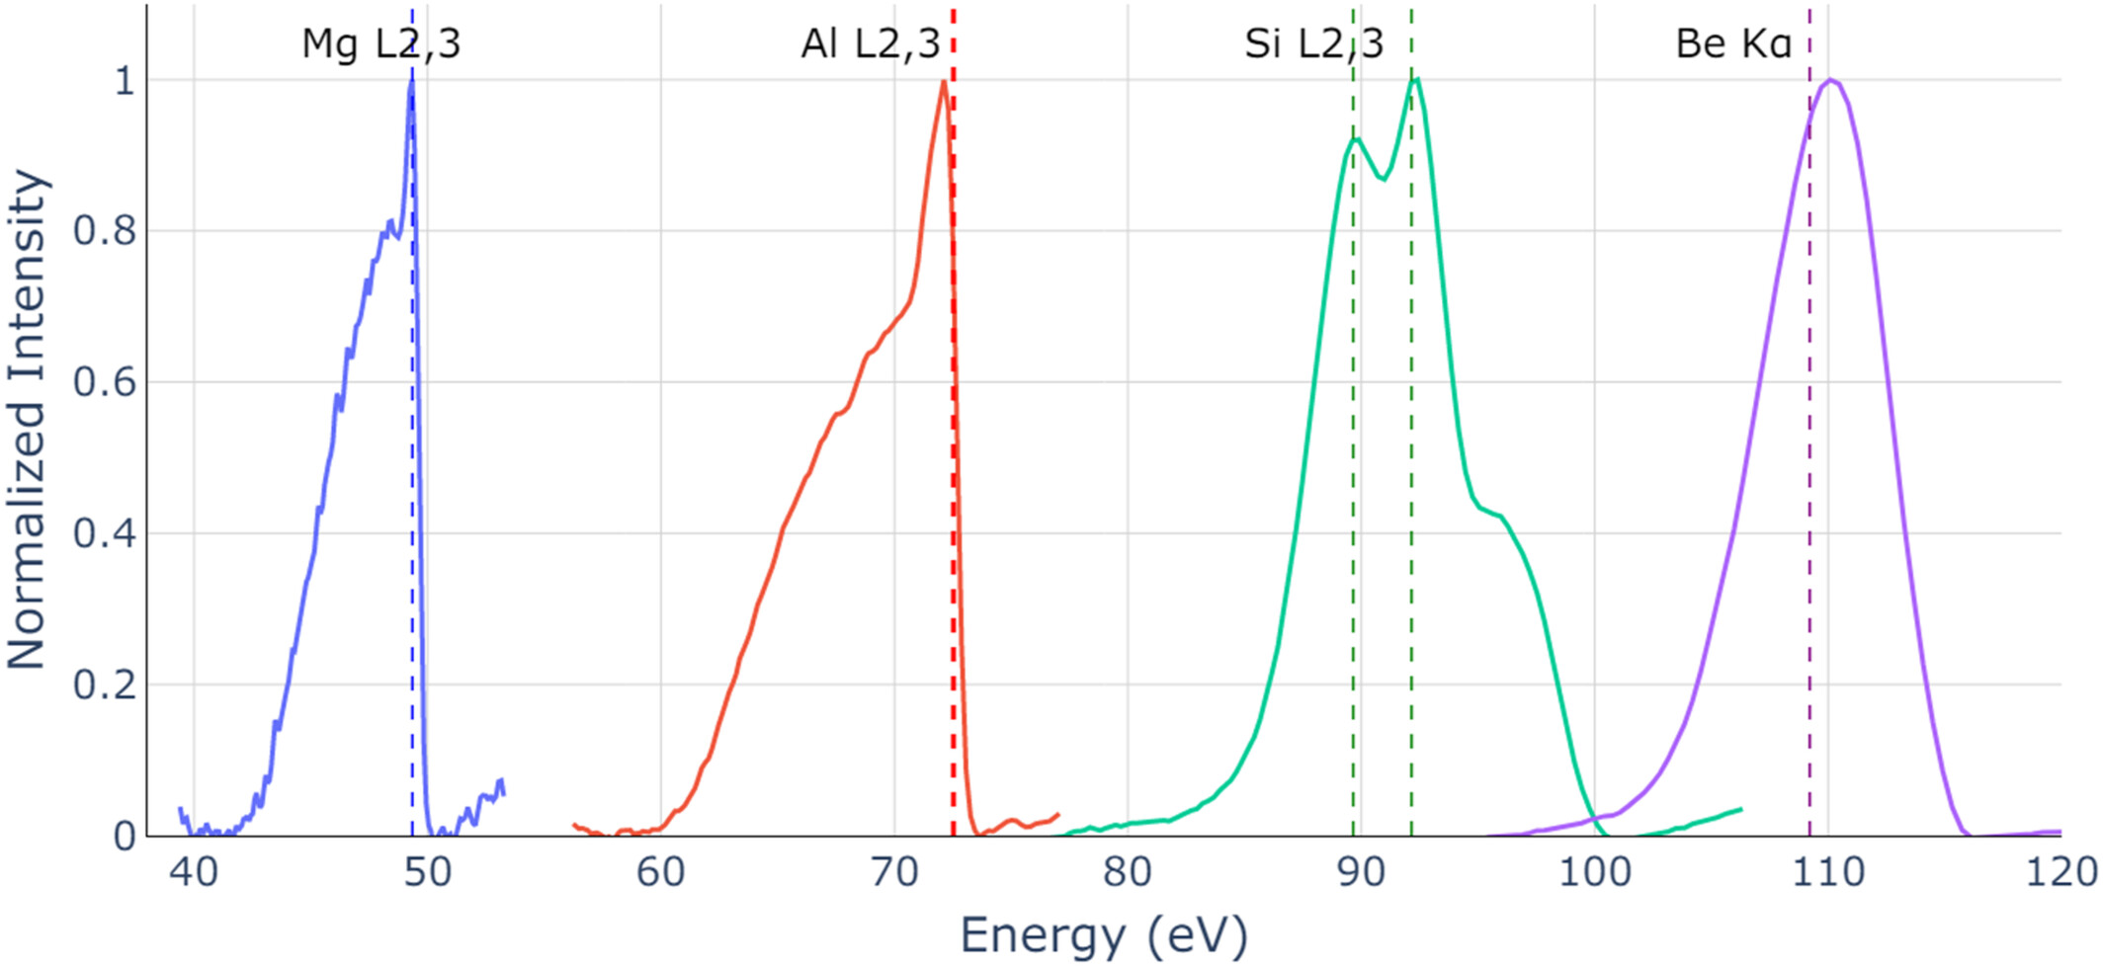
Detection
K. Hassebi, N. Rividi, M. Fialin, A. Verlaguet, G. Godard, J. Probst, H. Löchel, T. Krist, C. Braig, C. Seifert, R. Benbalagh, R. Vacheresse, V. Ilakovac, K. Le Guen, P. Jonnard, X-Ray Spectrom 2024, 1. https://doi.org/10.1002/xrs.3427
Element-specific information (Detect very light elements such as Li, Be, B, C…)
Associated energy
values from the literature
Resolution: 0.25 eV @ Mg L2,3 and 0.5 eV @ Al L2,3
(3sd → 2p)
(2p → 1s)
These emission bands are about 10 eV wide: the natural widths of the emission + the experimental broadening
-> reflect the widths of the valence bands.
Notes:
As we have discussed in the previous slides XES is capable of giving elt specific information, like we see in this figure where we observed some L and K emissions we acquired for different elements in their pure form in the whole range of the spectrometer, like for example the L2,3 emission of Mg L2,3 which occurs when there is a transition from 3sd to the 2p states where we see the sharp fermi edge characteristic of metals the resolution measured at this edge was 0.25 eV and 0.5 eV at the Al L2,3.
Most of those emissions have a wide of about 10 eV, which reflects the natural widths of the emission + the core states and experimental broadening is small this width reflects only the widths of the valence bands.

Slide 6
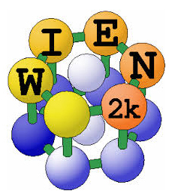
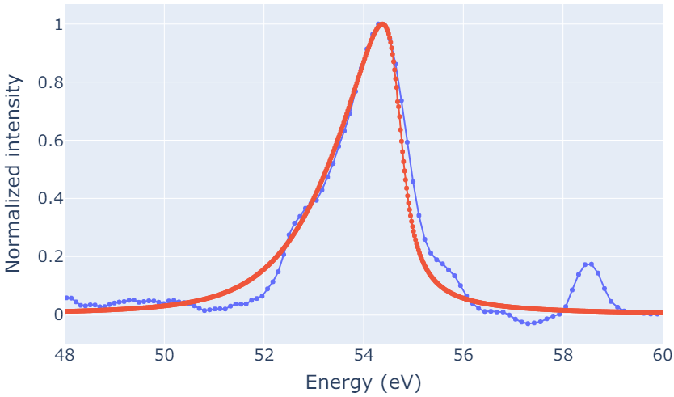
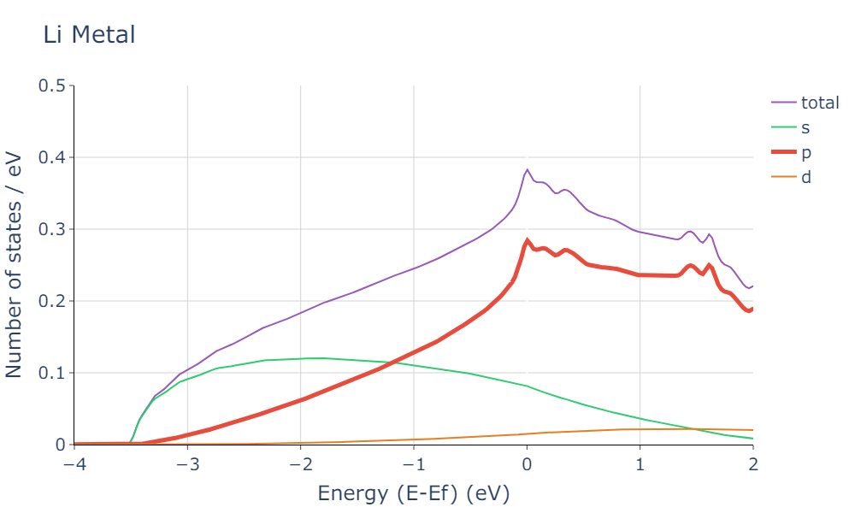

Li Metal
2p valence states transition to 1s core states in lithium atoms and therefore the spectrum reflects the distribution of the p states within the valence band.
E_{F}
Li K at @ 54.3 eV
Calculated
Density Functional Theory (DFT)
Measurements
E_{F}
O K
O K
Li K
K. Hassebi, K. Le Guen, N. Rividi, A. Verlaguet, and P. Jonnard, “Calculation of emission spectra of lithium compounds,” X-Ray Spectrometry, doi 10.1002/xrs.3329.
HV: 5 kV, Beam current: 299 nA, Acquisition time: 300 s
Not the optimal conditions
Notes:
Another example that I want to show also is the one of Li K emission in pure lithium, you can see that this emission has an asymmetric shape centered at around 54.3 eV.
This emission occurs when there is a transition from 2p valence states to the 1s core states and therefore the spectrum reflects the distribution of the p states within the valence band.
This can be seen in the DOS calculation using wien2k where we see the contribution of the p states to the total density of state.
We have also used wien2k to calculate the Li K emission band and compared it with the experimental curve in blue. The results are in very good agreement except for some small discrepancies due to the presence of the high diffraction orders of the O K emission, that we can remove in post processing steps of the spectra. For more details about the DFT calculations you can check our paper.

Slide 7
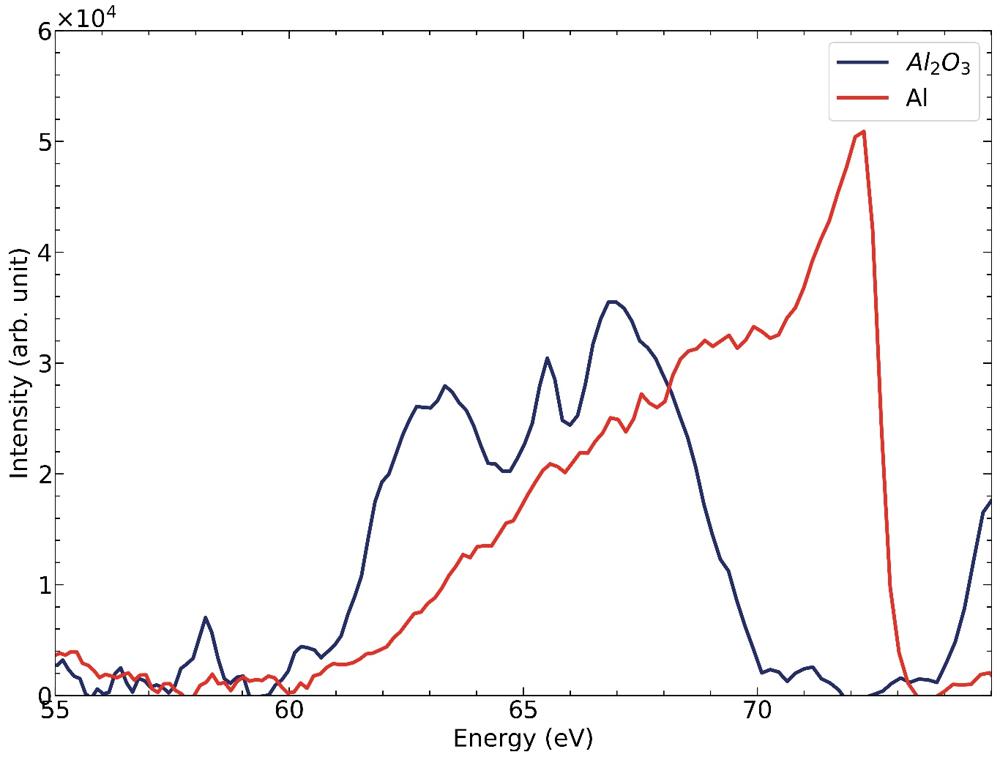
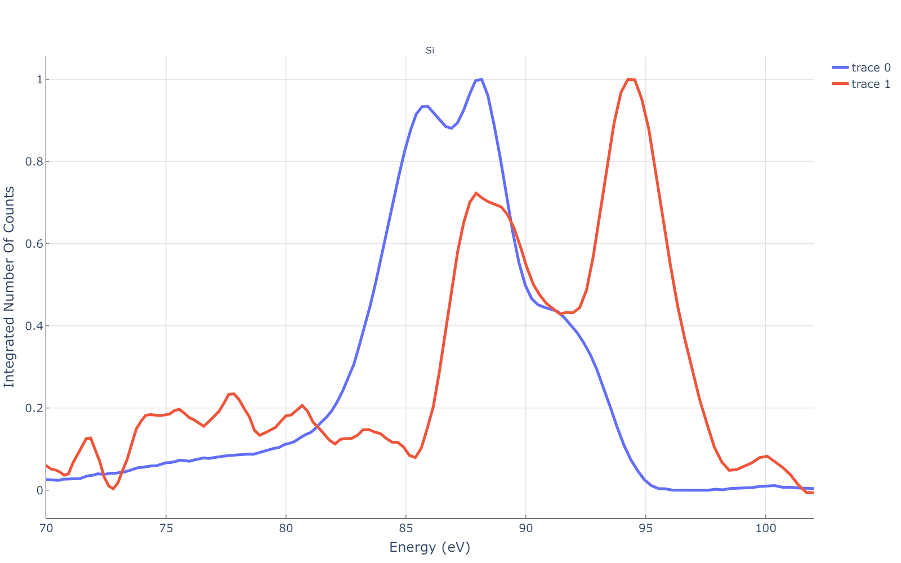
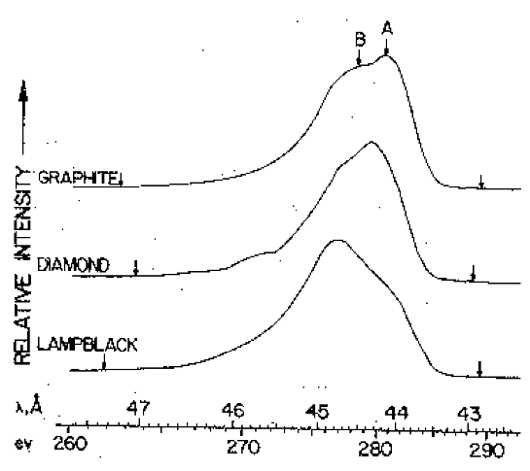
Chemical environment
Core binding energies depend on the chemical environment
But also information about the chemical state of an element by studying the peak positions,
band shapes, …
changes in the energy distribution of the electrons occupying the valence band.
Crystalline structure
Si oxide
(Al: 50 nA, 300s, Al₂O₃: 40 nA, 900s)
Si
Fischer, D. W., & Baun, W. L. (n.d.). THE EFFECT OF CHEMICAL COMBINATION ON SOME SOFT X-RAY K AND L EMISSION SPECTRA.
Application: Elemental mapping but also Chemical mapping…
Notes:
In the previous slides we have talked about element specific information, now we will discuss the information we get from the same types of atoms, that is manifested as changes in
peak positions because the core binding depend on the chemical environment,
Band shapes due to the changes in the energy distribution of the electrons occupying the valence band.
A concrete example of all this is the Al L2,3 emission in pure aluminum and Al2O3
The essential modification of Al L2,3 spectrum are trivial, characterized by the emergence of a double peak for the oxide, the dispearance of the sharp edge for the oxide…
Same is observed for the Si L2,3 emission.
Another example this time extracted from the literature where fischer shows dependence on cristaliine structure with changes of the C K between graphite, diamond, lampblack…

Slide 8
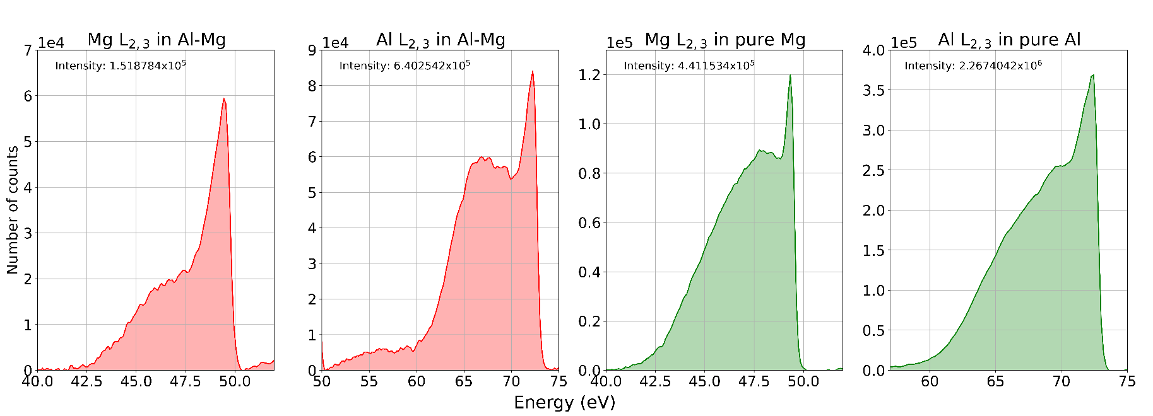
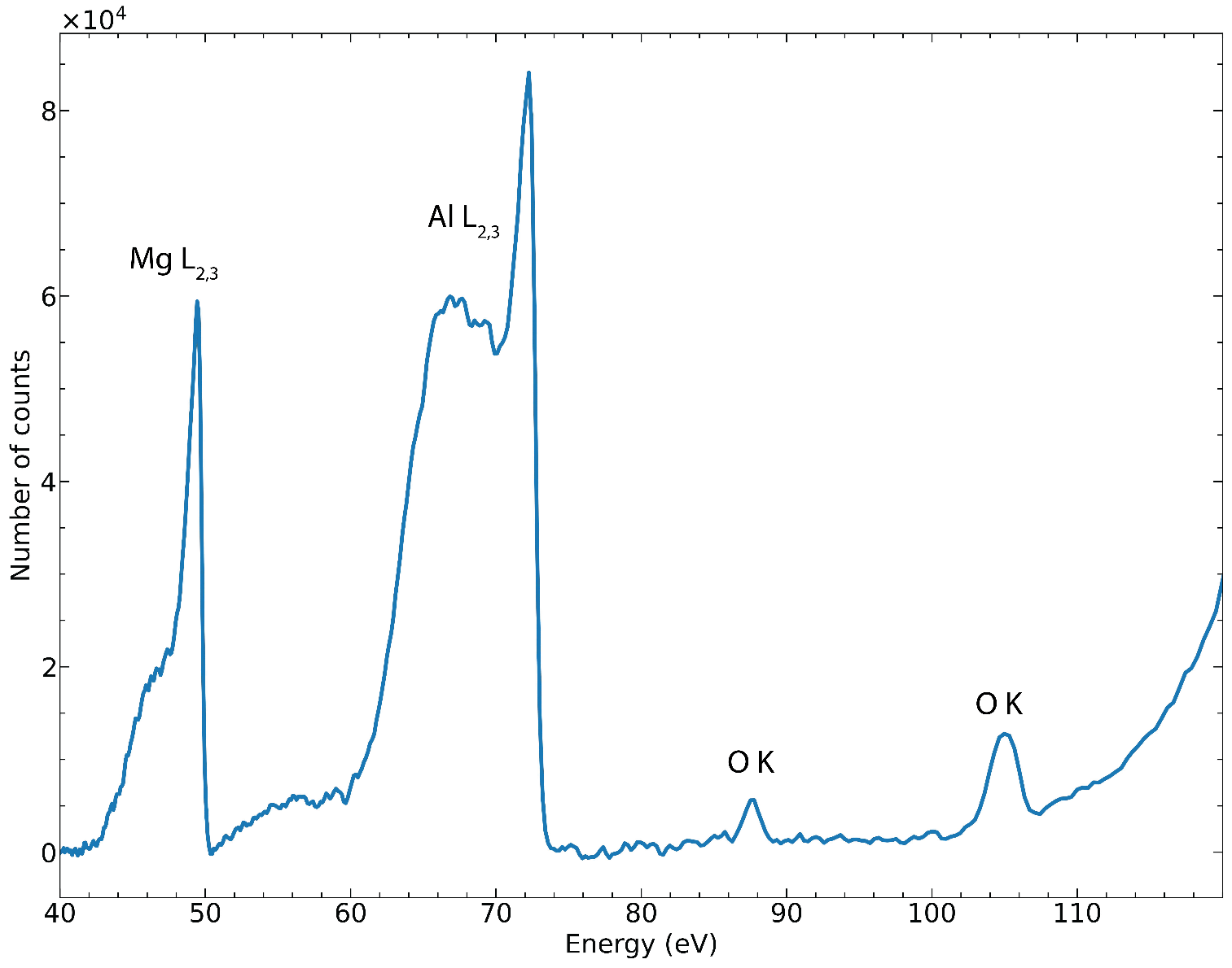
Quantification of Al-Mg alloy
The goal is to: Detect + Quantify
 |  | Al |  | Mg
 |  | Integral | Peak max | Integral | Peak max
wt% (RZP) | MAC30 | 84.2 | 84.74 | 15.7 | 15.2
 | Chantler | 86.6 | 80.9 | 12.6 | 19.0
 | EPDL97 | 76 | 70.41 | 24 | 29.5
 | EPDL23 | 75.5 | 70.2 | 24.4 | 29.7
 | Penelope 2018 | 75.6 | 71.3 | 24.4 | 28.6
wt% (crystal) |  | 62.3 |  | 37.6
Using the PAP model
Relative errors:
 | Al | Mg
 | I, % | Pk max, % | Integral, % | Peak max, %
MAC30 | 26 | 26.4 | 139.5 | 147.3
Chantler | 28 | 23 | 198.4 | 97.8
EPDL97 | 18 | 11.5 | 56.6 | 27.4
EPDL23 | 17.4 | 11.2 | 54.4 | 26.6
Penelope 2018 | 17.5 | 12.6 | 54.4 | 31.4
MACs are not well known in the ultra-soft x-ray range
Contaminations, quality of standards … → Introducing uncertainties
Notes:
As we said in the beginning our goal is not just to detect the presence of these elements but also to be able to quantify them.
The first example of quantification I will show here is the one of Al-Mg alloy,
The spectrum obtained in the full range of the RZP is presented in the figure up left where we see the presence of the Al L2,3 band and Mg L2,3 band with also small O K peaks from the surface contamination.
To perform the quantification we extract those emission bands in addition to the ones from the standards which are pure Mg and pure Al.
And then using the PAP correction model we have obtained the results in the table using different mass absorption coefficients.
This results were compared to the quantifications obtained from the standard crystal/multilayer spectrometer. With the relative errors presented in the table on the right.
The results are quite promising for an initial test with relative errors of about 11% to 26.6% depending on the element analyzed and method used for intensity.
The difference can be due to several factors including the uncertainties on the fundamental parameters such as the MAC that are not well known in the ultra soft x-ray range, the presence of contaminations, quality of standards (lilke the one of pure Mg that wasn’t that good from what I remember..)

Slide 9
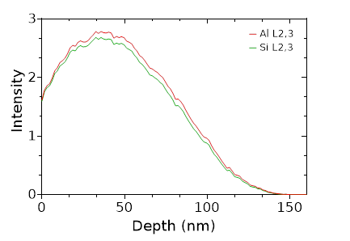
Quantification of Al-Si alloy
Depth distribution function for a 3 kV:
Monte Carlo simulation
 | Ultra-soft x-ray range
MAC database | Al (wt%) | Si (wt%)
MAC30 | 76.4 | 23.5
Chantler | 86.9 | 13
EPDL97 | 87.5 | 12.4
EPDL23 | 86.8 | 13.1
PENELOPE 2018 | 86.3 | 13.6
150 nm thick
Al-Si (1wt% Si)
Si Substrate
Notes:
The second example of the quantification I will present the one of Al-Si alloy where we have analyzed a 150 nm thick film of Al-Si deposited on a Si substrate.
Before analyzing this sample we have to make sure we do not excite the substrate and for that we made a Monte carlo simulation of the depth distribution function for the Al L2,3 and Si L2,3 emissions with 3kV acceleration voltage. and from the simulation we can see that with a 3kV we are safe and we do not excite the substrate.
The spectrum obtained with the RZP is presented on the left. You can see that the Si L2,3 is quite low which will affect the precision of the quantification.
The obtained concentrations are presented in the table on the right.

Slide 10
Quantification of AlCuLi quasicrystal
Background subtracted + normalized number of counts
Cu obtained by difference
 | Ultra-soft x-ray range
MAC database | Al (wt%) | Li (wt%) | Cu (wt%)
MAC30 | 74.2 | 16.2 | 9.4
Chantler | 49.6 | 19.8 | 30.5
EPDL97 | 51.2 | 19.1 | 29.6
EPDL23 | 63.8 | 12.9 | 23.2
PENELOPE 2018 | 57.3 | 20.7 | 21.9
 | Soft x-ray range
Wt% (crystal) | 59.6 | 16.9 | 24.0
We do not observe the M emission of the Cu
Comparison with the crystal spectrometer
Notes:
The last example will be this time for the quantification of Li in a quasicrystal, the spectrum shows the Al L2,3 emission and Li Ka emission .
The positions of carbon high diffraction orders and O K are shown in red and green.
The Cu M emission has very low intensity that’s why we couldn’t observe so we have used only the one of AL L2,3 and Li Ka and we obtained the one of Cu by difference again using different MAC databases and compared to the results obtained using crystals/mutlilayers where we are able to measure the intensity of Al and Cu and we obtain the one of Li by difference. The result in this case were very close with 57.3 weight percent for the Al

Slide 11
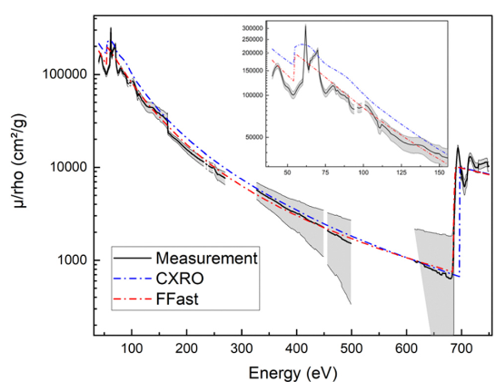
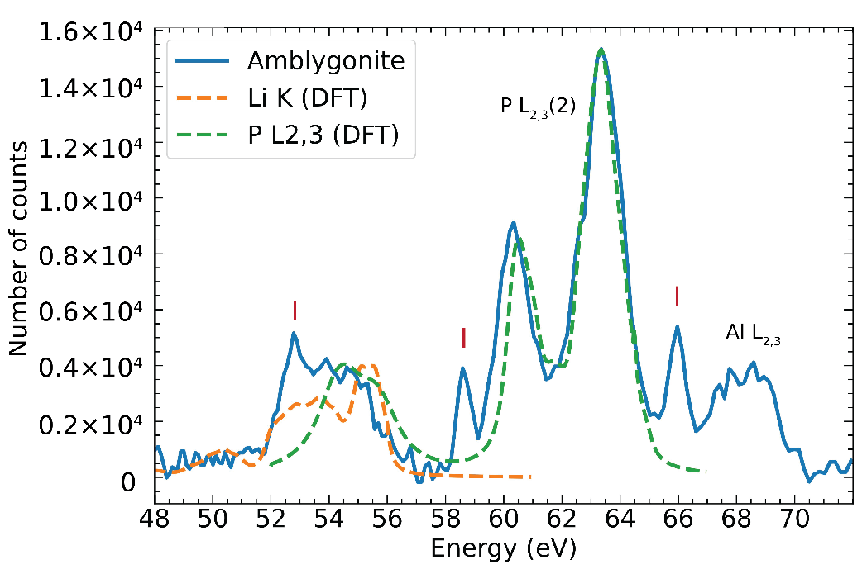
Challenges in the ultra-soft x-ray range
Schweizer, et al. https://doi.org/10.1039/D4CP00500G
Damage under the beam
Contaminations
Overlaps
Charging...
(Li,Na)AlPO₄(F,OH)
Uncertainties on MAC => Corrections => precision of the quantification
1% MAC introduces => 1% relative uncertainty in the measured concentration.
Fundamental parameters
Analysis

Slide 12
Conclusion
Successfully implementation of the RZP on EPMA
RZP provides good intensity and spectral resolution (0.25 eV at the Mg L_{2,3} edge)
Chemical state depends of the XES spectra
First attempts to quantify in the ultra-soft x-ray range (Li, Mg, Al…)
Challenges faced in this spectral range (MACs, contaminations…), still room for improvements

Slide 13



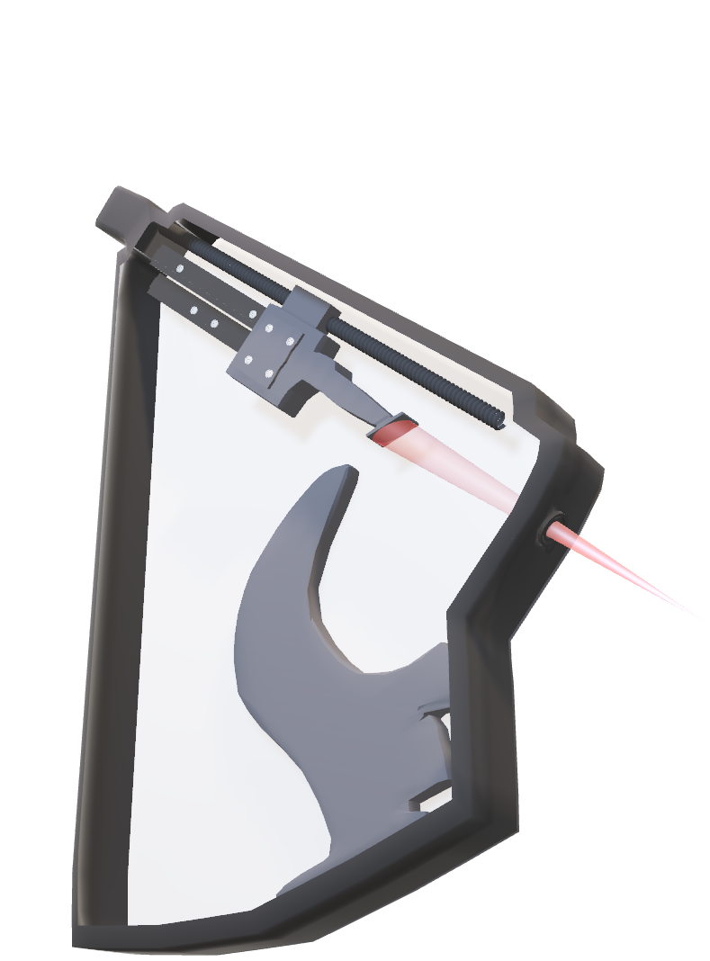
Acknowledgement:
Under the supervision of:
Dr. Philippe JONNARD
Dr. Nicolas RIVIDI
Dr. Anne VERLAGUET
Special thanks to all SQLX team:
Régis Vacheresse
Rabah Benbalagh
Karine Le Guen
Vita Ilakovac
Marie Christine Lépy
Michel Fialin

