Slide 1
Micro-perforated membrane for label-free cell capture and integrated electrical detection operating in whole blood
Matthieu Sagot^{a,b}, Elise Bou^{b}, David Bourrierª, Aline Cerf^{b},
Hervé Aubertª, Christophe Vieuª
a: LAAS-CNRS, Université de Toulouse, CNRS, INSA, INPT, 31400, Toulouse, France
b: SmartCatch, 1 Place Pierre Potier, 31100, Toulouse, France

Slide 2
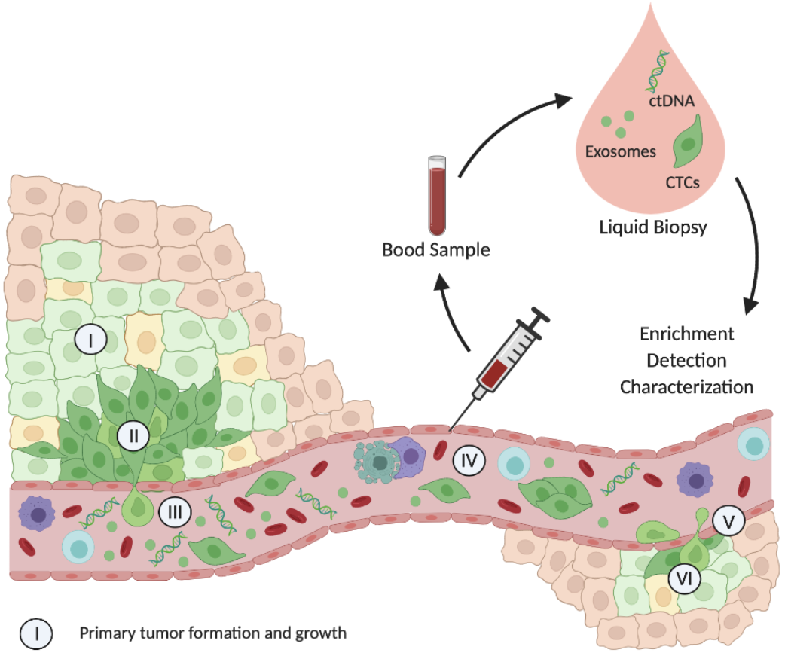
Dissemination of Circulating Tumor Biomarkers in Blood
1
Primary tumor formation and growth
Epithelial to mesenchymal transition (EMT)
Intravasation
Spread of CTCs
Extravasation
Mesenchymal to epithelial transition (MET)
Secondary tumor formation and growth
Blood Sample
Liquid Biopsy
2
1
Diagnosis, Prognosis
Treatment Response Monitoring
Anti-cancer substance assay
3
2
4
4
3
5
5
6
6
Cancer stem-like cell
Epithelial cell
Lymphocyte
Cancer cell
Endothelial cell
Phagocyte
Cancer cell after EMT
Erythrocyte
Dying CTC
Adapted from Melzer and al., 2017

Slide 3
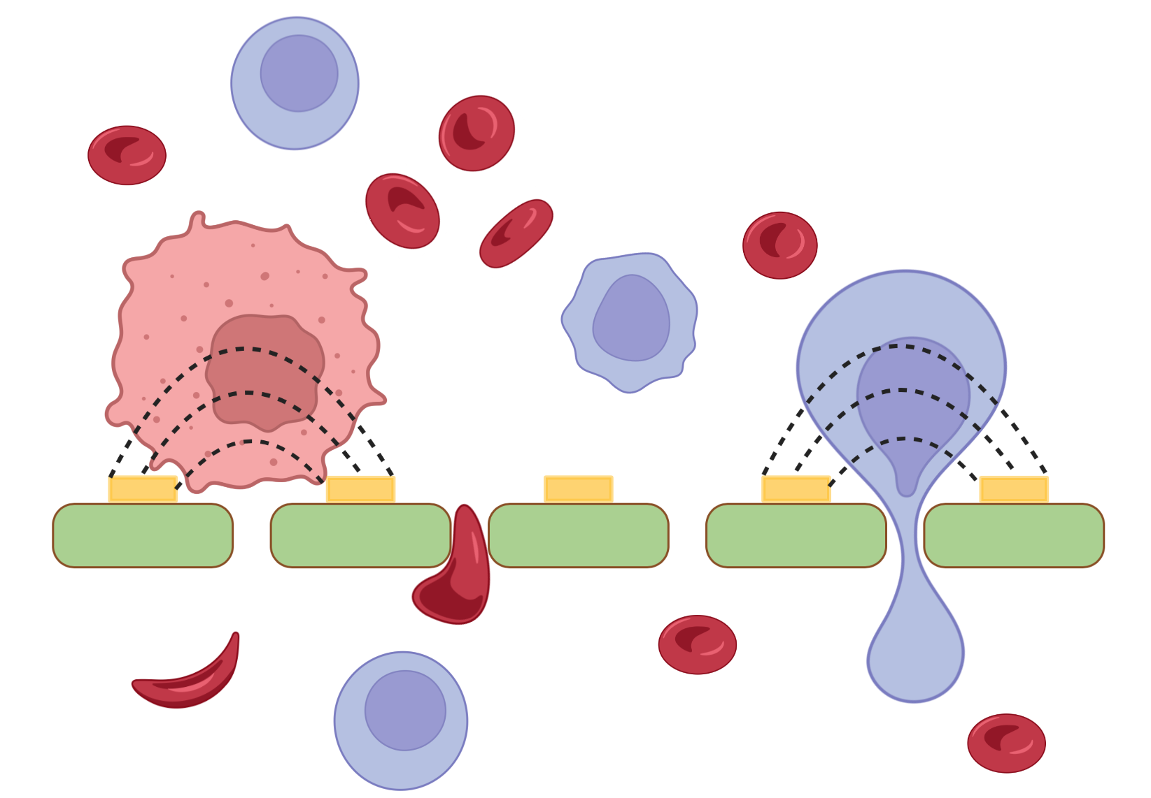
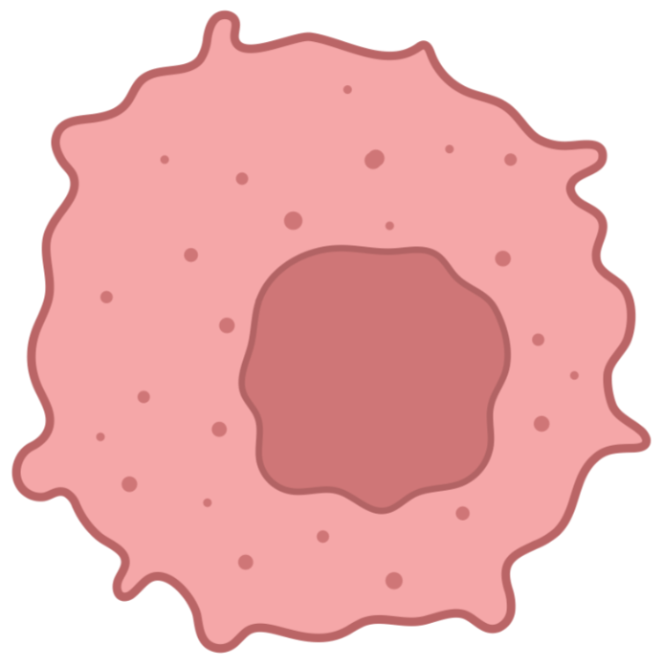
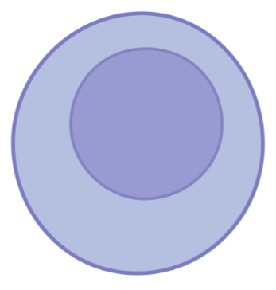
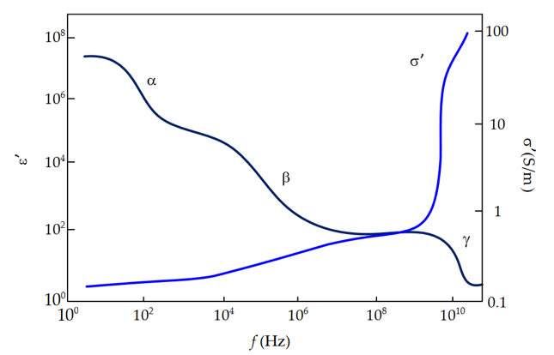
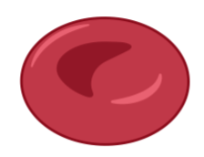
Combination of Cell Capture and Cell Detection
Blood Sample
CTC
17-52 µm
WBC
7 - 25 µm
Electrical Properties of Biological Cells
Sensing Electrodes
Filtering Membrane
RBC
6 µm
$α$ (Hz - kHz)
Capacitive behaviour: electrically insulating membrane
$β$ (500 kHz - 20 MHz)
Capacitive (membrane) and Conductive (cytoplasm) effects
$γ$ (RF)
Access to the Conductive intracellular medium (cytoplasm)
Martisen, G. et Grimnes, S., Bioimpedance and bioelectricity basics, 2008

Slide 4
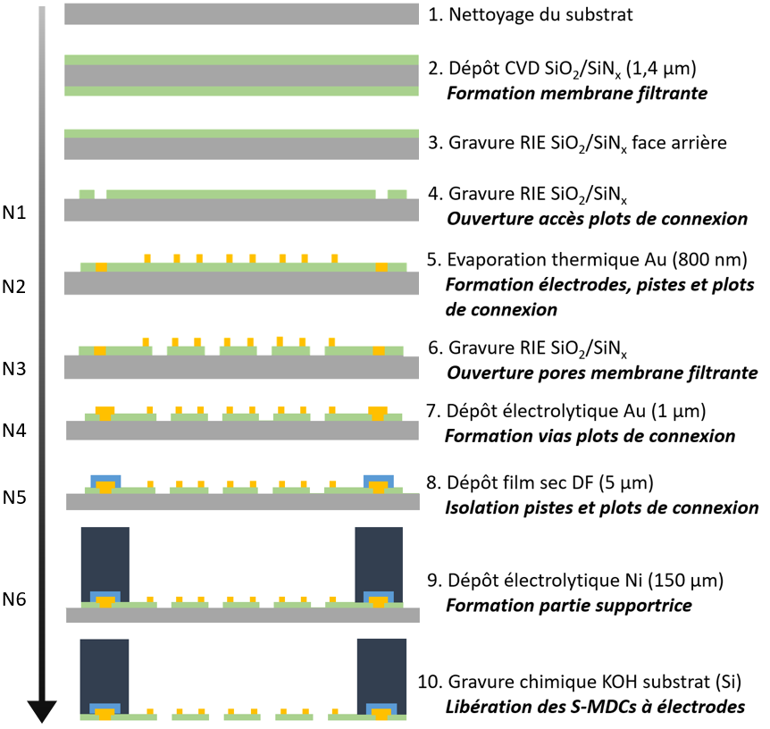
Microdevices Fabrication Process
1. Substrate Cleaning
1 mm
2. CVD Deposition SiO₂/Si₃N₄
Filtering Membrane
Connection Pads
3. RIE Etching SiO₂/Si₃N₄
Fluidic Slots
4. RIE Etching SiO₂/Si₃N₄
Openings for Connection Pads
5. Thermal Evaporation Au
Electrodes, Tracks and Connection Pads
Supporting Structure
6. RIE Etching SiO₂/Si₃N₄
Pores Filtering Membrane
7. Electrolytic Deposition Au
Connection Pads Thickening
150 µm
8. Dry Film Deposition DF
Tracks and Connection Pads Insulation
9. Electrolytic Deposition Ni
Supporting Structure
Filtering Membrane
10. Substrate Wet Etching (KOH)
Device release
Sensing Electrodes
Si
SiO₂/Si₃N₄ 0.8/0.6 µm
Au
0.8 µm
DF
5 µm
Ni
150 µm
E. Bou « Micro-dispositifs pour la biopsie liquide : vers la capture et détection intégrées de biomarqueurs cellulaires tumoraux ».

Slide 5
Cell Capture Experiments
Experimental Setup
Protocol
Pre-Processing: Ethanol & PBS
Sample Processing: 10 min in closed loop
Post-Processing: Fixation and Observation
Blood (EFS – French Blood Collection Site)

Slide 6
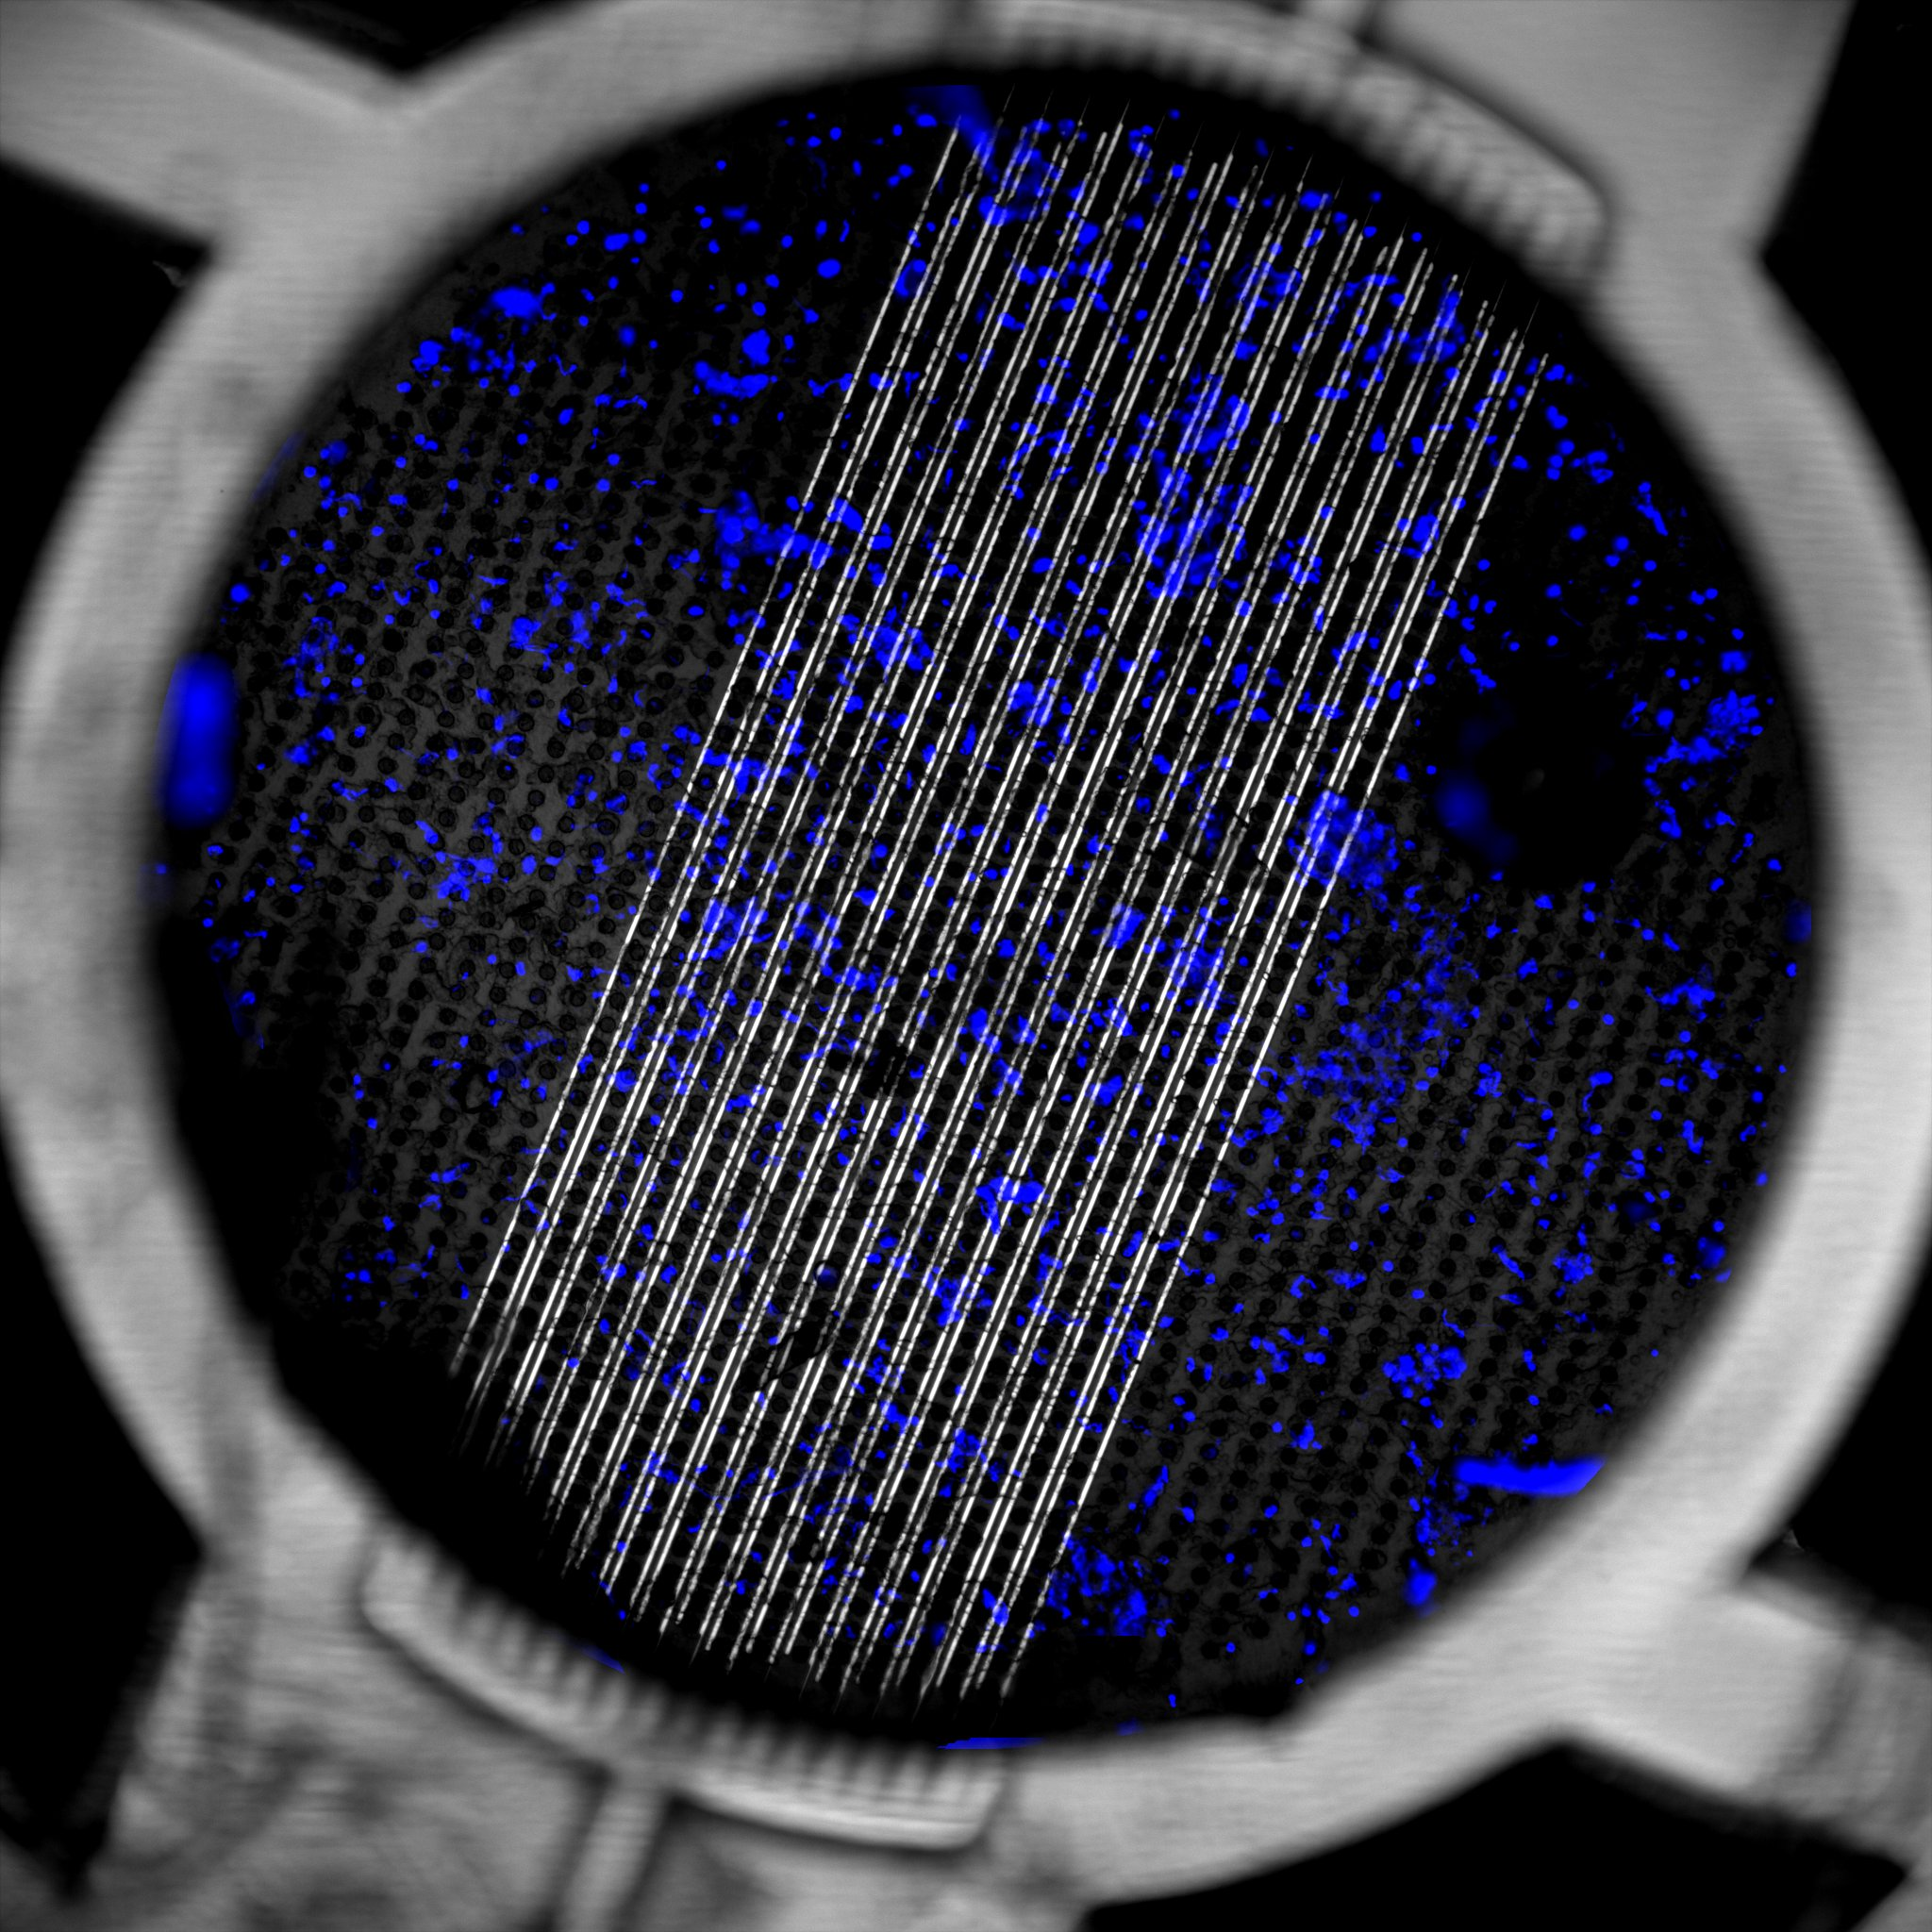
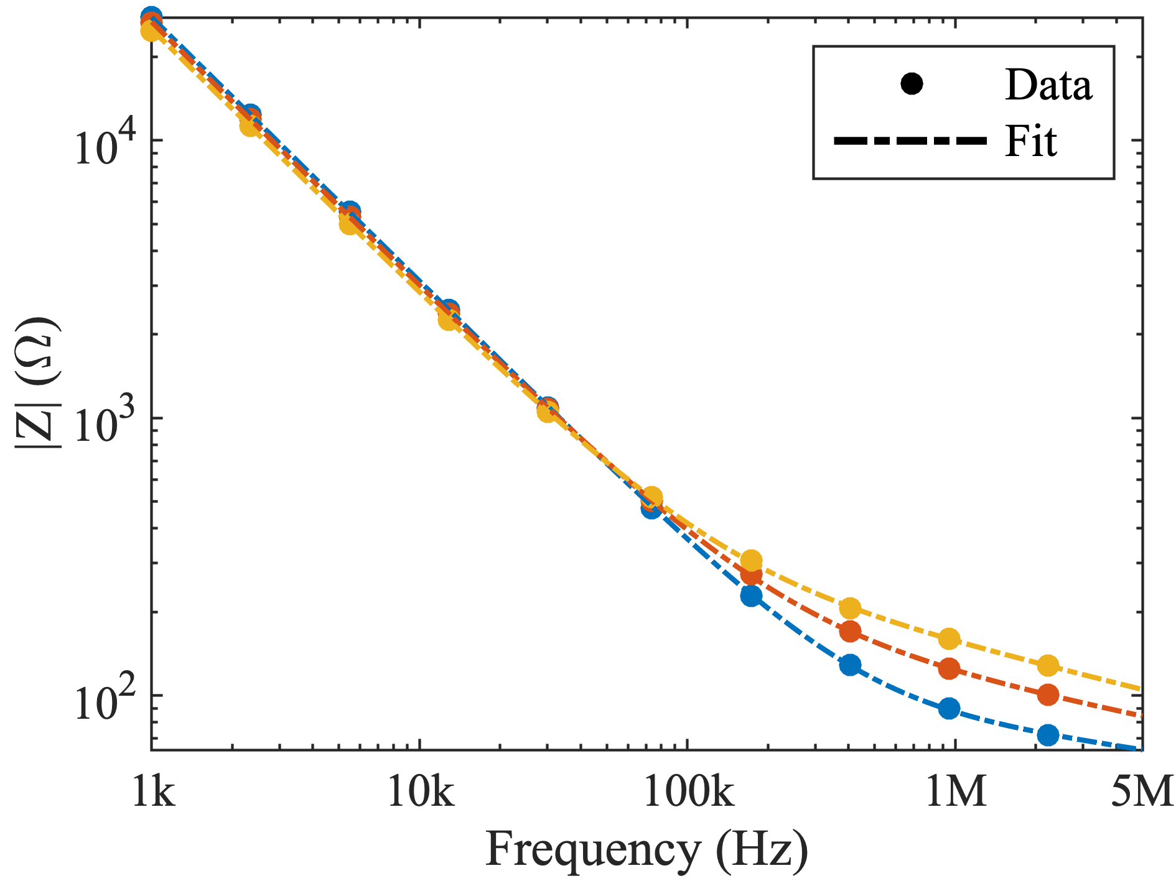
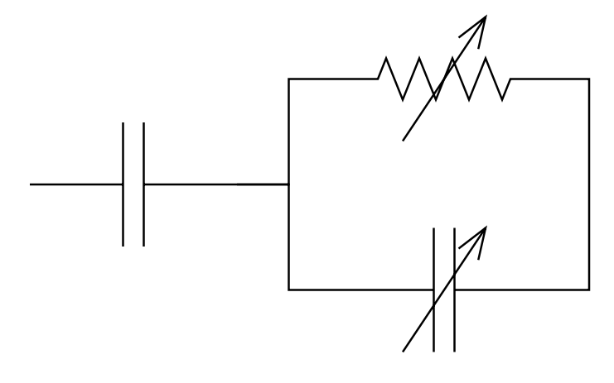
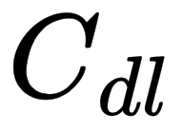
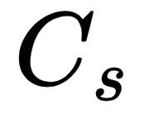
Impedance Evolution during Sample Processing
Impedance from 1kHz to 5MHz
Interface Impedance
R² > 0.99
10 min
0 min
Overlay Hoechst (Blue) and BF (Grey)
Medium Impedance
•Impedance increases during sample
processing (200 kHz - 5 MHz)
•Good fit with a simple electrical model
•Stability of the Interface Impedance
•Evolution of the Medium Impedance in Blood

Slide 7
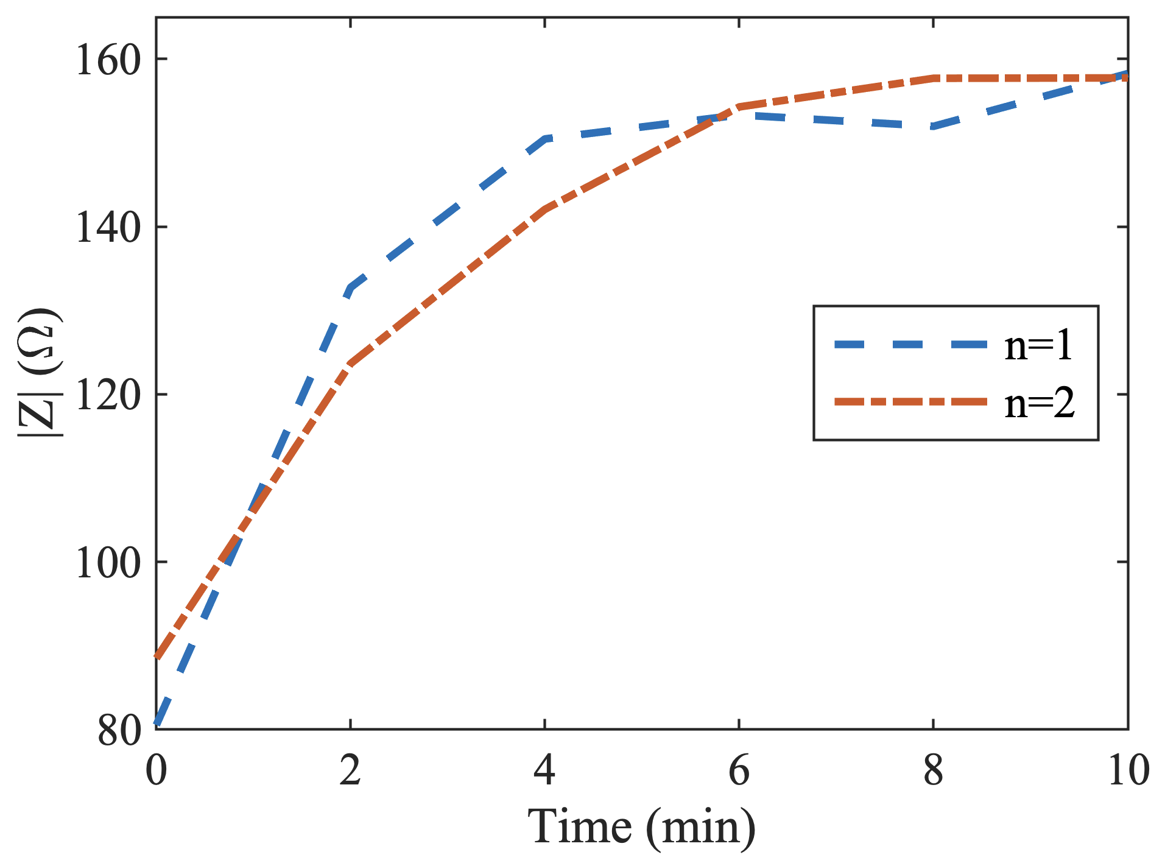
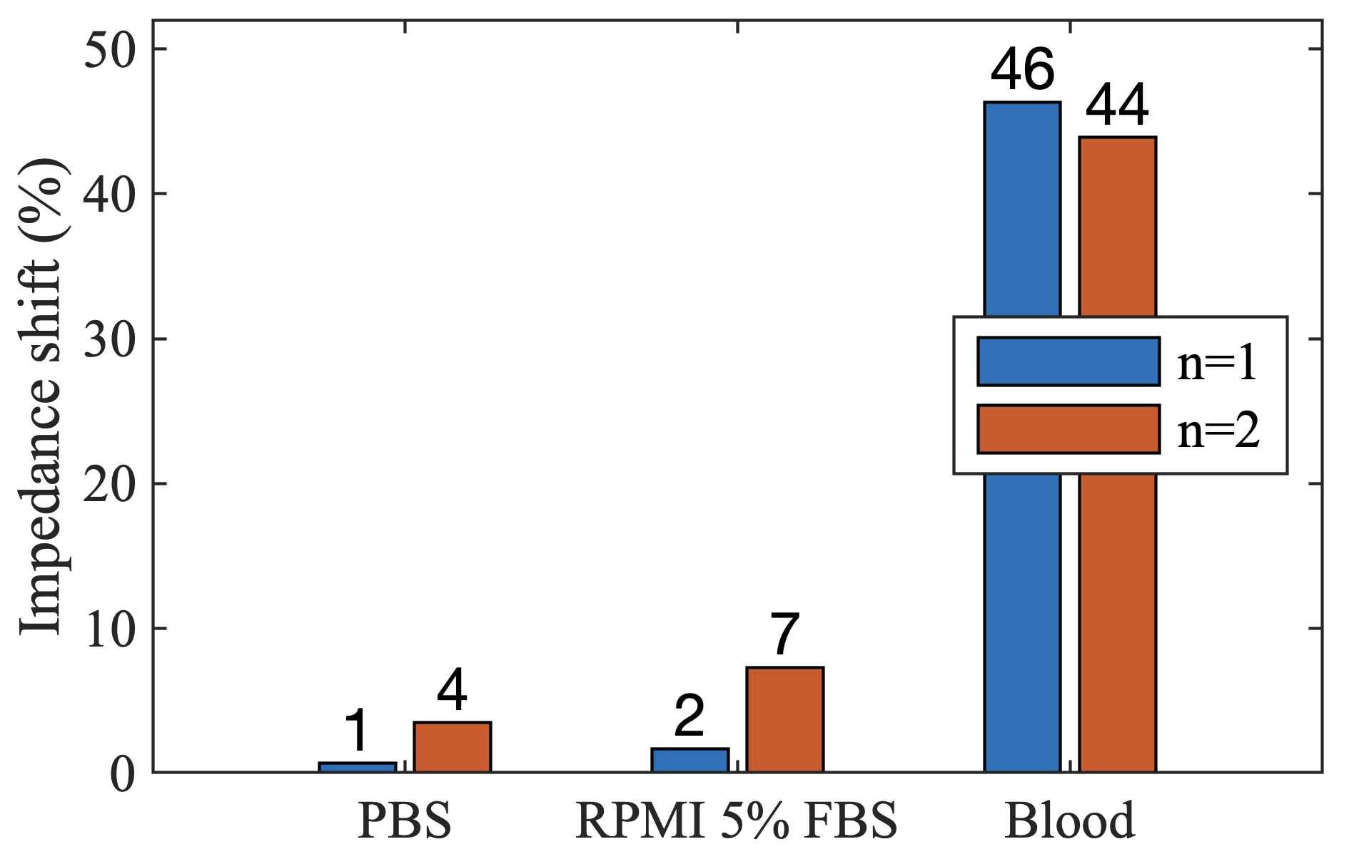
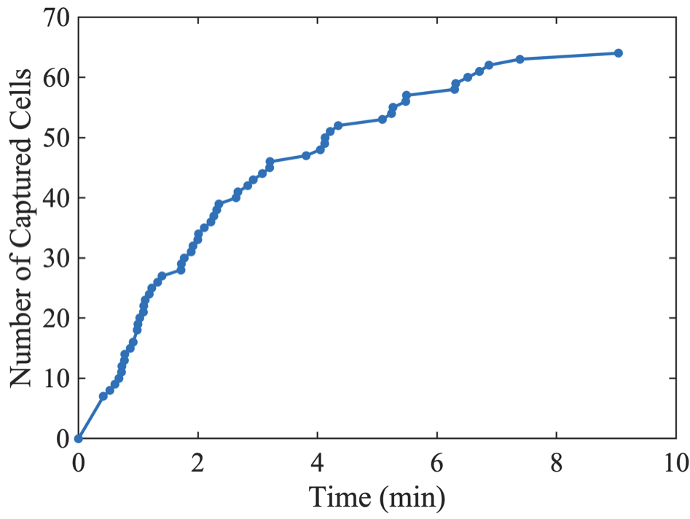
Detection of Captured Cells
Capture and Detection Kinetics
Impedance Shift for various Media
Proteins
Proteins + Cells
No Proteins / No Cells
•Detection of captured cells on the filtering membrane

Slide 8
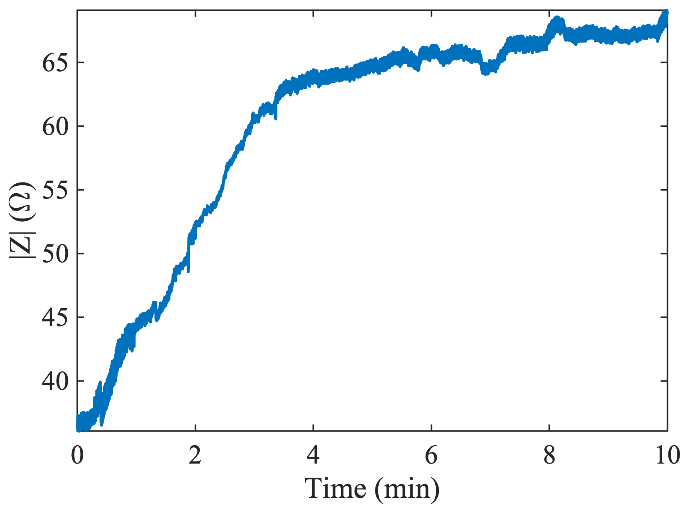
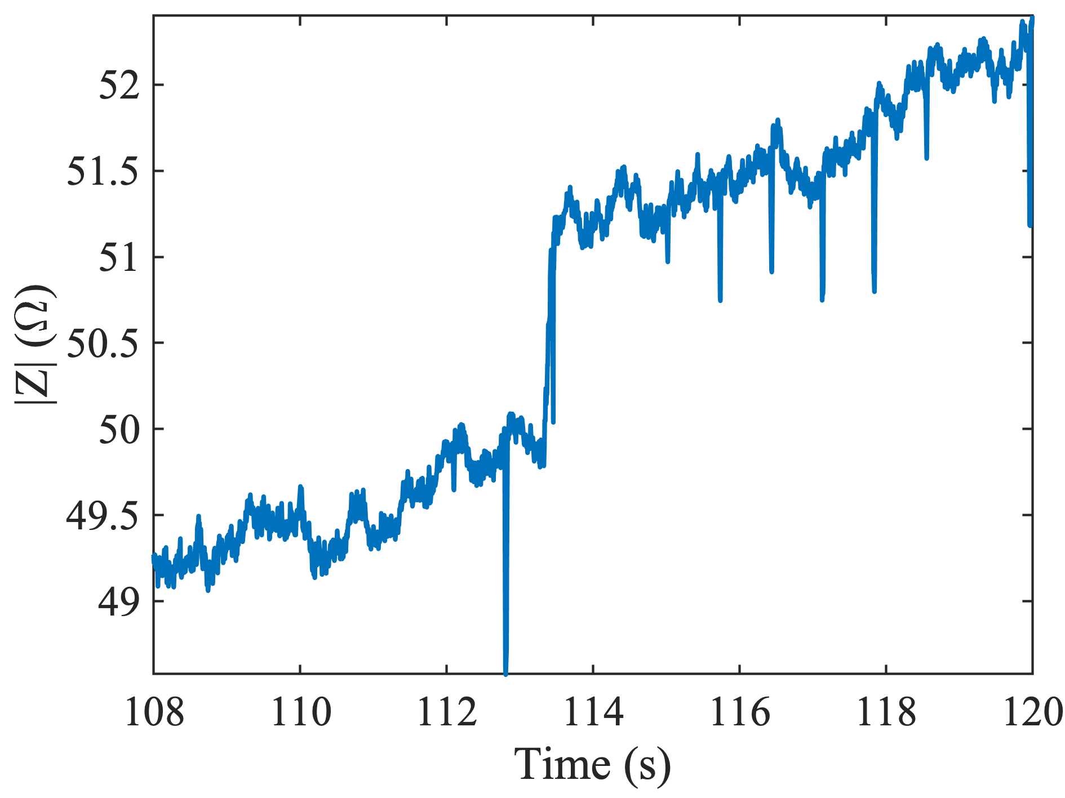
Conclusion and Prospects
We can selectively capture and detect in-situ cells in a whole blood sample without any pre-treatment !
Patent filed for integration into SmartCatch products intended for biology and pharmacology research fields
Detection of single cell capture events
Discrimination of CTCs based on their electrical signature

Slide 9
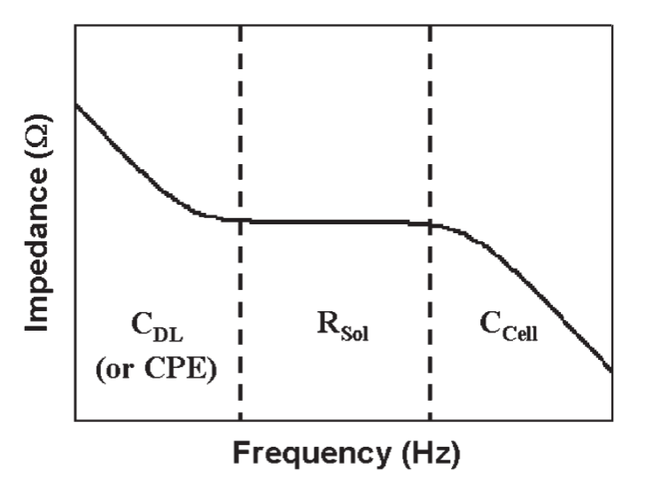
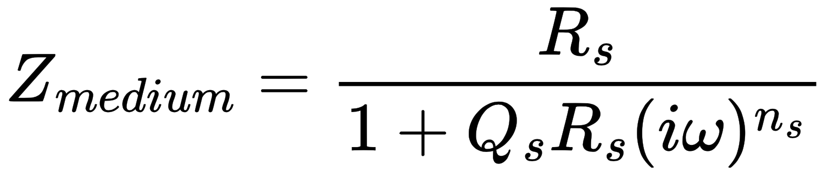
Impedance Model for Electrical Measurements
Electrode-Electrolyte Interface
Probed Medium
Cole, K. S. Permeability and Imperbeability of Cell Membranes for Ions. Cold Spring Harb. Symp. Quant. Biol. 1940, 8 (0), 110–122.

