Slide 1
Second French Plan for open science
Generalising open science in France 2021-2024

Slide 2
Overview of the First French Plan for Open Science (2018-2021)

Slide 3
Launch on 4 July 2021 by Frédérique Vidal, Minister for Higher Education, Research and Innovation
First Commitment : Generalise open access to publications
Second Commitment : Structure research data and make it available through open access
Third Commitment : Be part of a sustainable european and international open science dynamic

Slide 4
Governance : The Open Science Committee
Open science steering committee
Ministry of Higher Education, Research and Innovation (MESRI), research performing organisations, Universities, National Research Agency (ANR), Couperin consortium, High Council for Evaluation of Research and Higher Education (Hcéres)
Makes decisions, arbitrates the use of funds from the National Open Science Fund
Permanent secretariat for Open Science
MESRI, research performing organisations, Universities, ANR, Couperin consortium, Hcéres, ADBU, EPRIST, Colleges
Prepares decisions, proposes guidelines, monitors work
Colleges
Publications, Research Data, Skills and Training, Europe and International
(72 membres from 44 institutions)
Investigate issues, propose guidelines, initiate and manage projects

Slide 5
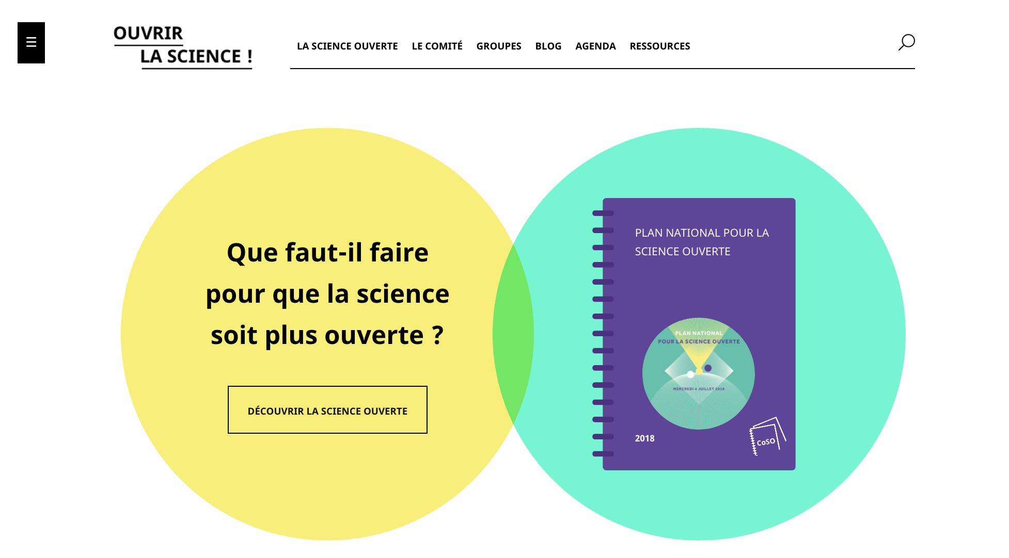
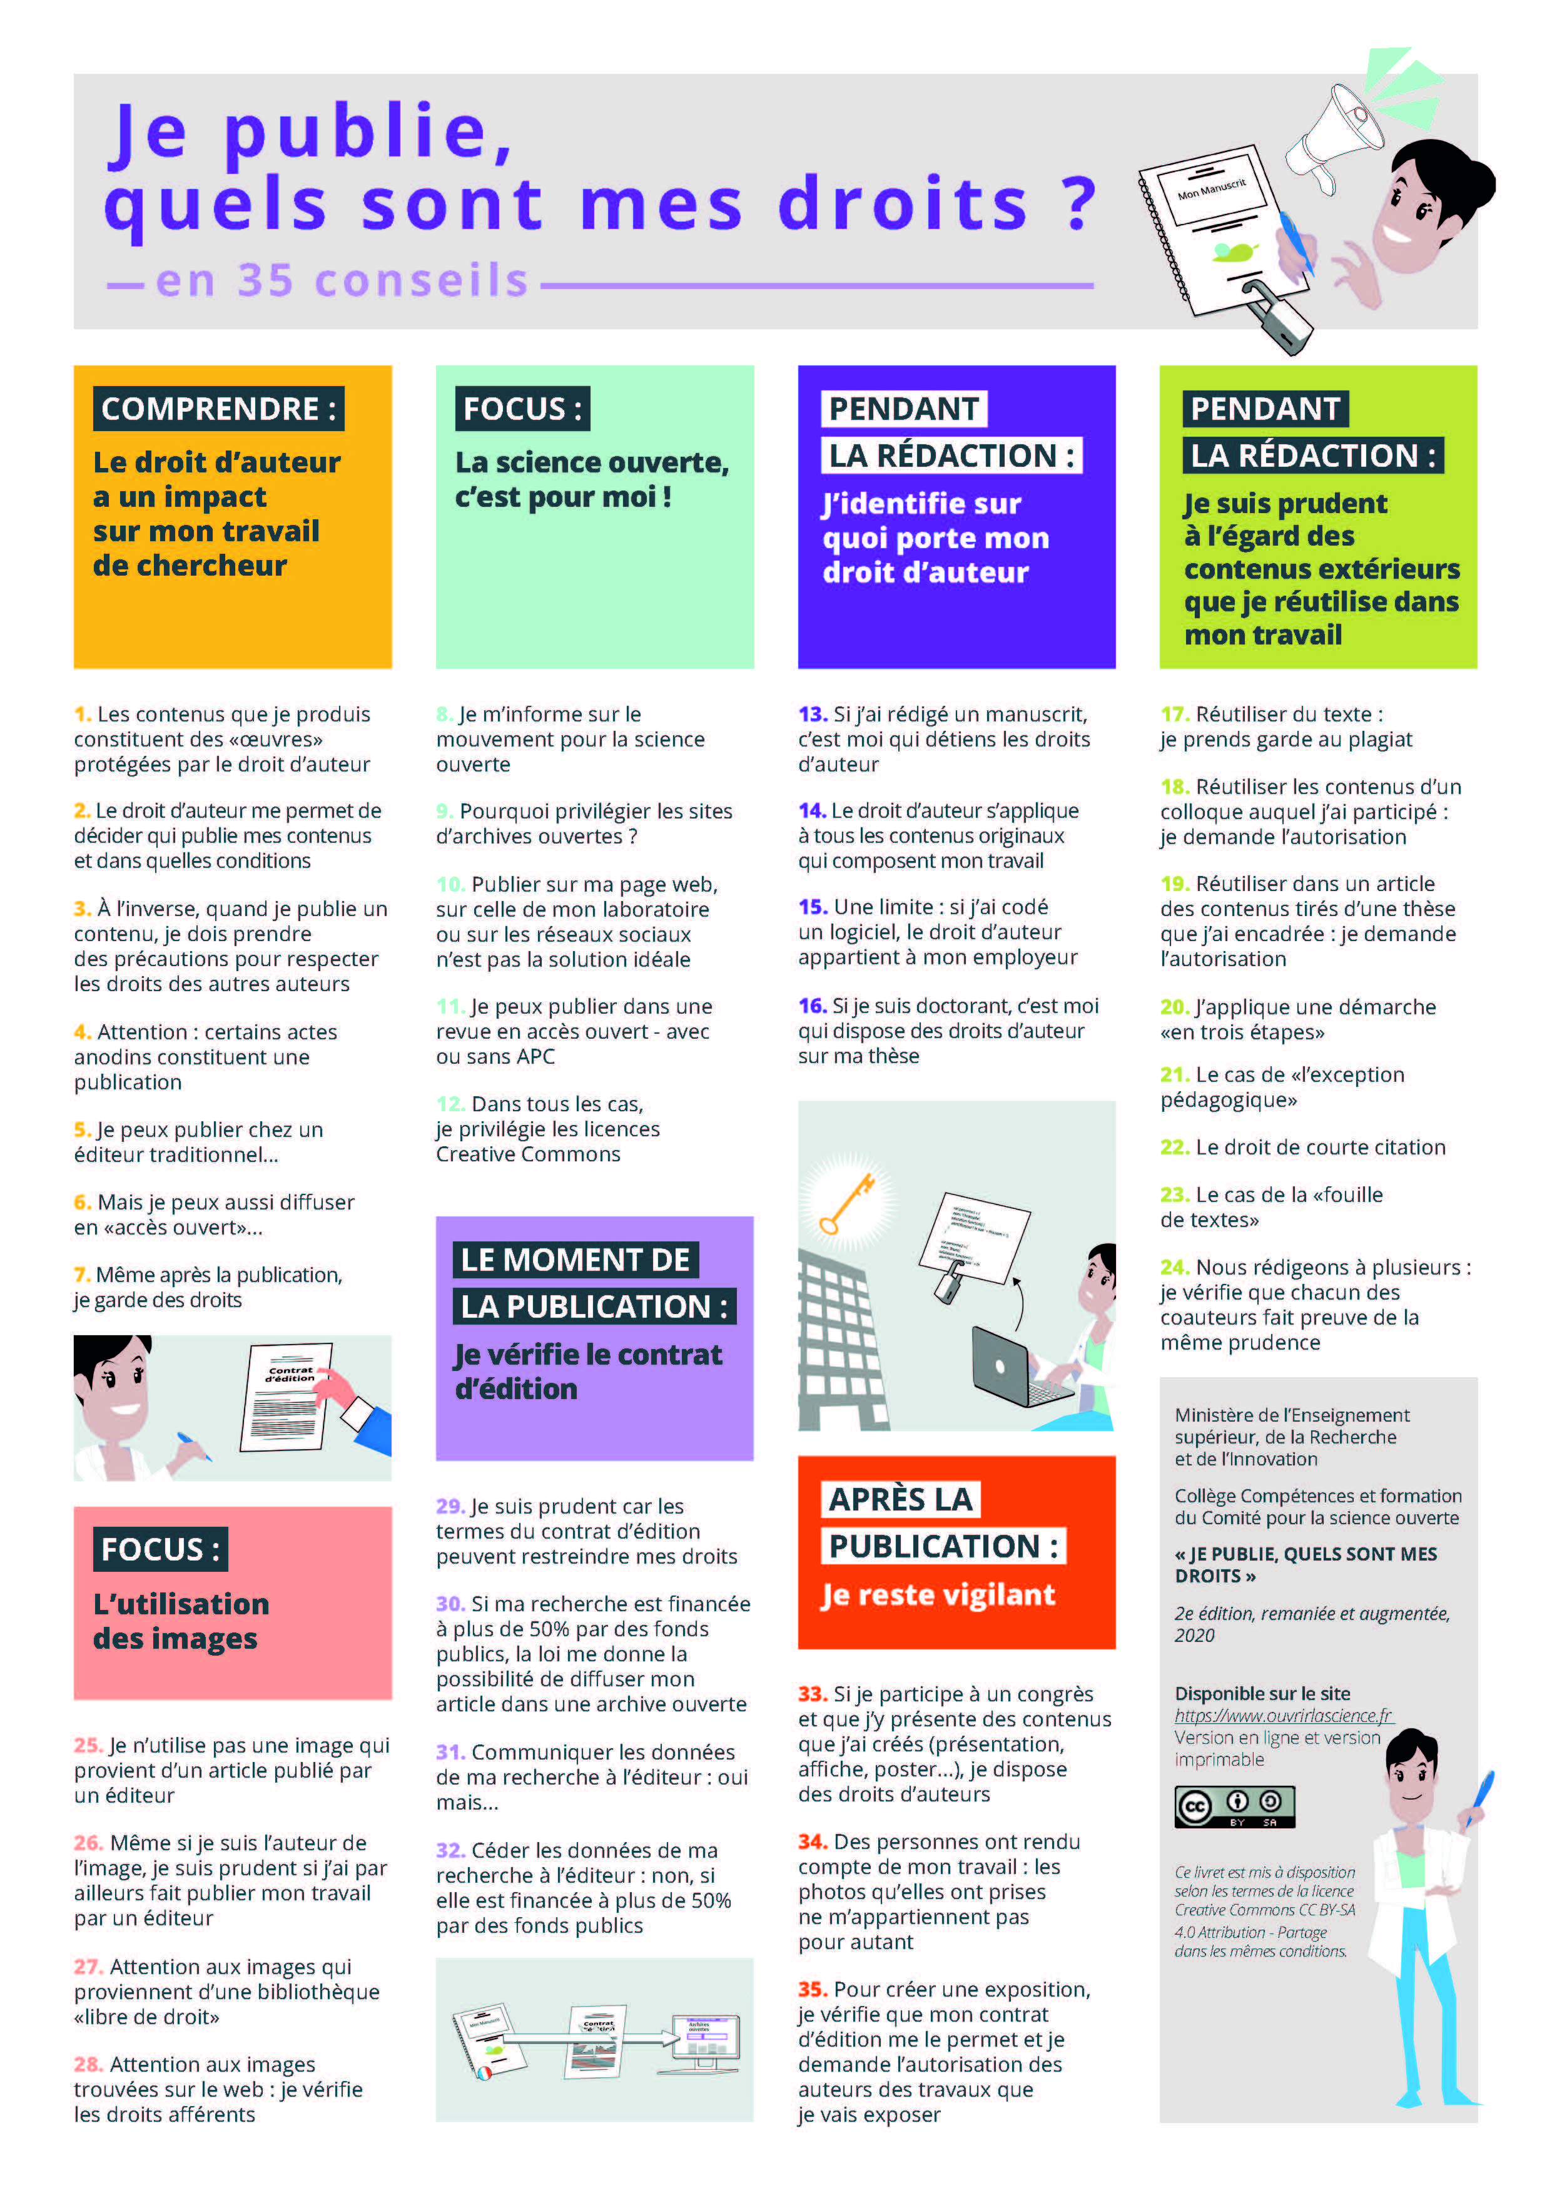
1 website
www.ouvrirlascience.fr
38 publications
Practical guides, recommendations, studies, surveys, strategic notes...
3195 followers
@ouvrirlascience
30 workgroups
2 national open science days

Slide 6
Main achievements
Creation of the National Fund for Open Science (11.6 M€ of resources over 3 years), a dedicated funding instrument for open science policy in France
Two calls for projects for "open access publishing, open publication and its ecosystem”
Support for the national open archive HAL: exceptional financial support, audit and ongoing renovation of the technical base, definition of a sustainable financing model and shared governance
The French National Research Agency and other funding agencies request the deposit of publications in an open archive and the drafting of data management plans for the projects they fund
ANR flash call for projects on open science: €2.3M, 25 projects supported to accelerate the maturation of disciplinary communities in the face of data management issues
Creation of the position of chief data officer at the Ministry of Higher Education, Research and Innovation

Slide 7
Main achievements
Creation of the open science barometer: measurement of the rate of French scientific publications in open access
Progressive deployment of open science strategies within research performing organisations and universities, creation of a network of open science referents
Training actions targeted at doctoral students: Passport to open science, practical guide for Phd students
Contribution to the structuring and governance of the EOSC: structuring of EOSC France, French presence on the board and other EOSC governance bodies
Support to international open science infrastructures: SCoSS labelled projects (DOAB, PKP, OpenCitations), RDA, Software Heritage Translated with www.DeepL.com/Translator (free version)

Slide 8
First Impact Assessment
Open Science Barometer:
Rate of French scientific publications in open access by year of publication

Slide 9
Second French Plan for Open Science (2021-2024)

Slide 10
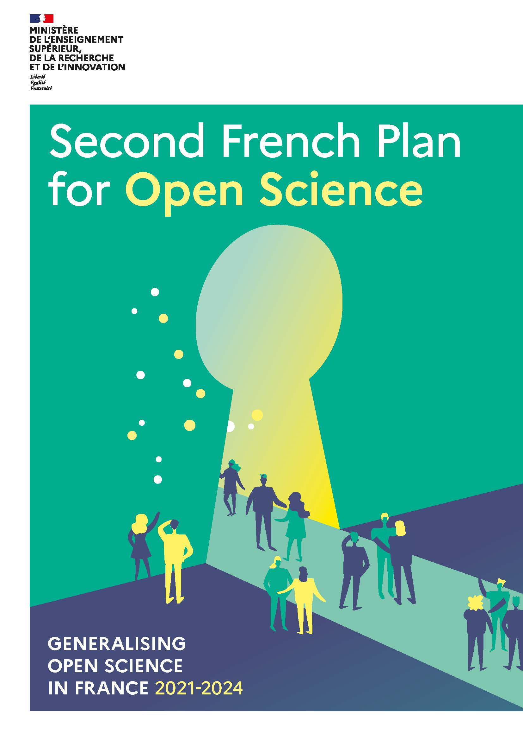
Launch on 6 July 2021 by Frédérique Vidal, Minister for Higher Education, Research and Innovation
Multiplying the levers for change in order to generalise open science practices
Structuring the policy for opening up or sharing research data
New commitments to the opening of source code produced by research
European and international inclusion in the context of the French Presidency of the European Union
Disciplinary and thematic variations: open science policies must be adapted to disciplinary specificities

Slide 11
Path One : Generalising open access to publications
1
2
3
Generalise the obligation to publish in open access all articles and books resulting from publicly funded calls for proposals
Support open access economic publishing models that do not require the payment of articles or books processing charges (“diamond” model)
Encourage multilingualism and the circulation of scientific knowledge by translating publications by French researchers
“Our goal is to reach 100% of open access publications”
“ We will support bibliodiversity so that the scientific community can regain control over the publishing system.”

Slide 12
Focus. Support open access economic publishing models that do not require the payment of articles or books processing charges (“diamond” model)
The major scientific publishers have made the transition to open access through the payment of article processing charges for authors and through transformative agreements with consortiums of university libraries
The risks associated with this model are becoming increasingly apparent:
uncontrolled budgetary burden
widening inequalities between institutions or disciplines
Quantitative inflation of published articles
open access "diamond" scientific publishing represents an alternative :
publication costs are covered beforehand by the State, a university, a consortium of public establishments or a non-profit organization
Study on diamond journals commissioned by cOAlition S
A part of the Second Franch Plan, support the diversification of economic models enabling a transition from subscription towards open access with no publishing fees, notably the "subscribe to open" model.

Slide 13
Continue to develop of the HAL national open archive
Reaffirm the French commitment to cOAlition S
Simplify the deposit process for researchers, even when they publish in other open access platforms across the world
Support the right retention strategy : allow immediate open access, including when the article is published in a subscription journal, by deposit in an open archive
Structure, support and modernise French scientific publishing
Support plan for scientific publishing
Continuing the renewal of the governance and financing model
Create common bodies to coordinate, promote and foster dialogue: an Alliance of public scientific publishers and an Scientific Publishing Observatory involving private publishers
Pooling technical tools and functions: distribution, digital publishing chains, detecting plagiarism....
Encourage multilingualism and the circulation of scientific knowledge
Developing a semi-automatic translation service for scientific texts
Supporting and facilitating its implementation for researchers
Supporting research on machine translation

Slide 14
Path Two : Structuring, sharing and opening up research data
4
5
6
Implement the obligation to disseminate publicly funded research data
Create Recherche Data Gouv, the federated national platform for research data
Promote widespread adoption of data policies that cover the whole lifecycle of research data, to ensure that they are Findable, Accessible, Interoperable and Reusable (FAIR)
« We will encourage practices that favor research data reuse. »
« We will create Recherche Data Gouv in order to involve all research fields in active practices of open data. »

Slide 15
Focus. Create Recherche Data Gouv, the federated national platform for research data
The answer to a scientific challenge concerning the loss and lack of pooling of research data and to an economic challenge concerning the control of research data
A sovereign and certified storage and signposting service for research data :
a multidisciplinary data repository, which complements (and does not replace) the infrastructures already used by some scientific disciplines
a catalogue signposting to data hosted in other repositories
A range of support services for researchers throughout the data cycle:
A network of labelled data workshops in the vicinity of institutions
Thematic reference centres specific to a discipline or research field
Shared governance: project led by INRAE with the participation of 7 research institutions (CNRS and universities)

Slide 16
Deploy a research data governance policy
Give recognition to and boost the reuse of research data
Award an annual research data prize to highlight the work of exemplary projects and teams in preparing to reuse or reusing research data
Create a network of Chief Data Officers in the universities and research performing organizations.
Launch a Europe-wide call for proposals on reusing research data
Promote open data policies
Generalise the effective implementation of data management plans, which guarantee economical preservation and the opening up and sharing of documented data
Developing Data Sharing statements, which publicly detail the conditions and procedures for accessing data that cannot be opened
Develop a proactive approach to opening up data associated with articles

Slide 17
Path Three : Opening up and promoting source code produced by research
7
8
9
Recognize and support the dissemination under an open source license of software produced by publicly funded research programmes
Highlight the production of source code from higher education, research and innovation
Define and promote an open source software policy
« The opening of software source code is a major challenge for the reproductibility of scientific results. »
« Distribution of software products under open source licence will be preferred. »

Slide 18
Define and promote an open source software policy
Recognise source code as a contribution to research
Create an open source research software prize
Produce a National Charter for Open Source Software coming from higher education, research and innovation
Build an ecosystem that connects code, data and publications
Develop proper coordination between software forges, open publication archives, data repositories and the scientific publishing sector.
Develop the link between data and software through a network of Chief Data Officers in the various universities and research performing organisations.
Support Software Heritage and recommend it for the archiving and referencing of source code
Provide greater recognition for software production in the career of researchers, research support staff
Develop the economic models of open source software and make them known within commercialization services

Slide 19
Path Four : Transforming practices to make open science the default principle
10
11
12
Develop and value
open science skills throughout the educational and career pathways of students and research staff
Value open science and the diversity of scientific productions in the assessment of researchers, of projects and of universities and research performing organizations
Triple the budget
for open science
through the National
Fund for Open Science
and the Investments
for the Future Programme
« Transformation of the assessment system is required
in order to foster long‑term open science practices. »

Slide 20
Focus. Value open science and the diversity of scientific productions in research assessment
Principles laid down in the San Francisco Declaration on Research Assessment (DORA) and the Leiden Manifesto for Research Metrics
reduce the quantitative dimension to the benefit of a more qualitative approach
taking into account the plurality of research findings beyond publications
make a reasoned use of metrics
reward cooperation and openness rather than competition and secrecy
Accelerating the implementation of these principles
in France :
Include open science in the Hcéres evaluation guidelines
Remove references to the journal impact factor in the texts of calls for projects
Woriking group or French DORA signatory institutions
in Europe :
European Open Science Conference on the 4 and 5 february 2022 in Paris
propose the creation of a coalition of European research assessment stakeholders committed to take open science into account

Slide 21
Develop and recognise the skills and professions of open science
Simplify researchers’ lives through open science
Facilitate researchers’ access to public data and to data of public interest owned by private parties
Develop data literacy, develop the range of initial and continuing education degree programmes in data science and engineering
Encourage stakeholders in higher education and research to adopt an open science policy
Encourage universities, research performing organisations, national research infrastructures, IDEX, I-SITE, European universities and projects funded by the PIA to adopt an open science plan and to request open-source publications, data and source code
Offer open science training at undergraduate and graduate levels
Support the evolution in skills and career pathways for research staff
Encourage researchers to adopt the ORCID identifier to consolidate their digital identity

Slide 22
Participate in the European and international open science landscape
Develop the Open Science Barometer for monitoring open science and measuring its impact
Introduce new indicators ot monitor the opening up of data and source code, the declarations of health studies, the use society makes of open science…
Continue Frenche contribution to the European Open Science Cloud (EOSC)
Develop research on research in order to inform and guide open science policies
Participate in the governance of standards for metadata and persistent digital identifiers and of open science services
Encourage the creation of an open ecosystem for citations
Create the Council of national open science coordinators (CoNOSC)
Create an Open Science Lab in France and an Open Science Observatory at international level
Propose the launch an annual call for projects involving research on research with an open science perspective.

Slide 23
Disciplinary and thematic variations
Social and human sciences
Climate, earth systems and biodiversity studies
Health Research
Research infrastructure
Vectors for the transformation of practices and the generalisation of open science
Artificial intelligence

