Slide 1
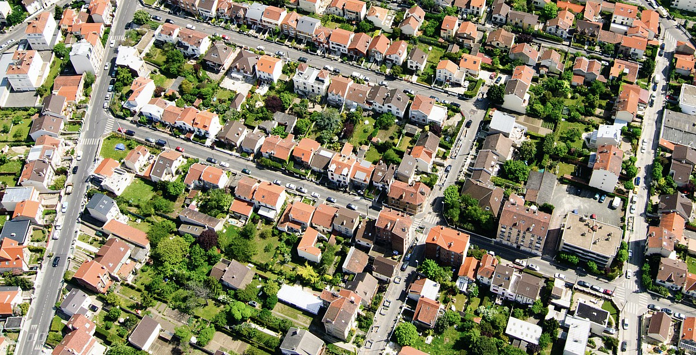
Planning the peri-urban green city: local regulations of private gardens in the Paris region
Anaïs Mohamed (INRAE, UMR SADAPT) & Romain Melot (INRAE, UMR BAGAP)
Planning, Law and Property Rights Conference 18th International Annual Congress, 2024
Notes:
First of all we will introduce you how we ended working on this subject according to the specific contexte of urban planning in Paris region and our research question. Then we will develop more about our methods, then our principle results and finally our conclusions and suggestions for a better way to integrate domestic gardens into local urban policies and to ensure their ecological and social benefits.

Slide 2
Table of contents
Context & Research question
Data & Methods Results
Conclusion and suggestions
Notes:
First of all we will introduce you how we ended working on this subject according to the specific contexte of urban planning in Paris region and our research question. Then we will develop more about our methods, then our principle results and finally our conclusions and suggestions for a better way to integrate domestic gardens into local urban policies and to ensure their ecological and social benefits.

Slide 3
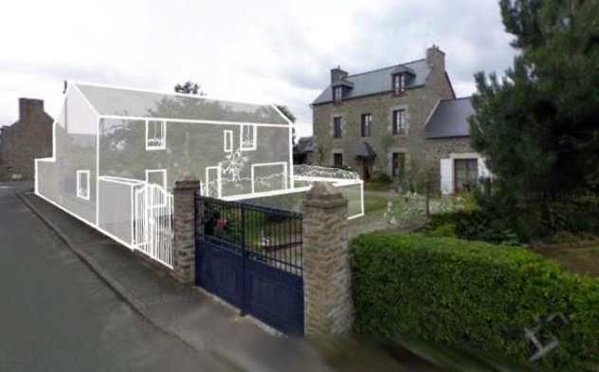
Context
Local Context:
-Growing population living in urban areas
-Urban densification to reduce urban sprawl and soil sealing :
By public policies
By private owners
-> private gardens represents 20% of all sealed area in Ile-de-France between 2012-2021
Notes:
In Paris Region (also called Ile-de-France) we have a constant growth of population in a concentric way: from near Paris suburbs to more rural towns.
With the industrial revolution and then urban policies after the WW2, the paris area was build on rural and natural lands around the capital with new cities and periurbanization. Since the early 2000s, with « solidarity law for urban renew » (SRU) a fight against urban sprawl begin at a national scale. Lately the Directive proposal of European commission on soil preservation under review since 2011 (voted at european scale last july) has been traduced at national scale as « ZERO net arfiticialization » law. This law reinforce the need for restraint cities and municipalities may integrate it to their local urban plan. At the same time, municipalities have to deal with new ecological goals from Grenelle Law translation at local scale.
If densification, made by pulic actors of by private owner is perceived as the better way to develop cities in this context. But il can imply a loose of green space inside urban boundaries, including a loose of private gardens. Indeed, they represents 20% of all sealed area in Paris region between 2012 ad 2021.

Slide 4
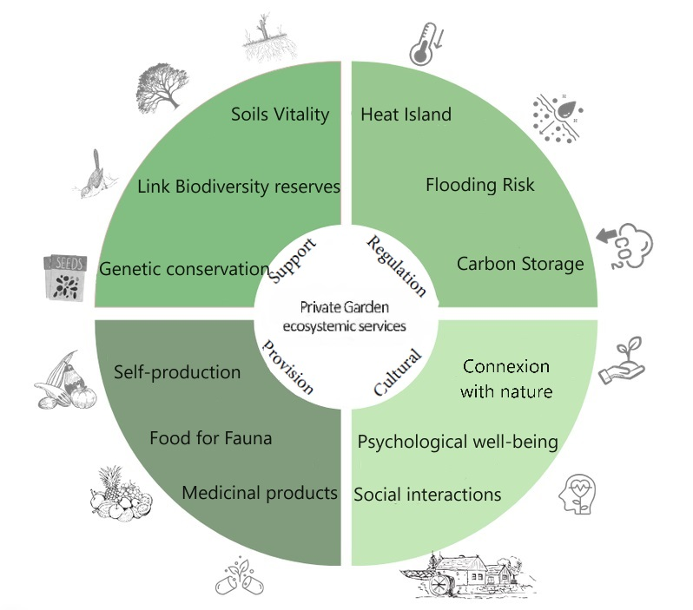
Context
Urban Domestic gardens :
-An important part of urban green infrastructure : 50,5% of urban green space (domestic + collective habitat) (Serret et al. 2014)
-A lever to cities’ resilience thanks to many ecosystemics services
Notes:
In recent scientific littérature, we can read about ecosystemic services provided by domestic gardens. They are and important part of urban green infrastructure especially in peri-urban and rural area where single housing is the main housing model. They contribute to air quality, reducing urban heat island, stores carbon, reduce flood-risk thanks to open-ground. They represents habitats and food for common urban species and also food provision for human thanks to vegetable gardens. Finally they provide cultural services: garden is a sociability space and they can be cultural transmission of gardening practices and psychological benefits by greening living space.
So they are a lot of benefits but they seems to disapear because of urban densification.

Slide 5
Research questions
[...] gardens are ‘often, disadvantaged by planning in comparison to other green spaces’ (Breuste, 2010:464)
Are domestic gardens identified in local urban policies as a key space for biodiversity, self-production and their other services?
Are domestic gardens protected by local land-use plans ?
What kind of protections are implemented ?
Theories of the legal instruments approach focus on tools used to apply policies and the way public authorities use them.
Legal tools such as Urban code tools are redefined depending on local issues and
relationships between actors.
(Lascoumes & Le Gales, 2007; Gerber & al., 2018)

Slide 6
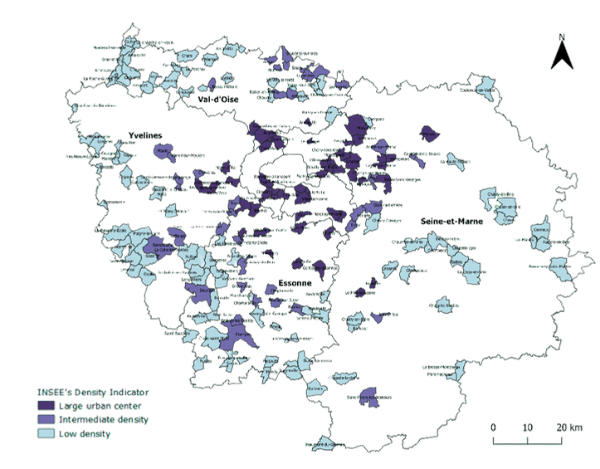
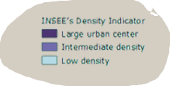
Study Area & Data
200 local urban plans (« Plan local d’urbanisme ») = 200 cities/1276 cities
Paris region is the most dense region of France (average 1022 hab/km²)
Proportional sample based on density levels (INSEE)
33.87% in Large urban center
76.27% in Intermediate density
90.07% in Low density

Slide 7
Methods
LOCAL LAND USE PLAN
Level of Concern exploration in textual parts:
-Overview report,
-Strategic project,
-Design guidelines
Bylaw’s Tools exploration
Occurrences and domestic gardens’ functions
Rules and Zonings
Thematic classification
Zonings
Count
Rules by urban sector
Number of occurrences in each part of the PLU and each type of "Garden"
Challenge covered (Yes or no)
Number of challenge related to UDG
Regulated (Yes or No)
Surface in metric
Regulated (Yes or No)
Indicators:
Level of concern
Bylaw’s Profils
Notes:
To understand the concern for private gardens, we chose to observe both the occurrences of the term ‘private garden’ and the functions associated with them in the textuals and more argumentative parts of the local land-use plan (presentation report, sustainable development plan, development and planning guidelines).
To identify domestic gardens’ function on literal parts, we chose to use an inductive thematic classification (Thomas, 2006) and regrouped those functions by similarity on the purpose.
In local land-use plans’ bylaws, we also observed the frequency and strength of use of bylaws tools: quantitative sector rules and zonings. Regarding bylaws, we selected the tools likely to influence garden structure in urbanised (U) and natural (N) zones. Urban development zones (AU) and agricultural zones (A) containing no housing were excluded.
Two indicators were constructed by for each kind of data (occurrences and legal tools): ‘indicator of local concern’’ and ‘Bylaws Profiles’.
Heterogeneity of rules’name and features made the quantitative analysis less easier. When data were difficult to compare, we simply created boolean variables to at least be able to compare presence/absence of a given rule.

Slide 8
Results
Are domestic gardens identified in local urban policies as a key space for cities’ resilience ?
Landscape and biodiversity benefits VS Self-production
Few cities have a « Strong concern »*
Landscape Heritage
Biodiversity
Green infrastructure
Land to build
Water management
Well-beeing and sociability
Reducing pollution and waste
Selfproduction of food
Only passive use of “UDG”
Low textual concern : 54%
Intermediate Concern: 44%
Strong textual concern: 2%
* Hierarchical ascendant classification by R ©
20%
40%
60%
80%
Notes:
First question to answer is Which domestic garden’s challenges are identified in textual parts of local land use plans ?
We observed a lot more occurrences for « private gardens » than for others kind of gardens (public gardens, community gardens » but majority of those occurrences are passive, it’s only a description such as « there are gardens in this district.
For the remaining occurrences that pointed a benefits or challenge about domestic gardens, not all those benefits are fully recognised. Indeed, There seem to be a widespread idea that domestic gardens enhance urban landscape heritage and also that they are beneficial for biodiversity – that doesn’t lead to target them as green infrastructure parts. On the contrary, they are much less identified for their self-production services or pollution and wasted reduction benefits.
To sum up this concern in textual parts, let’s see how litteral concern is distributed among cities we studied. We classified cities from the number of occurrences and the number of benefits they mentioned. 54% (fifty four) cities has a « low textual concern » with less than 1,7 benefits identified and 6,2 occurrence of « domestic garden ». 44% has an intermediate textual concern and only 2% (4 cities) showed a stong textual concern. So there was very heterogenous concern for domestic gardens.

Slide 9
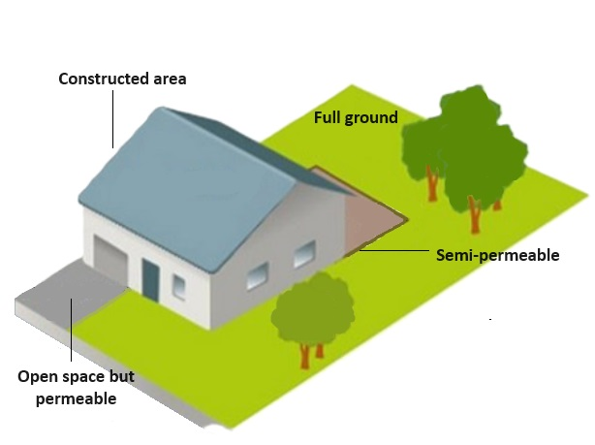
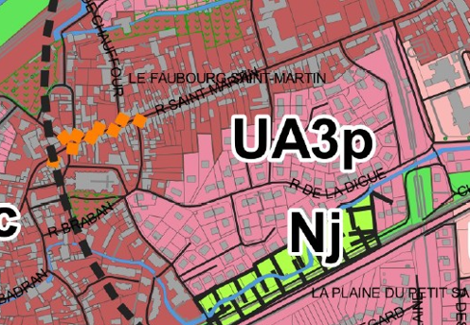
Results
Are domestic gardens protected ?
Many tools to implement those challenges on bylaws
Rules by sector:
55.5% Full ground surface area
38.5% Open spaces for plantations, play and leisure
25% Biotope coefficient surface area
Zonings:
39.5% Protected landscape area
25.5% Classified wooded area
18% Natural zone dedicated to gardens
2.5% Protected cultivated land
Notes:
First question to answer is Which domestic garden’s challenges are identified in textual parts of local land use plans ?
We observed a lot more occurrences for « private gardens » than for others kind of gardens (public gardens, community gardens » but majority of those occurrences are passive, it’s only a description such as « there are gardens in this district.
For the remaining occurrences that pointed a benefits or challenge about domestic gardens, not all those benefits are fully recognised. Indeed, There seem to be a widespread idea that domestic gardens enhance urban landscape heritage and also that they are beneficial for biodiversity – that doesn’t lead to target them as green infrastructure parts. On the contrary, they are much less identified for their self-production services or pollution and wasted reduction benefits.
To sum up this concern in textual parts, let’s see how litteral concern is distributed among cities we studied. We classified cities from the number of occurrences and the number of benefits they mentioned. 54% (fifty four) cities has a « low textual concern » with less than 1,7 benefits identified and 6,2 occurrence of « domestic garden ». 44% has an intermediate textual concern and only 2% (4 cities) showed a stong textual concern. So there was very heterogenous concern for domestic gardens.

Slide 10
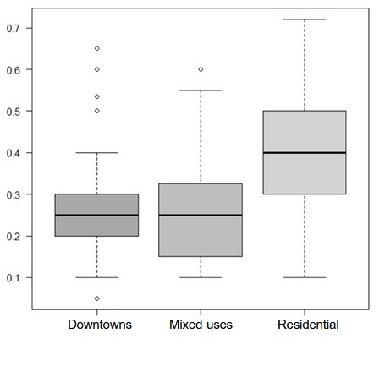
Results
What kind of protections are implemented ?
Various levels of implementation on bylaws
Various levels of protection inside one city
« Open-ground’s » sector rules’ values dispersion by urban sector (n=200)
3 strategies* for private garden protection
Regulation mainly by zonings : 29,5 %
Regulation mainly by sector rules : 44%
Full regulation (zonings + sector rules): 26,5%
* Hierarchical ascendant classification by R ©
Notes:
Again we classified cities according to their regulatory profiles. This index is build on number of each kind of bylaw tools: rules by zone and zoning. We identified 3 strategies regarding private gardens protection: use of zonings only for 29,5% of cities studies, use of sector rules in majority for 44% of the cities and mixed-tools or full regulation strategies for 26,5% of the cities. Regulation by zoning implies an analyse of key areas for garden protection (near forest or other natural landscape, near heritage buildings) to target protection areas. Unlike sector rules that generalize protection to all plots in an urban zone. We can’t evaluate the effects of those regulation on urban ecosystem yet so for now let’s not rank them. Let’s just say that full regulation profiles cities are the fewest.
We just see that regulation levels varies between cities. It also varies inside cities themselves according to their urban zone (downtown, mixed-use zones and residential zones). An other result we observed is that even if a zone tool is used, it does not presume its restrictiveness. For exemple, « open-ground for plantation, play and leisure area » are more often apply in mixed-use area but their value, the requested surface is higher for residential zone: more of 40% in a plot unlike for the two others urban zones. Rules apply on residential zones were mainly more demanding than in other urban zones.

Slide 11
Results
A gap between literal concern and bylaws strategies
Degree of concern by bylaws strategies (n=200)
More cities shown textual concern, more they are likely to have set a full regulation
But Textual concern does not systematically lead to greater use of regulatory tools for urban domestic garden protection
-> Difficulty to implement domestic garden’s protection or bigger issues to deal with ?
Low concern
Intermediate concern
Strong concern
100%
80%
60%
40%
20%
0%
Regulation by zoning
Regulation by Zones's Rules
Full regulation
Notes:
Positive correlation between textual concern and regulation profiles , it means that More cities shown textual concern, more they are likely to have set a full regulation. Indeen, All cities that expressed a strong concern for gardens set a full regulation with many legal tools to protect their gardens. But textual concen doen’t lead systematically to greater use of those tools. Let’s look at the « intermediate concern », they show concern but they are equally distributed between strategies. It means that there can be barriers to implementation of domestic garden’s protection or bigger issues not compatible with the use of domestic garden’s protections tools.

Slide 12
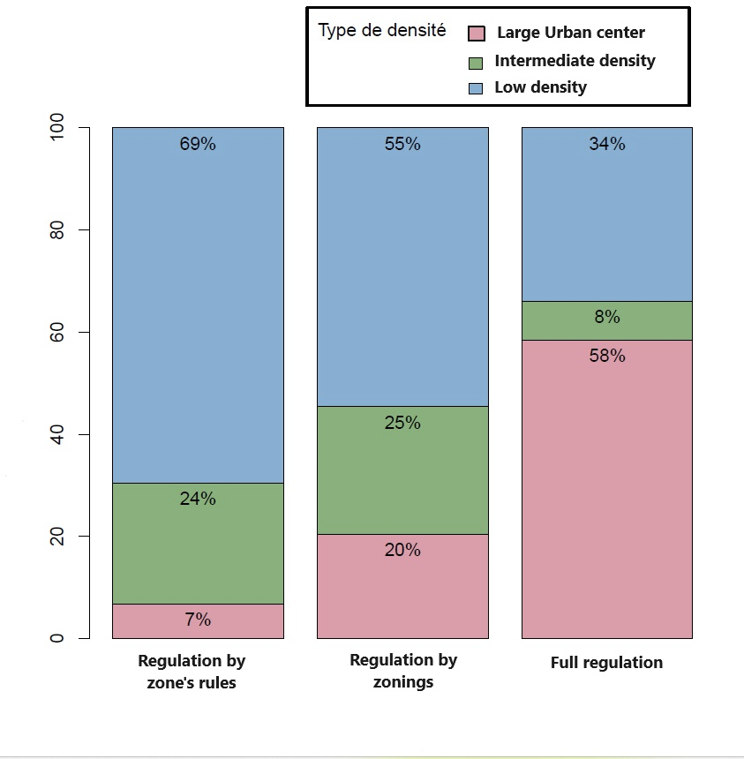
Results
Density of cities impact their concern for domestic gardens
Bylaws’ strategies by cities’s density (n=200)
Cities’ Density influence:
- Number of occurrences of « private garden »
- Number of benefits raised
- Number of rules set and Bylaws strategies
(But not necessarily the rules’ values)
Are more dense cities the more virtuous ones ?
-> protection of gardens in itself VS as a lever for land management
-> lack of public green spaces
Notes:
We made regressions model to explain this heterogeneous concern. We wanted to know what are the factors that can explain this range of concern?
It appeared that cities density affects textual concern indicators and bylaws tools indicator too.
More cities are populated, more they are likely to have express a bigger concern for domestic gardens and to have set a full regulation to protect them ( as we can see in this figure).
Set protection on gardens can be a way to keep control over land development in the context of the SRU law, to which the most densely populated municipalities have to abide. The SRU Law require of 25% of social housing in the housing stock. So if private owner divide their plot and make the private housing stock increase then cities won’t be able to increase their social housing stock.
And other way to explain more important concern from denser cities is the shortage of public green spaces. Ideed, some cities densified from a long time without creating open green-space so now they concentrate landscape and ecological management strategies on private green spaces.

Slide 13
Conclusion and suggestions
Heterogenous textual concern and bylaws strategies between cities and inside cities’ zones
A lot of bylaw tools that could be used but the less restrictives ones and less specialised one are the more currently used.
A difficulty to translate concern into bylaws ?
Clear the Bylaw toolbox : less tools, more accurate tools for more protection
Plan domestic garden protection at a greeter territorial level in synergy with habitants’ sensitization programs (intercommunal territorial coherence plan)
No Net Land Take policies: rethink garden’s definition as an « artificial space »
Notes:
To conclude, we saw that there are heterogenous textual concern and bylaws strategies between cities and inside cities’s zone. A lot of bylaw tools are available to protect domestic garden but there is a difficulty to translate concern into bylaws. Domestic gardens are protected for itselves and their benetfits (especially for landscape esthetics and for biodiversity) but also can be used into strategies to secure land tenur and not see for itselves.
From this work there is some advice we can do to urban planning’s actor: clear their toolbox it means use less tools that have the same results but concentrate more on what element we preserve on gardens (old trees, diversity of plants and flowers, full ground).
Next – at a greeter territorial level , plan domestic protection by integrating them into the green and blue networks managed at this level. Same for sensitization programs, there is a need to gather ressources for better inhabitants’ sensibilization programs.
Finaly, in future No net land take policies domestic gardens under 2500m² will be considered as artificialized, they will be one of the last urban areas left to build on so maybe cities won’t protect them anymore. We think we need to rethink the very definition of what is an “articifical space” because gardens are one of the keys to the future resilience of cities.

Slide 14
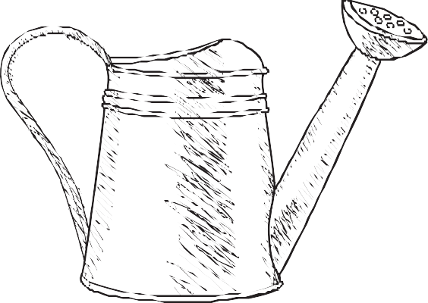
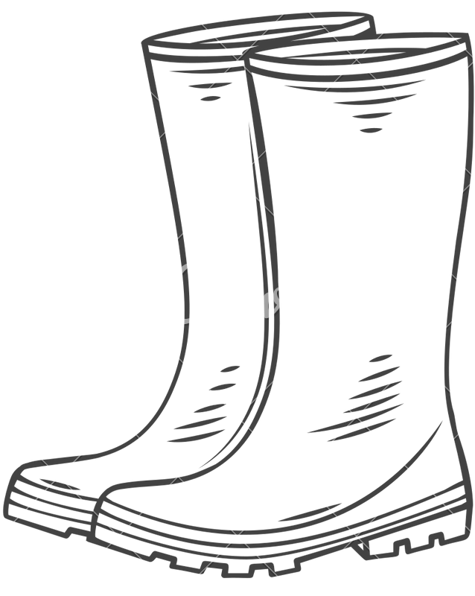
Planning the peri-urban green city: local regulations of private gardens in the Paris region
THANK YOU !
Romain Melot romain.melot@inrae.fr Research Profesor (INRAE- UMR BAGAP)
Anaïs Mohamed anais.mohamed@inrae.fr Research Ingeneer (INRAE –UMR SADAPT)

