Slide 1
Integrating theory and research into journalistic training around climate change
Emmanuel Marty & Chloë Salles (GRESEC, Univ. Grenoble Alpes)
ECREA Journalism studies Section Conference “Journalism studies meets practice”
Utrecht, the Netherlands – March 3-4, 2022

Slide 2
Context
* Climate change not necessarily regarded as a priority in media (Comby, 2009, 2017)
--> internal tactics to make the news a priority (Salles, 2021)
Requires specific competences in researching and documenting news (IPCC + other scientific reports)
* French local media are marked by a relative inability to deal properly with divisive political or scientific issues (notably because of their proximity to the political and economic actors of the territory)
* The Alps are sadly, a good location to focus on this topic.
→ Program in Grenoble School of Journalism, Université Grenoble Alpes to teach future journalists about climate change coverage through a workshop combining historical, socio-professional and discursive approach

Slide 3
The workshop
Consists of three steps bringing students from theoretical acculturation to the challenges of climate coverage to the development of renewed professional practices:
1. Discovering scholarly documentation about the emergence of climate change as a journalistic and political issue
2. Journalistic field work with local media focusing on the way they tackle climate and environment topics in their editorial content
3. Creation of their own editorial content in the form of a dedicated website

Slide 4
Discovering scholarly documentation
Highlighting documentation as an essential step (often short-circuited in newsrooms with lack of time)
A synthetic scientific bibliography from which to read and discuss & other sources of documentation (media, scientific, NGOs, political, etc.) to build from and upon.
Relevant issues and theoretical frames:
- Specificities of local news media in France: hegemonic situation of regional daily newspapers and structural dependance on institutionnal actors, emergence of new actors (Bousquet et al. 2015; Kleis Nielsen 2015)
link between social, economical and environmental issues/ specialisation or transversality in newrooms /(de)politicisation, time and money constraints for the investigation (Comby 2015, Saitta 2005, Pilmis 2014)
relationship to sources, technicality and newsworthiness of the topic, genres and formats (Neveu 2019; Anderson 2017, Molek-Kozakowska, K. (2017).

Slide 5
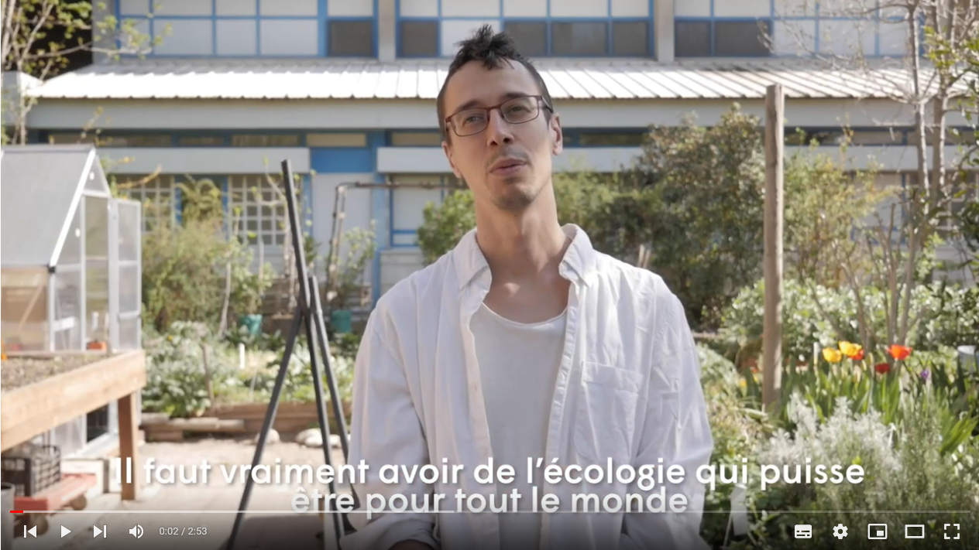
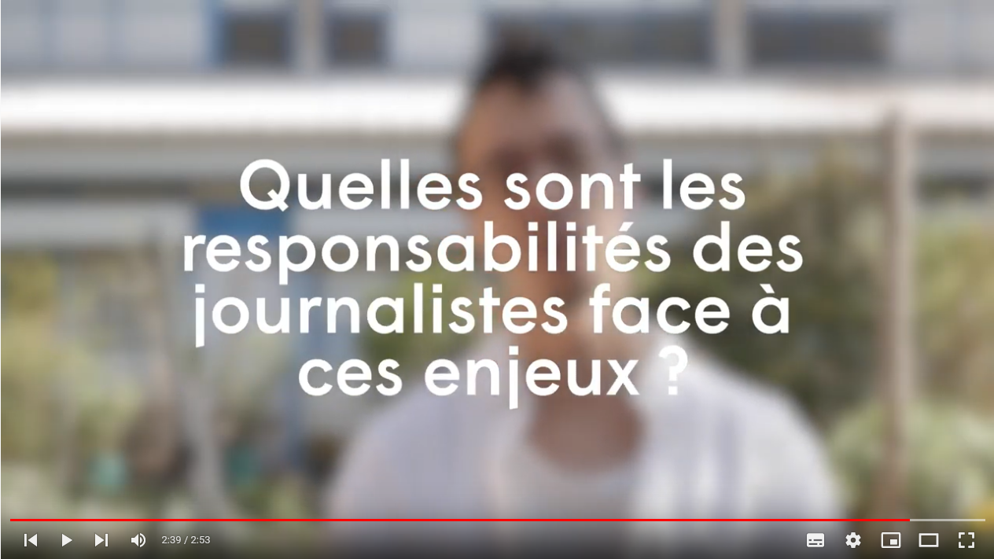
Journalistic field work with local media
Interviews to ask local media journalists around Grenoble about the way they tackle climate and environment topics (10 different newsrooms)
A common set of 5 questions:
1)How do you define the climate issue within your media?
2)How much space does your media give to climate issues?
3)Which sources do you use to cover these topics?
4)Is the climate issue of interest to your audience?
5)What are the responsibilities of journalists in relation to these issues?
Series of video interviews. The result of this work is entitled “Micro-climat” and is broadcast on our school media website and Youtube channel .

Slide 6
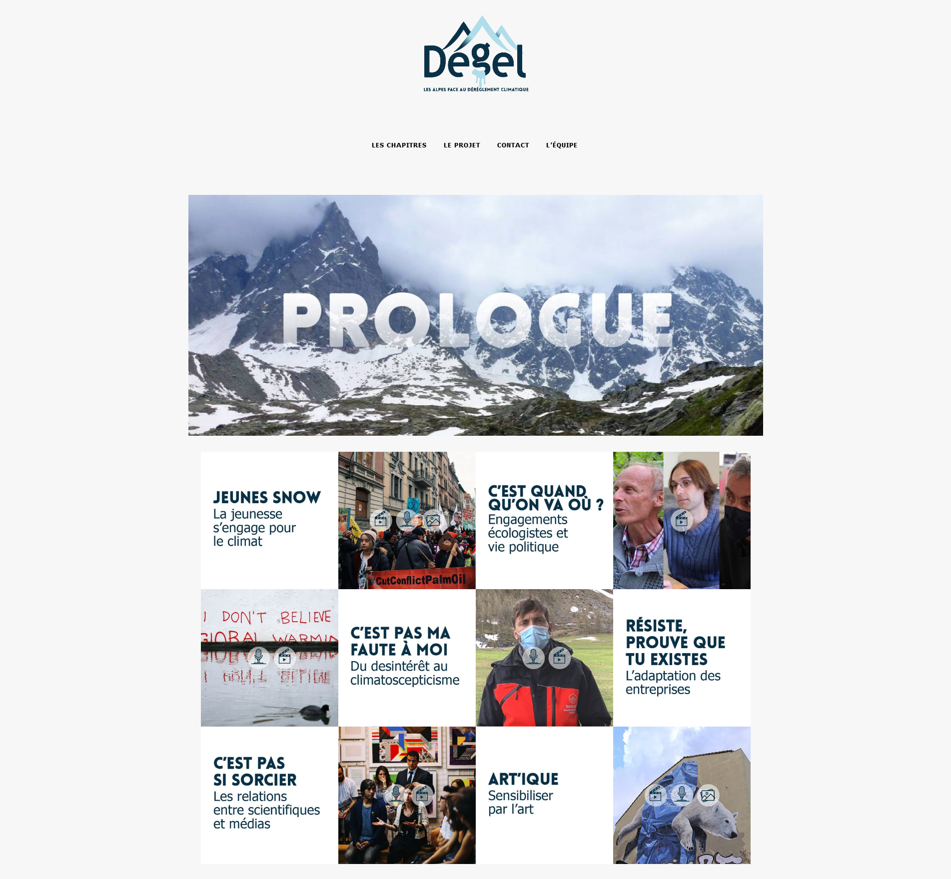
Creation of multimedia editorial content
Original multimedia content about climate change in the Alps, entitled “Dégel” (=melt)
In a prologue and six chapters, students documented the relationship of the Grenoble area to the environment.
Through the prism of politics, institutions, scientists but also youth, climate sceptics and art
A multitude of formats: audios, videos, podcasts and articles, trying to take benefit from lessons learnt from scholarly documentation and interviews with professionals

Slide 7
Results and conclusion
It WORKS! ☺
→ In a context in which theory and a scientific approach to media is complicated to fit and legitimise in very practice-oriented programs, the immediate application of academic knowledge to the service of original journalistic content and the experimental dimension and constant dialogue with students on the link between form and purpose of journalistic content creation somewhat success in:
- indirectly teaching students internal newsroom politics (and hopefully breading strategies and tactics for those most interested in covering the topic in the future);
- communicating future journalists' interest and sometimes commitment to the topic to future employers;
- the productions can then be used as tools by professional associations (which have their own agendas, including that of surviving by welcoming younger generations on their boards).

Slide 8
Thank you! Any question?
http://degel.ejdg.fr/
http://journalismes-info.ejdg.fr/

