Slide 1
The attention effect of the social presence: A demonstration with a time paradigm
Clément Belletier
Sylvie Droit-Volet
ESCOP 2022

Slide 2
Social presence

Slide 3
Social presence
The effects of social presence are complex : sometimes social presence improves performance, sometimes social presence undermines performance
Zajonc (1965) : the (still) influantial “Drive theory”
DOMINANT RESPONSE
Easy task
Performance
increases
Difficult task
Performance
decreases

Slide 4
Social presence
Other theories have tried to explore the cognitive mechanisms modulated by social presence (e.g. Blascovitch et al., 1999; Carver & Scheier, 1981, 2000; Guerin, 1983; Harkins, 1987)
Among these theories, the distraction-conflict hypothesis (Baron,1986) has been particularly studied in the last 20 years

Slide 5
Social presence and time estimation
To sum up, social presence effects could either be due to an increase in arousal or to an attentional distraction
This echoes temporal distortions observed in time estimation
Distraction (e.g. a secondary task) is known to lead to a shortening of subjective duration
Arousal (e.g. induction of emotion) is known to lead to a lengthening of subjective duration

Slide 6
Time estimation
Most theories postulate a clock-like system (a pacemaker + an accumulator)
At the beginning of the stimulus to be timed, a switch controlled by attention closes, and the pulses emitted by the pacemaker flow into the accumulator
The subjective duration thus depends on the number of pulses accumulated
Distraction would lead to the loss of some pulses. Arousal would lead to an increase in the number of pulses emitted by the pacemaker

Slide 7
Temporal Bisection : learning phase
Targets :
short duration = 10 pulses
long duration = 20 pulses
LTM
Pulses accumulating
”short” button
“long” button
Accumulator

Slide 8
Temporal Bisection : Experimental phase
Targets :
short duration = 10 pulses
long duration = 20 pulses
12 pulses
LTM
Comparison
12 Pulses
”short” button
“long” button
Accumulator

Slide 9
Temporal Bisection : Experimental phase
Targets :
short duration = 10 pulses
long duration = 20 pulses
18 pulses
LTM
Comparison
18 Pulses
”short” button
“long” button
Accumulator

Slide 10
Temporal Bisection : Experimental phase
Targets :
short duration = 10 pulses
long duration = 20 pulses
bisection point
15 pulses
LTM
Comparison
15 Pulses
?
”short” button
“long” button
Accumulator

Slide 11
Temporal Bisection : Effect of distraction
Targets :
short duration = 10 pulses
long duration = 20 pulses
15 pulses
LTM
Comparison
12 Pulses
LOSS OF PULSES
”short” button
“long” button
Accumulator

Slide 12
Temporal Bisection : Effect of distraction
Targets :
short duration = 10 pulses
long duration = 20 pulses
HIGHER
bisection point
18 pulses
LTM
Comparison
15 Pulses
LOSS OF PULSES
?
”short” button
“long” button
Accumulator

Slide 13
Temporal Bisection : Effect of Arousal
Targets :
short duration = 10 pulses
long duration = 20 pulses
15 pulses
LTM
Comparison
18 Pulses
”short” button
“long” button
Accumulator

Slide 14
Temporal Bisection : Effect of Arousal
Targets :
short duration = 10 pulses
long duration = 20 pulses
LOWER
bisection point
12 pulses
LTM
Comparison
15 Pulses
?
”short” button
“long” button
Accumulator

Slide 15
In summary
In the temporal bisection task :
Distraction causes the loss of some pulses. The bisection point is HIGHER
Arousal causes the acceleration of the internal clock (more pulses are produced). The bisection point is LOWER
Social presence :
Either distracts attention away
Or increases arousal

Slide 16
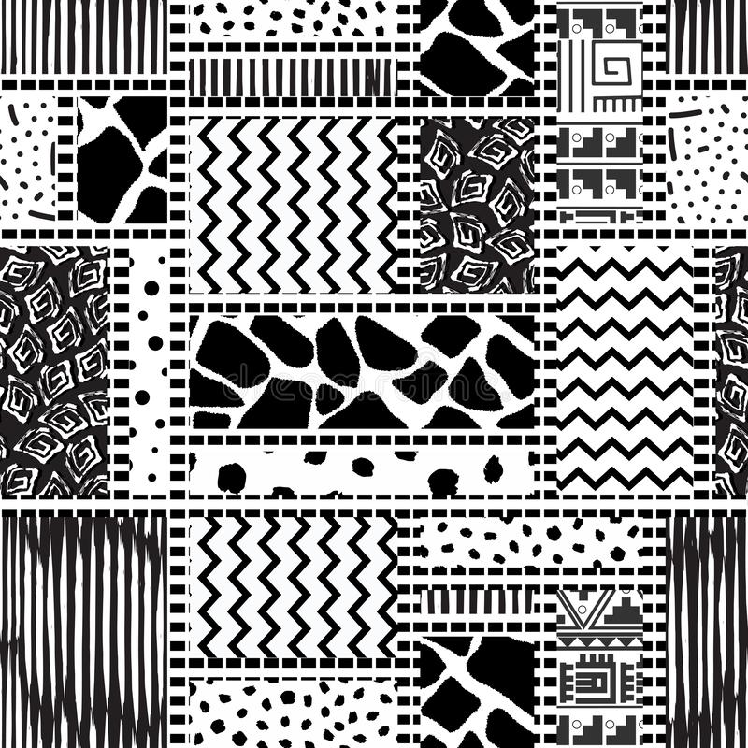
Experiment 1
Read
40 % of time
Look participant
60 % of time
ALONE CONDITION
EXPERIMENTER PRESENCE CONDITION
CONTROL CONDITION
2 ranges of durations : short durations (200ms vs 800ms) and long durations (400 ms vs 1600ms) 210 participants (35 per group)
70 trials
Notes:
In the short condition, the short standard duration was of 200ms and the long standard duration of 800ms In the long condition, the short and the long standard duration were 400 and 1600ms This made a total of 70 trials

Slide 17
Experiment 1
MAIN EFFECT OF GROUP : F_{2,204} = 8.87, p < 0.0001, η²_{p} = 0.08
Notes:
Bisection point short : 500ms Bisection point long : 1000 ms Experimenter VS Alone (short durations) : t(68) = 2.30, p = .02, Cohen’s d = 0.55
Experimenter VS Alone (long durations) : t(68) = 2.21, p = 0 .03, Cohen’s d = 0.59

Slide 18
Experiment 2
Same as experiment 1, except the following points:
The stimuli used for presenting the duration are auditive
Only the long duration condition was used (400/1600ms)
N = 105 (35 per groups)

Slide 19
Experiment 2
F_{2,102} = 2.14, p = 0.12
Notes:
Experimenter VS Alone : M = 803.77, SD = 137.22) (t(68) = 1.74, p = 0.087, Cohen’s d = 0.42, BF₁₀ = 0.88

Slide 20
CROSS EXPERIMENT ANALYSIS
Modality effect : F_{1,204} = 77.10, p < 0.0001, η²_{p} = 0.27
Group : F_{2,204} = 3.41, p = 0.035, η²_{p} = .03
None of the interactions were significant
Notes:
Our findings suggest that the effect of the social presence decreased when the temporal task was easy (i.e., in the auditory than in the visual modality). This support the models of attention according which attentional interferences on performance decrease in tasks requiring less attentional resources .
The decrease in the social presence effect in the auditory bisection can also be explained by the processing of the visual social stimulus (presence of experimenter) that compete less for attention resources with the temporal processing of an auditory than a visual stimulus.

Slide 21
Experiment 3
the experimenter was not physically presented but presented “virtually” via a mobile phone
Visual stimuli
Presence or Alone
Only the long duration condition was used (400/1600ms)

Slide 22
Experiment 3
t(118) = 2.97, p = 0.004
Cohen’s d = 0.542

Slide 23
conclusion
Our results demonstrate the robustness of attention interferences of social presence on temporal performance in different contexts, at home via a mobile phone as well as in laboratory
Nonetheless the modality (auditory/visual) seem to change the effects of social presence
More research is needed to understand why (difficulty ? Processes at stake ?)

Slide 24
Thank you!
Sylvie Droit-Volet
Ludovic Ferrand Jonas Matichard Laetitia Barthomeuf

