Slide 1

Publishing in the era of open science
- Thoughts from a fellow scientist -
Guillaume Sescousse
Centre de Recherche en Neurosciences de Lyon
- Jan 2024 -

Slide 2
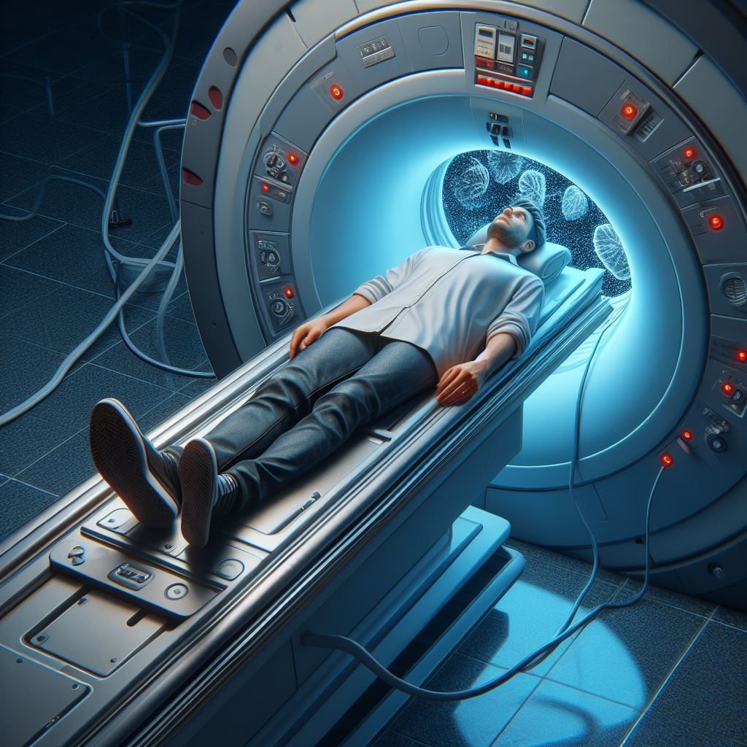
Disclaimer
I’m not an expert in open science
Personal interest in meta-research,
i.e. how science is performed and evaluated
- so don’t take everything I say for granted -
Notes:
Not comprehensive
Reflects my own understanding of a topic that proves quite complex once you dive into it
→ Some things I’ll say are probably inaccurate or incomplete -- Don’t take everything I say for granted

Slide 3
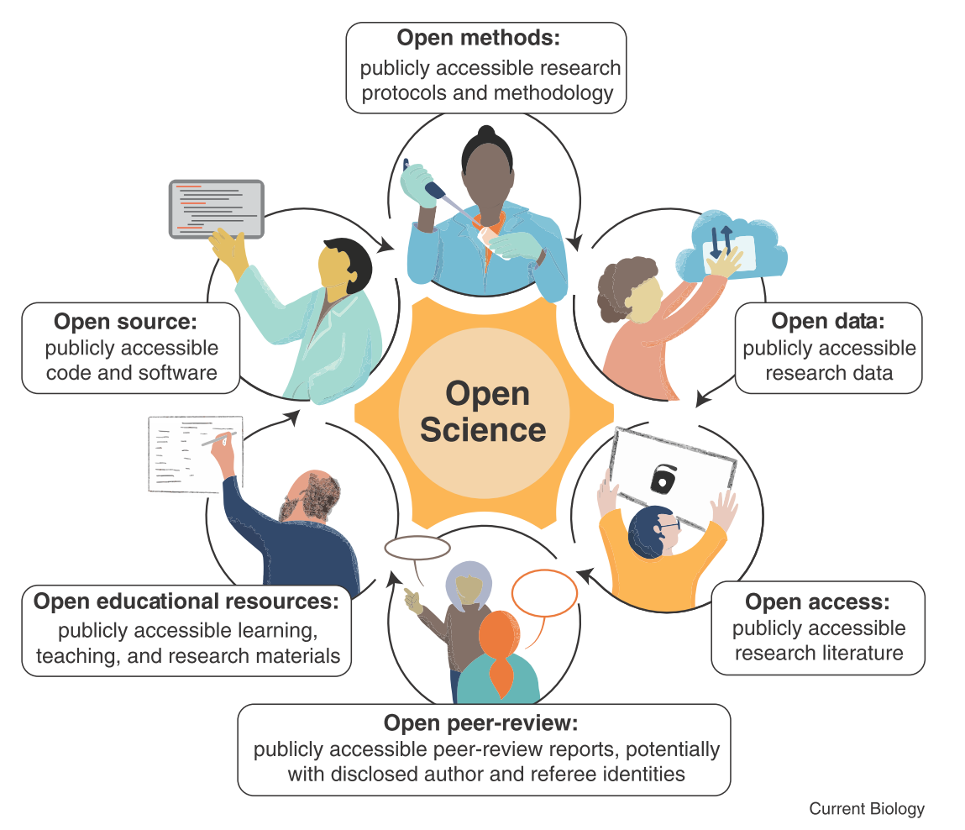
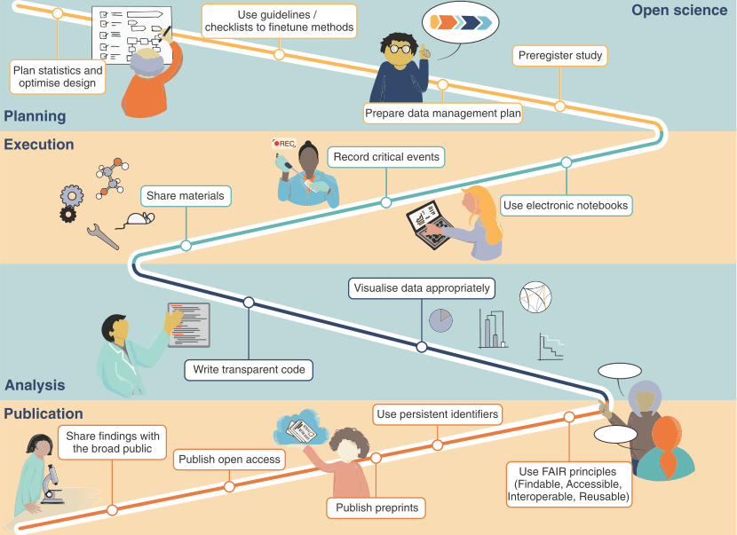
Open science
“Range of methods, tools, platforms, and practices that aim to make scientific research more accessible, transparent, reproducible and reliable”
Bertram et al., Curr Biol 2023

Slide 4

Articulating the problem (or Why the current publishing system is f…ed up)
Dr. Glaucomflecken
https://www.youtube.com/@DGlaucomflecken
Notes:
Let’s start with the problem

Slide 5
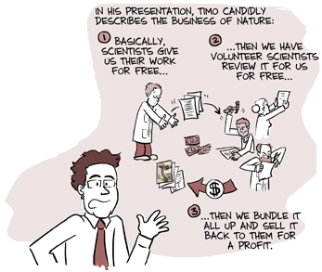
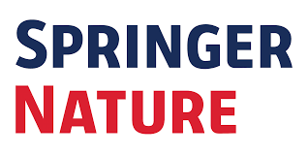



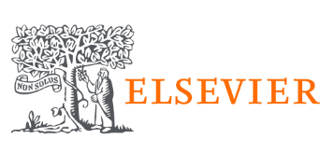












Articulating the problem (or Why the current publishing system is f…ed up)
Commercial
University Presses
Society-led
https://phdcomics.com/comics/archive.php?comicid=1200
Research institutions / Grant agencies
= taxpayer’s money
Publisher
Scientist
Notes:
Mention that sum of money paid by author corresponds to APC = cost of handling the paper… which includes peer-reviewing
Problem 1: taxpayer has no access to the research he paid for
Problem 2: research institutions pay 3 times
Problem 3: no incentive for thorough peer-review + wasted (not public) work
Commercial publishers are not affiliated to an academic institution. They have a for-profit business model, so money made in excess of operating costs might be paid to shareholders.
University presses and Society-led presses are attached to a university / society, and often receive financial support from them. They might receive academic support, e.g., peer reviewers or editorial boards might be drawn from the university’s academic staff. If the press makes money in excess of its operating costs, this might be returned to the university / society.

Slide 6


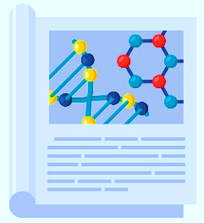

Articulating the problem (or Why the current publishing system is f…ed up)
2
Outside world (taxpayer)
1
Journal
https://phdcomics.com/comics/archive.php?comicid=1200
Research institutions / Grant agencies
= taxpayer’s money
Publisher
Peer-reviewer
3
Scientist
Notes:
Mention that sum of money paid by author corresponds to APC = cost of handling the paper… which includes peer-reviewing
Problem 1: taxpayer has no access to the research he paid for
Problem 2: research institutions pay 3 times
Problem 3: no incentive for thorough peer-review + wasted (not public) work

Slide 7



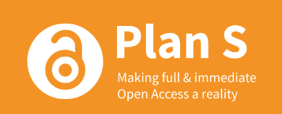
Open access: the guidelines
Loi pour une République numérique (2016)
“To give France a head start in the digital field by promoting an open data and knowledge policy"
https://en.wikipedia.org/wiki/Loi_pour_une_R%C3%A9publique_num%C3%A9rique
CNRS Roadmap Open Science (2019)
"Scholarly publications written and produced by CNRS researchers and
financed mainly from public funds must be 100% accessible and reusable"
https://www.science-ouverte.cnrs.fr
ANR guidelines (2022)
“The coordinator and partners of projects funded by the ANR from 2022 commit to make available in immediate open access […] any scientific publication resulting from a funded project”
https://anr.fr/en/anrs-role-in-research/commitments/open-science
The Plan S Principles (2021)
“All scholarly publications […] must be published in Open Access Journals, on Open Access Platforms, or made immediately available through Open Access Repositories without embargo”
https://www.coalition-s.org
Notes:
ANR: The ANR is committed to full and immediate open access to scientific publications while respecting bibliodiversity and the existence of a plurality of publication routes. As such The coordinator and partners of projects funded by the ANR from 2022 commit to :
To make available in immediate open access under a Creative Commons CC-BY license or equivalent, any scientific publication resulting from a funded project via one of the following routes:
Publication in a natively Open Access journal
Publication in a subscription journal that is part of a transformative agreement or in a transformative journal
Publication in a subscription journal using the Right Retention Strategy (RRS), in accordance with the procedures indicated in the grant agreement
Plan S is an initiative for open-access science publishing launched in 2018, by "cOAlition S", a consortium of national research agencies and funders from twelve European countries.

Slide 8

Open access: the different routes
Gold route
Open Access journal
Immediate Open Access
APC
Notes:
Here APC cover traditional costs (although exagerrated) + lack of income due to no subsciption

Slide 9


Open access: the different routes
Gold route
Open Access journal
Immediate Open Access
APC
APC = Article Processing Charges
→ from “pay-to-read” model to “pay-to-publish” model
APC
Subscription
Journal production costs:
Editing
Peer review
Hosting
Archiving
Preservation

Slide 10

Open access: the different routes
Gold route
Open Access journal
Immediate Open Access
APC
Subscription-based journal
Green route
Immediate or Delayed Open Access
(page charges)
self-archiving
(preprint/Postprint)
Subscription-based journal
Hybrid route
Immediate Open Access
(page charges)
Open access fee
Natively Open Access journal
Immediate Open Access
Diamond route

Slide 11


Open access: the different routes
Gold route
Open Access journal
Immediate Open Access
APC
How to identify (legitimate) Gold Open Access journals?
DOAJ (Directory of Open Access Journals)
Comprehensive Index of open access journals
https://doaj.org
Think. Check. Submit
Tools and practical resources
https://thinkchecksubmit.org/journals

Slide 12
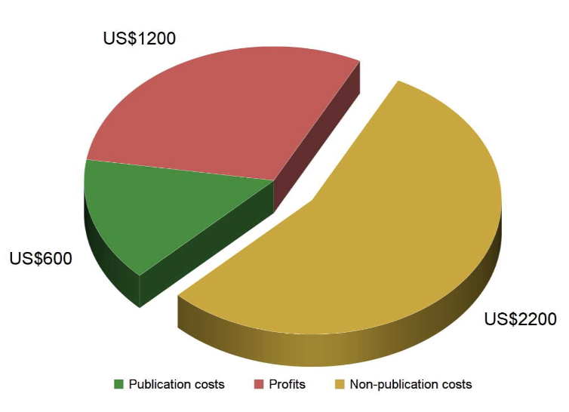
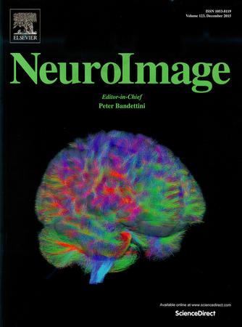

Open access: the different routes
Gold route
Open Access journal
Immediate Open Access
APC
Are there caveats?
Caveat #1: Excessive APCs
2020 - NeuroImage transitioned to gold OA with APC of $3,000
2023 – Elsevier raised APC to $3,450
2021 - NeuroImage: Reports started as gold OA journal with APC of $900
2023 - Elsevier doubled APC to $1,800
2022: Editorial board judged these APC "unethical and unsustainable"
so they asked Elsevier to lower NeuroImage’s APC to $2,000, but they refused
Resignation of entire editorial boards (> 42 researchers)
Creation of non-profit OA journal with APC of $1,650
Grossmann & Brembs, 2019
Notes:
APC vary substantially, their calculation is very opaque, and they’re sometimes inflated, often driven by journal impact
Elsevier saw an opportunity to increase revenue, since APC partly driven by journal’s prestiqe and Impact Factor
Mention APCs of other major journals:
Nature 11 690€
Scientific Reports 2 490$
Bature Communications 6 490$
The unusual guided review experiment will present authors with some choices. Nature editors will make an initial call about whether manuscripts submitted under this pilot are good enough to appear in one of six Nature journals: the highly rated Nature Genetics, Nature Methods, or Nature Physics, or in Nature Communications, Communications Biology, or Communications Physics. If the paper passes that minimum bar, authors who want open access then must pay a €2190 "editorial assessment charge" to cover review costs. Authors would pay an additional €2600 if the paper is accepted by one of the four journals with "Nature" in the title; the total fee would be roughly half of Nature publishing's top open-access charge. For papers that end up in Communications Biology or Communications Physics, authors would pay an additional €800.
Authors who don't want to publish in the journal that accepts the paper will lose their €2190 fee. But the publisher says the authors will be able to use the detailed evaluation report to refine the manuscript.

Slide 13
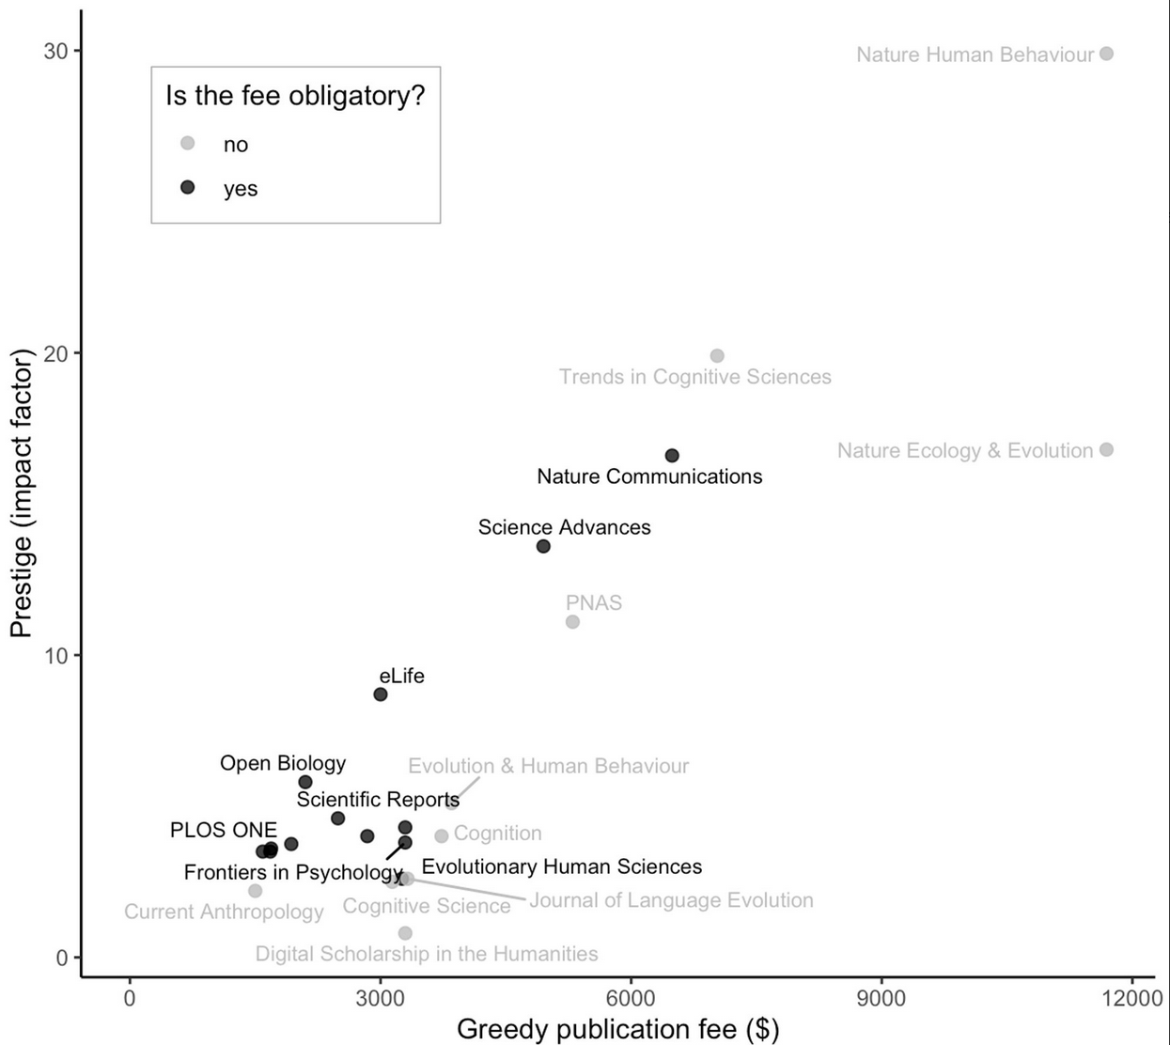
Open access: the different routes
Gold route
Open Access journal
Immediate Open Access
APC
Are there caveats?
Caveat #1: Excessive APCs
Source: Oleg Sobchuk, https://bsky.app/profile/sobchuk.bsky.social/post/3kggjewhicl2y
Notes:
APC vary substantially, their calculation is very opaque, and they’re sometimes inflated, often driven by journal impact
Elsevier saw an opportunity to increase revenue, since APC partly driven by journal’s prestiqe and Impact Factor
Mention APCs of other major journals:
Nature 11 690€
Scientific Reports 2 490$
Bature Communications 6 490$
The unusual guided review experiment will present authors with some choices. Nature editors will make an initial call about whether manuscripts submitted under this pilot are good enough to appear in one of six Nature journals: the highly rated Nature Genetics, Nature Methods, or Nature Physics, or in Nature Communications, Communications Biology, or Communications Physics. If the paper passes that minimum bar, authors who want open access then must pay a €2190 "editorial assessment charge" to cover review costs. Authors would pay an additional €2600 if the paper is accepted by one of the four journals with "Nature" in the title; the total fee would be roughly half of Nature publishing's top open-access charge. For papers that end up in Communications Biology or Communications Physics, authors would pay an additional €800.
Authors who don't want to publish in the journal that accepts the paper will lose their €2190 fee. But the publisher says the authors will be able to use the detailed evaluation report to refine the manuscript.

Slide 14
Open access: the different routes
Gold route
Open Access journal
Immediate Open Access
APC
Are there caveats?
Journal production costs:
Editing
Peer review
Hosting
Archiving
Preservation
Caveat #2: Predatory journals
Exploitative academic publishing business models that involve :
charging APC to authors without checking articles for quality (peer-review)
and without providing editorial and publishing services
https://en.wikipedia.org/wiki/Predatory_publishing
How to spot them:
Accept articles quickly with little or no peer review
Notify academics of article fees only after papers are accepted
Aggressively campaign for academics to submit articles or serve on editorial boards
List academics as members of editorial boards without their permission
Mimic the name or web site style of more established journals
...
Notes:
APC vary substantially, their calculation is very opaque, and they’re sometimes inflated, often driven by journal impact
Elsevier saw an opportunity to increase revenue, since APC partly driven by journal’s prestiqe and Impact Factor
Mention APCs of other major journals:
Nature 11 690€
Scientific Reports 2 490$
Bature Communications 6 490$
The unusual guided review experiment will present authors with some choices. Nature editors will make an initial call about whether manuscripts submitted under this pilot are good enough to appear in one of six Nature journals: the highly rated Nature Genetics, Nature Methods, or Nature Physics, or in Nature Communications, Communications Biology, or Communications Physics. If the paper passes that minimum bar, authors who want open access then must pay a €2190 "editorial assessment charge" to cover review costs. Authors would pay an additional €2600 if the paper is accepted by one of the four journals with "Nature" in the title; the total fee would be roughly half of Nature publishing's top open-access charge. For papers that end up in Communications Biology or Communications Physics, authors would pay an additional €800.
Authors who don't want to publish in the journal that accepts the paper will lose their €2190 fee. But the publisher says the authors will be able to use the detailed evaluation report to refine the manuscript.

Slide 15
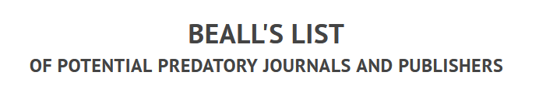

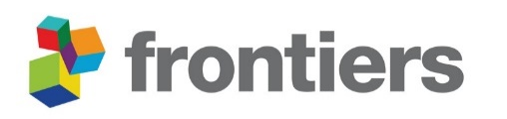
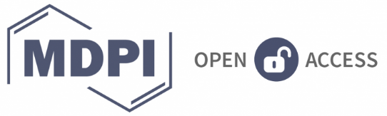
Open access: the different routes
Gold route
Open Access journal
Immediate Open Access
APC
Are there caveats?
Rights are retained
!!! Opportunity for predatory publishing (MDPI)
Caveat #2: Predatory journals
Exploitative academic publishing business models that involve :
charging APC to authors without checking articles for quality (peer-review)
and without providing editorial and publishing services
https://en.wikipedia.org/wiki/Predatory_publishing
How to spot them:
Hybride découragé
Transformative agreements
Droits d’auteurs
https://beallslist.net
https://predatoryreports.org
Infamous examples:
Notes:
APC vary substantially, their calculation is very opaque, and they’re sometimes inflated, often driven by journal impact
Elsevier saw an opportunity to increase revenue, since APC partly driven by journal’s prestiqe and Impact Factor
Mention APCs of other major journals:
Nature 11 690€
Scientific Reports 2 490$
Bature Communications 6 490$
The unusual guided review experiment will present authors with some choices. Nature editors will make an initial call about whether manuscripts submitted under this pilot are good enough to appear in one of six Nature journals: the highly rated Nature Genetics, Nature Methods, or Nature Physics, or in Nature Communications, Communications Biology, or Communications Physics. If the paper passes that minimum bar, authors who want open access then must pay a €2190 "editorial assessment charge" to cover review costs. Authors would pay an additional €2600 if the paper is accepted by one of the four journals with "Nature" in the title; the total fee would be roughly half of Nature publishing's top open-access charge. For papers that end up in Communications Biology or Communications Physics, authors would pay an additional €800.
Authors who don't want to publish in the journal that accepts the paper will lose their €2190 fee. But the publisher says the authors will be able to use the detailed evaluation report to refine the manuscript.

Slide 16
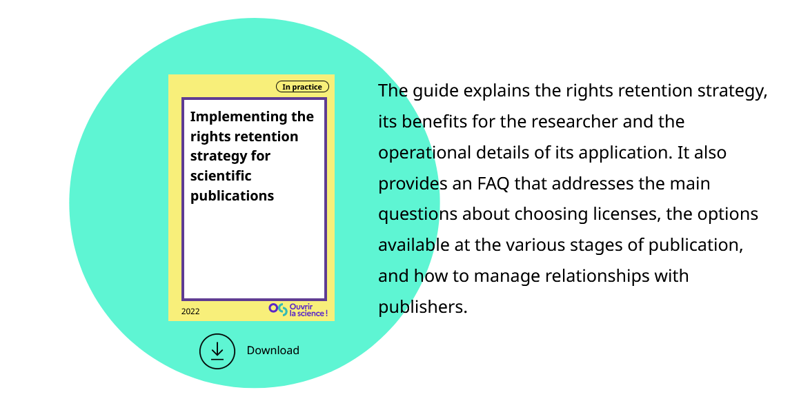
Open access: the different routes
Gold route
Open Access journal
Immediate Open Access
APC
What about copyright?
Authors retain the rights on their papers
≠ copyright transfer to the publisher in the subscription-based model
https://www.ouvrirlascience.fr/implementing-the-rights-retention-strategy-for-scientific-publications

Slide 17



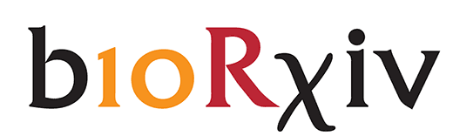


Open access: the different routes
Subscription-based journal
Green route
Immediate or Delayed Open Access
(page charges)
self-archiving
(preprint/Postprint)
Preprint / Postprint
Preprint: manuscript that has not (yet) undergone peer review
  can be updated (with version control) following revisions
https://www.biorxiv.org
https://osf.io
https://asapbio.org/preprint-servers
Postprint: manuscript that has undergone peer review and has been accepted
  publisher's version-of-record = after copy-editing and layout by publisher
  author’s version = before copy-editing and layout
https://hal.science
https://figshare.com

Slide 18

Open access: the different routes
Subscription-based journal
Green route
Immediate or Delayed Open Access
(page charges)
self-archiving
(repository / preprint)
Which version can I archive? When?
Best practice
Postprint author’s version
Immediately after publication
If not possible
(publishers are picky…)
Most recent preprint version
Postprint author’s version always possible
6 months after publication
[Loi pour une République numérique]
Sherpa Romeo
Info on publisher copyright and open access archiving policies
https://sherpa.ac.uk/romeo

Slide 19
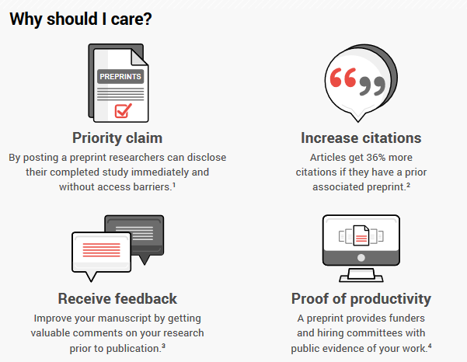
Open access: the different routes
Subscription-based journal
Green route
Immediate or Delayed Open Access
(page charges)
self-archiving
(repository / preprint)
Other benefits of preprints
Dorrego-Rivas et al., 2021. ASAPbio preprint infographics. Zenodo. https://doi.org/10.5281/zenodo.5592318

Slide 20
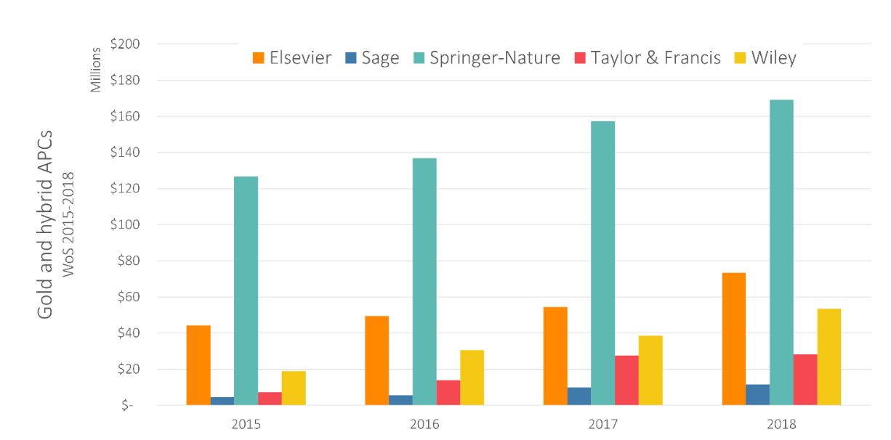
Open access: the different routes
Subscription-based journal
Hybrid route
Immediate Open Access
(page charges)
Open access fee
The problem
Double payment from subscription and APC
Commercial publishers
> 1$ billion in APC revenue between 2015 and 2018!
Butler et al., 2023

Slide 21
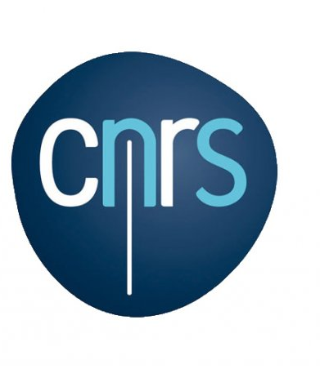

Open access: the different routes
Subscription-based journal
Hybrid route
Immediate Open Access
(page charges)
Open access fee
The problem
Double payment from subscription and APC
Publication costs for CNRS in 2020:
3€ million in APC (30€ million for the whole French academic system)
1.3€ million in page charges
→ Explicitly discouraged by CNRS
Alain Schuhl, Directeur général délégué à la science du CNRS:
"Le CNRS demande instamment à ses chercheurs et à ses chercheuses de ne surtout pas payer pour publier un article dans une de ces revues" (2022)
https://www.cnrs.fr/fr/cnrsinfo/le-cnrs-encourage-ses-scientifiques-ne-plus-payer-pour-etre-publies

Slide 22
Open access: the different routes
Subscription-based journal
Green route
Immediate Open Access
Hybrid route
(page charges)
Open access fee
self-archiving
(repository / preprint)
Some solutions
The easy one : use Green Open Access instead
The harder one : Transformative Agreements
Deals that are negotiated between institutions and publishers for a given portfolio of journals
+
+
Publisher
Subscription-based journal
Hybrid route
Immediate Open Access
(page charges)
Open access fee
For all articles published all authors of the institution

Slide 23

Open access: the different routes
Subscription-based journal
Green route
Immediate Open Access
Hybrid route
(page charges)
self-archiving
(repository / preprint)
Some solutions
The easy one : use Green Open Access instead
The harder one : Transformative Agreements
Deals that are negotiated between institutions and publishers for a given portfolio of journals
But these deals are meant to be temporary, as a transition to full Open Access
Hard to get information, one recent example:
Transformative Agreement
since Jan 1st 2022
Free Open Access in hybrid journals
10% discount on APC of Gold Open Access journals
But too soon to evaluate impact…

Slide 24


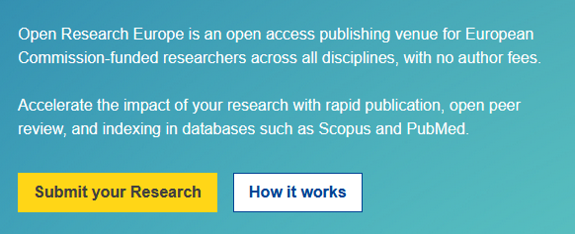

Open access: the different routes
Natively Open Access journal
Immediate Open Access
Diamond route
The ideal route but… very few journals
Community-driven and academic-led initiatives
Funded by non-profit organizations or by donations
Commitment to not using impact factors
Examples:
https://wellcomeopenresearch.org
https://open-research-europe.ec.europa.eu

Slide 25
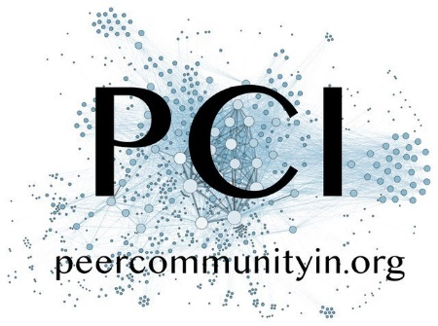

New emerging models
Submit preprint
Peer-review by members of a thematic Peer Community
Two outputs for free
Open “recommended” citable article
Open & citable editorial decision and review
Direct publication in Peer Community journal
(Diamond Open Access)
Submit to PCI-friendly journal with recommendation
→ fast track
Submit to traditional journal with recommendation

Slide 26

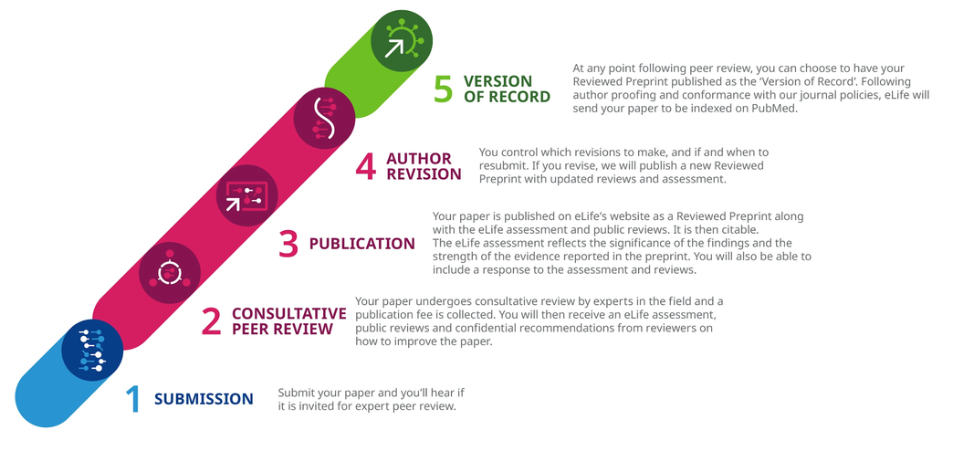
New emerging models
APC = $2,000

Slide 27


New emerging models
Each year, a journal’s content becomes open access if subscriptions to it reach a minimum target
Adopted by the American Society for Microbiology last June for all of its six subscription journals

Slide 28

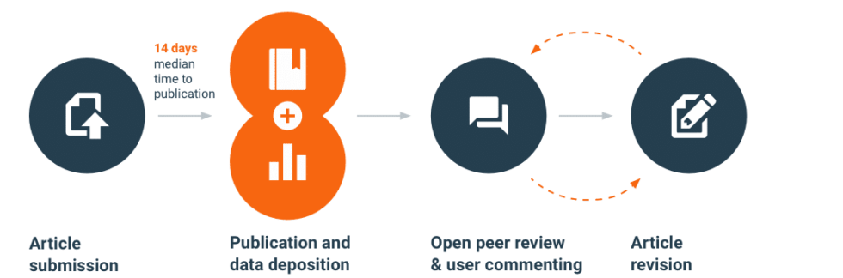
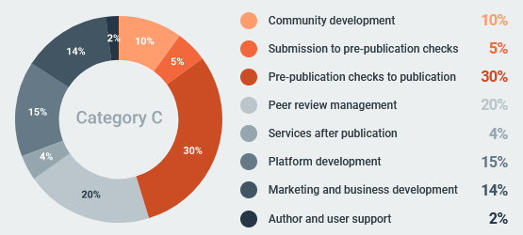
New emerging models
APC = $1,390

Slide 29
Conclusion: Benefits, Challenges and Misconsceptions on Open Access
Benefits
Everyone can read
New ideas dispersed more rapidly and widely
More citations and impact
Businesses have access → economic boost
Immediate use in teaching
Challenges
No Impact Factor for recent OA journals
Few high-quality OA journals in some disciplines
Full transparency means additional work
Cost of APC
Predatory journals
Misconceptions
you, as the author, will give away copyright
your publication will be published without peer review
your publication will not be indexed in scholarly databases
your publication will not have an impact factor
https://www.openaccess.nl/en/what-is-open-access/pros-and-cons

Slide 30
Thank you for your openess!
Additional random resources:
MOOC: https://www.fun-mooc.fr/fr/cours/la-science-ouverte/
Serious games: https://archibibscdf.hypotheses.org/9231?mc_cid=a696ed1694&mc_eid=f575d30aa6

Slide 31
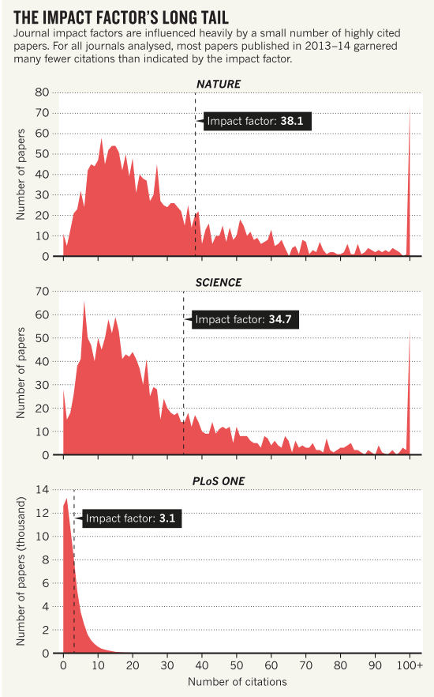
How do we build a first impression of a paper? Impact factor
Callaway, Nature 2016

Slide 32
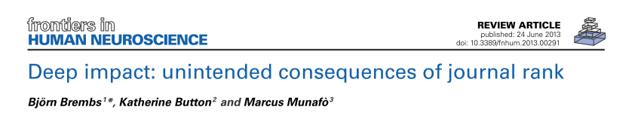
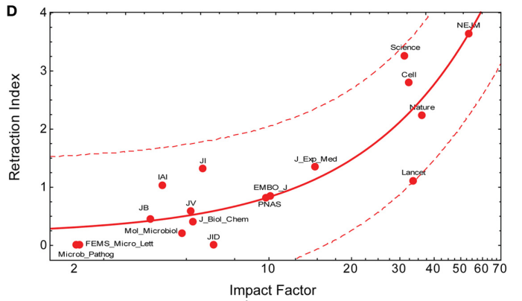
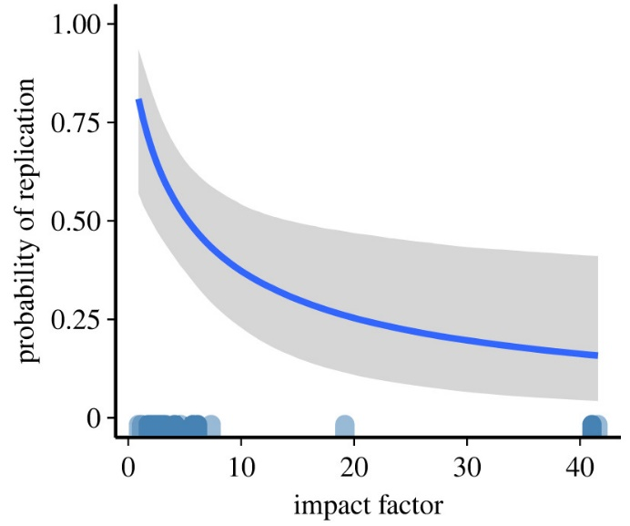
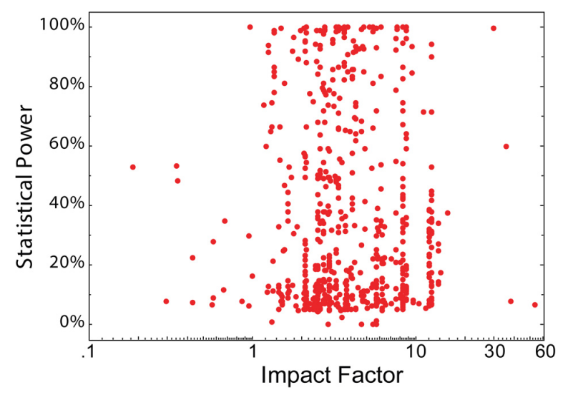
How do we build a first impression of a paper? Impact factor
Dougherty and Horne, Roy Soc Op Sci 2022
From Fang and Casadevall, 2011:
Articles published from 2001 to 2010 in 17 journals
“Retraction index” → likelihood that a paper in a given journal will eventually be pulled from the literature
Notes:
The 2011 report* proposed a “retraction index”, a measure of the likelihood that a paper in a given journal will eventually be pulled from the literature.
The authors looked at articles published from 2001 to 2010 in 17 journals and plotted the journals’ retraction indexes against their impact factor.
The paper’s two authors, each an editor-in-chief of a journal, saw no obvious explanations for the correlation.
1) One possibility, they write, is that researchers might be more willing to cut corners or even commit scientific misconduct to get into a prestigious journal.
2) They also note that papers in high-impact journals probably receive more scrutiny, making problematic articles harder to hide.
3) Probably a result of the top journals wanting ground breaking research but with small Ns and large effect sizes → false positives !
There was no significant correlation between statistical power and journal rank (N = 650; r_{s} = −0.01; t = 0.8).
Thus, the currently available data seem to indicate that journal rank is a poor indicator of methodological soundness.

Slide 33
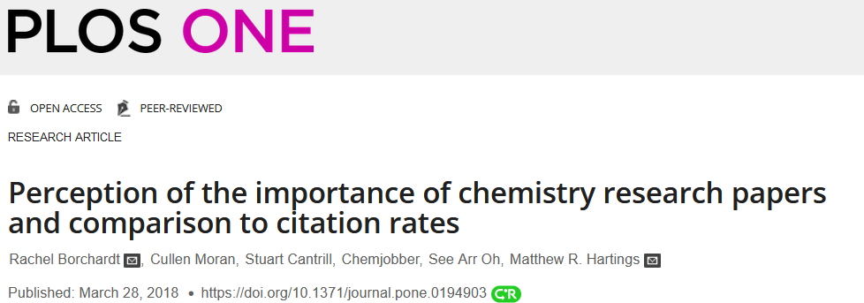
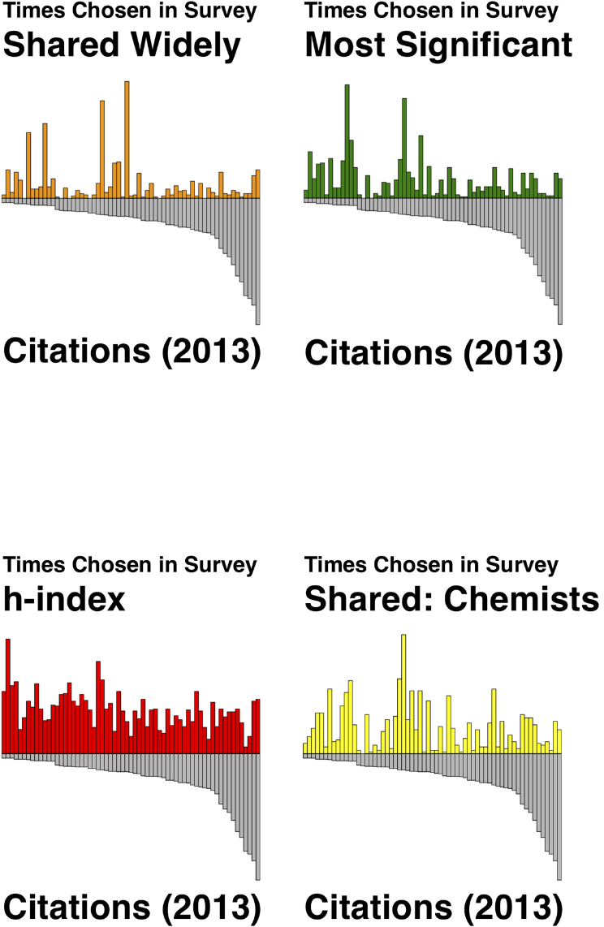
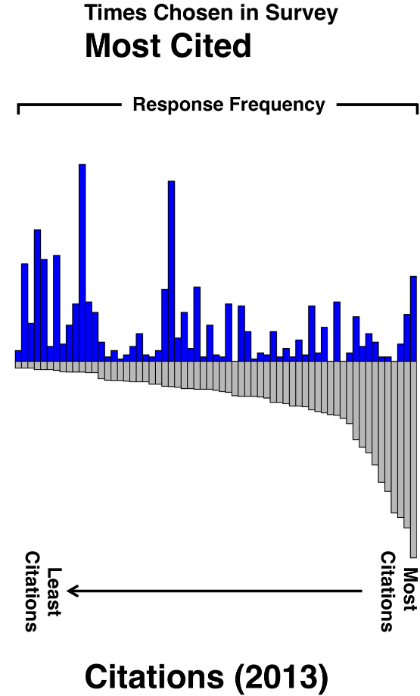
How do we build a first impression of a paper? Number of citations
63 articles from a 2003 issue of the Journal of the American Chemical Society
Survey in 2013 → 350 chemists asked to pick which article they thought was:
the most highly-cited
the most significant
The one they would share with other chemists
The one they would share more broadly
Perception of impact
Notes:
We asked readers to look at 63 articles from one issue of the Journal of the American Chemical Society.
We asked them to identify up to three articles in the issue that they thought were: the most significant (allowing them to define significance however they deemed fit); the most highly-cited; the articles they would share with other chemists; and the articles they would share more broadly.
We analysed data from more than 350 respondents.
In comparing the four questions to citation counts 10 and 13 years after the articles were published, the correlations ranged from .06 (articles to share with chemists) to .33 (highly-cited articles).
This shows a strikingly large discrepancy between researchers’ perceptions of impact and the metric we currently use to measure impact.
Why are these correlations so low?
There are likely a number of reasons why actual citation practice is not more closely aligned with researcher perception, but it highlights just how divorced perception is from current practice.
So what now? We think this work clearly highlights a major issue with metrics – they aren’t measuring what everyone commonly assumes we are measuring, or at least, are not accurately representing the more abstract perceptions of impact and importance that we measured in our survey.
https://blogs.lse.ac.uk/impactofsocialsciences/2018/05/14/the-academic-papers-researchers-regard-as-significant-are-not-those-that-are-highly-cited/

Slide 34
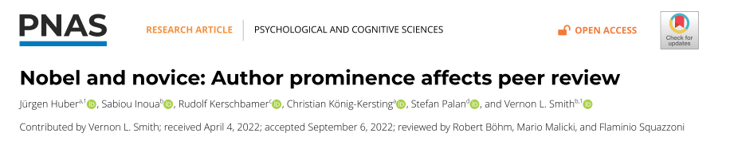
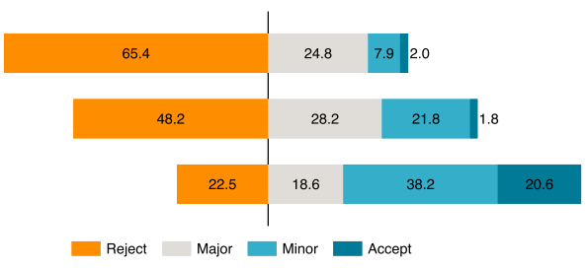
How do we build a first impression of a paper? Fame of the authors
Pre-registered field experiment: 3 300 researchers invited to review a finance research paper jointly written by a Nobel laureate and an early career researcher
Only early career author mentioned
No author mentioned
Only Nobel author mentioned
Notes:
Probably a bad idea to rely on prestige to judge a paper, given that we seem to be very biased.
Peer review is a well-established cornerstone of the scientific process, yet it is not
immune to biases like status bias, which we explore in this paper. Merton described
this bias as prominent researchers getting disproportionately great credit for their
contribution, while relatively unknown researchers get disproportionately little credit
[R. K. Merton, Science 159, 56–63 (1968)]. We measured the extent of this bias in
the peer-review process through a preregistered field experiment. We invited more than
3,300 researchers to review a finance research paper jointly written by a prominent
author (a Nobel laureate) and by a relatively unknown author (an early career research
associate), varying whether reviewers saw the prominent author’s name, an anonymized
version of the paper, or the less-well-known author’s name. We found strong evidence
for the status bias: More of the invited researchers accepted to review the paper when
the prominent name was shown, and while only 23% recommended “reject” when the
prominent researcher was the only author shown, 48% did so when the paper was
anonymized, and 65% did when the little-known author was the only author shown.
Our findings complement and extend earlier results on double-anonymized vs. single-
anonymized review

Slide 35
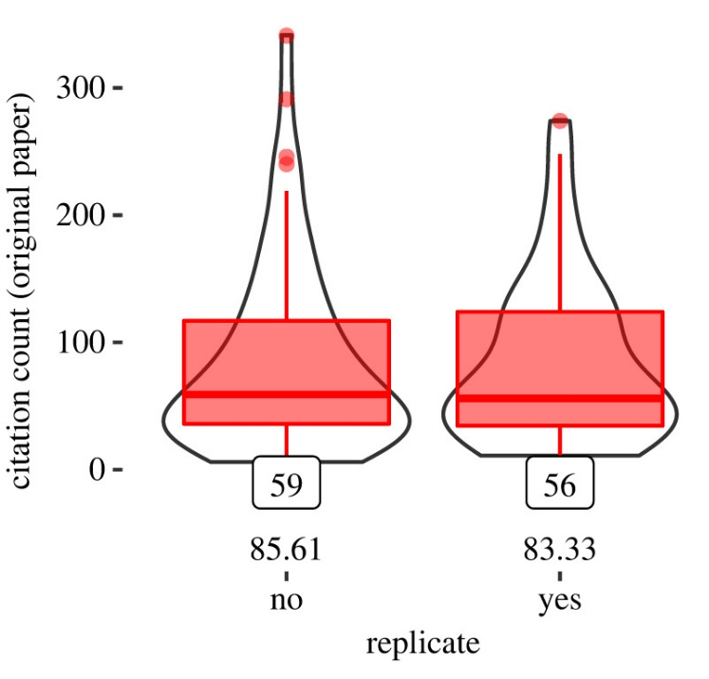

How do we build a first impression of a paper? Prestige of institution
Dataset of > 45 000 articles with > 660 00 statistical tests & data from 190 replication attempts
Do proxys like Impact factor, citation counts and institutional prestige predict indicators of research quality?
accuracy of statistical reporting
strength of statistical evidence (Bayes factor)
replicability of a given experimental result
Notes:
Neither the number of citations to the original paper (BF 10 = 1/1202), nor the number of citations garnered by the first author of the original paper (BF 10 = 1/131062), nor the institutional prestige of the first author (BF 10 = 1/67) were predictive of replication success.

