Slide 1
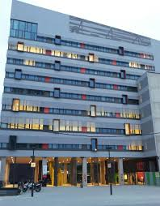
« … the last refuge of a complex mind » (O. Wilde)
Nicolas Froeliger, nicolas.froeliger@u-paris.fr

Slide 2
Well, first…
A warm thank you!
For my little person (unimportant)
But most of all…
For this brilliant idea: simplify!
Just what we are all looking for…

Slide 3
In arguably unsimple ways
A cognitive approach?
How to deal with specialized domains?
What kind of general knowledge do we need?
No, not this time…
But instead…
… How to deal with maths when maths never were your strong point in the first place?

Slide 4
And what do we mean by maths, here?
Anything that can be counted, computed and measured
Including in graphic form:
… tables, figures…
In other words:
Maths for non-believers (anybody here?)

Slide 5
What do we want to hint at?
Maths are not outside of culture
They can be understood
They help us reflect according to categories
Their universe is, yes, reassuring
We can model our reasoning and style according to them
But first, we have to stop fearing them
Our main focus, however: pragmatic translation (i.e. translation for communicative purposes)
(but we are open to discussion)

Slide 6
First, overcoming unreasonable fears
Taking inspiration from the funniest piece of XXth century literature
« […] Sean fils de l’oncle Jack, âgé de vingt et un ans, solide gaillard quoique hémophile également, et puis la fille de Franck (?) Bridie, âgée de quinze ans, pilier et soutien de la famille, ne dormant que le jour pour pouvoir recevoir la nuit, au tarif élastique de deux pences ou trois pences ou quatre pences ou même cinq pences ou une bouteille de bière l’étreinte, et cela dans la remise pour ne pas incommoder les siens, et puis l’autre fils de Jack Tom, âgé de quatorze ans, dont on disait diversement qu’il tenait de son père par la faiblesse de son esprit et de sa mère par la faiblesse de sa poitrine et de son grand-père paternel Jim par son goût des boissons fortes […]. » (Beckett, 1968/1992, p. 105)

Slide 7
And then the punchline (footnote)
« Ces chiffres étant incorrects, les calculs en découlant sont doublement erronés. » (Beckett, 1968/1992, p. 106)
It’s not just funny
It is (sadly) representative…
… of how we, translators, often relate to maths:
… decorative elements…
… which you don’t necessarily need to understand
And are often wont to despise

Slide 8
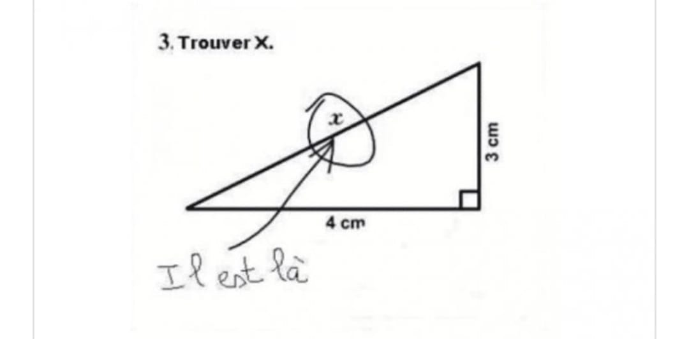
The consequence?
Navigating shallow waters:

Slide 9
What those metaphors tell us
Things that are linguistically possible
May be contextually implausible
Do not turn a blind eye to the problem at hand (here, maths)
… and if you do…
… don’t go complaining about low rates

Slide 10
Regarding maths, that would be pretty stupid…
(trying to make new friends, here…)
Because we can understand (“Yes, we can”)
Because this is part of our agency
Because ”No human thing is foreign to me” (Terence)
Because pragmatic texts are written around maths (and not vice versa)

Slide 11
An example
So far the study of solar variability has identified five solar periodicities […]: – […] – The 88 years Gleissberg cycle […]. Its length varies strongly over the centuries, with peaks of about 55 and 100 years […]. The longer period prevailed between 1725 and 1850. | L’étude de la variabilité solaire a permis, jusqu’à présent, d’identifier cinq périodicités solaires […] : – […] – Le cycle de Gleissberg, d’une période moyenne de 88 ans […]. La durée de ce cycle varie fortement, de 55 ans minimum jusqu’à plus de 100 ans […]. La plus longue période eut lieu entre 1725 et 1850

Slide 12
What does the translator say?
« Le texte anglais dit que le cycle dure entre 55 ans et 100 ans. Mais la phrase suivante “The longer period prevailed between 1725 and 1850.” vient contredire cela, puisqu’entre 1725 et 1850 il y a 125 ans et non pas 100 ans. J’ai donc choisi de traduire cette information par ‘’plus de 100 ans’’. »
In case of doubt, go for the figures!

Slide 13
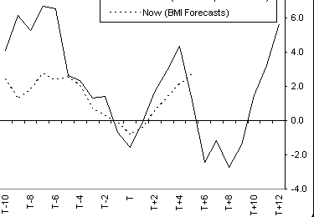
In fact…
A lot of texts are actually “translations” from mathematical of figurative expressions
« Wall Street thinks a double-dip recession is more likely than V-shaped recovery »

Slide 14
Besides…
There are words around terms too
Heard about phraseology?
let x be | soit x.... | posons partant de que
where | où...
knowing that | or, on sait que…
hence | il s'ensuit | d'où | on peut donc écrire…

Slide 15
Figures: it’s not just literal translation!
Yes, there are differences (commas, dots, spaces, plurals…)
OK but why tarry on commas, for G…d’s sake?!
Ask United Airways:
Le chiffre
1,86 : Une virgule mal placée et c'est le prix sacrifié — en dollar — d'un aller retour sur des lignes intérieures d'US Airways.
Source : Liberation.fr, 20 avril 2005

Slide 16
It can also get less trivial, though
A misplaced dot or comma can get someone killed, too (C. Balliu)
And how do I translate this?
About a third of children under five suffer from malnutrition.
Yes, “Un tiers des enfants de moins de cinq ans…”

Slide 17
And what about this?
The National Rifle Association (NRA), the nation’s leading gun lobbying group, increased its online ad spending sixfold after the deadly mass shooting at a Parkland, Fla., high school last month, according to a new report.
Is it “multiplié par six” or “par sept”?
Depends on what you are focused on: “increased” or “…fold”
Mathematically speaking, …
… post-Parkland spending = pre-Parkland spending + (pre-Parkland spending x 6) = 7 x

Slide 18
Ok, but who is aware of that?
Not all of our authors, obviously
And possibly not all translators either (just check Linguee on that…)
So always check, and start from the figures

Slide 19
And if words are just figures, translated
… then juggle
The poor record of SMEs in training is historic: « SMEs are much less likely to provide formal training to their employees than larger enterprises. »
Les PME n'ont jamais été de grosses consommatrices de formation continue. « Statistiquement, elles font beaucoup moins appel à la formation en bonne et due forme que les entreprises de plus grande taille. »

Slide 20
Therefore
Always check
Start with the figures, and the words will follow
And remember that you learned how to count, way back when…

Slide 21
II. Numbers do not exist outside of culture
Think of recipes: spoons, cups, or ml?
Or the way maths are taught in various countries: “Equivalence in difference” indeed (as Jakobson always sez…)
And how do you transfer first floor into French (or Italian…)?
In the EU: « rez-de-chaussée »
In the UK: « 1er étage »
And what about the US 13th floor?

Slide 22
In other words
It’s not the words; it’s the situation!
Use the context to reduce uncertainty…
… in both your and your client’s understanding
To make complex matters simple

Slide 23
An (old) example (1997)
“Mad cow” disease has had a negative impact on Cremonini, also due to the fact that the first BSE case in Italy was found in a cow slaughtered in the Group's Ospedaletto Lodigiano plant. The “mad cow” collective syndrome led to an impressive drop in meat consumption. In Italy volumes fell by 40%, prices by 20%, whereas in the same period Cremonini sales fell by 30%. This implied a growth in Cremonini's market share.
What do I do with the last sentence?
Has the author gotten it wrong?
And how do I decide (for a start)?

Slide 24
Let’s get concrete
“Mad cow” disease has had a negative impact on Cremonini, also due to the fact that the first BSE case in Italy was found in a cow slaughtered in the Group's Ospedaletto Lodigiano plant. The “mad cow” collective syndrome led to an impressive drop in meat consumption. In Italy volumes fell by 40%, prices by 20%, whereas in the same period Cremonini sales fell by 30%. This implied a growth in Cremonini's market share.
Volumes: tonnage (for instance)
Prices: speaks for itself, doesn’t it?
Sales: the combination of those two

Slide 25
So, a stylized calculation
[…] This implied a growth in Cremonini's market share.
Year 1, sales = volume (3 000 animals) x prices (2 000 € per animal). Therefore 6 millions euros
Year 2 : Italian market as a whole: (3,000 -40%) x (2,000 -20%) = 1,800 x 1,600 = 2,880,000 €.
Hence, a 52% drop for the whole market!
Therefore, if Cremonini only loses 30%...
… its relative share of the market is increasing
So buy its shares NOW!

Slide 26
Hence, the translation
[…] This implied a growth in Cremonini's market share.
Ce qui se traduit en fait par une croissance de la part de marché de Cremonini.
Why, « en fait »?
For those (like me, at first), who didn’t get it firsthand
NB: could also be « donc », depending on how maths-savvy your readers are

Slide 27
Yes, context and communication!
Use reality as a sieve between source and target document
This is the essence of pragmatic translation
To do that…
… inquire about your readers’ system of values
How do they see (and measure) the world?

Slide 28
Another example
Also in the USA the Corporate Average Fuel Economy (CAFE) standard […] forecast reaching and maintaining a standard of 55.2 miles per American gallon (mpg) in 2025.
Miles to kilometers; gallons to liters: that’s the easy part
But it would still be useless on the European continent…
Toujours aux États-Unis, la norme Corporate Average Fuel Economy (CAFE) […] prévoit de plafonner durablement la consommation d’essence à 4,261 litres pour 100 kilomètres (soit 55,2 miles par gallon, mpg) à partir de 2025.

Slide 29
V. Think according to categories
Including orders of magnitude
Sopra has just announced the acquisition of Organizacion Guver, a small Spanish company. This company (EUR6m, 120 employees) is based in Bilbao and Barcelona and is specialised in banking, industry and government.
Two traps orders of magnitude can help us overcome
Sopra vient d'annoncer l'achat de l'Espagnol Organizacion Guver. Installée à Bilbao et Barcelone, cette entreprise de taille modeste (EUR 6 m, 120 salariés) est spécialisée dans les services auprès des banques, de l'industrie et des administrations publiques.

Slide 30
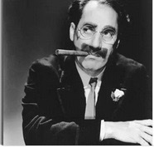
The stakes, here (again)
From a linguistic universe…
… to a pragmatic one
Approaching the digital by analogical means (let us remain realistic about ou maths abilities…)
Simple calculations, differentiating between stocks and flows, the works…
Use Groucho Marx for inspiration: « Either this man is dead or my watch has stopped. » (Monkey Business, 1931)

Slide 31
One step beyond…
From categories to systems
Whatever the domains…
… the basic components are similar
Just like maths help us compute any kind of objects
Those are unifyers: they make our life simpler (yes...)

Slide 32
A basically reassuring universe
Really?!
Well, maybe not for everyone, at least at first sight
Definitely for our authors, and readers: industrialization, forecasting, guiding action…
Through abstract means, though…
… and there’s the rub

Slide 33
Yet another financial example
The valuation looks undemanding: P/BV 22E is 1.5x for an ROE of 17%.
How do you read that, in the first place?
And what can it possibly mean?
Deconstruct!
Everything has a precise meaning (and the second part explains the first…)

Slide 34
And the results is…
The valuation looks undemanding: P/BV 22E is 1.5x for an ROE of 17%.
La valorisation semble attrayante [the share is unexpensive at the moment] : le ratio cours actuel [added precision, for clarity]/actif net par action fin 2022 [projection] est estimé à 1,5, pour un rendement des fonds propres de 17 %.
Complex at first, and then more and more easy:…
… it gets simple after a while

Slide 35
The very least, for that
Never give up on your understanding abilities!
Not exactly the same as in literary translation…
… where the full meaning might never be exhausted
In pragmatic translation, we aim at rendering the full, complete, overall intention – with full clarity
« Traduire, pour les ciblistes, c’est prendre en compte le lecteur et produire un texte qui n’aura pas besoin d’être décrypté, car l’interprétation se fait au moment de la traduction. » (Enora Dessagnat, ILTS student, 2021-23)

Slide 36
OK, but…
If everything gets that simple…
… why would the world still need translators?
How do we overcome this last contradiction?
By replacing unreflective simplicity by the simplicity of expertise
Which leads us (at last) to four conclusions

Slide 37
This is important!

Slide 38
The conclusions, then
Develop your high-end skills, all right, but…
… build them on solid ground (language and culture, maths…)
So as not to do this:

Slide 39
Redefining the job at hand
From translating texts to translating documents
A whole new definition of the task
With different compensation methods (words or hours, for instance)
A translator is a provider of multilingual solutions

Slide 40
A heuristic model
« What, then, to raise the old question once more, is mathematics? The answer, it appears, is that any argument which is carried out with sufficient precision is mathematical, and the reason that your friends and ours cannot understand mathematics is not because they have no head for figures, but because they are unable to achieve the degree of concentration required to follow a moderately involved sequence of inferences. […]. » (Gale and Shapley, 1962, p. 15)
Remember the Romans’ tuctor… (the one that certifies the quality of the product): that’s us, today and tomorrow

Slide 41
A stylistic model
Pragmatic translation: all about reducing uncertainties
Maths (including under graphic form): intrinsic clarity
So maths offer a template for achieving clarity…
… both for us (translators) and for our readers
Pragmatic translators’ fantasy turned real…
Provided you cease to be afraid of them

Slide 42
And do not under any circumstances read this!

