Slide 1
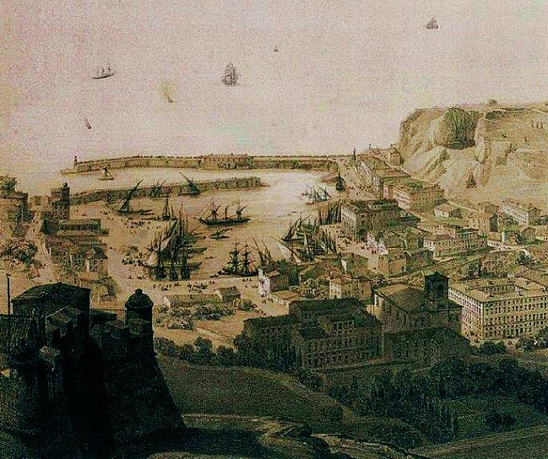
Observing and imagining Nice in Tobias Smollett’s Travels through France and Italy (1766)
Crédit image : Archives départementales des Alpes Maritimes
Nathalie BERNARD (Aix-Marseille Université - LERMA)
Colloque-anniversaire des 20 ans de la SELVA « Lire, écrire, voyager » (11-12 mai 2023, Université Côte d’Azur, Nice)

Slide 2
TRAVELS THROUGH FRANCE AND ITALY. CONTAINING OBSERVATIONS ON
CHARACTERS,|
CUSTOMS,|
RELIGION,|
GOVERNMENT,|
With a particular
TOWN, TERRITORY,
To which
A Register of the
a Residence of Eighteen
By T. SMO
POLICE,
COMMERCE,
ARTS, AND
ANTIQUITIES
DESCRIPTION of the
and CLIMATE of NICE:
is added,
Weather, kept during
Months in that City
LLETT, M. D.

Slide 3
Letter XIII: Description of Nice: geography; layout of the town and type of architecture; the harbour; type of administration; surrounding landcape (houses and vegetation); Cimiez: Roman remains.
Letter XIV: Fort du Mont Alban (its harbour and galleys) and Villefrance.
Letter XVI: Excursion to Cimiez (aqueducts and other Roman remains).
Letter XVII: Foundation and history of Nice; its current political system; Religion; the nobility.
Letter XVIII: Lodgings and conveniences available to foreign visitors; local markets: meat and fish to be found.
Letter XIX: Money/currency; the price and quality of meat/sea-birds/bread/ fruit and vegetables/ ‘sorbettes’ and wine; the cost of living for British residents.
Letter XX: Commerce, shopkeepers and artisans; law enforcement; a description of the common people of Nice ; religious institutions.
Letter XXI: The revenues of Nice; the state of the arts and sciences; the Patois or native tongue of Nice.
Letter XXII: Agriculture (fertiliser, tools, crops); sericulture (‘the culture of silk-worms’).
Letter XXIII: The methods of making wine and oil; other manufactures of Nice; sea bathing.
Letter XXIV: The climate of Nice: characteristics and effects upon various disorders.

Slide 5
“In all probability, many other noble monuments of this city have been dilapidated by the same barbarous œconomy.”
(T. Smollett, Travels, Letter XIII)

Slide 6
“I am attached to my country because it is the land of liberty, cleanliness, and convenience”
(T. Smollett, Travels, Letter XLI)

Slide 7
“They are all diminutive, meagre, withered, dirty, and half-naked”
“The great poverty of the people here, is owing to their religion”
(Travels, Letter XX)

Slide 8
Cicisbeo, sigisbée, chevalier servant.
“I do not choose to enter into particulars. I cannot open the scandalous chronicle of Nice, without hazard of contamination. With respect to delicacy and decorum, you may peruse dean Swift’s description of the Yahoos, and then you will have some idea of the porcheria, that distinguishes the gallantry of Nice.” (Travels, Letter XVII)

Slide 9
“I shall say nothing more on the subject, lest I should be tempted to deviate from that temperance and impartiality which I would fain hope have hitherto characterised the remarks of,
Dear Sir,
Your faithful humble servant”
(Travels, Letter XVII)

Slide 10
In summer, notwithstanding all the care and precautions we take, we are pestered with incredible swarms of flies, fleas, and bugs; but the gnats, or couzins, are more intolerable than all the rest. In the day-time, it is impossible to keep the flies out of your mouth, nostrils, eyes, and ears. They croud [sic] into your milk, tea, chocolate, soup, wine, and water: they soil your sugar, contaminate your victuals, and devour your fruit; they cover and defile your furniture, floors, cielings [sic], and indeed your whole body.)
(Travels, Letter XXIV)

Slide 11
When I stand upon the rampart, and look round me, I can scarce help thinking myself inchanted. The small extent of country which I see, is all cultivated like a garden. Indeed, the plain presents nothing but gardens, full of green trees, loaded with oranges, lemons, citrons, and bergamots, which make a delightful appearance. If you examine them more nearly, you will find plantations of green pease ready to gather; all sorts of sallading, and pot-herbs, in perfection; and plats of roses, carnations, ranunculas, anemonies, and daffodils, blowing in full glory, with such beauty, vigour, and perfume, as no flower in England ever exhibited. (Travels, Letter XIII)

Slide 12
“I am, however, mortified to reflect what flagrant injustice we everyday commit, and what absurd judgement we form, in viewing objects through the falsifying medium of prejudice and passion.”
(Jery Melford, Matthew Bramble’s nephew in Tobias Smollett’s The Expedition of Humphry Clinker (1771)

