Slide 1
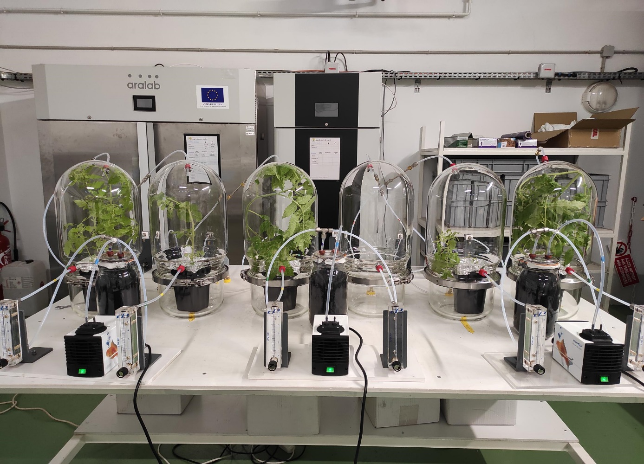
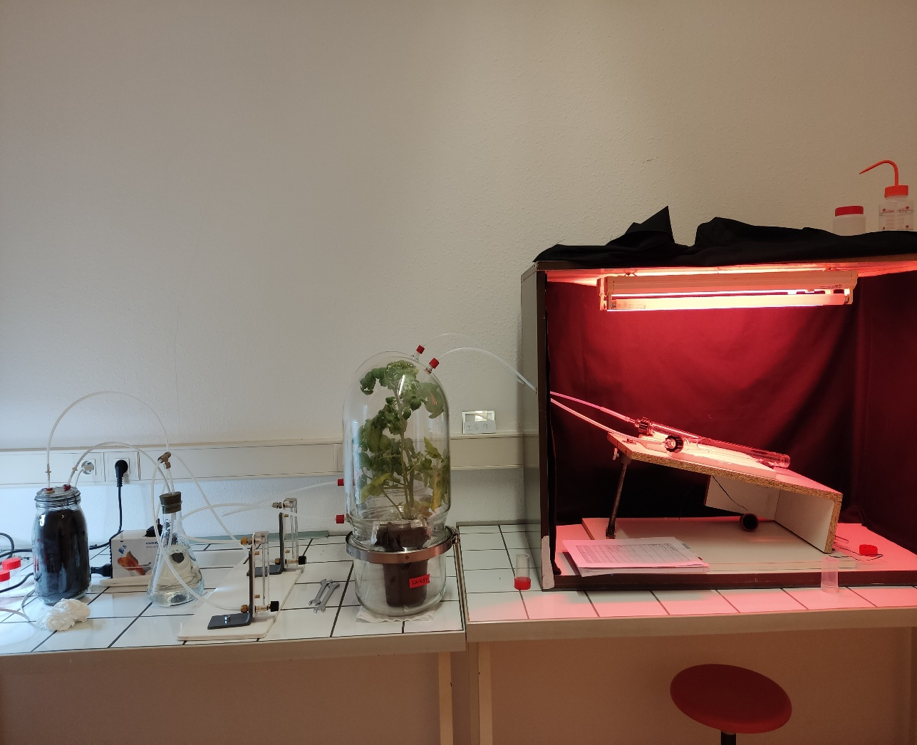
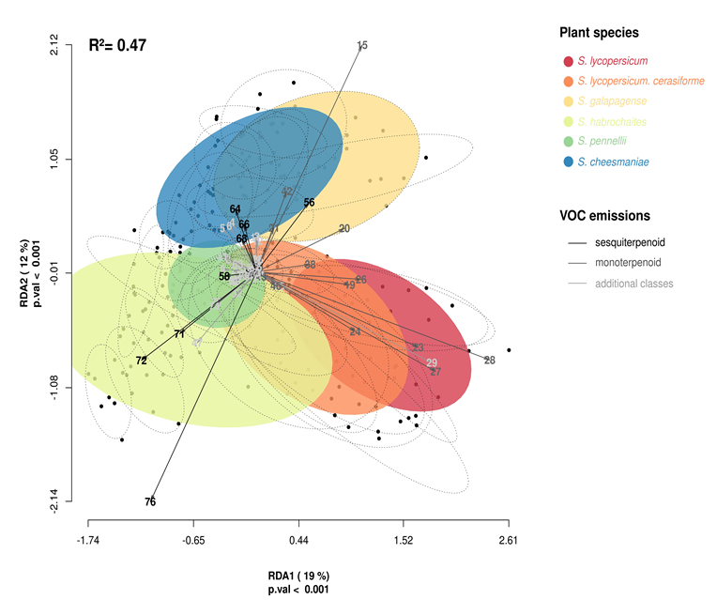
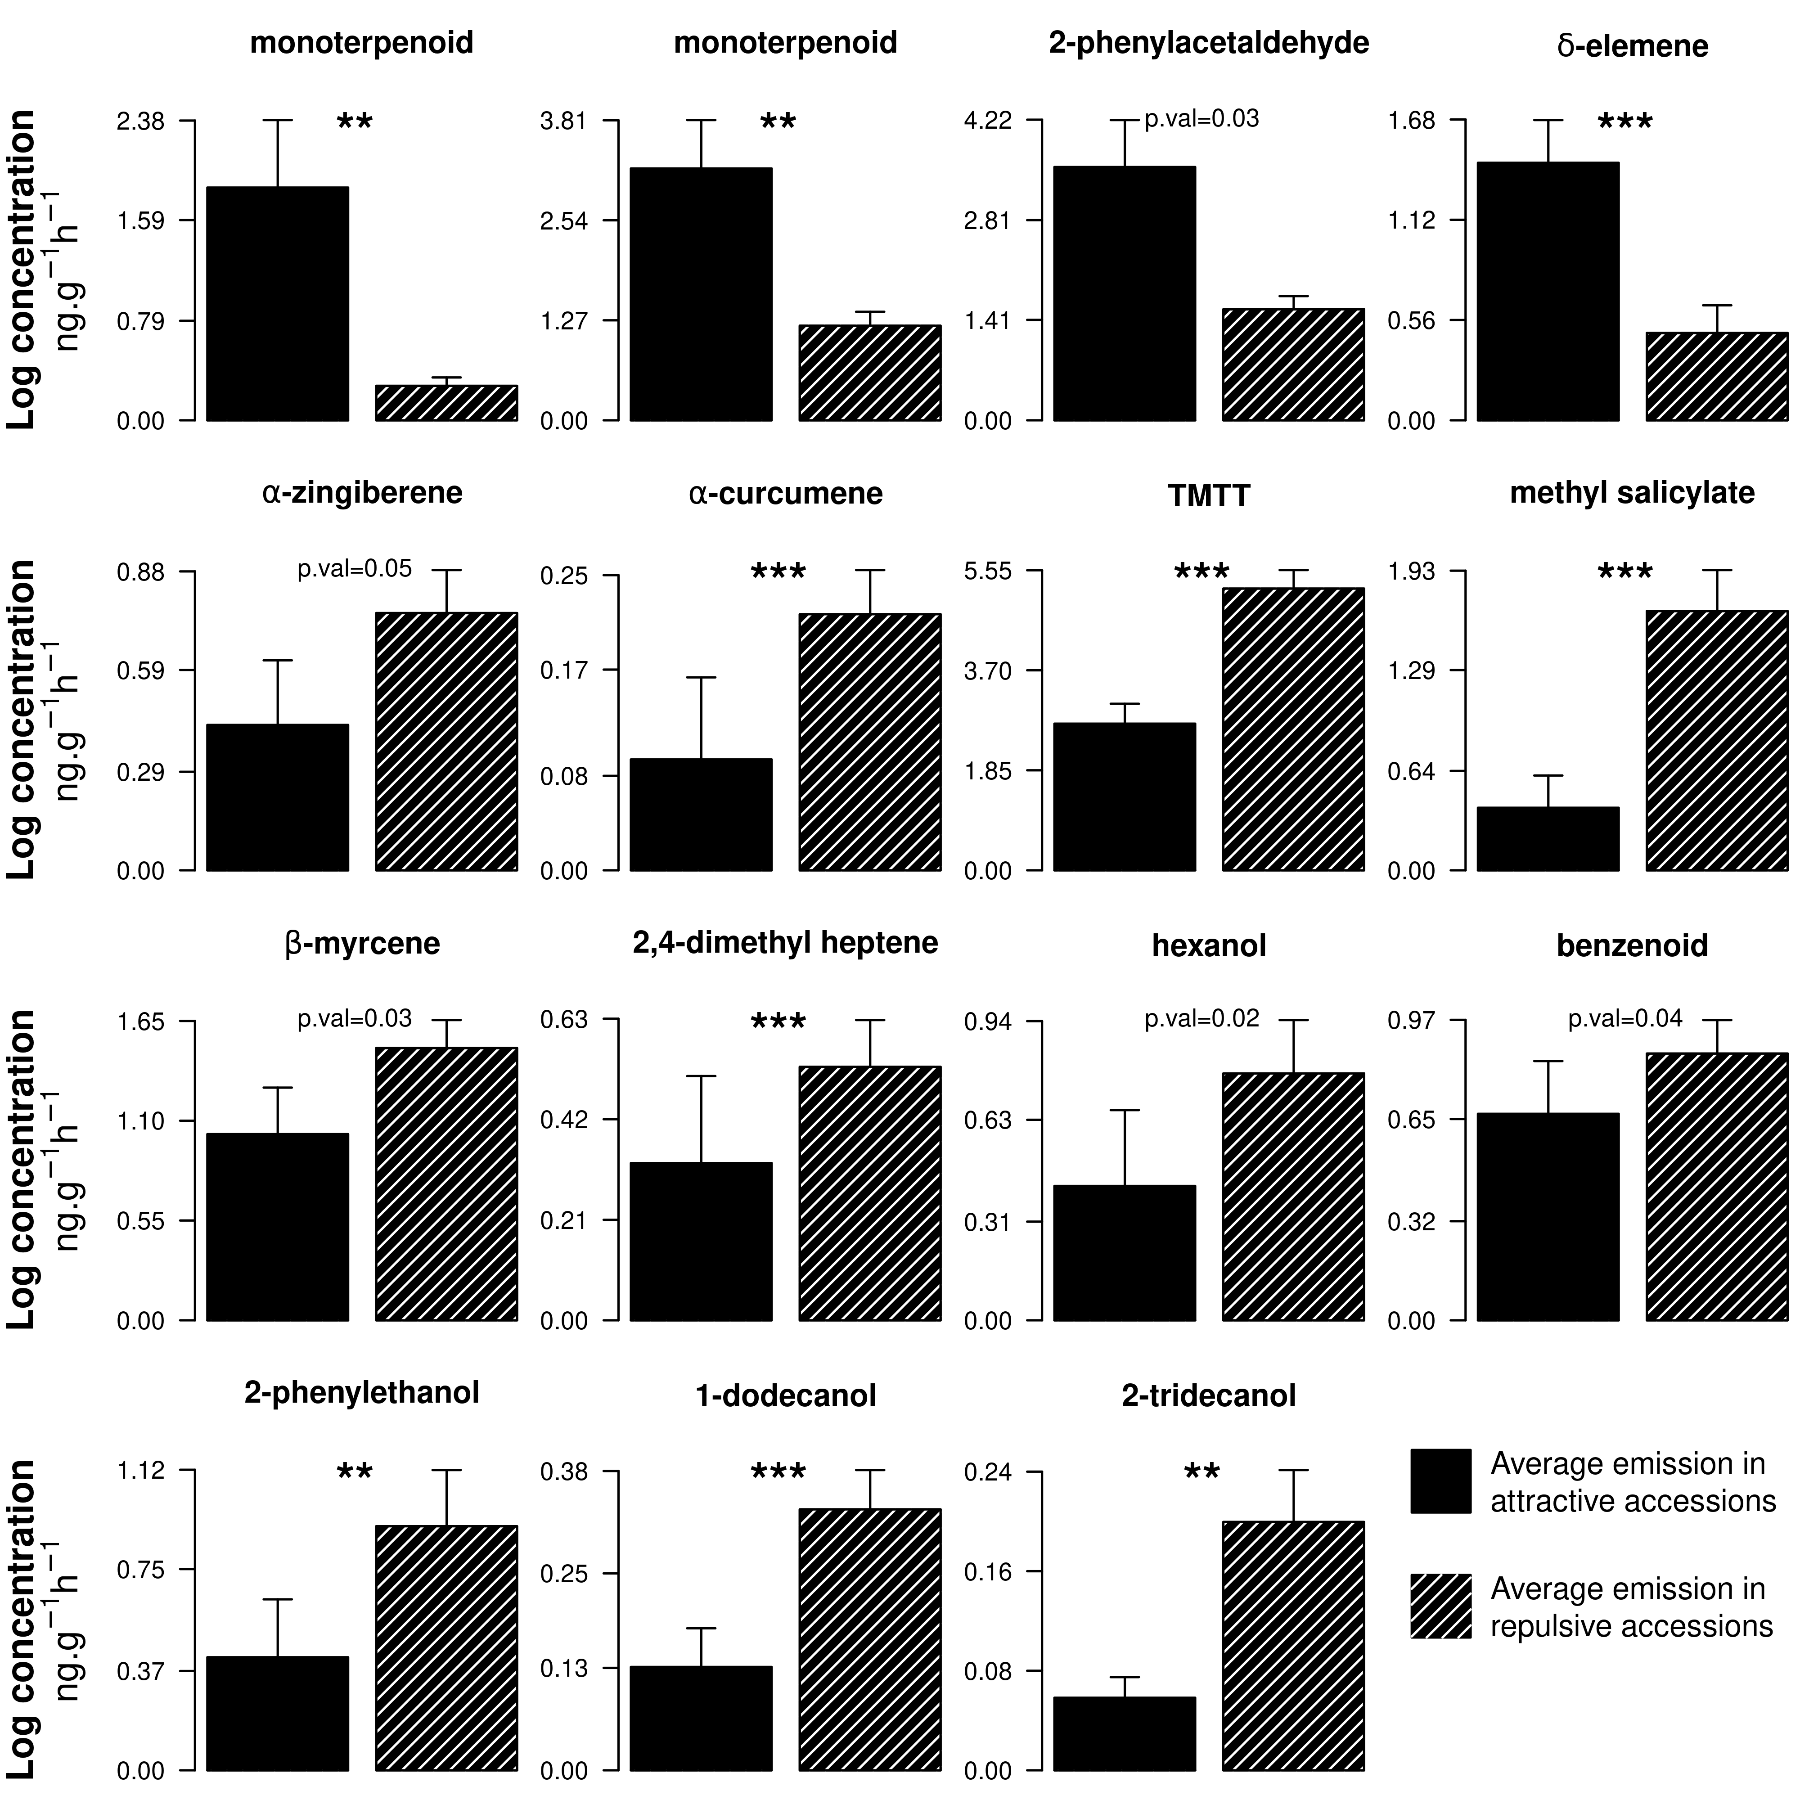
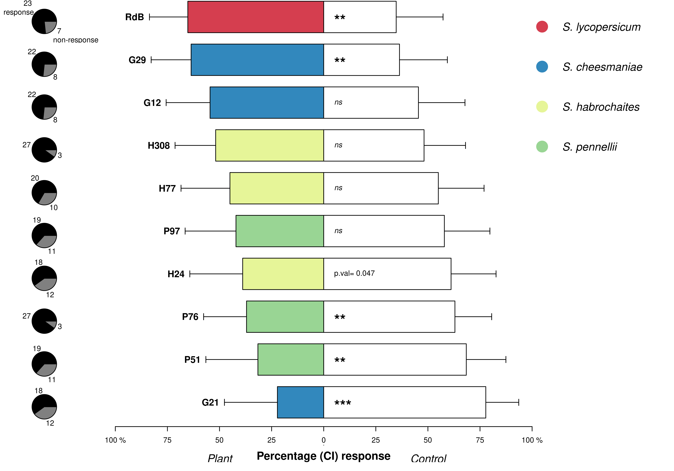
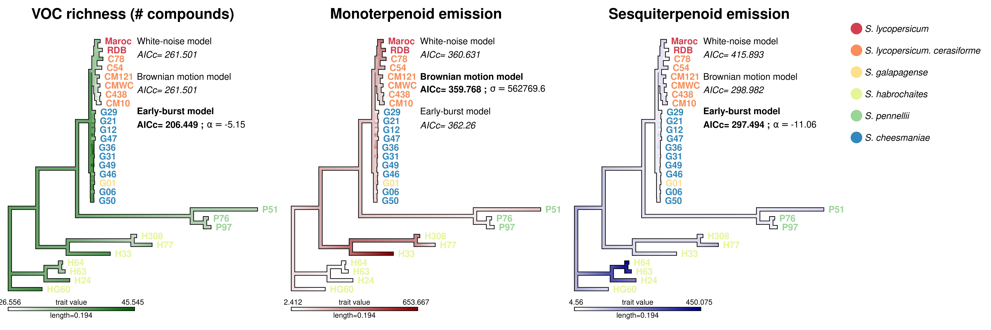







Phylogenetic drivers involved in the diversity of plant volatile profiles shape antixenosis resistance of tomato against Tuta absoluta
K. E. Amegan^{1,2,5}, Y. Fourati^{1,3}, R. Larbat^{1,4}, B. Caromel², AV. Lavoir ⁵, C. Robin¹, A. Kergunteuil¹*
¹Université de Lorraine, INRAE, LAE, F-54000 Nancy, France|²INRAE, GAFL, F-84140, Montfavet, France |³Institut National des Sciences Appliquées et de Technologie (INSAT), Université de Carthage, Tunisie|⁴Institut Agro, Université d’Angers, INRAE, IRHS, SFR QUASAV, F-49000 Angers, France |⁵Institut Sophia Agrobiotech, Université Côte D’Azur, UMR 1355, INRAE, F-06903 Sophia Antipolis, France
Background
Volatile Organic Compounds (VOC) released by plants mediate numerous ecological interactions. For instance, VOC shape antixenosis resistance since they repel/deters herbivore insects. Disentangling ecological and evolutionary sources of variation of VOC may help to elucidate the mechanisms supporting plant protection against pests. Here, we take benefit of the worldwide distribution of tomato to explore VOC diversity in plant lineages with a large range of local adaptations and, in turn, the consequences on plant resistance against a notorious pest, Tuta absoluta.
Objectives
1/ Compare VOC diversity released by 29 tomato accessions
- 5 species with different natural history and niche colonization patterns
- modern cultivars Vs wild species
2/ Study the relationships between VOC diversity and pest repulsion
- test correlations between VOC features and antixenosis
3/ Investigate the evolution of defensive features in VOC profiles
- conduct a phylogenetical approach to compare evolutionary models
Materials & Methods
S. lycopersicum : modern cultivars | S. habrochaites : wild species native from Peru and Ecuador | S. pennellii : wild species adapted to arid habitats of Andean regions
S. galapagense and S. cheesmaniae : wild species endemic from Galapagos
Phenotyping volatilome
266 plants at vegetative stage
Tenax TA - 30 min - 400ml/min
Volatile profile analyzed by GC-MS
Identification : NIST, PubChem
Phylogenetic analysis
DNA Sequencing method: Single Primer Enrichment Technology [1]
VCF file with only simple biallelic SNPs (3655 SNPs)
Phylogenetic tree: Maximum Likelihood in RAxML under the GTR + G model
Behavioral assay
Y- tube olfactometer
300 gravid females
10 accessions with divergent VOC profile
Results
Fig 1| Redundancy analysis of VOC profiles released by 29 tomato accessions
Dotted lines and coloured ellipses depict tomato accessions and species, respectively . Arrows depict loading scores for the 76 VOC detected
Fig 3| VOC with different emissions between attractive and repulsive accessions
Wilcoxon test : *** p.val <0.001 ; ** p.val<0.01
Fig 2| Behavioral response of T. absoluta females in a Y-shaped olfactometer
A dual choice between plants (coloured bar) and control (white bar) [3]
Exact binomial test : *** p.val <0.001 ; ** p.val<0.01 ; ns non-significant
VOC profiles vary with inter- and intra-specific diversity
The two species endemic from Galapagos Islands share similar profiles (S. cheesmaniae and S. galapagense)
Wild species : rich profiles with higher emissions of sesquiterpenoids [2]
Modern cultivars : poor profiles dominated by monoterpenoids
Among 76 VOCs, 15 compounds differ between attractive and repulsive accessions
Attractive accessions release monoterpenoids
Antixenosis resistance relies on sesquiterpenoids like α-zingiberene, α-curcumene [3] or TMTT.
Intra-specific variations of VOC affect pest behavior
2 attractive accessions including RdB (modern cultivar)
4 repulsive accessions among wild relatives : H24, P76, P51, G21
Ecological diversity of VOC arise from phylogenetic conservatism
‘Random-walk’ changes make monoterpenoid emissions proportional to the extent of shared ancestry
In line with adaptive radiation during plant-insect co-evolution [4], defensive features of VOC (richness, sesquiterpenoid) decrease exponentially with diversification
Fig 4 | Phylogeny of 29 accessions of tomato and evolutionary models of VOC richness, monoterpenoid and sesquiterpenoid emission
Take home messages
In opposition to convergent evolution, natural history and phylogenetic conservatism explain ecological diversity of tomato VOC profiles
In wild tomato, antixenosis resistance against T. absoluta relies on VOC richness and sesquiterpenoid emission
VOC-mediated plant defences are reduced in modern cultivars. This is in line with side-effects of domestication on natural plant defences [5]
Partnerships & Funding
References
[1] Barchi et al., 2019, [2] Bleeker et al., 2009, 2011
[3] Subramani et al., 2021,
[4] Ehrlich and Raven (1964) ; Fraenkel (1959),
[5] Fernandez et al., 2021
Contact
komla-exonam.amegan@inrae.fr

