Slide 1


Uncovering communities of pipelines
in the task fMRI analytical space
👤 Elodie Germani, Elisa Fromont*, Camille Maumet*
Univ Rennes, Inria, CNRS, Inserm
🌟 IEEE International Conference on Image Processing 2024
📍Abu Dhabi, Emirates
Notes:
Hi everyone, my name is Elodie Germani and today I’ll present you a project that I did during my PhD and which is entitled “Uncovering communities of pipelines in the task fMRI analytical space”.

Slide 2

Context
Notes:
During this project, we worked with functional MRI data.

Slide 3
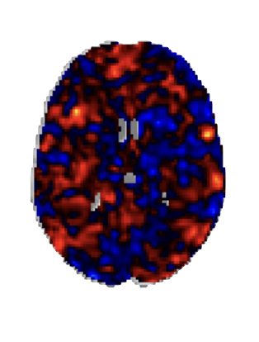
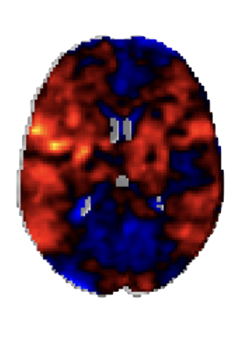
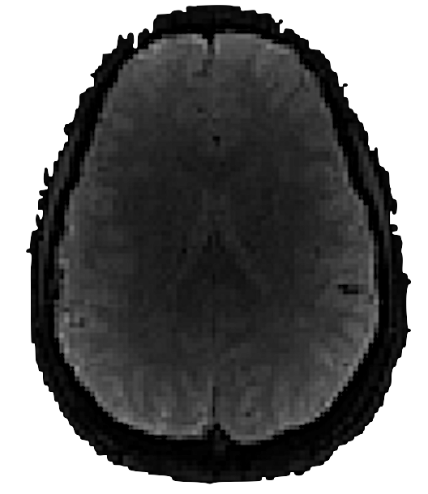
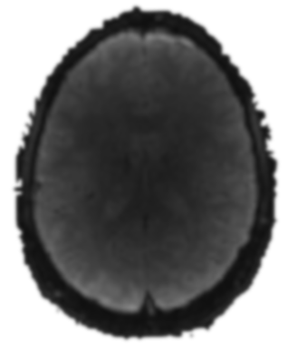
Context | How to analyze fMRI data?
Non invasive neuroimaging technique that studies brain activity
Preprocessing
Subject-level statistical analysis
Group-level statistical analysis
Raw data
Preprocessed data
Subject-level statistic maps
Group-level statistic maps
Notes:
fMRI is a neuroimaging technique that is used to explore brain activity, in particular by doing activation studies.
In these studies, raw data are analyzed with what we call a pipeline.
These pipelines are composed of 3 main steps:
first, we preprocess the raw data (which are the data obtained directly after the acquisition) to remove artefacts and standardize the data between participants
then, we perform a subject-level statistical analysis using a general linear model to compute the statistical map of individual brain activity. In these maps, the red parts corresponds to the areas of the brain detected as activated.
if we repeat these two processes for multiple participants, we can perform a second level of statistical analysis, called group-level

Slide 4



Context | High flexibility of analysis pipelines
Different
algorithms
Different
software packages
Different
computing environment
Order of steps, parameters value, etc.
FSL, SPM, AFNI, etc.
Software version, Operating system, etc.
Notes:
And, at each step, researchers have to make choices because fMRI pipelines are highly flexible.
Each step can be performed using different algorithms which sometimes need to be parametrized
These algorithms are implemented in several software packages
And pipelines can be executed in various computing environment.

Slide 5
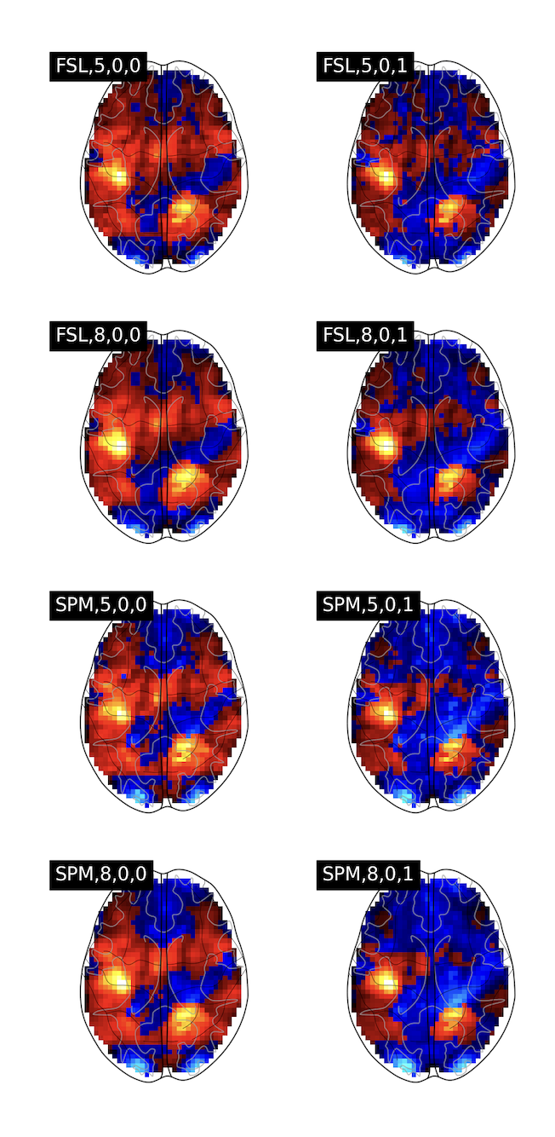
Context | Analytical variability
Variations in the results with different protocols and methods
FSL,5,0,0
FSL,5,0,1
SPM,5,0,0
SPM,5,0,1
FSL,8,0,0
FSL,8,0,1
SPM,8,0,0
SPM,8,0,1
There is no ground-truth that can be used to validate pipeline results
(Botvinik-Nezer et al., 2020)
Notes:
And the main problem, and our topic of interest, is that a single change in the way we analyse raw data can lead to variations in the final statistic maps. This is what we call analytical variability.
Here we can see for instance statistic maps obtained from the same raw data but analyzed with 8 different pipelines.
Statistic maps can be different depending on the pipeline and we thus have a multiplicity of results for a single study.
And in fMRI, we don’t have any ground-truth statistic maps that can be used to benchmark pipeline results.

Slide 6
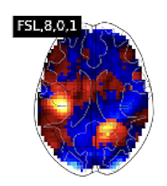
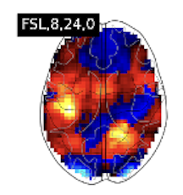

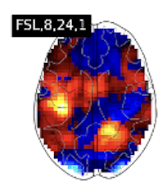



Context | Challenge
What are the factors that drives relationships between pipelines results?
Are relationships between pipelines results stable across different contexts?
Pipeline A
Pipeline B
Distant
Close
Distant
Pipeline C
Different tasks?
Different groups?
Notes:
Thus, it is necessary to better understand the properties of analytical variability to build solutions to mitigate its effect.
Indeed, we don’t really know which changes in the pipelines will make the results of a pipeline A far from those of a pipeline C, whereas pipeline B will give results that are close to those of pipeline C. This is the first question that we try to answer in this contribution.
Also, we have very few knowledge on the stability of those relationships.
For instance, relationships between pipeline results might be like this graph for one study context, so for a specific task and group of participants.
But we don’t know if these relationships will remain the same if we explore statistic maps from another task, or another group of participants. And this is the second question that we’re going to explore in this project.

Slide 7
Materials & Methods
Notes:
To answer these two questions, we used a multi-pipeline dataset that we built ourselves.

Slide 8



Materials | HCP multi-pipelines
Human Connectome Project Young Adult (Van Essen et al., 2013)
1,080 individual participants
1,000 groups
of 50 randomly sampled participants
5 paradigms of the motor task
Right-hand
Left-hand
Right-foot
Left-foot
Tongue
Notes:
In particular, we used the raw fMRI data from the Human Connectome Project to have access to large number of tasks and participants.

Slide 9


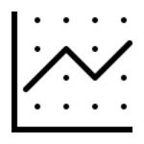

Materials | HCP multi-pipelines
Software package
Smoothing
HRF derivatives
Motion regressors
FSL
SPM
FWHM
5mm or 8mm
Use or not
0, 6 or 24
Preprocessing
Subject-level analysis
24 different pipelines
Notes:
Based on the previous litterature, we chose to apply 24 pipelines on these data and these pipelines vary on different aspects:
- Different software packages
- Different smoothing kernel which is a parameter related to the preprocessing
- And two parameters related to the general linear model used for the first-level statistical analysis.

Slide 10
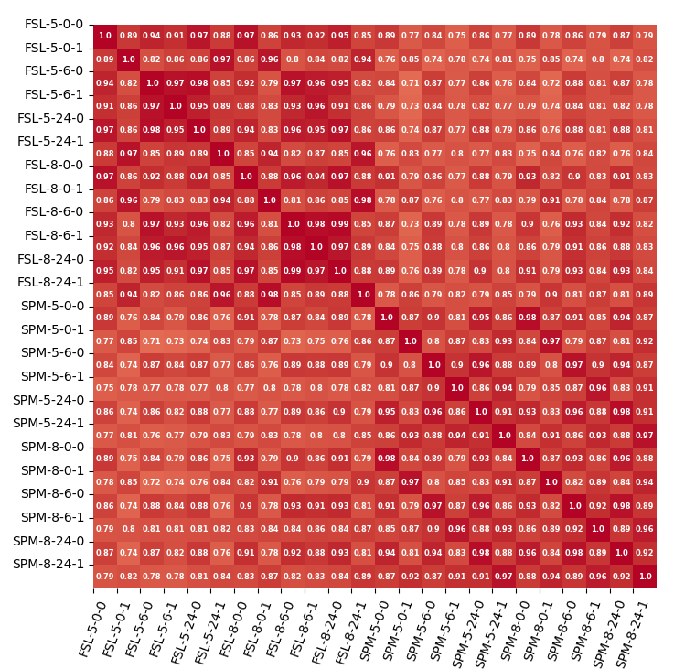
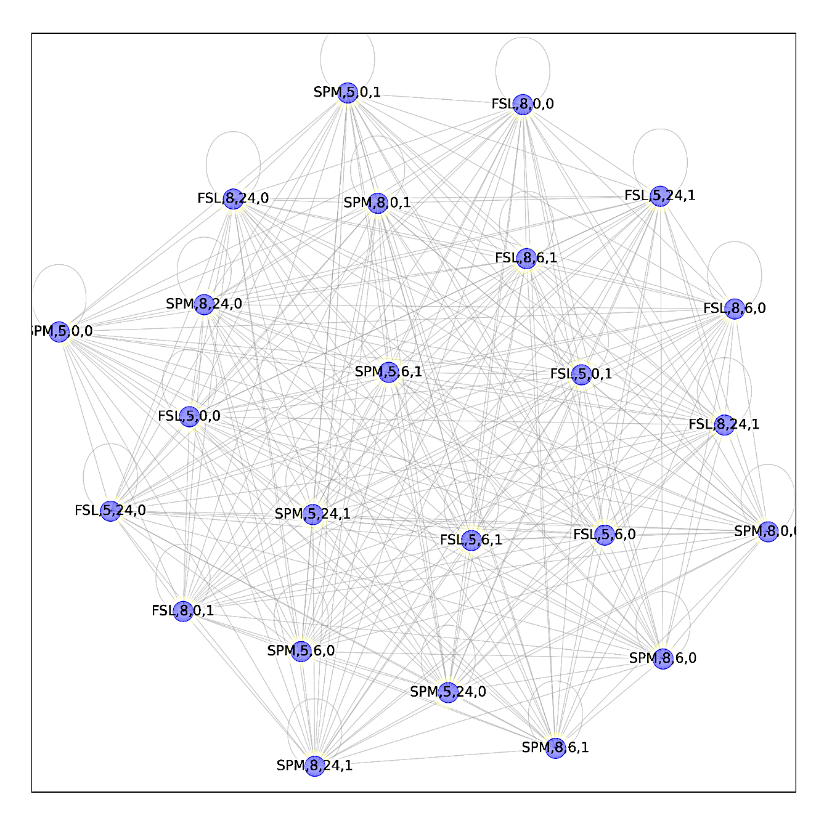
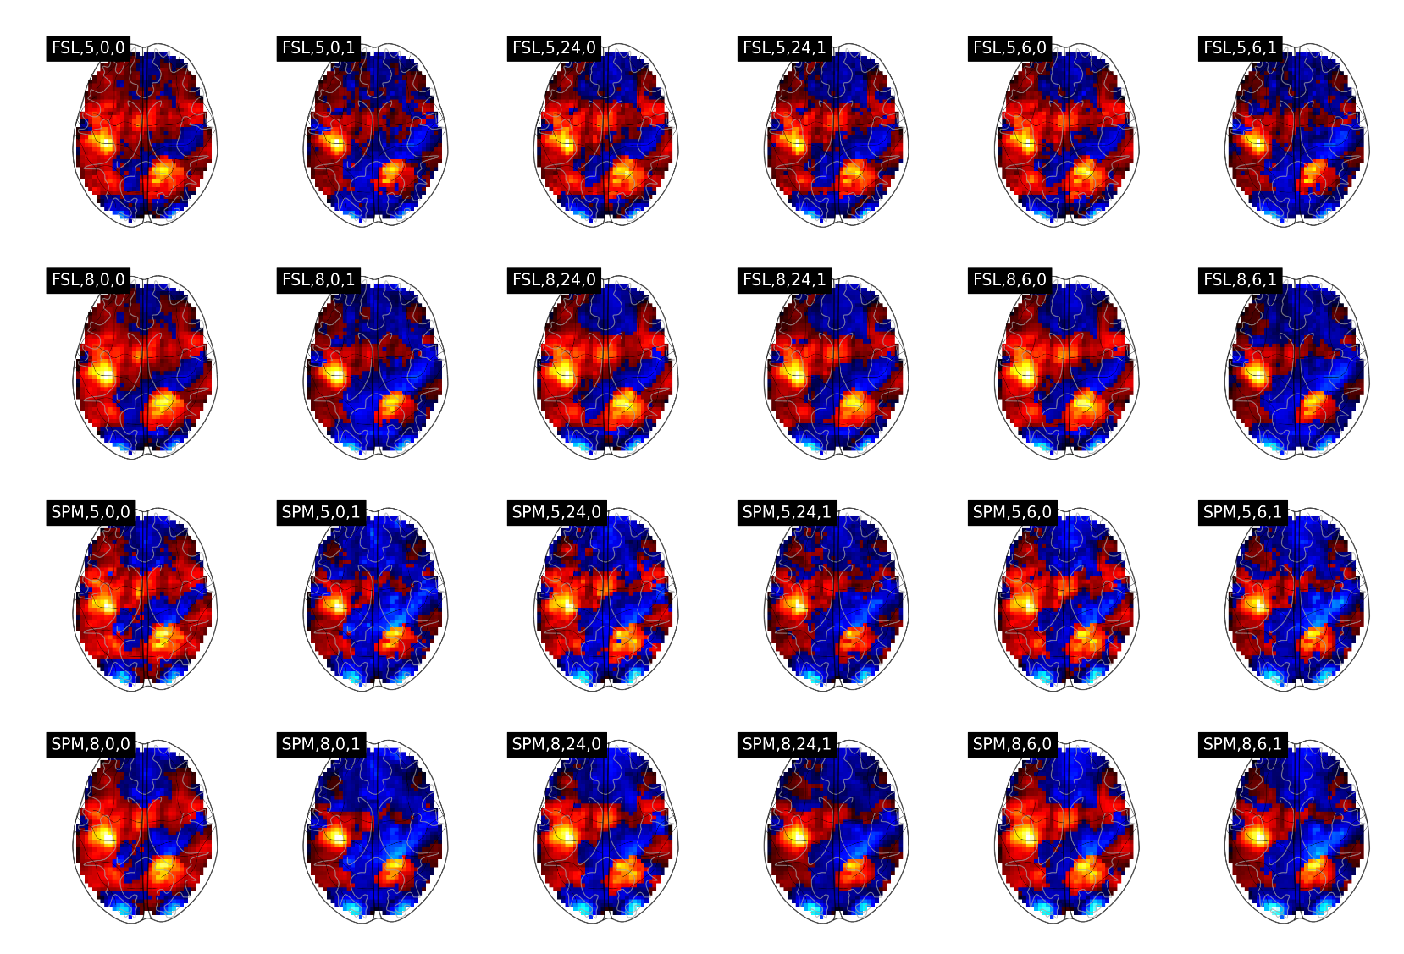
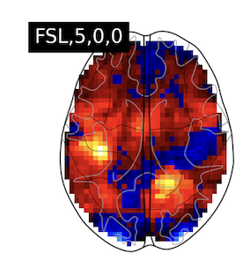
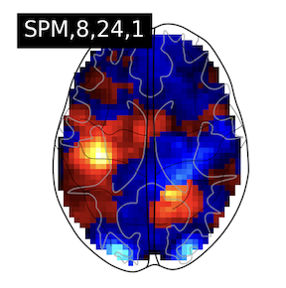
Methods | Pipeline communities
1
Modelling relationships between pipeline results
FSL,5,0,0
FSL,5,0,1
FSL,5,24,0
FSL,5,24,1
FSL,5,6,0
FSL,5,6,1
FSL,5,0,0
SPM,8,24,1
0.79
Pearson’s
correlation
FSL,8,0,0
FSL,8,0,1
FSL,8,24,0
FSL,8,24,1
FSL,8,6,0
FSL,8,6,1
SPM,5,0,0
SPM,5,0,1
SPM,5,24,0
SPM,5,24,1
SPM,5,6,0
SPM,5,6,1
Graph representation
Nodes: all pipelines
Edges: between all nodes,
weighted by correlations
SPM,8,0,0
SPM,8,0,1
SPM,8,24,0
SPM,8,24,1
SPM,8,6,0
SPM,8,6,1
Group 1
Task A
Notes:
To answer our different questions, we used a 3 steps methodology.
First, we needed to model the relationships between pipeline results in a given study context, so for a single task and group. We wanted to have more quantitative ideas on the similarity of the results.
Thus, we built correlation matrices where each box corresponds to the pairwise correlation between statistic maps of each pair of pipeline for the study context.
Here, for instance, 0.79 corresponds to the similarity between the maps of pipeline FSL 5 0 0 and SPM 8 24 1 for the same study context.
We then transformed these correlation matrices into a graph where each node corresponds to a pipeline and all nodes are connected to each other with edges weighted by the correlation computed in the initial matrice.

Slide 11
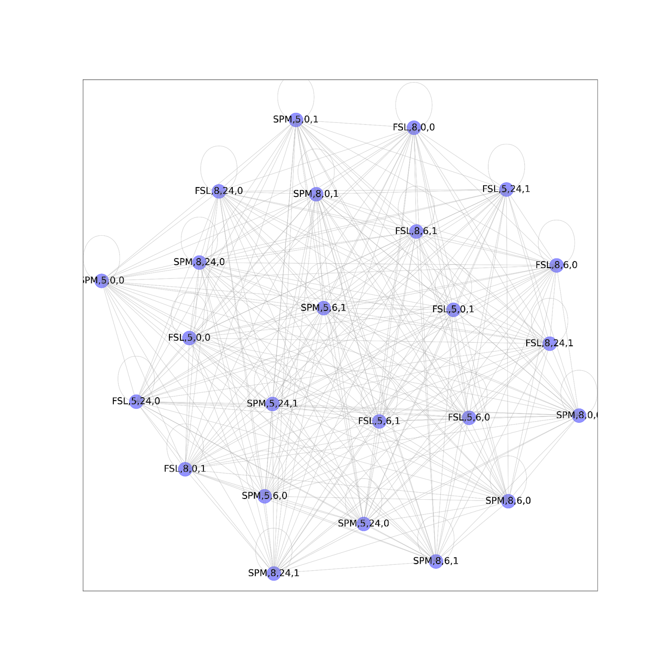
Methods | Pipeline communities
2
Finding groups of pipelines giving similar results
Louvain algorithm
(Blondel et al., 2008)
Group 1
Task A
Notes:
These graph representations are often used to study relationships. And in our case, it allowed us to use specific techniques to answer our first questions about the factors that drives relationships between pipeline results.
Since we wanted to know which parameters were leading to close or distant results, we used community detection algorithms to identify groups of pipelines that give similar results. In graphs, communities corresponds to groups of nodes that are highly related with each other but not with the rest of the graph.
In this study we used Louvain algorithm, and it allowed us to see in each study context which pipelines were leading to close results and what were the common parameters of these pipeline.

Slide 12
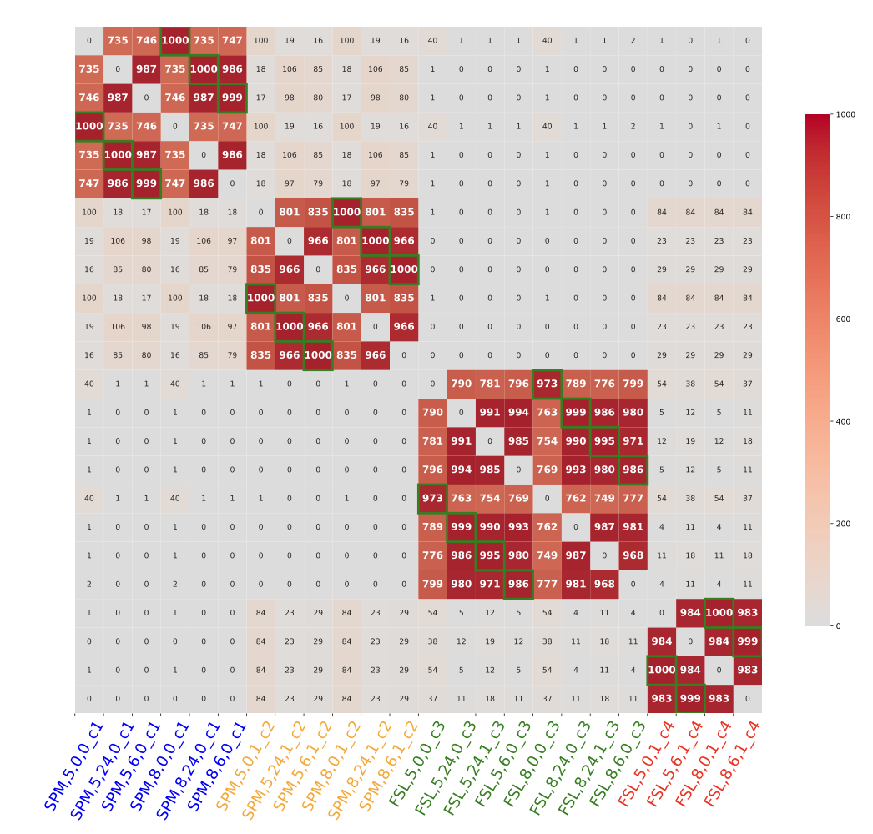
Methods | Pipeline communities
N. of groups in which the two pipelines were identified in the same community
High number → High stability
3
Comparing these groups in different contexts
Task A
…
…
→ Stability bw. tasks
Group 1
Group 1,000
→ Stability bw. groups
Notes:
However, it’s possible that these relationships and thus, the driving parameters, might be different between study contexts.
We thus compared the communities identified in different study contexts to answer our second research question on the stability of relationships.
First, we explored whether the communities were similar across the 1000 groups of participants, but within the same task. So we iterated step 1 and 2 for the statistic maps of each group for the same task. Then, we computed an occurrence matrix in which each value correspond to the number of groups of participants for which a pair of pipeline has been identified in the same community at step 2.
If this number is high, this means that across the different groups of participants, pipelines were often giving close results, and thus that their relationship is stable across groups.
And to study the stability across tasks, we built these occurrence matrices but with different tasks and compared the matrices obtained.

Slide 13

Results

Slide 14
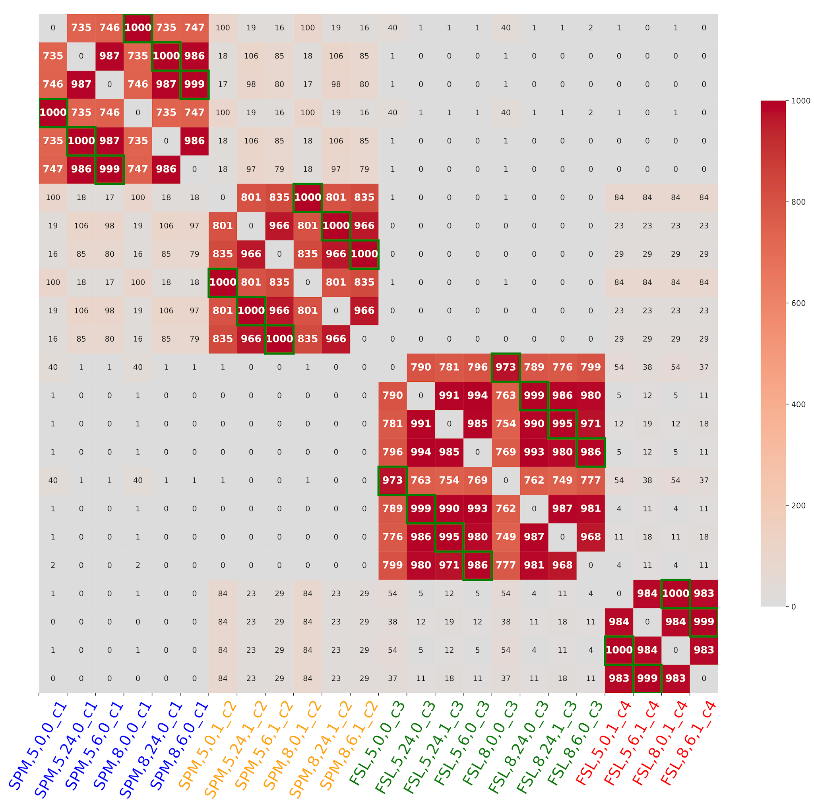
Results | Right-hand communities
Right-hand
Notes:
So, here are the results we obtained for the right-hand task. Different colors corresponds to different communities.
We can see that, on average, for this task, pipelines are grouped into 4 communities and pipelines seems to be grouped in the communities based on the software package and the HRF modeling used in the GLM.
And the number of co-occurence of pipelines is high, meaning that relationships between pipeline results are stable across groups for this tasks.
This can make us think that for this task, pipelines with the same software and same modeling of the HRF would give similar results regardless of the group of participant.

Slide 15
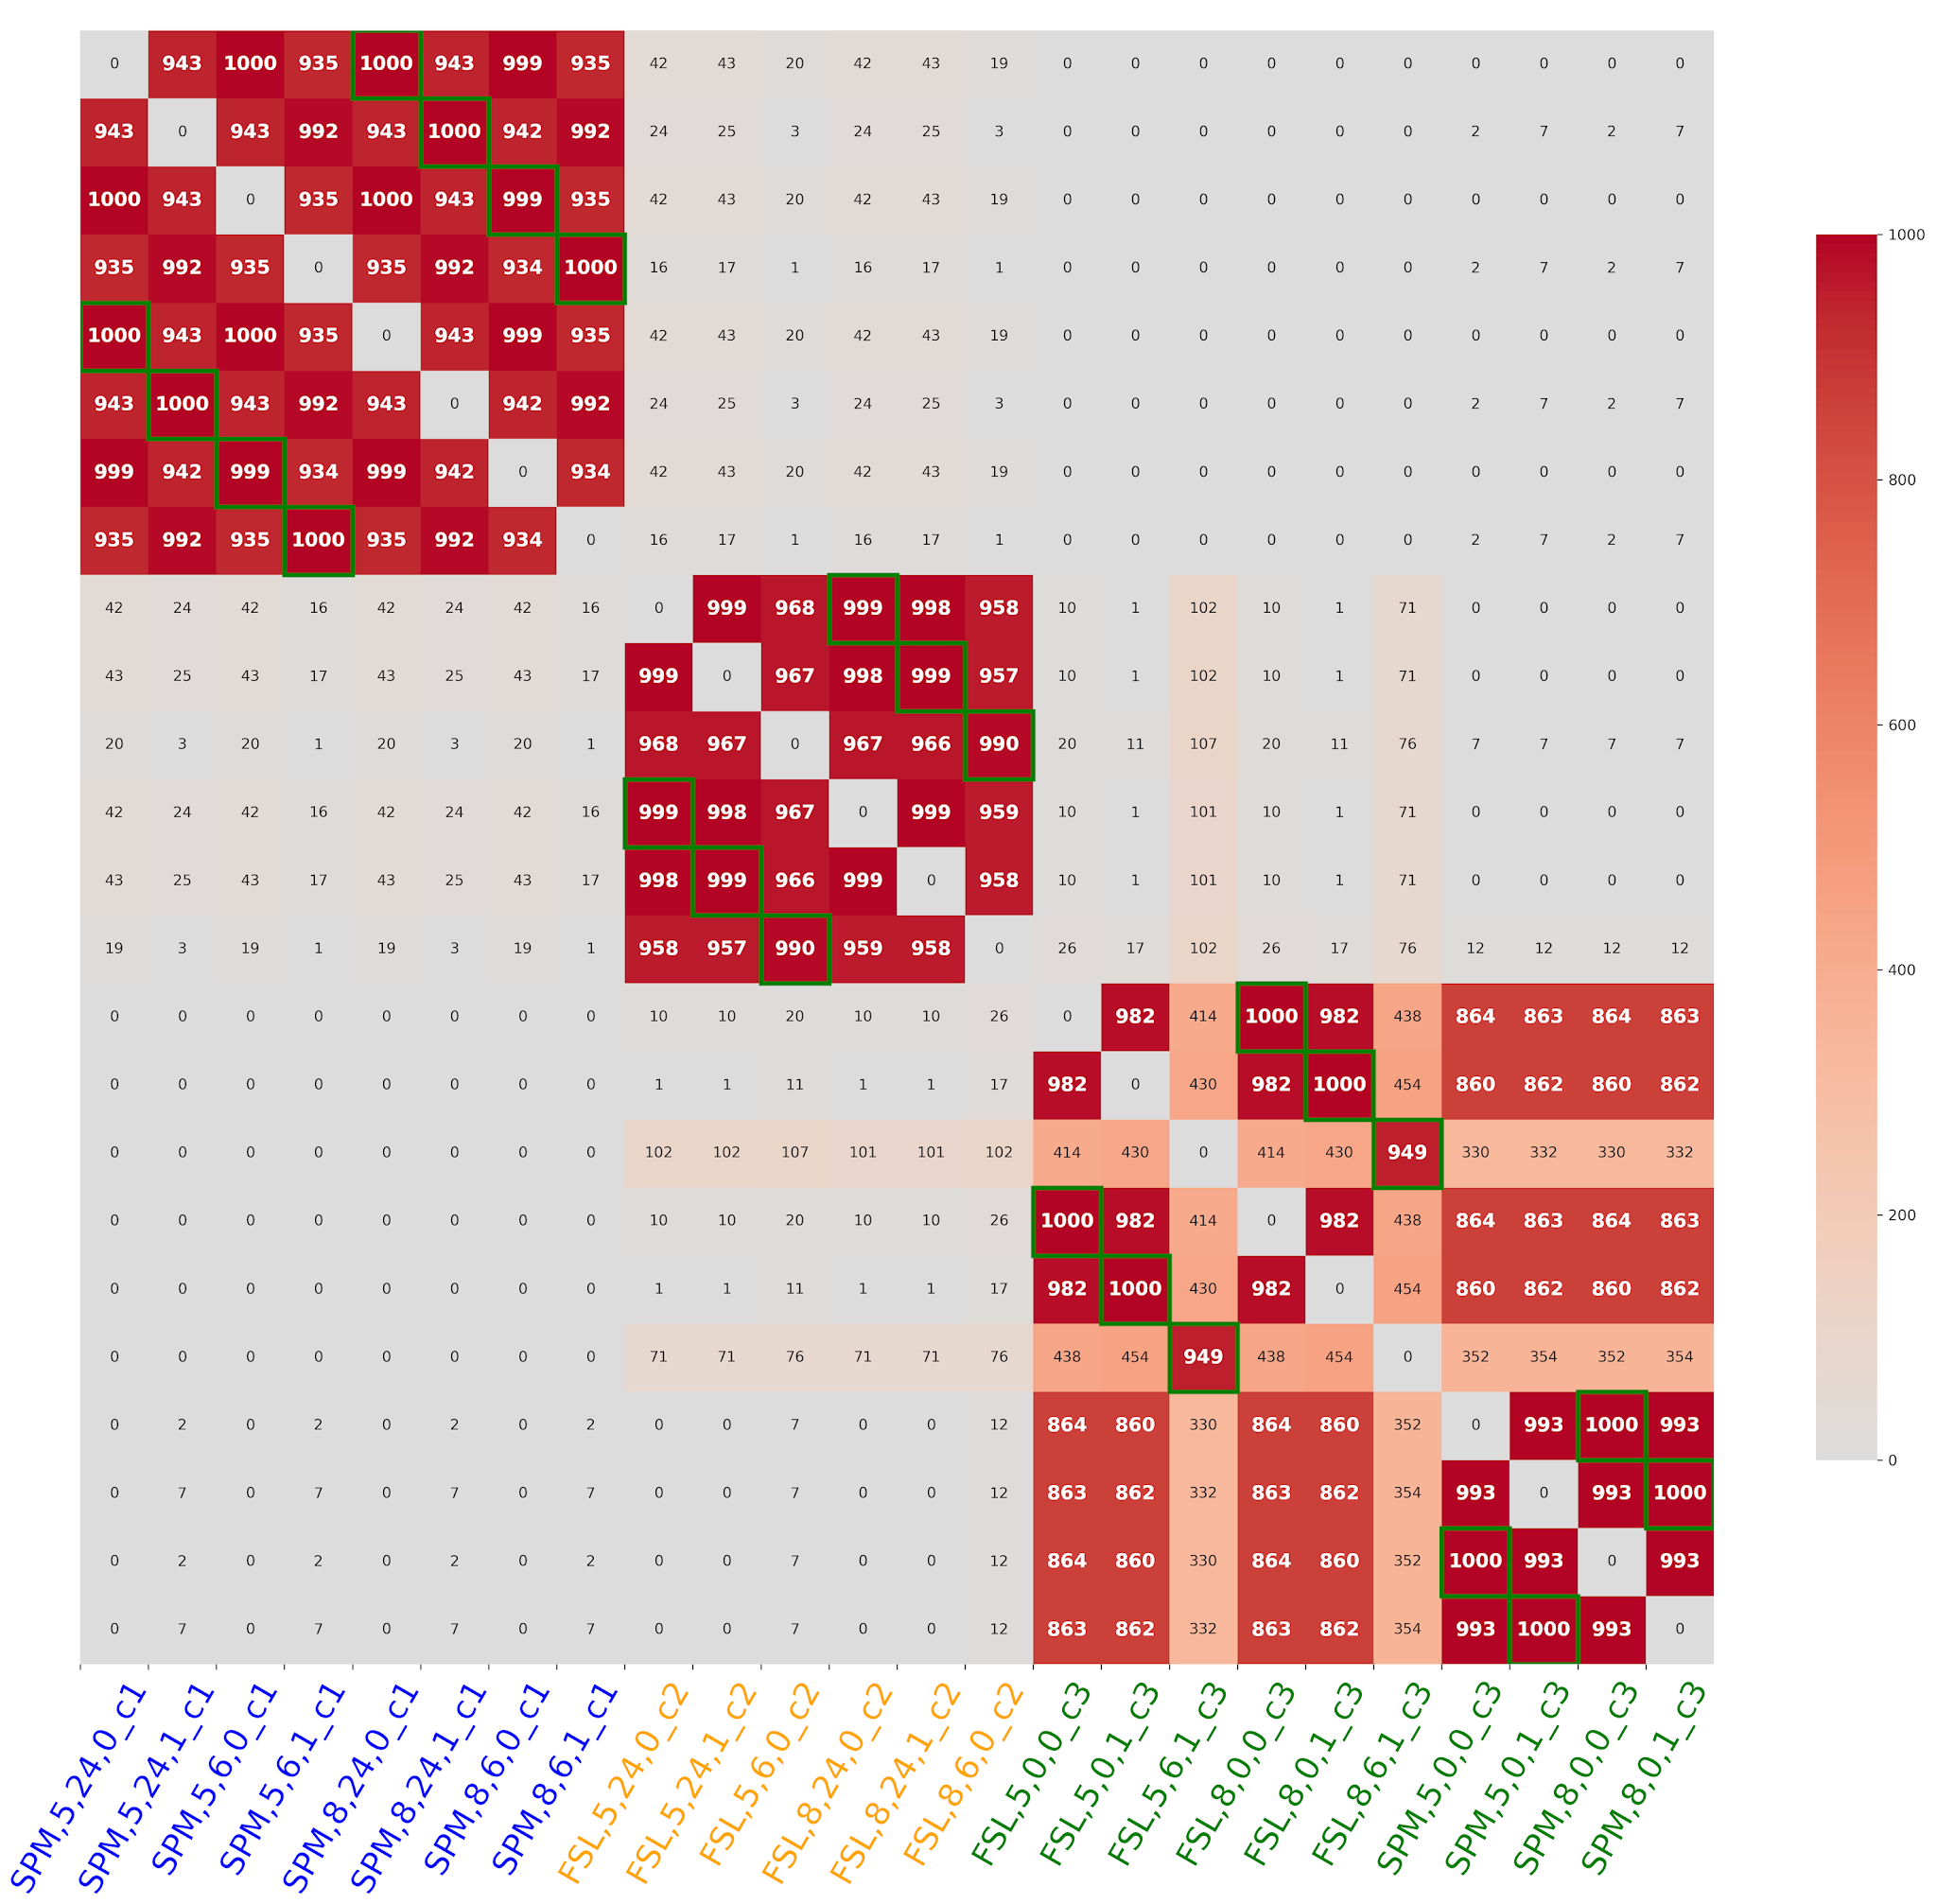
Results | Right-foot communities
Right-foot
Right-hand
≠
Notes:
However, we can see that for the right-foot task, this time, pipelines are on averaged grouped in only 3 communities and the driving parameters seems to be the number of motion regressors.
This leads us to think that relationships between pipeline results are not stable across different tasks: two pipelines with the same HRF will give similar results in the right-hand task, but not for the right-foot task.

Slide 16
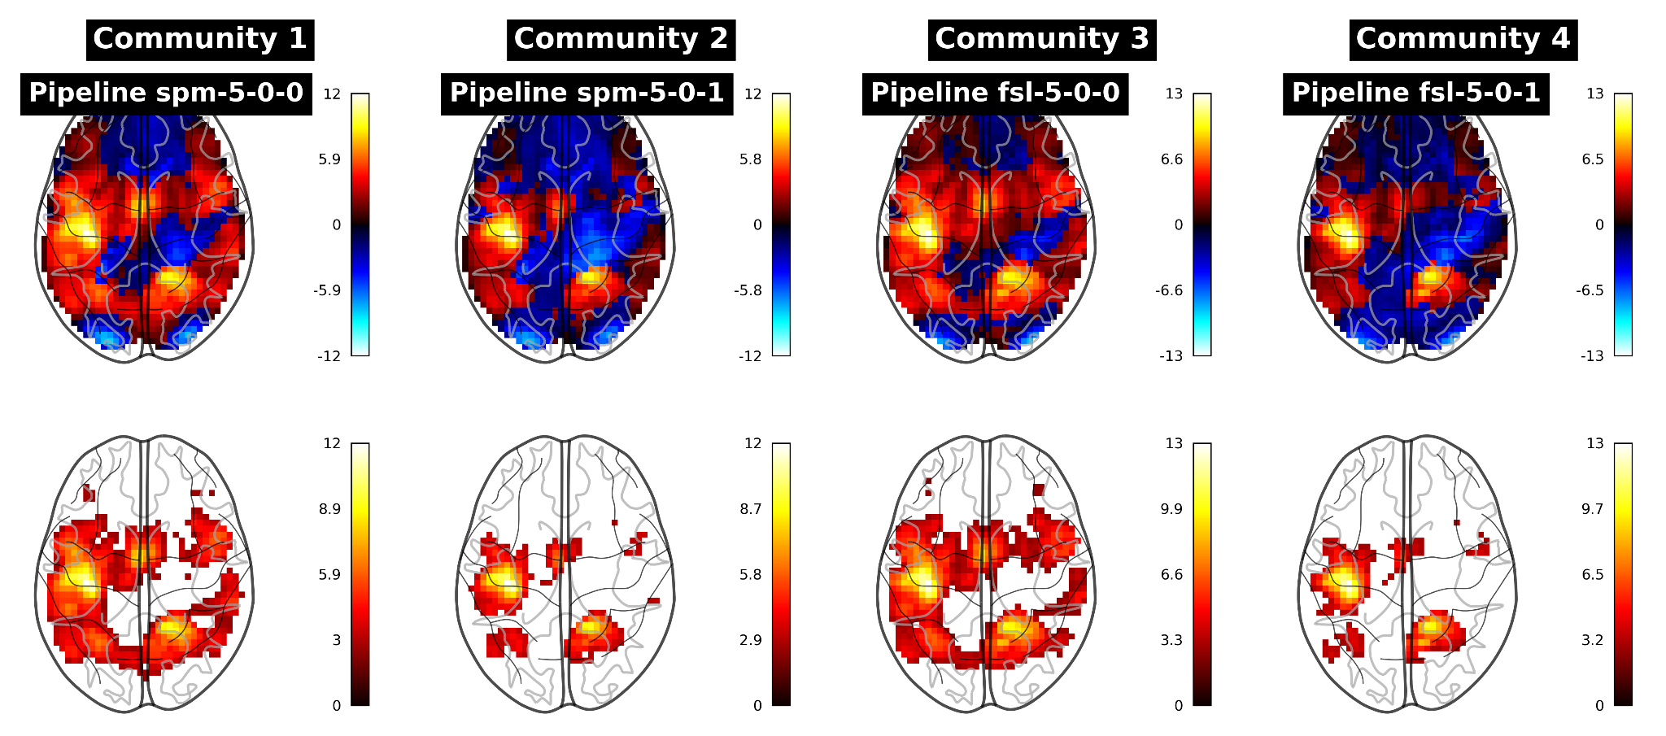
Results | Activation patterns in communities
Large activation areas
Right-hand
Small activation areas
Notes:
To better understand what was making the statistic maps of the pipelines in the different communities so different, we computed mean statistic maps of pipelines across groups and compared the maps of a representative pipeline for each community.
We can see that some parameters seem to lead to larger activation areas than other, leading to more sensitivity.

Slide 17

Conclusions

Slide 18

Conclusions
✓ Pipeline relationships can be variable across tasks
✓ Pipeline parameters can have a different impact on results depending on the task
? Robustness to dataset shift of potential solutions to mitigate analytical variability
Uncovering communities of pipelines in the task fMRI analytical space.
Elodie Germani, Elisa Fromont, Camille Maumet
2024 IEEE International Conference on Image Processing (ICIP), Abu Dhabi, United Arab Emirates, 2024, pp. 3044-3050.
⟨10.1109/ICIP51287.2024.10647701⟩
Notes:
To conclude on this project, we explored the relationships between pipeline results to give more insights into the properties of analytical variability.
We found that pipelines parameters can have a different impact on results depending on the task, and this impact is mostly related to the sensitivity of the analysis.
While this is helpful for researchers to give them guidelines on how to choose their pipeline, it also question the potential generalizability of solutions that start to be developed to mitigate analytical variability.
Thank you for your attention, and if you have any question, feel free to ask them, or you can also have a look at the paper !

