Slide 1
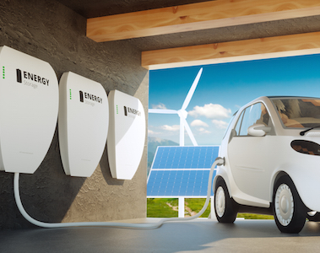
Economics of Electric Mobility: Utilities and Electric mobility
Yannick Perez
CentraleSupélec – University Paris-Saclay
Yannick.perez@centralesupelec.fr

Slide 2
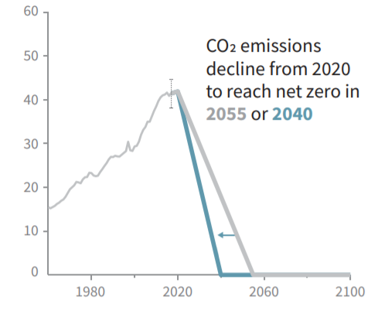
The need for decarbonization
The need for electric vehicles
Carbon neutrality needed by 2050 to limit global warming by 1,5°C*
Stylized pathway of global CO2 emissions compatible with 1,5°C scenario
GHG emissions in EU-28, 2019
IPCC 2018, Summary for policy makers. In: Global Warming of 1.5°C[…]
Own elaboration, data from Eurostat, EEA

Slide 3
EV sales are starting

Slide 4
Why?

Slide 5
Why the sales are booming?
1. Cost of the battery is going down
2. Industrial strategies of car manufacturers
3. Charging infrastructures are the week point
4. Innovations are about to come and challenges utilities around the world

Slide 6
1. Evs enjoy a Double dynamic: Increase in ENERGY DENSITY & decrease of COST
Source: IEA Global EV Outlook 2016
Notes:
Battery costs dropped from 1000$/kWh in 2008 to 268$/kWh in 2015
DOE target: 125$/kWh in 2022
GM: 145$/kWh in 2016 (Chevrolet Bolt), 100$/kWh by 2022
Tesla: 100$/kWh by 2020

Slide 7
Why the sales are booming?
1. Cost of the battery is going down
2. Industrial strategies of car manufacturers
3. Charging infrastructures are the week point
4. Innovations are about to come and challenges utilities around the world

Slide 8
Less cost => more stored energy / car

Slide 9
More « good cars » offers

Slide 10
Real good cars

Slide 11
Why the sales are booming?
1. Cost of the battery is going down
2. Industrial strategies of car manufacturers
3. Charging infrastructures are the week point
4. Innovations are about to come and challenges utilities around the world

Slide 12
Minimum charging infrastructures allows to start equipment
House
Work
Charging station
Public domain
During travel
Shopping time
7 logical options to charge but 95% of the charging is made at home
but a lot seems to be needed elsewhere to secure the EV buyer

Slide 13
The world leader is private

Slide 14
The followers are private and locals

Slide 15
And Public Investments are also displayed

Slide 16
But

Slide 17
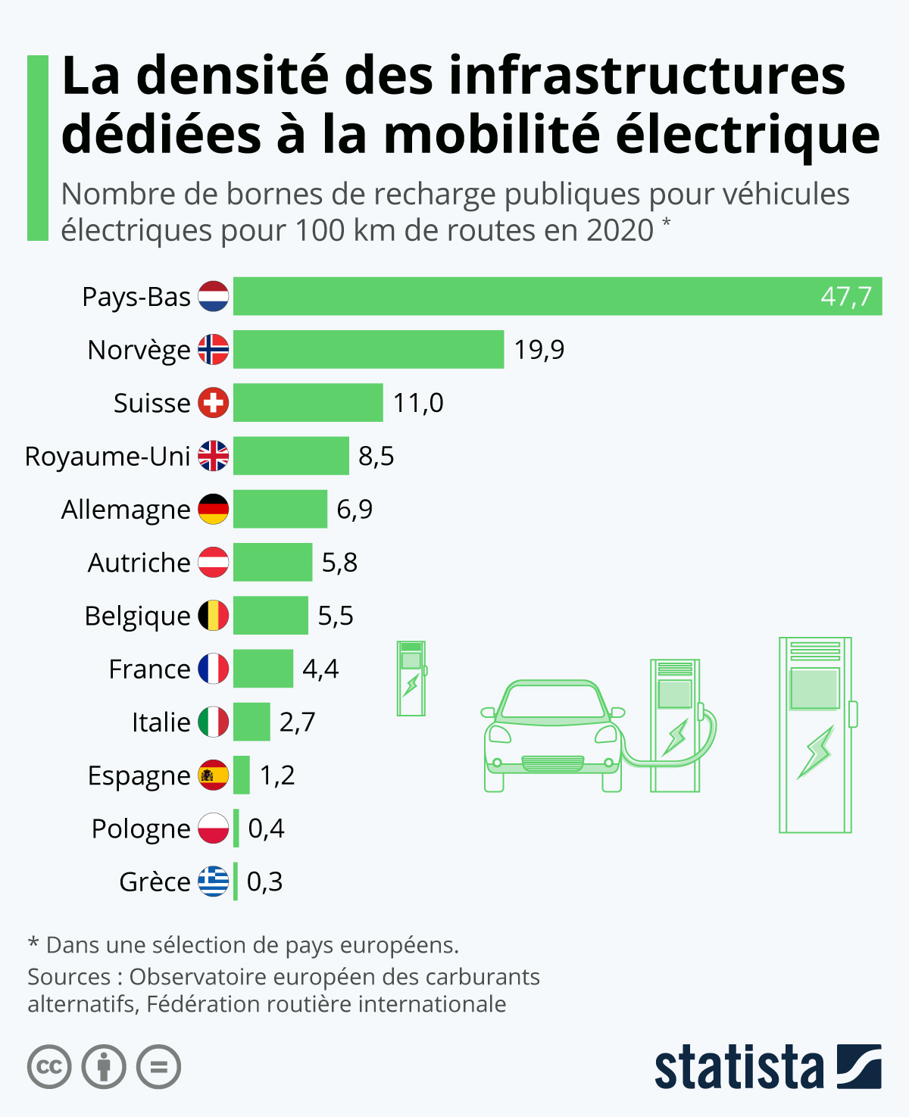

Slide 18
Why the sales are booming?
1. Cost of the battery is going down
2. Industrial strategies of car manufacturers
3. Charging infrastructures are the week point
4. Innovations are about to come and challenges utilities around the world

Slide 19
Electric cars Store more energy than they daily use
Size of the battery goes from 24 to 100 kWh
EV consumes 15-20 kWh per 100 km
EU- USA Mean Drivers Daily trips/day is between 24 km -40 km

Slide 20
Electric cars store more energy than they daily use
Size of the battery goes from 24 to 100 kWh
EV consumes 15-20 kWh per 100 km
EU- USA Mean Drivers Daily trips/day is between 24 km -40 km
EVs are very flexible resources (to store or deliver electricity) if needed = Distributed Storage Services (DSS)

Slide 21
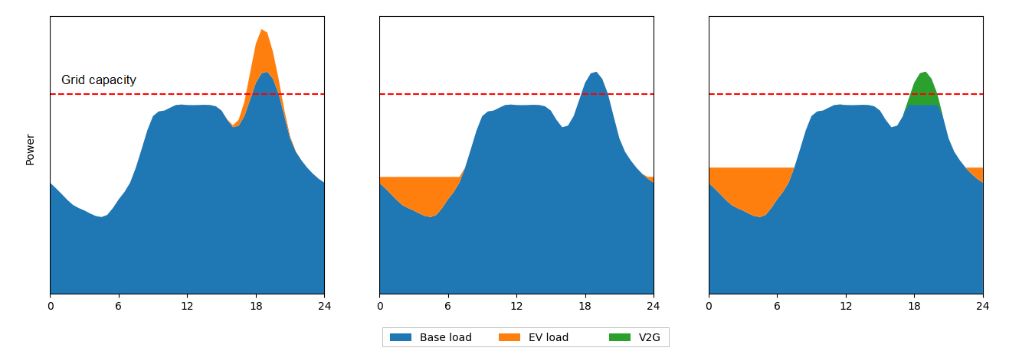
What is flexibility from EVs?
Ability to adapt the (dis)charging pattern of the EV
Many uses, for different stakeholders:
For end-users: optimizing electricity bill, self-consumption
For the whole system: frequency response, energy arbitrage
For distribution systems: congestion management, voltage regulation, fault-restoration, investment deferral
Uncontrolled
Smart charging
V2G
Grid capacity
Power

Slide 22
Electric cars save more energy than they daily use
Size of the battery goes from 24 to 100 kWh
EV consumes 15-20 kWh per 100 km
EU- USA Mean Drivers Daily trips/day is between 24 km -40 km
EVs are very flexible resources (to store or deliver electricity) if needed = Distributed Storage Services (DSS)
Arbitrage between private use (house-building) or other flexibility buyers of DSS (Energy markets / grids)

Slide 23
And after first life for mobility ?
Options are :
With 80% capacity : re-use for another usage like energy service provision = Ajax Amsterdam ARENA

Slide 24
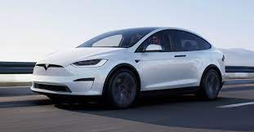
And after first life for mobility ?
Options are :
With 80% capacity : re-use for another usage like energy service provision = Ajax Amsterdam ARENA
Or battery material be directly recycled for car Use. Each car manufacturer want it’s own supply chain

Slide 25
New OEM constraints

Slide 26
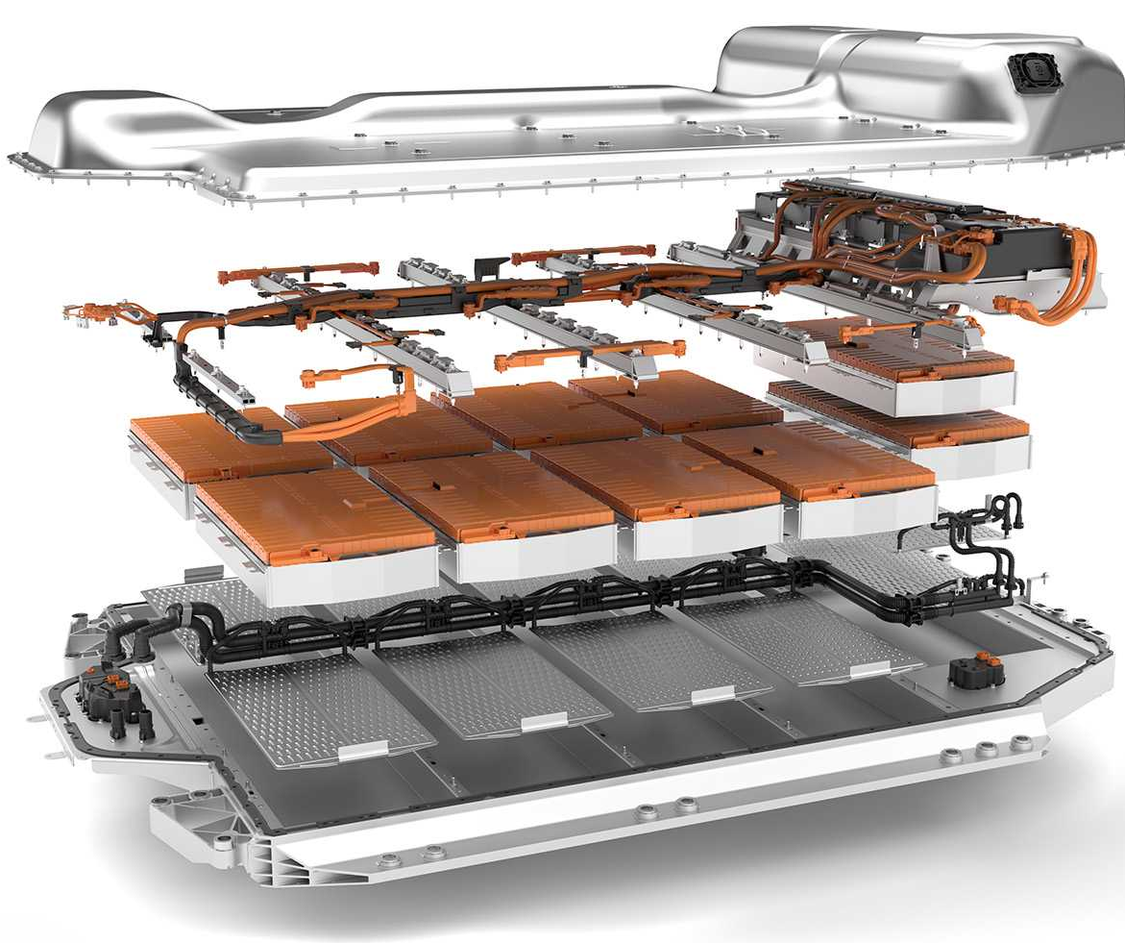
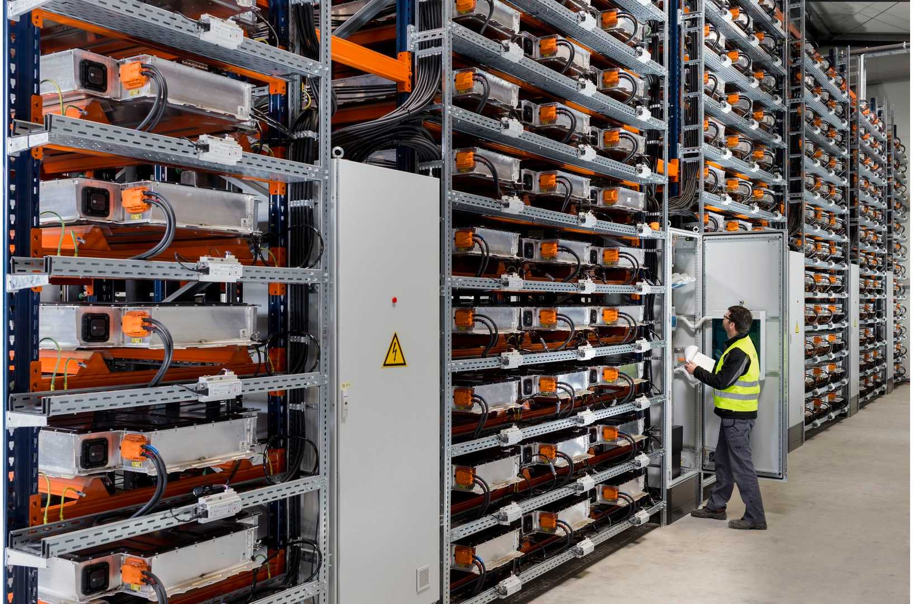
BMW

Slide 27
And EU Regulations ?

Slide 28
And EU Regulations ?

Slide 29
Conclusions
We need to work on many issues and many different directions
Car's technologies need to be improved in many ways
Infrastructures providers need to by displayed at the right place, with the good power level for the needed use, in a timely manner…
Governments regulations need to accommodate EV innovations in power system, and mobility systems…
Academics must provide models and analytical tools to help this eco-system to perform better in every dimensions and directions
Citizens should move forward and invest in EU-PV combo…

Slide 31
Who need flexible electricity storage? Who would buy flexibility provision?
Notes:
Each (segment / service) need a specific analysis…

Slide 32
Where are connected the Evs?

Slide 33
3 main sources
And Up to 16 services are tested around the world… and more to come
Notes:
3 main sources of revenues for Decentralized storage solutions : Wholesale market / Grid related services / customers in buildings or house

Slide 34
Values are limited by old – unadapted- inefficient regulations
VtoX
innovations
Wholesale Market rules
Utilities Networks rules and tariffs
Behind the meter services

Slide 35
Wholesale Market rules are not ready for EVs

Slide 36
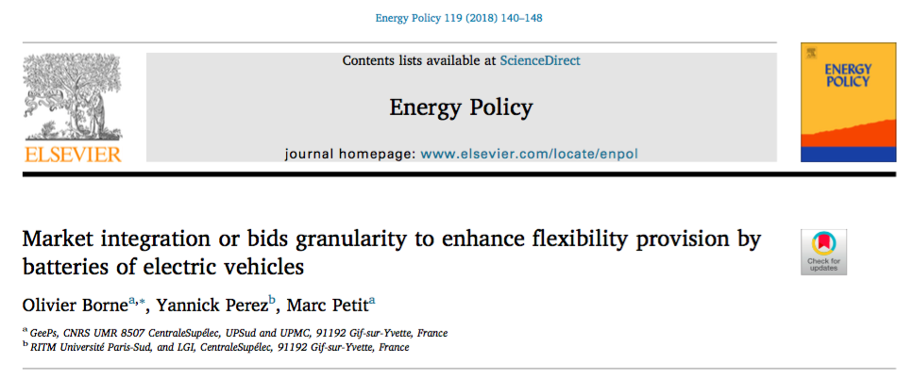
Problem… Rules are inadapted
Wholesale market rules:
Size of the market bid is crucial

Slide 37
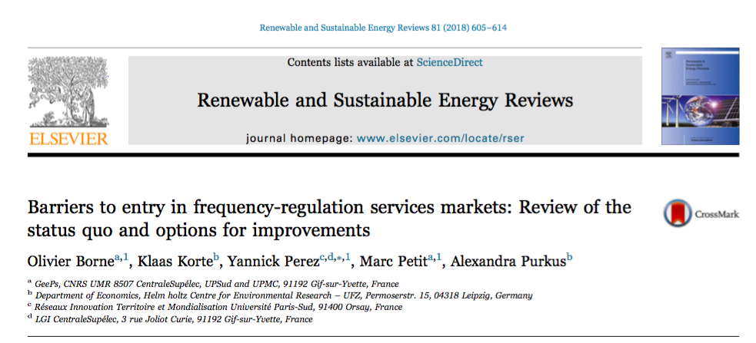
Problem… Rules are inadapted
Utilities networks rules : TSO

Slide 38
Utilities networks rules : TSO

Slide 39
Utilities networks rules : DSO

Slide 40
Utilities networks rules : DSO new tariff design

Slide 41
Utilities networks rules : DSO EV-PV

Slide 42
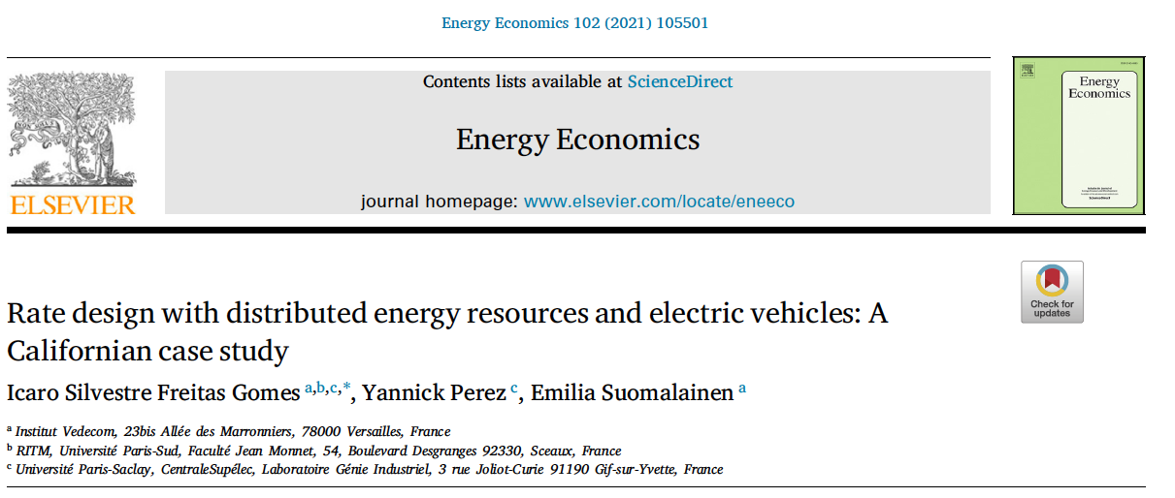
Some possibles improvements

Slide 43
Planning Charging infrastructure tool is missing

Slide 44
References on demand
Marc-Olivier Metais, Jaafar Berrada Oualid Jouini Yannick Perez and Emilia Suomalainen 2022. Too much or not enough? Planning electric vehicle charging infrastructure: a review of modeling options. Renewable and Sustainable Energy Review 153 (2022) 111719.
Icaro Silvestre Freitas Gomes, Yannick Perez, Emilia Suomalainen 2021. Rate design with distributed energy resources and electric vehicles: A Californian case study. Energy Economics 102 (2021) 105501.
Felipe Gonzalez Venegas, Marc Petit, Yannick Perez 2021. Barriers for the participation of distributed energy resources on local flexibility markets: an electric vehicle fleet case study. eTransportation 10 (2021) 100131.
Felipe Gonzalez Venegas, Marc Petit, Yannick Perez 2021. Active integration of electric vehicles into distribution grids: barriers and frameworks to use flexibility. Renewable and Sustainable Energy Review, Volume 145, July 2021, 111060.
Icaro Silvestre Freitas Gomes, Yannick Perez, Emilia Suomalainen 2020 Coupling small batteries and PV generation: A review, Renewable and Sustainable Energy Reviews 126 (2020) 109835.
Andrew Thompson and Yannick Perez 2020, Vehicle-to-Anything (V2X) Energy Services, Value Streams, and Regulatory Policy Implications, Energy Policy 137 (2020) 111136.
Quentin Hoarau & Yannick Perez, 2019, Network tariff design with distributed energy resources and electric vehicles, Energy Economics, Volume 83, September, Pages 26-39.
Ramírez Díaz Alfredo, Marrero Gustavo, Ramos-Real Francisco, Perez Yannick, 2018 Willingness to pay for the electric vehicle and their attributes in Canary Islands, Renewable and Sustainable Energy Reviews Volume 98, December 2018, Pages 140-149.
Ramírez Díaz Alfredo, Ramos-Real Francisco Javier, Perez Yannick, Barrera Santana Josue, 2018, Interconnecting isolated electrical systems. What is the best strategy for the Canary Islands? Energy Studies Review- Vol. 22 (2018) pp. 37–46.
Hoarau Quentin and Perez Yannick, 2018, Interactions Between Electric Mobility And Photovoltaic Generation: A Review, Renewable and Sustainable Energy Reviews 94 (2018) 510–522.
Rodríguez Brito Maria Gracia, Ramírez-Díaz Alfredo Jesús, Ramos-Real Francisco J., Perez Yannick, 2018, Psychosocial traits characterizing EV adopters' profiles: The case of Tenerife (Canary Islands), Sustainability 2018, 10, 2053.
Borne Olivier, Yannick Perez and Marc Petit 2018, Market integration or bids granularity to enhance flexibility provision by batteries of Electric Vehicles, Energy Policy, Volume 119, August 2018, Pages 140–148.
Borne Olivier, Korte Klaas, Perez Yannick, Petit Marc and Purkus Alexandra 2018, Barriers to entry in Frequency-Regulation Services Markets: Review of the status quo and options for improvements, Renewable and Sustainable Energy Reviews. Volume 81, Part 1, January 2018, Pages 605–614.
Codani Paul, Perez Yannick and Petit Marc 2016, Financial Shortfall for Electric Vehicles: economic impacts of Transmission System Operators market designs, Energy, Volume 113, pp 422-431.
Eid Cherrelle, Codani Paul, Perez Yannick, Reneses Javier, Hakvoort Rudi, 2016, Managing electric flexibility from Distributed Energy Resources: A review of incentives for market design, Renewable and Sustainable Energy Reviews, Volume 64, pp 237–247.
Ramírez Alfredo, Ramos-Real Francisco, Marrero Gustavo & Perez Yannick, 2015, Impact of Electric Vehicles as Distributed Energy Storage in Isolated Systems: The Case of Canary Islands, Sustainability, 7(11):15152-15178 November.
Marrero Gustavo, Perez Yannick, Petit Marc & Ramos-Real Francisco 2015, Electric Vehicle Fleet contributions for Isolated Systems. The case of the Canary Islands. International Journal of Automotive Technology and Management. Vol.15, No.2, pp.171 - 193.
Kempton Willett, Perez Yannick, and Petit Marc, 2014, Public Policy Strategies for Electric Vehicles and for Vehicle to Grid Power. Revue d’Economie Industrielle. N° 148, pp 263-291.

Slide 45
Economics of Electric Mobility: Utilities and Electric mobility
Yannick Perez
CentraleSupélec – University Paris-Saclay
Yannick.perez@centralesupelec.fr

