Slide 1
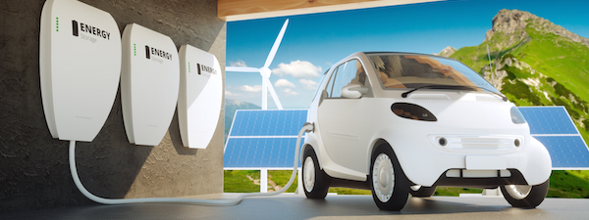
Using EVs… to do what?
Yannick Perez
CentraleSupélec – Paris
Yannick.perez@centralesupelec.fr

Slide 2
Electric cars save more energy than they daily use
Size of the battery goes from 24 to 100 kWh
EV consumes 15-20 kWh per 100 km
Mean Drivers Daily trips/day is between 24 km -40 km
EVs are very flexible resources (to store or deliver electricity) if needed = Distributed Storage Services (DSS)
Arbitrage between private use (house-building) or other flexibility buyers of DSS (Energy markets / grids)

Slide 3
Arbitrage
Between…
16 services
Notes:
3 main sources of revenues for Decentralized storage solutions : Wholesale market / Grid related services / customers in buildings or house

Slide 4
Who need flexible electricity storage? Who would buy flexibility provision? Who need to be decarbonized?
Electricity markets
Electricity grids (TSO or DSO)
Buildings/ Houses
Car manufacturers
Notes:
Each (segment / service) need a specific analysis…

Slide 5
1. Electricity Markets

Slide 6
ELECTRICITY MARKETS ORGANIZATION and EV Fleet
Years ahead
Months ahead
Day-ahead (h-24)
h-1
Real Time
intraday
Time
Capacity
Forward Markets
Energy
Forward Markets
Spot Market
Intraday
Balancing Services
Redispatch
Imbalances
Primary & Secondary Reserves
Reserves
Lead Time
And best adapted grid services for ev fleets

Slide 7
Reg : market friendly and transparent rules

Slide 8
But Electricity wholesale market rules are for existing technologies
Not for Distributed Storage Services

Slide 9
Market rules are not really ready for EVs

Slide 10
2. For Electricity grids (TSO-DSO)

Slide 11
Example: TSO potential need for EV flexibility is large (manage Renewables)

Slide 12
BUT
Need regulatory adaptations

Slide 13
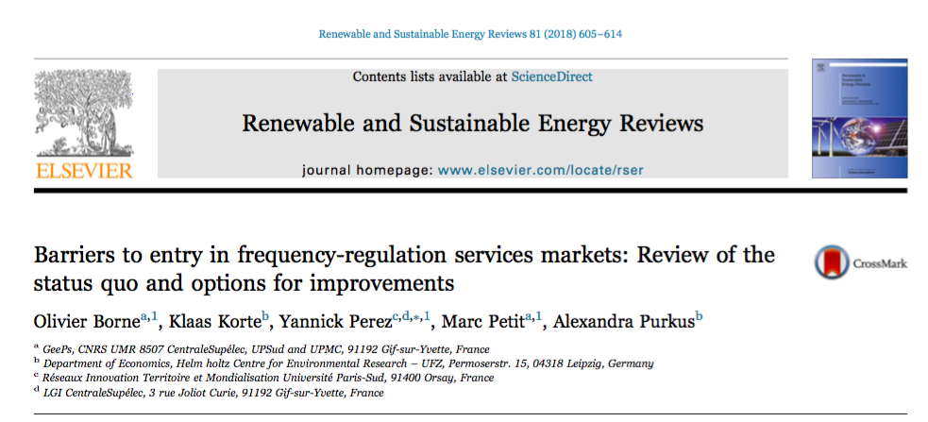
Problem… Rules are inadapted
TSO and EVs

Slide 14
Same issues Distribution grids
DSS are potential local provision of flexibility where and when it is needed

Slide 15
Evs and DSO: technical barriers to entry

Slide 16
3. For behind the meter services

Slide 17
Behind the meter and EVs

Slide 18
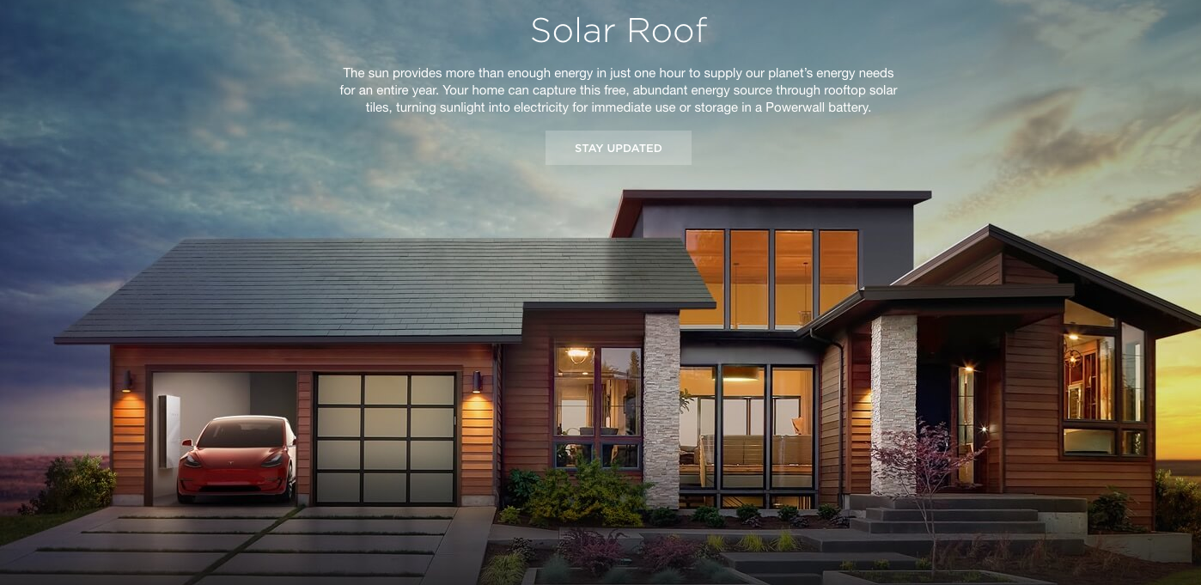
And the off-grid « solution » VtoL
New companies propose “off grid green” solution
Home Storage + Solar Roof + EV (100kWh) < Energy + networks + taxes + sunkcosts

Slide 19
4. And Net zero for OEMs?

Slide 20
OEMs Deep decarbonization = huge challenges
Net zero emission : Stellantis example
2022 → actual 450 millions tonne of CO₂ per year
Scope 1 → direct activity emision (5%)
Scope 2 → OEM energy use in the making of the cars (15%)
Scope 3 →emissions related to usage and suppliers (80%)

Slide 21
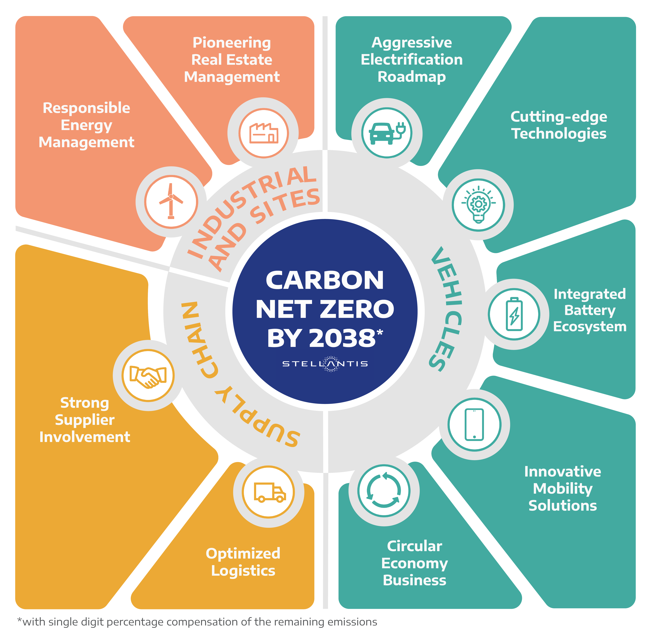
Net zero => 1. Only EV are to be sold + fueled only with RES during use phase + 2. RES for making + 3. decarb the all Supply chain + 4. circular economy

Slide 22
Who EVs are going to help?
DRIVERS and
Energy Markets / grids / Behind the meter uses / car manufacturers?

Slide 23
Depends on Regulatory decisions and Economic evaluation country / country
EV and Energy market: Need to change the market rules
EV and Transmission grid : Need to change the transmission rules
EV and Distribution grid : Need to change the distribution rules
Vehicle to buildings = VtoB : Out of regulators scope
Vehicle to Home = VtoH : Out of regulators scope
Vehicle to Load (electrification) = VtoL: Out of regulators scope
OEM net zero
compatibility

Slide 24
Using EVs to Provide Grid electric Services: Regulatory challenges
Yannick Perez
CentraleSupélec – Paris
Yannick.perez@centralesupelec.fr

