Slide 1
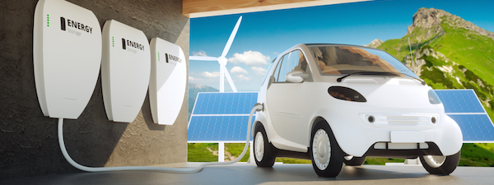
Using EVs to Provide Grid Electric Services: Regulatory Challenges
Yannick Perez
CentraleSupélec – Paris
Yannick.perez@centralesupelec.fr

Slide 2
The Armand Peugeot Chair
The chair is funded by Stellantis and the CentraleSupélec foundation.
  2011-2023 : 3 contracts have been signed
  2024- 2029 : 4th contract is under design fro deep decarbonisation of the OEM business
  Joint work between Economists (LGI) / Engineers (Geeps) / Managers (ESSEC) from CS and ESSEC
  Objectives of the chair : define the role of EVs for Grids, Users and the society
  Means :
    3 professors / 2 PhDs students / 1 assistant : 400 k€/year
    Organisation of an Annual conference since 2013
    PhDs programs (6 completed / 2 ongoing)
    Participating in the public discussions / academic debates
    Publications in scientific reviews and communications in conferences

Slide 3
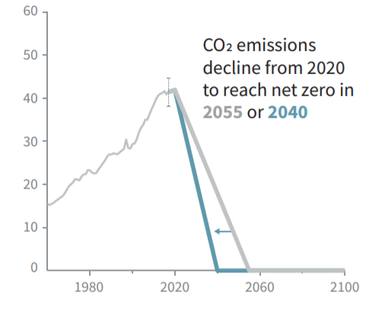
The need for decarbonization
The need for electric vehicles
Carbon neutrality needed by 2050 to limit global warming by 1,5°C*
Stylized pathway of global CO2 emissions compatible with 1,5°C scenario
GHG emissions in EU-28, 2019
IPCC 2018, Summary for policy makers. In: Global Warming of 1.5°C[…]
Own elaboration, data from Eurostat, EEA

Slide 4
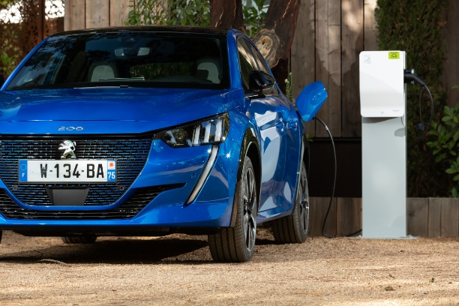
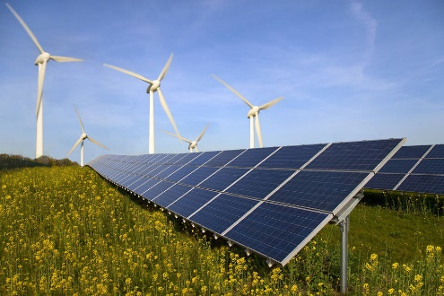




Towards low carbon mobility
The need for electric vehicles
Deep decarbonization of electricity generation + electrification of transport to reduce externalities
  GHG, atmospheric pollution, noise
Numerous commitments to boost electric vehicle adoption
  Combustion vehicle sales bans: UK (2030), Norway (2025), France (2040)…..
  (Ultra)-Low emission zones in cities: Paris, London, Amsterdam…
  Car manufacturers all-electric commitments: Jaguar, Fiat 2030….
  Fast development of battery electric vehicles, +34% increase in world-wide sales in 2020

Slide 5
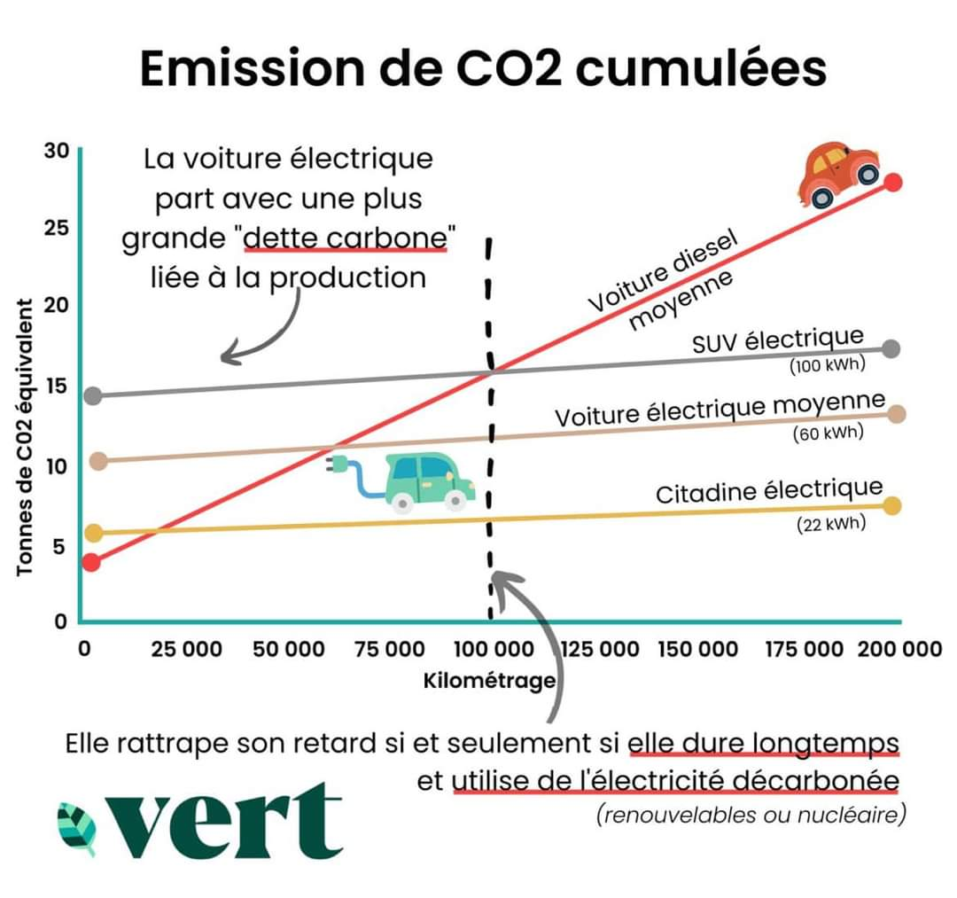

Slide 6
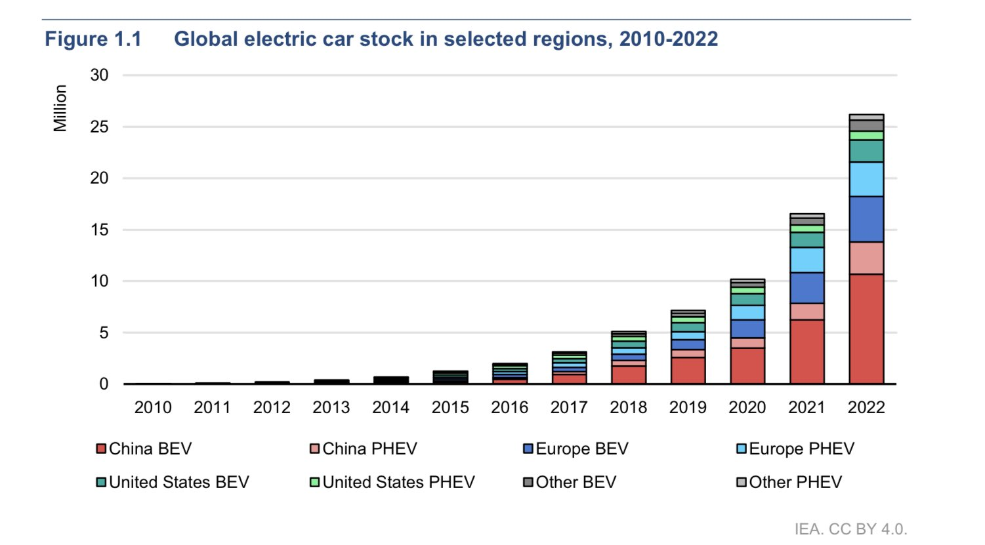
EV sales are starting

Slide 7
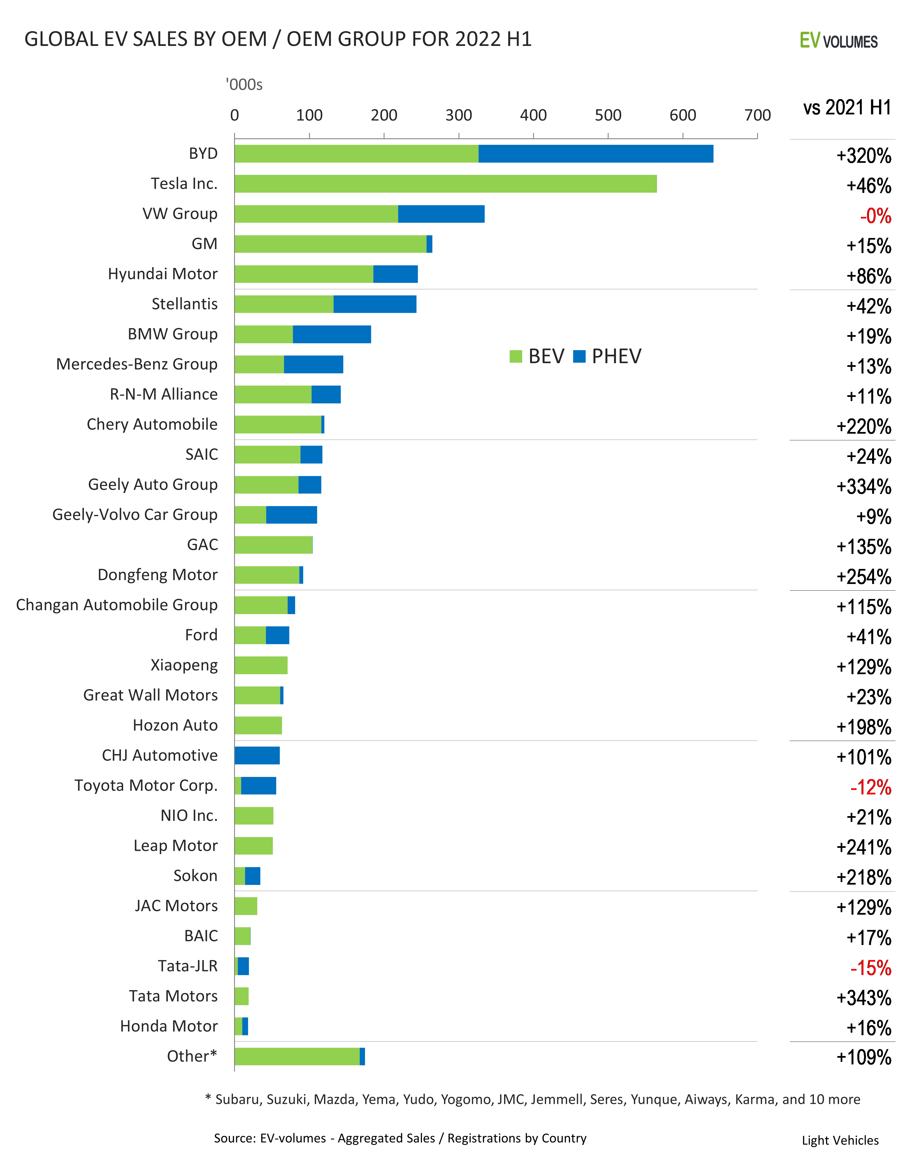
Sales per company

Slide 8
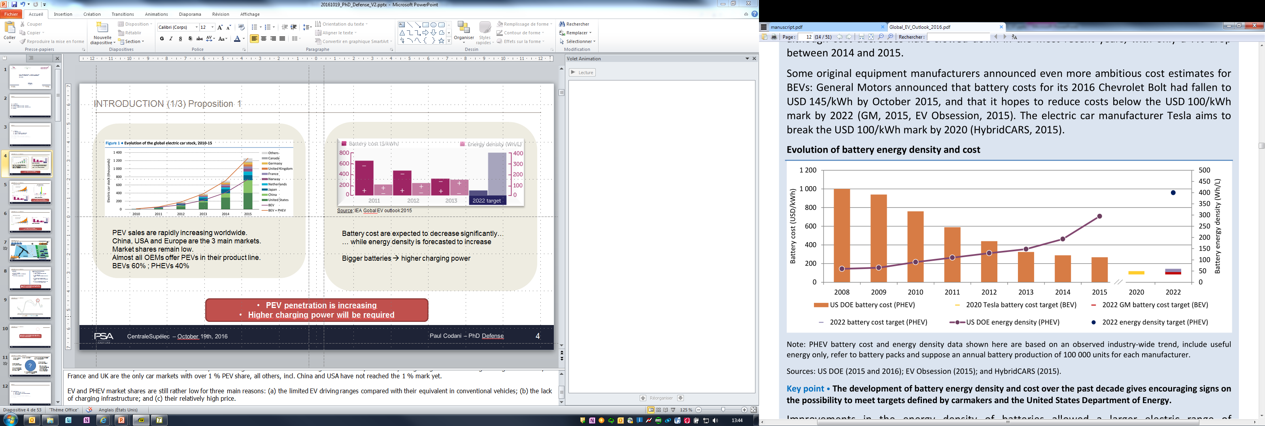
Evs enjoy a Double dynamic:
Increase in ENERGY DENSITY & decrease of COST
Source: IEA Global EV Outlook 2016
Notes:
Battery costs dropped from 1000$/kWh in 2008 to 268$/kWh in 2015
DOE target: 125$/kWh in 2022
GM: 145$/kWh in 2016 (Chevrolet Bolt), 100$/kWh by 2022
Tesla: 100$/kWh by 2020

Slide 10
Electric cars store more energy than they daily use
    Size of the battery goes from 24 to 100 kWh

Slide 11
Common strategy: more stored energy / car

Slide 12
Electric cars Store more energy than they daily use
    Size of the battery goes from 24 to 100 kWh
    EV consumes 15-20 kWh per 100 km
    Mean Drivers Daily trips/day is between 24 km -40 km

Slide 13
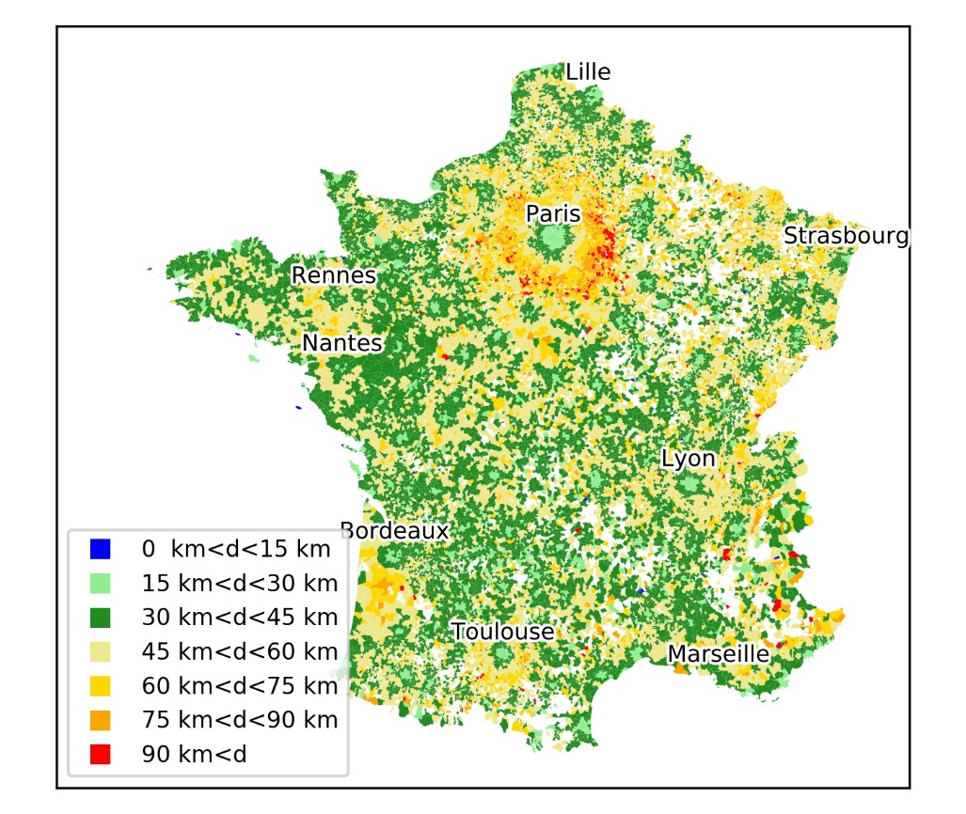
Daily commuting distance

Slide 14
Electric cars store more energy than they daily use
    Size of the battery goes from 24 to 100 kWh
    EV consumes 15-20 kWh per 100 km
    Mean Drivers Daily trips/day is between 24 km -40 km
      EVs are very flexible resources (to store or deliver electricity) if needed = Distributed Storage Services (DSS)

Slide 15
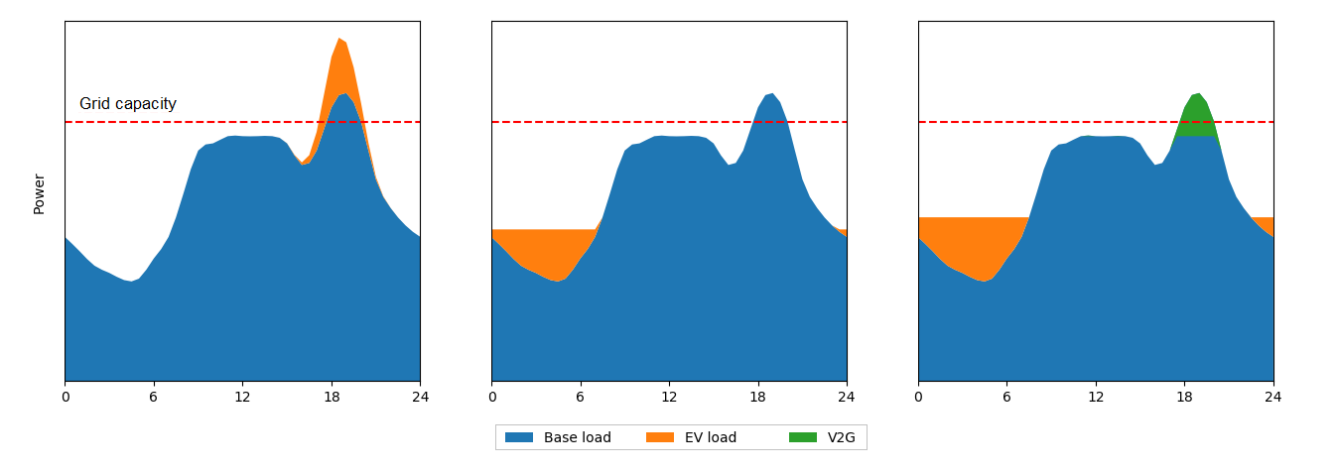
What is flexibility from EVs?
Ability to adapt the (dis)charging pattern of the EV
Many uses, for different stakeholders:
  For end-users: optimizing electricity bill, self-consumption
  For the whole system: frequency response, energy arbitrage
  For distribution systems: congestion management, voltage regulation, fault-restoration, investment deferral
Uncontrolled
Smart charging
V2G
Grid capacity
Power

Slide 16
Electric cars save more energy than they daily use
    Size of the battery goes from 24 to 100 kWh
    EV consumes 15-20 kWh per 100 km
    Mean Drivers Daily trips/day is between 24 km -40 km
      EVs are very flexible resources (to store or deliver electricity) if needed = Distributed Storage Services (DSS)
      Arbitrage between private use (house-building) or other flexibility buyers of DSS (Energy markets / grids)

Slide 17
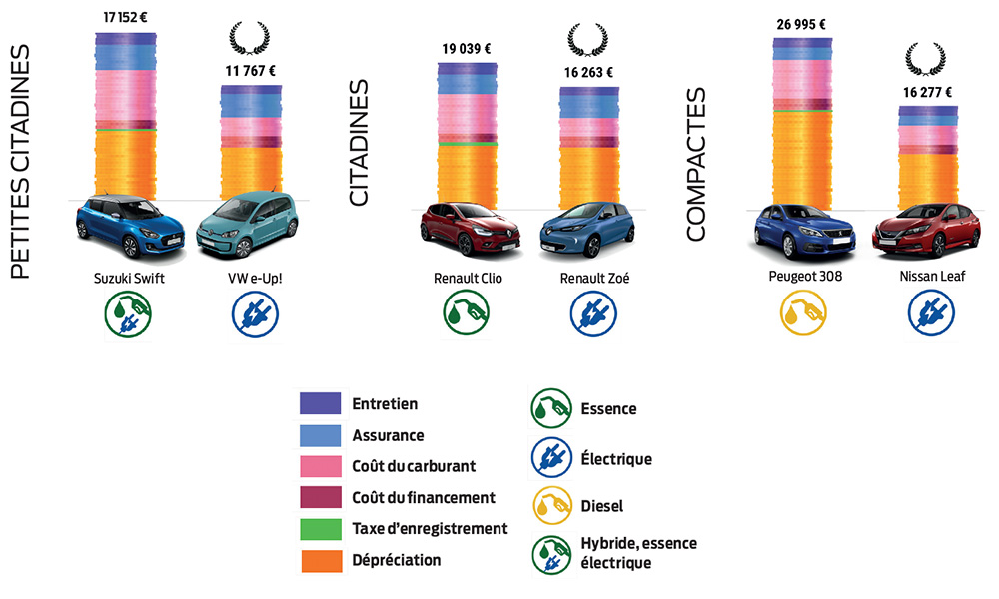
First Goal : EVs as ressources to make EV cheaper than ICE…

Slide 18
Who need flexible electricity storage?
Who would buy flexibility provision?
Electricity markets
Electricity grids (TSO or DSO)
Buildings/ Houses
Notes:
Each (segment / service) need a specific analysis…

Slide 19
The landscape of EVs for smart charging opportunities (VtoX) with or without regulation (Behind the meter)

Slide 20
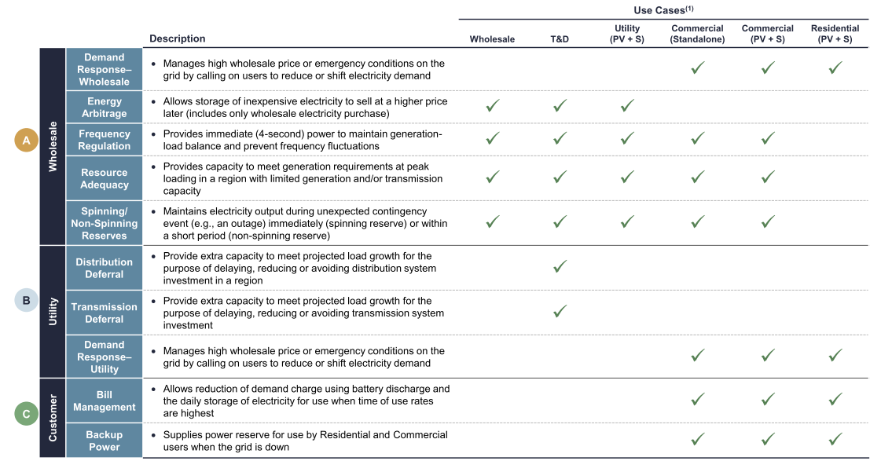
3 main sources
And Up to 16 services
Notes:
3 main sources of revenues for Decentralized storage solutions : Wholesale market / Grid related services / customers in buildings or house

Slide 21
1. Electricity Markets

Slide 22
ELECTRICITY MARKETS ORGANIZATION and EV Fleet
Years ahead
Months ahead
Day-ahead (h-24)
h-1
Real Time
intraday
Time
Capacity
Forward Markets
Energy
Forward Markets
Spot Market
Intraday
Balancing Services
Redispatch
Imbalances
Primary & Secondary Reserves
Reserves
Lead Time
And best adapted grid services for ev fleets

Slide 23
Managing data to create
“bundle of valuable flexible resources” for potential markets
Times | MW or MWh | Services on market base if exist
Second | MW | Frequency regulation Voltage regulation Quality of delivery
Hour | MW Or MWh | Terciary reserve market Demand response Balancing services Congestion management Intraday-market Coupling With RES ...
Block orders | MWh | Day head market Time of Use Coupling with RES ...
Notes:
Parler de la non uniformité des règles entre les GRT
Complexe mais non incertain

Slide 24
Reg : market friendly and transparent rules

Slide 25
But
Electricity wholesale market rules are for existing technologies
Not for Distributed Storage Services

Slide 26
Market rules are not really ready for EVs

Slide 27
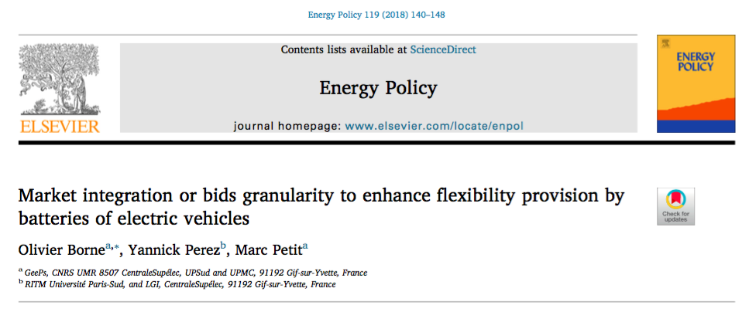
Problem… Rules are inadapted
Electricity markets and EVs : Size of the market bid is crucial

Slide 28
2. For Electricity grids (TSO-DSO)

Slide 29
Example 1: TSO potential need for EV flexibility is large (manage Renewables)

Slide 30
BUT
Need regulatory adaptations

Slide 31
TSO and Evs (1)

Slide 32
Frequency remunerations for EV :
PJM real case / France exploration/ Netherlands / Denmark and France under construction
Charging point capacity (kW) |  | Revenus /VE/ year
Primary | Secondary
3 | 0 | 179,4 €
3 | 3 | 310,7 €
3 | 7 | 505,7 €
3 | 22 | 1346,8 €
7 | 0 | 474,5 €
7 | 3 | 543,4 €
7 | 7 | 780 €
7 | 22 | 1448,2 €
1500 €/ year and per car in PJM Zone
for only « frequency regulation market base
Provision »
Kempton (2016)
Sources: Codani, Petit & Perez (2016)

Slide 33
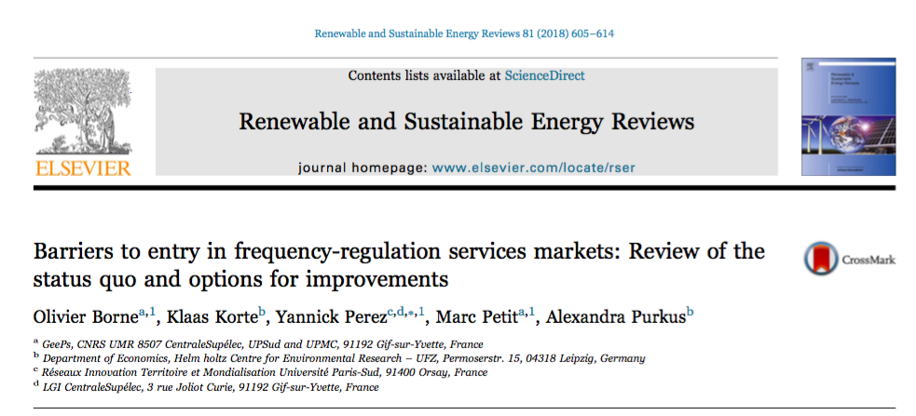
Problem… Rules are inadapted
TSO and EVs (2)

Slide 34
Borne , Korte , Perez, Petit and Purkus (2016)
We built a framework in order to understand where the barriers are, and to rank them for different countries: France, Germany, UK and Denmark.
Optimal market-design for participation of aggregators
Module C
Do the rules allow aggregators to extract the full value of the service?
Yes
Module B
Do the rules allow aggregators to provide their full flexibility?
Yes
Sub-optimal remuneration of the flexibility provided
Module A
No
Do the rules allow aggregators to provide reserve ?
Yes
Limited provision of existing flexibility
No
No
No entry in the market

Slide 35
Same issues Distribution grids
DSS are potential local provision of flexibility where and when it is needed.
Value depends on the local needs…

Slide 36
Evs and DSO: technical barriers to entry

Slide 37
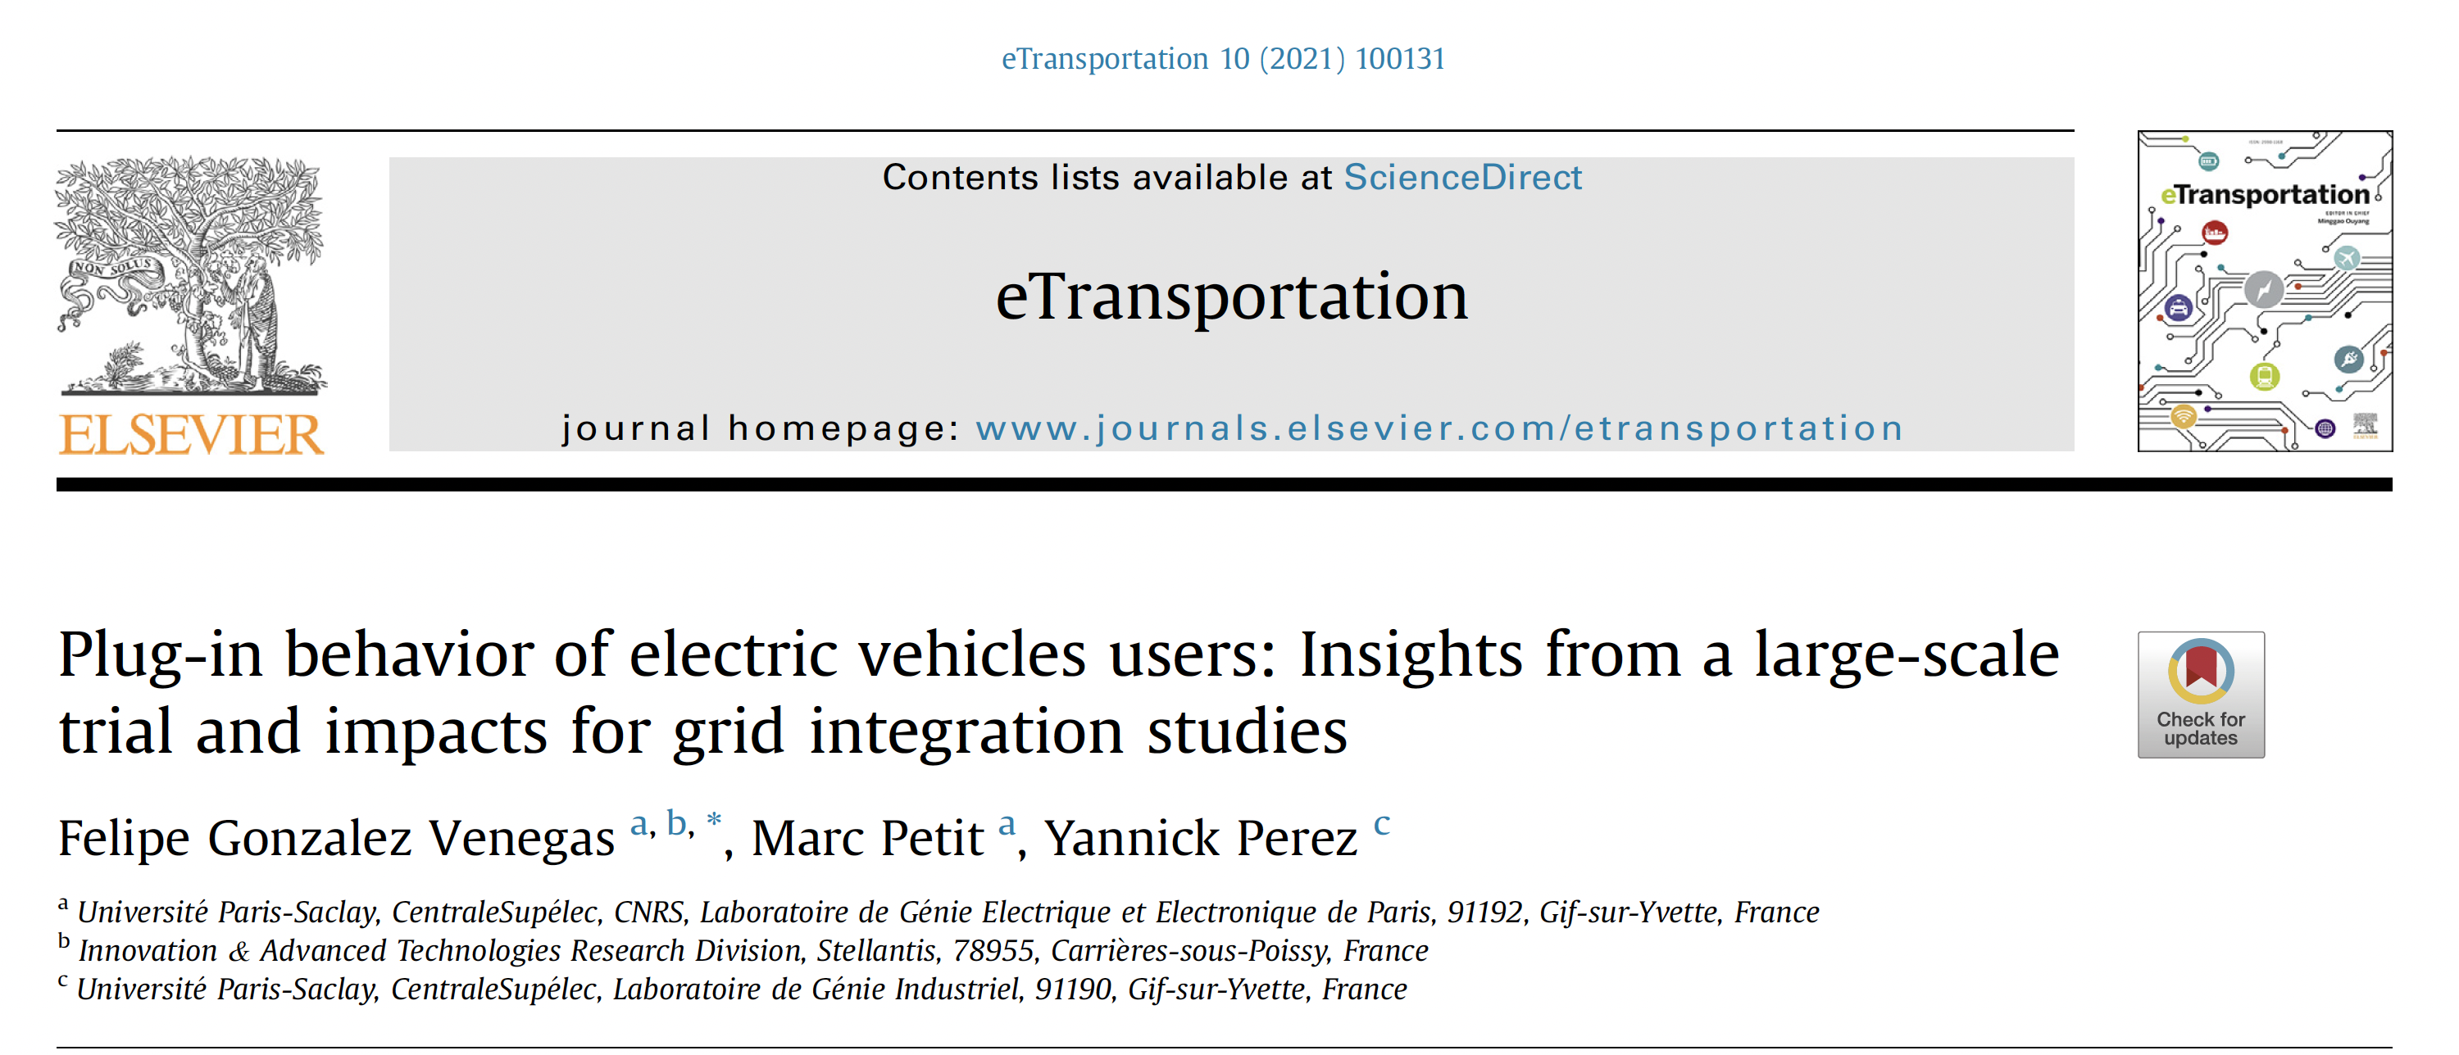
And the role of Users…

Slide 38
3. For behind the meter services

Slide 39
The landscape of EVs for smart charging opportunities (VtoX) with or without regulation (Behind the meter)

Slide 40
Behind the meter and EVs

Slide 41




Contractual solution (s) for VtoB
Objectives of the site manager
  Minimizing energy cost over time
  Maximizing self-consumption of local renewable energies
  Minimizing the peak demand toward networks
  Reducing the network connexion fee
Sharing potential benefits with the consumers and / or DSO
Vehicle-to-building
Agregator
TSO
or
DSO

Slide 42



Contractual solution (s) for VtoH
Objectives of the House manager
  Minimizing energy cost over time
  Maximizing self-consumption of local renewable energies if incentives are aligned
  Providing Distribution grid services (optional)
Vehicle-to-home
DSO

Slide 43
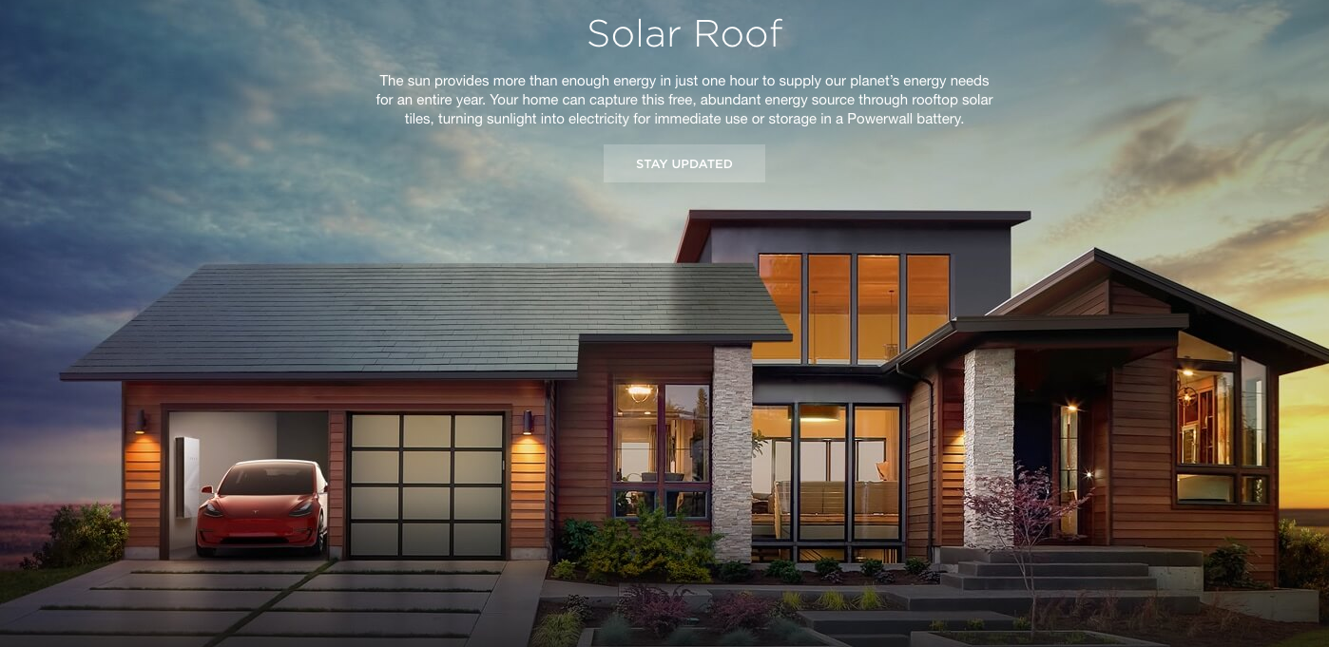
And the off-grid « solution » VtoL
New companies propose “off grid green” solution
  Home Storage + Solar Roof + EV (100kWh) < Energy + networks + taxes + sunkcosts

Slide 44
New regulations for DSS seem to be needed
We did not cover all the potential services…
But we think that we have evidence for Economics and technical rules adaptation on a case by case

Slide 45
Public policy for
1.Standardisation
2. Regulation
3. DSS definition
Communication standards
Data collection and usages
Who is doing what with the data (EV / EVSE / Networks / OEMs…) ?
Reg : Rooming rules for charging
Local level
European Level
Reg : Barriers to entry
Most Flex markets are today built for large players
Most revenues streams are still untapped
=> Network codes and market rules for Distributed Storage Solutions
Moving with an EV and charge it is an IT/ legal/ Economic challenge
Goal:« Plug and play »
Standards are not adopted yet
EU to decide data protection / use?
National level
“Meter war”

Slide 46

Who EVs are going to help?
Energy Markets / grids / Behind the meter uses, others ?

Slide 47
Depends on Regulatory decisions and Economic evaluation country / country
EV and Energy market: Need to change the rules
EV and Transmission grid : Need to change the rules
EV and Distribution grid : Need to change the rules
Vehicle to buildings = VtoB : Out of regulators scope
Vehicle to Home = VtoH : Out of regulators scope
Vehicle to Load (electrification) = VtoL: Out of regulators scope

Slide 48
Using EVs to Provide Grid electric Services: Regulatory challenges
Yannick Perez
CentraleSupélec – Paris
Yannick.perez@centralesupelec.fr

Slide 49
Cooperation with RTE

Slide 50
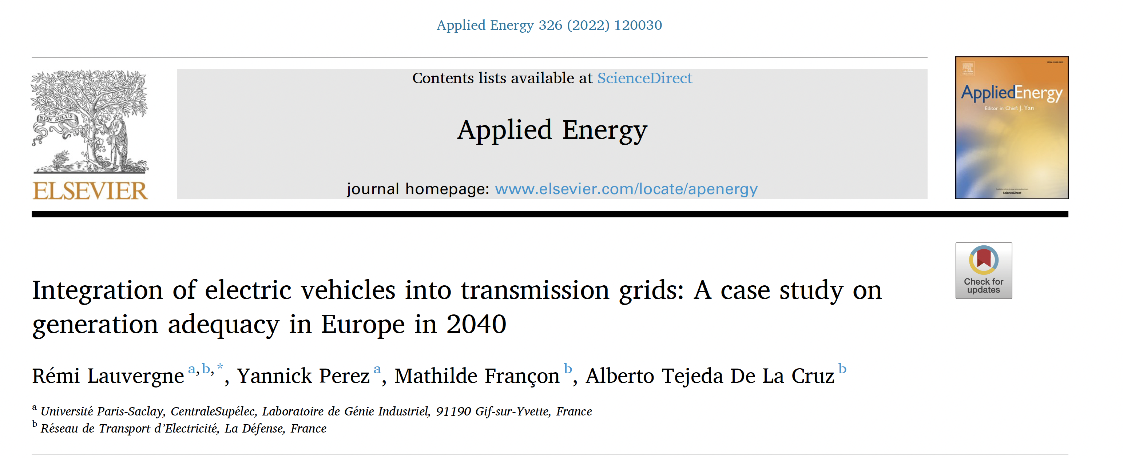
And we try to define what will be the impact of VtoG on the French Grid

Slide 51
Marginal production costs depending on charging scenario
Higher EV flexibility reduces the frequency of zero/negative price hours and reduces the marginal cost at peak residual demand

Slide 52
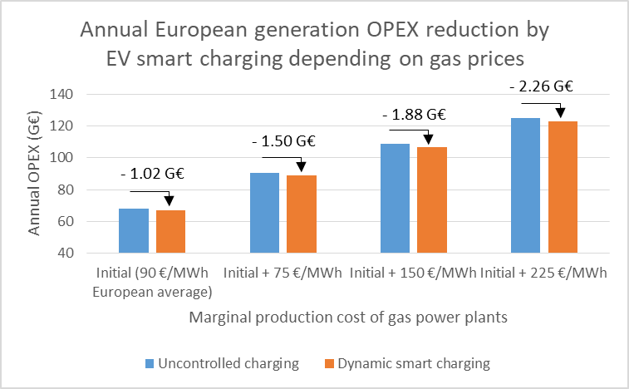
Result sensitivity to higher gas prices
The results are very sensitive to the gas price considered in the study, and the higher the gas price, the more beneficial smart charging is for the electrical system

Slide 53
Cooperation with Vedecom

Slide 54
Discussion on Tariff design issues
With EV / PV / Home storage…

Slide 55
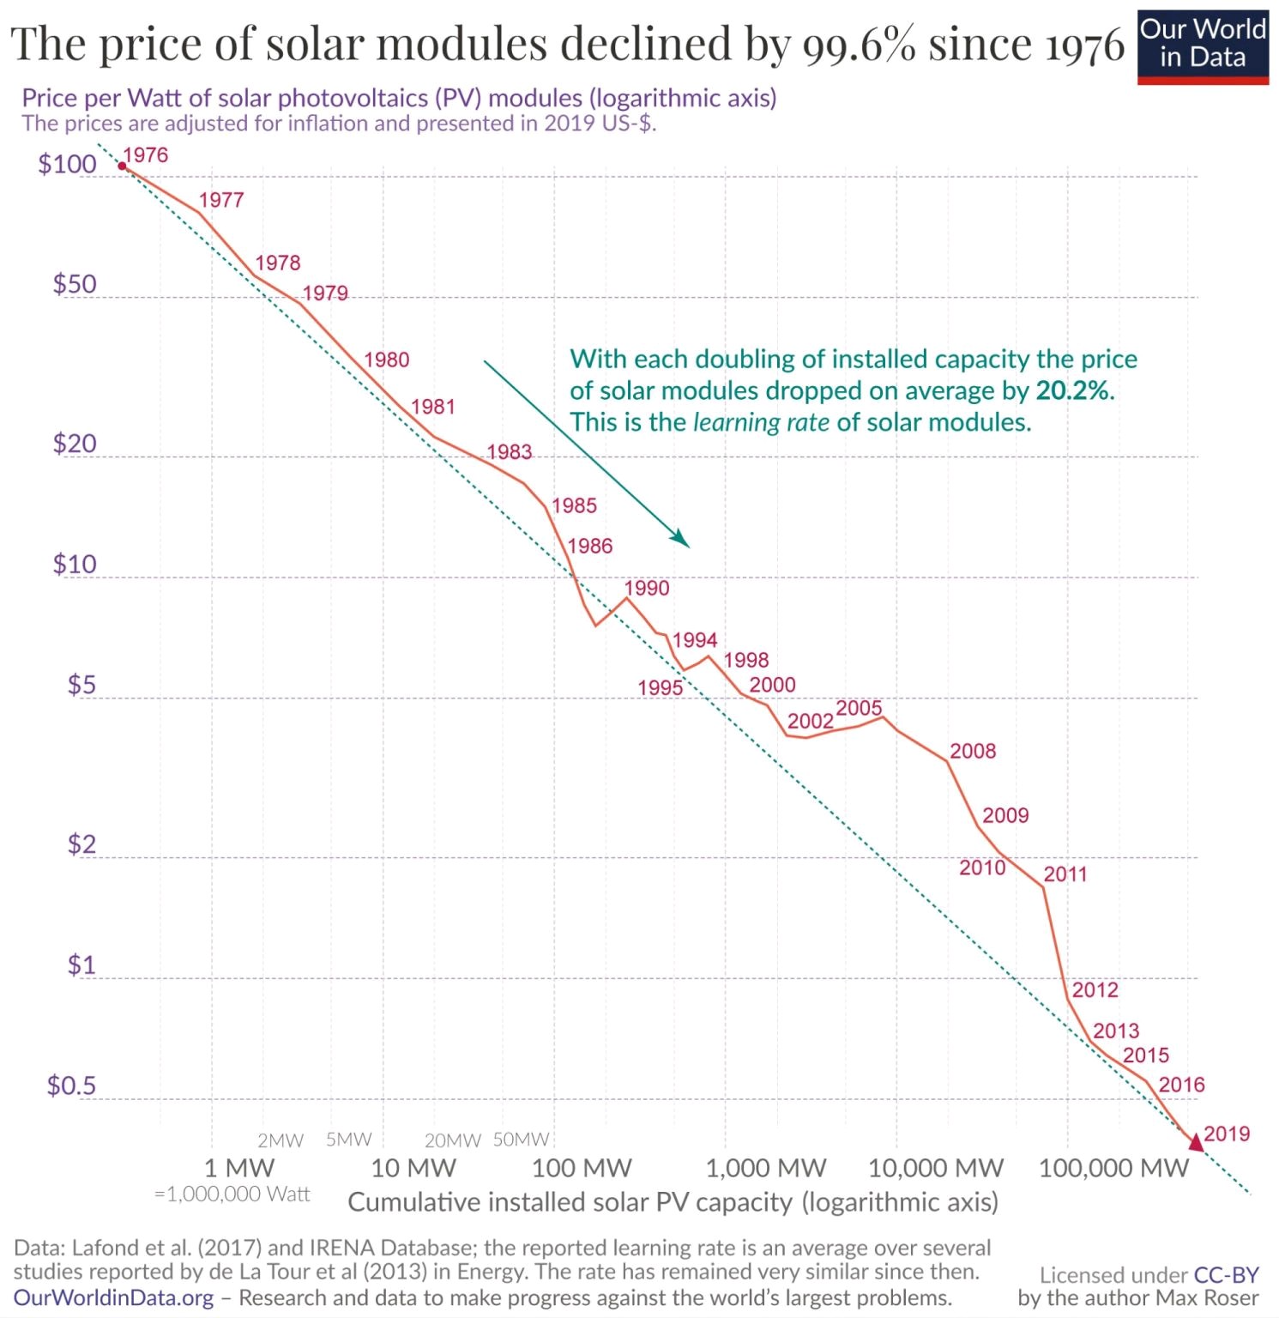

Slide 56
EV sales are starting

Slide 57
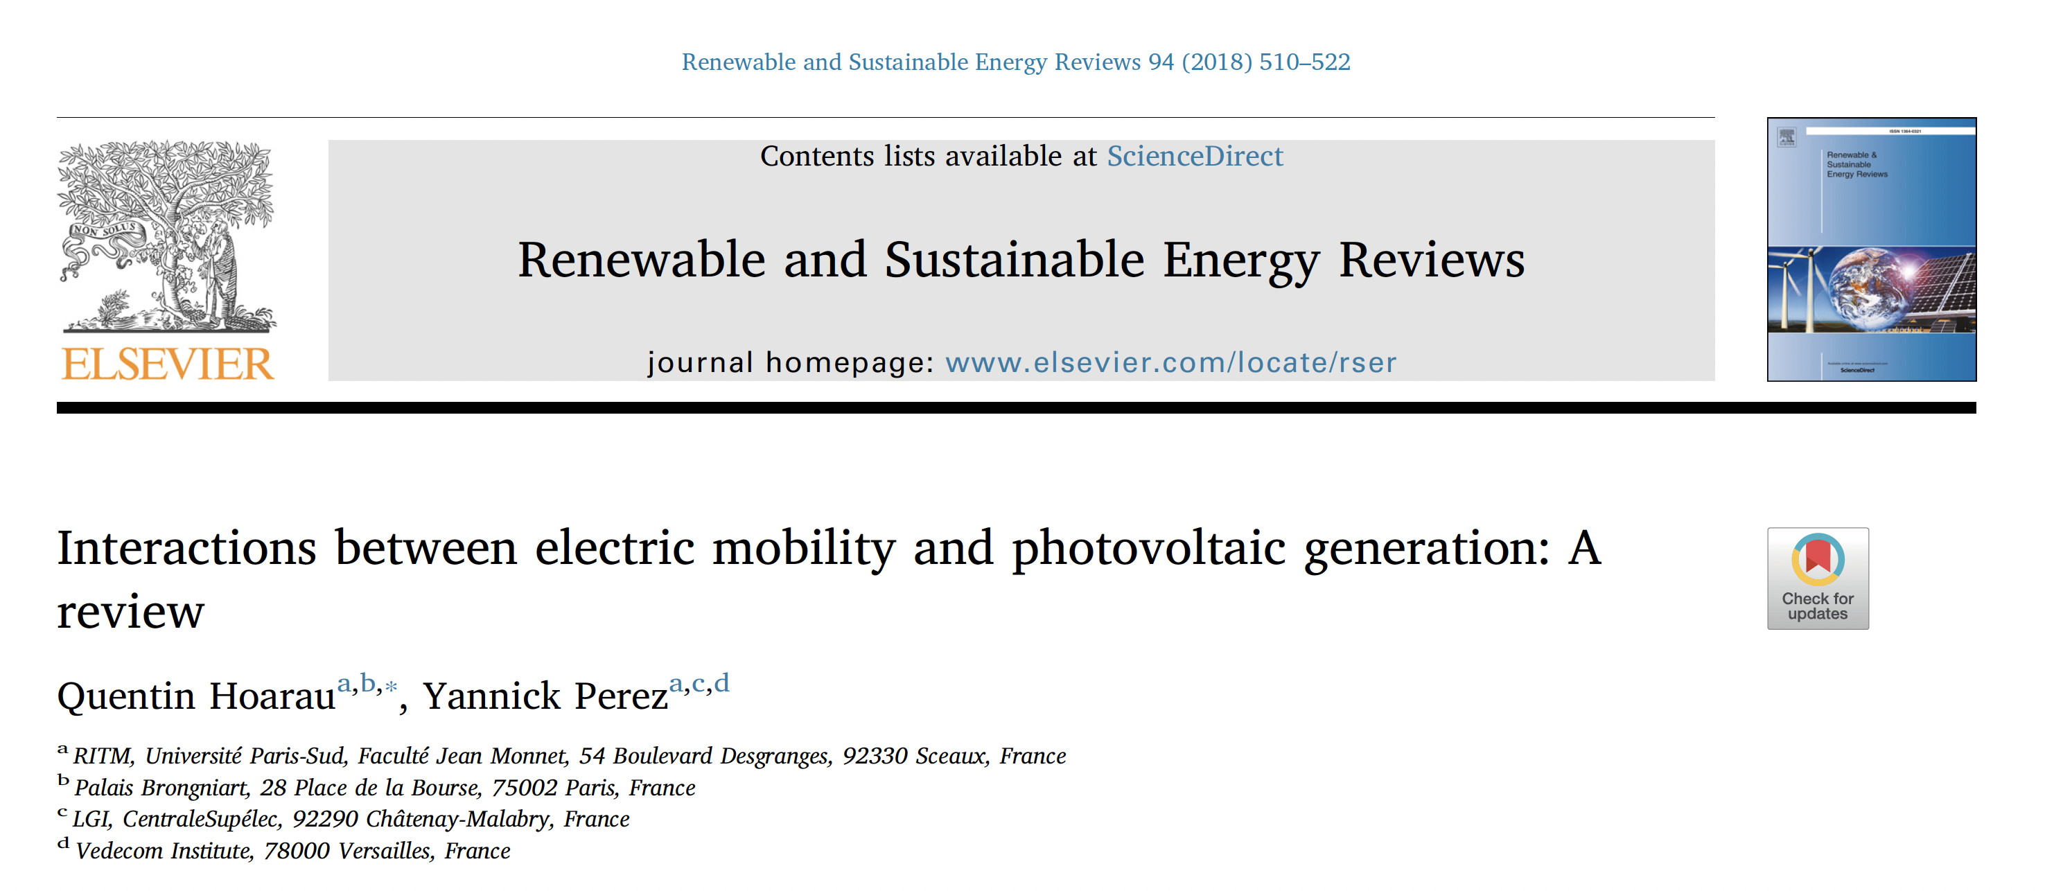
EV-PV identification of the issues

Slide 58
EV – PV and DSO services : the roadmap

Slide 59
DSO’s Death spiral
PV diffusion
Revenus énergie réseaux déclinent
Régulateur augmente les tarifs
Rentabilité PV s’accroit
Couts totaux du système
Augmentent = PB efficacité
Les consommateurs traditionnels voient la facture électrique monter
= Problème d’équité

Slide 60
4 types of consumer
PV EV | Active | Passive
EV | Full innovator | Mobilité verte
Pas de VE | Prosumers | Traditionnels

Slide 61
From quiet to smart grids

Slide 62
EVs and DSO : looking for new tariff design

Slide 63
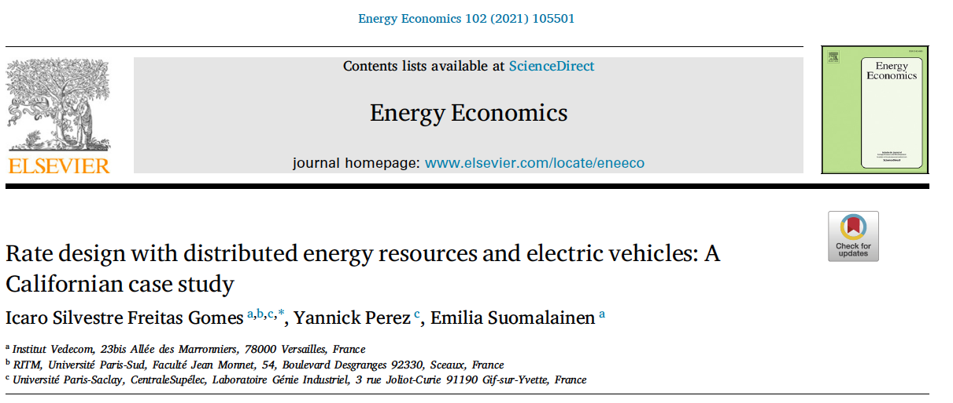
A case study

Slide 64
Discussion on rational implementation of charging point infrastructures

Slide 65
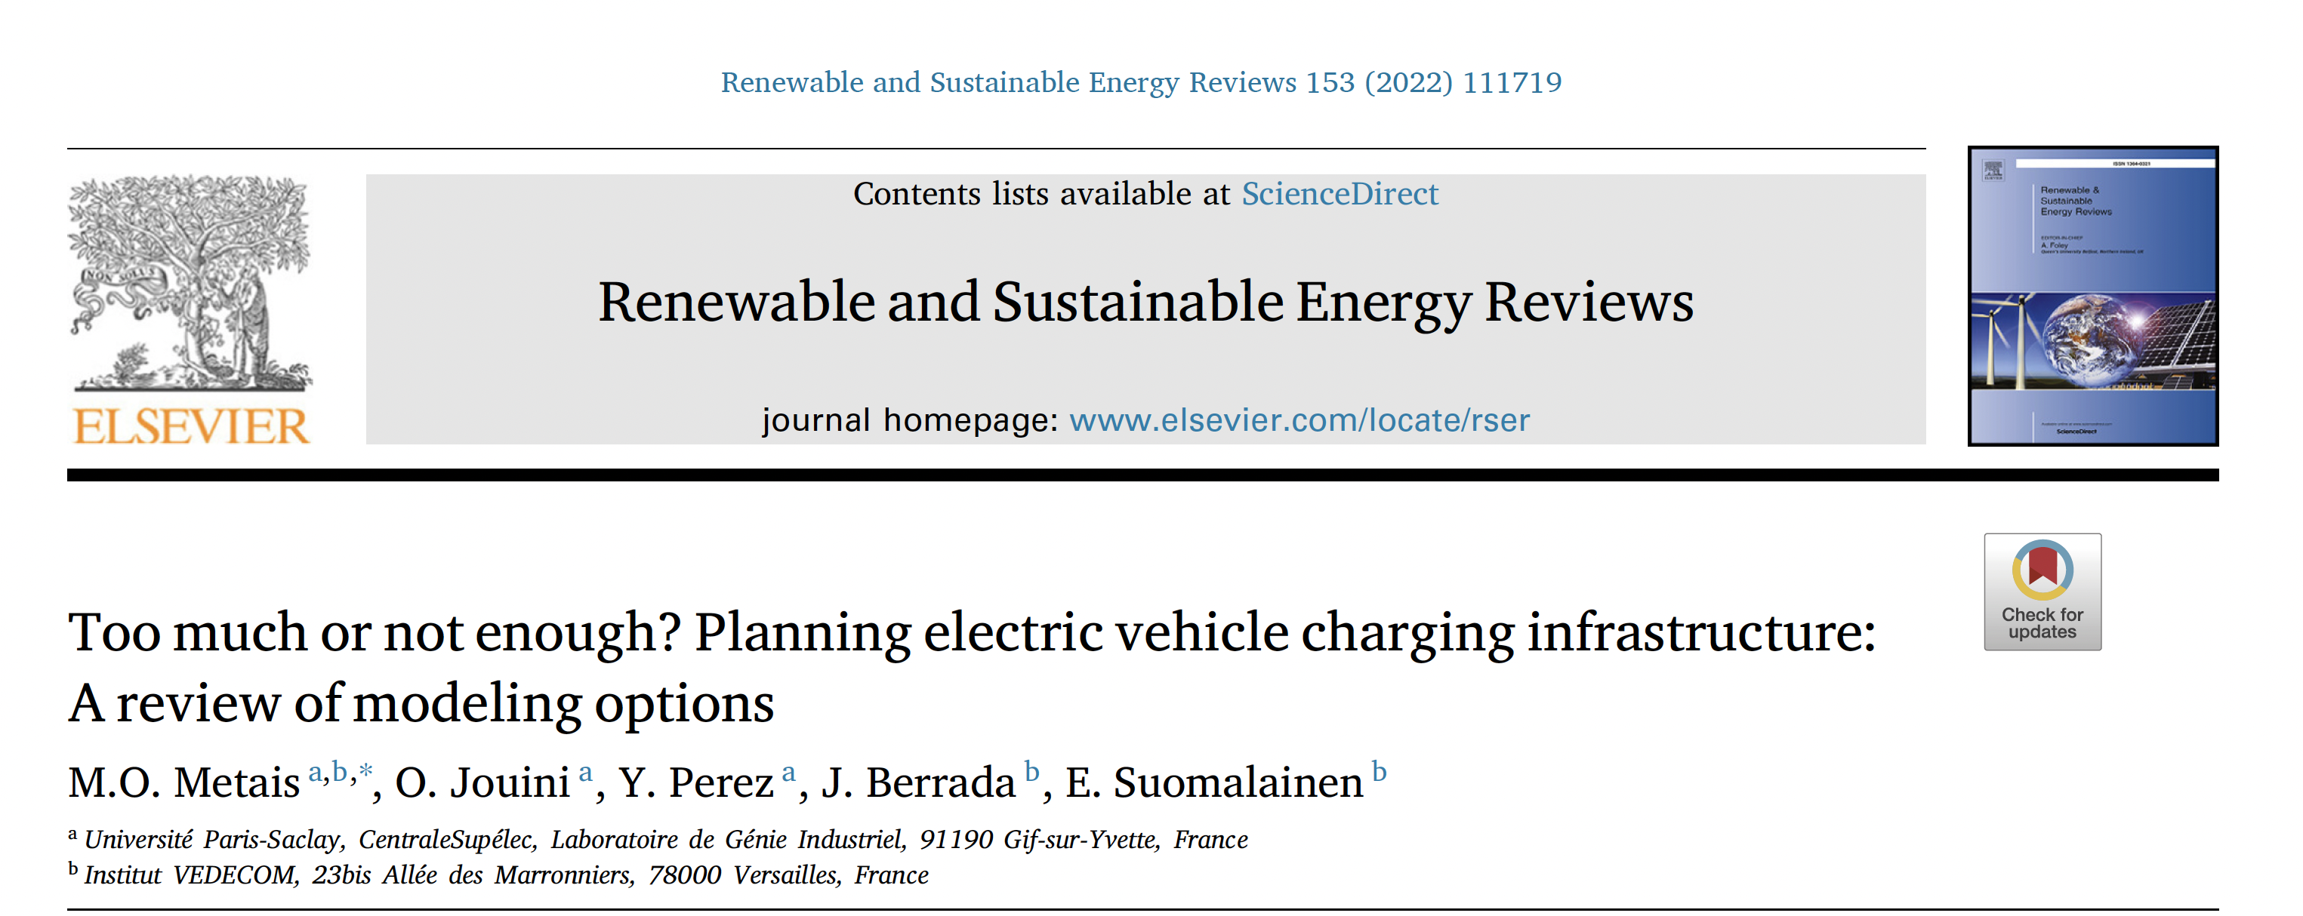
Selection of simulation / optimisation models

Slide 66
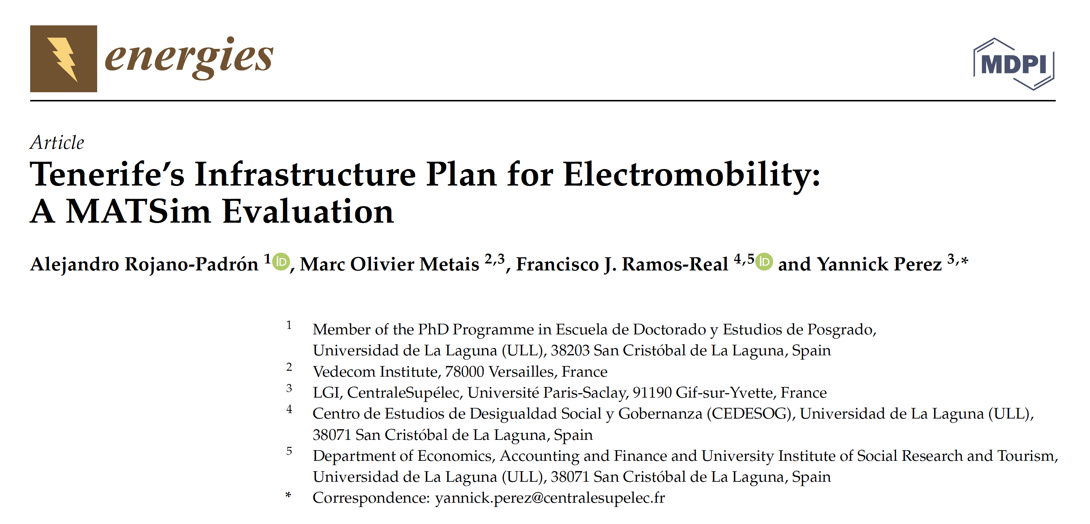
Application of MATsim

Slide 67
VtoG from paper work to public company
Yannick Perez

Slide 68
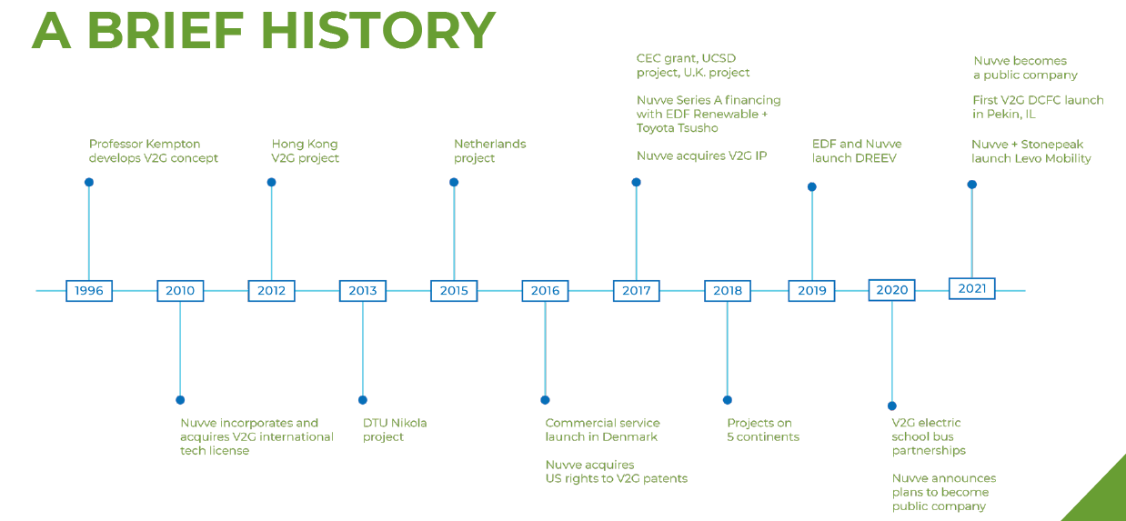

Slide 69
From Idea to introduction in the French market
Feb : Invitation of W Kempton for 2 weeks
Repeated game since with annual conferences to share the results of the research and applied work done
2013-2016
PhD of P. Codani on VtoG To TSO
Grid Motion Project
2019
Joint Venture between Nuvve and EDF May
DREEV
2018-2021
PhD of Felipe Gonzalez Venegas on VtoG for DSO
2016-2019
PhD of Olivier Borne on VtoG To TSO
2012
Feb 2022: DREEV can do VtoG for French TSO
1997-2002
1997 :Kempton First paper on VtoG idea
2002 : Kempton and Tomic seminal paper

