Slide 1
Damages to nature:
An Economic Point of View
Yannick PEREZ**
*LIRAES, Université Paris Cité
**Industrial Engineering Research Lab,
CentraleSupélec-Université Paris Saclay
yannick.perez@centralesupelec.fr

Slide 2
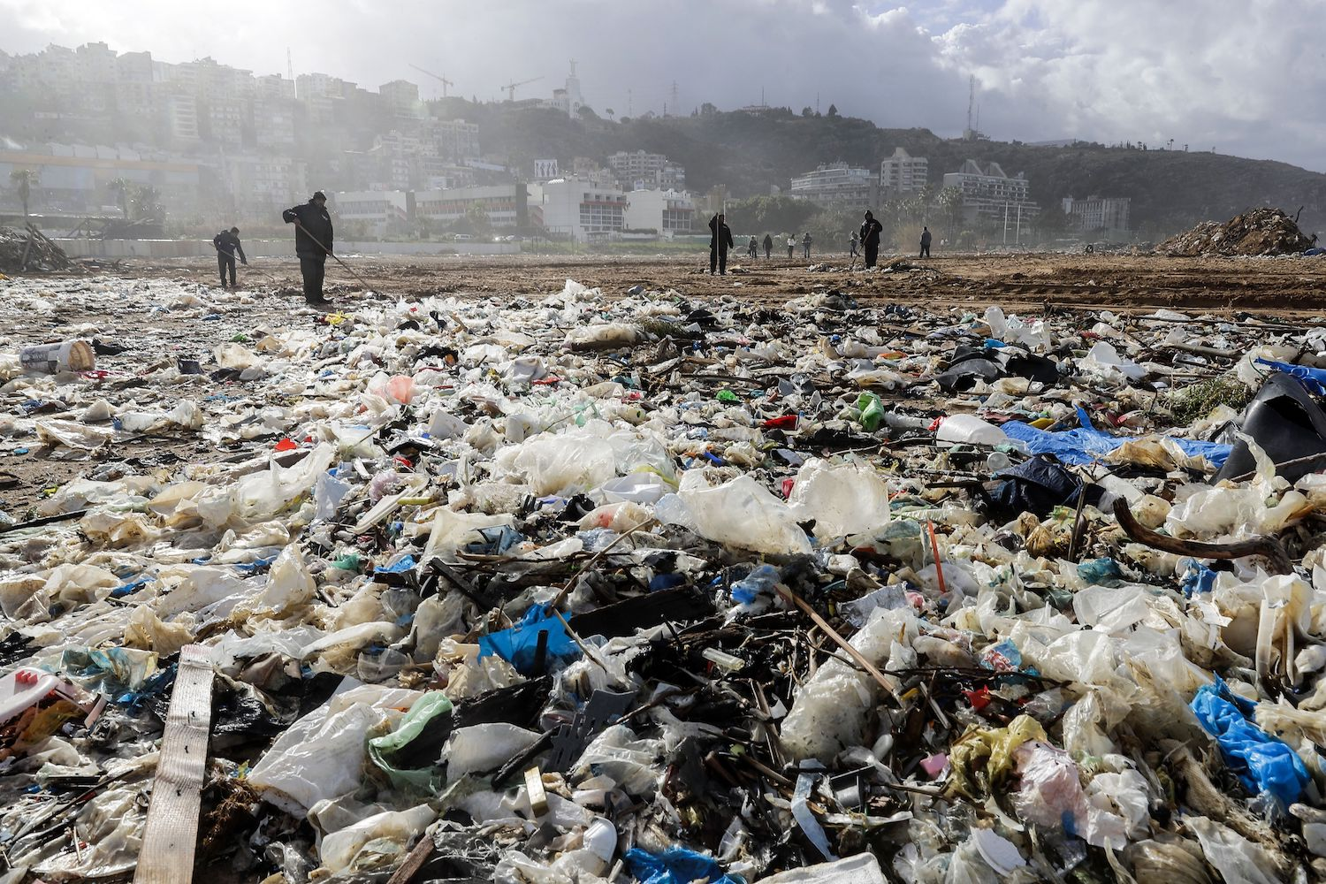
The main difference between the legal and the economic approach to damages
The legal system intervenes
after the damage =>
Ex-post tool to compensate victims of pollution
Economists think of tools to make people (firms, consumers) internalize the cost of pollution ex-ante => incentive effect
Liability and compensation rules are also supposed to have this incentive effect…
… on the condition that the compensation is proportional to the severity of damage and polluters cannot avoid their responsibility…
Notes:
D’un point de vue économique la responsabilité joue deux fonctions : reparation et incitation. L’inconvenient de la responsabilité comme outil incitatif, c’est que ça ne fonctionne bien que 1) si on peut faire le lien entre l’auteur et le dommage 2) si tous les comportements négligeants sont systématiquement sanctionnés et 3) si les sanctions monétaires sont à la hauteur des dommages subis… ça fait beaucoup de conditions qui paraissent insuffisantes pour discipliner les agents étant donnée l’urgence de la situation.

Slide 3
2 options to make people internalize the cost of pollution ex ante:
Administrative solutions like norms/regulations/ban..
Economic solutions
like
taxes and CO2 markets
3
Notes:
Negative prices solutions are multiple but have to be work by many different actors.

Slide 4
What is the goal of ex ante solutions?
Common features between norms, taxes, and market for pollution
For companies
Short term: they reduce their polluting production
Long term: they innovate and drive technological change
For consumers
Short term: People adjust their habits of consumption, transportation, heating…
Long term: they invest in energetic renovation, …
Notes:
Le coup du input factor est à enlever. Ça ne vaut que pour les instruments économiques. Pour consumers et

Slide 5
Economists prefer economic to administrative tools
Norms = same objective for all (producers/consumers)
For some actors, norms are too strict (costly) for others too easy to reach
Norms have hidden costs for most users and seem more socially accepted when issued
Taxes or markets for pollution
Actors (public and private) must include them in their economic calculation of production and consumption (play as an input factor)
They compare them with their costs of depollution
Ex: if the value of a tonne of CO2 is set at 30 euros, a depollution decision of less than 30 would be undertaken by consumers and producers.
The cost of depollution is minimized compared to administrative tools
Notes:
Example :
NORM: Alternative driving scheme: based on the last digit of license plate numbers: prohibits even plates: Mister A lives close to a metro station (low cost of depollution: 20 euros) but takes his car because he has an odd number: low cost of depollution but no effort. Mister B who lives very far from the city and has no other option has a very high cost of depollution 100 dollars but unfortunately, he has an even number: big and costly effort
TAX : Avec une taxe à 90 euros : Mister A takes the metro et Mister B takes his car

Slide 6
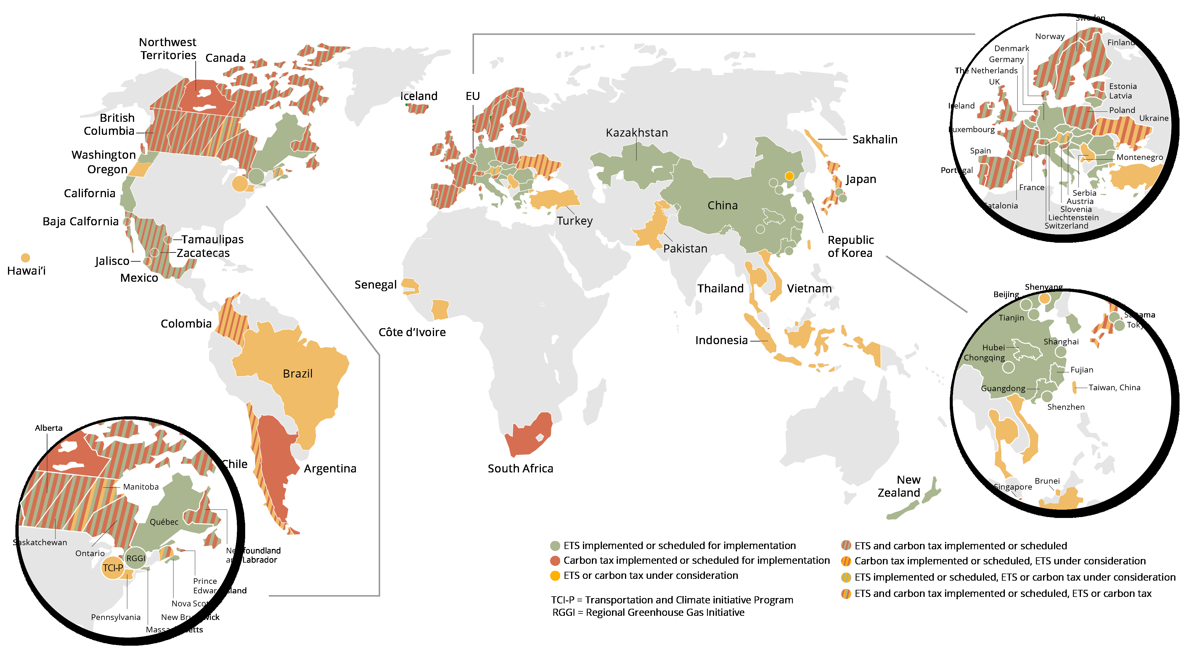
Carbon tax or CO2 market price
Source : World Bank, State and Trends of Carbon Pricing 2020
Source : World Bank, State and Trends of Carbon Pricing, 2021

Slide 7
Taxes or markets?
If we choose taxes, how to set a price to carbon = 20 € or 100€ or 250€ or 1000€ ?
How to set the tax at the “right level”?
The first approach is to make a cost-benefit analysis (CBA) to compare the costs of depollution with the costs of damages → carbon price equalizes marginal costs
Necessity to give a monetary value to all the damages
It can be made via many different techniques and works well for well-defined local damage
But, the CBA is not satisfying for climate change damages: boundaries are not correctly defined regarding probability, severity, and time duration…
Example: What is the monetary value NOW of the impact of a tonne of CO2 in 200 years? Economists have tried to answer this question, but their methodology is necessarily biased

Slide 8
Taxes or markets (2)?
2d approach: as CBA did not work for climate, economists have worked out another method: A cost-effectiveness analysis
It comes from operational research and in particular from constrained optimization techniques
The principle is to find the most effective program for a given cost of the less costly program for a given benefit

Slide 9
Cost-effectiveness analysis applied to climate change
Climatologists define the world maximum pollution level = world carbon budget to limit to 1.5 or 2 degrees more (1100Gt)…
Estimation of an emission trajectory in the reference scenario
Modelling of emission trajectories enabling a target to be reached
Calculation of discounted costs to reach the target
The carbon price obtained is the one that allows the economy to reach the target
Gollier 2021 : for 2degrees = 150€ today and 500 € in 2050.

Slide 10
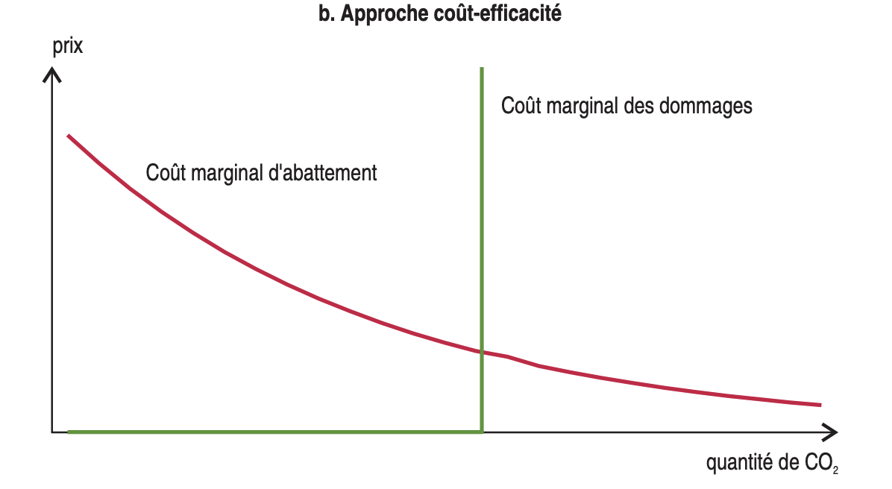
Cost-effectiveness analysis (Gollier 2021)
Price
2050
2023
2020
Carbone budget
1100 GtCO2 for 2 degrees
Abatement marginal cost
500 €
150 €
Tonnes of CO2

Slide 11
What most economists agree on:
We need a globalized price for carbon (the social cost of the ton of carbon emitted is the same whoever and wherever the emitter is).
On all producers and consumers
But there is a problem of acceptability because giving a value to carbon is very anti-redistributive…. => same cost for poor and rich but with big revenue differences : Clearly Unfair
On a local, national or international scale, carbon pricing cannot be implemented without a well-thought-out redistribution system
Local / national / International Green Fund
Notes:
Global price pour éviter les fuites de carbone

Slide 12
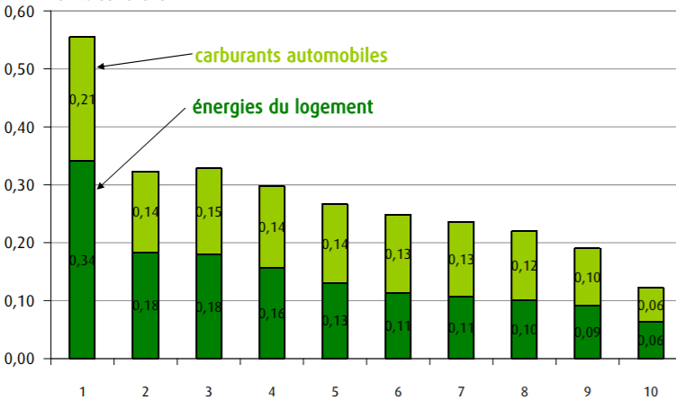
Impact of a 22 €/T carbon tax on the household revenues
% of disposable income
Deciles of income
Source : Mathilde Clement, CGDD-INSEE, using households surveys (2016)

Slide 13
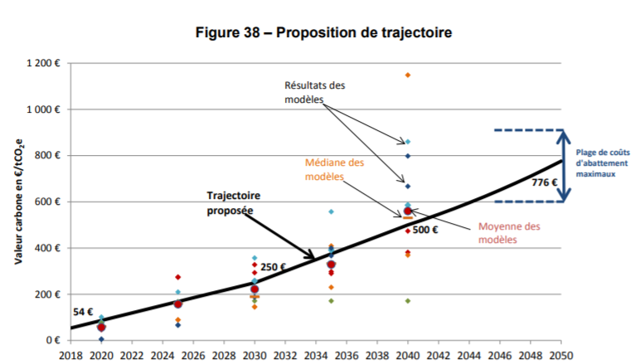
Example : 2019 carbone neutrality in 2050 for France
Source : Alain Quinet, La valeur de l’action pour le climat, 2019.

Slide 14
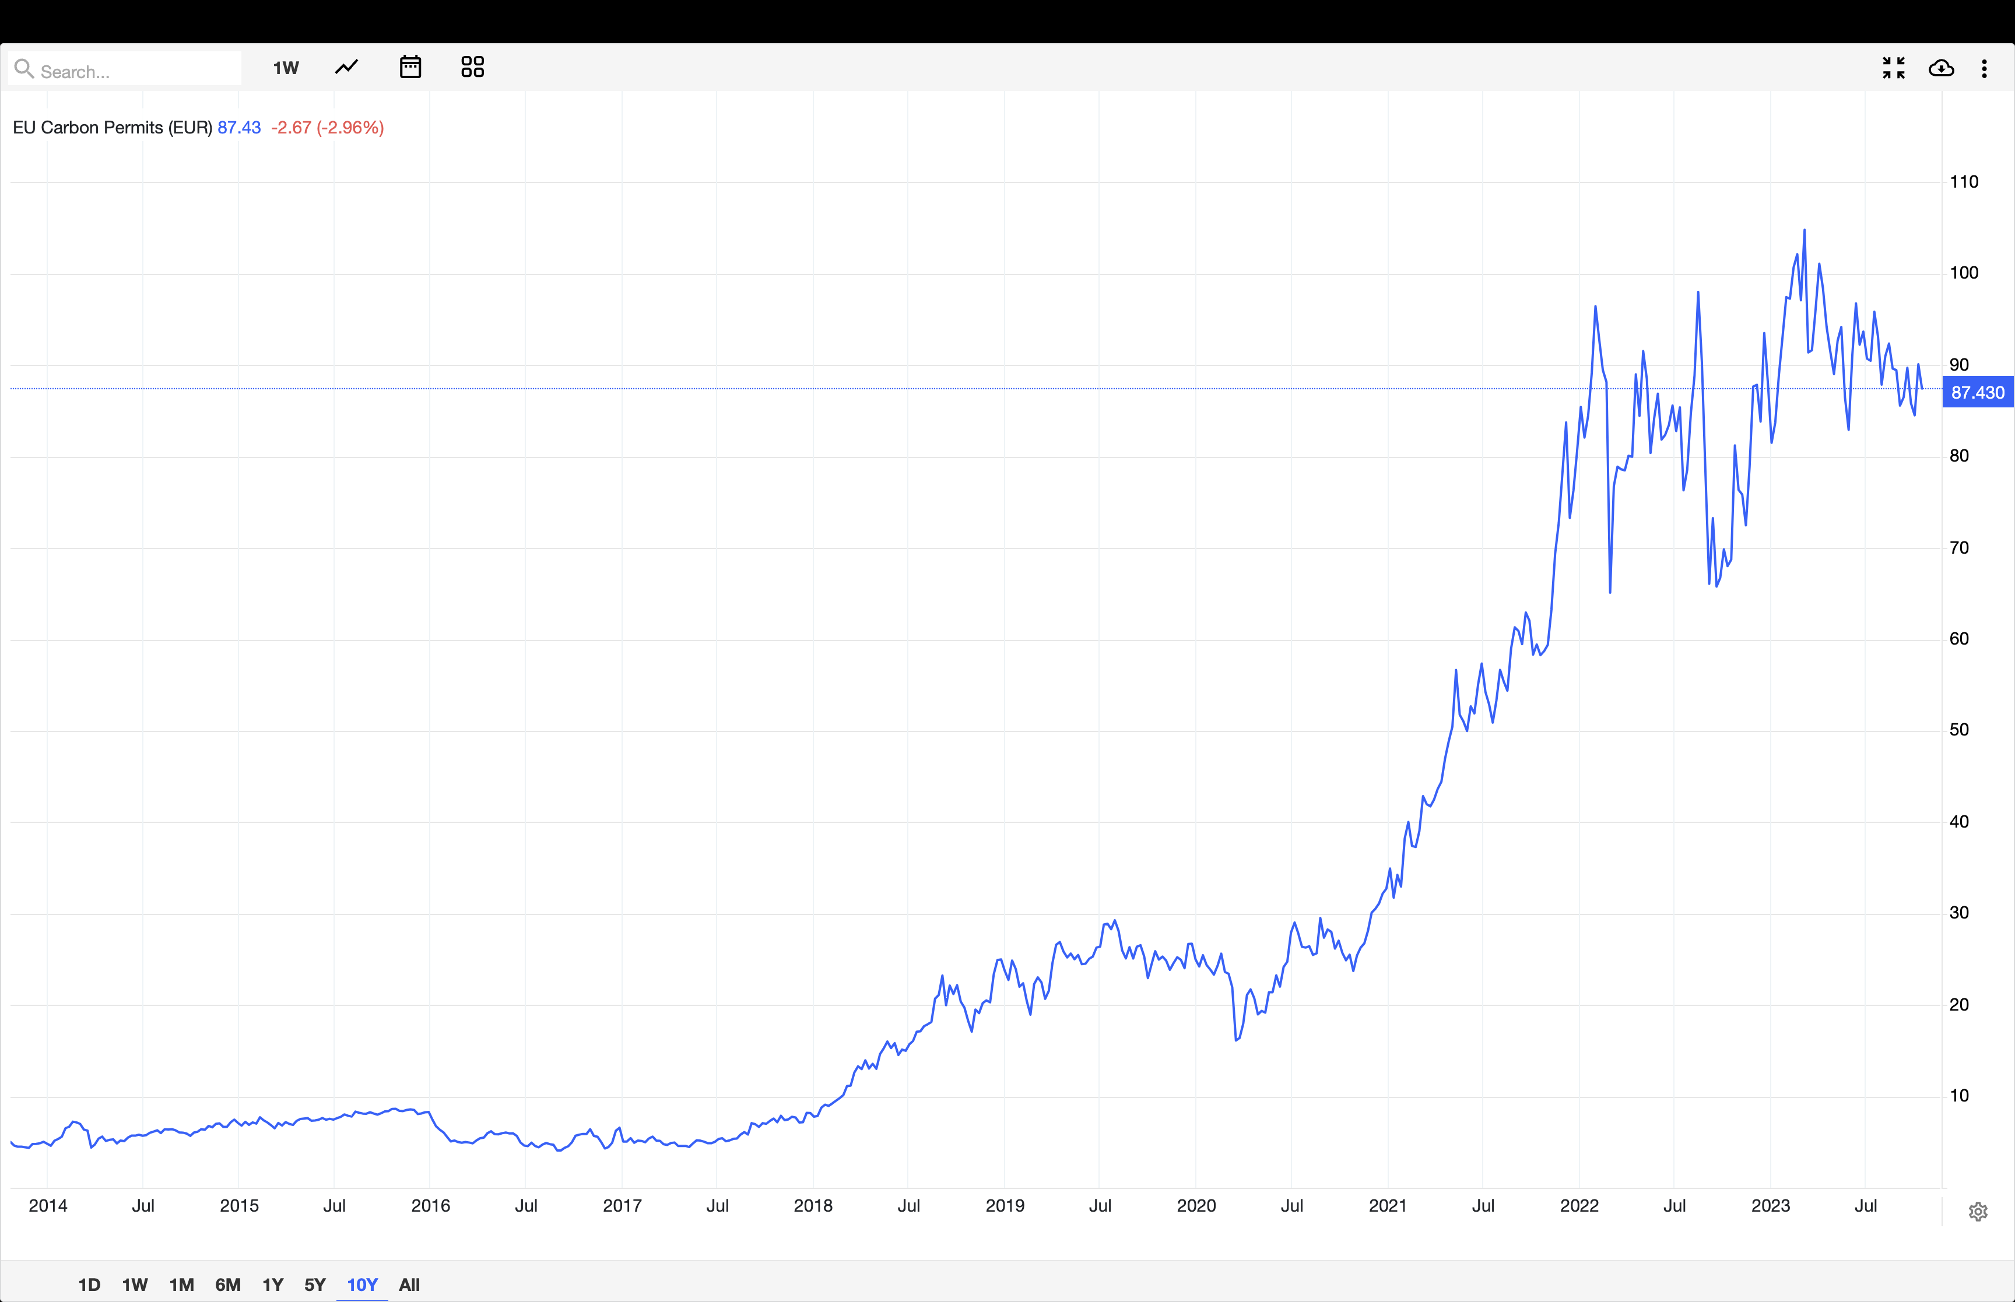
Actual carbon market prices in EU

Slide 15
Discussions
Carbon pricing makes the costs of the transition visible → This climate policy is difficult to support
Should costs be hidden by using ineffective policies with less transparent costs?
Any subsidy to X is a tax to Y
What happens if X and Y are not from the same country?
Avoid exemptions (taxis, road transport, aviation, farmers, etc, poor countries...).
The French “Yellow Vests” were right to point out that some do not pay a fair contribution
The feeling of injustice is sounded and must be resolved

Slide 16
Main messages
The social cost of carbon is incredibly important because it enables policymakers or private decision-makers to make sound decisions
The social cost of taxes and CO2 markets are less than norms
The actual social cost of carbon is underestimated compared to most estimations
Quinet 2: 75€ today, 775€ in 2050.
Stern and Stiglitz : $100 per ton by 2030;
Carleton = $125 per ton of carbon by 2030
Frances Moore, put it at $220 per ton in 2030.
CO2 markets/taxes are a source of revenues for policymakers, they must use it to help low-income people (in all countries) face the unfair burden effects of this policy

Slide 17
Additional material

Slide 18
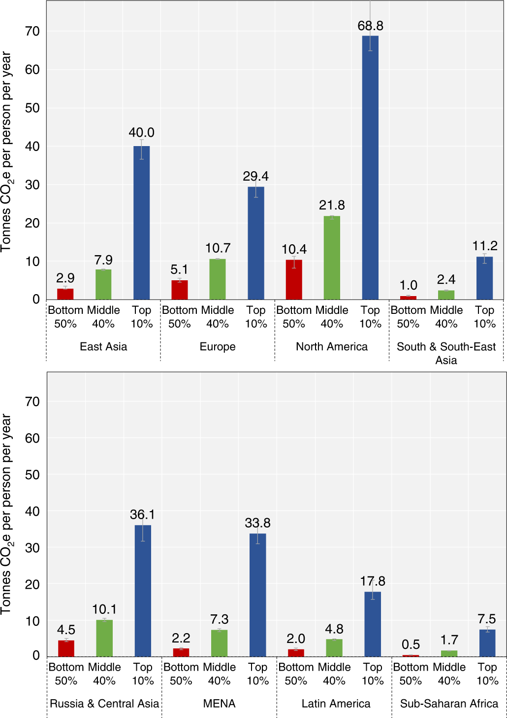
Emiters per region and per deciles
Chancel 2022: https://www.nature.com/articles/s41893-022-00955-z

Slide 19
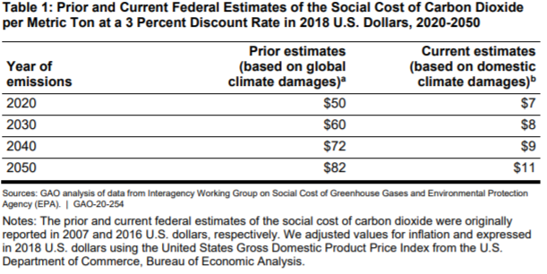
Obama VS Trump : how to manipulate the Social Cost of Carbon

Slide 20
Parameters of the calculation
“Discount rate debate”:
Question: who will pay the cost of carbon in the next 200 years = intergenerational equity .
Tool : a lower rate means valuing the harms to future generations more highly today, while a higher rate means allowing them to bear more of the burden.
Level: Most scientists assume a rate of 2 or 3 %, while Trump administration policies used a rate as high as 7 %.
“Growth rate debate”:
Question : In the next 25 years what would be the growth rate?
Setting the parameters: The bigger, the more we need a high price of carbon
Level of uncertainty :
Question : how to consider the data we did not know? What are the risks we may face in the future?
In terms of investments, do we have to make a difference according to the level of risks?
Nice online tool : Social Cost of Carbon Explorer
https://www.rff.org/publications/data-tools/scc-explorer/

Slide 21
EU’s plan for a Carbon Border Adjustment Mechanism (CBAM).
Problems: Competition from low cost polluters and ‘carbon leakage’
The European Parliament and the Council of the European Unionsigned the CBAM Regulation on 10 May 2023.
the CBAM will be phased in gradually and will initially apply only to a selected number of goods at high risk of carbon leakage:
iron/steel, cement, fertilisers, aluminium, hydrogen and electricity generation.
From october 23 a reporting system has started.
Importers will start paying the CBAM financial adjustment in 2026.
Its coverage will probably increase after 2026 to include chemicals and polymers…
Notes:
i.e. companies based in the EU could move carbon-intensive production abroad to take advantage of lax standards, or EU products could be replaced by more carbon-intensive imports.

