Slide 1
Before, During and After the Deluge: Monitoring the French Resident Population’s Response to the Covid-19 Pandemic with a Probability-Based Longitudinal Survey
ESRA23, Milan, 18 July 2023

Slide 3
THREE YEARS LATER: TIME FOR AN ASSESSMENT
In France, the COVID-19 pandemic is legally over:
“La loi abroge à partir du 1er août 2022 les dispositions du code de la Santé publique relatives à l'état d'urgence sanitaire, créé au printemps 2020, ainsi que le régime de gestion de la crise sanitaire instauré par la loi du 31 mai 2021”
39,866,718 COVID-19 cases (JHU 2023)
166,176 COVID-19 deaths (JHU 2023)
Excess mortality: 7.5% in 2020, 6.3% in 2021 (Blanpain 2022)
GDP: -7.9% in 2020 (Baleyte et al 2021)
€ 424 billion extra state expenditure 2020-2022 (Minister Olivier Dussopt, RFI, 14 April 2021)

Slide 4
AFTER COVID: AN EARLY LEGACY OF THE PANDEMIC?
COMPARING ECONOMIC AND PSYCHOLOGICAL WELL-BEING (2019-2022)
Inequalities exacerbated during COVID period, but after?
Which social groups have ‘lost ground’ because of the pandemic?
Are there social groups who have in fact ‘gained ground’ during the pandemic?
How much the pandemic had a direct effect (through COVID infections and COVID-related interventions) and an indirect (through life disruptions or categorical burdens) effect on individuals’ economic and psychological well-being?
Research question
Did economic and psychological well-being change over the pandemic, and if yes, over which social groups?

Slide 6
DATA: THE ELIPSS PANEL (1)
A high-quality probability online panel for the scientific community since 2012
2012: initial recruitment round (1,039 participants)
2016: expansion recruitment round (817 first round + 2,514 additional participants)
2020: expansion recruitment round (1,391 first rounds + 890 additional participants)
2023: expansion recruitment round (1,736 first rounds + 905 additional participants)
INSEE recruited a random sample of individuals aged over 18 with a fixed address in metropolitan France who can read French

Slide 7
DATA: THE ELIPSS PANEL (2)
A large production…
Cross‐sectional or longitudinal projects with no thematic restrictions
Monthly survey, 10 waves per year
9 waves designed by research applicants; 1 wave for the ELIPSS core questionnaire
20 minutes duration per wave
… to data dissemination for research

Slide 8
DATA: THE ELIPSS PANEL (3)
The life cycle of an ELIPSS survey

Slide 9
DATA: THE ELIPSS PANEL (4)
Focus on the annual survey
Repeated once a year
Sociodemographic and general attitude module
Systematically matched with the data files available on the dissemination platform
20 minutes duration per wave
Focus on the ‘CoCo’ Project (Coping with Covid-19)
ANR Flash Covid-19 call (March 2020)
Compare pre- and post-lockdown everyday life and inequality

Slide 10
BUILDING ON ELIPSS: THE COCO SURVEYS
Why? Compare pre- and post-lockdown everyday life and inequality
How? Eight waves in total:
1-5th April 1-June 5, 2020, during and just after the first lockdown
6th at the end of October 2020, just before the start of the second lockdown
7th in mid-November 2020, during the second lockdown
8th in mid-April 2021, during the third (and final) lockdown
Each wave open to panelists for 1-week; the first 5 waves were scheduled every other week

Slide 11
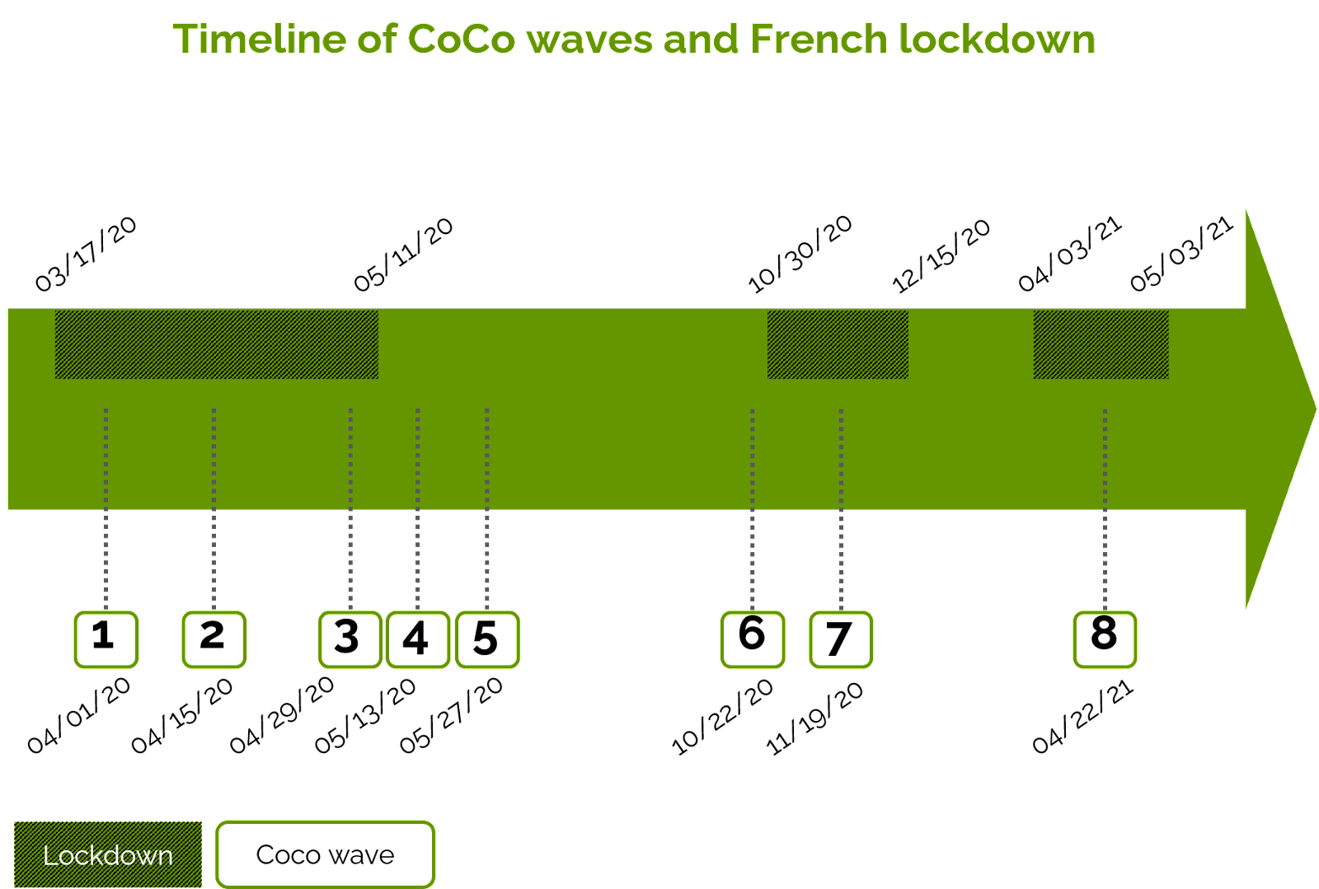

Slide 12
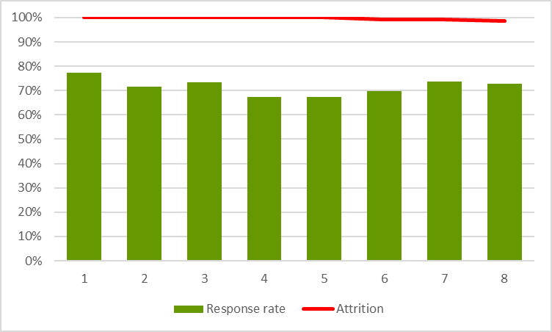

Slide 13
SAMPLE LIMITS
Sample under-represents the following categories:
One-person households
People in the Paris area
Households with individuals over 60 years or under 25 years of age
People with lower education
Ethnoracial minorities
Other minority groups – like the homeless and people living in retirement homes – not included despite potentially most at risk during the pandemic

Slide 15
Objective
Assess mental health changes across different social groups using pre- and post- pandemic measures (MHI-5)
Data
Mental Health Inventory 5 and individual-level predictors
(3.7% missing in 2022)
Analytical strategy
Model determinants of mental health in the pre-pandemic period
Model 2019-2022 changes

Slide 16
Measuring Mental Health - Background

Slide 17
Subjective well-being (Recchi et al 2020)
‘Eye of the hurricane’ paradox
Mental Health Inventory 5
In the past two weeks, have there been times when you felt:
Very nervous
So discouraged that nothing could lift your spirits
Calm and relaxed
Sad and defeated
Happy
always, often, sometimes, rarely, never
Responses recoded from 0 to 1, so that 0 represents the lowest feeling (‘always nervous’, ‘never happy’); expressed as the mean score on a 0-100 point scale

Slide 18
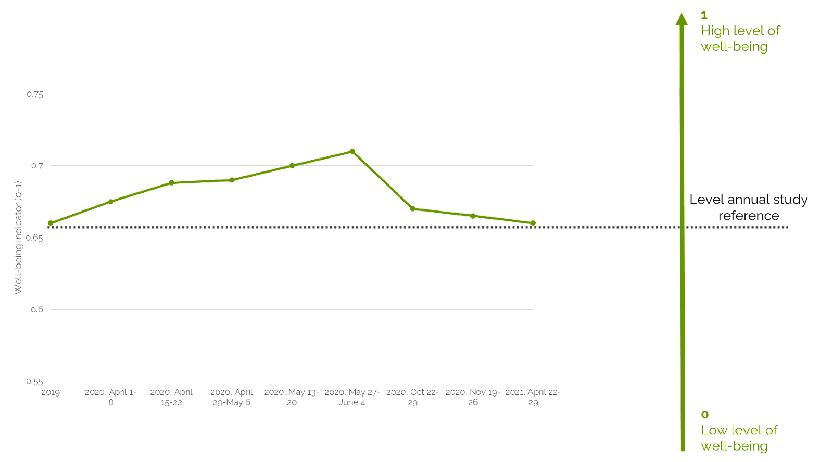
The Eye of the Hurricane
How do people assess their health and stress levels?

Slide 19
MHI-5 - Descriptive results (1)

Slide 20
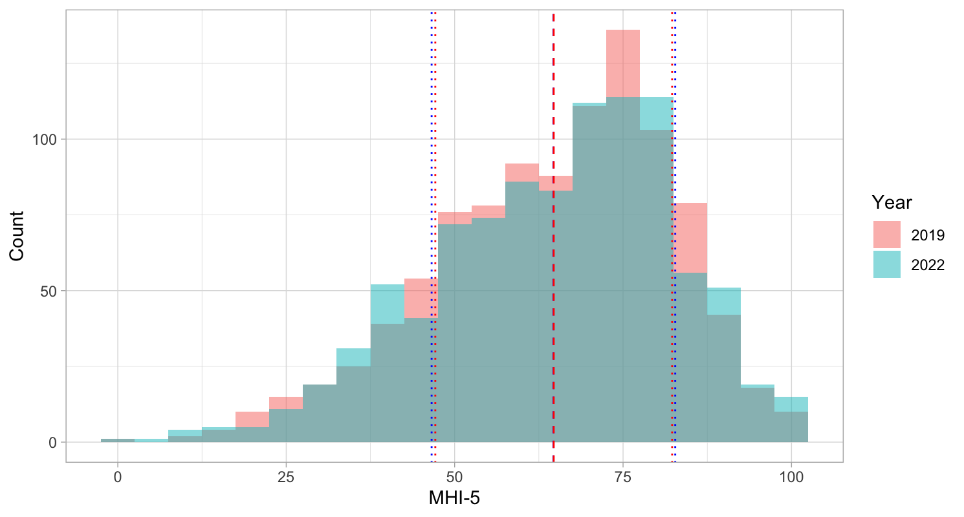
Figure 9. MHI-5 distribution (2019 & 2022) with means and ±1 SD, n=966

Slide 21
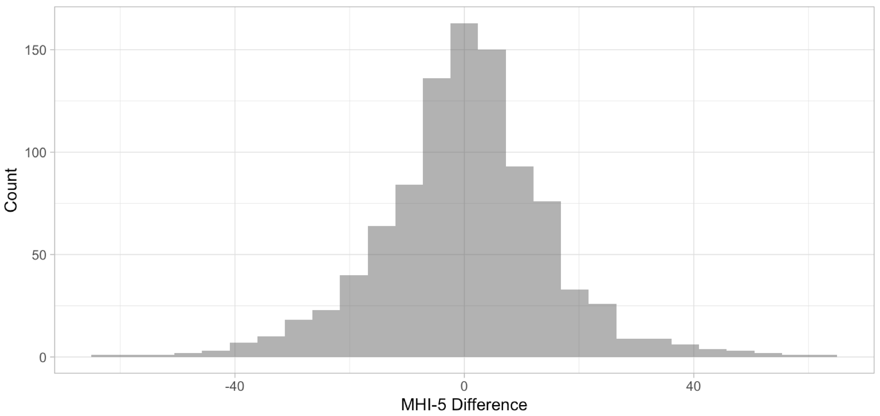
Figure 10. MHI-5 difference (2019 to 2022), n=966

Slide 22
Results - Modeling 2019 MHI-5 (2.1)

Slide 23
MODELING 2019 MHI-5
Objective
Assess the determinants of mental health in a baseline, pre-pandemic period
Outcome variable
MHI-5 2019 (0 to 100)
Predictor variables
Individuals’ sociodemographic profiles (1)
Individuals’ economic situation (2)
Individuals’ health situation (3)
Models
OLS regressions
Robustness checks
MHI-5 cutoff as binary outcome variable

Slide 24
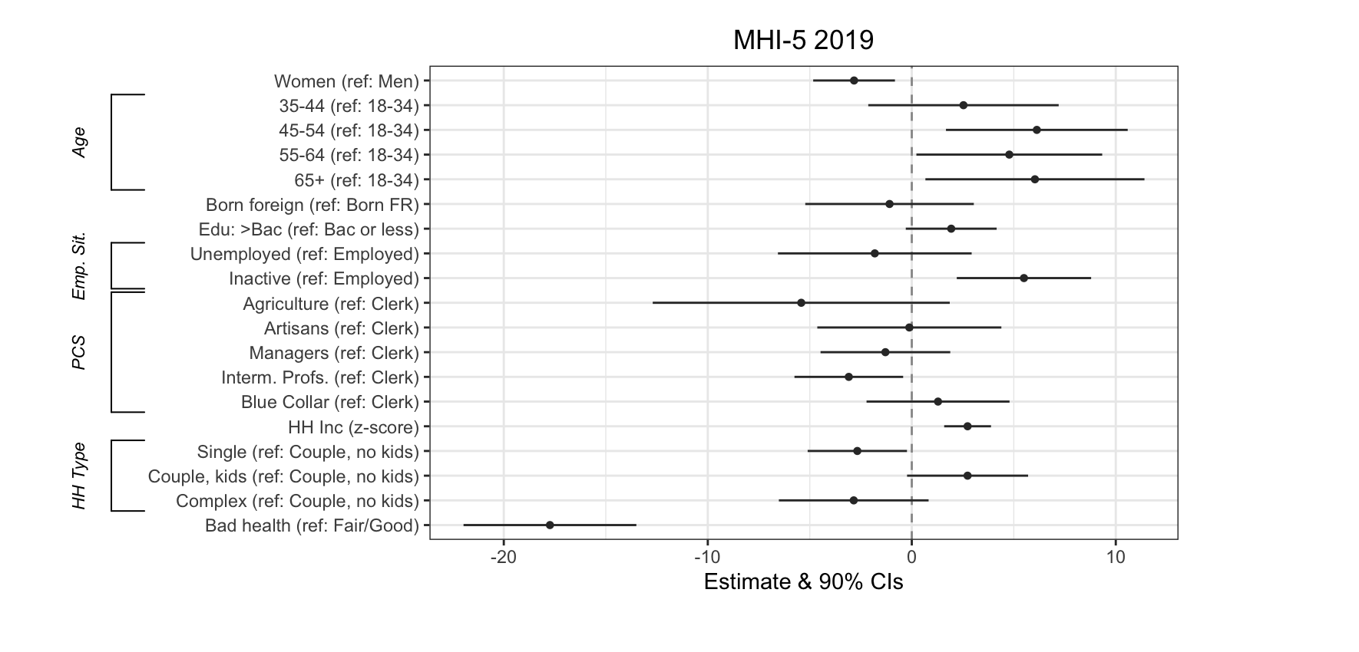
Figure 11. OLS model on MHI-5 2019, n=865

Slide 25
Results - Modeling MHI-5 Changes

Slide 26
MODELING 2019-2022 MHI-5 CHANGES
Objective
Assess the determinants of changes in mental health
Outcome variable
MHI-5 2022
Predictor variables
Identical to 2019 analyses (sociodemographic profile, economic, and health situations)
+ COVID-19 factors (infection and post-COVID symptoms, knowing people who died)
+ MHI-5 2019
Models
OLS regressions
Robustness checks
MHI-5 difference as outcome variable
MHI-5 cutoff as binary outcome variable

Slide 27
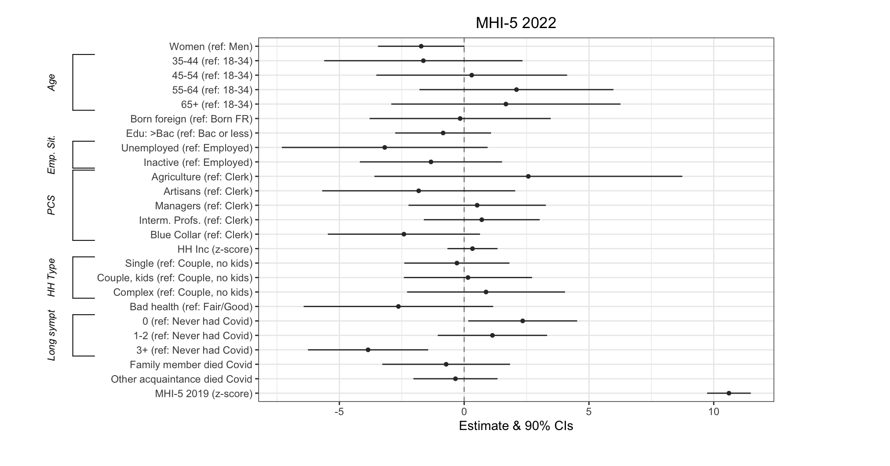
Figure 12. OLS model on MHI-5 2022, controlling for 2019 characteristics, n=828

Slide 28
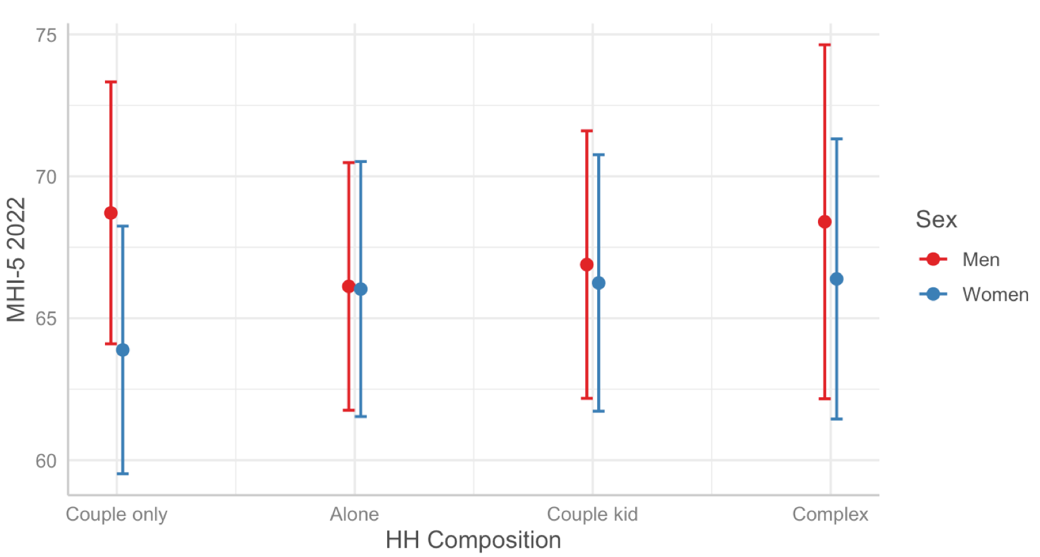
Figure 13. Marginal effects on interaction between gender and household comp.

Slide 29
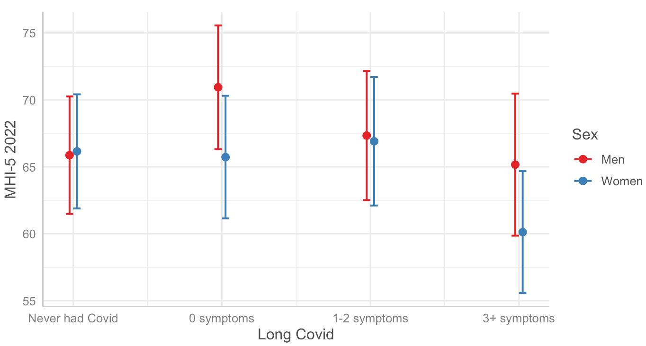
Figure 14. Marginal effects on interaction between gender and long COVID

Slide 31
RESULTS
As a disease, COVID-19 had no direct impact on household income, but it did on mental health
Psychologically, most people’s mental health did not deteriorate. Still, for about ¼ it did. Mostly women and those who were already in poor health, unemployment, and blue collar work
However, an infection with no post-COVID symptoms has a mental health ‘survivor’ effect (for men)
CAVEATS
We monitor changes in outcomes, but do not explore mechanisms (eg, telework) and confounders (eg, inflation)
Uniquely longitudinal and solid sample, but small and not representative of particularly at-risk groups

Slide 32
NEXT STEP: COCO-WaL SURVEYS: 9TH AND 10TH WAVES (2022)
Two new modules fielded in October-November 2022 to take on board the ‘Winners and Losers’ project
Questions: follow-ups of CoCo and retrospective assessments
Rationale: unwrap continuity and changes from the pre-COVID period, weighing in on the effect of the COVID experience
Focus on economic and psychological well-being

Slide 33
Thank you
mathieu.olivier@sciencespo.fr

