Slide 1
Gizey onomatopoeia
Guillaume Guitang
Université libre de Bruxelles
Pius W. Akumbu
LLACAN (CNRS – INaLCO – EPHE), PARIS
#SLE2023, Athens, Aug. 29 – Sept. 1
Workshop: Sound symbolism and onomatopoeia

Slide 2
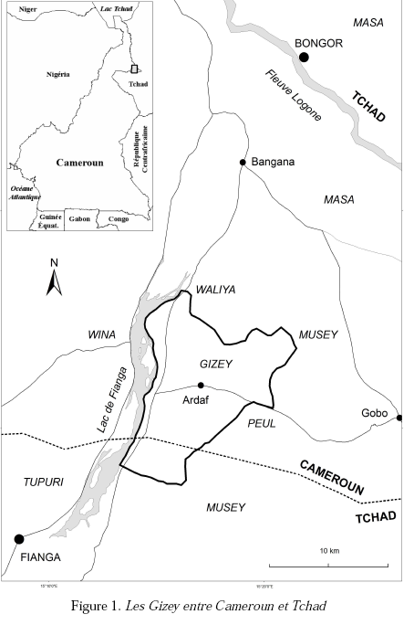
Gizey
Masa language (Chadic < Afroasiatic)
Spoken in Cameroon & Chad
12 000 -19 000 speakers
Gaffuri, Luigi & Melis, Antonino & Petrarca, Valerio. 2014. Les Gizey du Cameroun et du Tchad: identité, dynamismes, échanges culturels. In Baldi, Sergio & Magrin, Gérard (eds.), Les échanges et la communication dans le bassin du lac Tchad : actes du colloque de Naples du réseau Méga-Tchad, Università degli studi di Napoli “L’Orientale”, Naples 13-15 septembre 2012, vol. 6, 515–546. Italy: Mega-Chad Research Network / Réseau Méga-Tchad.
Guitang, Guillaume. 2021. Gizey (Cameroon and Chad) - Language snapshot. Language documentation and description 20. 236–243. (doi:https://doi.org/10.25894/ldd52)
Seignobos, Christian & Iyebi-Mandjek, Olivier. 2000. Atlas de la province de l’Extrème-Nord Cameroun. Yaounde: IRD Editions - MINREST/INC.

Slide 3
Gizey: literature on expressives
“Ideophones in the Gizey grammar” (under review)
Discusses onomatopoeic nouns
mɛ́ɛ́ ‘goat’ (< mɛ́ɛ́ ‘baa’);
bùtùtúk ‘Senegal Coucal’ (< bùdùdù ‘call of the Senegal coucal’)

Slide 4
Gizey: phonology
26 consonants: p, b, t, d, k, g, Ɂ, ɓ, ɗ, ʧ, ʤ, f, v, ɬ, ɮ, s, z, h, ɦ, m, n, ŋ, l, r, w, j
5 vowels: i, u, ɛ, ɔ, a (with long counterparts iː, uː, ɛː, ɔː, aː)
2 tones: H, L
De Dominicis, Amedeo. 2008. Phonological Sketch of Gizey. Studi Linguistici e Filologici Online 6. 1–78.

Slide 5
Gizey: phonology
Open syllables | CV (ɓɔ́ ‘gloom’) | CVV (hàà ‘until’
Closed syllables | CVC (ʤàɓ ‘tie’) | CVVC (kààm ‘yesterday’)
Onsetless syllables disallowed (glottal closure)
ɔ́ɬ > ʔɔ́ɬ ‘cough’
Consonant clusters disallowed (occur when a vowel is deleted)
ɓálák > ɓlák ‘spoil’

Slide 6
Gizey: morphology
Limited inflectional morphology
Nominal plurality (only a limited set of count nouns)
e.g., bàk ‘leather’: bɨ̀k-ɛ́j ‘leathers’
viewpoint aspect (imperfective/perfective)
e.g., Class 1 verbs: kál(à) ‘leave’ # kàl(á) ‘left’
No overt derivational morphology

Slide 7
Data sources
Gizey-French dictionary (2008)
Folktales (2019)
Elicitation (via WhatsApp, 2023)
Ajello, Roberto & Melis, Antonino. 2008. Dictionnaire gizey-français, suivi d’une liste lexicale français-gizey. Pisa Edizioni ETS. Pisa.
Körtvélyessy, Lívia. 2020. Onomatopoeia – A Unique Species? Studia linguistica 74(2). 506–551.

Slide 8
Data sources
104 items
4 categories of sound sources: elements, animals, human, artifacts

Slide 9
Onomatopoeia: phonology
Sound inventory and distribution is mostly like the prosaic system
Attestation of two marginal (onomatopoeia and elsewhere) consonants: /ɲ/ and /ɾ/ and vowel /œ/
ɲìgí ‘Guinea fowl_call’
pɾɛ́k pɾɛ́k ‘lightning_sound’
ʔœ́ːk ‘frog_call’

Slide 10
Onomatopoeia: phonology
br, bl, pr, kr consonant sequences tend to be allowed in onomatopoeia
blúk ‘sound of thrown stone’
brít ‘pooing_sound’
krɛ́w krɛ́w ‘sparrowhawk_call’
pɾɛ́k pɾɛ́k ‘lightning_sound’

Slide 11
Onomatopoeia: root structure
Dominant root structure: CVC (like in the rest of the lexicon)
Disyllabic constraint: “roots never exceed two syllables” (same in the prosaic system)
CiC is the dominant model (morphological niche) for the creation of new onomatopoeia
De Dominicis, Amedeo. 2008. Phonological Sketch of Gizey. Studi Linguistici e Filologici Online 6. 1–78.

Slide 12
Onomatopoeia: root structure
CiC is the dominant model (morphological niche) for the creation of new onomatopoeia
dìm ‘sound of heavy object thrown in water’
ɗít ‘sound of violent hit’
dìt ‘final sound of noisy process’
No transparent CiC-meaning association
De Dominicis, Amedeo. 2008. Phonological Sketch of Gizey. Studi Linguistici e Filologici Online 6. 1–78.

Slide 13
Onomatopoeia: root structure
/i/ is amongst the most utilized vowel
/i/ is overrepresented in onomatopoeia

Slide 14
Onomatopoeia: root structure
CiC is the dominant model (morphological niche) for the creation of new onomatopoeia
dìm ‘sound of heavy object thrown in water’
ɗít ‘sound of violent hit’
dìt ‘final sound of noisy process’
CiC was probably first associated with NOISE before turning to a regular morphological niche from which new forms are modelled (under analogy)

Slide 15
Onomatopoeia: sound symbolism?
Very limited obvious sound symbolism
Examples include: dominance of /w/ for FLYING or air connection
vìw ‘sound of fire in windy situation’
wíí wíí ‘sound of flying mosquito or wasp’
wì wì wì ‘sound of flying fly’
kíwíwwíw ‘sound of a thrown knife’
but also in:
nɛ́w nɛ́w nɛ́w ‘sound of white-faced whistling duck’
kírìw ‘sound when sharpening a knife’

Slide 16
Onomatopoeia: sound symbolism?
Very limited obvious sound symbolism
Potential meaningful tonal contrast?
H: wíí wíí ‘sound of flying mosquito or wasp’
L: wì wì wì ‘sound of flying fly’
Also búm ‘gunshot sound ’ # bùm ‘sound when burning a wet object’
Limited examples (minimal pairs) to draw any conclusion

Slide 17
Onomatopoeia: sound symbolism?
coda trill usually describes extended or prolonged sound-events
ʤɛ̀r ‘sound of oil while frying’
ʧɛ́r ‘call of yellow-billed oxpecker’
But tír ‘hard_hit’

Slide 18
Onomatopoeia: sound symbolism?
Final /m/ = LOUD SOUND?
dìm ‘sound of something heavy thrown in water or of someone diving in water’
brùm ‘sound of something big and heavy thrown in water’
ʤùm ‘sound of someone diving in water’
búm ‘sound of gun’
gùrùm ‘sound of the gurlum’ (kind of gun)

Slide 19
Onomatopoeia: morphology
Onomatopoeia do not show any inflectional or derivational morphology
They do not host any agreement morpheme
“expressive morphology” (iconic, showing depictive properties)
Final /r/ lengthening e.g., ʧɛ́rrr ‘call of yellow-billed oxpecker’
Final syllable doubling (frozen form): bìgìm-gìm ‘loud water sound’
Sounds produced by animals often come repeated e.g., kɛ̀kɛ̀rɛ́k kɛ̀kɛ̀rɛ́k ‘Guinea fowl call’ (imitation)

Slide 20
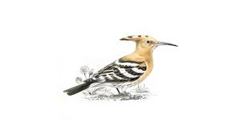
Onomatopoeia: note on reduplication
Reduplication is not a productive process in Gizey
Only a few frozen reduplicatives are attested, including final syllable doubling: bìgìm-gìm ‘loud water sound’
-CVC reduplicative pattern indexes length, straightness and large quantity
dùmúl-múl | ‘snake sp’
ʤùkúl-kúl | ‘hoopoe’
ʧìkíl-kíl | ‘Elapsoidea guntheri’
tùgùl-gúl | ‘variable cat snake’
dùwér-wér | ‘part of the intestine’

Slide 21
Onomatopoeia: morphology
Animal onomatopoeic forms can have nominal counterparts
The nominal counterparts can include part, or all, of the material found in the onomatopoeia
Onomatopoeia | Related noun
mɛ́ɛ́ ‘baa’ | mɛ́ɛ́ ‘goat’ (also ɦù mɛ́ɛ́ ‘caprine baa’)
bùdùdù ‘call of the Senegal coucal’ | bùtùktúk ‘Senegal Coucal’
ʧɛ́r ‘call of the yellow-billed oxpecker’ | ʧɛ́r ‘yellow-billed oxpecker’
kɔ́ɔ́gɔ́gùlɔ́k ‘cock-a-doodle-do’ | gùlɔ́k ‘cock’

Slide 22
Onomatopoeia: morphology
The onomatopoeic nouns show properties associated with nouns, e.g.,
plural marking: mɛ́ɛ́-gɛ́ ‘goat-PL’,
hosting of the definiteness clitic: bùtùktúk=ŋà ‘Senegal Coucal=DEF.SM’,
subject role, etc.
Onomatopoeia | Related noun
mɛ́ɛ́ ‘baa’ | mɛ́ɛ́ ‘goat’ (also ɦù mɛ́ɛ́ ‘caprine baa’)
bùdùdù ‘call of the Senegal coucal’ | bùtùktúk ‘Senegal Coucal’
ʧɛ́r ‘call of the yellow-billed oxpecker’ | ʧɛ́r ‘yellow-billed oxpecker’
kɔ́ɔ́gɔ́gùlɔ́k ‘cock-a-doodle-do’ | gùlɔ́k ‘cock’

Slide 23
Onomatopoeia: syntax
Onomatopoeia can occupy two slots
predicate modifier
Ø | kā | ɦùn gùn | gù | k=ɔ̄m | ɓát
pro | cut.pfv | branch | rev | with=3sm | onom
‘(He) broke a branch ɓát’

Slide 24
Onomatopoeia: syntax
Onomatopoeia can occupy two slots
“Demonstration” (quotational construction)
ŋàk=ŋ | ʔáj | wān | là | ŋàgí | ŋàgí
crane=def.sm | exist.pst | there.lying | quot | onom | onom
‘Crane was lying there crying: ŋàgí ŋàgí.’

Slide 25
Onomatopoeia: semantic relations
insufficient evidence to illustrate clear semantic relationships between onomatopoeia
possibility to use more than one form for a sound from a single source
dìm ‘sound of something heavy thrown in water or of someone diving in water’
brùm ‘sound of something big and heavy thrown in water’
ʤùm ‘sound of someone diving in water’

Slide 26
Onomatopoeia: conclusion
Sparse data at this stage
Few discrepancies between onomatopoeia and the rest of the system
Only limited (and probably disputable) cases of sound symbolism

Slide 27
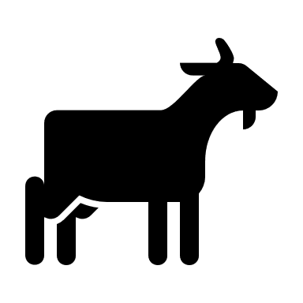
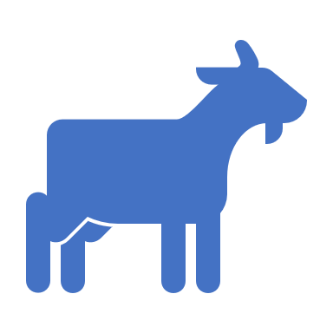
Thank you!
mɛ́ɛ́ ‘baa’
(ɦù) mɛ́ɛ́ ‘goat’

