Slide 1


Visualizing data with professor Tsugita: a history within distinct macromolecular classes
Enrique Wulff in Marine Sciences Institute of Andalusia (CSIC)

Slide 2

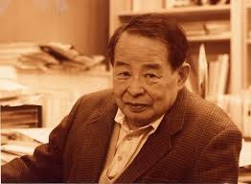
Akira Tsugita
(1928, August 18, 2007, May 31)
prof. Tsugita was a Japanese molecular biologist and director who moved to Europe, as a Visiting Lecturer on leave of absence from the Osaka University.

Slide 3
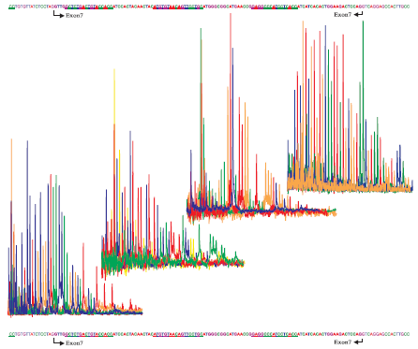
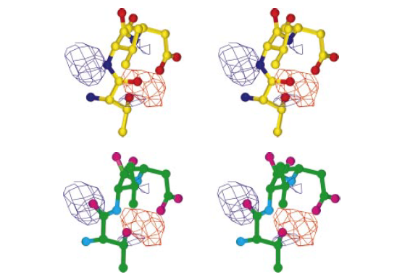
The biological sciences have been traditionally a visually-rich discipline. The deduced protein sequence and the amino acid sequences determined directly from the protein analysis agree with this postulate.
Sequencing Exon 7 of the human p53 tumor suppression gene by Matrix-assisted laser desorption and ionization-Time of flight (MALDI-TOF) mass spectrometry (Tsugita, 2000).
Professor Tsugita (1928-2007), a university affiliated biochemist, used to say "Nucleic acid mass spectral data are typically
accurate to fractions of a Dalton. This is quite a change from the data that molecular biologists usually confront!".
A difference map showing electron density and structural model superposed. Top: During the process of structure determination; bottom: corrected model (Tsugita, 2000).

Slide 4
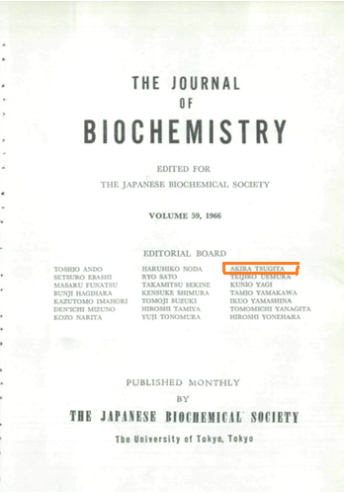
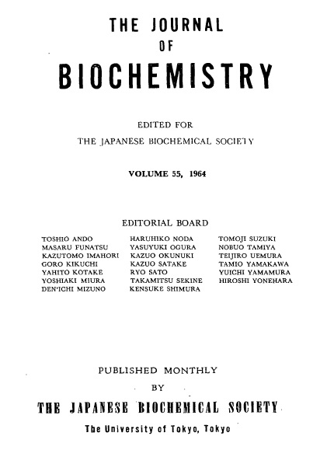
He was awarded the Promotion Prize from the Japanese Biochemical Society (1964) and in 1966 he was included in the Editorial Board of the Journal of Biochemistry

Slide 5
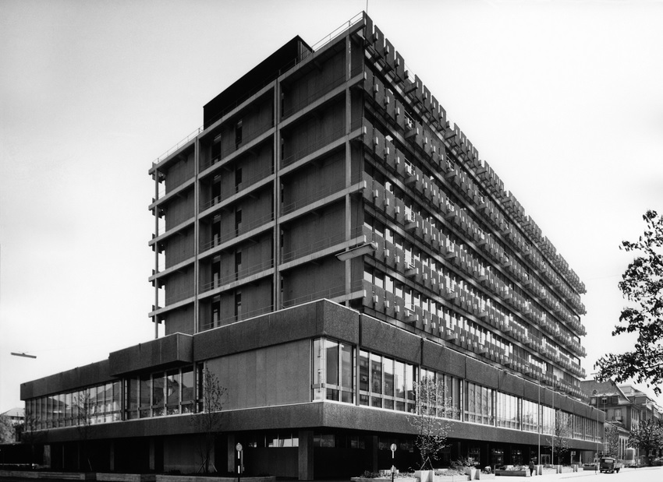
In 1976, Akira Tsugita received the honorary membership of the University of Basel (Biocenter).

Slide 6
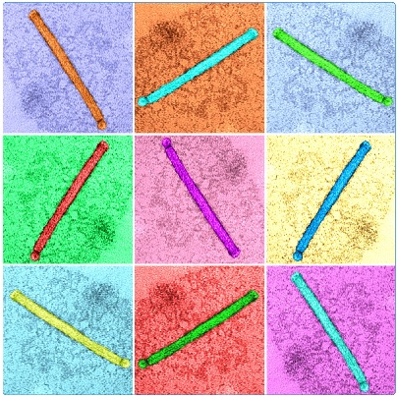
Two milestones in research on tobacco mosaic virus (TMV) can be attributed to Tsugita (Harrison & Wilson, 1999):
In 1960 (Tsugita et al., 1960)(Strasser, 2010), he reported the complete sequence of a strain of TMV, and from that suggested that the genetic code should be universal.
In 1962, Tsugita provided the key evidence that nucleotide triplets encoding individual amino acids do not overlap (Tsugita, 1962).

Slide 7
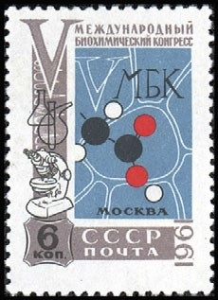
Both ideas were put into circulation at the Fifth International Congress of Biochemistry, in Moscow, 10-16 August 1961.

Slide 8
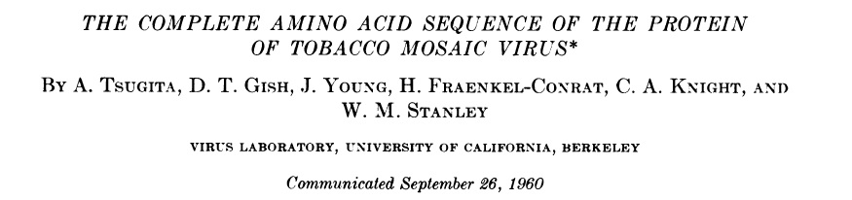
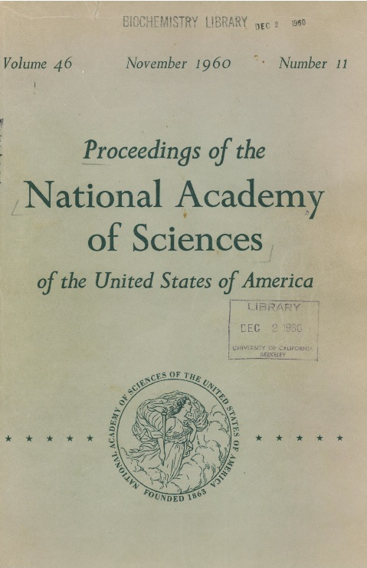
Firstly: In 1960, he published the complete amino acid sequence of the TMV coat.

Slide 9
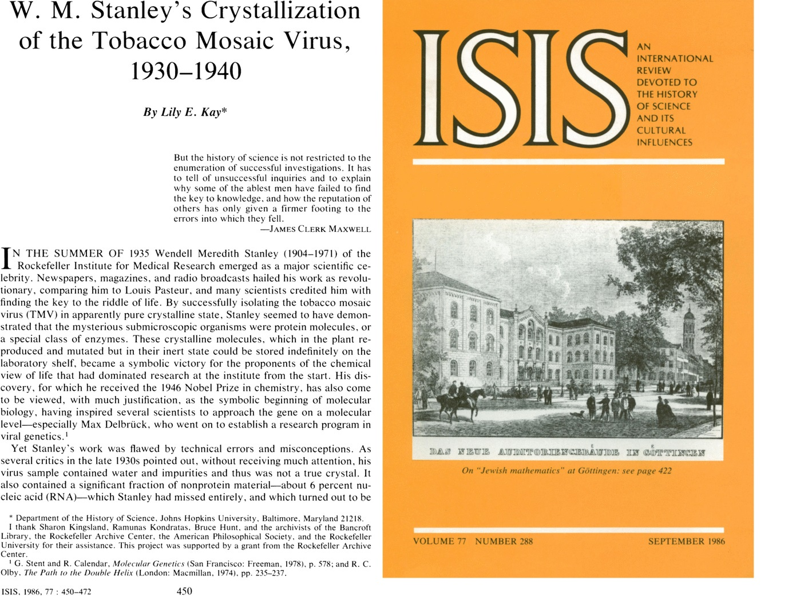
Tsugita was at the Virus Laboratory directed by Nobel Prize in Chemistry 1946, Wendell Meredith Stanley in the University of California, Berkeley.

Slide 10
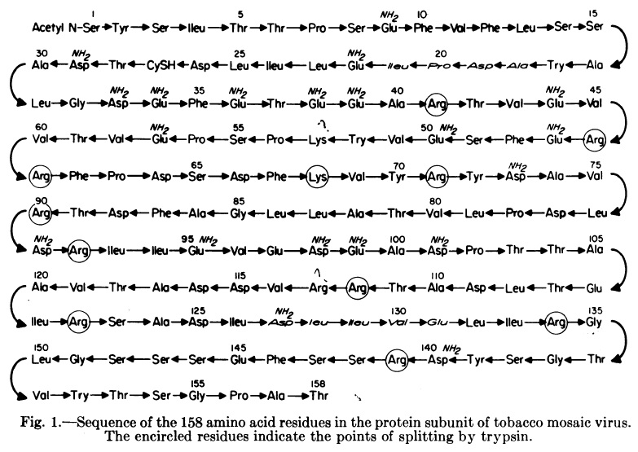
George Gamow said that he viewed TMV as "a beautiful 158 jewel necklace".

Slide 11
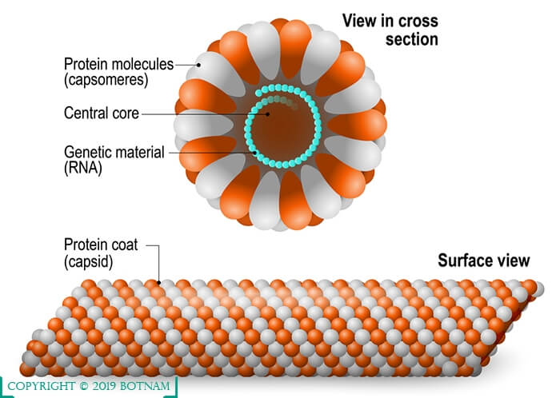
He added that he had spent his efforts trying to decode it, using an overlapping code, six or seven years ago!

Slide 12
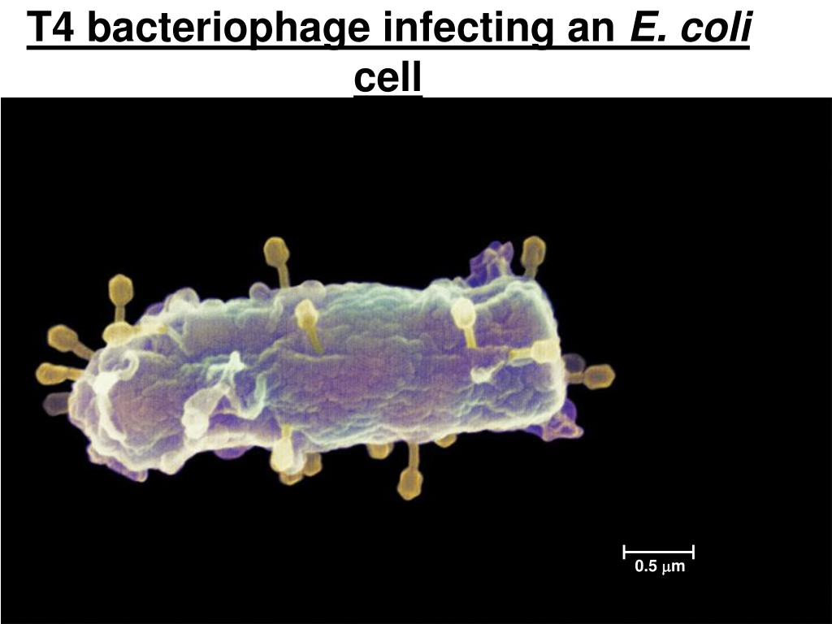
Using tobacco mosaic virus (TMV), Tsugita and Fraenkel-Conrat extracted some of its RNA and introduced this viral RNA into the bacterial protein-synthesizing system of E. coli.

Slide 13
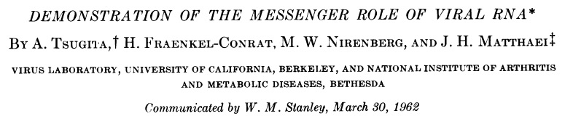
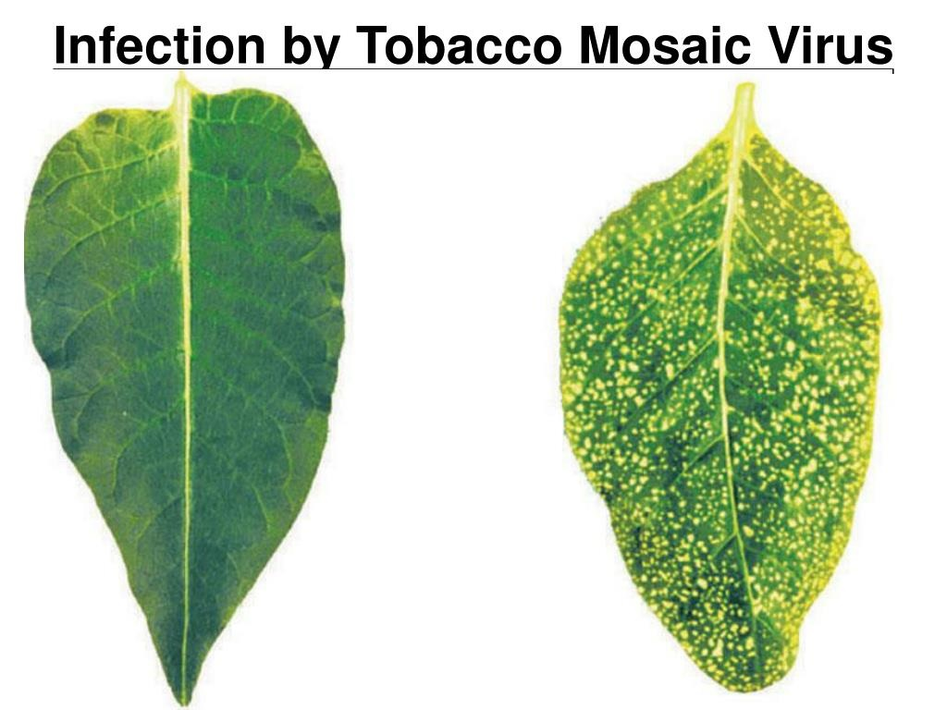
From that, he attained the conclusion that in all living organisms the genetic code is the same.
Tsugita’s research into TMV led to the conclusion that the genetic code may constitute a common "language" understood by all living things.

Slide 14
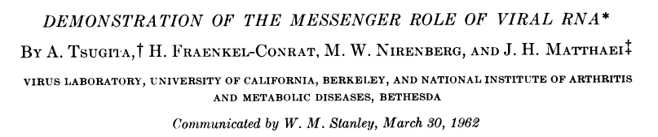

The result was an evidence of marked structural similarity between proteins synthesized by the E. coli system and by tobacco plant cells, under the direction of the same viral RNA.
In what clearly indicated that the genetic code is quite similar for widely divergent living organisms
(since instructions from the same virus were needed in similar fashion by a bacterium and by a plant) and thus may be universal!

Slide 15
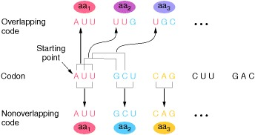
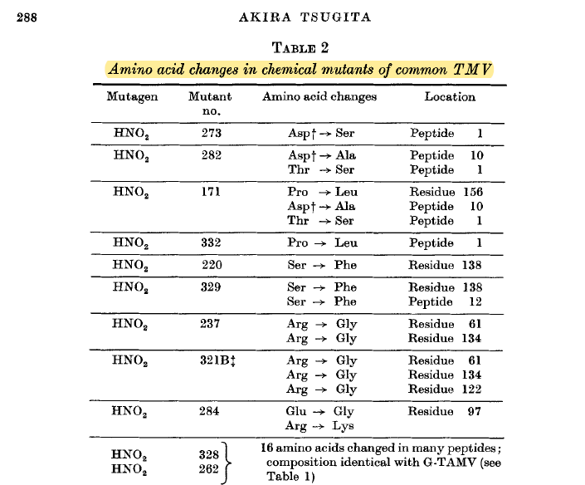
Secondly: In 1962, Tsugita provided the evidence that nucleotide triplets encoding individual amino acids do not overlap, that the genetic code is not overlapping!

Slide 16
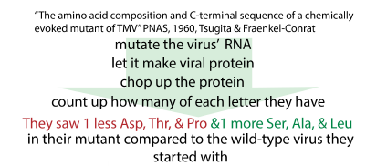
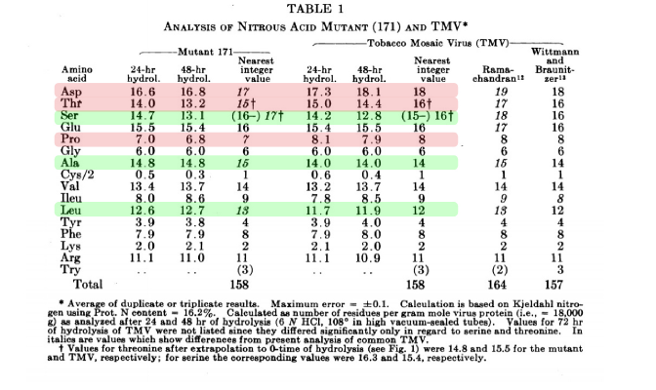
Because changes of single nucleotides in the RNA virus (TMV) entailed substitutions of only one but not of two or three amino acids in the coat protein.

Slide 17
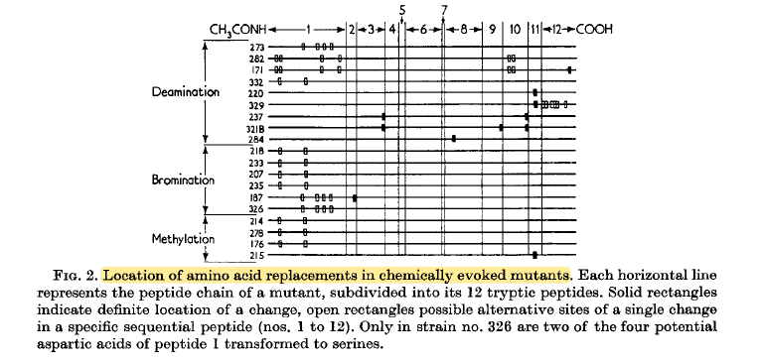
.
In 1962, Tsugita provided the exact location.
A comparison of the amino acid exchanges of all the TMV strains and mutants analyzed shows that a host of the changes can be traced back to a modification of only one nucleotide base per codon.

Slide 18
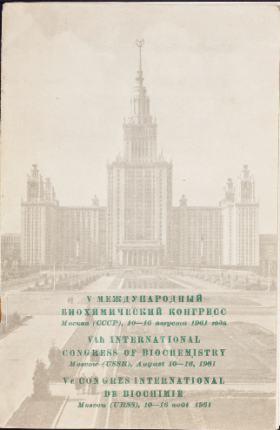
In particular, the contribution Tsugita presented in Moscow made amino acid composition analysis reveal that aspartic acid, threotine, and proline residues of the wild-type protein were, correspondingly, substituted by alanine, serine, and leucine.
After a decade of research, this biological coding problem was brought to bay.

Slide 19
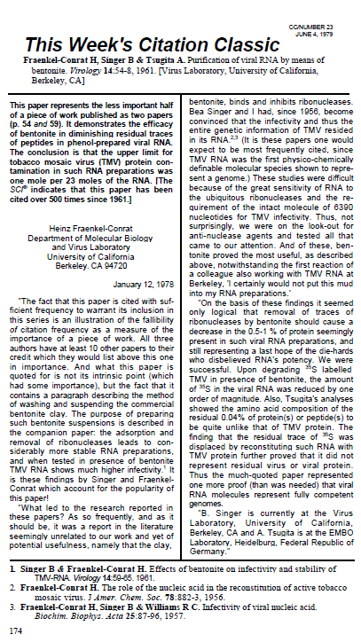
In May in the year of the congress, Tsugita had succeeded, together with Fraenkel-Conrat and Singer, in developing the purification of viral RNA by means of bentonite, which went on to become a standard protocol, and their paper a citation classic
(Current Contents, 1979).

Slide 20
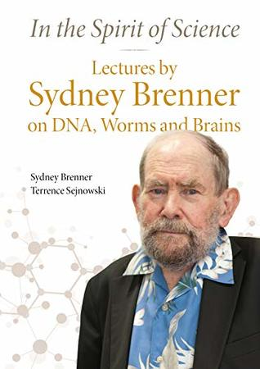
Material for the history of the political position of Tsugita in relation to Europe is of course sparse, with minimal data relating to his letter correspondence with Sydney Brenner in two different periods: 1965-1967 & 1981-1982. Over the two decades, Brenner was at the Laboratory of Molecular Biology in the Cambridge Medical School; and, Akira Tsugita occasionally visited him there.

Slide 21
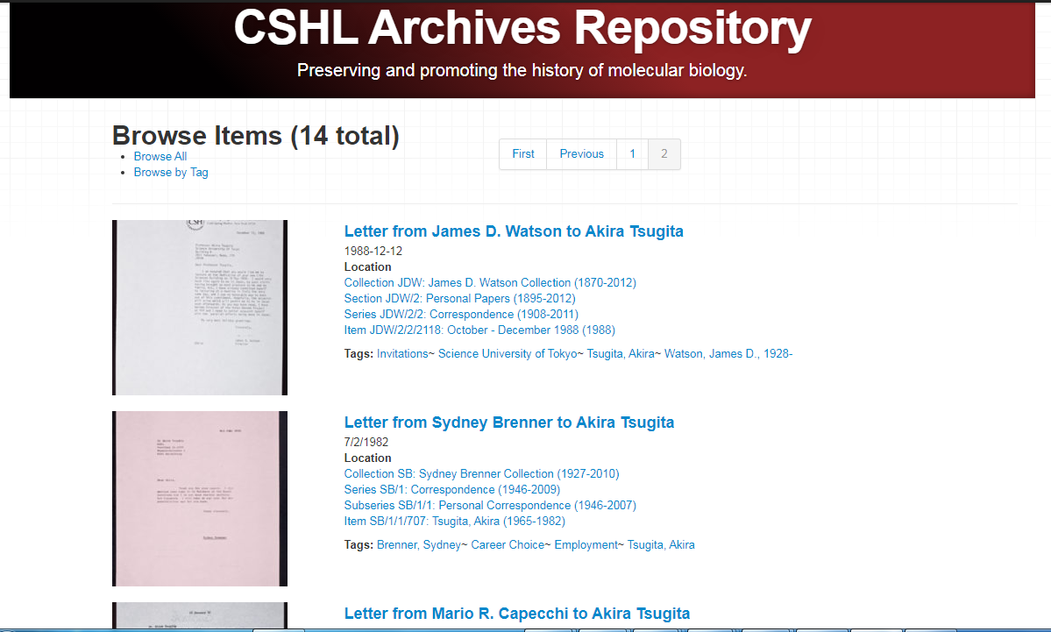
Four letters regard experiments and meetings and cover the period of 1965-1967, while Tsugita was serving at the laboratory of molecular genetics in the University of Osaka. Two letters on employment and career choice, embrace the interval from 1981 to 1982, and were
handwritten by Tsugita from the European Molecular Biology Laboratory in Heidelberg.

Slide 22
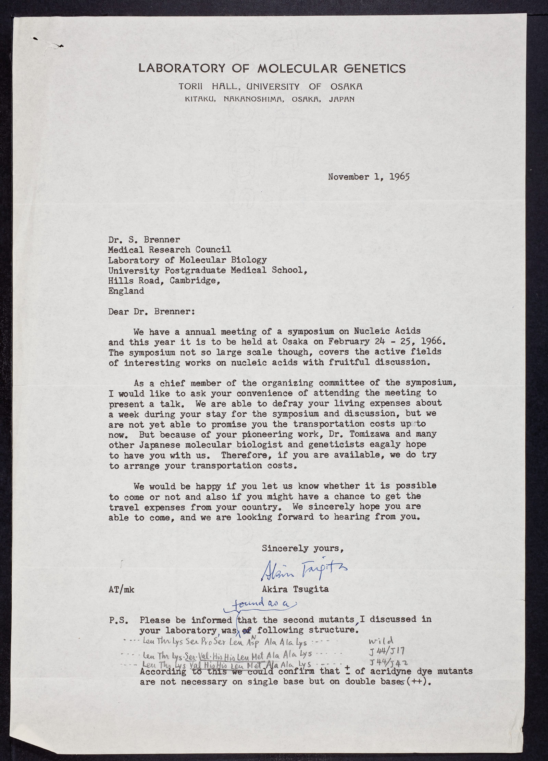
Tsugita decided to invite Brenner to participate in the Annual Meeting on Nucleic Acids at Osaka on 1966.

Slide 23
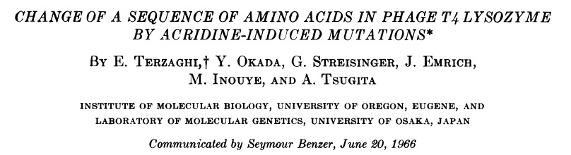
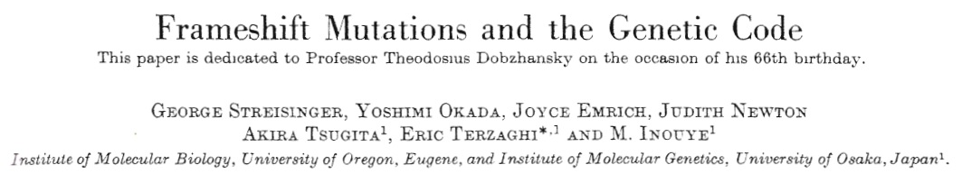
He had explained that the reading context exerted a large effect upon genetic suppressor strains in a communication to the NAS presented by Seymour Benzer (Terzaghi et al., 1966).
And found the general mechanism of frameshift mutation, in a paper dedicated to Theodosius Dobzhansky (Streisinger et al., 1966). Frameshift mutations consist of additions or deletions of varying numbers of base-pairs (that are not in multiples of three).

Slide 24
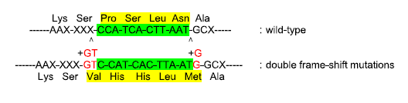
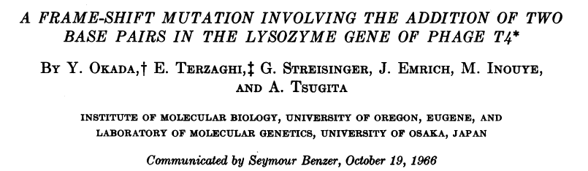
The 20-bp DNA sequence of the gene for T4 phage lysozyme highlighted in green was unambiguously determined as shown.
Tsugita had participated in the team that unambiguously determined the first DNA sequence of a gene by using the mechanism of double frameshift mutation, 11 years before Frederick Sanger.

Slide 25
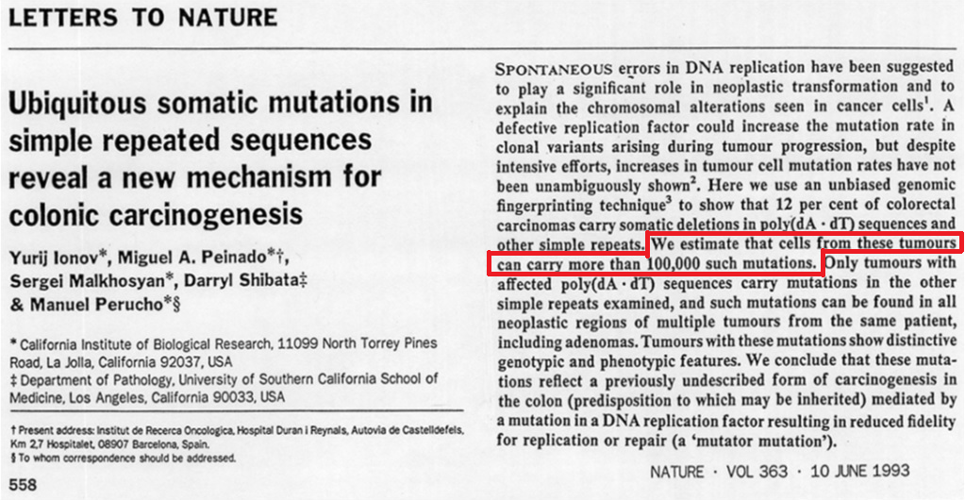
As a framework for visualizing mutations in cancer, frameshift mutation (Ionov et al., 1993) has provided evidence for a mutator mutation significant role in carcinogenesis.
Also suppressors specific for frameshift mutations have been studied.

Slide 26
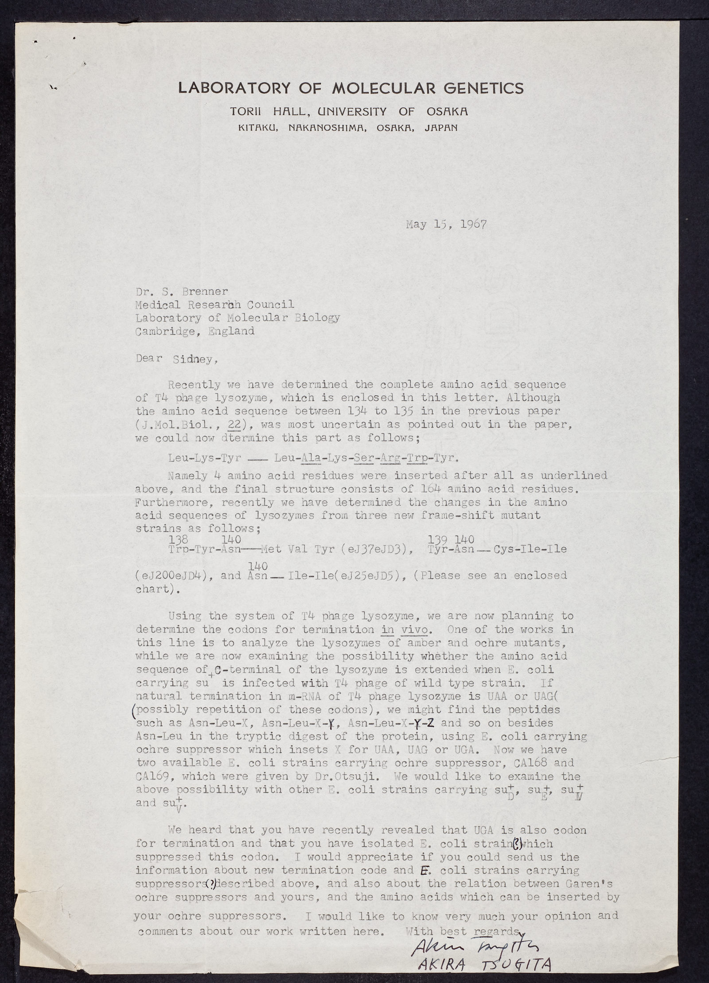
By using his T4 lysozyme system, he wrote to Brenner in his next letter on 15 May 1967 that he had determined the changes in the amino acid sequences from 3 new frameshift mutant strains and planned to determine the codons for termination in vivo.
Tsugita required information from Brenner, on Alan Garen who co-discovered suppressor mutations for tRNA.

Slide 27
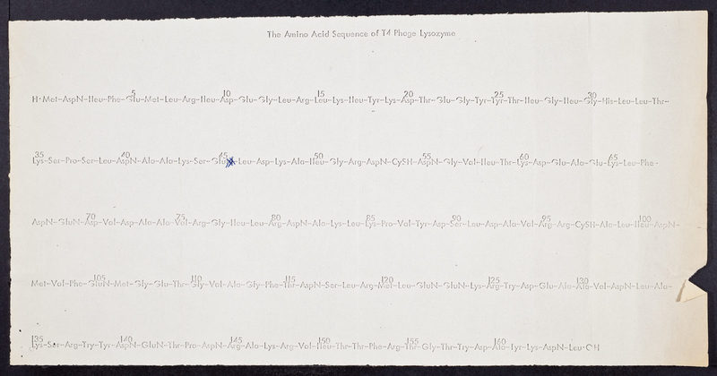
In his May 15, 1967, letter to Brenner, Tsugita enclosed the complete amino acid sequence of T4 phage
lysozyme.

Slide 28
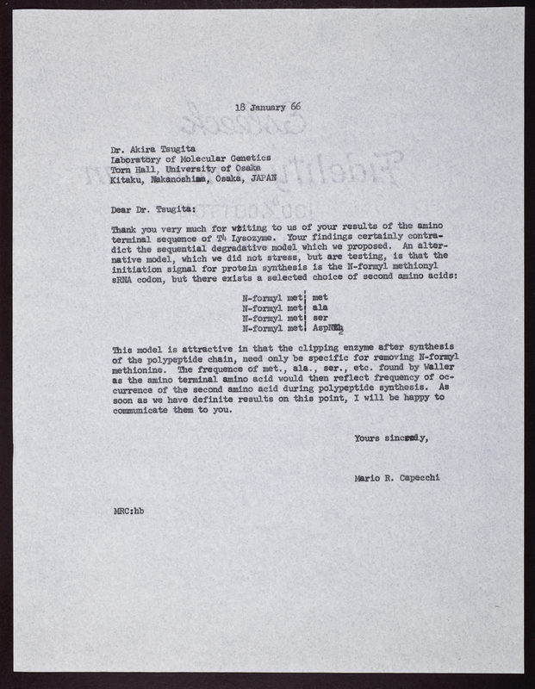
Mario Capecchi also thanked Tsugita for having send the amino terminal sequence of T4 Lysozyme, in 1965.
He expressed the stop codon discrepancy on the second amino acid during polypeptide synthesis.

Slide 29
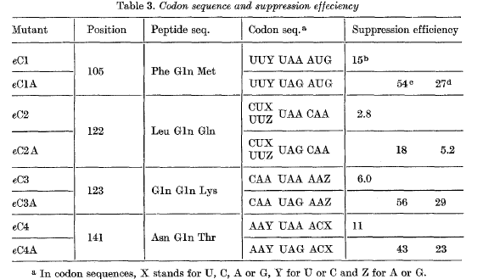
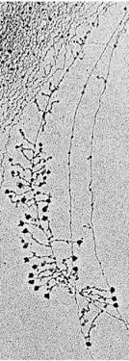
In 1970, Tsugita provided further knowledge on the real ending mechanism of protein synthesis, the stop codon (Yahata et al., 1970). The results have been communicated to the National Academy of Sciences (NAS) by WM Stanley, and included considerations on the chain terminating mechanism and the releasing factors.
The efficiency with which stop codons can be suppressed in E. coli can be influenced by the identity
of adjacent codons (Yahata et al., 1970).
In 1970, the process of transcription was first visualized by electron microscopy (Source: (Miller et al., 1970)).

Slide 30
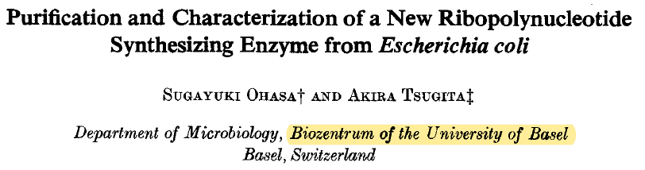
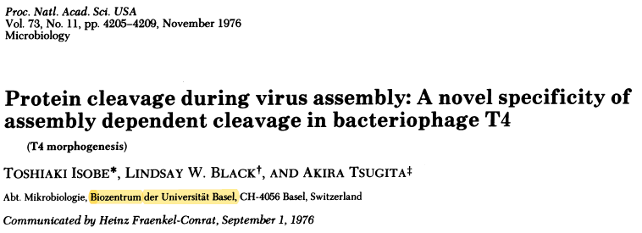
As a Visiting Lecturer in Basel (Biocenter), from 1972 to 1976, Tsugita researched on medical microbiology and immunology.

Slide 31
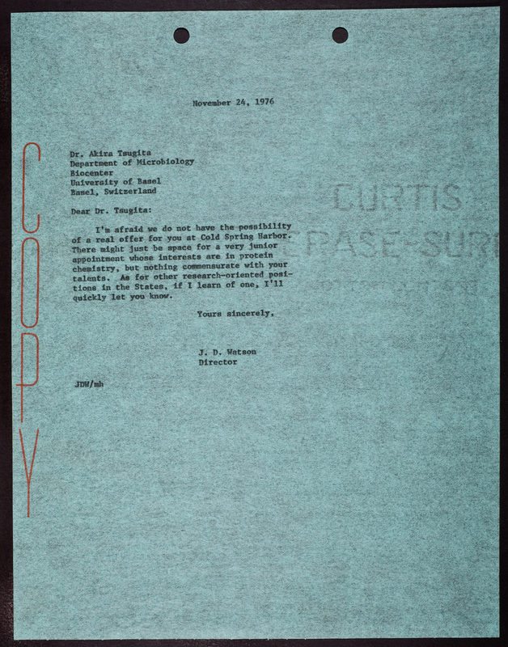
In 1976, Tsugita had tried to come to Cold Spring Harbor, but James D Watson could not get any answers that could help him.

Slide 32
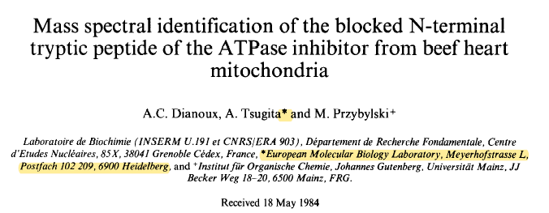
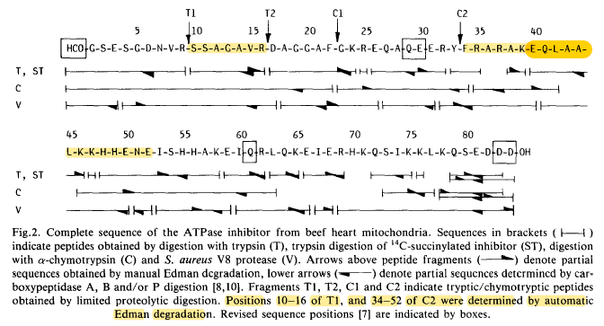
In EMBL, Heidelberg, Tsugita developed comparative visualization of protein conformations using gel electrophoresis and mass electrophoresis. He was searching for a fully automated electrophoresis system for this purpose.

Slide 33
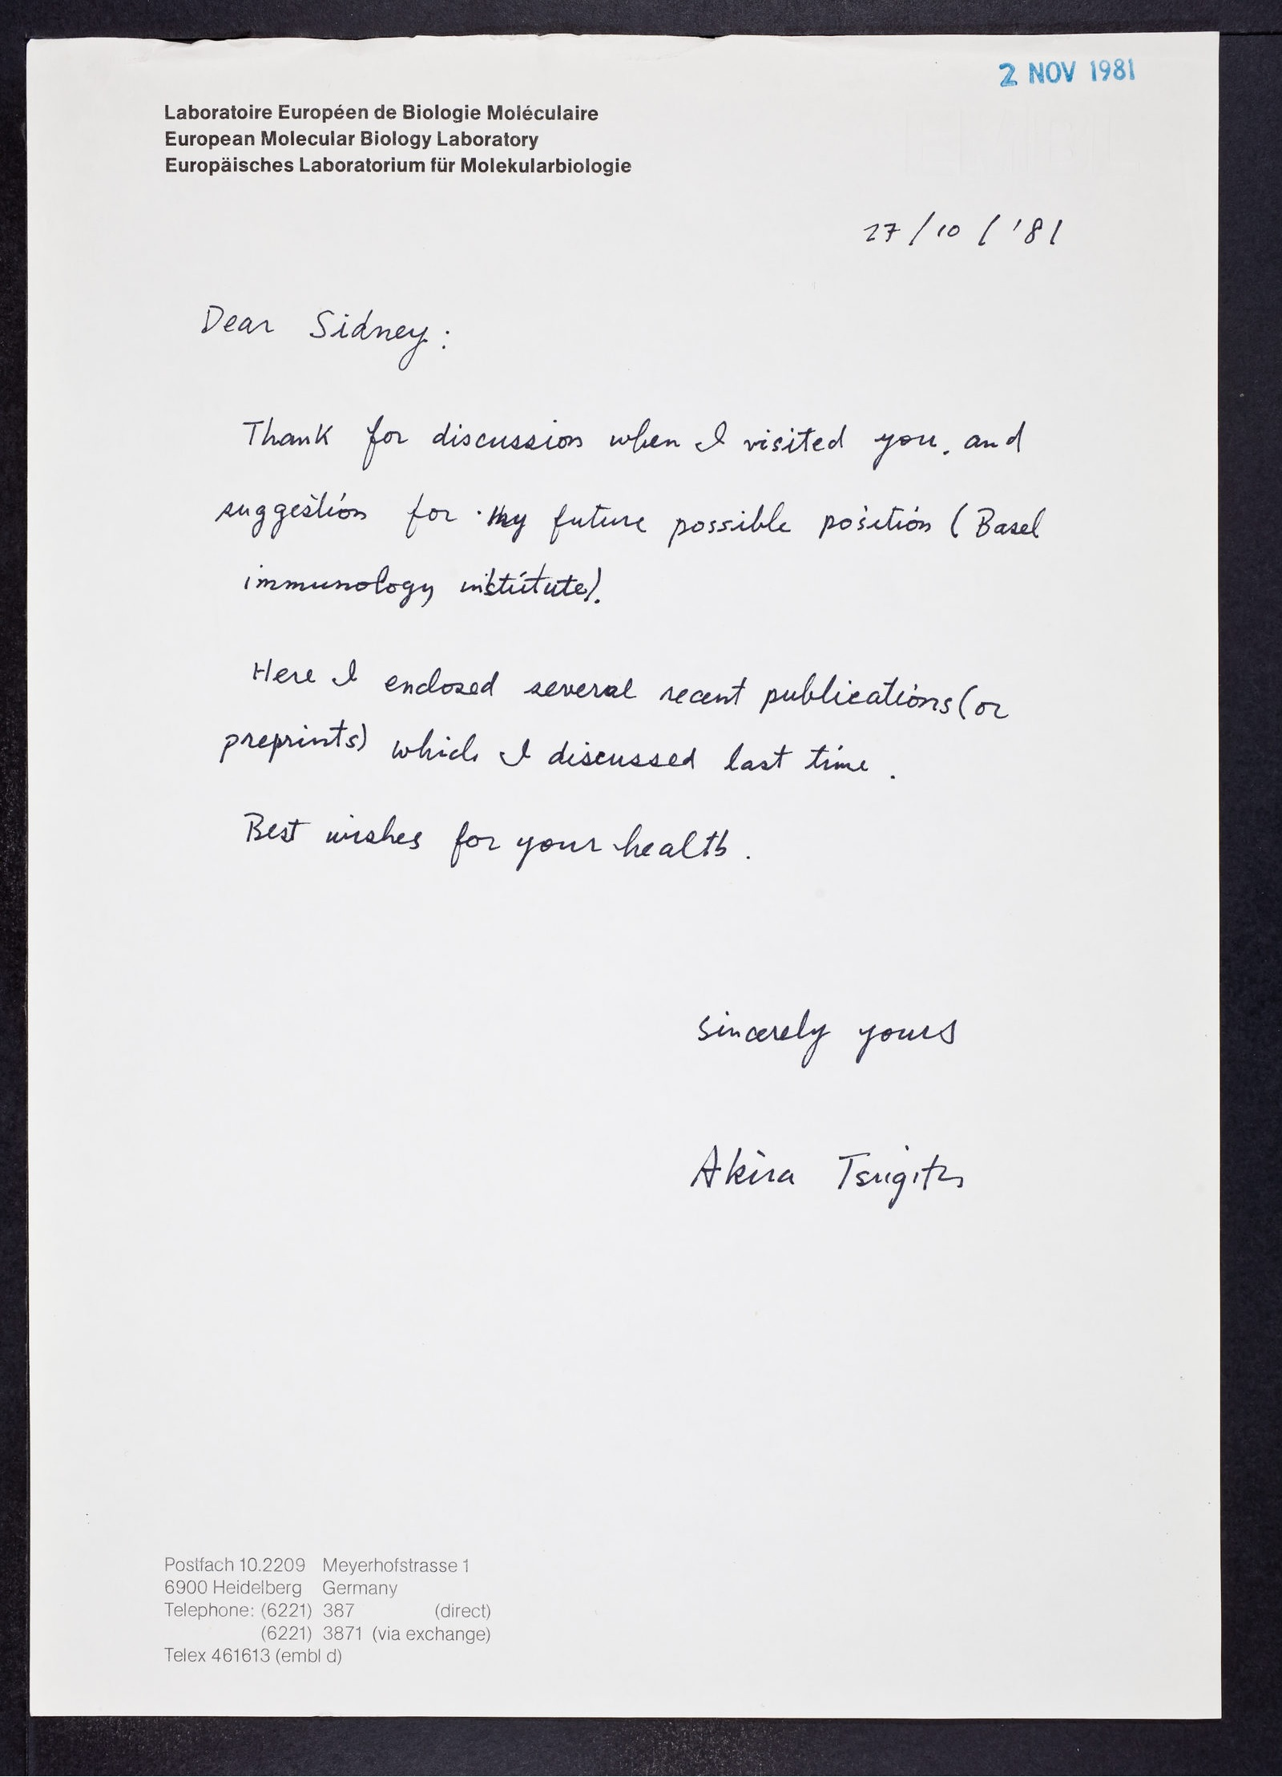
In a 1981 letter, Tsugita writing from EMBL in Heidelberg, asked Brenner for a chance to participate in the Basel Institute for Immunology (BII).

Slide 34
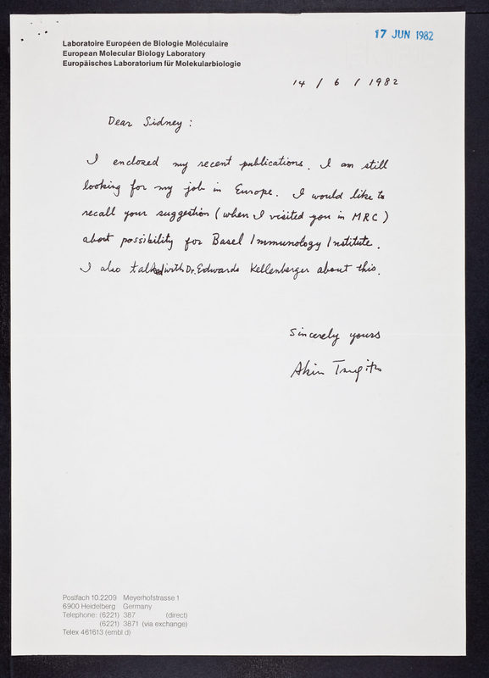
The correspondence ends with a brief contact initiated by Tsugita back in 1976 when at the Biocenter of the University of Basel, working with its Founder, Eduard Kellenberger, on conformational changes of proteins. He asked again Brenner to be
involved in the BII.

Slide 35
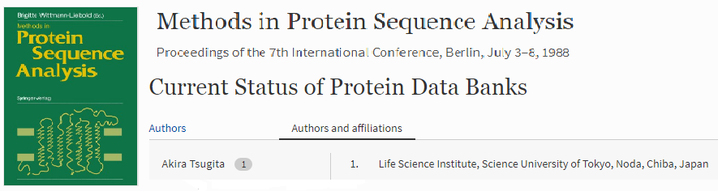
Upon his return to Japan, in 1985, Tsugita had questions regarding the quality of protein data banks as a diagnostic tool. Since 1988, he started his participation to the Protein Information Resource (PIR)-International Protein
Sequence Database from the Science University of Tokyo.

Slide 36
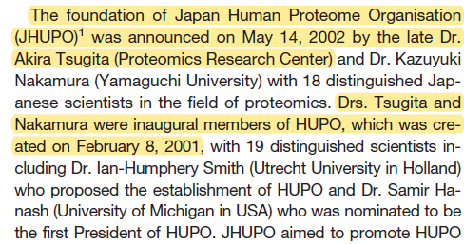
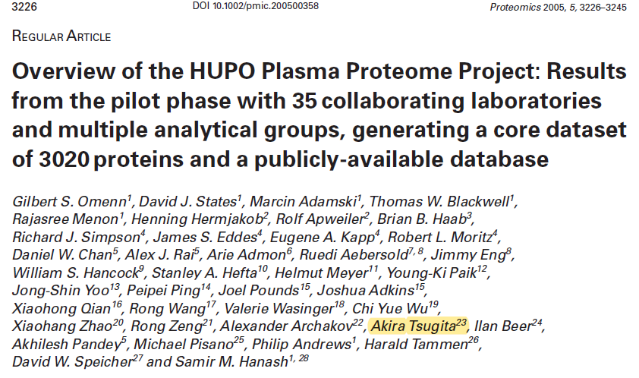
The proteome is the protein complement of a genome, Tsugita said (1999). 2D visualizations had enabled comparison of the proteome of normal tissues with cancer or diseased states. The value of the proteome in studying diseases made Tsugita involved in the HUPO Plasma Proteome Project (Omenn et al., 2005).

Slide 37
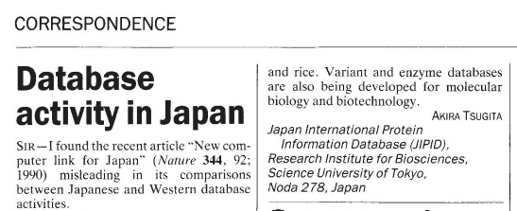
The rapidly increasing number of sequenced genomes continued to add to the enormity and diversity of
genomic information in global databases. And Tsugita was concerned with opinions suggesting that Japanese databases (eg DNA Data Bank of Japan (DDBJ)), were not able to cope with such a massive amount of data as arise from the Human Genome Project.

Slide 38
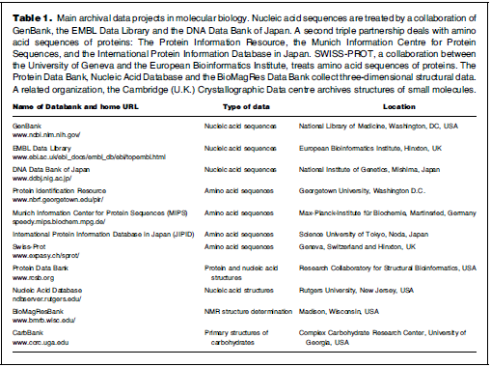
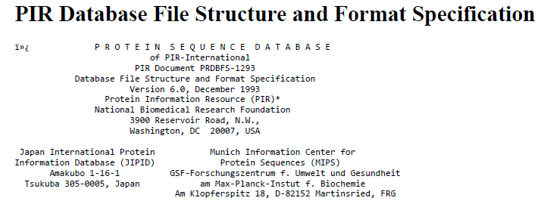
Tsugita answered by designing a new architecture for the Japanese International Protein Information
Database (JIPID). JIPID (Japan) formed an international collaboration with National Biomedical Research Foundation (NBRF) (USA) and Munich Information Center for Protein SeqSequences (MIPS) (FRG) to form PIR-International, and that
by adopting a common data entry format.

Slide 39

Another important problem in implementing major proteomics related databases solved by Tsugita,
was MIAPE (minimum information about a proteomics experiment) (Taylor et al., 2007). Were there enough sequence data for protein engineering? Authors when preparing manuscripts were required to fit MIAPE Guidelines, so that to increase the reproducibility and comparability of their research. As such, they were
prepared by the HUPO-Proteomics Standards Initiative (PSI) group, to ensure that a paper contains all the
relevant information required for an eventual reader to fully understand how the experiment was performed.
In this way, Tsugita, as the leader of the proteomics community, was opposed to the policy of "publish or
perish" and in favor of unrestricted public access to valuable data.

Slide 40


In teaching biochemistry students about the relationship between genomic sequence analysis and
the synthesis of specific proteins associated with that of viral RNA in healthy plants, Tsugita eventually
succeed to be involved in bioinformatics. For the most part, traditional laboratory tests have analyzed one protein at a time; proteomics offered the potential to analyze hundreds all at once. And his role in the
Committee on Data for Science and Technology of the International Council of Scientific Unions made him recognize the kinds and extents of errors that may appear in nucleic acid and protein databases (Tsugita, 2000).
Tsugita was the third one from the right, first row. CODATA Task Group on Biological Macromolecules meeting, held in Tokyo September 28-29, 1996

Slide 41
As the quality of data is the most important determinant in the state of the experimental art, from
Tsugita's point of view, the history of proteomics is also a history of mistakes, of science not realized,
of questions left behind without answer or never formulated. This flying blind, this assessment of quality of a set of protein coordinates without the experimental data from which it was derived, is linked to multiple factors:
disinterest in the scientific community, consideration of what is prestigious or not, allocation of budgets,
priorities in research programs on public funds. In the case of proteomics, the paradox is striking..
Akira Tsugita (1928, August 18 (Okayama), 2007, May 31 (Tsukuba))

Slide 42
Bibliography
Fraenkel-Conrat, H. (1979). This Week's Citation Classic. Current Contents, 23, 174.
Harrison, B.D., & Wilson, T.M.A. (1999). Philosophical Transactions of the Royal Society (London), B: Biological Sciences, 354, 521–529.
Ionov, Y., Peinado, M.A., Malkhosyan, S., Shibata, D., Perucho, M. (1993). Nature, 363, 558-561.
Okada, Y., Terzaghi, E., Streisinger, G., Emrich, J., Inouye, M., Tsugita, A. (1966). PNAS, 56, 1692-1698.
Omenn, G.S. et al., (2005). Proteomics, 5, 3226–3245.
Strasser, B.J. (2010). Journal of the History of Biology, 43, 623–660. doi:10.1007/s10739-009-9221-0
Taylor, C.F. et al., (2007). Nature Biotechnology, 25, 887–893.
Terzaghi, E., Okada, Y., Streisinger, G., Emrich, J., Inouye, M., Tsugita, A. (1966). PNAS, 56, 500-507.
Tsugita, A., Gish, D.T., Young, J., Fraenkel-Conrat, H., Knight, C.A., Stanley, W.M. (1960). PNAS, 46(11), 1463–1469.
Tsugita, A. (1962). Journal of Molecular Biology, 5, 284-292.
Tsugita, A., Fraenkel-Conrat, H., Nirenberg, M.W., Matthaei, J.H. (1962). PNAS, 48, 846-853.
Tsugita, A., Kawakami, T. (1999). Nippon Hoigaku Zasshi-Japanese Journal of Legal Medicine, 53(2), 191-198.

