Slide 1
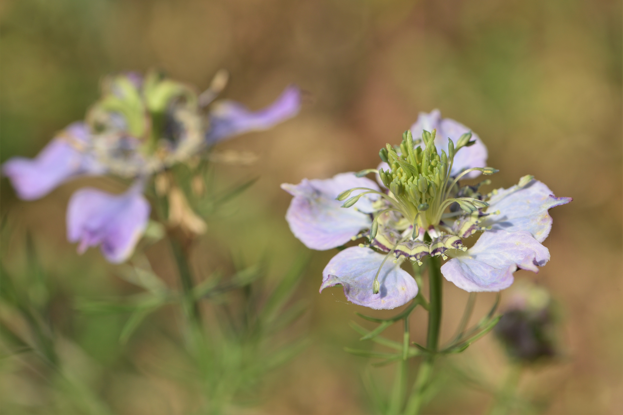
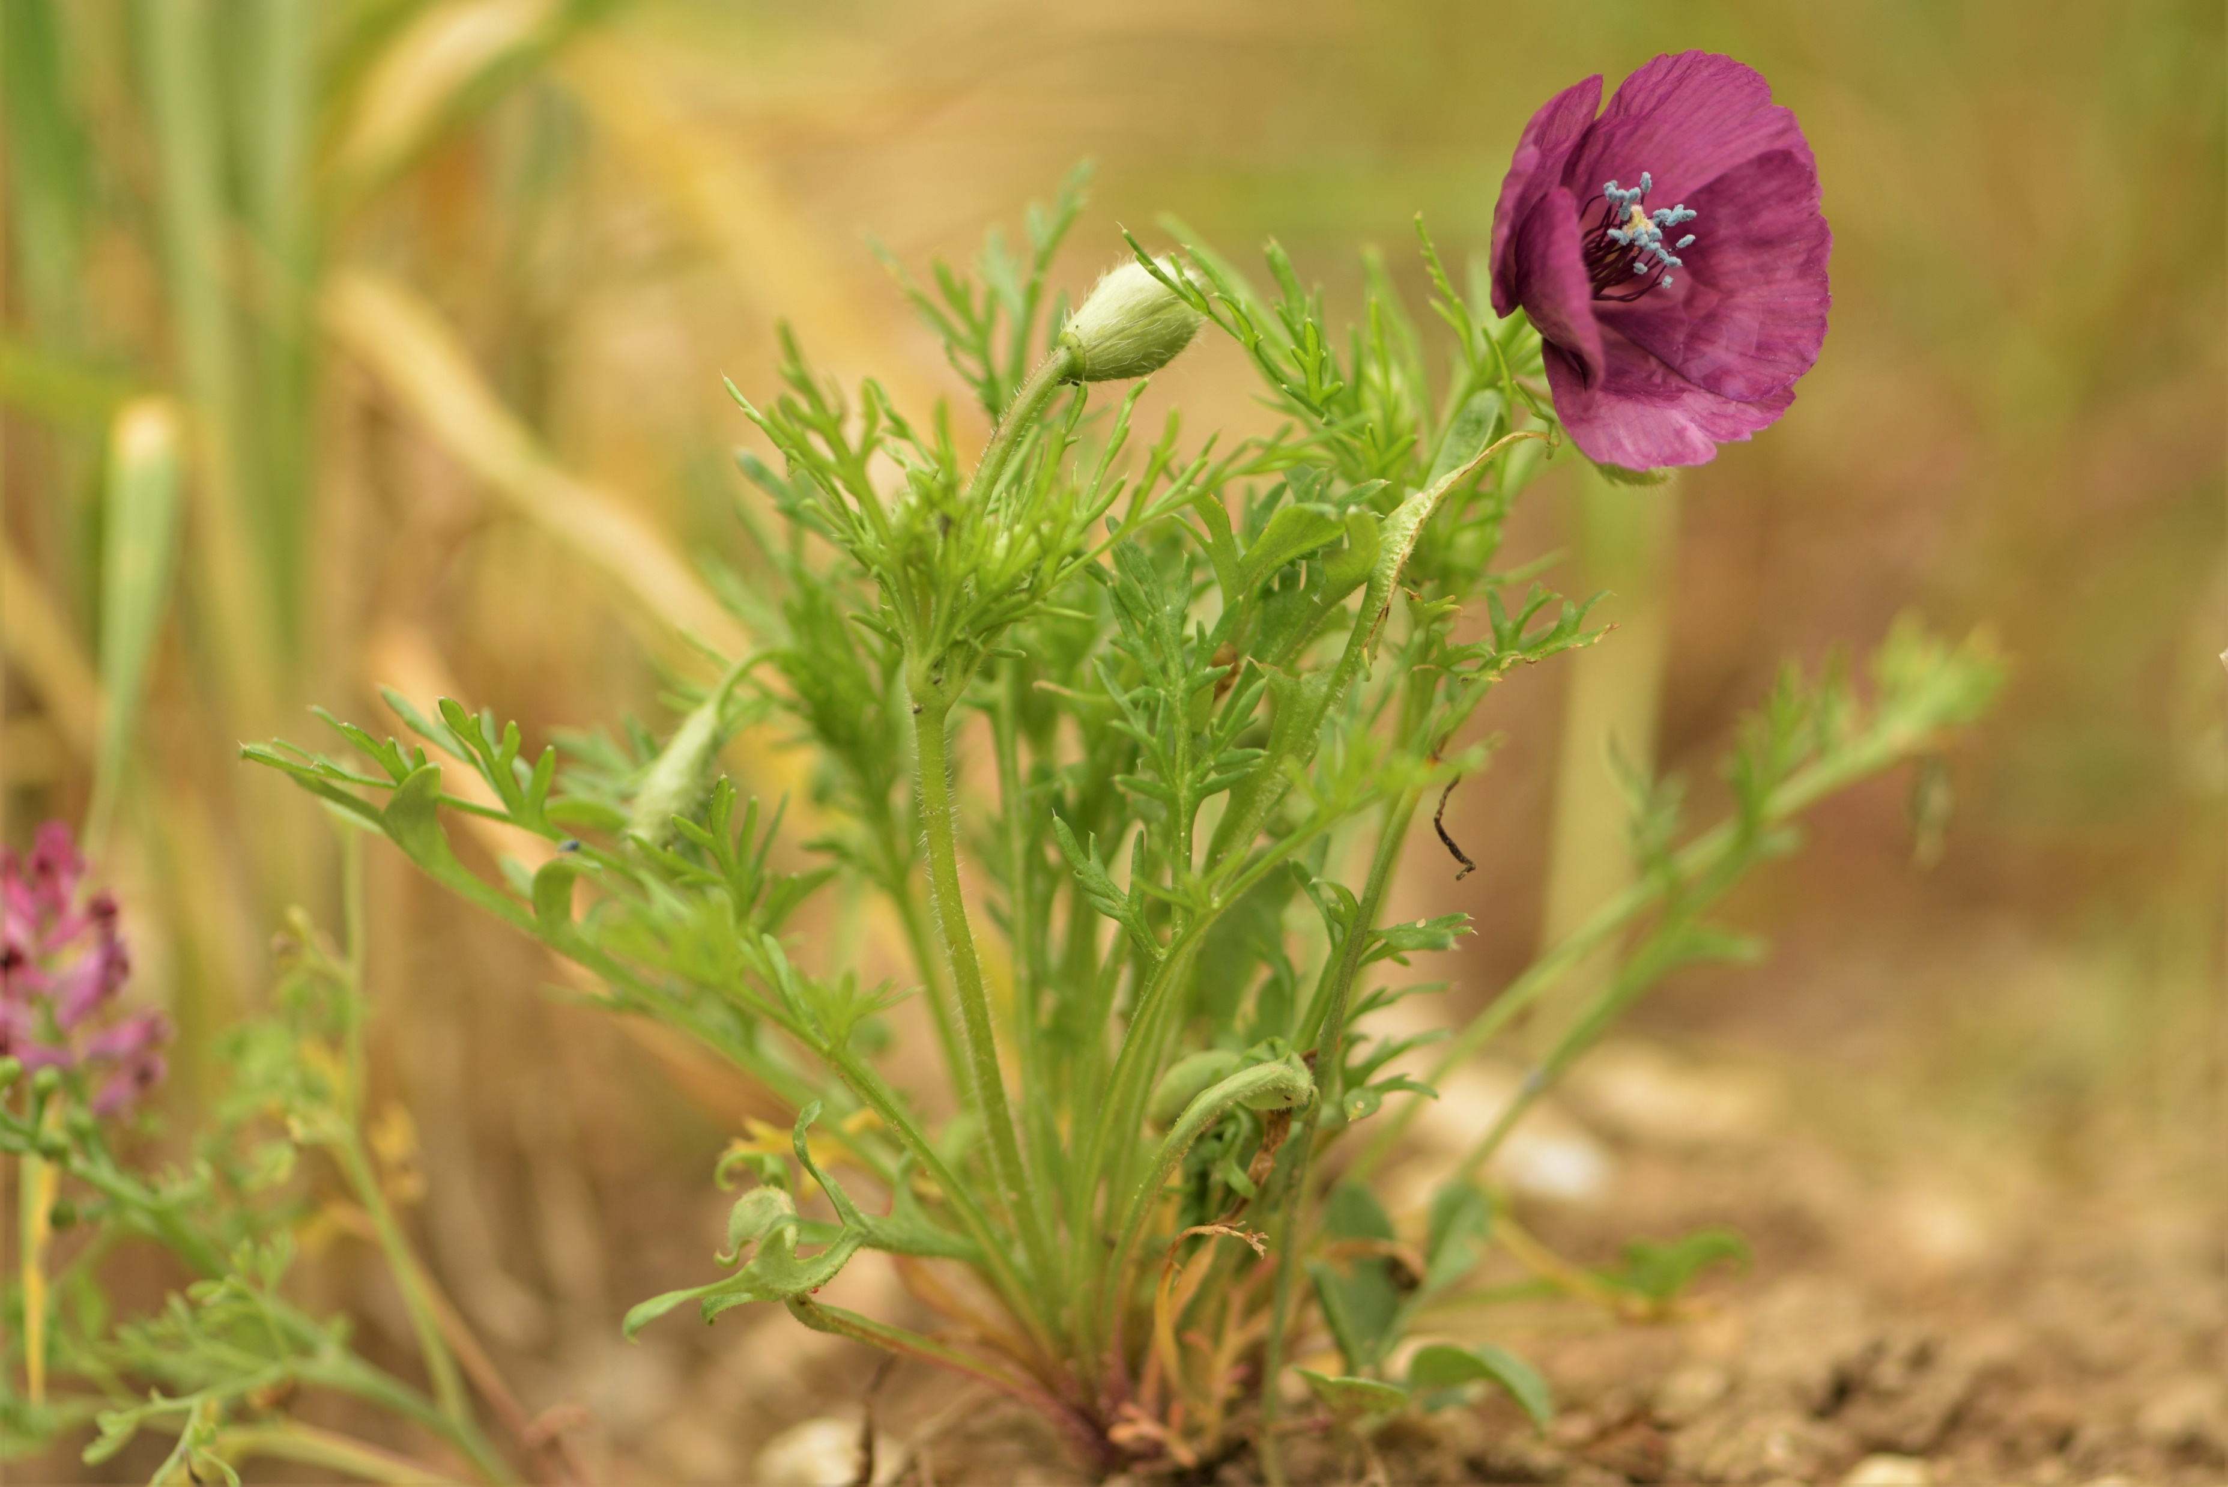
Red-list status of 102 segetal species across 37 EU countries
Guillaume ADEUX and Jocelyne CAMBECÈDES
Workshop of the EWRS Working Group “Weed Vegetation and Biodiversity”
Prague, Czech Republic, 10th of May 2023
Nigella arvensis
Roemeria hybrida

Slide 2
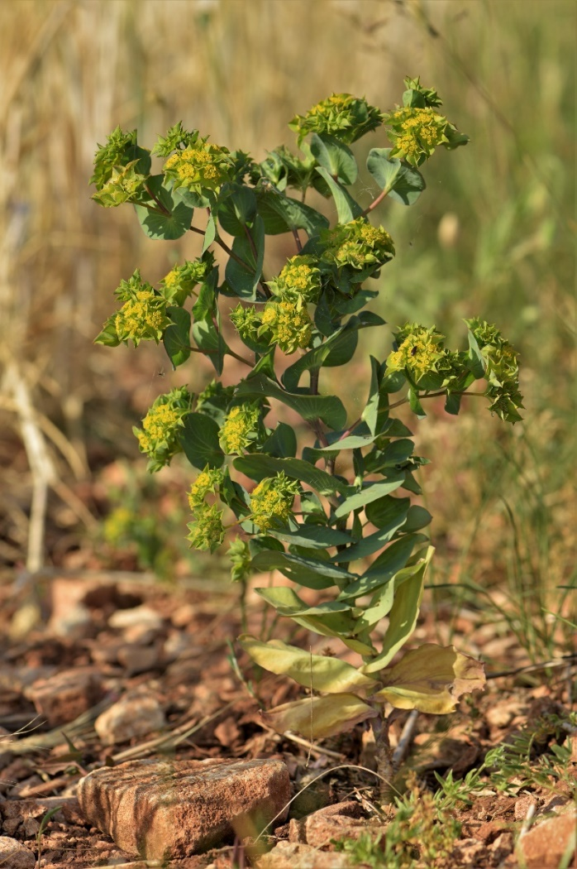
Segetal plants
= Plant species whom dwell in winter cereals
Annuals
Autumn/winter germination
Spring flowering
Oligotrophic
Heliophilous
Base rich soils
Archeophytes

Slide 3
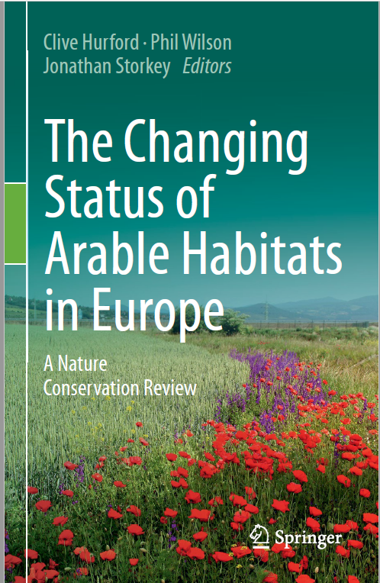
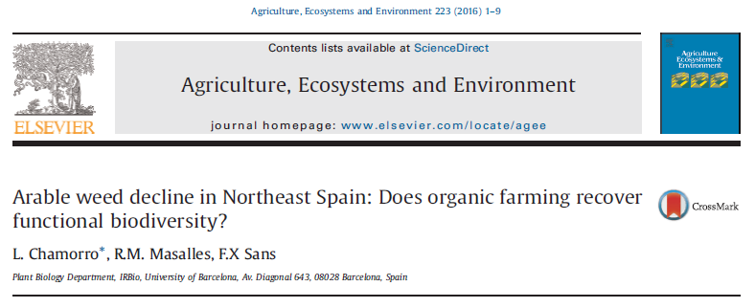
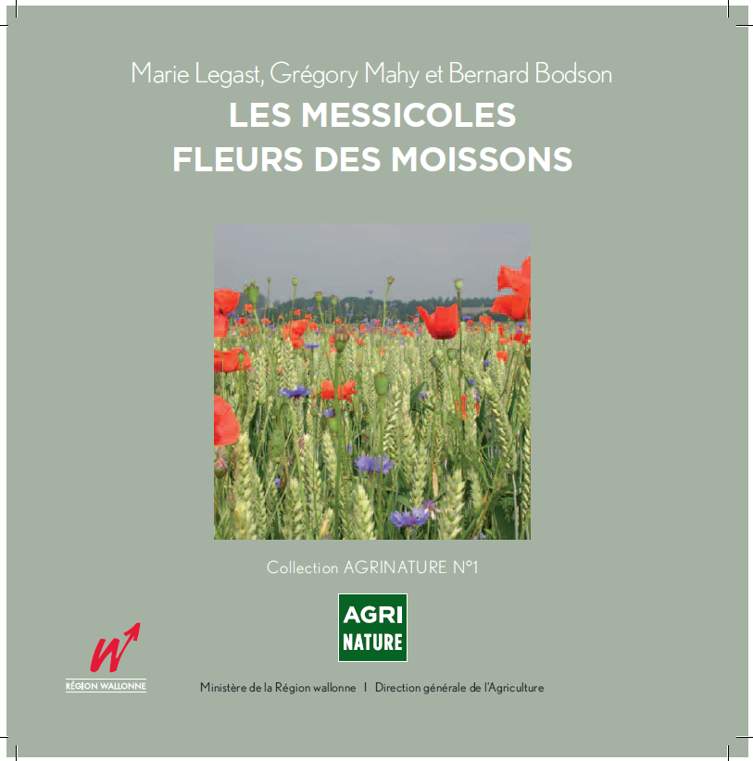
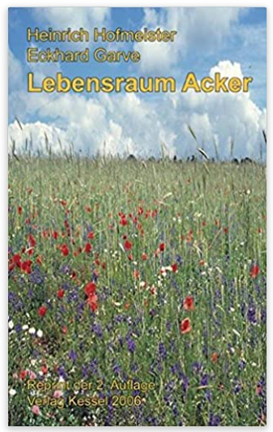
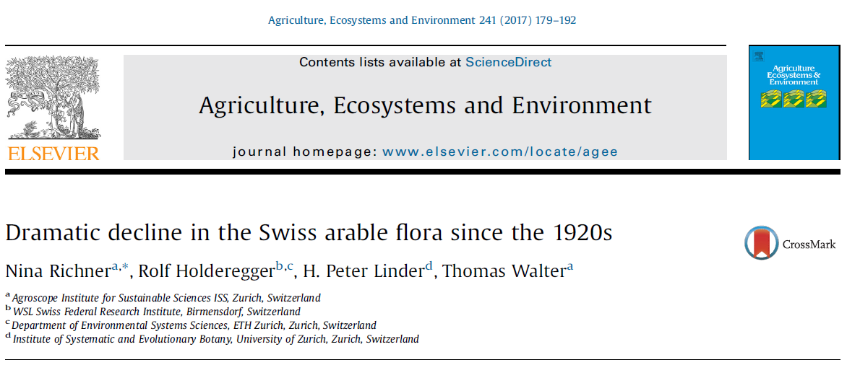
Conservation status
Historically common : Cornuti (1635) reported an abundance of Adonis annua, Agrostemma githago, Turgenia latifolia, Gypsophila vaccaria in the current city of Paris
Diversity of small scale studies scattered around Europe highlight their decline
Alsace (France) : -56% (in-field richness) or -84% (density) when comparing before/after 1990 in Alsace (Fried, 2020)
Northeast Spain : -75% (segetal richness) or -87% (rare species) when comparing 1953-1988 vs. 1996-1999 vs. 2005-2007
England : 47% of species undergoing the most drastic decline are segetal plants (Preston et al., 2002)
Belgium : segetal plants represent 25% of all plant extinctions (Legast et al., 2008)
Germany : 63% of segetal plants present in 1900 are now extinct or endangered (Hofmeister et al., 1998)
Switzerland : 130 of the species present before 1990 were not observed in 2012 (Richner et al., 2017)

Slide 4
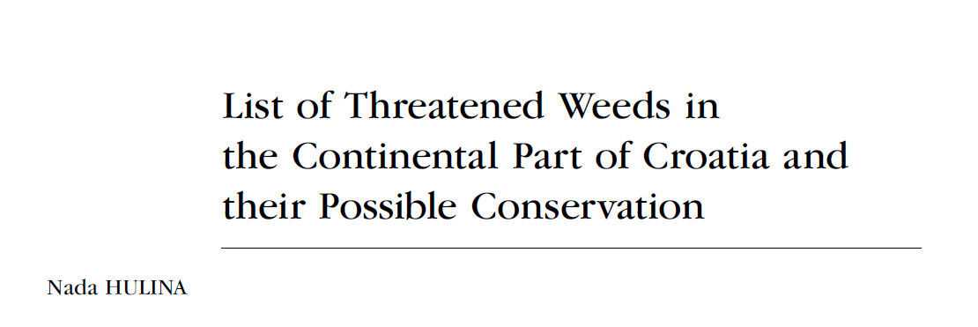
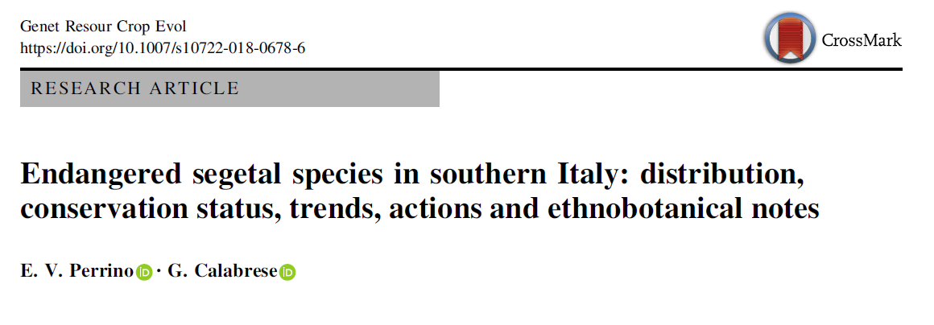
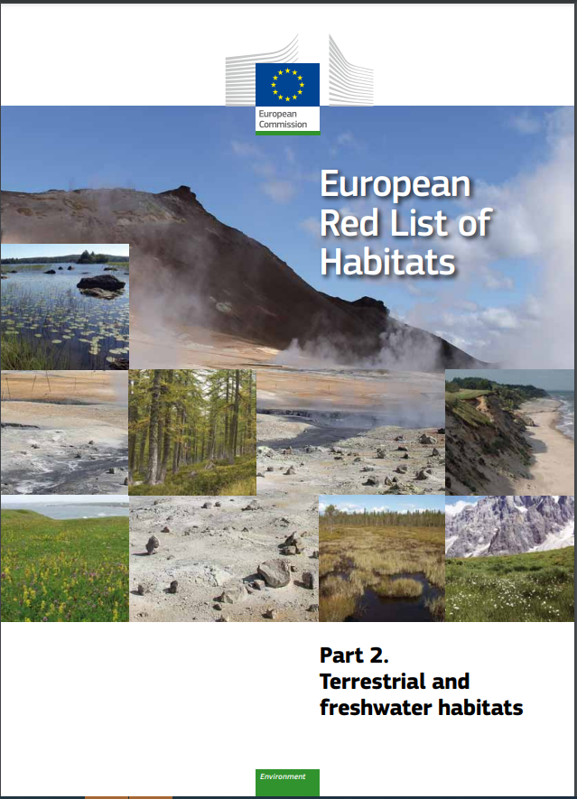
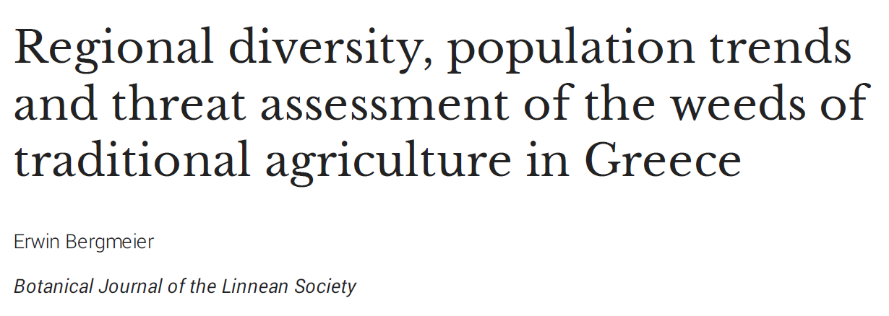
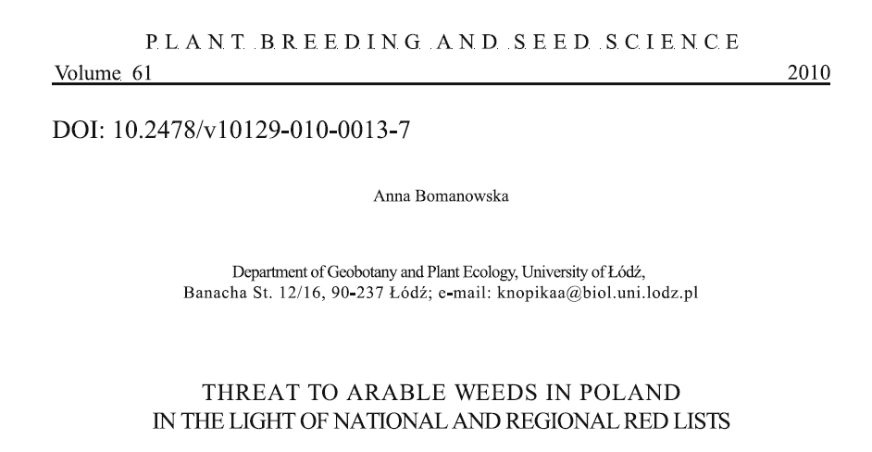
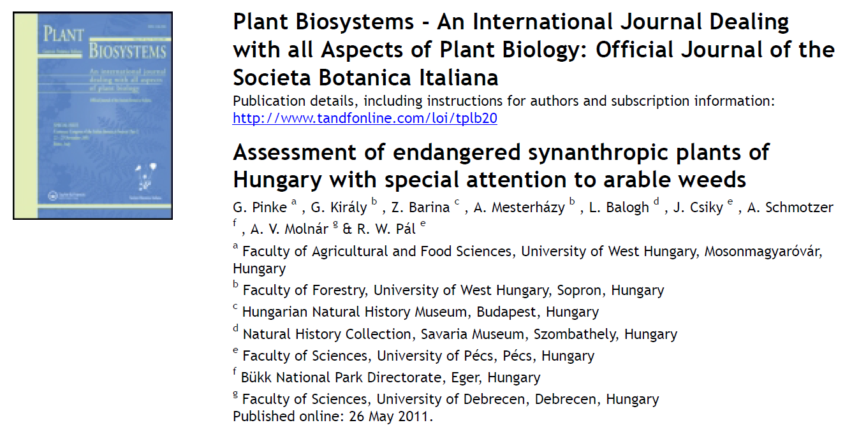
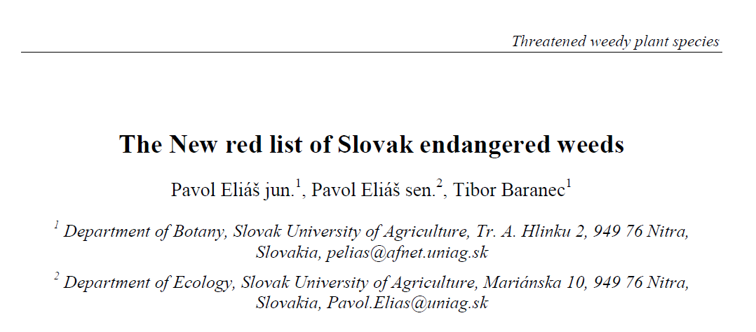
Boom of red lists for weeds and their habitat
Arable land with unmixed crops grown by low-intensity agricultural methods

Slide 5
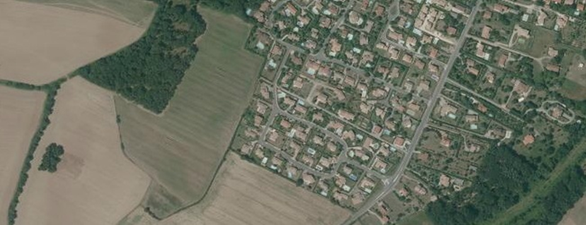
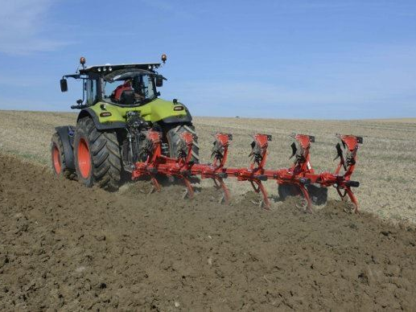
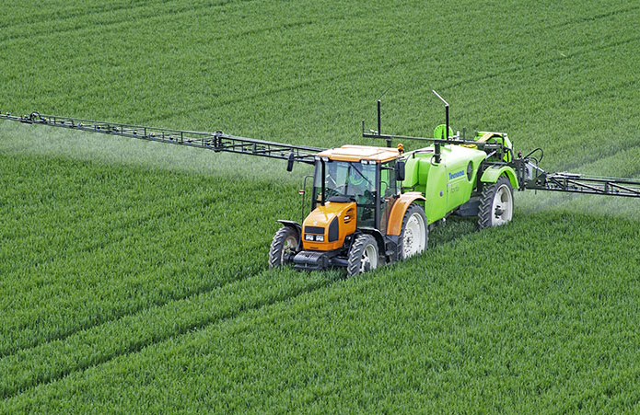
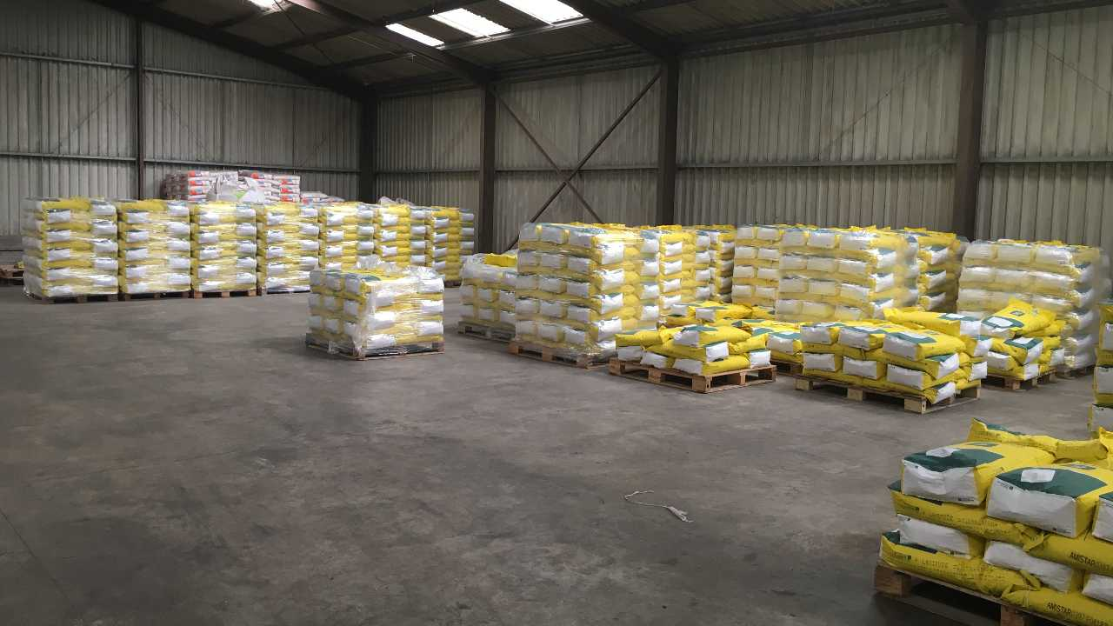
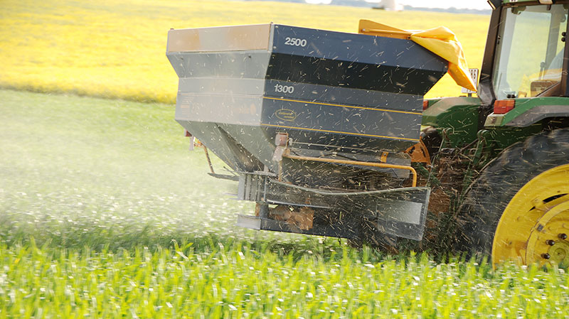
Reasons responsible for their decline
Importance is species and context dependant
Simplification of landscapes (increase in field size, loss of semi-natural habitats…)
Abandon / change of land occupation
Intensification of farming practices (cropping system specialisation, seed cleaning, herbicides, nitrogen fertilisers + competitive crop varieties + increase sowing rates, intensive tillage (or no-till), irrigation, liming, drainage…)

Slide 6
Questions
Which segetal species are most and least frequent across Europe ?
Which segetal species are most and least frequently cited on European red lists ?
What priorities for France in terms on conservation of segetal plants?

Slide 7
Methodology
Target species:
102 species present on the French National Segetal Plant list (Aboucaya, 2000)
Absence/Presence:
Retrieval of all available national checklists, floras, and databases
Residence status (archeophyte/native vs. introduced):
Euromed database
Redlist status
Retrieval of all freely available redlists in Europe (N=37) established with IUCN criteria

Slide 8
Results : presence/absence
Introduced
Uncertainty
Indigenous/archeophyte
Endemic
Number of countries/regions
Segetal species

Slide 9
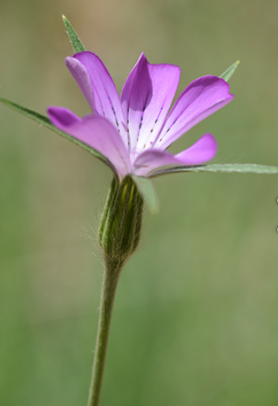
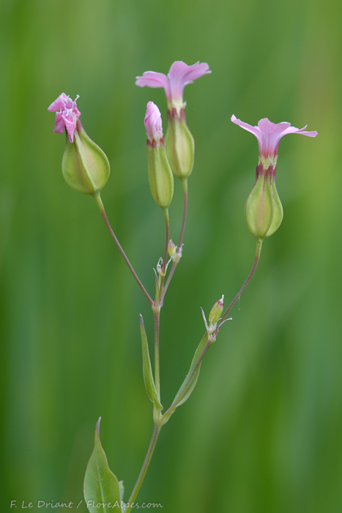
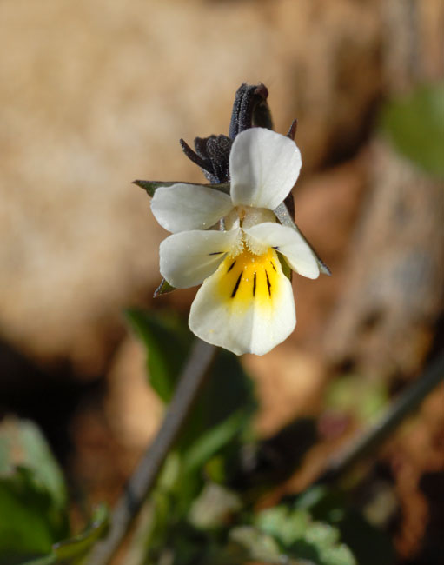
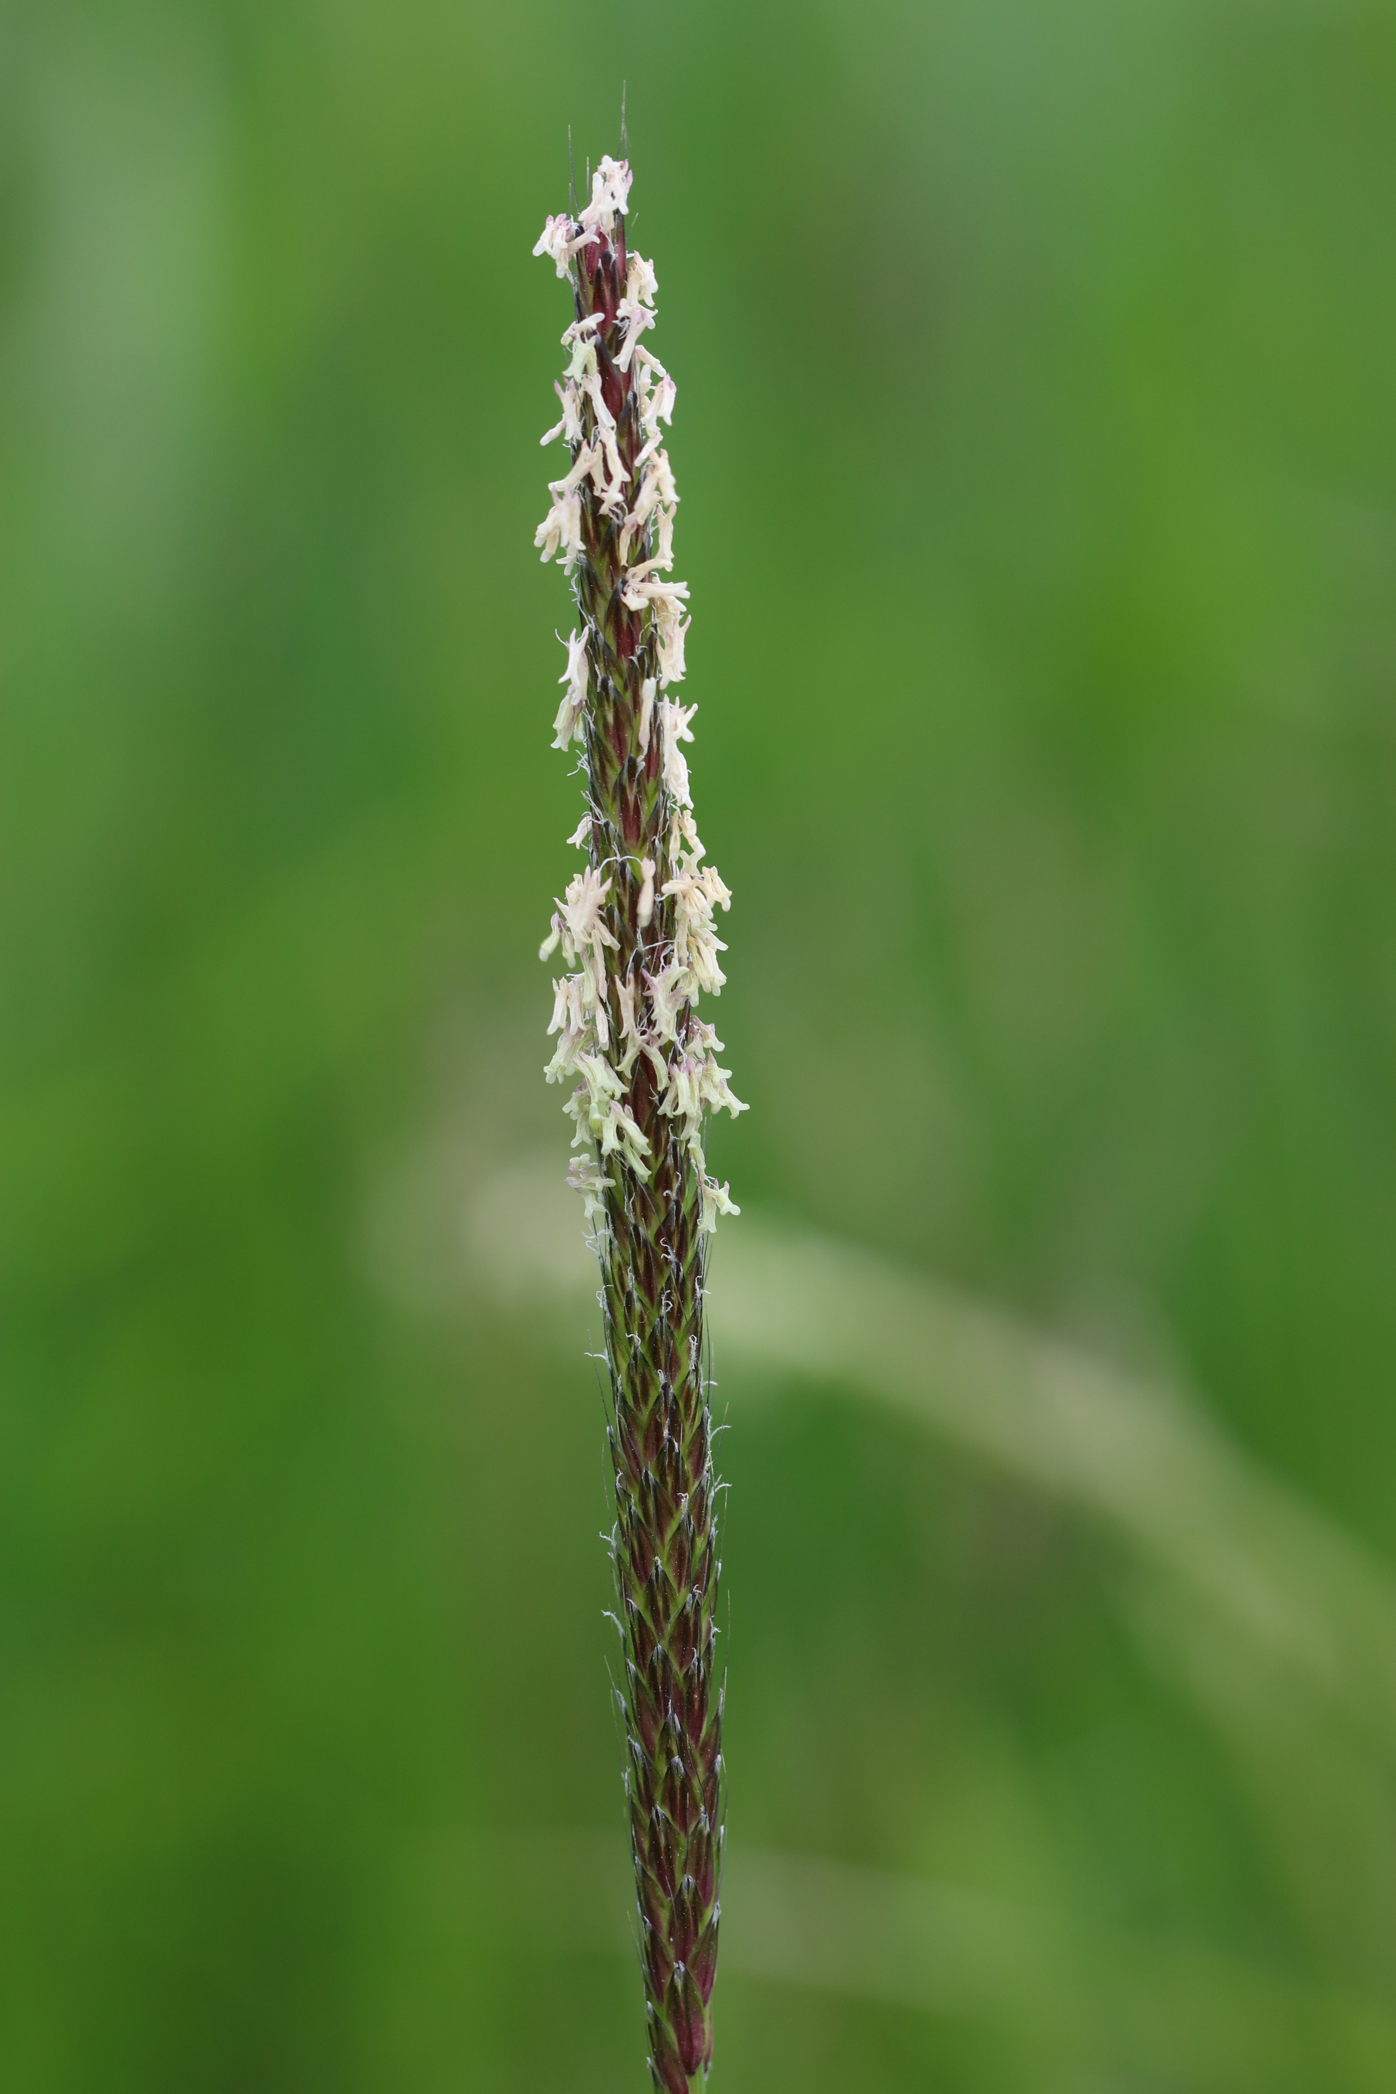
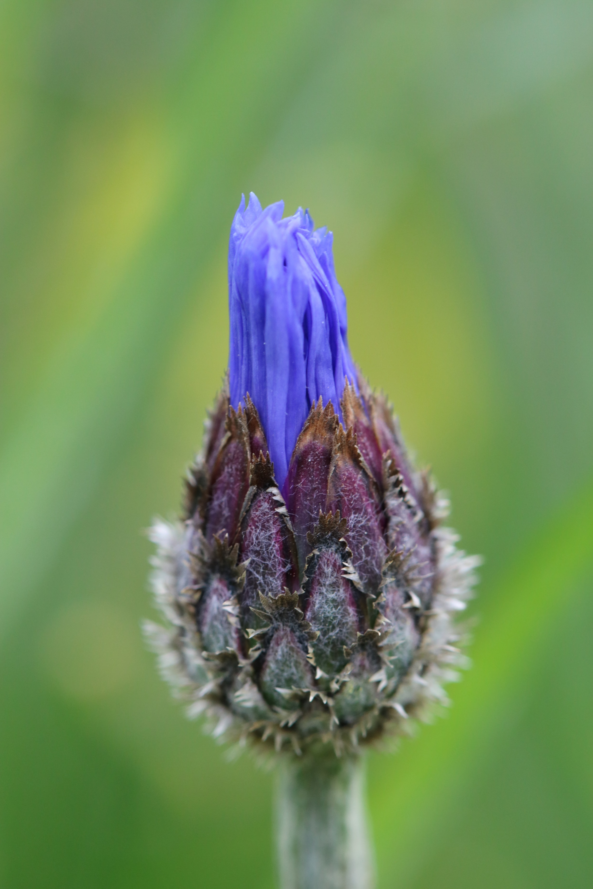
Results : geographically widespread species
Agrostemma githago
Common corn-cockle
Alopecurus myosuroides
Blackgrass
Cyanus segetum
Cornflower
Gypsophila vaccaria
Cowcockle
Viola arvensis
Field pansy

Slide 10
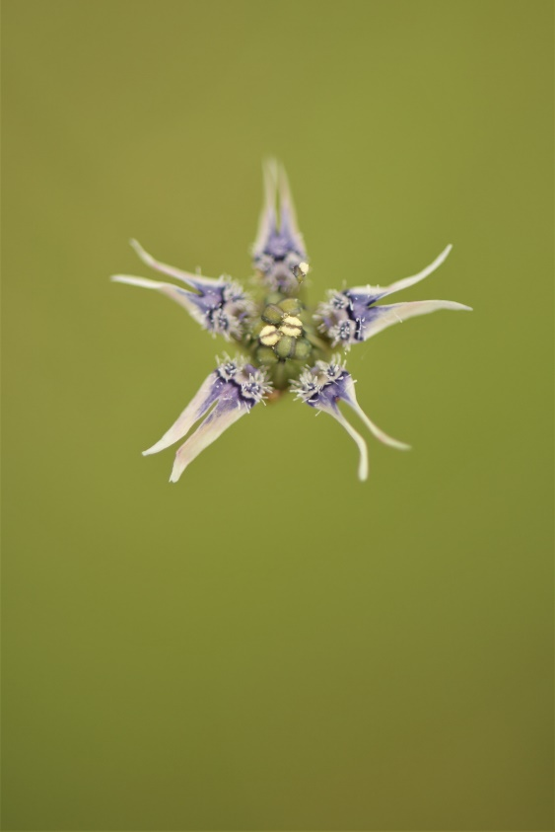
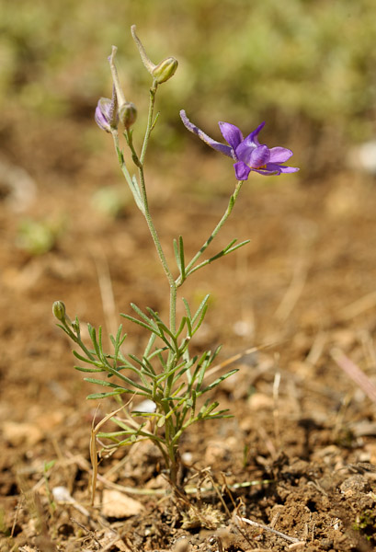
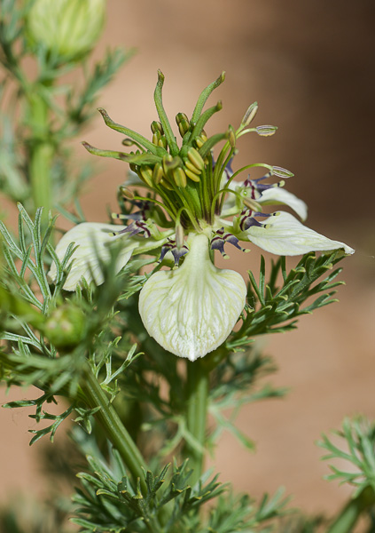
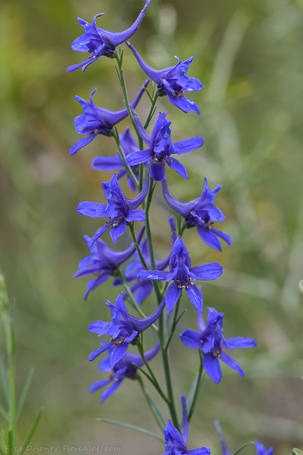
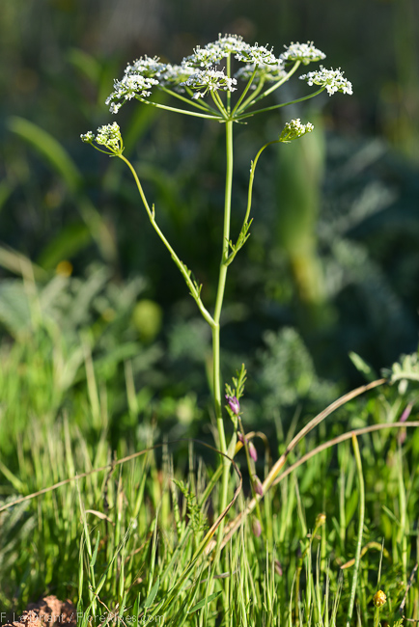
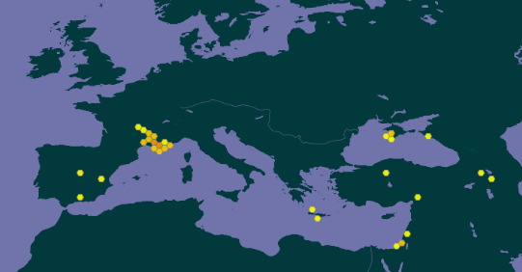
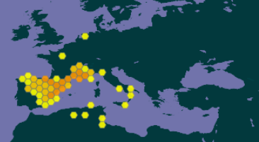
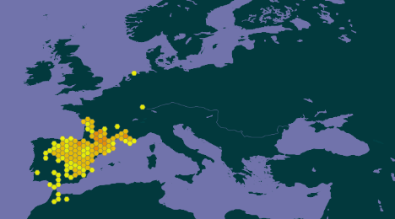
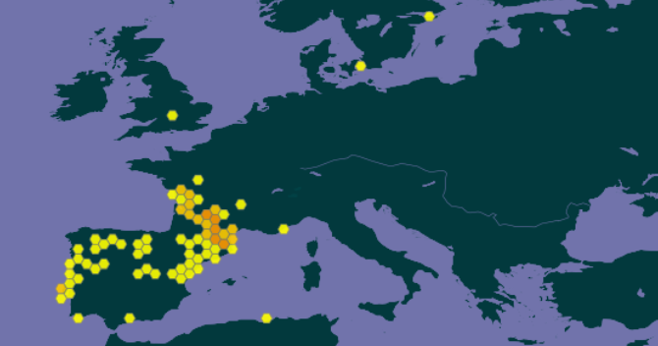
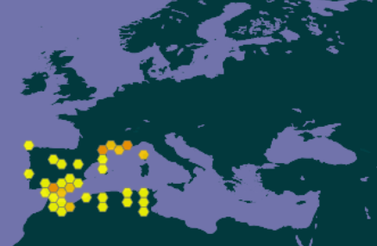
Results : geographically restricted species
And different micro-taxa of tulips…
Nigella nigellastrum
Dwarf Nigella
Delphinium pubescens
Hairy larkspur
Nigella gallica
Pale Fennel-flower
Delphinium verdunense
Bunium pachypodum

Slide 11
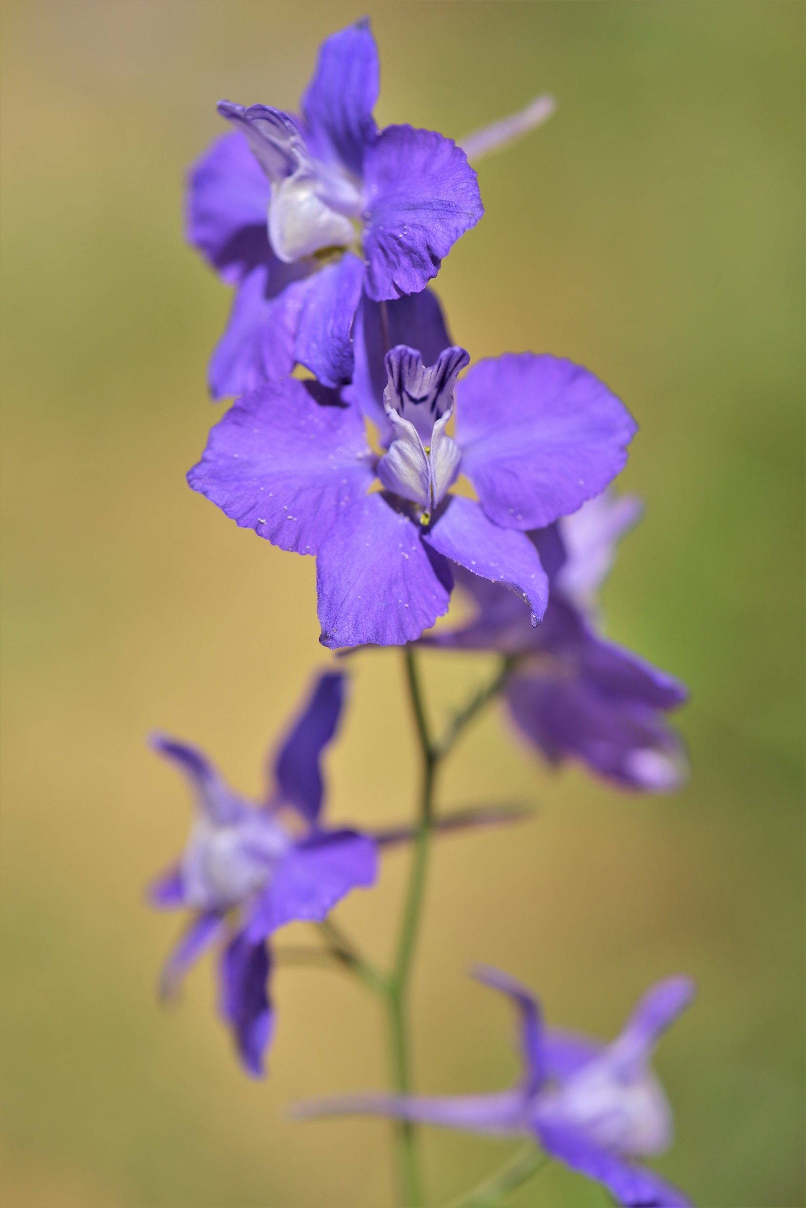
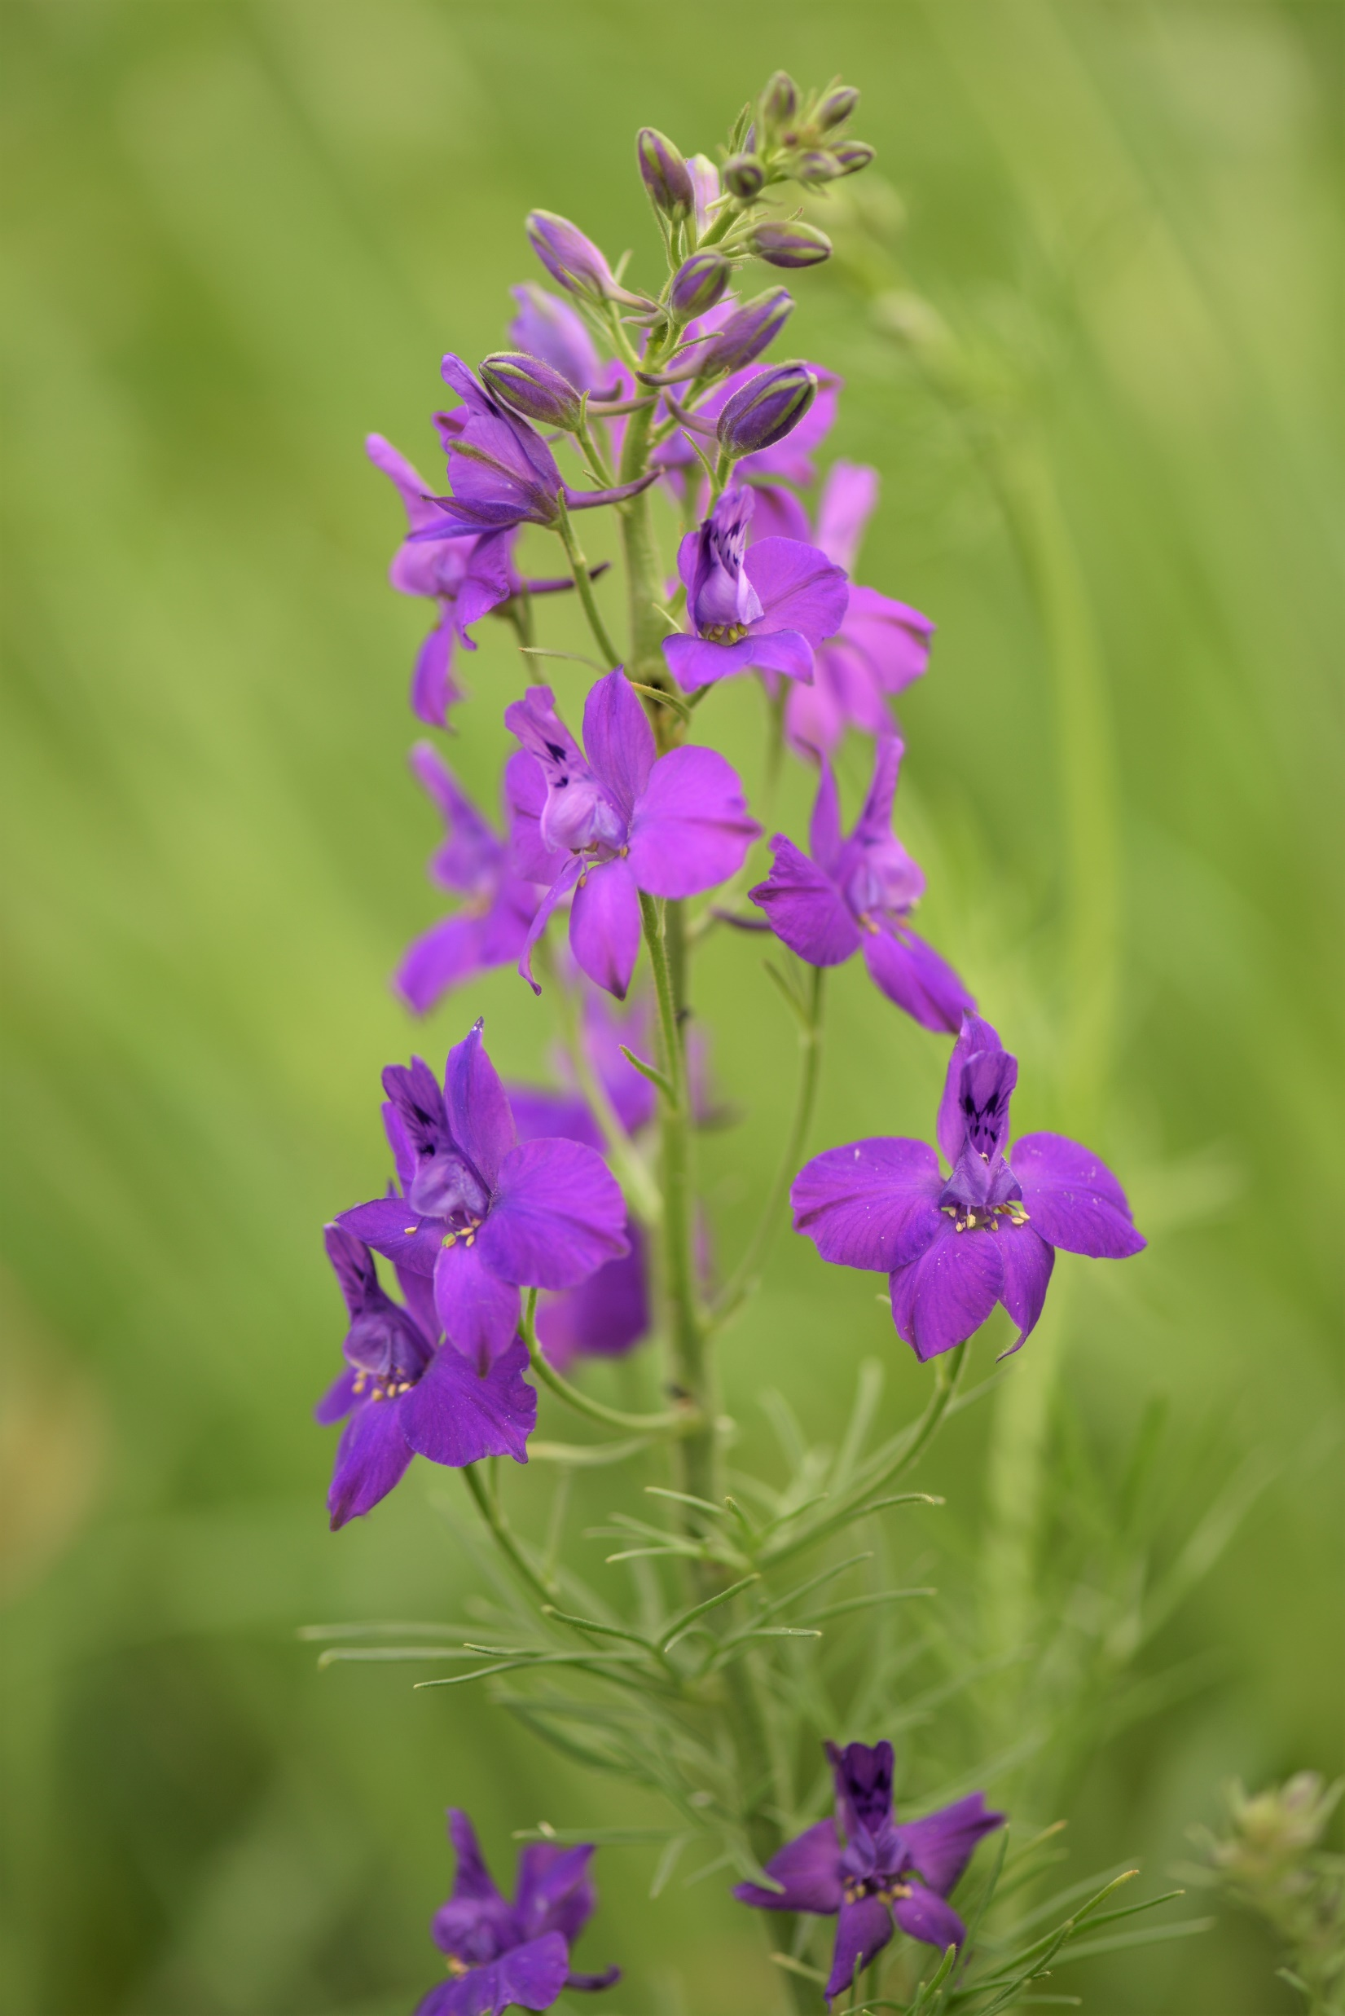
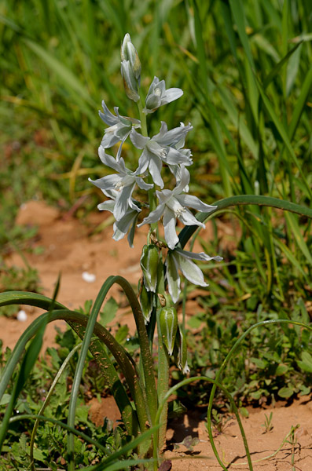
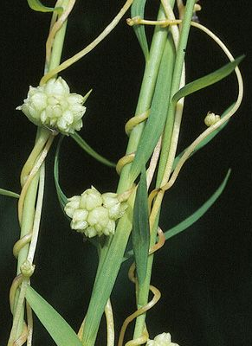
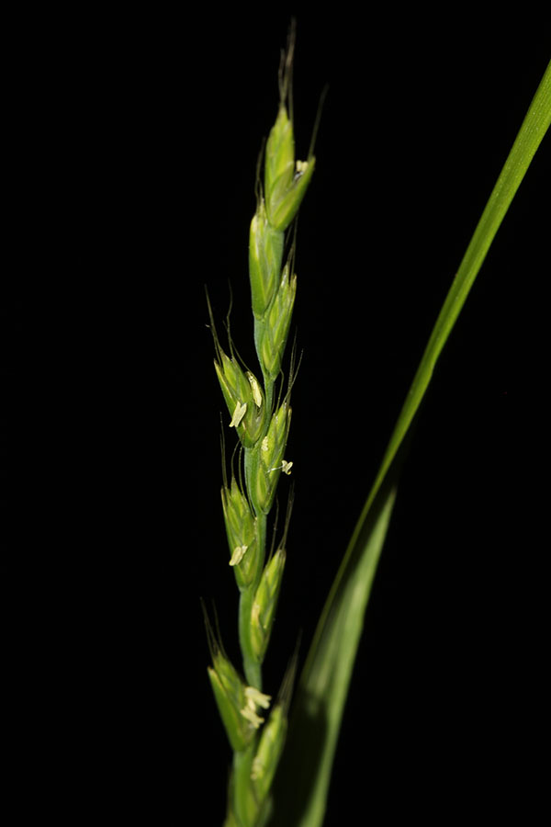
Results : introduced species
Delphinium ajacis
Doubtful knight's spur
Delphinium orientale
Oriental Knight’s-Spur
Honorius nutans
Drooping star-of-Bethlehem
Cuscuta epilinum
Flax dodder
Lolium remotum
Flax-field ryegrass
And different micro-taxa of tulips…

Slide 12
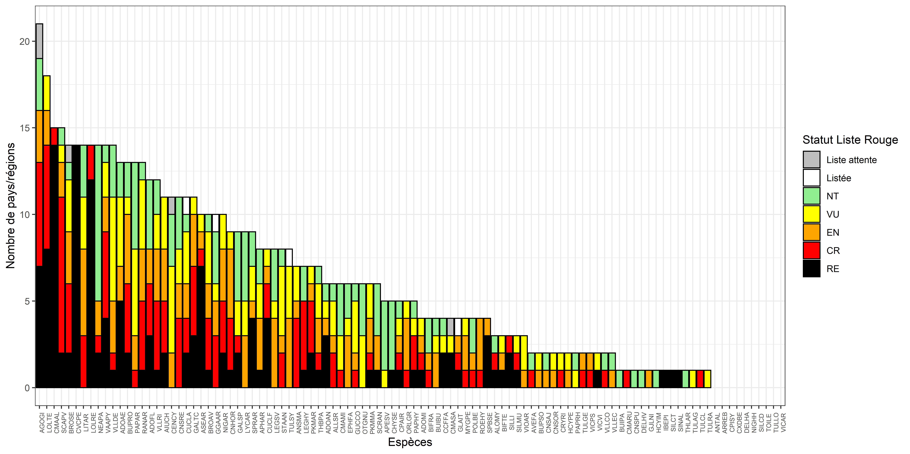
Results : red lists
Waiting list
Listed
NT
VU
EN
CR
The taxa present in the French segetal plant list were cited on average in 6 red lists
EX
Number of countries/regions
Segetal species

Slide 13
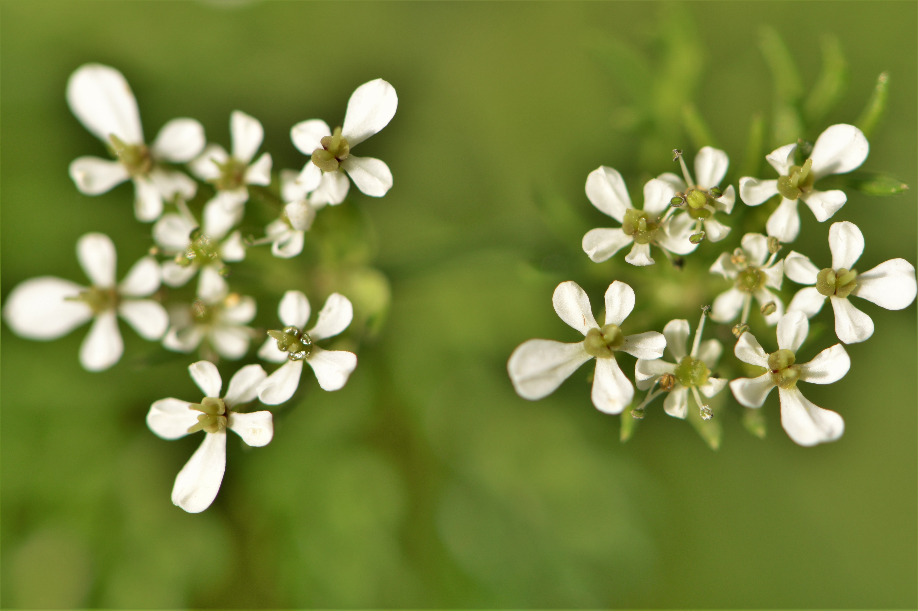
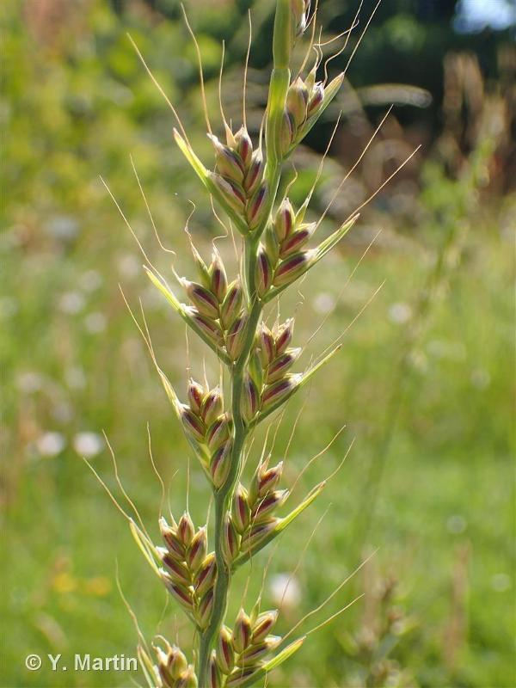
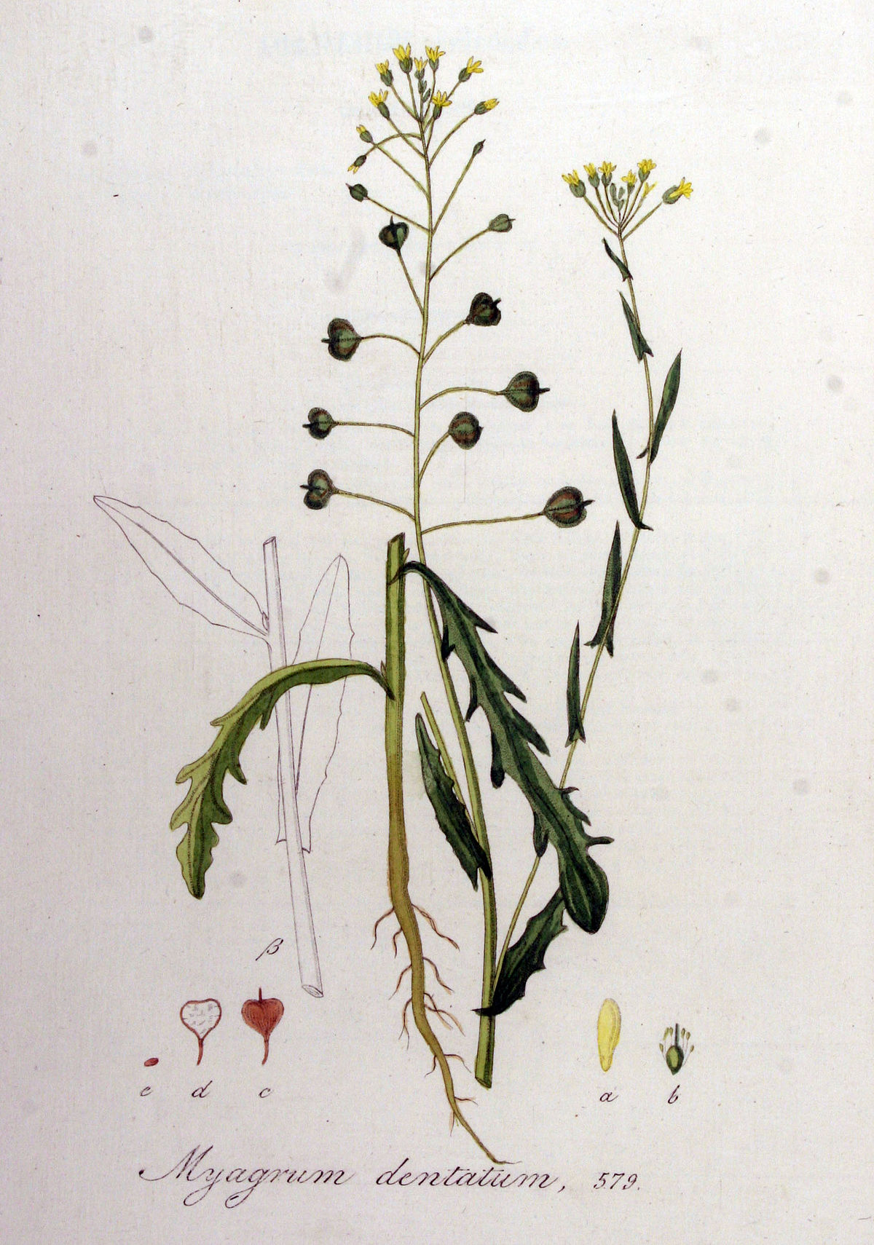
Results : most frequently cited species
Agrostemma githago
Common corn-cockle
Scandix pecten-veneris
Shepherd's-needle
Lolium temulentum
Darnel ryegrass
Camelina alyssum
Flat-seed false flax

Slide 14
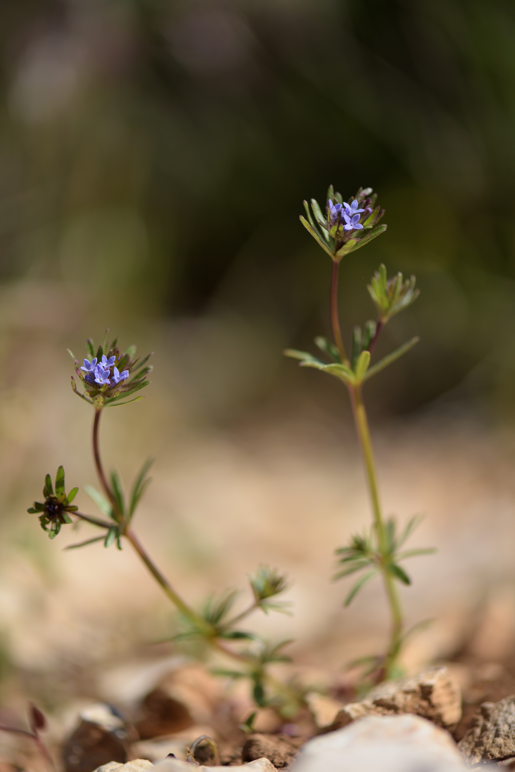
Results : frequently cited as extinct
Asperula arvensis
Blue woodruff
Agrostemma githago
Common corn-cockle
Lolium temulentum
Darnel ryegrass
Lolium remotum
Flax-field ryegrass
Cuscuta epilinum
Flax dodder
Camelina alyssum
Flat-seed false flax
Cereal specialists
Flax specialists
= Speirochorous species

Slide 15
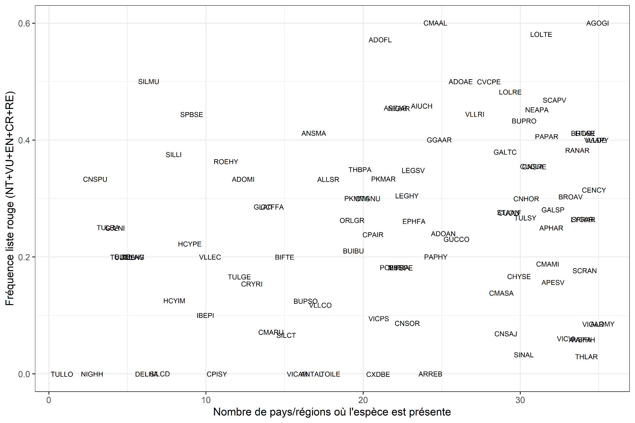
Results : priorities for France
Frequency of citation on red lists (NT+VU+EN+CR+EX)
Number of countries/regions where the species is present

Slide 16
Results : priorities for France
RESTRICTED DISTRIBUTION AND RED-LISTED
WIDE DISTRIBUTION AND RED-LISTED
Frequency of citation on red lists (NT+VU+EN+CR+EX)
RESTRICTED DISTRIBUTION AND ABSENT FROM MOST RED LISTS
WIDE DISTRIBUTION AND ABSENT FROM MOST RED LISTS
Number of countries/regions where the species is present

Slide 17
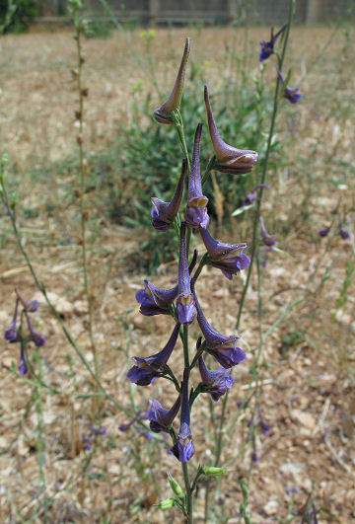
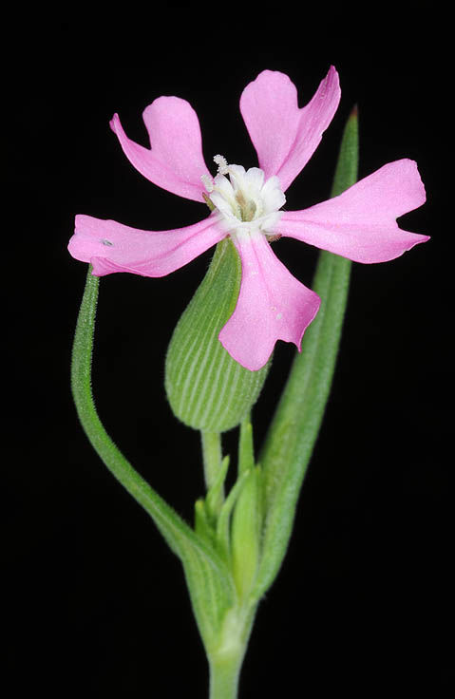
Results : priorities for France
Species belonging to this category are protected by national law (Tulipa spp., Nigella spp., …) except three:
Delphinium halteratum
Bunium pachypodum
Silene conoidea
RESTRICTED DISTRIBUTION AND ABSENT FROM MOST RED LISTS

Slide 18
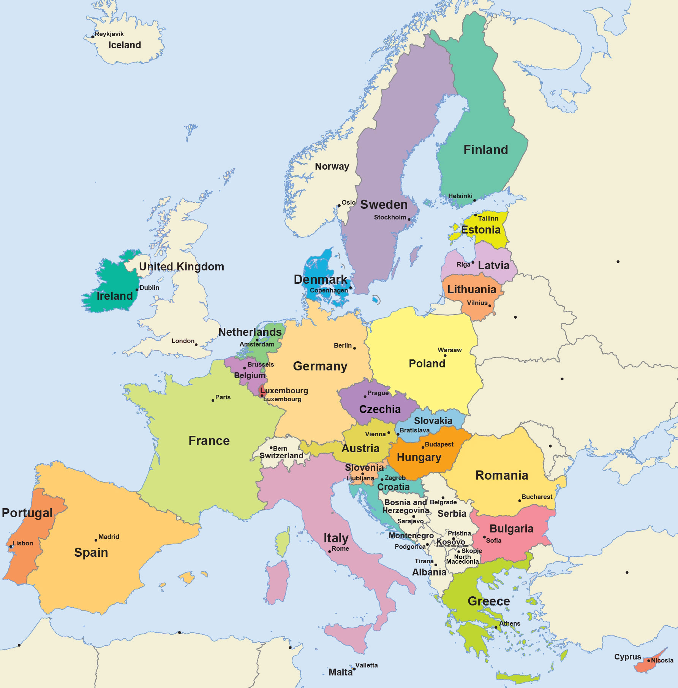
Discussion
Good spatial coverage of red-lists
Some lists >30 years old
IUCN criteria : absence of data -> expert knowledge prevails
Lack of available data in south-east Europe (a potential hot-spot?)
?
?
?
?
?
?

Slide 19
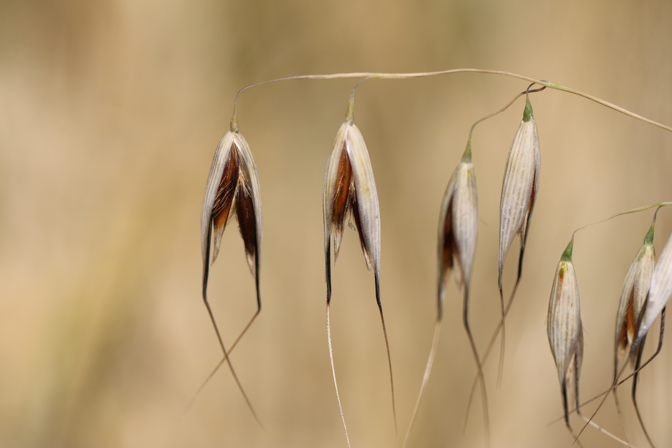
Discussion
Confirms the drastic state of segetal plants at the European scale
Highlights different groups of segetal plants in terms of conservation :
Still common today
Widely distributed but often red-listed
Restricted distribution and red-listed or not

Slide 20
Discussion
Over-optimistic results for certain countries (e.g. Spain) ?
Archeophytes are not necessarily included in red list assessments
Number of provinces cited after 2000
Number of provinces cited after 2000
Number of provinces cited before 2000
Segetal species
Notes:
>60% of species are present in less than 1/3 of the provinces

Slide 21
Discussion
Over-optimistic results for certain countries (e.g. Italy) ?
Archeophytes are not necessarily included in red list assessments
Extinct
Historical mention
Occasional
Introduced
Naturalized
Cryptogenic
Indigenous
Number of regions where the species is (or was) present
Segetal species
Notes:
Vast majority of species present in half of Italian regions

Slide 22
Discussion
A very French perspective
Need for national lists of segetal plants
Need for a worldwide view ?
How to explain the differential decline of the different species ?
Gypsophila vaccaria
Notes:
Vast majority of species present in half of Italian regions

Slide 23
Thank you for your attention.
Notes:
To the jury for having accepted to review my work and to everyone for your attention.

