Slide 1
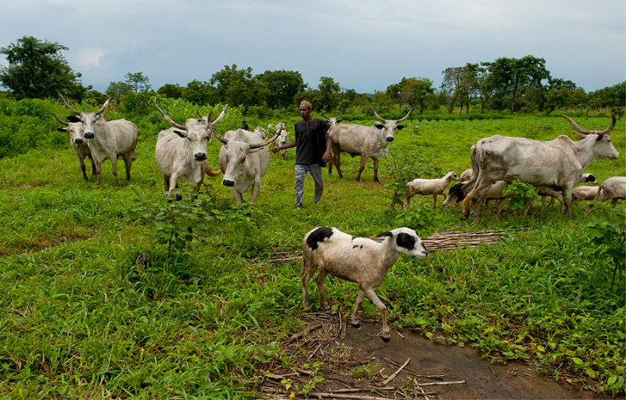
Conative animal calls in Babanki and Bum (Grassfields languages of Cameroon)
Pius Akumbu
LLACAN (CNRS-INaLCO-EPHE)
Alexander Andrason
University of Cape Town,
Living Tongues Institute for
Endangered Languages
Seminar Series: La communication au-delà de l'humain
STL, Universite de Lille, 16 juin 2023

Slide 2
Introduction
Study of Conative Animal Calls (CACs), a subtype of conative interjections used to influence the behavior of animals (summonses, dispersals, directives, etc.)
Call (Bynon 1976, Ameka 1992, Aikhenvald 2010, Andrason 2022)
Directives (Amha 2013; Heine 2023)
Volitive interjections directed to animals (Wierzbicka 2003)
2
Notes:
2

Slide 3
Road map
- Babanki and Bum
- CAC prototype (Andrason & Karani 2021)
- Babanki and Bum CACs
Evidence
Discussion
Similarity
3
Notes:
3

Slide 4
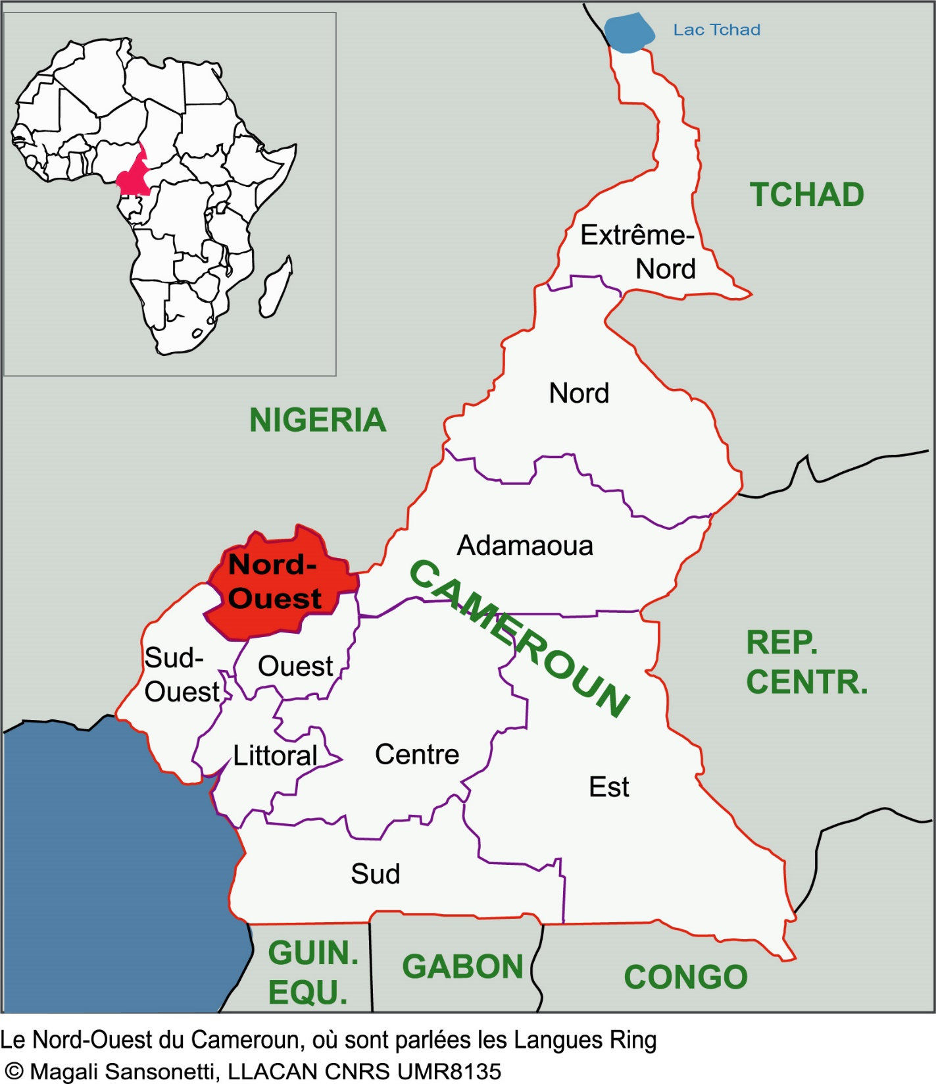

Slide 5
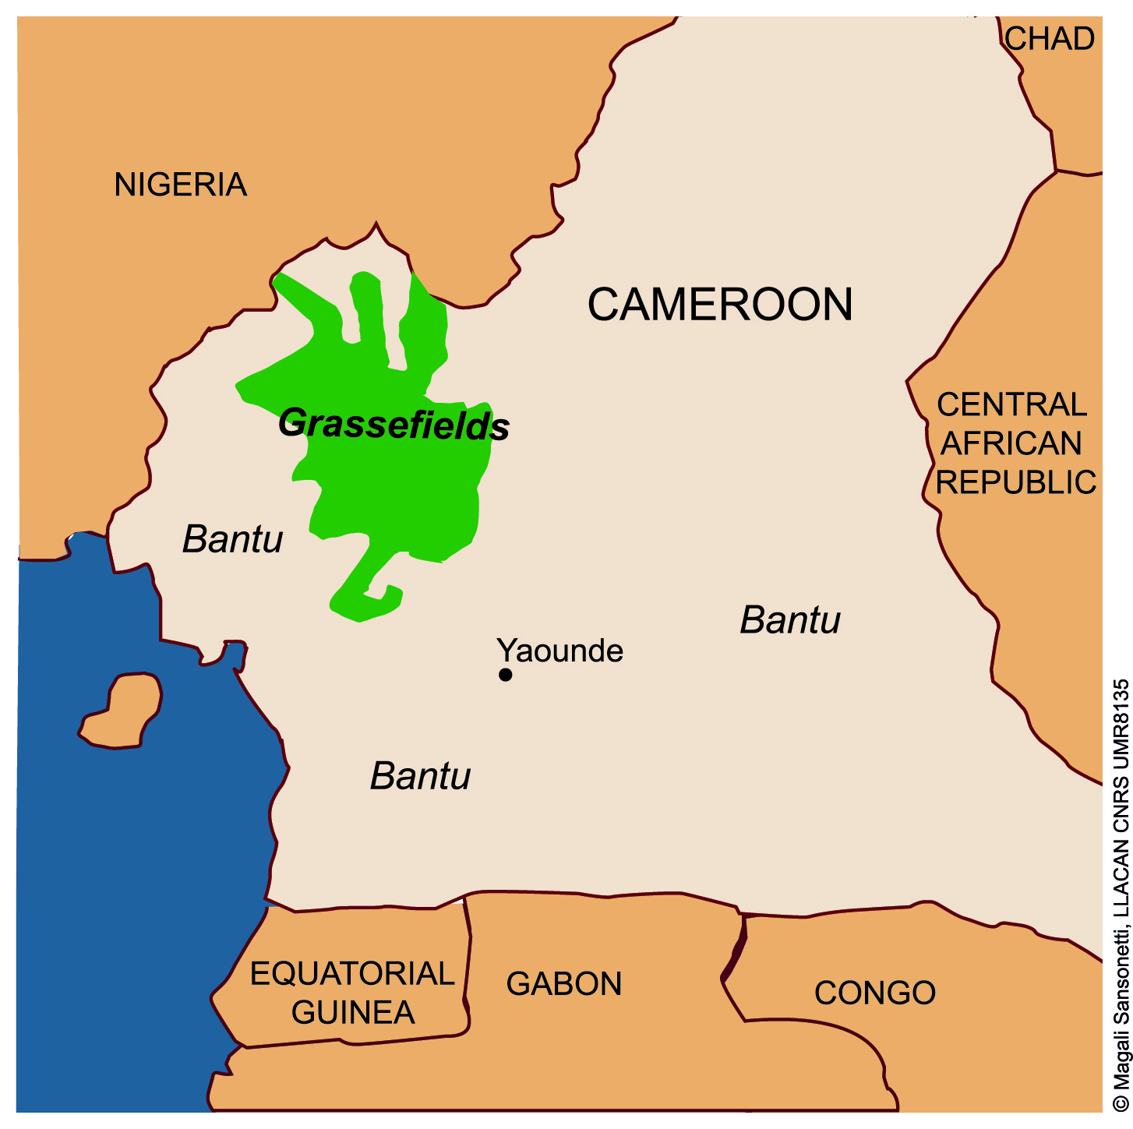

Slide 6
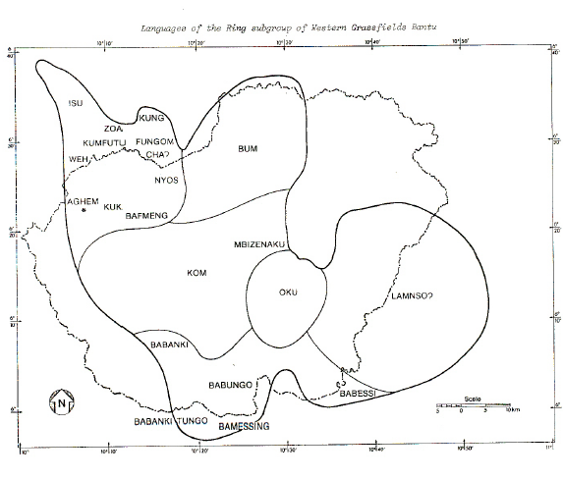

Slide 7
CAC prototype (Andrason & Karani 2021: 33-36, Andrason 2022: 27-30)
Non-formal properties: semantics and pragmatics (SP)
(SP‑1) a prototypical CAC is a lexicalized (i.e., fully entrenched) directive that communicates requests, wishes, desires, demands, or orders and is (specifically) addressed to animals;
(SP‑1.1) the action requested by a prototypical CAC is related to motion: (a) summonses call the animal; (b) dispersals chase it away; and (c) directives urge it to start its motion, halt it, or modify it;
(SP‑1.2) domestic species can act as the referents/recipients of summonses, dispersals, and directives; in contrast, wild animals tend to be only compatible with dispersals
7
Notes:
7

Slide 8
CAC prototype (Andrason & Karani 2021: 33-36, Andrason 2022: 27-30)
Non-formal properties: semantics and pragmatics (SP)
(SP‑2) a prototypical CAC is monosemous and highly specialized – it requests a specific action from a specific animal. [As a result, the meaning of a CAC is relatively context‑independent.]
(SP‑3) a prototypical CAC is dialogical and deliberate
8
Notes:
8

Slide 9
CAC prototype (Andrason & Karani 2021: 33-36, Andrason 2022: 27-30)
(b) Formal properties: Phonetics (P)
(P‑1) a prototypical CAC exhibits a consonantal nature: it makes extensive use or is entirely made up of consonants;
(P‑2) a prototypical CAC contains or is entirely made up of extra‑systematic sounds; such extra‑systematic sounds may be of two types:
(P‑2.1) [non‑IPA] sounds […], specifically whistles and kissing sounds;
(P‑2.2) sounds that are foreign to the language in which particular CACs are found; in this group of sounds, clicks are especially pervasive;
9
Notes:
9

Slide 10
CAC prototype (Andrason & Karani 2021: 33-36, Andrason 2022: 27-30)
(b) Formal properties: Phonetics (P)
(P‑3) a prototypical CAC is accompanied by suprasegmental operations, which are grouped into two clusters:
(P‑3.1) extensions: prolongation, replication, and repetition;
(P‑3.2) modulations: intensity, loudness, rate of delivery, and intonation;
10
Notes:
10

Slide 11
CAC prototype (Andrason & Karani 2021: 33-36, Andrason 2022: 27-30)
(b) Formal properties: Phonetics (P)
(P‑4) the various types of suprasegmental accompaniments are correlated:
(P‑4.1) punctual realization is correlated with loudness and rapidly falling intonation;
(P‑4.2) prolongation is correlated with slowly falling intonation;
(P‑4.3) replication is correlated with uniform intonation or with slightly falling intonation;
(P‑4.4) repetition is correlated with falling intonation, slower pace, and pauses between words;
11
Notes:
11

Slide 12
CAC prototype (Andrason & Karani 2021: 33-36, Andrason 2022: 27-30)
(b) Formal properties: Phonetics (P)
(P‑5) the accompaniments are also correlated with different motion types:
(P‑5.1) summonses are correlated with (vowel) lengthening, replication and repetition, and friendly intonation;
(P‑5.2) dispersals are correlated with a raised voice and articulatory speed (i.e., short rate of production), with repetition being optional;
(P‑5.3) ‘go’‑type directives are correlated with punctual pronunciation, short syllables, and raised voice; ‘continue’‑type directives are correlated with short syllables and raised voice; ‘halt’‑type directives are correlated with prolongation
12
Notes:
12

Slide 13
CAC prototype (Andrason & Karani 2021: 33-36, Andrason 2022: 27-30)
(c) Formal properties: Morphology (M)
(M‑1) a prototypical CAC is primary. However, CACs may also be secondary or borrowed from other languages. The typical sources of secondary CACs are nouns (specifically vocatives, natural‑kind labels, and proper names), imperative verbs, and adverbs;
13
Notes:
13

Slide 14
CAC prototype (Andrason & Karani 2021: 33-36, Andrason 2022: 27-30)
(c) Formal properties: Morphology (M)
(M‑2) a prototypical CAC is mono‑morphemic or built around mono‑morphemic segments, therefore:
(M‑2.1) it does not host inflectional or derivational morphemes; the common exceptions are secondary CACs and primary CACs derived from secondary ones, which may exhibit gender and/or number markers, as well as diminutive and intensifying affixes;
(M‑2.2) a prototypical CAC does not make use of compounding mechanisms;
14
Notes:
14

Slide 15
CAC prototype (Andrason & Karani 2021: 33-36, Andrason 2022: 27-30)
(c) Formal properties: Morphology (M)
(M‑3) a prototypical CAC is structurally extra‑systematic – it does not exploit a typical word structure of the language in which it occurs;
(M‑4) when assessed holistically, the category of CACs is structurally opaque – the ‘directive‑to‑animal’ function is not associated with a clear morphological pattern. This opacity may even characterize CACs that are primary “from birth”, whose only typical morphological feature is the absence of morphological complexity (itself not limited to CACs). Overall, no affix or pattern unavoidably relates a given form to a ‘directive‑to‑animal’ function in a language
15
Notes:
15

Slide 16
CAC prototype (Andrason & Karani 2021: 33-36, Andrason 2022: 27-30)
(d) Formal properties: Syntax (S)
(S‑1) a prototypical CAC may be used both as a lexical and holophrastic element. It functions as a word in an utterance and as a non‑elliptical utterance, respectively;
16
Notes:
16

Slide 17
CAC prototype (Andrason & Karani 2021: 33-36, Andrason 2022: 27-30)
(d) Formal properties: Syntax (S)
(S‑2) in its word‑like non‑holophrastic uses, a CAC may, to a relatively large extent, be integrated into a clausal structure, although such an integration is not compulsory. To be exact, a prototypical CAC contains an inherent 2nd‑person subject referent; it may act as a transitive (rarely) or intransitive (commonly) predicate, thus projecting arguments or allowing for a variety of adjuncts, in particular locative, ablative, allative, temporal noun phrases, prepositional phrases, and adverbials, as well as expressions of means and manner; it can also be modified by modal and pragmatic particles;
17
Notes:
17

Slide 18
CAC prototype (Andrason & Karani 2021: 33-36, Andrason 2022: 27-30)
(d) Formal properties: Syntax (S)
(S‑3) in addition to forming hierarchical structures with arguments, adjuncts, and modifiers mentioned in (S‑2) above, prototypical CACs may form constructions with vocatives (nouns, proper names, and pronouns), imperative verbs, emotive interjections, and other CACs;
(S‑4) a prototypical CAC occupies a peripheral, left/initial position in a clause and sentence, although other positions are also possible if the CAC is accompanied by vocatives, interjections, imperatives, adjuncts, or modifiers.
18
Notes:
18

Slide 19
Babanki and Bum CACs
Within the existing descriptions various language domains and grammatical and lexical categories, the class of CACs has particularly been overlooked in Babanki, Bum, and the entire Grassfields family.
We provide a systematic description of CACs in Babanki and Bum, following the CACs prototype presented above, keeping aside Syntax.
The grammatical description is couched within nonformal (“basic”) theories of language (Goldberg 2003, Dryer 2006, Dixon 2010)
19
Notes:
19

Slide 20
Babanki and Bum CACs
Data collection methods
Heterogenous, consisting of introspection, semi-structured interviews, and focus-group discussions.
Half of the Babanki CACs based on native-speaker competence; others produced spontaneously by 2 females, 3 males during a number of WhatsApp group-discussion sessions in January and March 2023 that lasted approximately 3 hours.
CACs in Bum were elicited from a native speaker (Julius Ntang) through semi-structured interviews conducted via WhatsApp in November 2022 and April 2023.
All CACs in Babanki and Bum were recorded with smart phones as .ogg or .acc audio files and stored online on a safe repository platform facilitated by the Living Tongues Institute for Endangered Languages.
20
Notes:
20

Slide 21
Babanki and Bum CACs
Table 1: See handout
39 Babanki CACs roughly comprehensive because usual size of CAC categories in a language ascends to around 40 or 50 constructions: 39 in Tjwao (Andrason and Phiri 2023), 40 in Xhosa (Andrason 2022), 45 in Arusa Maasai (Andrason and Karani 2021)
20 Bum CACs less complete but capture the most stabilized and entrenched CACs that are found in the language and, therefore, warrant their inclusion in the present study and a comparison with Babanki.
21
Notes:
21

Slide 22
Babanki and Bum CACs: Evidence
Eco-pragmatics
CACs reflect the presence in the Babanki and Bum ecosystem of goats, sheep, dogs, cats, poultry (mostly chickens and ducks), cattle (typically, cows), and pigs.
Horses owned by cattle-heading Fulani
No donkeys, contrary to what can be observed in many languages in Western and Central Africa where donkeys are common referents of CACs
dogs and cats are not pets sensu stricto (contrary to their role in Western households). Serve in hunting (dogs), and protection from rats (cats)
22
Notes:
22

Slide 23
Babanki and Bum CACs: Evidence
Eco-pragmatics: Use of personal names for dogs
The names reflect the knowledge and worldview of the speakers and the stereotypes propagated in the respective communities
Names of countries Proper names (English)
dʒàpān ‘Japan’ dʒìmí ‘Jimmy’
dʒámân ‘German’ ràmbō ‘Rambo’
tʃáínà ‘China’
zàyî ‘Zaire’
Color (English) Common nouns (English)
blāk ‘black’ lɔ́kì ‘lucky’
wískì ‘whisky’
* Horse name: wat (Fulfulde origin)
23
Notes:
23

Slide 24
Babanki and Bum CACs: Evidence
Semantics
Typical action triggered by CACs = motion: sole semantic component of 32 Babanki CACs (82%) and 19 Bum CACs (94%)
Hierarchy: Babanki
Summonses (20 CACs with 17 exclusively summonses)
Directionals (14 CACs with 8 exclusively directives)
Dispersals (9 CACs with 3 exclusively dispersals)
Bum
Summonses (9)
Dispersals (6)
Directionals (3)
24
Notes:
24

Slide 25
Babanki and Bum CACs: Evidence
Semantics
Non-motion CACs
Babanki
encouraging cattle to eat grass during the day (4 CACs)
Mating (2 CACs)
Silencing (1 CAC)
Bum
Silencing (1 CAC)
25
Notes:
25

Slide 26
Babanki and Bum CACs: Evidence
Semantics
Monosemy of CACs (specific animal, specific meaning)
Babanki
bùús / mùús (cats - summons)
mɔ̀ní / ɲàm (pigs - summons)
kə̀tsàf / kwe (dogs - excitement)
Bum
fû, tʃàlà, lɔ̂, lɔ́tʃâ (dogs – chase)
{object-1}(pigs– chase)
{spank-1} (horse– directional)
26
Notes:
26

Slide 27
Babanki and Bum CACs: Evidence
Semantics
Polysemy (more than one animal, more than one meaning)
Babanki
ʃː (all animals – chase, silence)
háréì (cattle, horses – chase both, encourage cattle to eat grass)
Bum
ʃː (all animals – chase, silence)
káhí (goats, sheep, dogs, cats, poultry, and cows - directional)
27
Notes:
27

Slide 28
Babanki and Bum CACs: Evidence
Phonetics
Both consonants and vowels employed, but consonants more prominent and, therefore, more fundamental.
No plain vocalic CACs; but those with approximants, e.g. waa and yeee , but
Consonantal CACs: ʃː, ǀʷ, ǁ̠
CACs have consonantal onsets with only a few exhibiting an approximant, e.g. waa, yeee, hə́ə́iʔ
28
Notes:
28

Slide 29
Babanki and Bum CACs: Evidence
Phonetics
Extra-systematic phonetic elements: IPA sounds
Labialized dental click [ǀʷ] (sometimes produced with the closure made more closely to the palatal zone than dental, thus approximating [ǂ])
Alveolar click [ǁ̠]
Glottal fricative or approximant [h] (e.g., hə́ə́iʔ) and the trill [r] (e.g., kɨ́rɨ́)
29
Notes:
29

Slide 30
Babanki and Bum CACs: Evidence
Phonetics
Extra-systematic phonetic elements: non-IPA sounds
{whistle-1} is a series of short high-tone high-pitch whistles produced with strongly protruded lips (Babanki)
{kiss-1}is a crosslinguistically common kissing sound noted as [↓B’] (Babanki and Bum)
Melodic uninterrupted vocalization {tune-1}, a holistic song-like pattern hummed to tend cattle (Babanki)
30
Notes:
30

Slide 31
Babanki and Bum CACs: Evidence
Phonetics
Extra-systematic phonetic elements: non-IPA sounds
{snap-1}, a short finger snap that can be repeated in a series
with relatively short intervals (Babanki and Bum)
{spank-1}, combines an auditory feature (i.e., a relatively loud but dull bang similar to claps with a gestural and tactile component often used in CACs (Bum)
{object-1}) is made by means of a receptacle, usually a container used to give food. The speaker hits the container to alert the animals to come to eat.
31
Notes:
31

Slide 32
Babanki and Bum CACs: Evidence
Phonetics
Syllable structure: CACs allow consonantal nuclei.
Consonantal CACs: ʃː, ǀʷ, ǁ̠ (Babanki and Bum), ʔʃ̩ (Babanki)
Glottal onset: ʔʃ̩ often replicated as ʔʃ̩-ʔʃ̩-ʔʃ (Babanki)
Contour tones and diphthongs: bùús, mùús, and tʃááìʔ (Babanki) or tʃáì, mɛ̀ɛ́ʔ, and mɔ̀ɔ́ʔ (Bum)
32
Notes:
32

Slide 33
Babanki and Bum CACs: Evidence
Phonetics
Length: Long vowels are common and need not convey any type of intensity of emphasis: hə́ə́iʔ, hə́rə́ə̀, waa, tʃaaaiʔ, tʃḛ̋ḛ̀ḛ̀iʔ, and yeee (Babanki).
Long consonants ʃː which can be lengthened to ʃːː or exhibit even more exaggerated duration.
CACs are often shouted, pronounced with particular intensity, speed, and excessive high pitch, sung following a determined melody pattern, or uttered with strongly modified voice thus being hummed, murmured, and/or whispered. tʃḛ̋ḛ̀ḛ̀iʔ, is in fact usually pronounced with heavy laryngealization or creaky voice.
33
Notes:
33

Slide 34
Babanki and Bum CACs: Evidence
Phonetics
semantic types of CACs are correlated with determined phonetic features:
Summonses realized with the so-called “friendly intonation” (Andrason and Karani 2021, Andrason 2022) and thus with a gentle voice, higher pitch, and melodically.
Dispersals realized with hostile pronunciation: loudly, quickly, and harshly (Andrason and Karani 2021, Andrason 2022)
34
Notes:
34

Slide 35
Babanki and Bum CACs: Evidence
Morphology
Primary CACs morphologically simple. All primary CACs (21 in Babanki and 19 in Bum) are monomorphemic, without inflectional nor derivational affixes, nor compounding.
Replications are particularly common in summonses. Indeed, several summonses tend to occur in series, as illustrated by
ɲàm-ɲàm-ɲàm, ǁ̠-ǁ̠-ǁ̠ (Babanki). Such CACs require replications: kɔ̀kɔ̀kɔ̀ kɔ̀kɔ̀kɔ̀ (Babanki) and kɔ̀kɔ̀kɔ̀kɔ́kɔ́k (Bum).
{whistle-1}, {kiss-1}, and {snap-1} all envisioned as holistic replicative patterns.
Replications expressive phonetic strategy rather than an (exclusively) derivative and thus morphological device
35
Notes:
35

Slide 36
Babanki and Bum CACs: Evidence
Morphology
Secondary CACs morphologically complex? When present complexity of secondary CACs is a property of the sources of CACs rather than CACs themselves.
Secondary CACs draw on imperative verbs host inflections (inherited from the original imperatives)
Babanki Bum
fʉ̀ʉ́ ‘go out!’, fû ‘exit!’
lùú ‘leave!’ lɔ̂ ‘leave!’
No derivational marking and compounding strategies
36
Notes:
36

Slide 37
Babanki and Bum CACs: Similarities
Form and function
18 of 59 CACs (30%) coincide formally. 16 are primary CACs: 12 built around IPA phones, 4 exploit non-IPA sounds. 2 shared CACs are secondary.
The “IPA” CACs – i.e., kɔ̀ (found in kɔ̀kɔ̀kɔ̀ kɔ̀kɔ̀ kɔ̀ and kɔ̀kɔ̀kɔ̀kɔ́ɔ́kɔ́k), mɛ̀ɛ́ʔ, mɔ̀ɔ́ʔ, ʃː, ǀʷ, and ǁ̠ – not only coincide formally but also express the same meaning, although the specific animal referents may sometimes differ slightly. Specifically, kɔ̀ -, mɛ̀ɛ́ʔ, mɔ̀ɔ́ʔ, ǀʷ and ǁ̠ are all used to summon animals, while ʃː is used to chase them away.
37
Notes:
37

Slide 38
Babanki and Bum CACs: Similarities
Form and function
Sibilant, click-driven CACs for dispersals and summonses respectively is highly common crosslinguistically.
Sibilants extensively exploited to chase away animals, being the most recognizable exponent of the prototype of a prototypical dispersal (Andrason 2023).
Even in non-click languages, clicks tend to be used to call animals, e.g., Arusa Maasai (Andrason and Karani 2021)
38
Notes:
38

Slide 39
Babanki and Bum CACs: Similarities
Form and function
The remaining shared CACs are onomatopoeic imitating the sounds made by the animals summoned. This means that the surface similarity in form and function between primary CACs in Babanki and Bum need not stem from some common source originating in an ancestor proto language. Equally likely is that this similarity has emerged independently – it manifests certain typological regularities and has an iconic and/or cognitive motivation.
39
Notes:
39

Slide 40
Babanki and Bum CACs: Similarities
Form and function
The “non-IPA” CACs ({kiss-1} and{snap-1}) have same form and are summonses in both languages.
Not phylogenetic but may rather reflect crosslinguistic pressures, e.g., {kiss-1} commonly used to summon animals in many languages, e.g., Xhosa (Andrason 2022)
fʉ̀ʉ́ (Babanki) and fû (Bum) formally similar, suggesting a phylogenetic relationship (both exploit a verbal form that existed in the proto language), but process of harnessing this root for a directive-to-animal function may have occurred independently in Babanki and Bum and stemmed from iconic pressures.
40
Notes:
40

Slide 41
Babanki and Bum CACs: Similarities
Form and function
Low extent of relatedness between CACs in Babanki and Bum visible in the primary CACs used to summon cats.
Three crosslinguistic cat CAC strategies:
{miau}-type (found in Akan, Kihunde, and Oromo),
{niau}-type (found in Maasai and Xhosa), and
{b/mVs}-type (found in Bono and Arabic).
Babanki uses the first and the third but Bum the second one.
Conclusion: Babanki and Bum do not have undeniable cognates (with the exception of fʉ̀ʉ́ and fû).
41
Notes:
41

Slide 42
Babanki and Bum CACs: Discussion
The prototype. Babanki and Bum CACs are canonical:
Semantics: CACs mainly express actions related to motion and have domestic species as their referents.
Phonetics:
CACs, especially their primary subclass, tend to be monosyllabic.
Exploit consonantal material more extensively than vocalic material,
exhibit extra-systematic sounds (both IPA or non-IPA) and sound combinations,
Marked by a series of suprasegmental features such as length and various types of modulations.
42
Notes:
42

Slide 43
Babanki and Bum CACs: Discussion
The prototype. Babanki and Bum CACs are canonical:
Morphology:
Mostly monomorphemic roots with no inflections, derivations, and compounding – a form that makes the entire category opaque.
Summonses and dispersals are correlated with a series of more specific phonetic and morphological properties.
43
Notes:
43

Slide 44
Babanki and Bum CACs: Discussion
Prototype violation:
Polysemy:
Predicted monosemy is attested
polysemous CACs seem to be equally common
Similar extents of polysemy of CACs have been observed in other languages (see, for example Andrason 2022, Andrason and Phiri 2023)
Andrason 2022: 49 “the polysemy of CACs may be […] greater than assumed thus far”.
Greater divergence from the prototype with regard to phonetics and morphology are found in secondary CACs – a phenomenon that is also well documented in literature (Andrason and Karani 2021).
44
Notes:
44

Slide 45
Babanki and Bum CACs: Discussion
Implications for the general typology of CACs:
Eco-pragmatics: Linguistic nature of CACs embedded in the fauna and flora of the community that speaks a given language and the economy that it practices.
CACs and imperative verbs: semantic and formal relationship between both. They are directive and draw on short or even monomorphemic forms.
Therefore, most secondary CACs derive from imperative verbs across languages (cf. Andrason and Phiri 2023).
45
Notes:
45

Slide 46
Babanki and Bum CACs: Discussion
Implications for the general typology of CACs:
Clicks and trill: apart from allowing for the presence of clicks in non-click languages, CACs may exhibit some tendency to exploit the trill [r] in non-trill languages e.g., Akan (Andrason and Phiri 2023).
Resistance to inheritance: confirms hypothesis that CACs are more resistant to be inherited throughout the history of a language or a language branch – fewer cognates found in dialects of a language or in related languages, than is the case of other lexical classes e.g., Akan (Andrason and Phiri 2023).
46
Notes:
46

Slide 47
Babanki and Bum CACs: Discussion
Contribution to Babanki and Bum linguistics:
CACs demonstrate that radical contour tones and diphthongs (i.e., those found in roots) are not foreign to Babanki and Bum speakers.
Babanki and Bum speakers are not unfamiliar with clicks, trills, and glottal fricative/approximants.
Length(ening) and replications do not always carry intensifying functions in Babanki and Bum. While the intensifying function of length(ening) and replications may indeed apply to onomatopoeias and ideophones, they are not inherent to CACs.
47
Notes:
47

Slide 48
Conclusion
Systematic analysis of conative animal calls in Babanki and Bum – two under-researched Central-Ring Grassfields languages of Cameroon.
In both languages, the categories of CACs instantiate the prototype of a CAC to a large extent with regard to both semantics, phonetics, and morphology
Several linguistic properties of CACs have their source in the ecosystems inhabited by the respective communities of speakers
48
Notes:
48

Slide 49
Conclusion
Similarity between the CACs in Babanki and Bum is low and their phylogenetic relationship minimal.
Syntax of CACs not discussed due to lack of corpora capturing spontaneous language use
Need to study CACs in other closely related languages to confirm low level of inheritance claimed.
49
Notes:
49

Slide 50
References
Aikhenvald, A. 2010. Imperatives and Commands. Oxford: Oxford University Press.
Ameka, F. 1992. The meaning of phatic and conative interjections. Journal of Pragmatics 18(2‑3): 245‑71.
Amha, A. 2013. Directives to humans and to domestic animals: The imperative and some interjections in Zargulla. In M‑C. Simeone‑Senelle & M. Vanhove (eds), Proceedings of the 5th International Conference on Cushitic and Omotic Languages, Paris, 16‑18 April 2008. Köln: Rüdiger Köppe, pp. 211‑29.
Andrason, A. 2022. Conative Animal Calls in Xhosa: Testing the Prototype. Africana Linguistica 28: 25–54.
Andrason, A. and A. Phiri. 2023. Talking to animals in a moribund language: Pragma-semantics, phonetics, and morphology of Conative Animal Calls in Tjwao. Linguistic Variation 23 (2): 1–25.
Andrason, A. and M. Karani. 2021. “Conative Calls to Animals: From Arusa Maasai to a Cross-linguistic Prototype.” Łódź Papers in Pragmatics 37 (1): 3–40.
Bynon, J. 1976. Domestic animal calling in a Berber tribe. In C. McCormack & S. Wurm (eds), Language and Man: Anthropological Issues. The Hague/Paris: Mouton, pp. 39‑66.
Dixon, R.M.W. 2010. Basic Linguistic Theory. Methodology. Vol 1. Oxford: Oxford University Press.
Dryer, Matthew. 2006. Descriptive theories, explanatory theories, and basic linguistic
theory. In Ameka, F., A. Dench, and N. Evans Catching Language. The Standing Challenge of Grammar Writing, 207–234. Berlin: Mouton de Gruyter.
Goldberg, A. 2003. Constructions: A new theoretical approach to language. Trends in Cognitive Science 7 (5): 219–224.
Heine, B. 2023. The Grammar of Interactives. Oxford: Oxford University Press.
Wierzbicka, A. 2003. Cross‑cultural Pragmatics: The Semantics of Human Interaction. Berlin: Mouton de Gruyter.

