Slide 1
Territorial and Digital Mobilities through Tourism and Work Territoires et Mobilités Numériques par le tourisme et le Travail
Digital Nomadism
New places, new links?
TERMONUTT Project / Presentation and main results
Clément Marinos
Associate Professor
University of Southern Brittany
February 6th, 2020
TIDES Seminar
Notes:
I’m very happy to be here today to share my research with you.
I would like to thank Nancy Davila for the organization of this conference.
May name is Clément Marinos, I’m an associate professor in economics in Southern Brittany University in France.
My researche fileds are focused on digital and collaborative economy, networks and territories, specially those located outside big metropolises
Today we’re going to talk about digital nomadism and its relation to space throught one of my research project named TERMONUTT

Slide 2
A few words about Digital Nomadism
Contemporary changes in lifestyles and ways of working linked to the “Civilization of leisure”
Possible phenomenon origins
historically : “Grand Tour”: long trip to Europe made by wealthy young people in the 18th century and wanderlust from Romantic Germans
also sabbatical leaves (US, Germany) and travel bloggers
More recently: flatsharing and Erasmus program (« L’auberge Espagnole »), low cost flights, work-holyday visa and … coworking (collaborative spaces)
Expanded with the development of digital tools and networks
Consequences on certain territories? Many, including new "social infrastructures" such as coworking spaces (more on this later).
Notes:
Let’s start with a short introduction about digital nomadism : definition, origins,
Digital nomads are people who, in the processes of their professional activities (or studying, creating art, free time), are not confined to particular spots through using Internet technologies and mobile connection.
I think that this phenomenon of DN belongs to the network information-communication society and to the leisure society
It also appeared in the context of two interdependent global trends: mobility and digitalization.

Slide 3
TERMONUTT: a brief history of the project
“Spin-off” of a project about innovation in coworking spaces located in peripheral areas
Innovation capabilities through networking outside metropolis
Coworking spaces as a new development tool for remote territories
Visit of a coworking space in Audierne, a small fishermen village in Brittany in 2015
People from Paris and abroad coming for a temporary retreat in order to be more productive, creative, innovative and to focus on their projects
Leaving an overflow of social connections
Temporary hosting a population called digital nomads
Mixing leisure / tourism and professional activities during their stay
« When regular coworking spaces are not enough, we look further »

Slide 4
Notes:
An opportunity to meet people in order to share their resources and network
Importance of the place

Slide 5
General context
Digital Nomads (Makimoto et Manners, 1997 ; Müller, 2016 ; Mohn, 2017): No fixed location and no anchorage for their professional activities
Independent workers and freelancers
Solopreneurs
Employed teleworkers
Between 0.5 million and 1 million individuals worldwide (Reddit forum, Facebook)
Injunction to creativity and productivity, to the reinvention of their professional practices (not physically surrounded and supported by an organization)
Work without geographical constraints, only dependent on accessibility to digital networks (Dal Fiore et al., 2014)
Coworking spaces as "third places" (Oldenburg, 1991 ; Jeffres at al., 2009) that now host a large proportion of these digital workers (Suire, 2016)
Notes:
More and more knowledge workers are becoming location
independant wether they are freelancers, solopreneurs or employed
Third place differs from the first place (home) and the second place (work place). Oldendurg talk about library, bars where people socialized and helps each other.
This concept of third place has a great success in France such that French Goverment just decided to make a dedicated a national policy to support it.

Slide 6
Research topic: from the third place to the fourth place
Other types of places that have been developing in recent years -> new hybrid places: fourth-places (Marinos, 2018; Aelbrecht, 2016)
Considered as spaces
at the centre of a triptych "work, home, holidays (or wanderlust), "
also called « Coworkation spaces »
located in territories far from major urban centres
Digital nomads who, a priori, can free themselves from any form of anchoring to a place of production (the office) …
… but who, through their practices of temporary hybrid mobility (work, leisure/tourism), favour specific locations.
Approximately 200 in the world who identify themselves as coworkation spaces
Notes:
It’s possible to take a census of those places.
Relying on specific platforms like cowoli.com
First obervation is …

Slide 7
Notes:
The case illustrate the “work / holyday / home” tryptic
The place is located above the polar circle
To reach this place is earned, you need to make an effort.
But the question is: what's the reward?

Slide 8
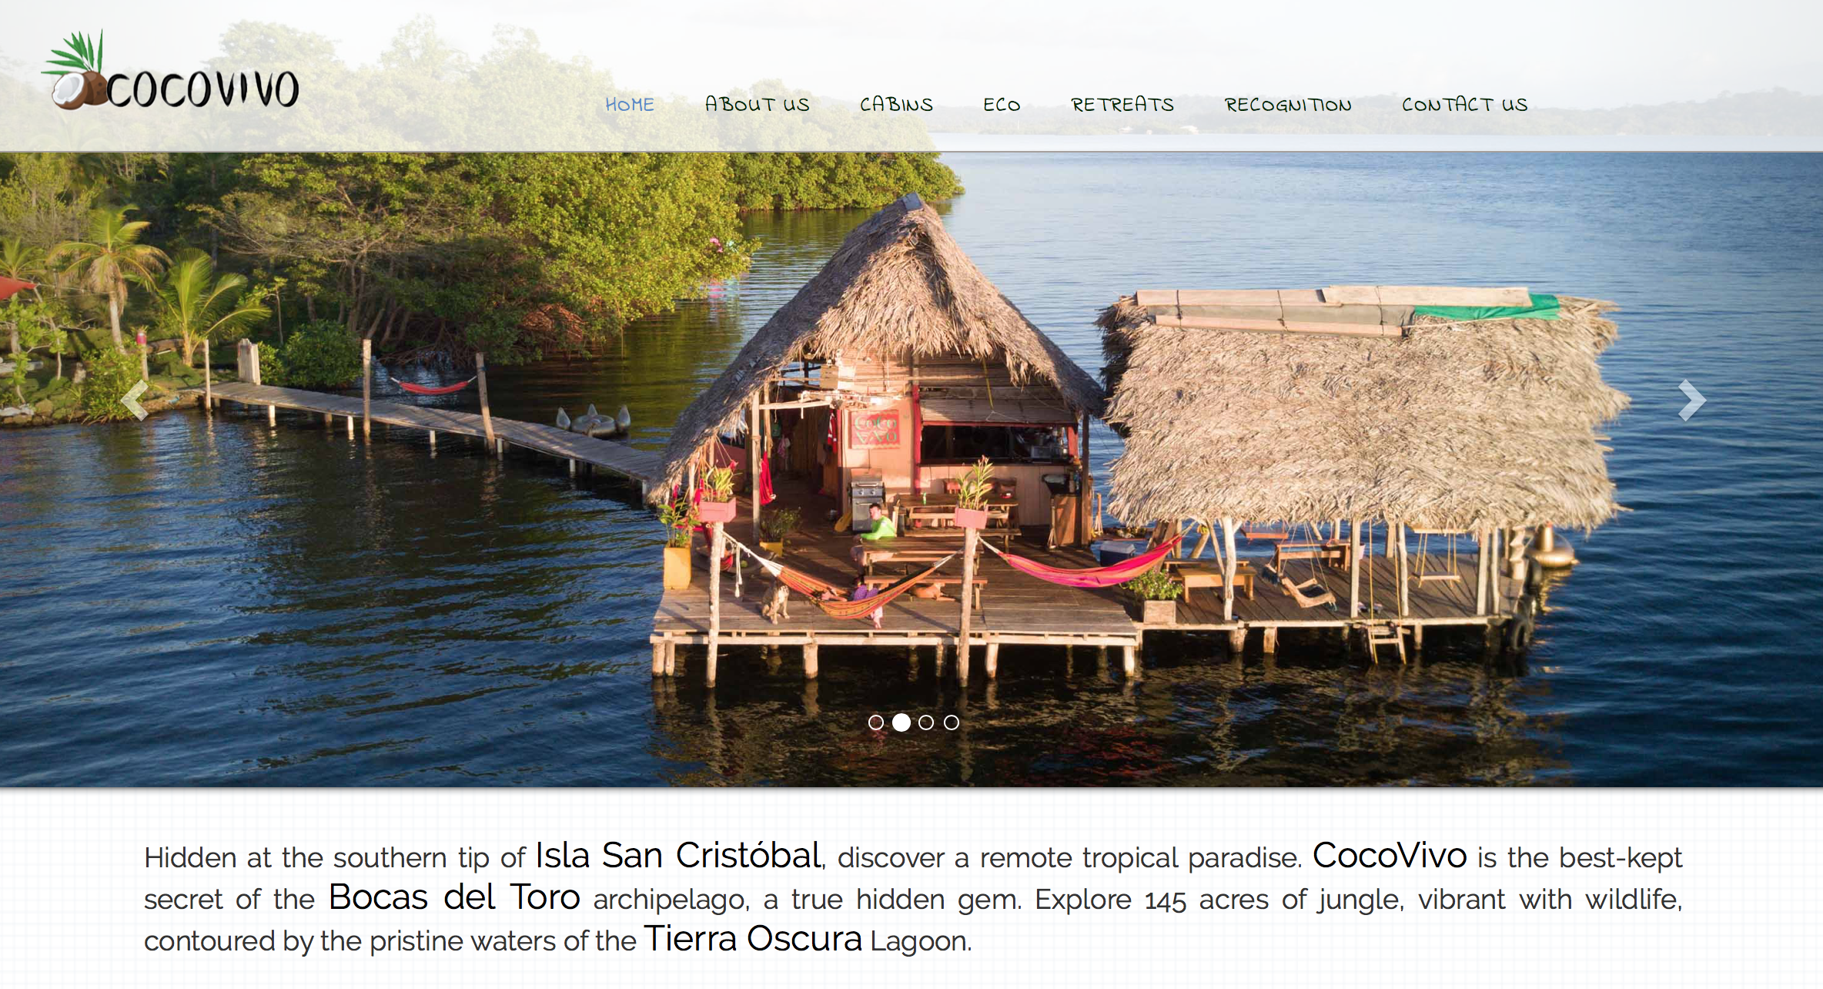
Notes:
It looks like a race to the distance : “the further you go, the better it is !”

Slide 9
Aims of the research project
To characterize and analyze this form of hybrid spaces and the associated mobilities
To question the perception, representation and use of the territory by these spaces (managers and members)
To identify the criteria for choosing destinations
To question the community dimension of these fourth-places
External: relations with local stake-holders
Internal: emerging peer communities
A multidisciplinary approach: management, information and communication, geography, economics, etc.
Notes:
Research about the territorial dimension of digital nomadism that remains poorly documented

Slide 10
Main Hypothesis
The relationship to time and space is
reinvented in these new spaces
Working there (physically) ... and elsewhere (digital ubiquity)
Working all the time without any schedule constraint
Abolishing the temporal boundaries between work and personal time
Being a tourist and a (local) worker at the same time … a new category of people ?
Notes:
Summerise the hypothesis

Slide 11
Methodology
Construction of an analytical database of 55 fourth-places
Main source: secondary data from the websites of the spaces
Fourth-places located outside major urban centres, outside the main hubs of the digital economy (Silicon Valley, Western capitals)
Semi-directive interviews with founders, facilitators, managers and guests (25 completed so far)
Distribution of an online questionnaire to users / guests / digital nomads (proceeding)
Notes:
It takes an effort to go in such remote places

Slide 12
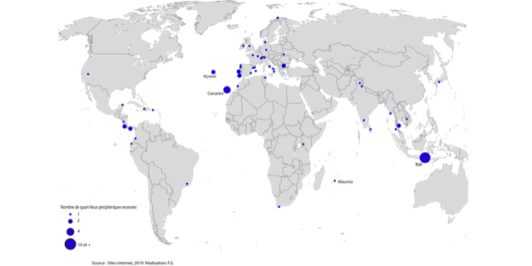
Location of fourth-places
Notes:
Some unexpected places

Slide 13
Exploratory results: situations of territorial intermediation
Intermediation between local and global scales
Local anchoring for globalized and hyper-mobile workers
Social networks and websites as the main vectors of visibility of places on the "world map".
Valorization and promotion of the territory by the creators and managers of the places.
Networking of places (and their territory) by the
flow of digital nomads
exchanges between managers all over the world
Fourth-places that question new forms of economic development
Networking, exchanging, innovating, creating a system with local actors? (« co-giving »)
Role of the facilitator in activating proximities (Rallet and Torre, 2004) and social embeddedness (Granovetter, 1985)?
Notes:
Somethink very local is becoming very global thanks to digital tools
Interesting because the fourth place emoby (incarne) the territory and brings him to a global level.
This embodiemnt is provided by the managers
Promity with local companies in order to share skills and to developp some cooperations …

Slide 14
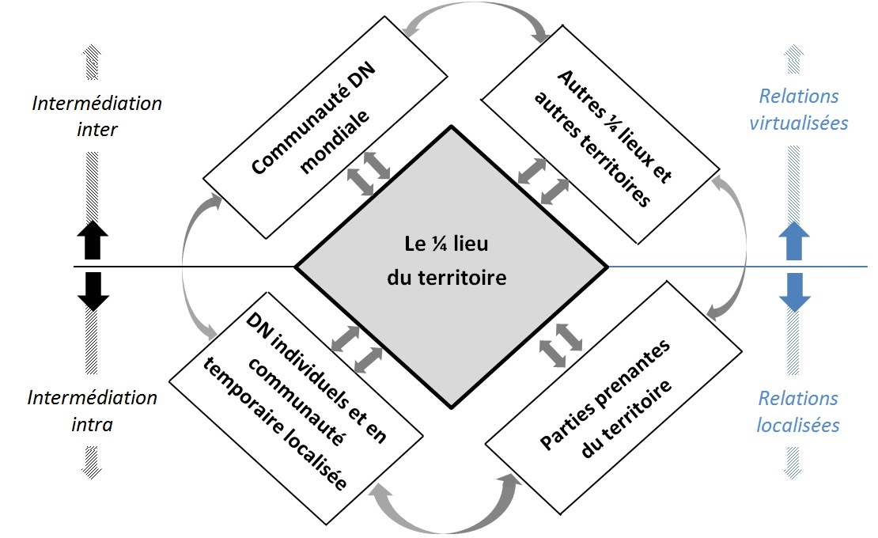
Exploratory results: situations of territorial intermediation
Notes:
Here is a diagram of those different situations
At the center you can see the fourth place.
The main idea is to show the different way it interacts with local and global scales
It underlines the complementarity between located relations and virtual relations : it stands on two legs

Slide 15
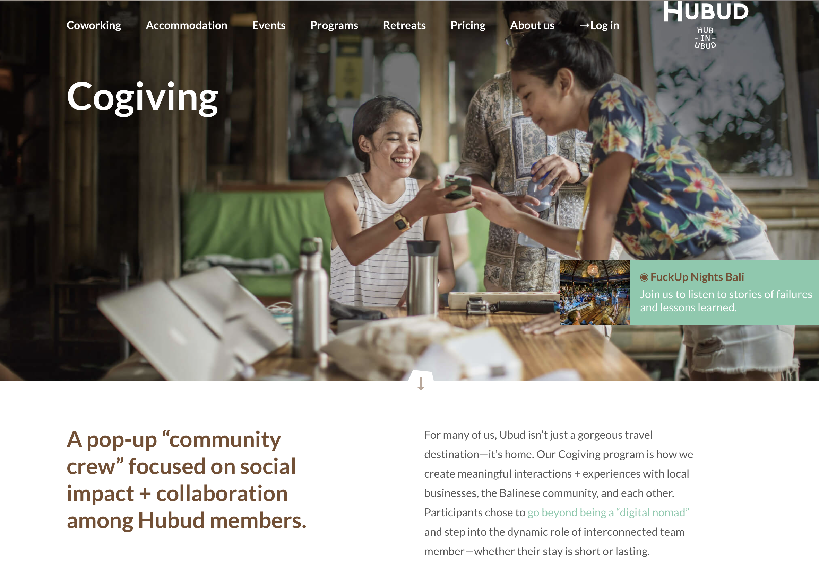
Notes:
This is an illustration of how a coworkatin space aims to connect DN with local community (local business)

Slide 16
Exploratory findings: three fourth-places paradoxes
Singularity VS Standardization : authentic and original places but standardization of the functioning, the services, the public, the websites ...
Process of institutional isomorphism (Di Maggio and Powell, 1983)
Same public (age, social categories, ...), common objectives and common representations?
A-spatiality of the web
Hypermobility of digital nomads (Thompson, 2018) -> dissemination
Places nevertheless rooted in their environment (Debarbieux, 2014)
Territorializing of fourth-places (Liefooghe and Leducq, 2018)
Integration of local specificities and profiles of the founders/managers
Notes:
There is a convergence between organizations belonging to the same field : We can observe it
Isomorphism is a process of homogenization in terms of structure and culture

Slide 17
Exploratory findings: three fourth-places paradoxes
2. Centrality VS Periphery: peripheral places that become central places, “compulsory passages”
New global value chain decomposition (Defever and Mucchielli, 2006)
Digitization of work that questions the Theory of Location of Activities (Krugman's New Geographic Economy)
No proximity to the market?
Online competition?
Geographic centrality as a condition of innovation for the creative class (Florida, 2003)?
Notes:
P. Krugman relies on the location choices made by companies. According to the American economist, the high transportation costs and the increasing returns of industry with increasing size imply a concentration of human activities on certain territories to the detriment of others, going as far as the formation of economic poles.
By 'economic geography' he means 'the location of production in space'; that is to say, the branch of economics that is concerned with the place where things happen and the relationships between them.

Slide 18
Exploratory findings: three fourth-places paradoxes
3. Connection VS Disconnection: looking for isolation but also for social and community relations
On the one hand, social relations provide access to resources for innovation (Fabbri et al., 2016; Suire, 2013) ...
… on the other hand, the fourth-places are based on temporary exclusion, relative isolation
Encourages creativity (Borrillo, 2002)
"Participants in the creative process would be more likely to be creative as they move away from the original sources" (Ward et al., 2002).
It questions the theory of clusters (Porter), the effects of agglomeration (innovation economy) ... of the spatial accumulation of social capital (Putnam, 1995).
Notes:
Putnam (1995) teaches us that the ability to create links within a territory has consequences for its economic and social development.

Slide 19
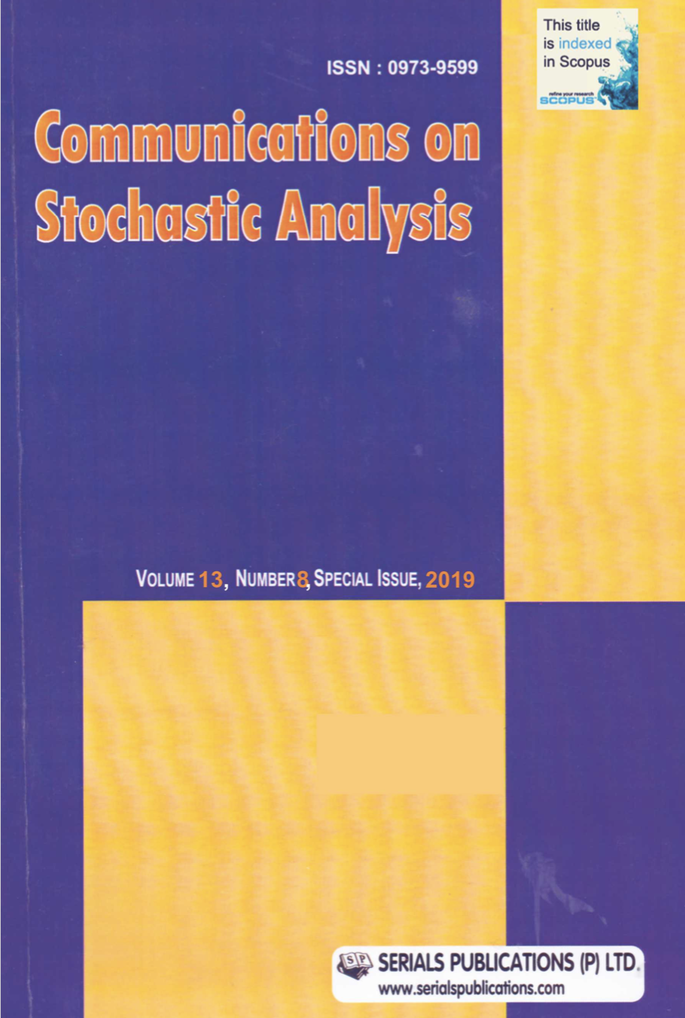
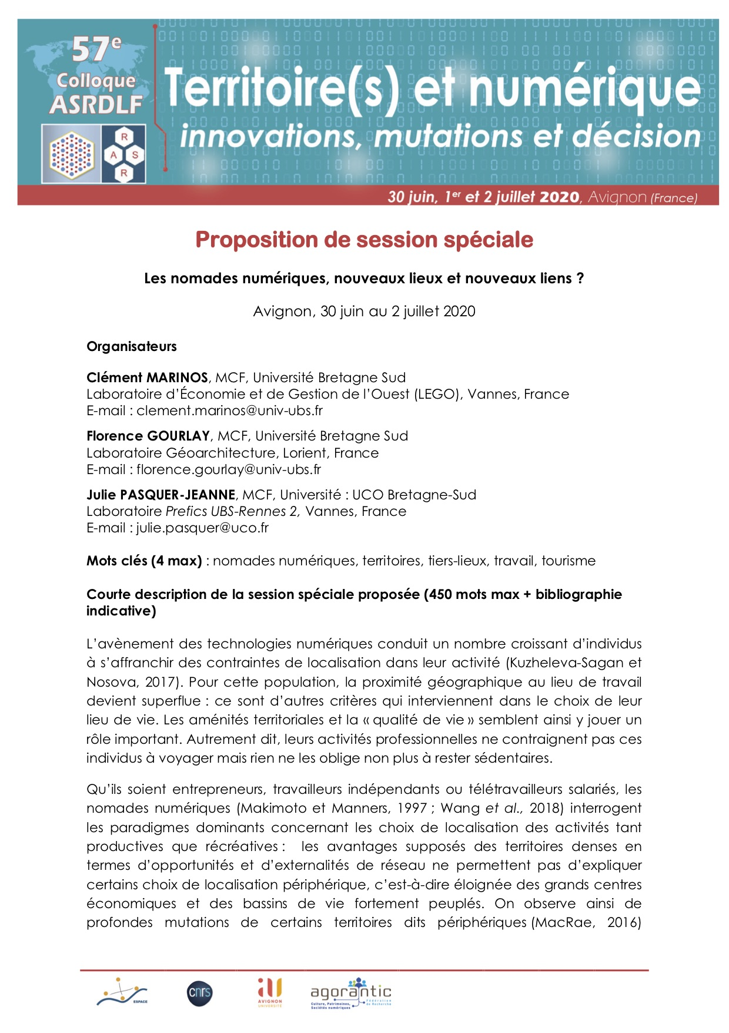
Scientific valorization
Les nouvelles situations d’intermédiation territoriale : l’exemple des « quart-lieux » périphériques (espaces de coworkation), Géographie, Economie et Société (to be published)
Digital Nomads Tourism in Bali, Communications on Stochastic Analysis, vol. 13, No. 8 (Special Issue 2019), 133-145
Organization of a special session during the ASRDLF congress (ERSA for francophones), May 2020

Slide 20
Research perspectives
Continuation of the analysis of the triptych “holidays, work, home” (fourth places as an intermediation device)
Instrumentalization of peripherality (notion of ”tamed” peripherality)
Analysis of the representations of the place by the users
Measure the impacts in terms of economic development
…

Slide 21
International cooperation
Partnership with Indonesian researchers
From Udayana Universitas (Bali)
Research trip planned this summer
Supported by the French Embassy and the French Foreign Affaires Ministry
2 years funding
Opportunity to make the project bigger
Strengthen the team with Las Palmas academics?
ERC type funding?
On the longer term, create a research community about digital nomadism studies?

Slide 22
gracias por su atención
TerritorIAL and Digital MobilitIES through Tourism and Work
Contact : clement.marinos@univ-ubs.fr
Twitter : @docmarins
https://www.labo-lego.fr/membres/clement-marinos/

