Slide 1
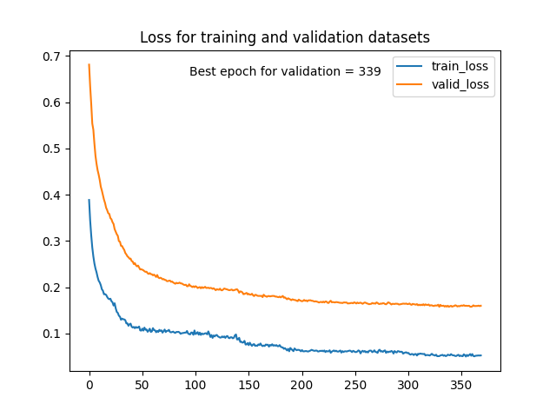
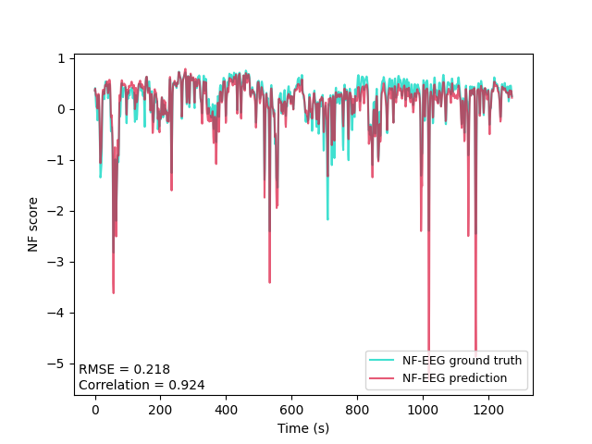
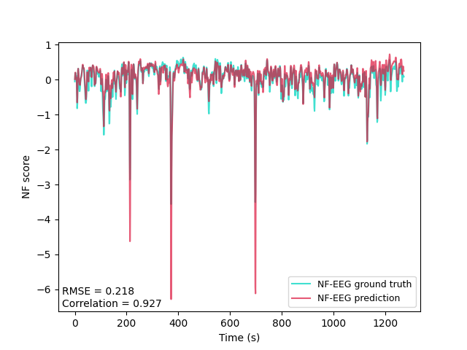
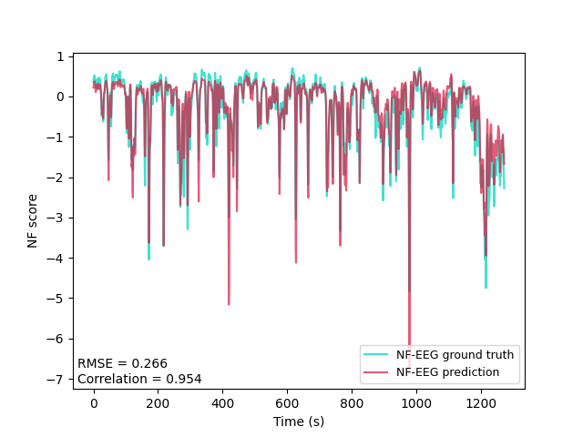
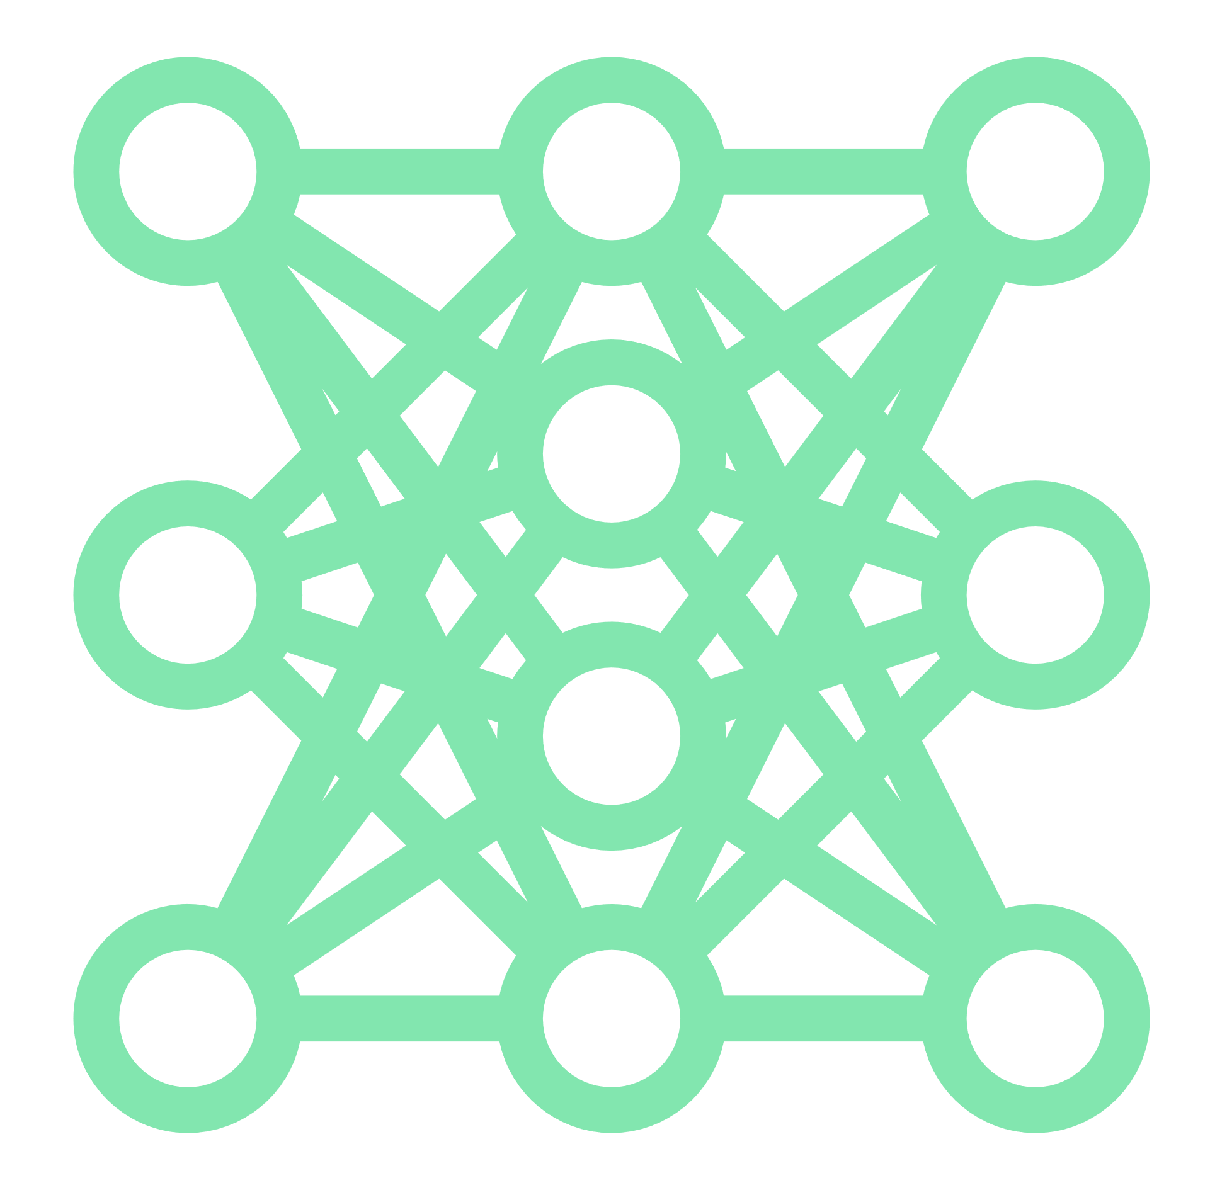
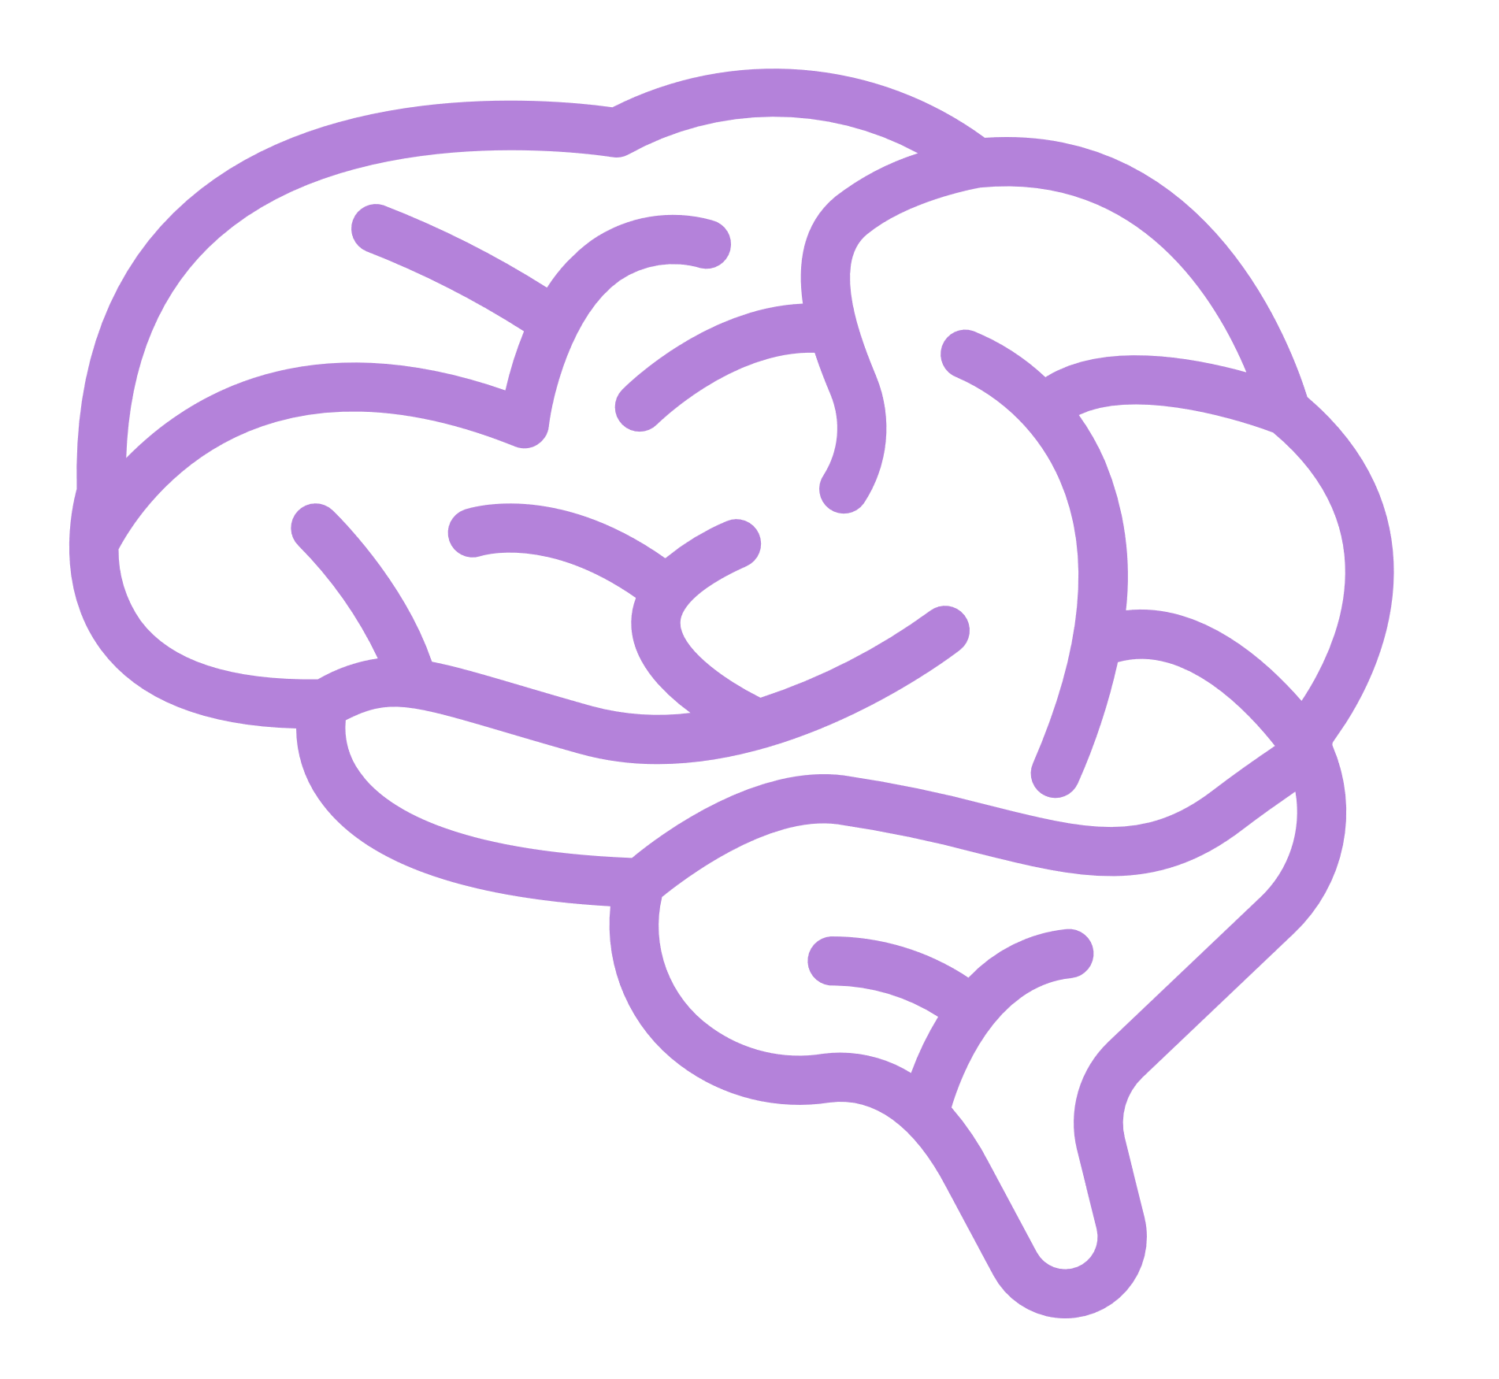
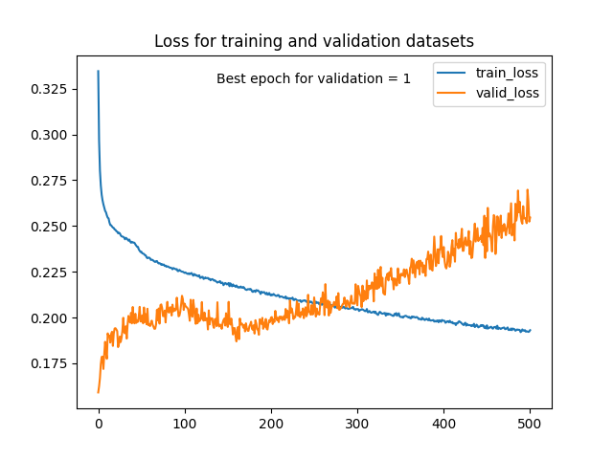
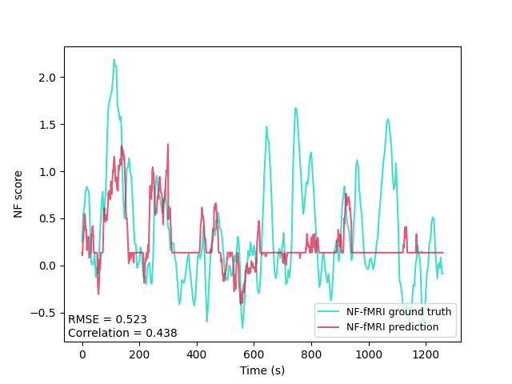
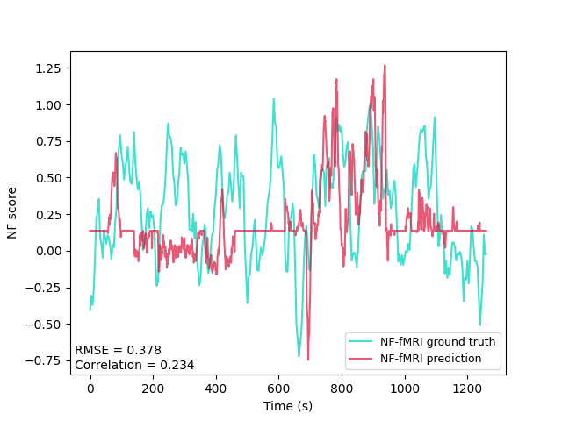
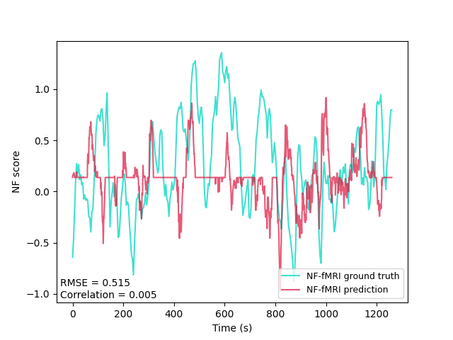
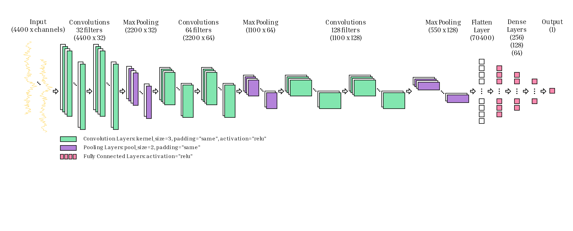
Can neural networks help improve portability of combined EEG – fMRI neurofeedback?
Improving portability of bimodal neurofeedback: predicting NF-fMRI scores from EEG signals
Results
 | Predicting NF-EEG scores | Predicting NF-fMRI scores
Mean RMSE | 0.23 | 0.47
Mean correlation | 0.94 | 0.23
Min-max correlation | (0.92 → 0.95) | (0.00 → 0.44)
Caroline Pinte
@Caroline_Pinte
caroline.pinte@irisa.fr
Predicting NF-EEG scores to validate our approach:
Introduction
Neurofeedback (NF) training is more effective with simultaneous EEG-fMRI acquisitions [1].
However, the use of MRI is expensive and draining for the subject.
So, we need to reduce its use.
→ We propose a method based on a one-dimensional convolutional neural network (1D CNN). With this model, we aim to predict fMRI information from EEG recordings.
Objective
Learning a neural network model from simultaneous EEG-fMRI data to predict NF-fMRI scores from EEG signals alone.
Methods
Data: We acquired simultaneous EEG-fMRI data on 15 healthy subjects in a motor imagery context, described in [2]. This includes fMRI and EEG data for three NF runs of five minutes per subject, with their respective NF scores.
Preprocessing: We compute a supervised learning dataset, where a certain number of timesteps from a selection of EEG channels become one sample that has one NF score as ground truth.
Training: We train the 1D CNN model. Since we have 15 subjects with 3 runs each, the training dataset consists of 14 subjects and 2 runs, the validation dataset of the same 14 subjects and their last run, and the test dataset of the 3 runs from the 15th subject.
Analysis: After the model is trained, NF-fMRI scores are predicted, and compared to the ground truths with the RMSE and Pearson correlation metrics.
Discussion
We are currently working on improving the correlations, which are negatively impacted by:
Sensitivity to the neural network hyperparameters
Noisy nature of the EEG modality
Lack of diversity in data
Conclusion
The interest of this method compared to the previous modeling [3] is to train a single deep learning model for all subjects, which would eventually allow the use of the model to predict these fMRI scores directly online.
An important aspect of the issue is to interpret this model, in order to understand links between EEG and fMRI.
Fig. 2: Prediction of NF-EEG scores: train and valid loss curves (top left) and comparison between NF-EEG ground truth and NF-EEG prediction for the 1st run (top right), the 2nd run (bottom left) and the 3rd run (bottom right) from the test subject.
Predicting NF-fMRI scores to achieve our goal:
Take a picture to download the poster
Fig. 3: Prediction of NF-fMRI scores: train and valid loss curves (top left) and comparison between NF-fMRI ground truth and NF-fMRI prediction for the 1st run (top right), the 2nd run (bottom left) and the 3rd run (bottom right) from the test subject.
1. Perronnet et al. "Unimodal versus bimodal EEG-fMRI neurofeedback of a motor imagery task." (2017)
2. Lioi et al. "Simultaneous EEG-fMRI during a neurofeedback task, a brain imaging dataset for multimodal data integration." (2020)
3. Cury et al. "A sparse EEG-informed fMRI model for hybrid EEG-fMRI neurofeedback prediction." (2020)
Caroline Pinte¹, Claire Cury¹, Pierre Maurel¹
¹University of Rennes, CNRS, Inria, Inserm, IRISA UMR 6074, EMPENN — ERL U 1228, Rennes, France.
Fig. 1: Architecture of the 1D CNN used to predict NF-EEG and NF-fMRI scores from raw EEG signals. The input sample consists of 4400 timesteps from every EEG channels selected. When predicting NF-EEG scores, we select 9 channels corresponding to the laplacian of the C3 channel, and when predicting NF-fMRI scores, we select 25 channels above the motor area.
Notes:
(-0.15 → 0.36)

