Slide 1

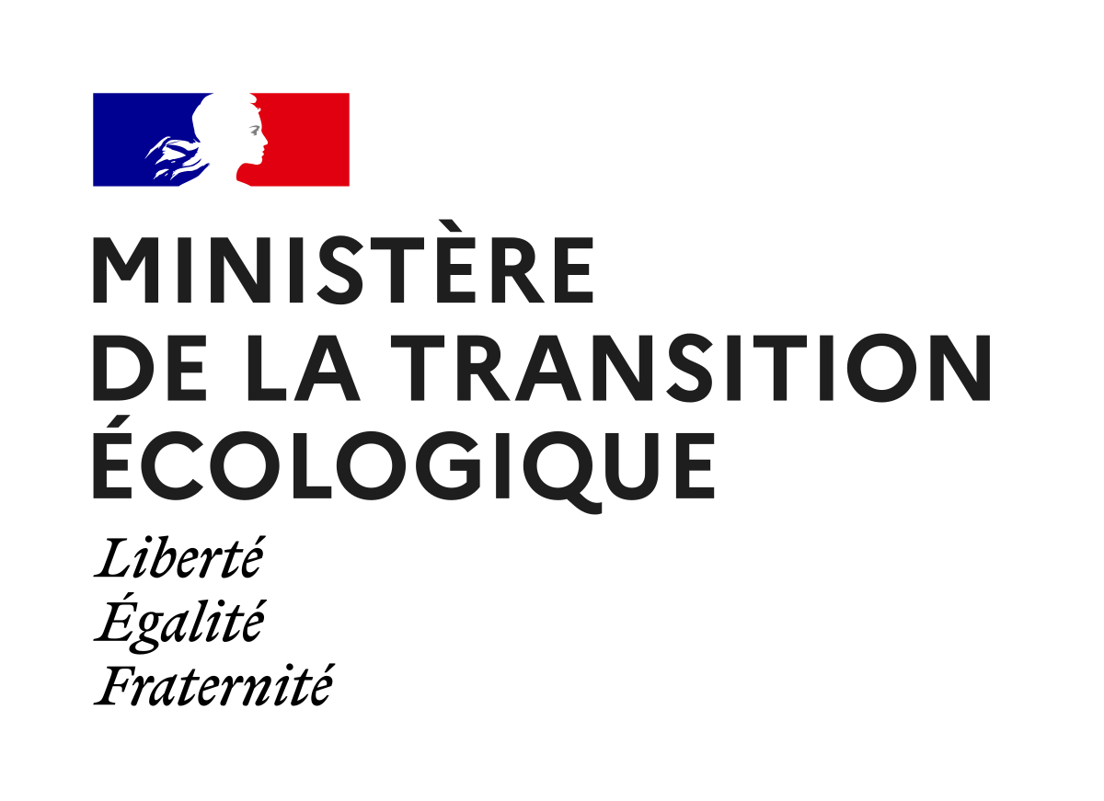

The Endless World: Plastic debris in the Seine estuary as a case study
Romain Tramoy, Johnny Gasperi, Rachid Dris, Bruno Tassin
Notes:
This presentation shows some results from the MacroPLAST project financed by the Ministry of the Ecological Transition.
We will see some general features of the plastic system and focus on transfer dynamics of plastic debris from land to sea through rivers.

Slide 2
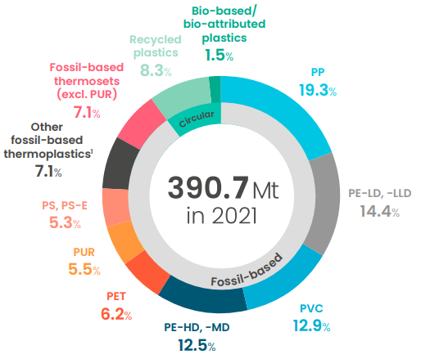
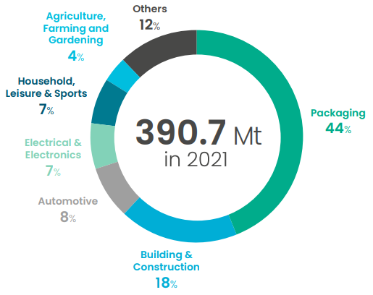
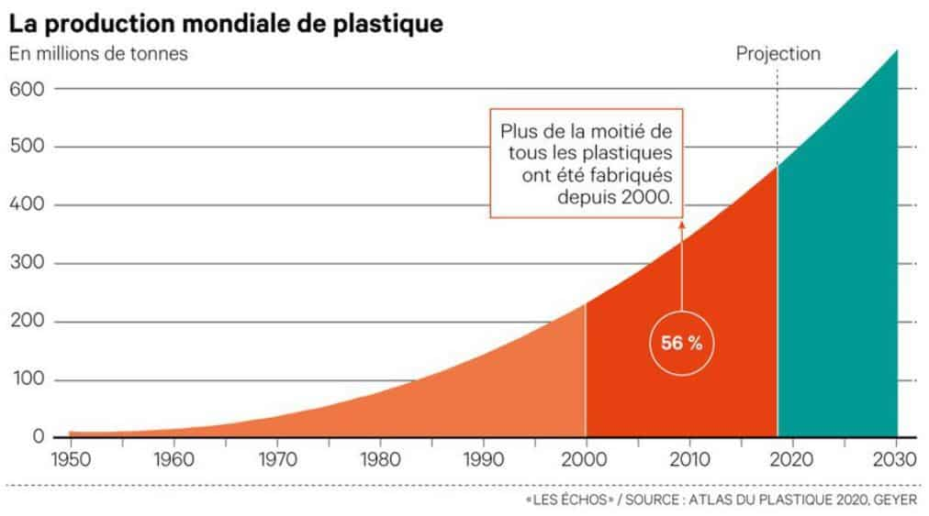
Global plastic production : an endless growth…
Plastic production, including fibers
In million metric tons
4%/yr
Projection
More than half of plastics have been produced since 2000
Notes:
Global plastic production is emblematic of the Anthropocene with an exponential and endless growth of 4% per year, reaching around 400 million metric tons in 2022. Plastics are everywhere.
They are used in every economic sector and under many chemical and physical configurations.
Plastics are made of a polymer, fillers and additives which give different and extraordinary properties to the plastics. But most of plastics are used for packaging with PE and PP as main polymers.
More than 90% of plastics are fossil-based, but bio-based plastics have the same impacts than fossil-based plastics once they reach the environment, because they have the same chemical properties that make them persistent.

Slide 3
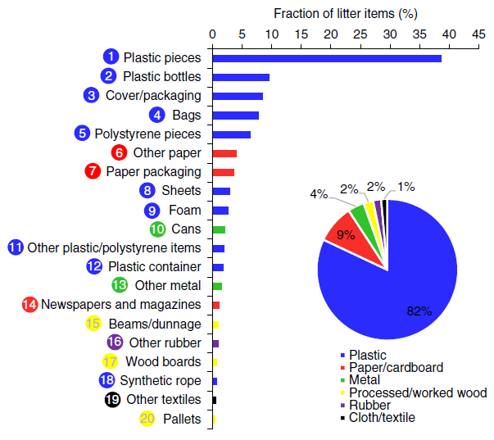
Global plastic pollution : an endless leakage into the Ocean…
1500 rivers = 80% of global macroplastic emissions
0.8 to 2.7 Mt/yr
5 kt/yr in Europe
Gonzalez et al. 2021
Meijers et al. 2021
Notes:
An endless production growth yields an endless leakage into the environment and in particular from lands into the Ocean. Once in the global Ocean, plastics may travel worldwide.
Rivers are major pathways of plastics from lands into the Ocean. One way to estimate macroplastic emissions from river is visual counting from bridges.
The most advanced global model based on this method suggests that between 0.8 and 2.7 Mt/yr enters into the Ocean from rivers, in which more than 1500 correspond to 80% of global emissions. This represents up to 3% of the estimated Mismanaged Plastic Waste.
In Europe, macroplastic emissions are rather small with 5 000 mt/yr thanks to an efficient waste management but may be far greater for microplastics from car tyre wear, textiles, personal care products and agriculture.

Slide 4
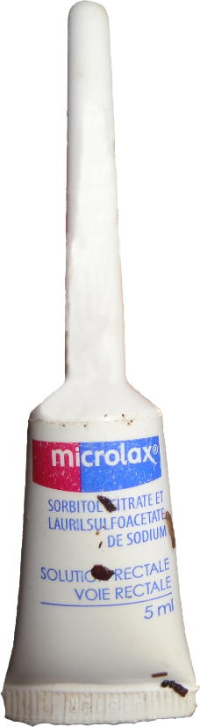
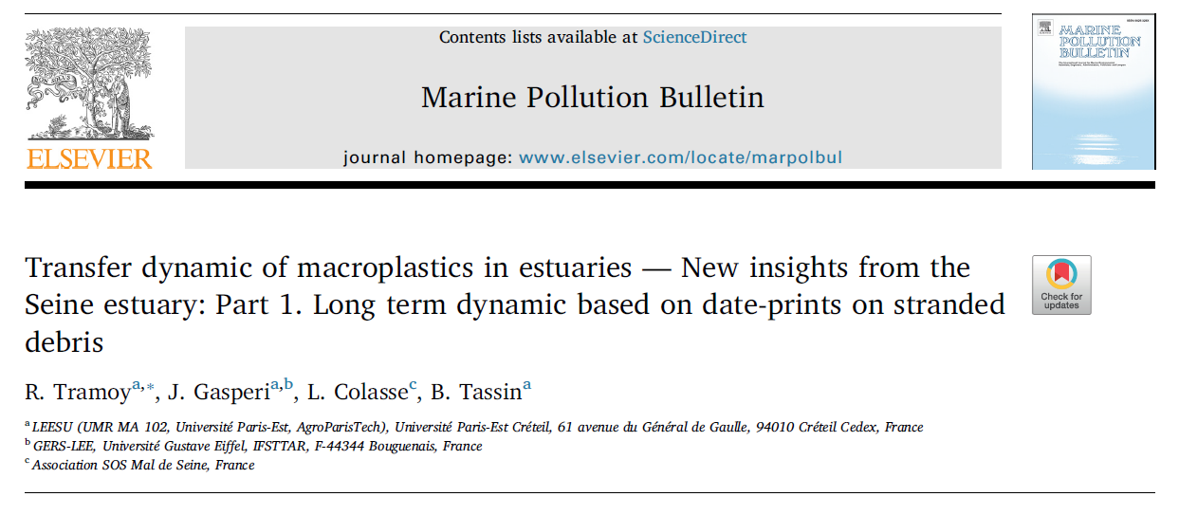
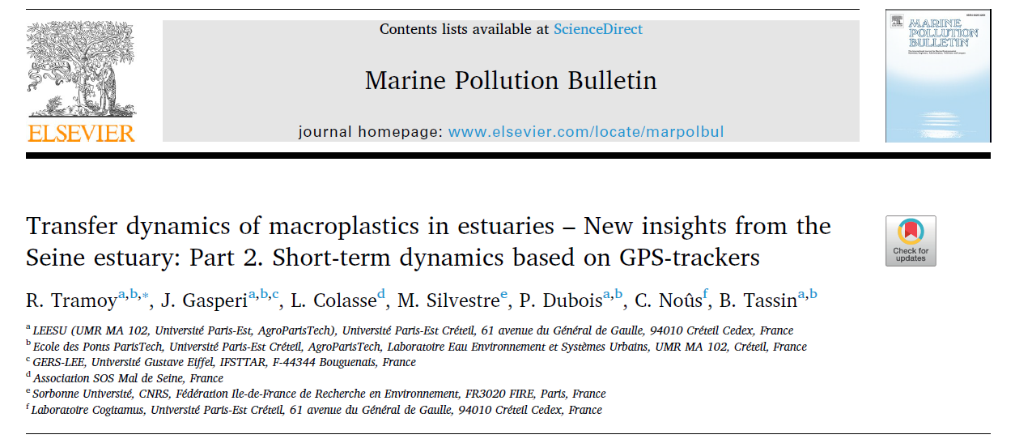
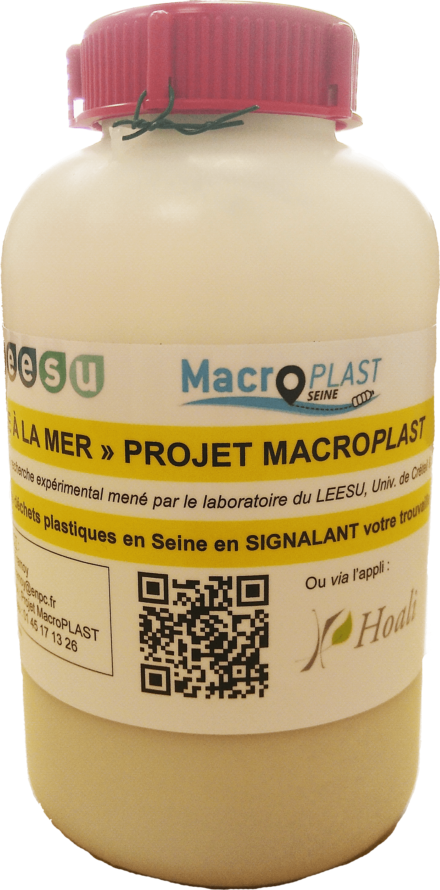
Plastic debris: an endless journey in rivers
Transport up to decades
Back and forth movement in estuaries
Storage and remobilization from riverbanks
➔ Chaotic and non straightforward transport
Notes:
1. Little is know about the transfer dynamics of plastics in rivers. So we performed tracking of riverine litter over time.
2. First we collected hundreds of Microlax in the Seine estuary, which is a packaging of medicine showing engraved dates. The distribution of their Use-By-Dates suggest that riverine litter may remain stored on riverbanks for decades (until the 80’).
3. Second, we performed real time tracking of floating and sub-floating bottles using GPS-trackers in the estuary covering a wide range of hydrometeorological conditions and tidal cycles. Results show a succession of storage/remobilization episodes in combination with back and forth transport in the estuary related to tides.
4. Plastic debris are thus submitted to an endless journey in rivers, especially in estuaries with a Chaotic transport.

Slide 5
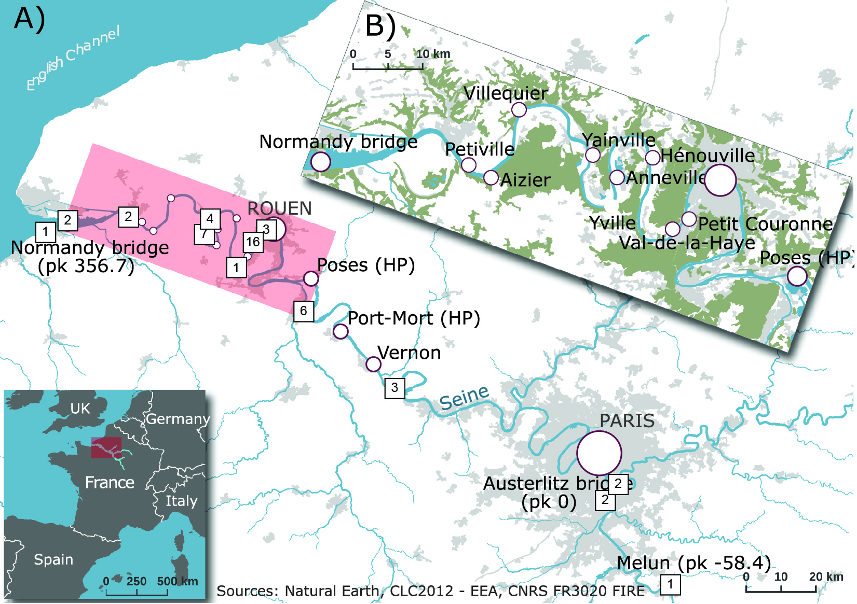
Notes:
You can see in red the Seine estuary where numbres correspond to the location of bottle release for GPS tracking.
Most of trajectories were performed in the estuary, but none of them reach the sea during their tracking time, up to two months.

Slide 6
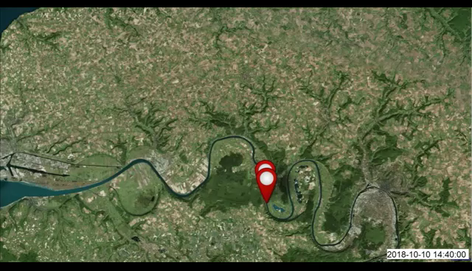
Plastic debris: an endless journey in rivers
Notes:
Here is a video from a tracked bottle showing this chaotic transport with back and forth movements.
When it stops, it means the bottle is temporally stored on a riverbank.

Slide 7
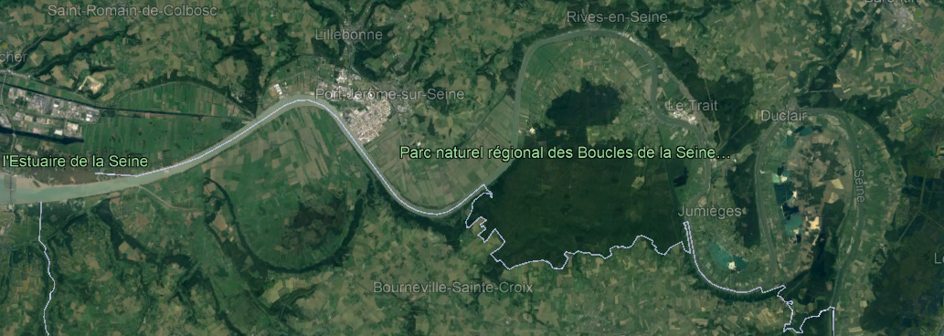
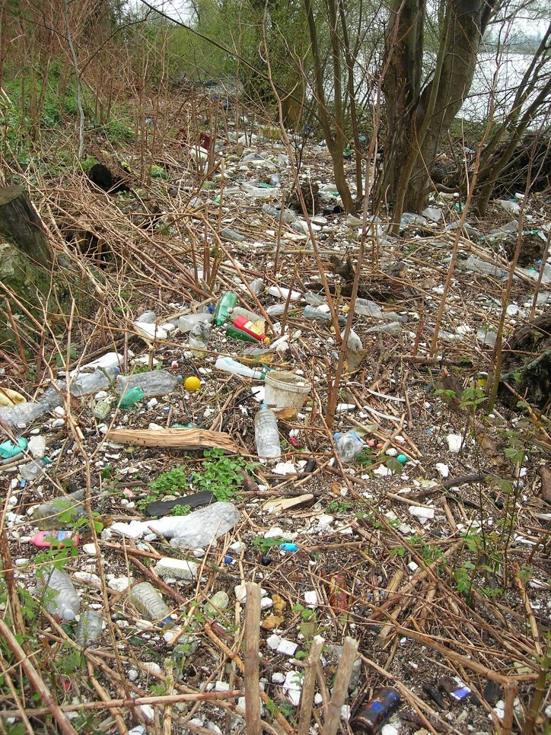
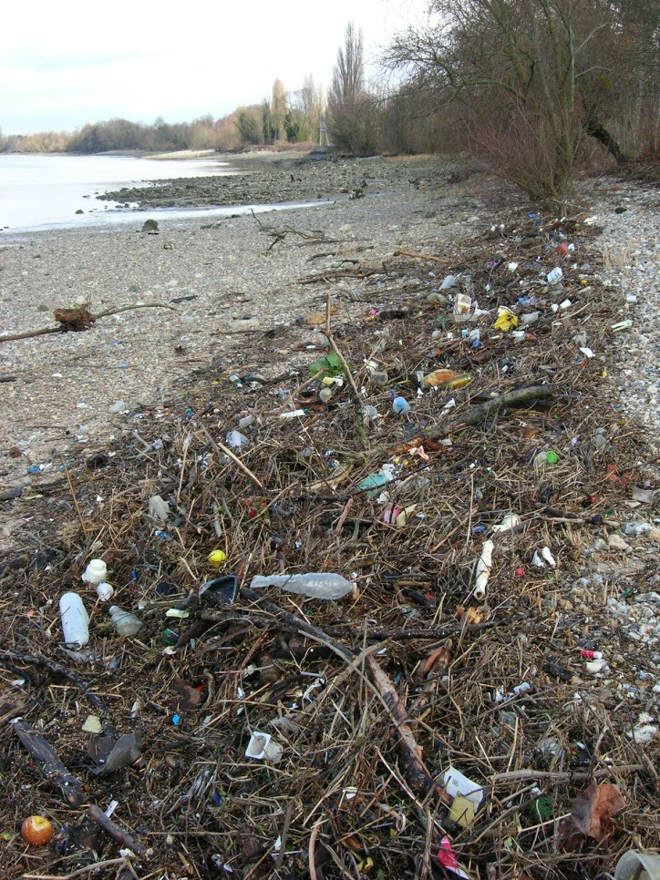
Plastic debris: an endless accumulation
Villequier
Yville
Notes:
Thanks to this transport dynamic, plastic debris accumulate on riverbanks together with the organic material as you can see on two different sites in the Seine estuary
The diversity of items on riverbanks is the highest when compared to water column, water surface or riverbed, suggesting riverbanks integrate most of the plastic pollution in rivers

Slide 8
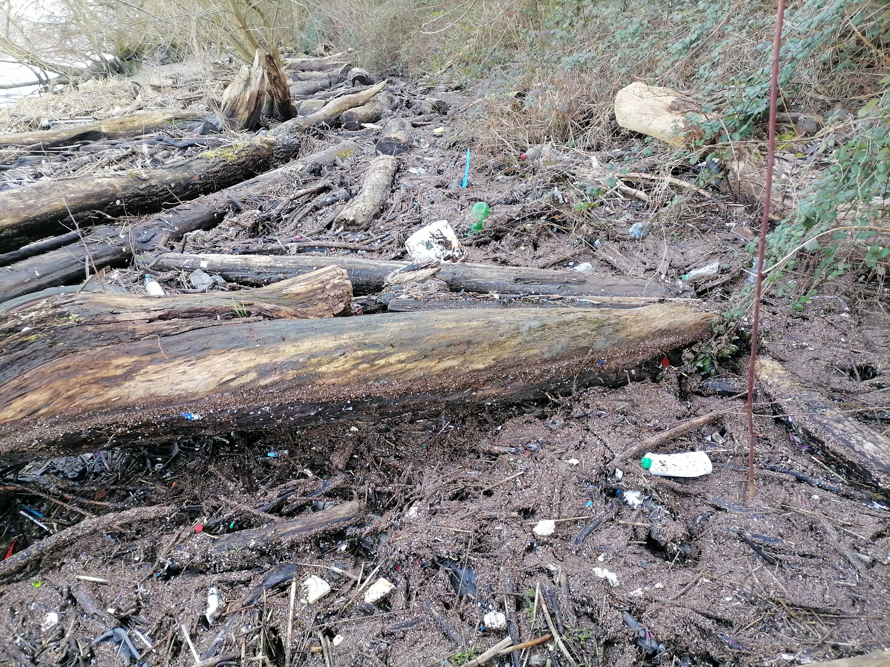
Plastic debris: an endless accumulation
Quillebeuf
Notes:
Plastic debris accumulate almost in every natural sites in the estuary, depending on the riverbank morphology and the presence of vegetation.
Sometimes, microplastics accumulate along with macroplastics.

Slide 9
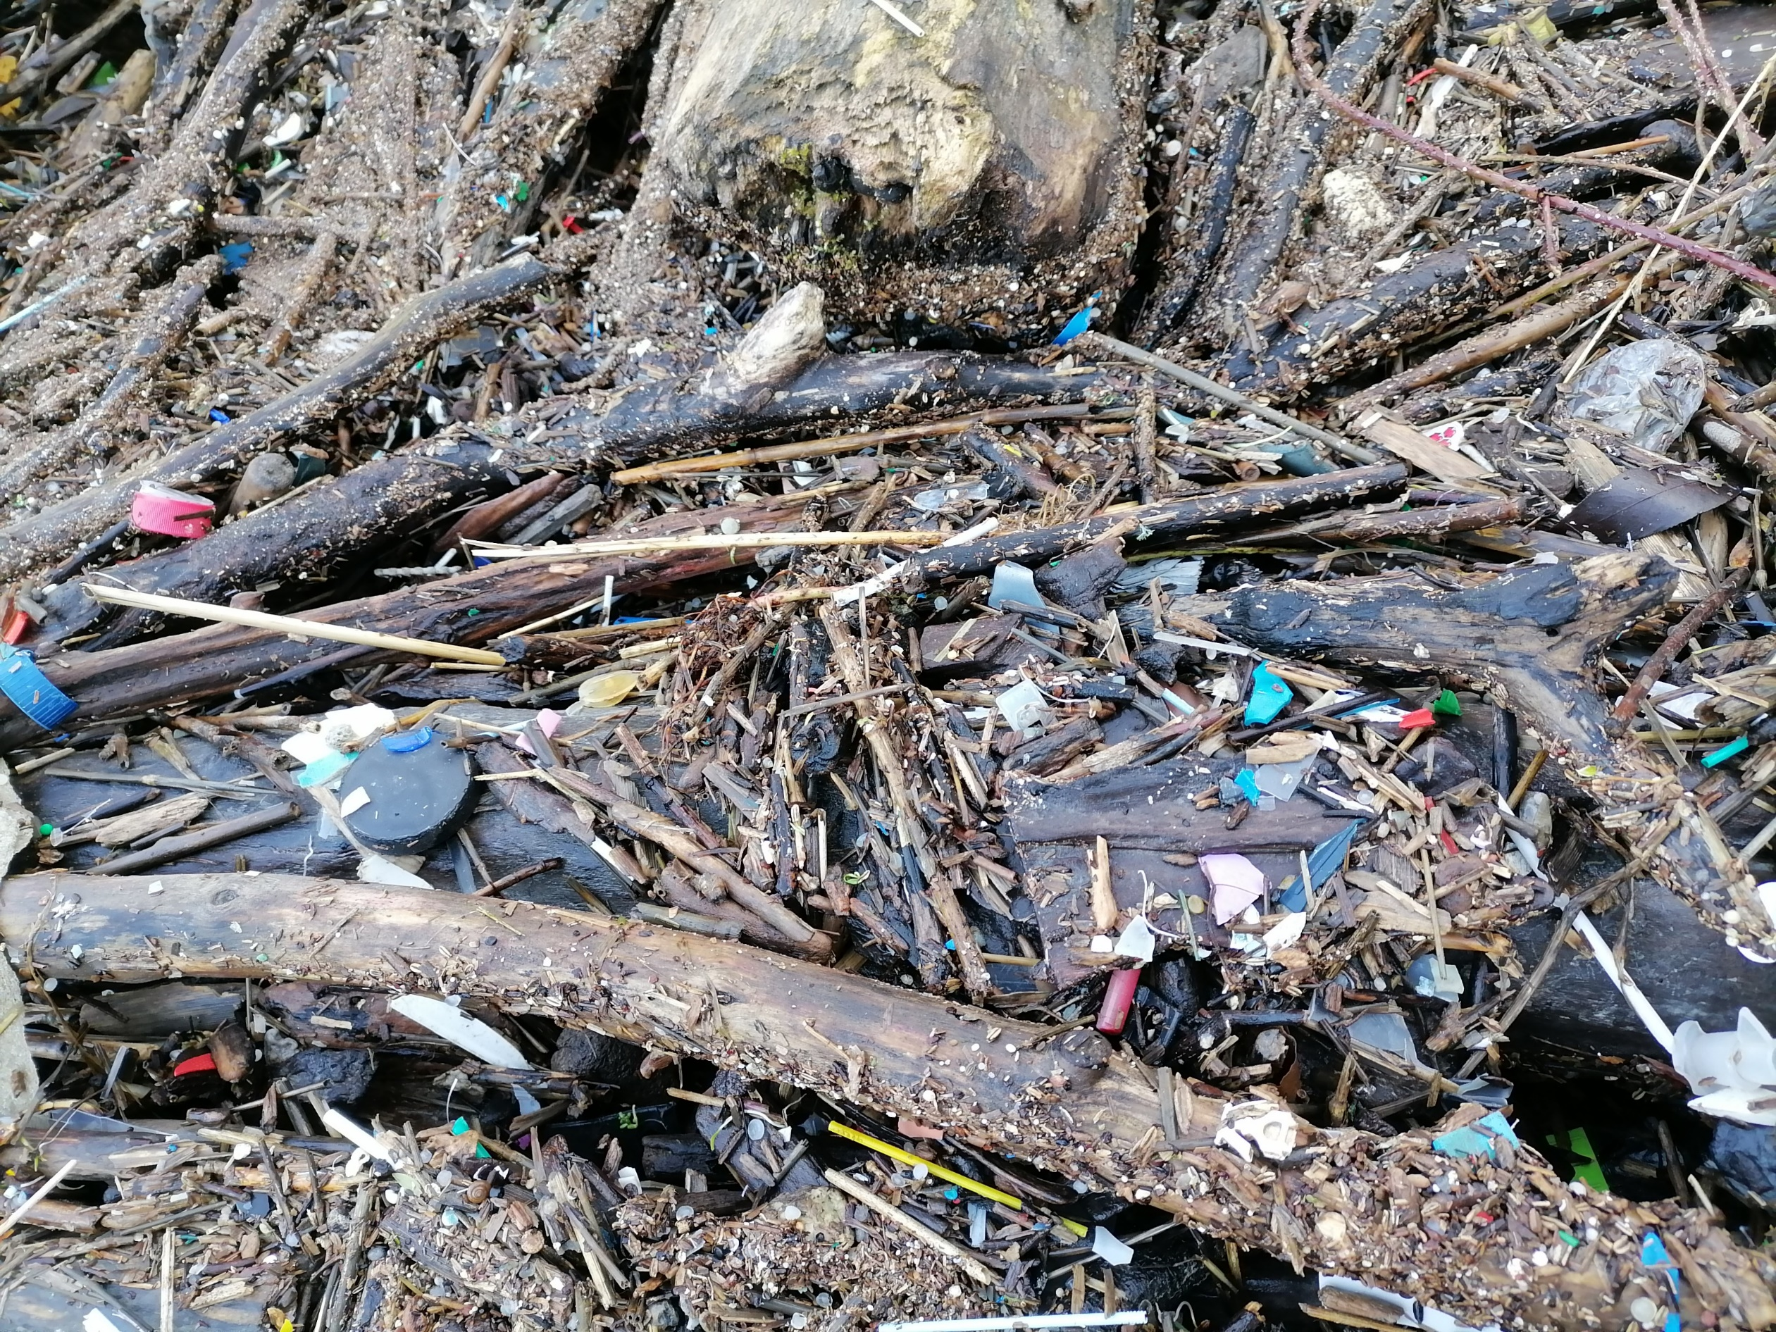
Plastic debris: an endless fragmentation
Notes:
When we zoom in, pellets are recognizable, but also a lot of fragments from larger debris.
Then, the chaotic transfer dynamics of plastic debris may also concern the biggest fraction of microplastics

Slide 10
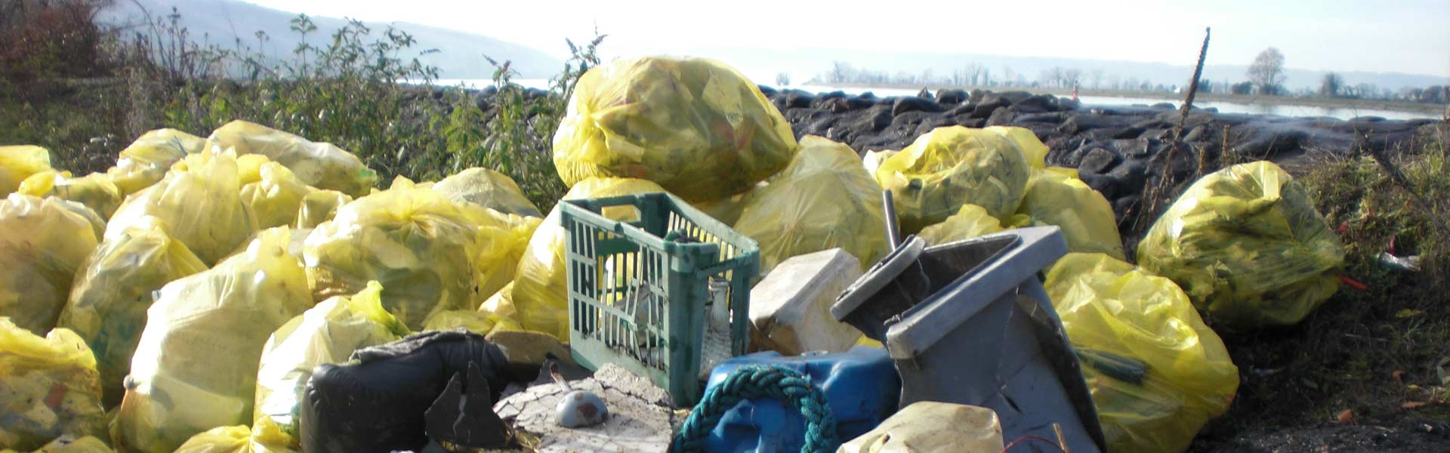
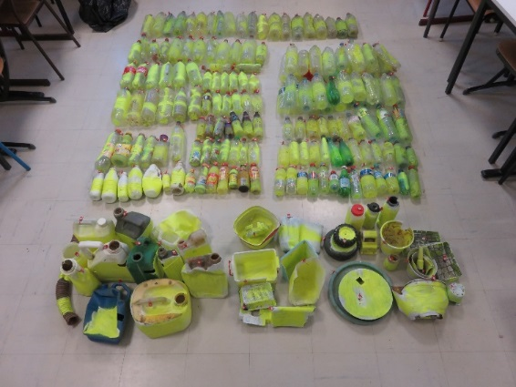
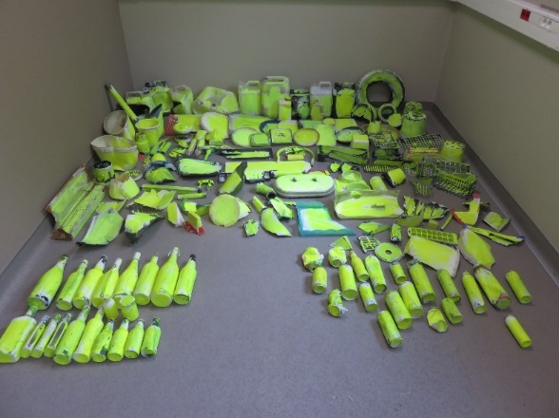
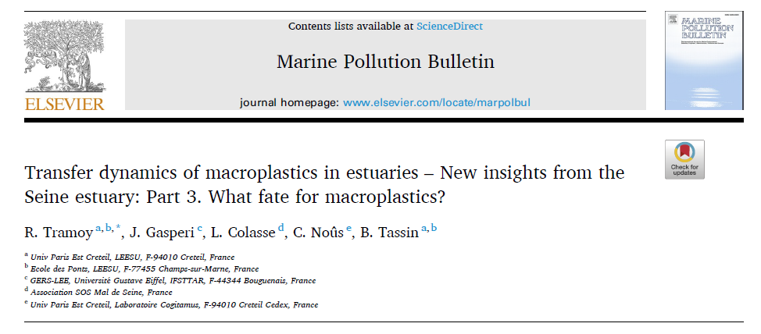
Plastic debris: an endless cleaning
Cleaning
Tagged litter
Cleaning operation + Tagged litter + transfer dynamics
➔ Plastic emission of 100-200 mt/yr
➔ 10 g/cap/yr
Notes:
In this context where plastic debris accumulate on riverbanks, then cleaning riverbanks can be an endless because end-of-pipe solution to prevent their emission into the Ocean.
Such a cleaning strategy may also be an opportunity to better estimate mass flows of plastic debris in estuaries.
In 2018 and 2019, we have released tagged litter in the estuary that were previously collected on riverbanks. Then we determined how much were recovered by cleaning operation to obtain a collecting rate and the fraction not collected.
This fraction was considered as the maximum emission of plastic debris into the sea, that is 100-200 mt/yr, which is equivalent to 10 g/cap/yr

Slide 11

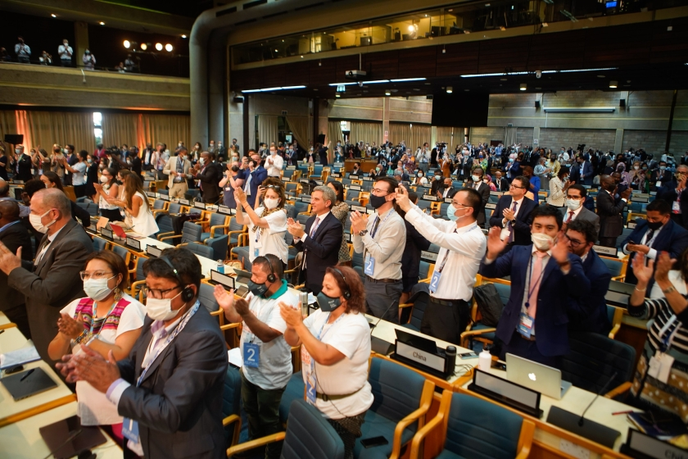
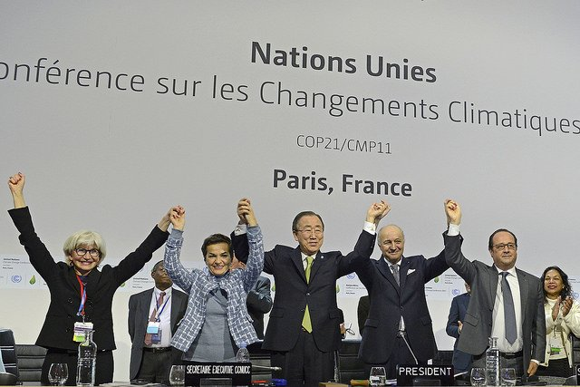
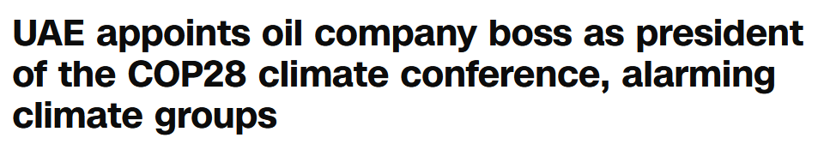
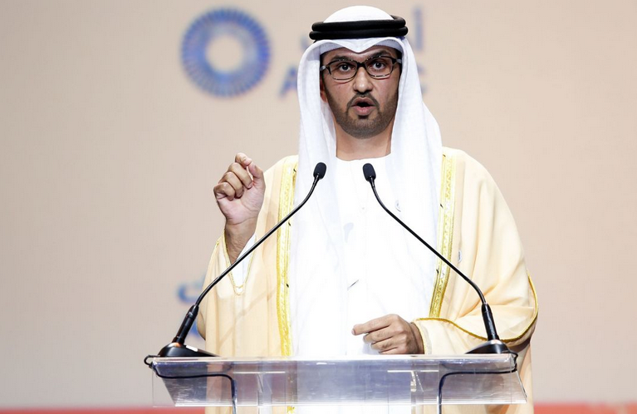
Plastic debris: endless discussions like COP ?
“Historic resolution to end plastic pollution and forge an international legally binding agreement by 2024.
(CNN)
COP 21
Notes:
To prevent endless cleaning of plastic debris, “a historic resolution was adopted to develop an international legally binding instrument on plastic pollution” in order to tackle plastic pollution at source.
Hoping this will not be endless discussions for nothing like the COP for climate change. The difference may fit in two words : “legally binding”
But in the mean time… THIS IS FINE

Slide 12

Plastic debris: endless discussions like COP ?
“Historic resolution to end plastic pollution and forge an international legally binding agreement by 2024.
KC Green
(CNN)
COP 21
Notes:
To prevent endless cleaning of plastic debris, “a historic resolution was adopted to develop an international legally binding instrument on plastic pollution” in order to tackle plastic pollution at source.
Hoping this will not be endless discussions for nothing like the COP for climate change. The difference may fit in two words : “legally binding”
But in the mean time… THIS IS FINE

Slide 13
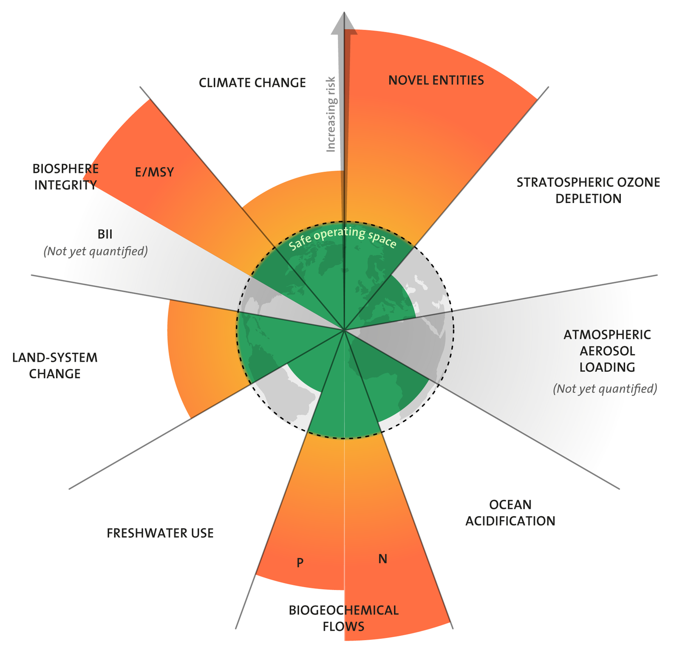
Our endless world HAS physical boundaries…
Including plastics
Licenced under CC BY-NC-ND 3.0 Credit: "Azote for Stockholm Resilience Centre, based on analysis in Persson et al 2022 and Steffen et al 2015"
…most of which are already exceeded!
Notes:
Finally, no matter how small are leakage of plastic debris in the environnement relative to the amount produced and consumed, This amount is so huge that we have already exceeded the limit for novel entities beyond of which the system remains safe.
However, we have already exceeded 6 of the 9 identified planet boundaries…
Plastics are emblematic of those excesses characterizing the Anthropocene.
Those excesses are exclusively the consequences of human activities on a global scale; activities that are organized for an endless world, but in finite world.

Slide 14

Thank you for the attention
Notes:
So this is not fine :p

