Slide 1
e-VITA Activities Daily Living ICSR 2022 Workshop
The project has received funding from the European Union H2020 Programme under grant agreement n° 101016453.
The Japanese consortium received funding by the Japanese Ministry of Internal Affairs and Communication (MIC). Grant n° JPJ000595

Slide 2
Summary
Objective
Contextualisation
Smart living sensors (SLS)
Home sensors
Wearable sensors - smartwatch
Wearable sensors - smartphone
Trustworthy AI
Integration
Fiware standard
Data Fusion Platform (DFP)
2 solutions
Architecture example

Slide 3
Objective
E-Vita objective 2 :
Develop an advanced intercultural virtual coach with seamless integration of smart living technologies, advanced AI and tailored dialogue interaction
Integration
Smart living technologies
Dialogue Interaction
Trustworthy AI

Slide 4
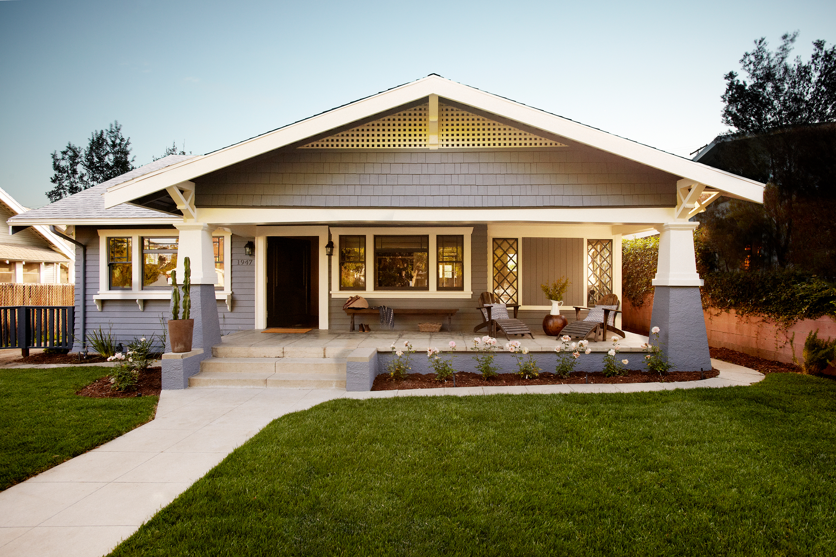
Contextualisation - SLS
Home sensors
PIR sensor : Is there someone in the room ?
Contact sensor : Is my door open ?
Climate sensor: Is the house warm enough?

Slide 5
Contextualisation - SLS
Wearable sensors - smartwatch
Optical sensor : Heart rate & SPO2
Inertial sensor: accelerometer, gyroscope
Other sensors: magnetometer, altimeter, etc

Slide 6
Contextualisation - SLS
Wearable sensors - smartphone
Connected to Internet
Inertial sensor: accelerometer, gyroscope
Other sensors: magnetometer, altimeter, GPS, etc

Slide 7
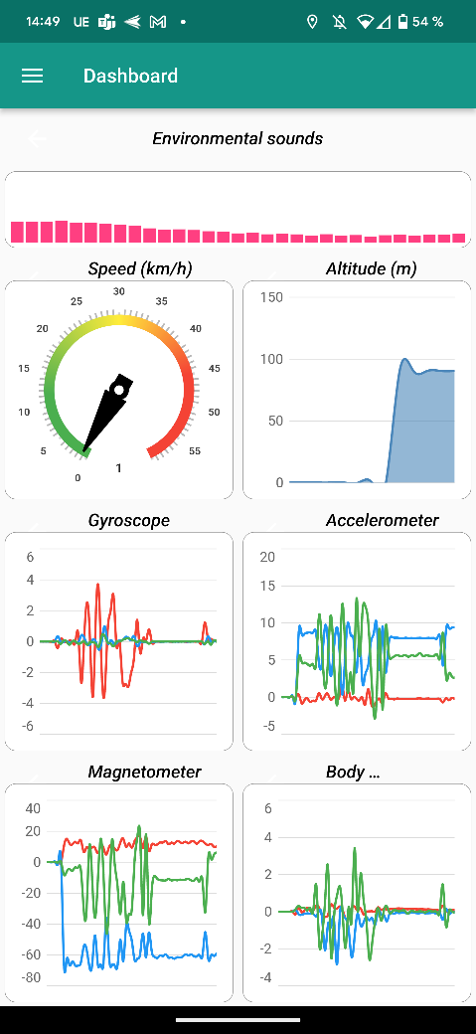
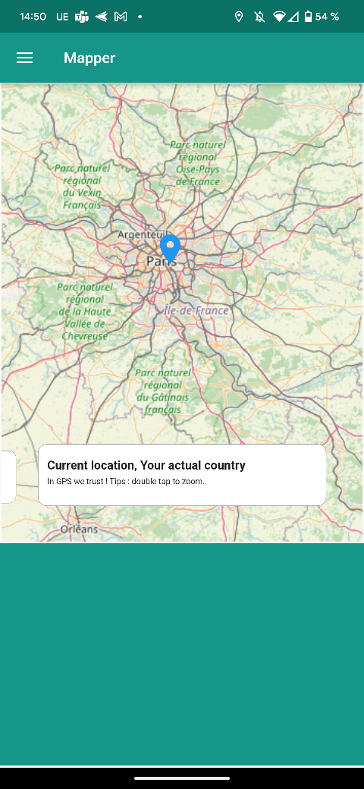
Contextualisation - SLS
Wearable sensors - smartwatch

Slide 8
Contextualisation - Trustworthy AI
ADL computing
Minimize dependency on data sources to maximize recombination.
Able to follow the evolution of its sensors in order to keep a real time logic
Measurable and monitored to track its life cycle

Slide 9
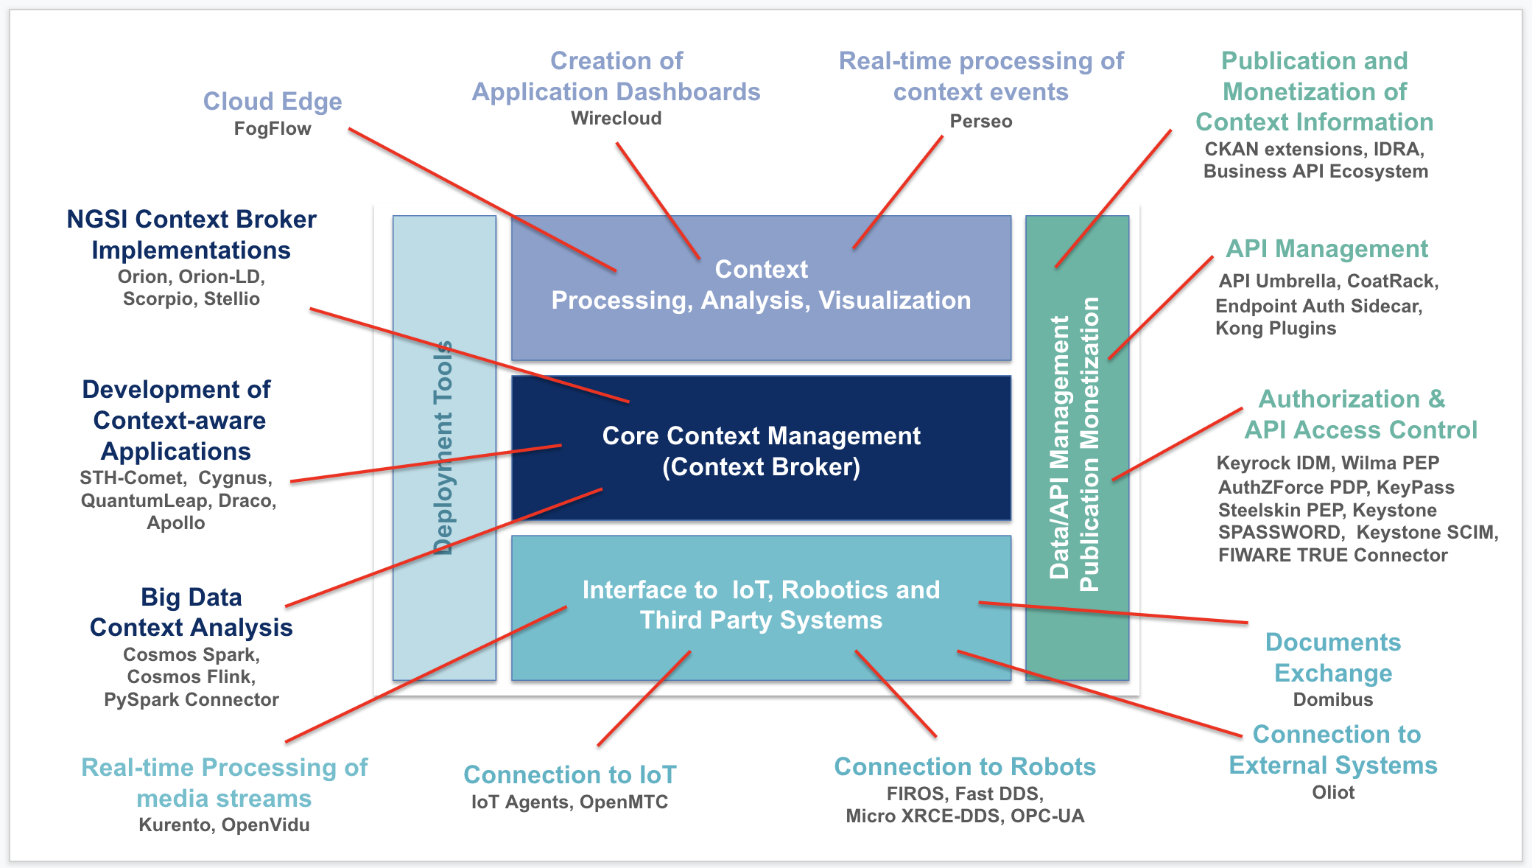
Integration
Fiware Standard
Fiware project : https://www.fiware.org/

Slide 10
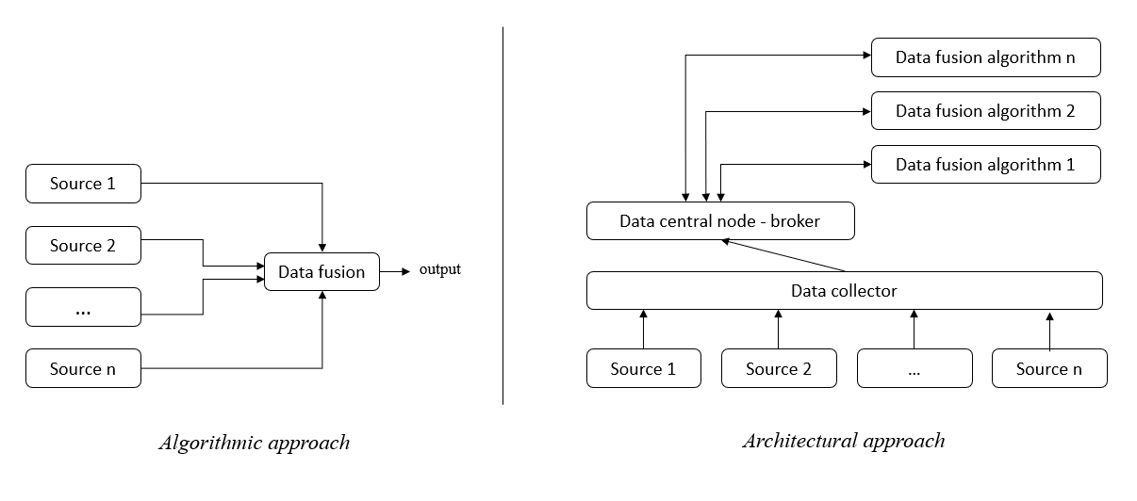
Integration - DFP
2 solutions

Slide 11
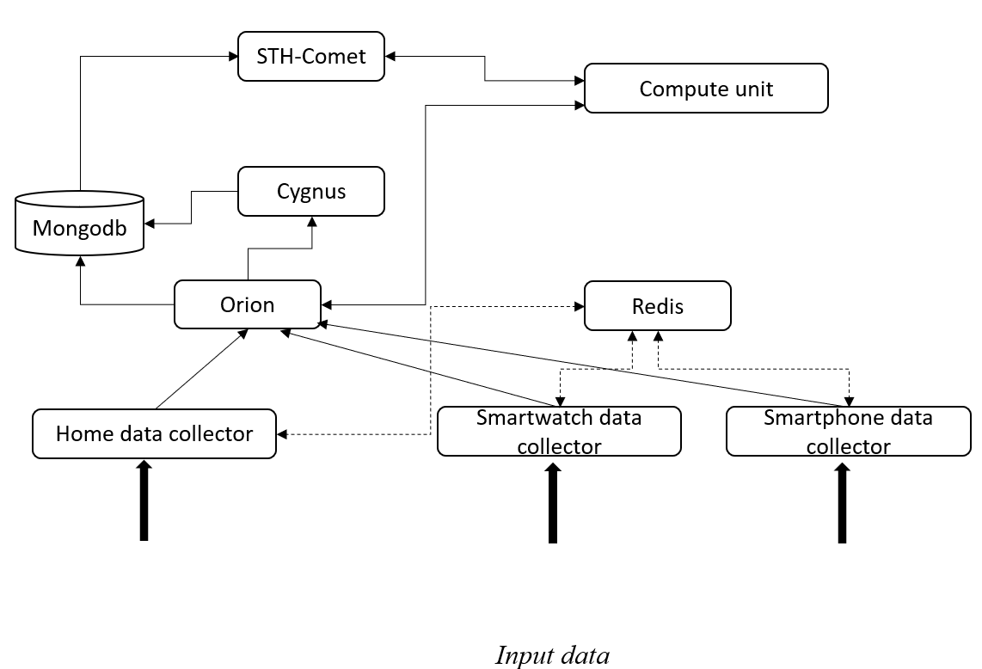
Integration - DFP
Architecture example

Slide 12
Conclusion
Integration
Smart living technologies
Dialogue Interaction
Trustworthy AI

Slide 13
Thank you for your attention !
Presented by Florian Szczepaniak
With the support of
Jerome Boudy
Mossaab Hariz
Christophe Lohr
Gerard Chollet

