Slide 1
Sapir et l’International Auxiliary Language Association
Chloé Laplantine

Slide 2
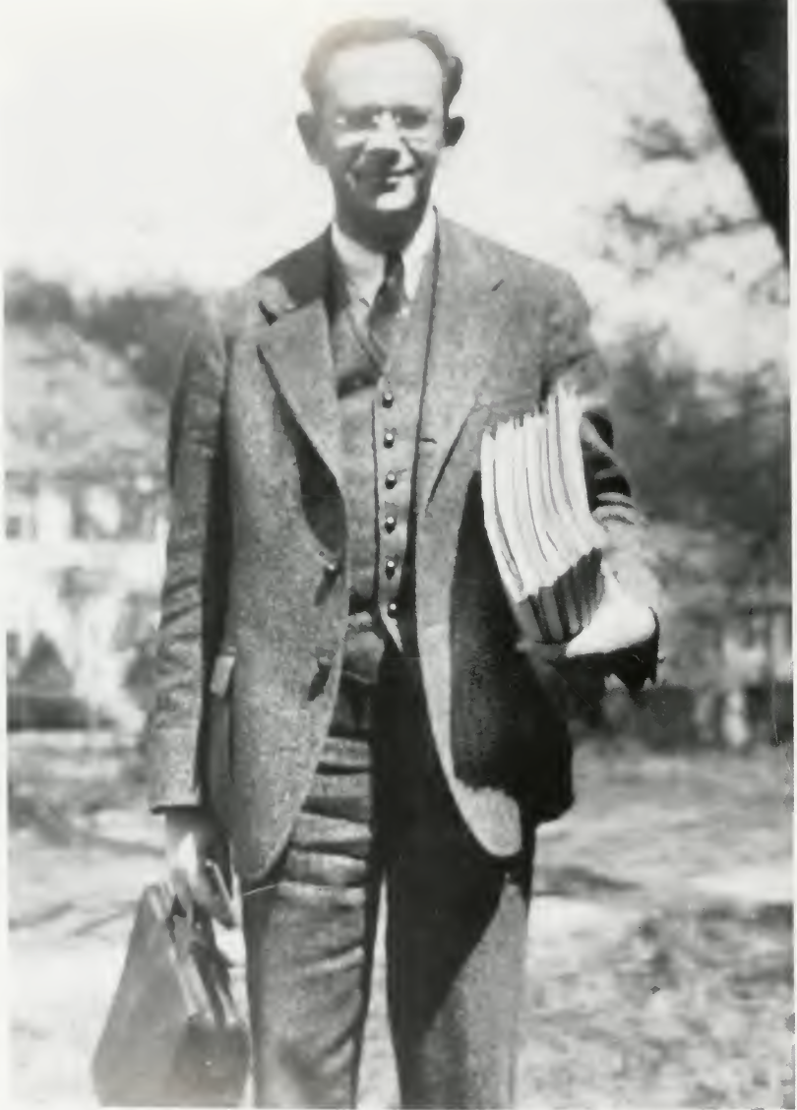
Edward Sapir (1884-1939)

Slide 3
It is the appreciation of the relativity of the form of thought which results from linguistic study that is perhaps the most liberalizing thing about it. What fetters the mind and benumbs the spirit is ever the dogged acceptance of absolutes.

Slide 4
Perhaps the best way to get behind our thought processes and to eliminate from them all the accidents or irrelevancies due to their linguistic garb is to plunge into the study of exotic modes of expression. At any rate, I know of no better way to kill spurious “entities”.

Slide 5
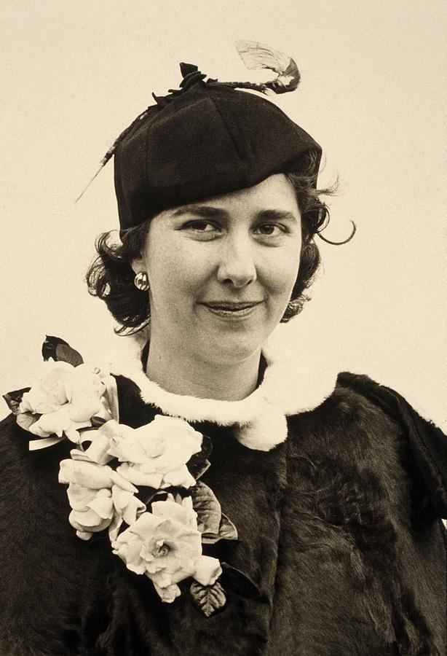
Alice Vanderbilt Morris (1874-1950)

Slide 6
Sapir, Edward (1921). Language. An Introduction to the Study of Speech. New York: Hartcourt, Brace & World, Inc.
Ogden, Charles Kay and Ivor Armstrong Richards (1923), The Meaning of Meaning. London: Kegan Paul).
Sapir, Edward (1924). The Grammarian and His Language. American Mercury 1: 149-155.
Sapir, Edward (1925). Memorandum on the problem of an international auxiliary language. The Romantic Review 16 : 244-255.
Sapir, Edward (1929). The Status of Linguistics as a Science. Language 5(4) : 207-214
Sapir, Edward (1930). Foundations of language. International Auxiliary Language Association in the United States. In: Annual Meeting. May 19 1930. New York: International Auxiliary Language Association in the United States : 14-15
Sapir, Edward (1930). Totality. (Language Monographs 6). Baltimore: Linguistic Society of America / Waverly Press.
Sapir, Edward (1931). Communication. Encyclopaedia of the Social Sciences, Vol. 4. New York: Macmillan : 78-81.
Sapir Edward (1931). The function of an international auxiliary language. Psyche 11, p. 4-15.
Sapir, Edward (1931). Wanted, a world language. The American Mercury 22 : 202-209.
Sapir, Edward (1944 [1930]). Grading: a study in semantics. Philosophy of Science 11 : 93-116.
Sapir, Edward and Swadesh, Morris (1932). The Expression of the Ending-point relation in English, French, and German. Morris, A. V. (ed.). (Language Monographs, 10.) Baltimore: Linguistic Society of America/Waverly Press.

Slide 7
Falk, Julia S. (1995). Words without grammar: linguists and the international auxiliary
language movement in the United States. Language and Communication 15 : 241–259.
Joseph, John (1995). Natural grammar, arbitrary lexicon: an enduring parallel in the
history of linguistic thought. Language and Communication 15 : 213–225.
Joseph, John (1996). The immediate sources of the “Sapir-Whorf hypothesis. Historiographia Linguistica 23(3) : 365-404.
Joseph, John (1999). Basic English and the debabelization of China. In: Heinz Antor and Kevin L. Cope (ed.). Intercultural Encounters: studies in English literatures. Heidelberg: C. Winter : 51–71.
Falk, Julia S. (1999). Women, Language and Linguistics: three American stories from the first half of the twentieth century. London: Routledge.
McElvenny, James (2018). Language and Meaning in the Age of Modernism: C. K. Ogden and his contemporaries. Edinburgh: Edinburgh University Press.

Slide 8
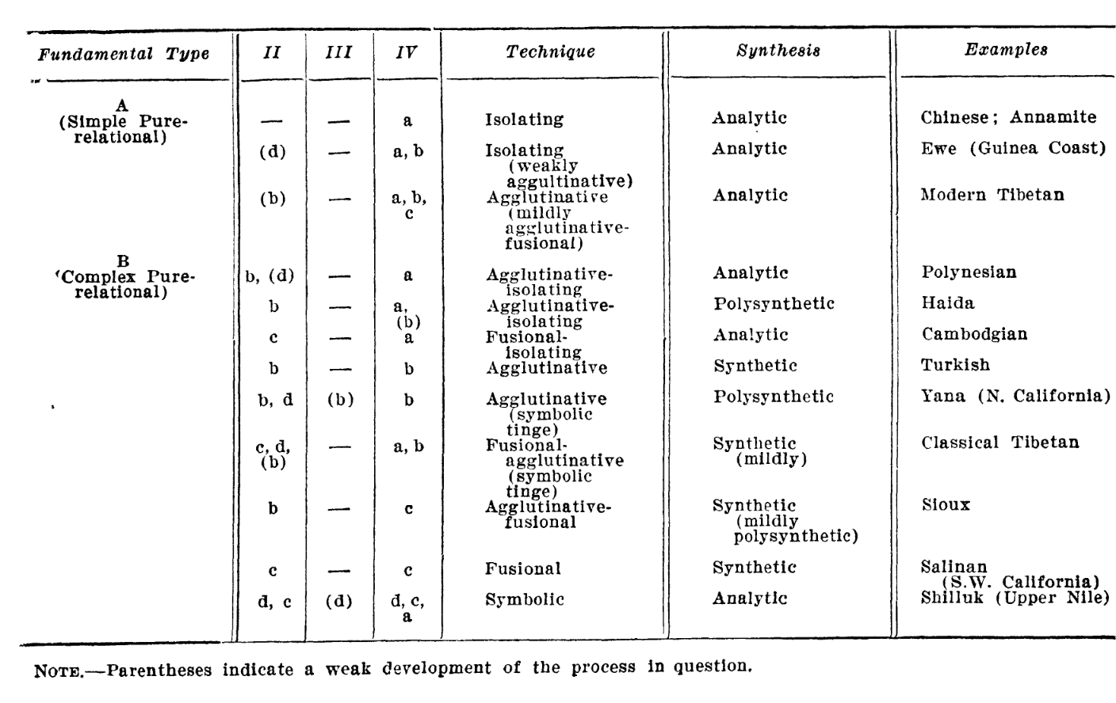
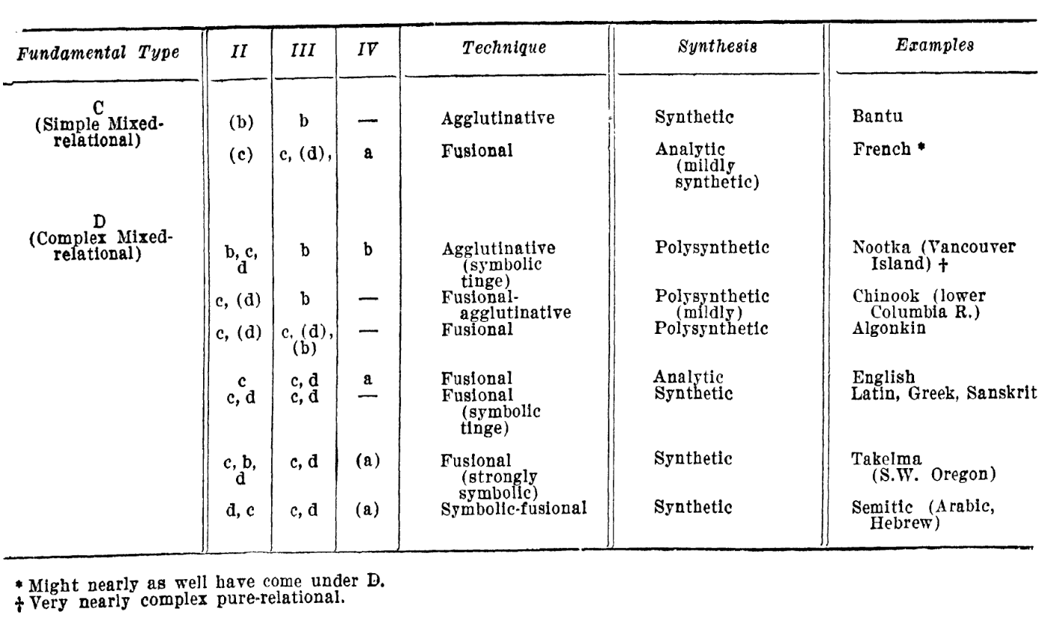

Slide 9
Why not push English, for instance, which is already spoken over a larger area than any other language of modern times, and which shows every sign of spreading in the world of commerce and travel? The consideration which gives rise to reflections of this sort, grounded in impatience as it is, looks for no more worthy solution of the difficulty than a sort of minimum language, a lingua franca of the modern world. Those who argue in this spirit invariably pride themselves on being 'practical,' and, like all ‘practical' people, they are apt to argue without their host.
(“The function of an international auxiliary language”)

Slide 10
It is, therefore, highly desirable that along with the practical labour of getting wider recognition of the international language idea, there go hand in hand comparative researches which aim to lay bare the logical structures that are inadequately symbolized in our present day languages, in order that we may see more clearly than we have yet been able to see just how much of psychological insight and logical rigour have been and can be expressed in linguistic form. One of the most ambitious and important tasks that can be undertaken is the attempt to work out the relation between logic and usage in a number of national and constructed languages, in order that the eventual problem of adequately symbolizing thought may be seen as the problem it still is.
(« The function of an international auxiliary language”)

Slide 11
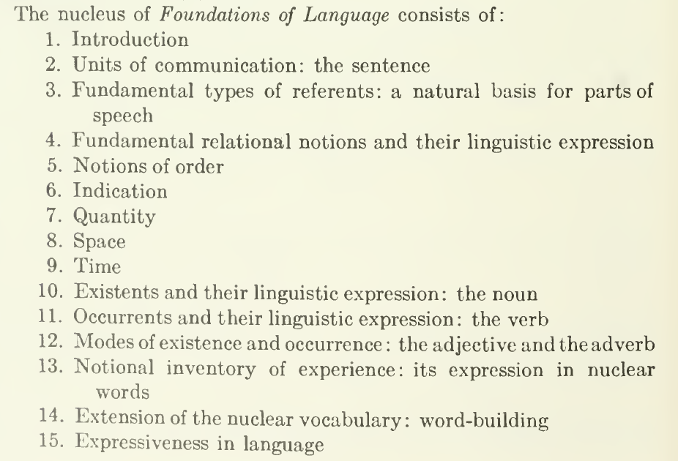
« Totality »

Slide 12
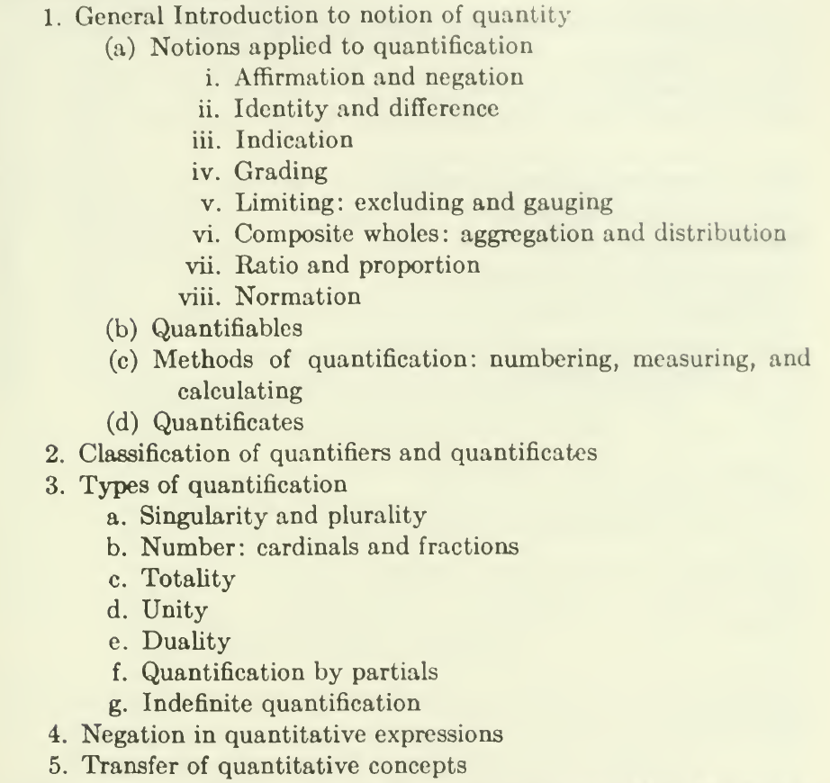

Slide 13
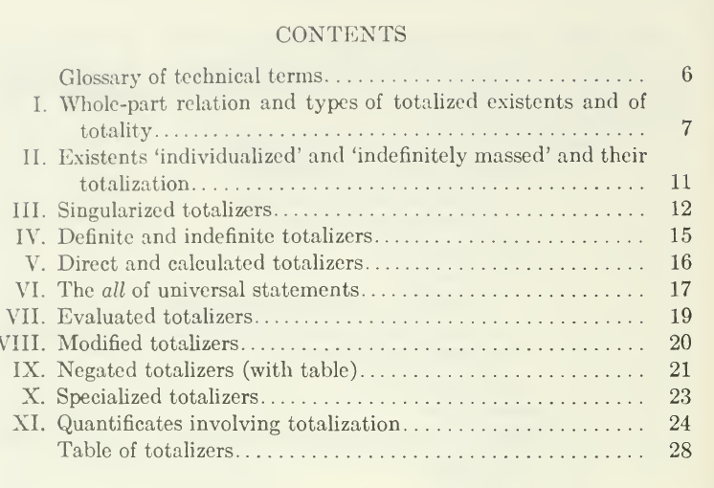

Slide 14
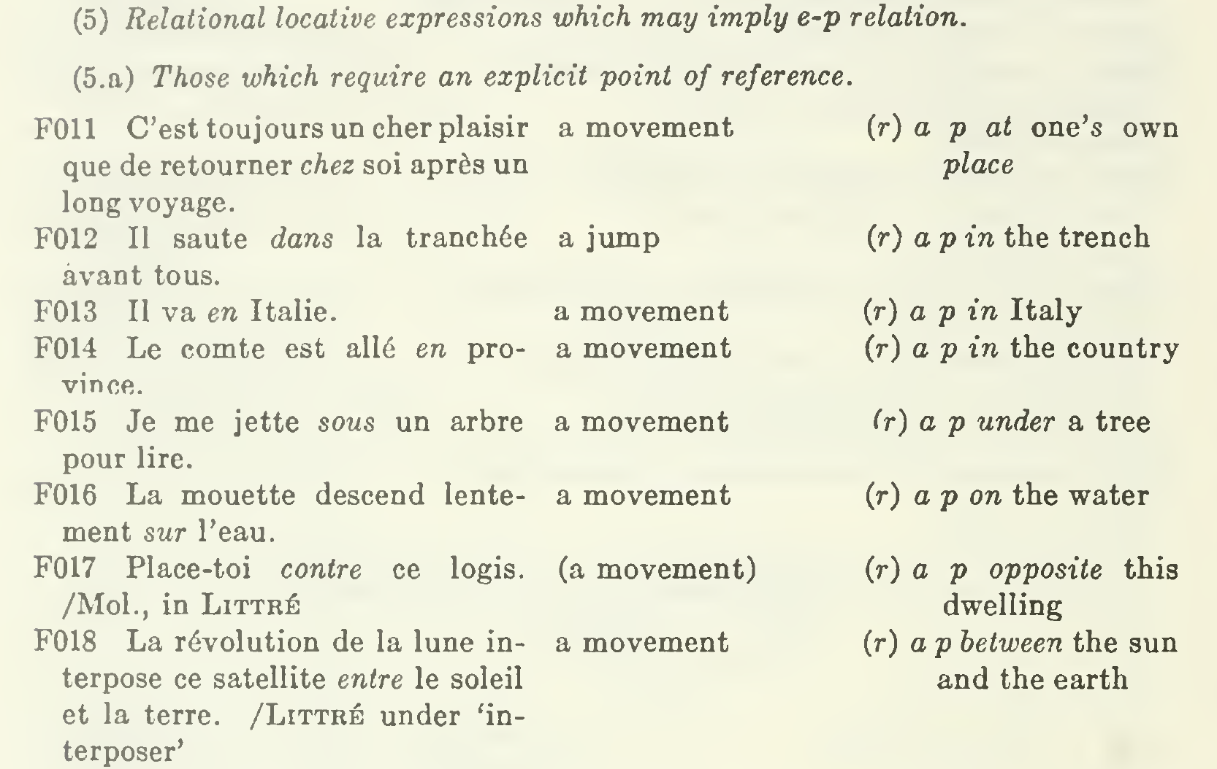
The Expression of the Ending-point relation in English, French, and German.

Slide 15
What is needed above all is a language that is as simple, as regular, as logical, as rich, and as creative as possible; a language which starts with a minimum of demands on the learning capacity of the normal individual and can do the maximum amount of work; which is to serve as a sort of logical touchstone to all national languages and as the standard medium of translation. It must, ideally, be as superior to any accepted language as the mathematical method of expressing quantities and relations between quantities is to the more lumbering methods of expressing these quantities and relations in verbal form. This is undoubtedly an ideal which can never be reached, but ideals are not meant to be reached: they merely indicate the direction of movement.

Slide 16
Were a language ever completely “grammatical,” it would be a perfect engine of conceptual expression. Unfortunately, or luckily,
no language is tyrannically consistent.
All grammars leak.

Slide 17
a perfect hornet's nest
of bizarre and arbitrary usages

Slide 18
A rigorous thinking out of the true content of a sentence as contrasted with its purely formal convolutions often reveals the humiliating fact that it could have been expressed with half the apparatus. Abstract nouns, in particular, are not nearly so useful or necessary as is generally assumed. There should, perhaps, be some provision for their formation, perhaps by means of some indefinite noun like thing or matter or way {e.g., wise way for wisdom), but the real point is that they can often be easily avoided, and with a gain in vividness. Thus, there is nothing in the sentence "The wisdom of old age chills youth" which is not as adequately expressed, and with a more intuitive impact, in such a sentence as "Wise old person make cold (to) young person" (or « The wise old make cold the young"). In other words, we must not too lightly assume that the grooves of thought which we are accustomed to in our European languages are the easiest or most natural in a universal sense. It may be worth our while to get into the habit of simplifying the pattern of our thought. We are likely to find that it is helped, rather than hindered, by the unassuming simplicity of such languages as Chinese. Much of our seeming subtlety in expression is really verbiage.

Slide 19
…. this is undoubtedly an ideal which can never be reached, but ideals are not meant to be reached : they merely indicate the direction of movement.

Slide 20
Tout y parlerait
À l’âme en secret
Sa douce langue natale.

Slide 21
we are the dupes of our forms.

Slide 22
There is no doubt that the critical study of language may also be of the most curious and unexpected helpfulness to philosophy. Few philosophers have deigned to look into the morphologies of primitive languages nor have they given the structural peculiarities of their own speech more than a passing and perfunctory attention. When one has the riddle of the universe on his hands, such pursuits seem trivial enough, yet when it begins to be suspected that at least some solutions of the great riddle are elaborately roundabout applications of the rules of Latin or German or English grammar, the triviality of linguistic analysis becomes less certain. To a far greater extent than the philosopher has realized, he is likely to become the dupe of his speech-forms, which is equivalent to saying that the mould of his thought, which is typically a linguistic mould, is apt to be projected into his conception of the world. Thus innocent linguistic categories may take on the formidable appearance of cosmic absolutes. If only, therefore, to save himself from philosophic verbalism, it would be well for the philosopher to look critically to the linguistic foundations and limitations of his thought. He would then be spared the humiliating discovery that many new ideas, many apparently brilliant philosophic conceptions, are little more than rearrangements of familiar words in formally satisfying patterns.

Slide 23
There is no doubt that the critical study of language may also be of the most curious and unexpected helpfulness to philosophy. Few philosophers have deigned to look into the morphologies of primitive languages nor have they given the structural peculiarities of their own speech more than a passing and perfunctory attention. When one has the riddle of the universe on his hands, such pursuits seem trivial enough, yet when it begins to be suspected that at least some solutions of the great riddle are elaborately roundabout applications of the rules of Latin or German or English grammar, the triviality of linguistic analysis becomes less certain. To a far greater extent than the philosopher has realized, he is likely to become the dupe of his speech-forms, which is equivalent to saying that the mould of his thought, which is typically a linguistic mould, is apt to be projected into his conception of the world. Thus innocent linguistic categories may take on the formidable appearance of cosmic absolutes. If only, therefore, to save himself from philosophic verbalism, it would be well for the philosopher to look critically to the linguistic foundations and limitations of his thought. He would then be spared the humiliating discovery that many new ideas, many apparently brilliant philosophic conceptions, are little more than rearrangements of familiar words in formally satisfying patterns. In their recently published work on “The Meaning of Meaning” Messrs. Ogden and Richards have done philosophy a signal service in indicating how readily the most hardheaded thinkers have allowed themselves to be cajoled by the formal slant of their habitual mode of expression. Perhaps the best way to get behind our thought processes and to eliminate from them all the accidents or irrelevances due to their linguistic garb is to plunge into the study of exotic modes of expression. At any rate, I know of no better way to kill spurious “entities.”
(“The Grammarian and His Language”)

Slide 24
Wu-river stream mouth evening sun sink,
North look Liao-Tung, not see home.
Steam whistle several noise, sky-earth boundless,
Float float one reed out Middle-Kingdom.

Slide 25
Single Algonkin words
are like tiny imagist poems.

Slide 26
And yet in the recorded texts of primitive tradition and song there are many passages of unique vigor and beauty. The structure of the language often forces an assemblage of concepts that impresses us as a stylistic discovery. Single Algonkin words are like tiny imagist poems. We must be careful not to exaggerate a freshness of content that is at least half due to our freshness of approach, but the possibility is indicated none the less of utterly alien literary styles, each distinctive with its disclosure of the search of the human spirit for beautiful form.
(Language)

