Slide 1
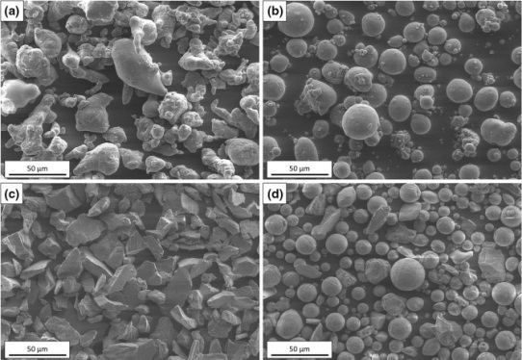
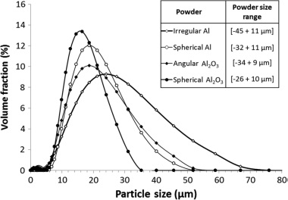
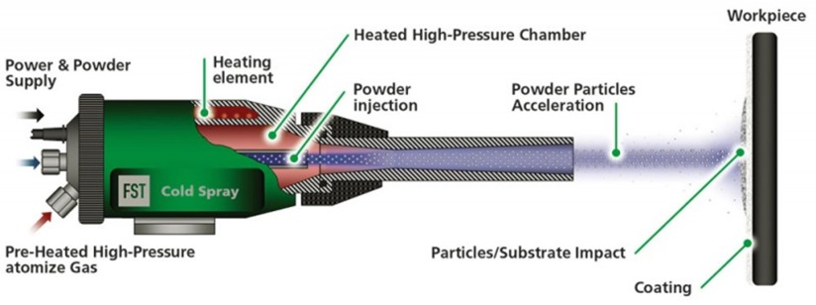
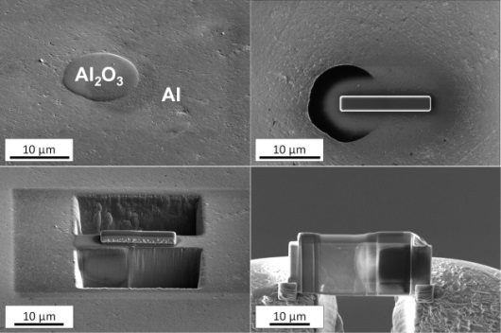
Advanced TEM investigation of interfaces in Al-Al₂O₃ cold sprayed coatings
M. Sennour, F. Gaslain, P. E. Leger F. Borit, M. Jeandin
I. INTRODUCTION
Cold spray coating is recognized as a leading thermal spray process with a high potential to meet industrial demands [1]. In this work, aluminum (Al) powders with spherical and irregular particle shapes were mixed with two alumina (Al₂O₃) powders with either a spherical or an angular particle shapes to achieve high-performance cold-sprayed coatings onto steel [2]. Al/Al and Al/Al₂O₃ interfaces were investigated using TEM to understand coating strengthening effects due to alumina addition at the scale of the particle.
II. MATERIALS AND METHODS
Al powders and Al-15 wt.% Al₂O₃ mixtures were cold sprayed using CGT Kinetics 3000M facilities. Nitrogen was used as spraying gas. The process gas pressure was 2.5 MPa with a gas temperature of 400 °C.
TEM samples
https://www.fst.nl/systems/cold-gas-spray/
TEM thin foils were extracted using the focused ion beam (FIB) technique on Helios 660 SEM-FIB. TEM observations were carried out on Thermo Fisher Tecnai F20-ST microscope.

Slide 2
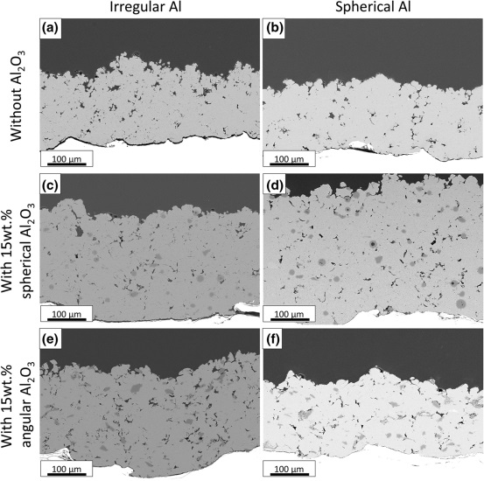
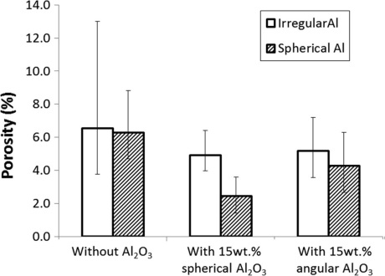
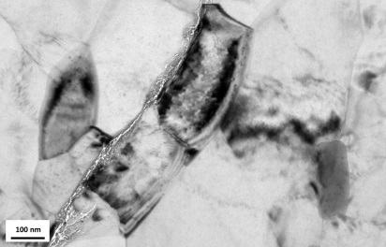
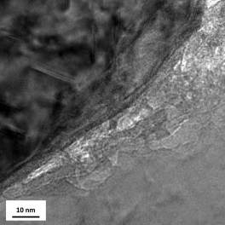
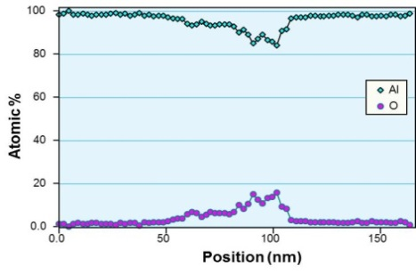
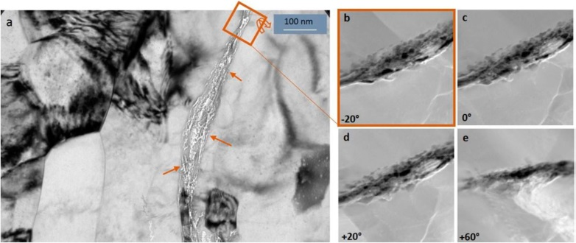
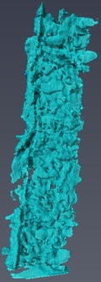
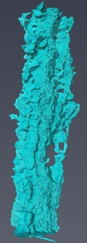
Advanced TEM investigation of interfaces in Al-Al₂O₃ cold sprayed coatings
M. Sennour, F. Gaslain, P. E. Leger F. Borit, M. Jeandin
III. RESULTS
Microstructure
TEM and nanotomography characterization of the spherical Al-15%wt spherical Al₂O₃ coating
Spherical Al – 15 wt.% spherical Al₂O₃ mixture presents the best result decreasing the porosity of the coating to about 2%.
EDX linescan
Al
Al
Al
The Al/Al interfaces are composed of an amorphous phase, aluminum nano- grains and nanoporosities. A small layer of Al oxide is detected by linescan EDX analysis of several Al/Al interfaces.
Al
3D reconstruction
TEM nanotomography highlighted that nanoporosities are interconnected forming nanochannels.

Slide 3
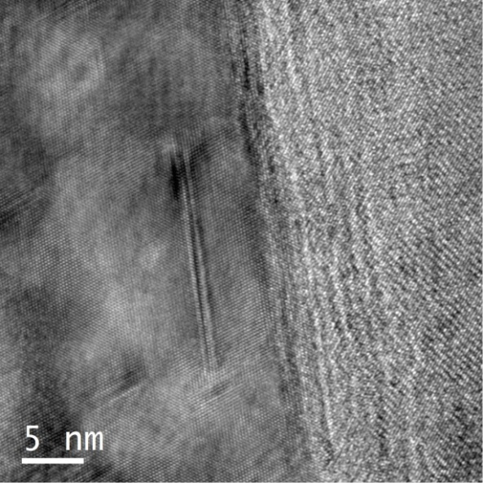
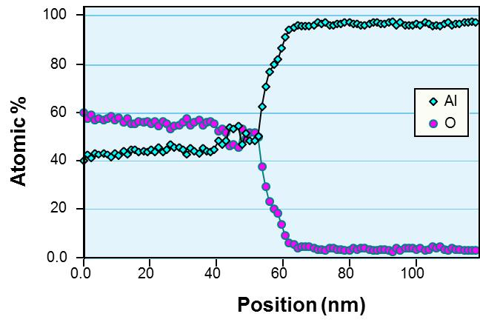
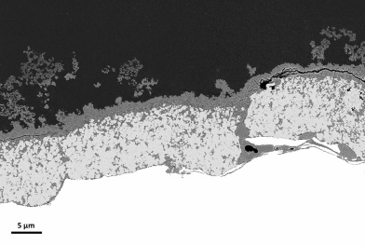
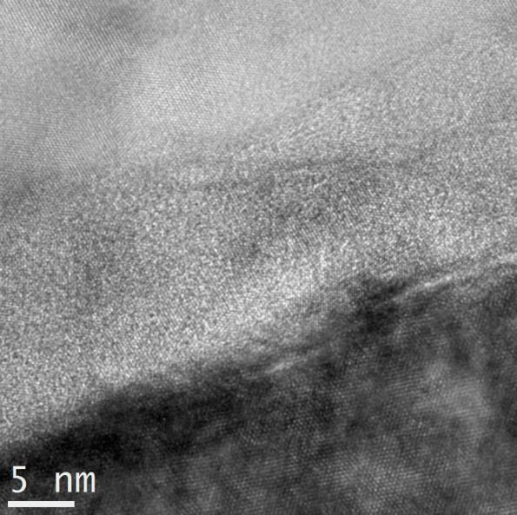
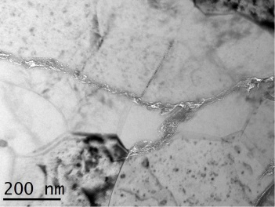
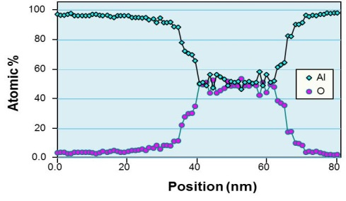
Advanced TEM investigation of interfaces in Al-Al₂O₃ cold sprayed coatings
M. Sennour, F. Gaslain, P. E. Leger F. Borit, M. Jeandin
Corroded cold-sprayed Al-Al₂O₃ coating
Al
Al₂O₃
Al
Al₂O₃
The Al/Al₂O₃ interface is free of nanoporosity and oxide. Al and Al₂O₃ present orientation relationship:
[1-10]_{Al2O3} // [1-10]_{Al}
(110)_{Al2O3} // (111)_{Al}
Al
1-12
121
03-1
Coating
[5-1-3] – Al(OH)3
Steel
Al
Corrosion product
EDX linescan
Al
Al
Al
No corrosion products are present at Al/Al₂O₃ interfaces in contrast to Al/Al interfaces. Corrosion products have been identified as being probably a mixture of Al₂O₃ and Al(OH)₃ .

Slide 4
Advanced TEM investigation of interfaces in Al-Al₂O₃ cold sprayed coatings
M. Sennour, F. Gaslain, P. E. Leger F. Borit, M. Jeandin
IV. SUMMARY
Pure aluminum and composite Al-Al₂O₃ coatings were successfully cold-sprayed onto grit-blasted steel. The very low oxygen content detected by TEM confirms that cold spray is a really protective process which only oxidized at a very fine scale.
- Alumina addition decreased porosity in aluminum coatings. Spherical
alumina addition strengthened the coating at nanoscale.
From a thorough TEM study, interface improvement was shown to result
from alumina addition. Al/Al₂O₃ interfaces showed no porosity actually,
unlike Al/Al interfaces which were somewhat nanoporous.
- TEM nanotomography highlighted that nanopores are interconnected
forming nanochannels.
TEM investigations carried out on corroded Al-Al₂O₃ coating highlighted
that no corrosion products are present at Al/Al₂O₃ interfaces in contrast
to Al/Al interfaces. Using electron diffraction and EDX experiments
corrosion products have been identified as being probably a mixture of
Al₂O₃ and Al(OH)₃ .
REFERENCES
[1] A. Vardelle et al., J. Therm. Spray Technol., 2016, 25(8), p 1376-1440
[2] P.E. Leger et al, J. Therm. Spray Technol., 2017, 26(7), p. 1445–1460
ACKNOWLEDGEMENTS
This work was carried out within the MATMECA consortium and supported by the ANR under contract number ANR-10-EQUIPEX-37. It has benefited from the facilities of the Laboratory MSSMat (UMR CNRS 8579), Centrale Supélec, France. The authors would like to acknowledge D. Billières (Saint-Gobain Coating Solutions/Cavaillon, France) for help in providing alumina powders. Staff members of the Competence Centre for spray Processing (C2P) at MINES ParisTech/Materials Center are gratefully acknowledged for use of spraying facilities and characterization.

