Slide 1
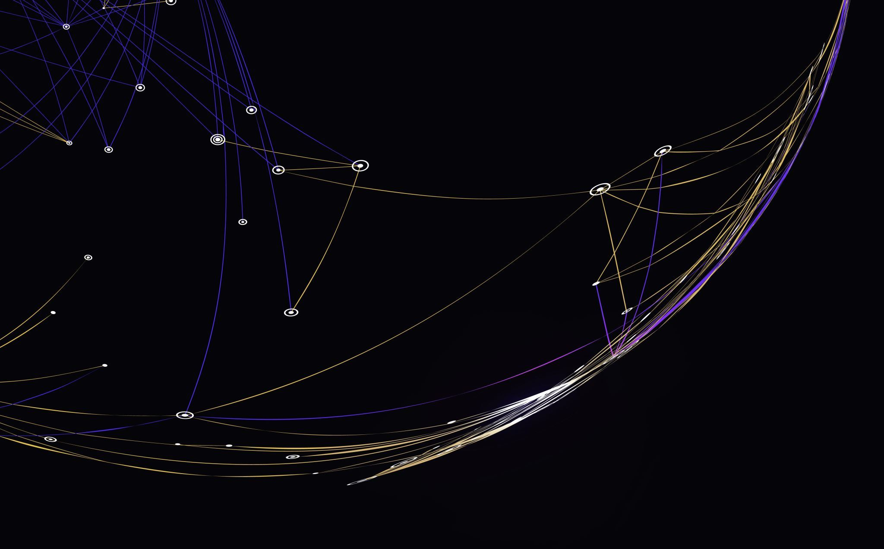
A methodological approach on the study of Aboriginal language loanwords in contemporary standard Australian English : creating an extensive corpus
Marjolaine Martin and Stéfany Thierry
LLL – University of Tours, France
Forum on Australian Englishes – La Trobe University
October, 7th 2022

Slide 2
Outline
Context of the study
Collecting data
Filling in gaps
Other ideas
Conclusion

Slide 3
1. Context of the study
Aims
Guierrian approach SAusE
ILA

Slide 4
Context of the study and aims
Phonological and phonetical study on loanwords from Indigenous Languages of Australia (ILA) - PhD by Stéfany THIERRY – still a WIP
Dictionary study – Lionel Guierre’s and his followers’ approach
Aims – to compare the pronunciation of loanwords from ILA in SAusE and in the source languages
What features are maintained, adopted, invented? The lexical stress pattern? The pronunciation of consonants? Of stressed and unstressed vowels? What is the impact of their orthography?
How does it impact SAusE?

Slide 5
Guierrian approach
An empirical approach on large datasets, often from computerised pronouncing dictionaries;
Orthographic information is taken into consideration : graphophonemics
Our morphological approach assumes that semantically opaque constituents play a role in stress assignment (orthographic geminates <oo, ee> = strong ending if prefix or not)
We assume that English phonology includes a number of different subsystems which correspond to different lexical strata of borrowings (or words perceived as such). (‘Italian’ words, works on loanwords in -eur/euse – See P. Fournier 2016 and 2018)
A. C. Gimson about Guierre in the foreword of Drills in English Stress-Patterns (1984 new ed.):
“L. Guierre has carried out a computer analysis of the stress-patterns of the majority of words in the Jones English Pronouncing Dictionary and has been able to derive from this analysis sufficient rules of general validity to be of great practical help for the foreign learner. […] The tendencies of word-stress which have emerged are likely to reflect the underlying rules which the native English speaker has as part of his linguistic generative capability […]”

Slide 6
Standard Australian English (SAusE)
“By Australian English we mean that form of English that originated early in the nineteenth century among those children of British settlers who were born and raised in the colony. Australian English has had a continuous tradition ever since as the mother tongue of a large proportion of the Australian community. It is the national variety of English, and the variety which speakers of other varieties, or indeed of other languages, meet when they come to Australia, whether as visitors or as immigrants.”(Delbridge, 1981, p.12)
“AusE is dear to the hearts of those of us who are Australian – we know each other by the sound of the language we speak, by the special words we use, by the sense of shared experience and a common history that filters through it. AusE therefore becomes one of the icons of our culture.”Butler (2001, p.151)

Slide 7
Indigenous Languages of Australia (ILA)
“Although English has been the dominant language in Australia for the last two centuries it has not been the only language spoken. Many Aboriginal languages are still spoken, albeit by a vastly reduced number of speakers.”(Collins, 1989, p.4)
Census 2021 : 237 ILA
“Of the estimated 250 original Aboriginal and Torres Strait Islander languages in Australia, it was found in 2012 that 120 are still spoken and of these 13 are considered strong in the sense that they are still spoken by all age groups. The 13 strongly spoken languages is a decline from the 18 found to be strong in 2004. Some languages considered to be strong also show signs of declining vitality.”
Australian Government Action Plan for the 2019 International Year of Indigenous Languages

Slide 8
2 . Collecting Data for the corpus

Slide 9
Creating an extensive corpus including
For each item in SAusE :
Etymology (source language, year of appearance in the SAusE lexicon)
Orthographies
Pronunciation(s) : IPA transcription and audio file
Grammatical category/ies
Definition
Frequency of use
For each corresponding item in ILA:
Orthographies
Phonological description of the source language
Pronunciations : IPA transcription and/or audio file
Grammatical category/ies
Definition or meaning in ILA
Meaning in SAusE
Notes:
How can we assemble the most extensive list of loanwords from ILA? (dictionaries, lexicons, others? )
What linguistic data are we looking for in SAusE? In ILA?
Which ILA do the loanwords come from?
How are the ILA at stake described?
To what extent does this impact the constitution of the corpus?

Slide 10
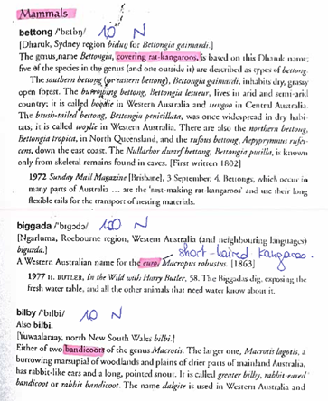
Reference books – SAusE –
Australian Aboriginal Words in English : Their Origin and Meaning ; Dixon et al. 2006 (AAWE)
"Up until the late 1980s, all dictionaries of English – including the Macquarie Dictionary (1981) - included some words borrowed from the indigenous language of Australia, but without stating their specific origin" Dixon et al. (2006)
The Macquarie Dictionary ; 5ème edition, 2009 (MD 2009)
The Macquarie Dictionary ; online edition (2020/2022) (MD 2020)
Australian Aboriginal Words in English : Their Origin and Meaning ; Dixon et al. 2006, p,51

Slide 11
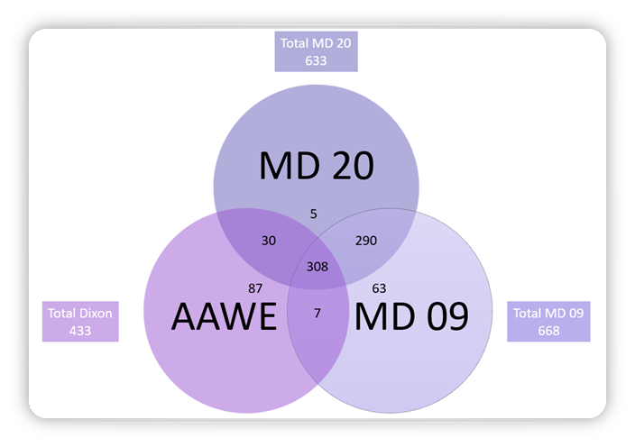
SAusE - data
308 words in common in AAWE, MD 09 et MD 20
mainly fauna (107) and flora (91)
290 words in common in the two editions of MD (majority of toponyms (240))
30 words in common in both AAWE and MD 20
mainly fauna and flora
7 words in common in both AAWE and MD09
divided in flora, fauna, toponyms, natural phenomena
! The rest of the study presented here does not involve toponyms

Slide 12
Creating an extensive corpus including
For each item in SAusE :
Etymology (source language, year of appearance in the SAusE lexicon)
Orthographies
Pronunciations : IPA transcription and audio file
Grammatical category/ies
Definition
Frequency of use
Notes:
For each item in SAusE :
Etymology (source language, year of appearance in the SAusE lexicon)
Orthographies
Pronunciation(s) : IPA transcription and audio file
Grammatical category/ies
Definition
Frequency of use

Slide 13
Etymology
Ask authors for content
In order to find ILA data, we need to have precise etymology
For 470 items out of 508 we found an etymology including the ILA (not just « Aboriginal Australian »)

Slide 14
ILA at stake
ILA | Area | Rank | Nb of loanwords in Dixon et al 2006
Nyungar | WA | 1 | 60
Dharuk | NSW | 2 | 56
Dharuk probably | NSW | 2 | 2
Wiradhuri | NSW | 3 | 23
Western Desert language | NT, SA, WA | 4 | 20
Yagara | QLD | 5 | 18
Kamilaroi | NSW | 6 | 15
Gaurna | SA | 7 | 13
Wemba-wemba | NSW | 8 | 11
Yuwaalaraay | NSW, QLD | 9 | 10
Diyari | SA | 10 | 9
Aranda | NT | 11 | 8
Dyirbal | QLD | 12 | 8
Yaralde | SA | 13 | 8
Wuywurung | VIC | 14 | 7
Nhanta | WA | 15 | 6
Wathawurung | VIC | 16 | 6
Yindjibarndi | WA | 17 | 6
Panyjima | WA | 18 | 5
Bandjalang | NSW | 19 | 4
Ask authors for content
The 508 items were borrowed from 75 ILA (out of 237 found in 2021 Census)
Ranked in terms of nb of loanwords in Dixon et al 2006
52 of these 75 ILA do no longer have speakers

Slide 15
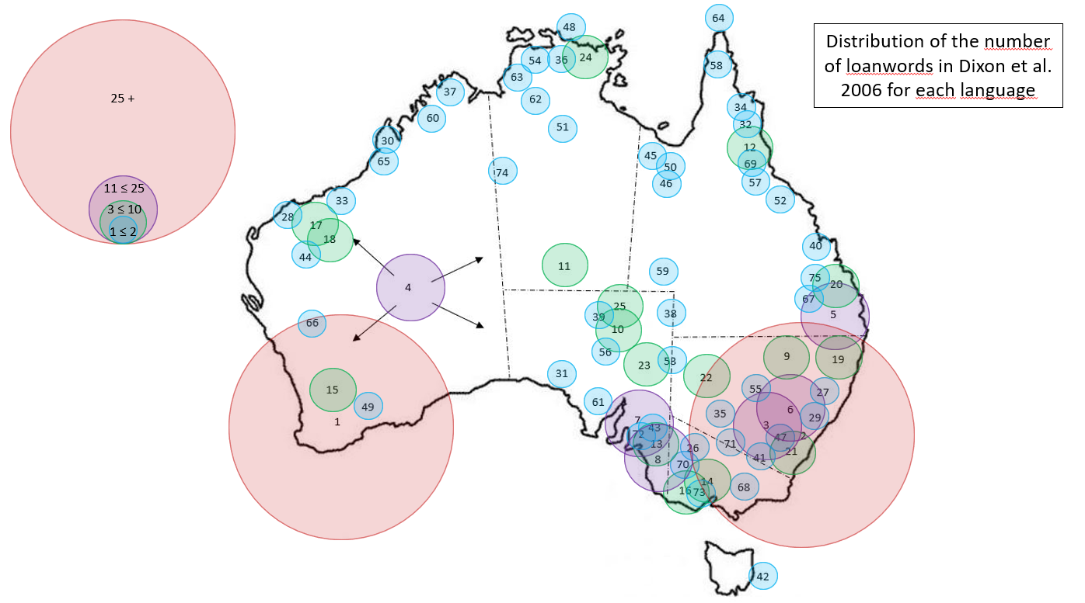
Source ILA and nb of loanwords
Ask authors for content
Focus on Dixon et al. 2006
433 words borrowed from 70 different ILA
45 languages provided max to 2 loanwords
23 languages provided between 3 and 24 loanwords
2 languages provided more than 25 loanwords : Nyungar 60 items and Dharuk 56 items

Slide 16
Looking for data on the 75 ILA source languages
33 references were taken into account (dictionaries, lexicons, web applications) See specific bibliography for details
Most of the time these are grammars containing extensive linguistic descriptions regarding history, territory, phonology, syntax, morphology, sample texts and lexicons in ILA

Slide 17
ILA - data
Ask authors for content
This is how we organized the data found in the different references per ILA
ILA | other name(s) | Nb of Loanwords | Dictionary and lexicons | Websites and Apps | Authors | Orthographies | Phonological description | IPA transcription | Recordings
Arabana | Arabana or Arabuna /ˈʌrəbʌnə/ | 2 | Hercus, L. A. (2015a). A Grammar of the Arabana-Wangkangurru Language, Lake Eyre Basin, South Australia. Pacific Linguistics. |  | Hercus | / | yes | no | no
Aranda | Arrernte | 8 | Green, J. (2005). A Learner’s Guide to Eastern and Central Arrernte. IAD Press |  | Jenny Green | yes | yes | to do | no
Awabakal |  | 2 | Threlkeld, I. E. (1892). An Australian Language as spoken by the Awabakal people of Awaba or Lake Macquarie. Charles Potter. | https://downloads.newcastle.edu.au/library/cultural%20collections/awaba//language/dictionary/dic001.html | Threlkeld | yes | no | no | no
Baagandji | The Darling language, or Paakantyi (Baagandji) | 3 | Hercus, L. A. (2011). Paakantyi Dictionary. Panther Publishing & Printing. | https://www.omniglot.com/writing/paakantyi.htm / | Luise A. Hercus | yes | yes | to do | no
Biri | Yuwi, Biria, Birigaba, Wiri, Wirri or Widi | 1 | Terrill, A. (1998). Biri. Lincom Europa. |  | Terrill | no | yes | no | no
Dharawal | dialecte du Dharug | 3 | Troy, J. (1993). The Sydney Language. | https://dharug.dalang.com.au/language/dictionary | Troy | yes | yes | to do | no
Dharuk | Dharug | 56 | Troy, J. (1993). The Sydney Language. | https://dharug.dalang.com.au/language/dictionary | Troy | yes | yes | / | no
Dharumbal | Dharambal | 1 | Terrill, A. (2002). Dharumbal : The Language of Rockampton, Australia. Pacific Linguistics. |  | Terrill | yes | yes | to do | no
Diyari | / | 9 | Austin, P. K. (2013). A dictionary of Diyari, South Australia. SOAS. |  | Peter K. Austin | yes | yes | to do | no
Djingulu | Jingulu (Djingili | 1 | Pensalfini, R. (2003). A grammar of Jingulu, an Aboriginal language of the Northern Territory. Pacific Linguistics. | ﷟https://omniglot.com/writing/jingulu.htm#:~:text=Jingulu%20(Djingili),are%2023%20speakers%20of%20Jingulu. | Pensalfini | no | yes | to do | no

Slide 18
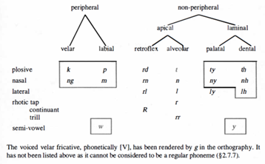
Example of a phonological description
Here is what we found for the Wanganguru language
3 loanwords
Reference book: Hercus, L.A. A Grammar of the Arabana-Wangkangurru Language, Lake Eyre Basin, South Australia. C-128, xx + 344 pages. Pacific Linguistics, The Australian National University, (1994)
Pages: 26-47

Slide 19
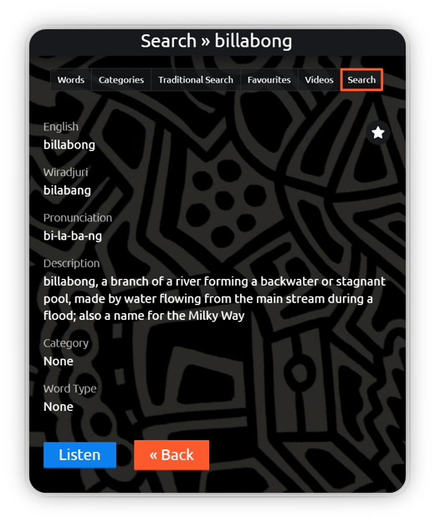
Apps
Apps containing ILA data: 7 created by Regenr8, 1 by the AECG (Aboriginal Education Consultative Group of NSW) and 1 by speakers of the Gadjigadji language
The apps work like bilingual dictionaries
It is possible to use a traditional search tool using a photo, which avoids the spelling/reading problem
An example in the Wiradhuri app by Regenr8 : billabong

Slide 20
Retrieved ILA data for the corpus
33 references (grammars, bilingual dictionaries or apps) for ILA :
27 include spelling
26 include phonological description
7 include phonetical transcription
4 include recordings
→ Lack of oral data
Ask authors for content

Slide 21
Creating an extensive corpus including
For each item in SAusE :
Etymology (source language, year of appearance in the SAusE lexicon)
Orthographies
Pronunciations : IPA transcription and audio file
Grammatical category/ies
Definition
Frequency of use
For each corresponding item in ILA:
Orthographies but no info on how they were created
Phonological description of the source language
Pronunciations : IPA transcription and/or audio file
Grammatical category/ies
Meaning in ILA
Meaning in SAusE

Slide 22
3 . Filling in gaps
IPA transcriptions, socio-linguistics survey and perception test

Slide 23
Transcribing
When possible, use of the correspondence between spelling and pronunciation given for a particular ILA to build IPA transcriptions of the loanwords
Ex in Nyungar : « kitj » (« gidgee » in SAusE). Whitehurst 1997 gives a correspondence between spelling and pronunciation. For this example we used the following correspondence :
“ k not in standard English, but almost as in skill “
“ i as in hit “
“ dj and tj are the same sound ”
“ dj not in standard English, but almost as in dew “
To transcribe the word [kɪdj].
Bias linked to the spelling, sometimes unstable – need for more details on the decision making process of the orthographies – use of OED?
Marjolaine MARTIN, Stéfany THIERRY - LLL University of Tours - Do not share on social media

Slide 24
Survey – AusE - ILA oral data and frequency perception test
Use of COCAE and BNC for other studies – not possible here
Creation of a sociolinguistic survey to retrieve oral data and perform a frequency perception test
The survey is divided into 3 parts:
Collection of social data
Perception test : AusE speakers on their frequency of use of loanwords from ILA
Bias: indication but not totally reliable
Acknowledgments and recordings in AusE and ILA
Difficulty: the focus on ILA speakers – 4 months in Australia in 2023

Slide 25
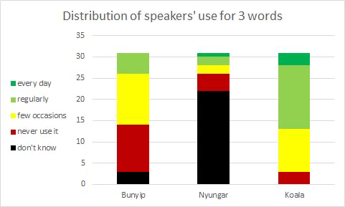
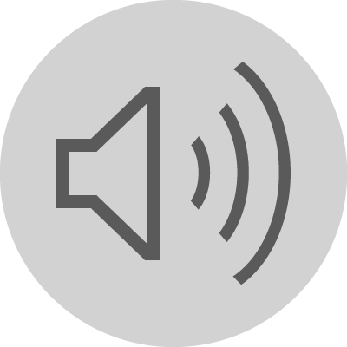
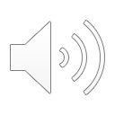
First results
Ask authors for content
To this day (Oct, 1st), 31 speakers responded to the perception test on frequency data
8 of them recorded themselves in English
An example of different pronunciations for the same word: nyungar
Great diversity for some words but not enough data yet
No recording in ILA for the moment

Slide 26
4 . Other ideas
YouGlish, toponyms,
OED

Slide 27
Other ideas
YouGlish
Use other AusE oral data from YouGlish
Toponyms
291 toponyms including only 50 items with precise etymology – small numbers because of dictionary checked data
Idea: concentrate on one specific area and work with local ILA speakers
OED
Using the Oxford English Dictionary to complete the corpus
Using the “Australian Aboriginal” filter in order to collect missing data – preliminary study 20 words out of 195 items
Frequency bands as an indication

Slide 28
5. Conclusion

Slide 29
Conclusion
A recipient language that is well described when the donor languages are not
Different methods used to compensate the lack of data:
IPA transcriptions based on graphophonology
Sociolinguistic survey and perception test
Recordings in SAusE and ILA (Survey, YouGlish, Field work)
Ideas

Slide 30
Thank you for your attention

Slide 31
Bibliography
Butler, S. Australian English - an identity crisis. In : COLLINS, P., BLAIR, D., (éd.), English in Australia. Amsterdam : John Benjamins Publishing Company, 2001, p. 151–161.
Clyne, M. Eisikovits, E. Tollfree, I. Ethnic Varieties of Australian English. In D. Blair and P. Collins (eds.), Varieties of English around the World: English in Australia, Amsterdam: John Benjamins, 2001, p.221-238
Cox, F., & Fletcher, J. (2017). Australian English; Pronunciation and Transcription (2ème édition). Cambridge University Press.
Crystal, D. (2002). The English Language (2ème). Penguin books.
Dixon, R. M. W. (1980). The Languages of Australia. Cambridge University Press.
Dixon, R. M. W. (2002). Australian Languages : Their Nature and Development. Cambridge University Press.
Dixon, R. M. W., Moore, B., Ramson, W. S., & Thomas, M. (2006). Australian Aboriginal Words in English : Their origin and meaning (Oxford University Press)
Delbridge, A. The need for an Australian dictionary. In : Delbridge, A., Bernard, J. R. L., Blair, D., Ramson, W. S., Butler, S., (éd.), Macquarie Dictionary. St Leonards : Macquarie Library, 1981. p. 12–17.
Fournier, P. (2016) ‘Nouvelles perspectives sur l’accentuation des emprunts en anglais contemporain’, Itinéraires, 2015–2.
Fournier, P. (2018) ‘Stress Assignment in Italian Loanwords in English and its Impact on the Stressing of Foreign Words by Native English Speakers’, Corela HS-24 Multicultural Spoken English.
Harrington, J., Cox, F., & Evans, Z. (1997). An acoustic phonetic study of Broad, General, and Cultivated Australian English Vowels. Australian Journal of Linguistics, 17, 155‑184.
Haspelmath, M., & Tadmor, U. (Éds.). (2009). Loanwords in the World’s Languages. De Gruyter Mouton.
Koch, H., & Nordlinger, R. (Éds.). (2014). The Languages and linguistics of Australia : A comprehensive Guide. De Gruyter Mouton.
Macquarie Dictionary (5ème). (2009). Pan Macmillan.
Macquarie Dictionary (8ème). (2020). Pan Macmillan.
Macquarie Dictionary (onlne edition). (s. d.). Pan Macmillan. https://www.macquariedictionary.com.au/
Martin, M. (2011). De l’accentuation lexicale en anglais australien standard contemporain [Thèse de doctorat]. Université de Tours. http://www.applis.univ-tours.fr/theses/2011/marjolaine.martin_2850.pdf
Mitchell, A. G. (1951). Australian English. The Australian Quarterly, 23(1), 9‑17.
Mitchell, A. G., & Delbridge, A. (1965). The Pronunciation of English in Australia. Angus & Robertson.
Moore, B. (s. d.). The vocabulary of Australian English. Australian National Dictionary Center.
Peters & Delbridge. (1989). Standardisation in Australian English. In Australian English : The language of a new society (University of Queensland Press, University of Queensland Press, p. 127‑137).
Poplack, S. (2018). Borrowing. Oxford University Press.
Martin M., Przewozny-Desriaux A. Lexical Stress in Standard Aboriginal English: A comparative Corpus Based Account of Dictionary and Spoken Data. Phonology of Contemporary English 2021 (PAC2021), Phonology of Contemporary English - Phonologie de l'Anglais Contemporain, Sep 2021, Toulouse and Online, France. ⟨hal-03524481⟩
Przewozny-Desriaux, A. (2016). La Langue des Australiens : Genèse et description de l’anglais australien contemporain (Lambert-Lucas) [Computer software]. Lambert-Lucas.
Ramson, W. S. (1965). Australian English—An Historical Study of the Vocabulary 1788—1898 (Australian National University Press) [Computer software]. Australian National University Press.
Thierry, S. (2020). Intégrations phonétiques et phonologiques des emprunts lexicaux faits aux langues aborigènes dans la variété d’anglais australien standard contemporain (p. 156) [Mémoire de Master 2]. Université de Tours. http://memoires.scd.univ-tours.fr/index.php?fichier=Linguistique/Master2/2020LING_M2_Thierry_Stefany.pdf
Troy, J. (1990). Australian Aboriginal Contact with the English Language in New South Wales : 1788 to 1845. Pacific Linguistics.
Treffers-Daller, J. (2007). Borrowing. John Benjamins Publishing Company, Handbook of Pragmatics.

Slide 32
Reference books – ILA
Austin, P. K. (2013). A dictionary of Diyari, South Australia. SOAS.
Breen, G. (s. d.). Introduction. In Innamincka Words ; Yandruwandha dictionary and stories. ANU Press.
Capell, A. (1942). Languages of Arnhem Land, North Australia. 12(4), 364‑392.
Carroll, P. J. (1976). KUNWINJKU A Language of Western Arnhem Land. The Australian National University.
Dixon, R. M. W. (2009). The Dyirbal language oj North Queensland. Cambridge University Press.
Douglas, W. H. (1988). An introductory dictionary of the Western Desert language. Edith Cowan University.
Green, J. (2005). A Learner’s Guide to Eastern and Central Arrernte. IAD Press.
Haviland, J. B. (s. d.). A LAST LOOK AT COOK’S GUUGU YIMIDHIRR WORD LIST. Harvard University.
Hercus, A. (1994). A GRAMMAR OF THE ARABANA-W ANGKANGURRU LANGUAGE, LAKE EYRE BASIN, SOUTH AUSTRALIA. Pacific Linguistics.
Hercus, L. A. (2011). Paakantyi Dictionary. Panther Publishing & Printing.
Hercus, L. A. (2015a). A Grammar of the Arabana-Wangkangurru Language, Lake Eyre Basin, South Australia. Pacific Linguistics.
Hercus, L. A. (2015b). A Grammar of the Wirangu Language from the West Coast of South Australia. Pacific Linguistics.
Hercus, L. A. (2015c). Victorian languages : A late survey. Pacific Linguistics.
Meyer, H. . A. E. (1843). Vocabulary of the language spoken by the Aborigines of the Southern and Eastern portions of the settled districts of South Australia. James Allen.
Moorhouse, M. (1990). A vocabulary and outlines of the grammatical structure of the Murray River language.
NGARLUMA DICTIONARY; ENGLISH-NGARLUMA WORDLIST AND TOPICAL WORDLISTS. (2008). Wangka Maya Pilbara Aboriginal Center.
Patz, E. (2002). A grammar of the Kuku Yalanji language of north Queensland. Pacific Linguistics.
Pensalfini, R. (2003). A grammar of Jingulu, an Aboriginal language of the Northern Territory. Pacific Linguistics.
Terrill, A. (1998). Biri. Lincom Europa.
Terrill, A. (2002). Dharumbal : The Language of Rockampton, Australia. Pacific Linguistics.
Thieberger, N. (1993). Handbook of Western Australian Aboriginal languages south of the Kimberley Region. Pacific Linguistics.
Threlkeld, I. E. (1892). An Australian Language as spoken by the Awabakal people of Awaba or Lake Macquarie. Charles Potter.
Troy, J. (1993). The Sydney Language.
Westerlund, T. (2015). A grammatical sketch of Ngarla. Asia-Pacific Linguistics.
Whitehusrt, R. (1997). Noongar Dictionary—Noongar to English and English to Noongar (Second Edition, Second Edition) [Computer software].
Wordick, F. J. F. (2015). THE YINDJIBARNDI LANGUAGE. Pacific Linguistics.

Slide 33
Web sites and Apps
https://downloads.newcastle.edu.au/library/cultural%20collections/awaba//language/dictionary/dic001.html
https://www.omniglot.com/writing/paakantyi.htm
https://dharug.dalang.com.au/language/dictionary
https://dharug.dalang.com.au/language/dictionary
https://omniglot.com/writing/jingulu.htm#:~:text=Jingulu%20(Djingili),are%2023%20speakers%20of%20Jingulu.
https://glosbe.com/dbl/en
https://gubbigubbidyungungoo.com/gubbi-gubbi-language http://doczz.net/doc/659217/dictionary-of-the-gubbi-gubbi-and-butchulla-languages
https://www.njamed.com/
https://www.yugambeh.com/learn-the-language
http://yolngudictionary.cdu.edu.au/
https://dnathan.com/gaman/

