Slide 1






Sub-optimal ¹⁵N metabolic labelling in plant for large scale protein turnovers:
A new look at the isotopic distribution
Willy Bienvenut, IDEEV, GQE
Journée Club Jeune FPS – Bordeaux, 25-27/04/2022

Slide 2
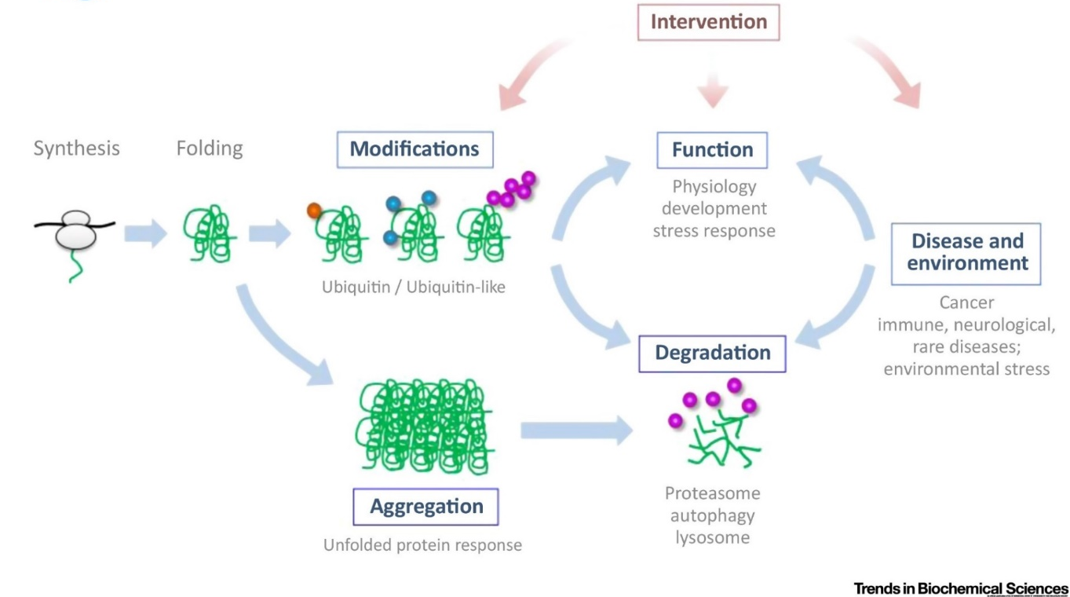
Proteostasis and large scale protein turnover rate determination
[mRNA] ∝ [protein]
Dissmeyer et al. Trends Biochem. Sci. 2019
Influence of protein Half-life and Turnover rate
in protein abundance variability
Journée Club Jeune FPS – Bordeaux, 25-27/04/2022

Slide 3
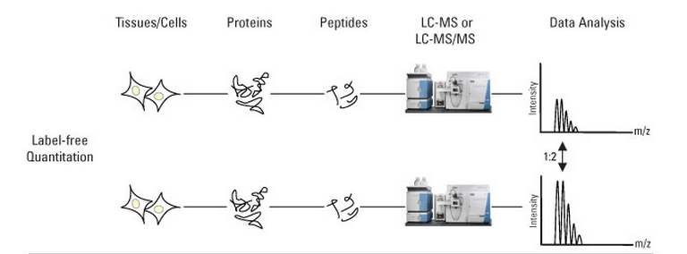
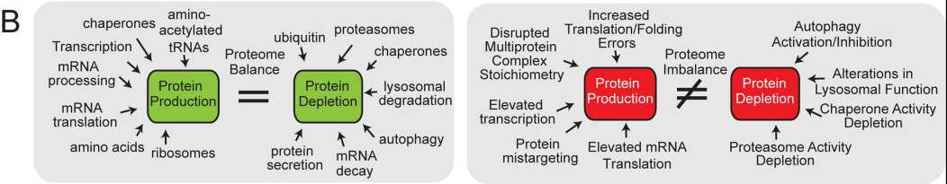
Protein quantitation
Synthesis
Synthesis
Condition 1
Catabolism
Catabolism
Synthesis
Catabolism
Catabolism
Condition 2
Synthesis
Synthesis
Harper Bennett, Nature 2016; 537(7620): 328-338
Journée Club Jeune FPS – Bordeaux, 25-27/04/2022

Slide 4
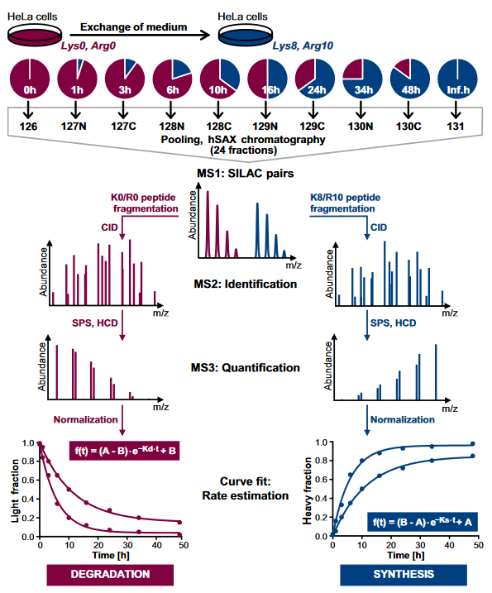
Protein turnover rates and SILAC: a convenient approach for cultured cells
Zecha et al., Mol Cell Proteomics 2018; 17(5): 974–992.
Journée Club Jeune FPS – Bordeaux, 25-27/04/2022

Slide 5
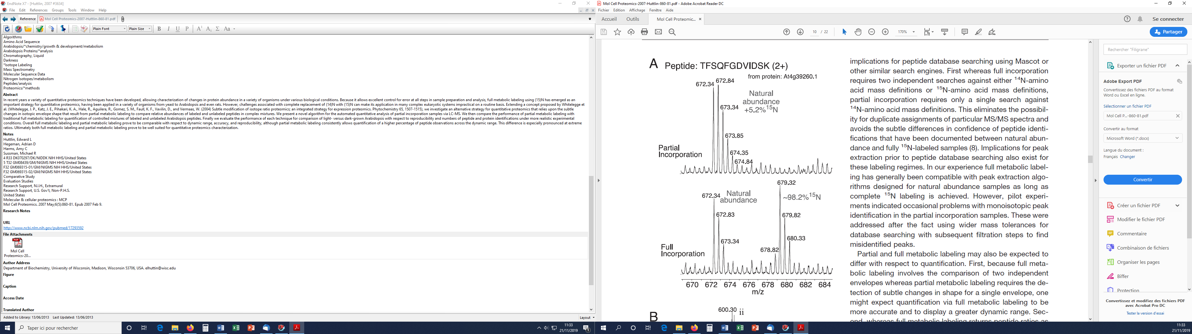
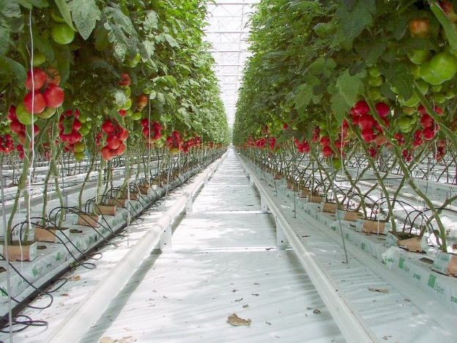
What about phototrophic organisms
Not possible to use
heavy-labelled amino acid
Water, CO₂, fertilizers and trace elements…
C H N O S
¹²C → ¹³C (CO₂)
¹⁴N → ¹⁵N (NH₄NO₃)
Huttlin et al. Mol. Cell. Proteomics 2017
Journée Club Jeune FPS – Bordeaux, 25-27/04/2022

Slide 6
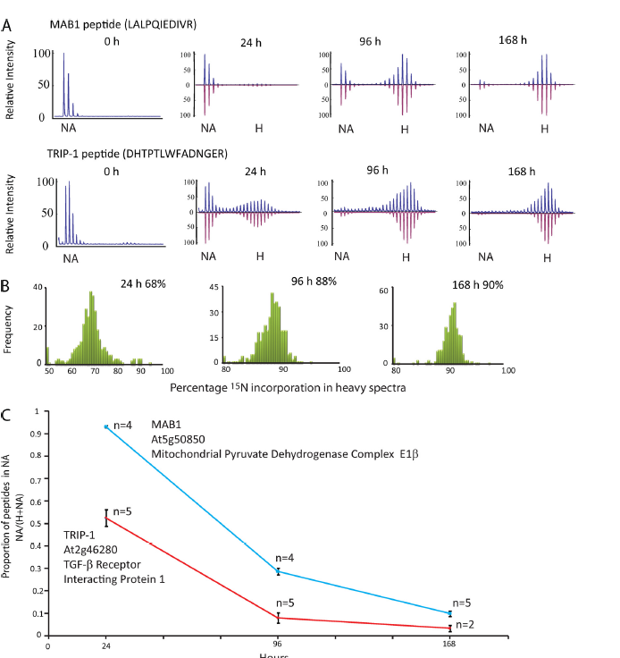
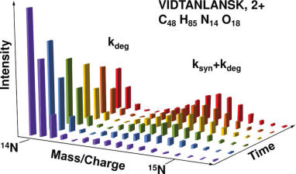
Variable ¹⁵N incorporation
Huttlin et al. Mol. Cell. Proteomics 2017
Martin et al. J Proteome Res 2012
Li et al. Mol Cell Proteomics 2012
Journée Club Jeune FPS – Bordeaux, 25-27/04/2022

Slide 7
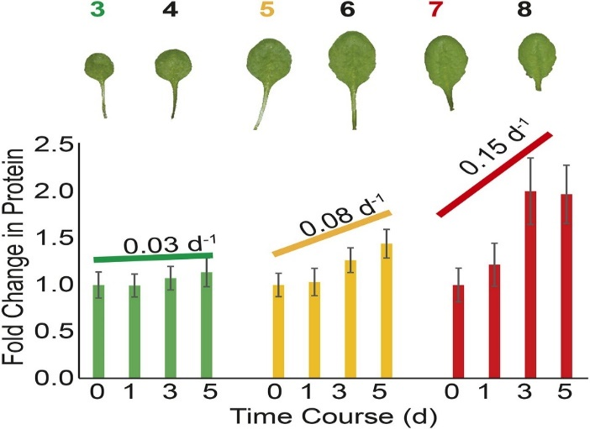
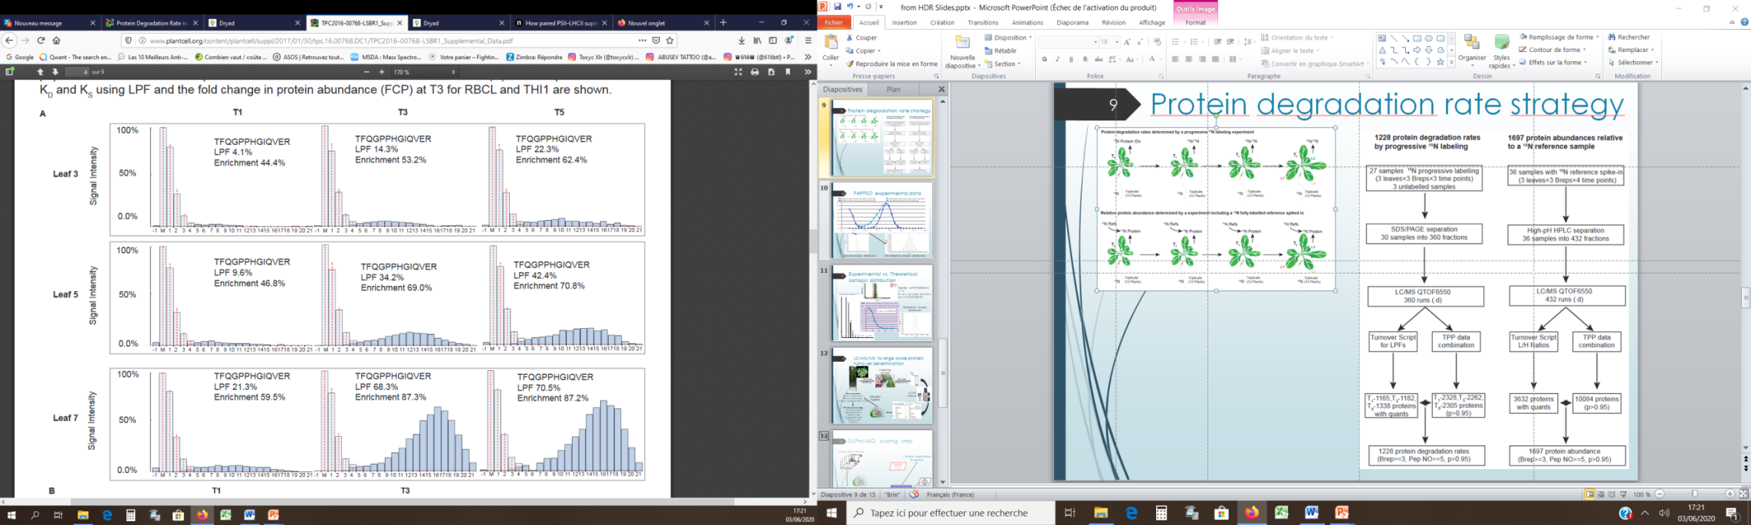
Li et al. approach, Plant Cell 2017; 29:207-228
21 days old non-labelled Arabidopsis plants
Determination of the FCP coefficient
(Fold Change in Protein)
Determination of the LPF
(Labelled Protein Fraction)
Journée Club Jeune FPS – Bordeaux, 25-27/04/2022

Slide 8
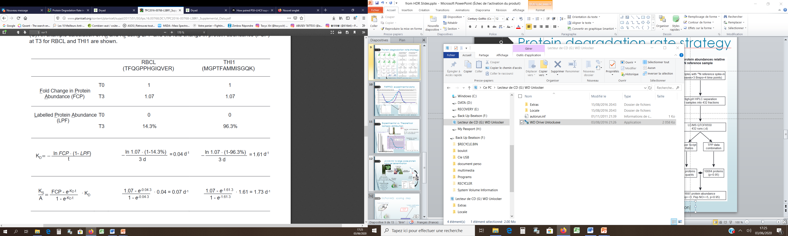
K_{D} and K_{S} calculation
- High data-processing
- Scripts not available
- …
Alternative approach… ?
Adapted to the processing tools available locally
Adaptable to field investigations
Lower cost
…
Journée Club Jeune FPS – Bordeaux, 25-27/04/2022

Slide 9
Large scale protein turnover measurement…
Crucial information to better understand proteostasis…
Pulse SILAC metabolic labelling is not compatible with plants
Alternatively: ¹⁵N metabolic labelling
  Suboptimal ¹⁵N labelling even with 98% isotopic purity…
  Strongly increase sample complexity
Journée Club Jeune FPS – Bordeaux, 25-27/04/2022

Slide 10
Large scale protein turnover measurement…
Proposed alternative
  Low labelling rate (5-6% vs. >70-90% ¹⁵N )
    Advantage :
      Peptide isotopic distribution is moderately modified!!!
        Heavy & light isotopomers overlay
        Minor sample complexity increase
    Bottlenecks…
      Intensive post-acquisition data processing:
        ¹⁵N labelling yield # peptide isotopic distribution
        Protein amount variation (label free quantitation)
  Processing based on our open sources softwares
    X!Tandem Pipeline, MassChroQ, MCQR (R package),…
    Additional R and Python processing scripts under development…
Journée Club Jeune FPS – Bordeaux, 25-27/04/2022

Slide 11
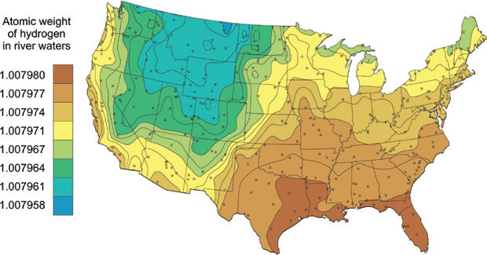
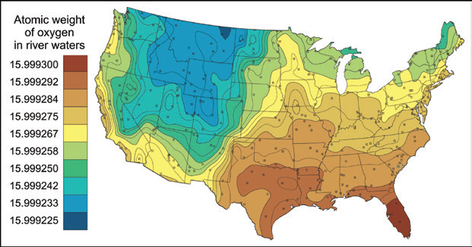
“Theoretical” isotopic distribution
A geographical question…
  IUPAC Periodic Table of the Elements and Isotopes (IPTEI) for the Education Community. Pure Appl. Chem. 2018; 90(12) 1833-2092
Journée Club Jeune FPS – Bordeaux, 25-27/04/2022

Slide 12
“Theoretical” isotopic distribution
Journée Club Jeune FPS – Bordeaux, 25-27/04/2022

Slide 13
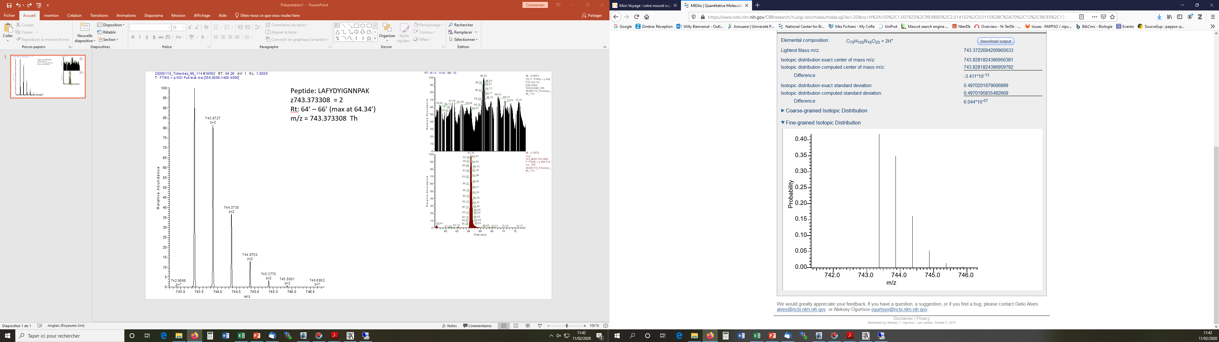
The isotopic distribution world…
Peptide: LAFYDYIGNNPAK
z = 2+
m/z = 743.3733 Th
IFS= 4.1
Peptide experimental isotopic distribution
Isotope Fitting Score (IFS) = -log(1-Corr.)
Peptide simulated isotopic distribution
Isotopic profile = f(% ¹⁵N)
Journée Club Jeune FPS – Bordeaux, 25-27/04/2022

Slide 14
How isotopic distribution could be used?
No universal isotopic distribution…
  « Theoretical isotopic distribution » = f([¹⁵N])
But at low ¹⁵N labelling rates
  Variation of the isotopic intensity ~ f(t_{i}[¹⁵N ]-t₀[¹⁵N ] )
Additionally, needs to know some ¹⁵N rates
  Performed by A. Marmagne at IJPB Versailles (SATURN team)
    By ICMS: isotopic composition mass spectrometry
  For
    (Basal/natural ¹⁵N rate)
    Final labelling rate…
Approach provide the apparent ¹⁵N labelling rate
1 day lag time (Cao et al. New Phyto. 2002: 233-3,1188-1201)
Journée Club Jeune FPS – Bordeaux, 25-27/04/2022

Slide 15
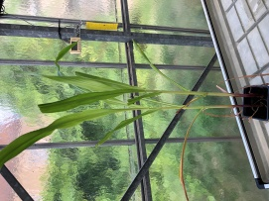
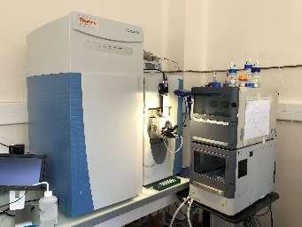


Standard samples preparation and proteins ID
¹⁵N labelling pulse
½ MS media 10% of ¹⁵N
(90% of ¹⁴N)
Collecting samples at
multiple time points
Standard proteomics sample preparation
Z. maize B73 in potting soil;
Normal growth until leaf 6
X!Tandem
Q-Exactive Raw files
Raw file mzML conversion
Zm-B73-REFERENCE-DB.protein.fasta
RP-LC Q-Exactive analysis
List of identified
peptides and proteins
Journée Club Jeune FPS – Bordeaux, 25-27/04/2022

Slide 16
Isotopic distribution metabolic labelling kinetics
Peptide sequence: AGVKEYKLTYYTPEYETK
t₀ Ctrl
t₄ Ctrl (10 days)
t₁ (1 day)
t₃ (6 days)
t₂ (3 days)
t₄ (10 days)
Journée Club Jeune FPS – Bordeaux, 25-27/04/2022

Slide 17
Post Acquisition Data Processing
Raw files
X!Tandem search results
?
Protein turnover calculation
Journée Club Jeune FPS – Bordeaux, 25-27/04/2022

Slide 18
Post Acquisition Data Processing
Raw files
X!Tandem search results
?
Protein turnover calculation
Protein Fold Change
(PFC)
¹⁵N Labelled Protein Fraction (LPF)
Journée Club Jeune FPS – Bordeaux, 25-27/04/2022

Slide 19

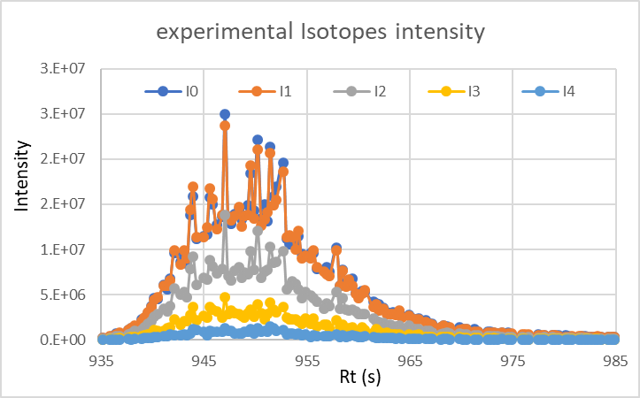
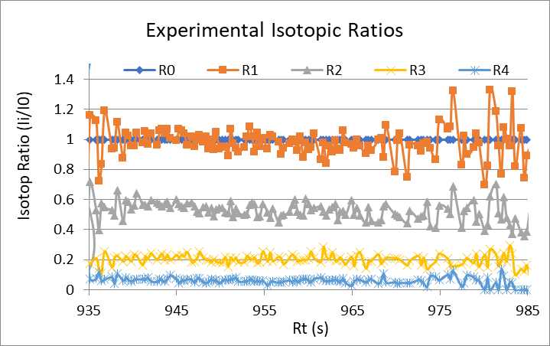
Post Acquisition Data Processing
Peptides isotopic
XIC profiles and Ratios
X!Tandem Pipeline
Raw files
X!Tandem search results
Multiple files protein inference,
Grouping and filtering
Protein turnover calculation
Protein Fold Change
(PFC)
Filtering raw data
¹⁵N Labelled Protein Fraction (LPF)
Journée Club Jeune FPS – Bordeaux, 25-27/04/2022

Slide 20
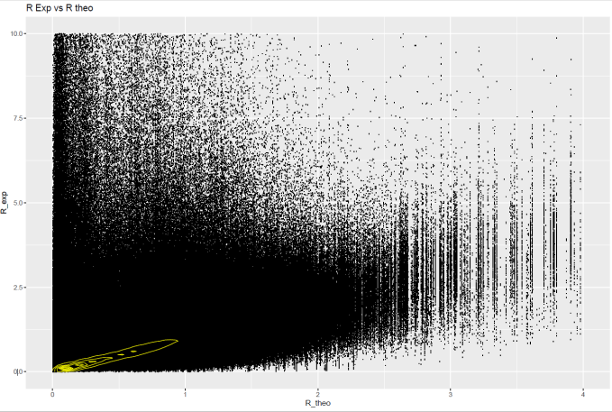
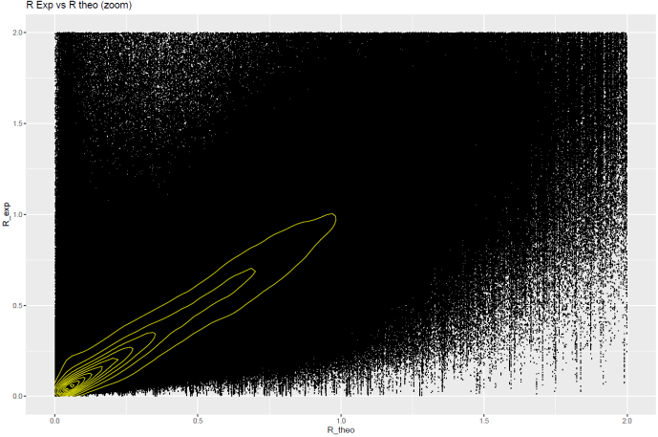
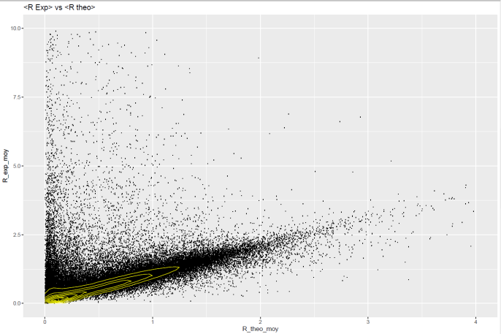
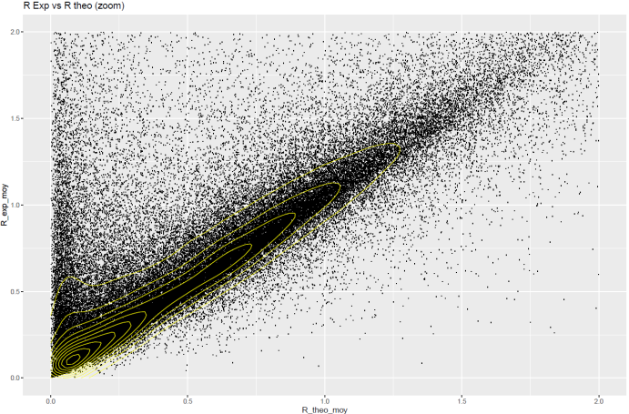
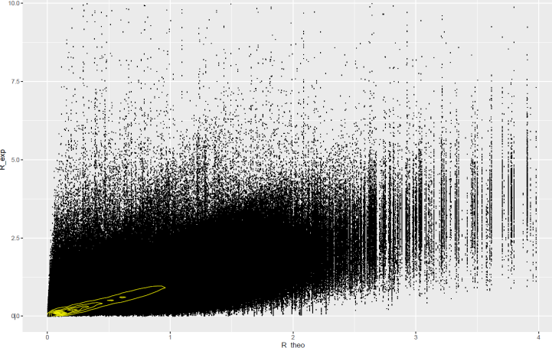
A view Exp vs Theo Ri…
8755972 MS²
26800 peptides
R² = 0.069
IFS = 0.03
R² = 0.081
IFS = 0.04
Pre-processing
Removing outliers: R_{i} _{Exp}(pepID) < R_{i Theo}(pepID) * 1.2 at 6% ¹⁵N
7839391 MS²
R² = 0.80
IFS = 0.71
Journée Club Jeune FPS – Bordeaux, 25-27/04/2022

Slide 21
Filtering data
2 levels filters
Peptide Ri distribution
Inter-Spectrum Correlation
Journée Club Jeune FPS – Bordeaux, 25-27/04/2022

Slide 22

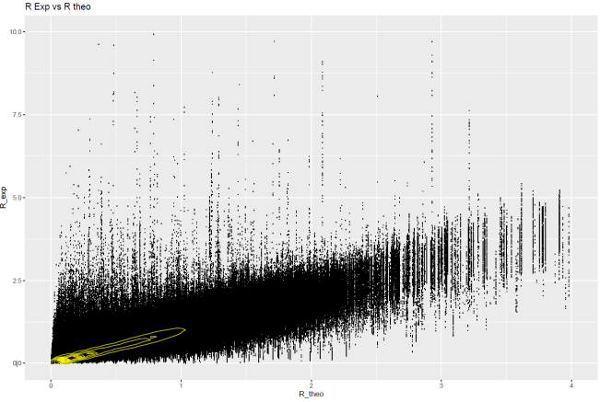
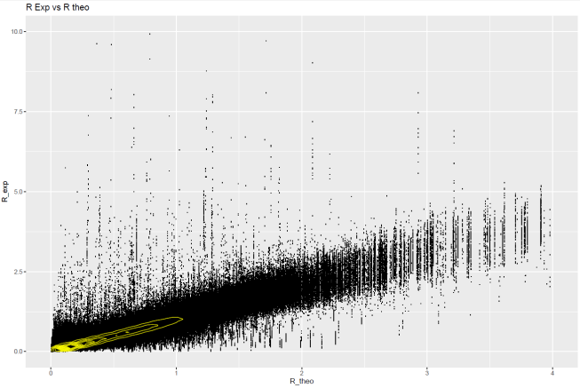
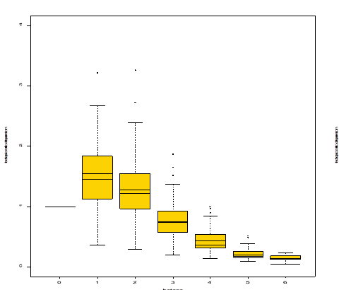
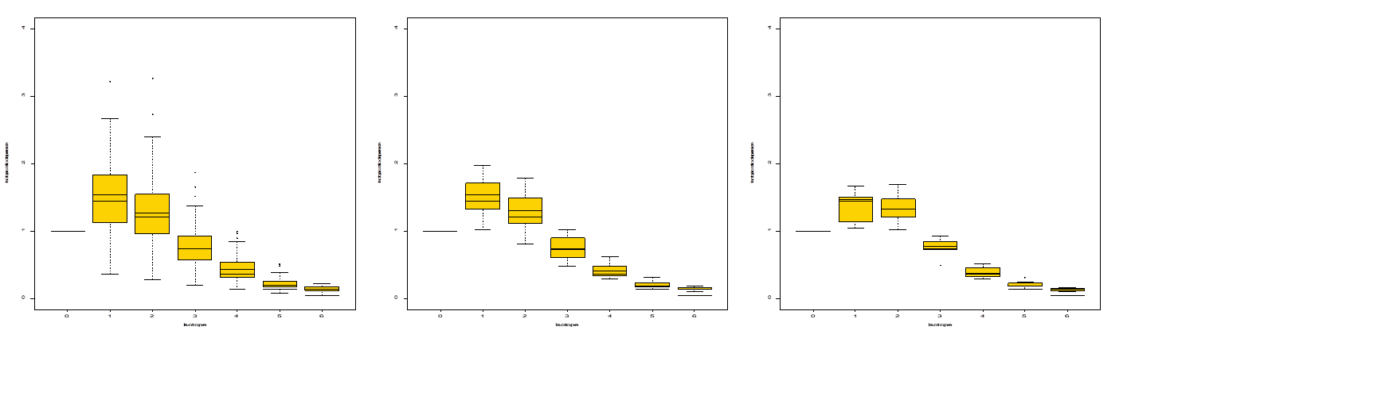
Isotopic ratios and profile filtering
2 levels filters
Raw ratios
Peptide(Ri) dist.
Spectrum² Corr.
7839391 MS²
6756789 MS²
2842304 MS²
R² = 0.80
IFS = 0.71
R² = 0.92
IFS = 1.08
R² = 0.96
IFS = 1.37
Journée Club Jeune FPS – Bordeaux, 25-27/04/2022

Slide 23

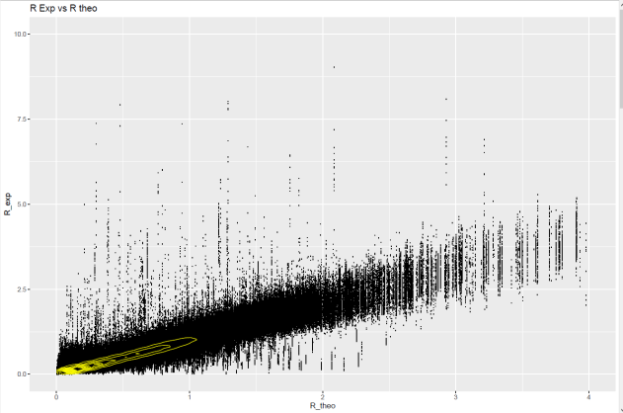
Additional filters …
Raw ratios
Ri filters
8755972 MS²
2842304 MS²
R² = 0.96
IFS = 1.37
R² = 0.069
IFS = 0.03
Favouring data redundancy
Redundant measurements
in multiples replicates (>= 2/4 MSrun)
Minimum isotopes ratios (> 4 I)
Minimum number of spectra (5 MS²)
2709529 MS²
R² = 0.96
IFS = 1.43
Journée Club Jeune FPS – Bordeaux, 25-27/04/2022

Slide 24
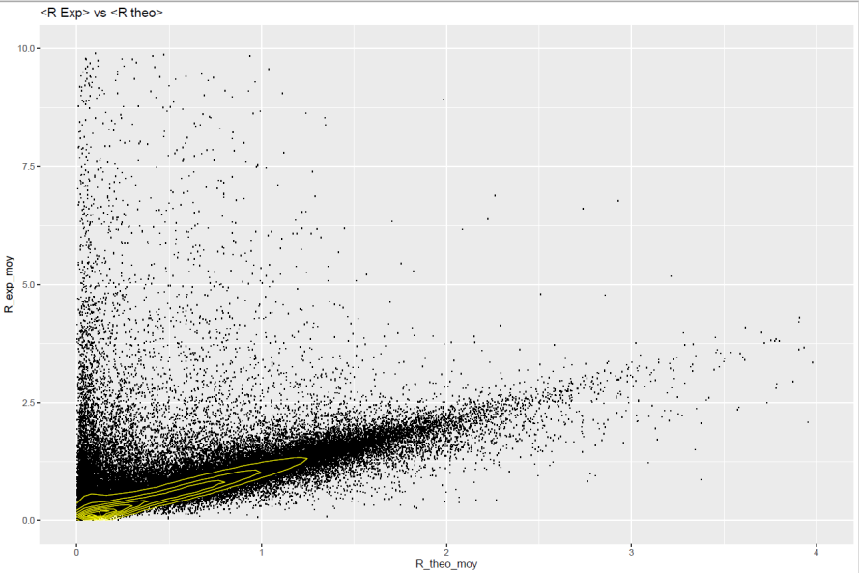

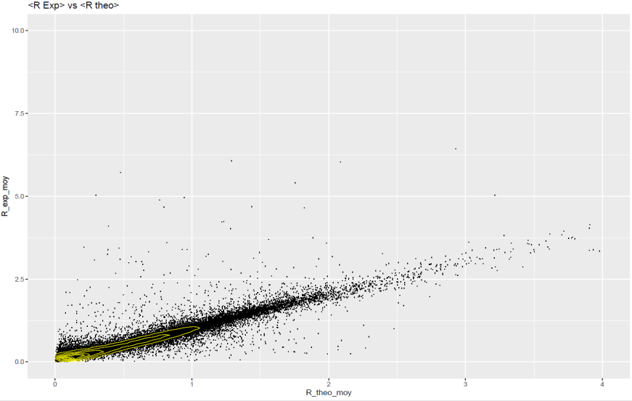
A view Exp. vs Theo. Ri…
8755972 MS²
26800 peptides
R² = 0.069
IFS = 0.03
R² = 0.08
IFS = 0.04
2709529 MS²
12052 peptides
R² = 0.96
IFS = 1.43
R² = 0.95
IFS = 1.35
Journée Club Jeune FPS – Bordeaux, 25-27/04/2022

Slide 25
A view Exp. vs Theo. Ri…
8755972 MS²
26800 peptides
R² = 0.069
IFS = 0.03
R² = 0.08
IFS = 0.04
2709529 MS²
12052 peptides
R² = 0.96
IFS = 1.43
R² = 0.95
IFS = 1.35
Journée Club Jeune FPS – Bordeaux, 25-27/04/2022

Slide 26
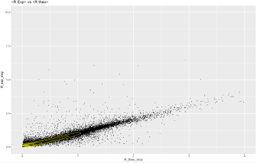
Post Acquisition Data Processing
Peptides isotopic
XIC profiles and Ratios
X!Tandem Pipeline
Raw files
X!Tandem search results
Multiple files protein inference,
Grouping and filtering
Protein turnover calculation
Protein Fold Change
(PFC)
Standard Averaged Ratio
Ratio modelling by
multiple regression
¹⁵N Labelled Protein Fraction (LPF)
Journée Club Jeune FPS – Bordeaux, 25-27/04/2022

Slide 27
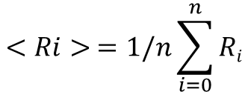
Post Acquisition Data Processing
Highly redundant peptide isotopic profiles
Multiple acquisitions (Triplicate at least)
Multiple Rt (10-30 s peptide elution)
Multiple z (2+,3+…)
Standard Averaged Ratio
Ratio modelling by
multiple regression
$$<Ri> =1/n\sum_{i=0}^{n}{Ri}$$
log(R_{ijk}) = isotope_{i} + MSrun_{j} + RT_{k} + ε_{ijk}
isotope_{i}: isotope i fixed effect
MSrun_{j}: MS run j fixed effect
RT_{k}: = retention time random effect
ε_{ijk}: residual
(NB & SD add.)
1 isotopic distribution per non-redundant peptide
Journée Club Jeune FPS – Bordeaux, 25-27/04/2022

Slide 28
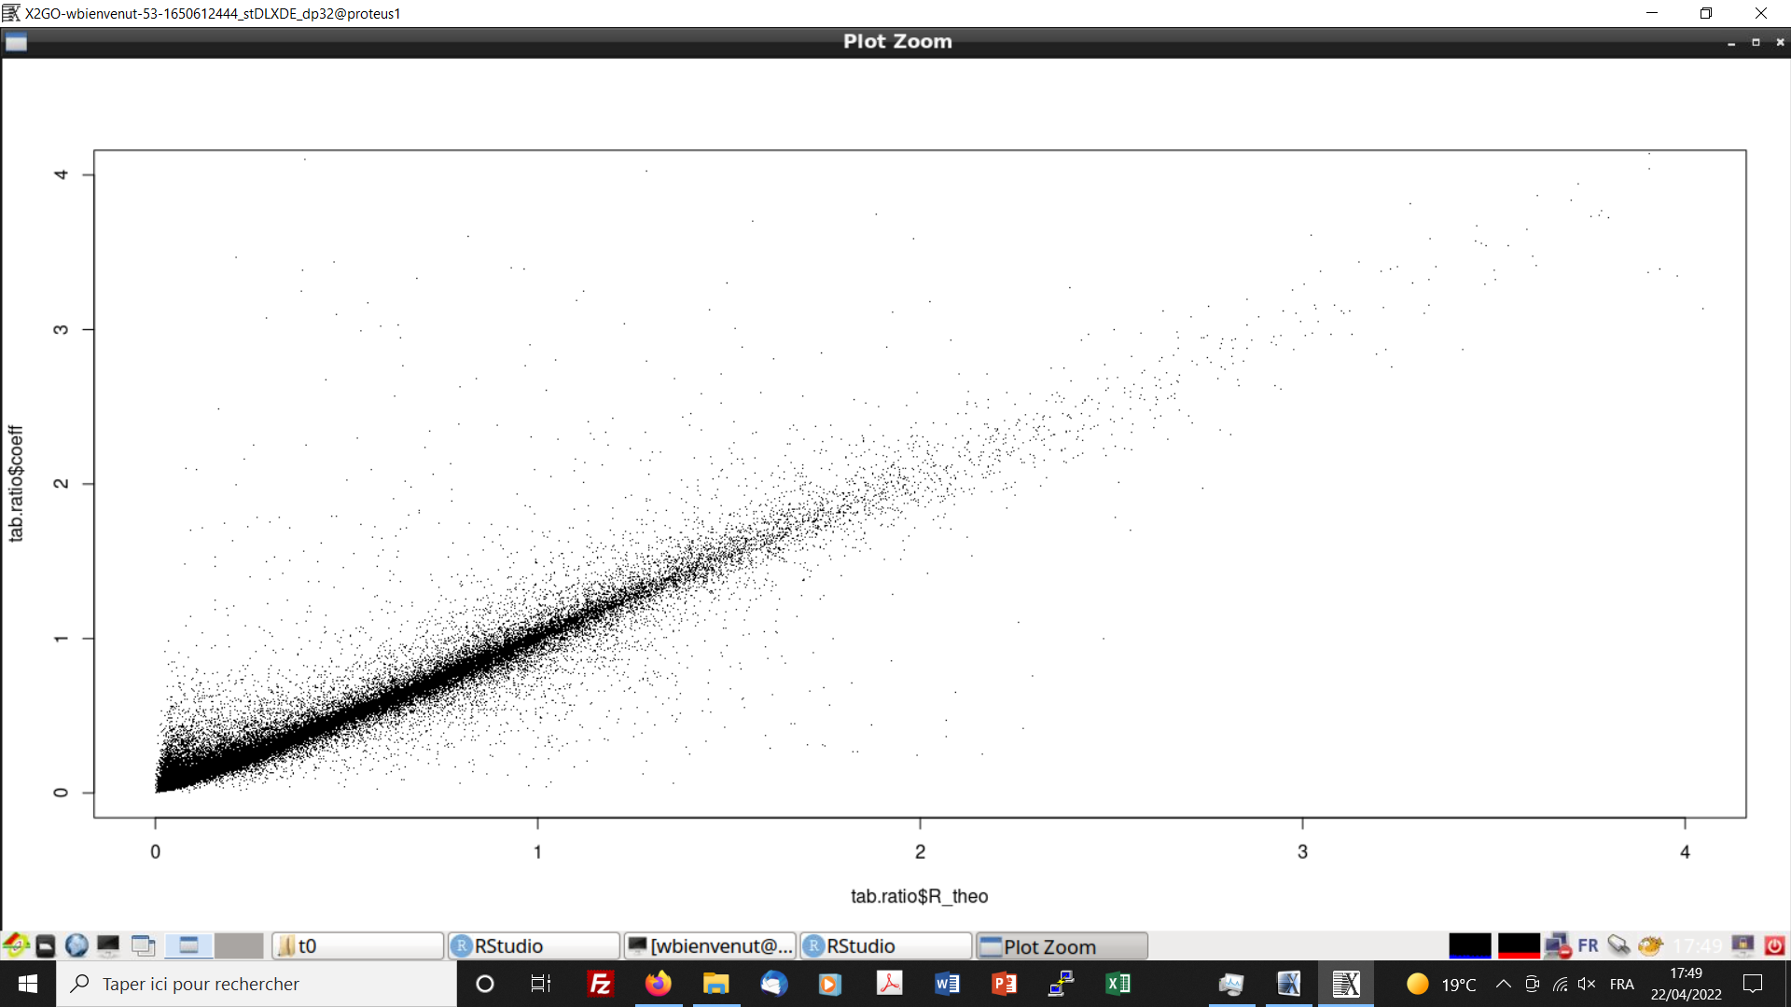
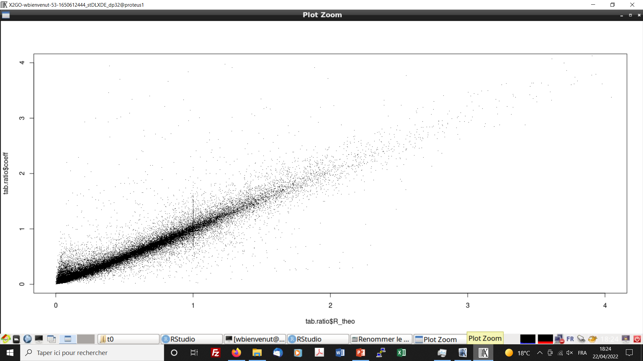
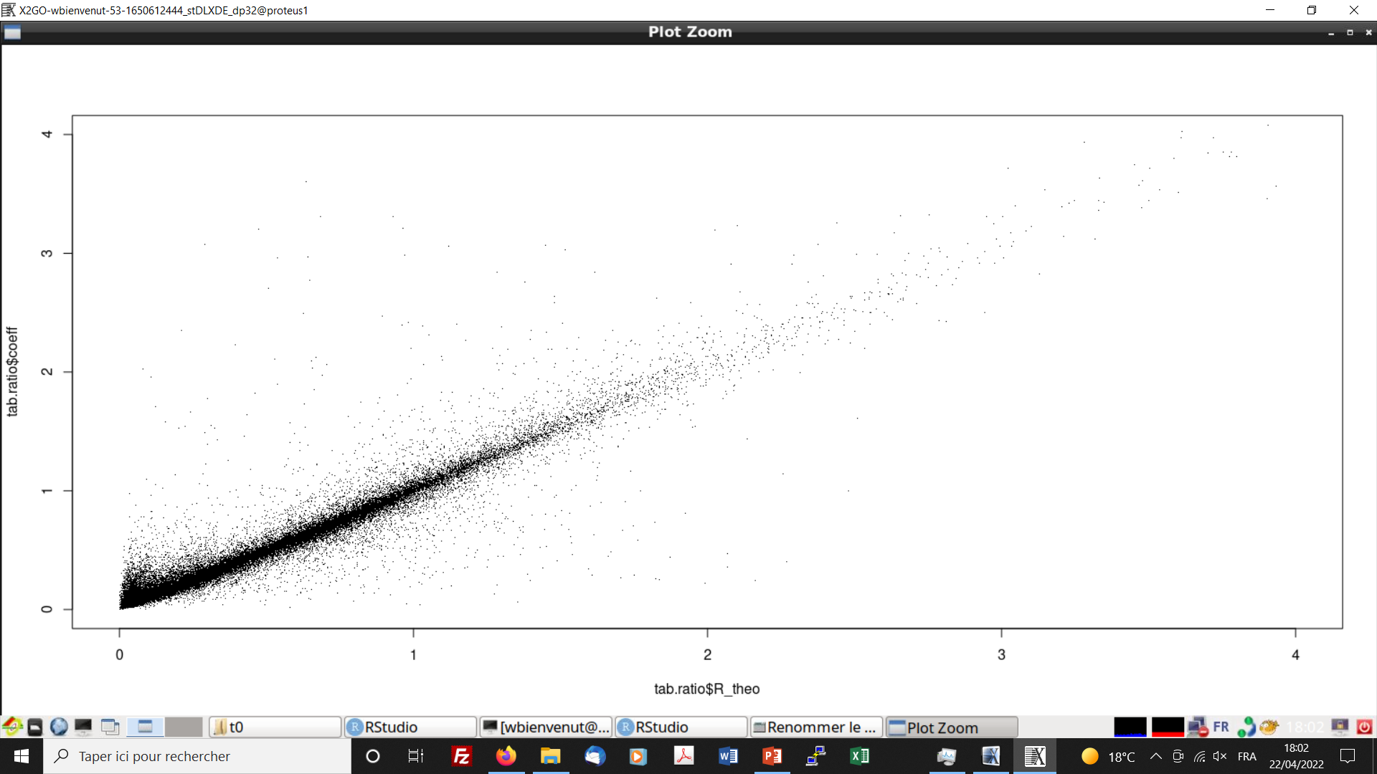
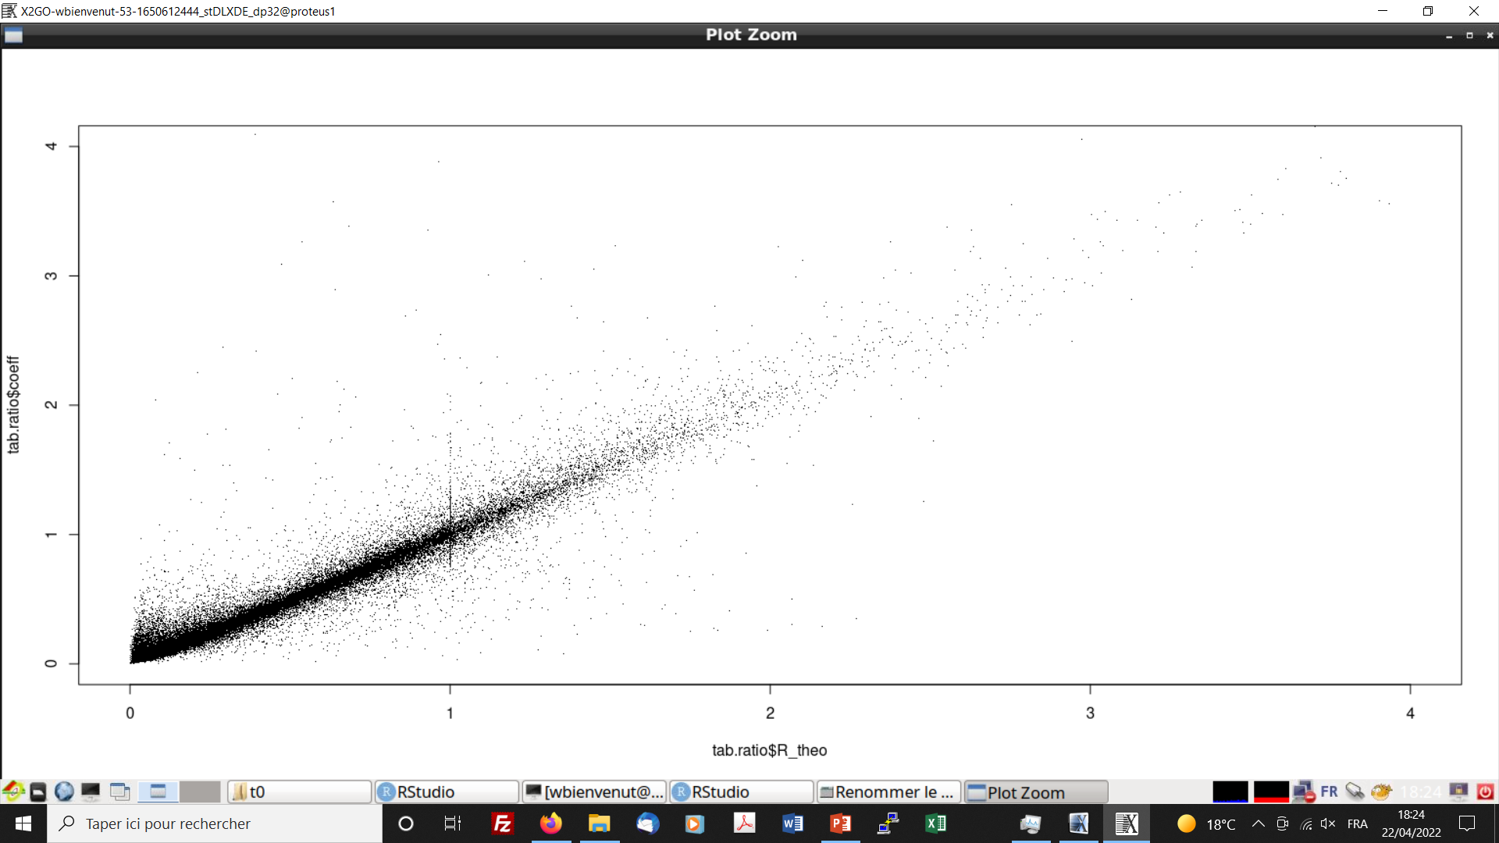
Managing the isotopic distribution
Standard Averaged Ratios
Ratios modelling by
multiple regression
MS Corr.
> 0.8 ± 1 SD
R² = 0.96
IFS = 1.35
R² = 0.95
IFS = 1.33
Spectrum Corr.
R² = 0.97
IFS = 1.38
MS Corr.
> 0.9 ± 2 SD
R² = 0.97
IFS = 1.47
Journée Club Jeune FPS – Bordeaux, 25-27/04/2022

Slide 29
Post Acquisition Data Processing
Peptides isotopic
XIC profiles and Ratios
X!Tandem Pipeline
Raw files
X!Tandem search results
Multiple files protein inference,
Grouping and filtering
Exports of the PeptIDs list
IsoSpec.py
Theoretical isotopic distribution calculation for different ¹⁵N rates
Protein turnover calculation
Protein Fold Change
(PFC)
peptide “modelled” ratios
¹⁵N Labelled Protein Fraction (LPF)
Estimation of the ¹⁵N incorporation
Journée Club Jeune FPS – Bordeaux, 25-27/04/2022

Slide 30
¹⁵N rate: an iterative approach
IsoSpec.py
Theoretical isotopic distribution calculation for different ¹⁵N rates
Exports of the PeptIDs list
R² = 0.97
IFS = 1.47
IFS
Slope
Intercept
Estimation of the ¹⁵N incorporation
<¹⁵N rate> =
0.35% ± 0.53%
n=10245
Journée Club Jeune FPS – Bordeaux, 25-27/04/2022

Slide 31
Filtering the ¹⁵N rate
Slope & Intercept = Av ± 2*SD
<¹⁵N rate> =
0.37% ± 0.27%
n=7945
R² >= 0.99
IFS >=2
Slope = 0.98 ± 0.27
Intercept= 0.021 ± 0.24
Ctrl sample
Journée Club Jeune FPS – Bordeaux, 25-27/04/2022

Slide 32
¹⁵N rate evolution
Ctrl sample
¹⁵N Metabolic labelling
Ctrl t₀
¹⁵N t₁
¹⁵N t₂
¹⁵N t₃
¹⁵N t₄
<¹⁵N > = 0.37% ± 0.27%
n=7945
<¹⁵N > = 0.53% ± 0.55%
n=8690
<¹⁵N > = 1.35% ± 0.84%
n=7265
<¹⁵N > = 1.95% ± 0.95%
n=7712
<¹⁵N > = 2.06% ± 0.80%
n=7552
Journée Club Jeune FPS – Bordeaux, 25-27/04/2022

Slide 33
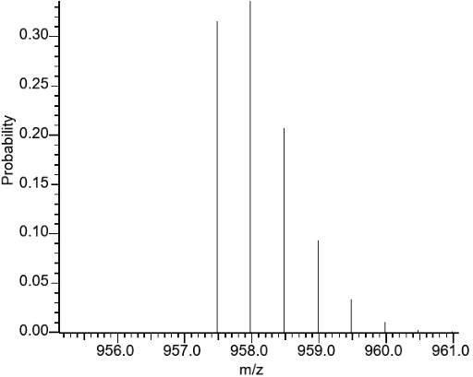
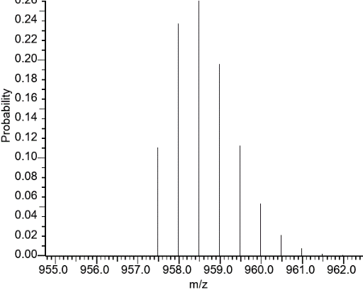
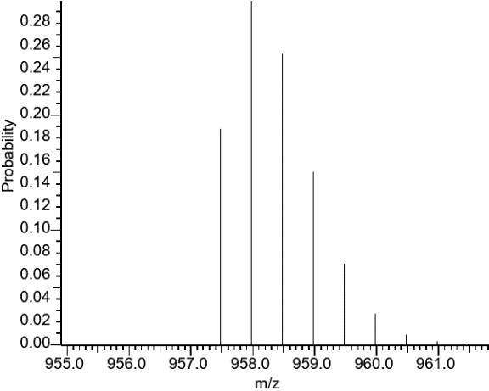
Apparent ¹⁵N rate to LPF
0.368% ¹⁵N
5%% ¹⁵N
Signal sum (1/1)
+
=
LPF = [labelled] / ([initial] + [labelled])
Theoretical (2.68 %)
([initial] + [labelled] = 1
¹⁵N_{App} = (¹⁵N_{Nat} x [initial] + ¹⁵N_{Max}x [labelled]) / ([initial] + [labelled])
[labelled] = (¹⁵N_{App}-¹⁵N_{Nat})/(¹⁵N_{Max} – ¹⁵N_{Nat}) = LPF
Journée Club Jeune FPS – Bordeaux, 25-27/04/2022

Slide 34
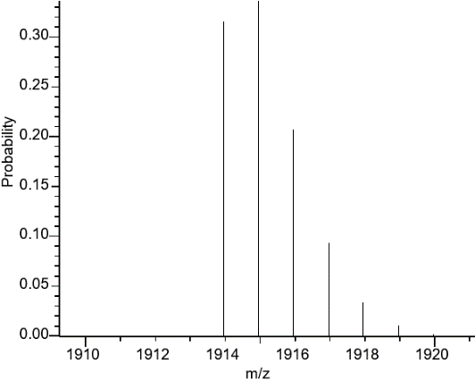

The isotopic addition and subtraction
Theoretical
0.368% ¹⁵N
5%% ¹⁵N
+
=
Journée Club Jeune FPS – Bordeaux, 25-27/04/2022

Slide 35
“Gold standard” measurement
Journée Club Jeune FPS – Bordeaux, 25-27/04/2022

Slide 36
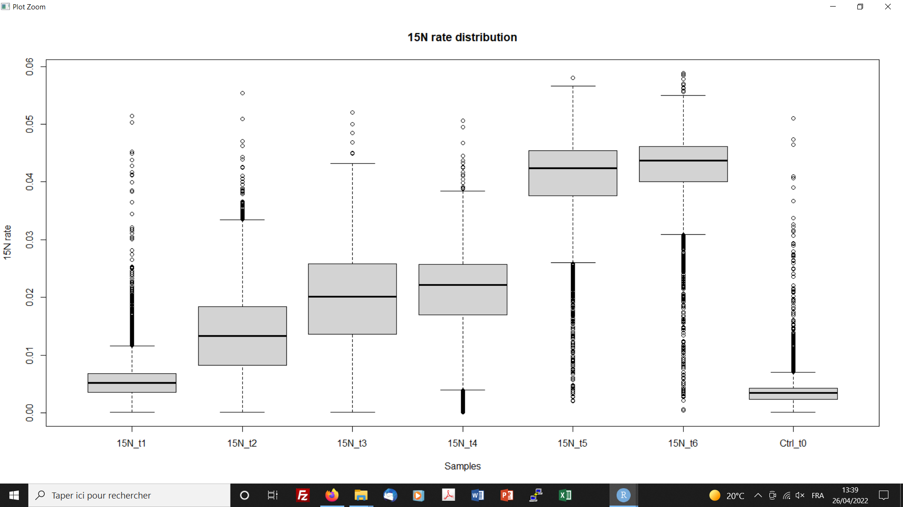
Journée Club Jeune FPS – Bordeaux, 25-27/04/2022

Slide 37
Post Acquisition Data Processing
Peptides isotopic
XIC profiles and Ratios
X!Tandem Pipeline
Raw files
X!Tandem search results
Multiple files protein inference,
Grouping and filtering
Exports of the PeptIDs list
IsoSpec.py
Theoretical isotopic distribution calculation for different ¹⁵N rates
Protein turnover calculation
Protein Fold Change
(PFC)
peptide “modelled” ratios
¹⁵N Labelled Protein Fraction (LPF)
Conversion of ¹⁵N apparent rate in LPF
Estimation of the ¹⁵N incorporation
Journée Club Jeune FPS – Bordeaux, 25-27/04/2022

Slide 38
MCQR
A set of objects and functions for R
to handle MassChroQ results:
  Label free quantitation
  Developed for natural isotopic abundance!
Requires some adaptations
  Isotope selection
  Fine tuning…
Journée Club Jeune FPS – Bordeaux, 25-27/04/2022

Slide 39
Under development
Presently:
  Selected isotope: Max Ri (Alt. Mono-I, I₁…)
  Few processing validation statistical tests
Requires some adaptations
  Isotope selection (0-6…)
  Testing statistical tests
  Fine tuning…
Journée Club Jeune FPS – Bordeaux, 25-27/04/2022

Slide 40
Post Acquisition Data Processing
Peptides isotopic
XIC profiles and Ratios
X!Tandem Pipeline
Raw files
X!Tandem search results
Multiple files protein inference,
Grouping and filtering
Exports of the PeptIDs list
MCQR
IsoSpec.py
Theoretical isotopic distribution calculation for different ¹⁵N rates
Protein turnover calculation
Protein Fold Change
(PFC)
peptide “modelled” ratios
¹⁵N Labelled Protein Fraction (LPF)
Conversion of ¹⁵N apparent rate in LPF
Estimation of the ¹⁵N incorporation
Journée Club Jeune FPS – Bordeaux, 25-27/04/2022
Journée Club Jeune FPS – Bordeaux, 25-27/04/2022

Slide 41
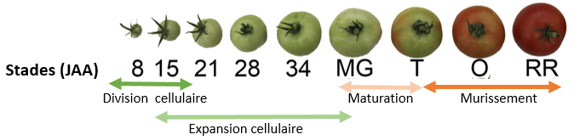
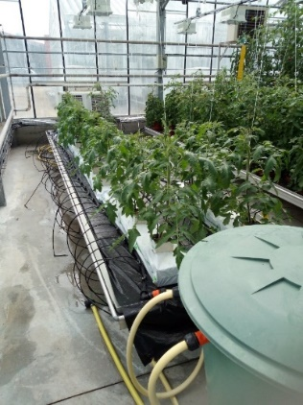
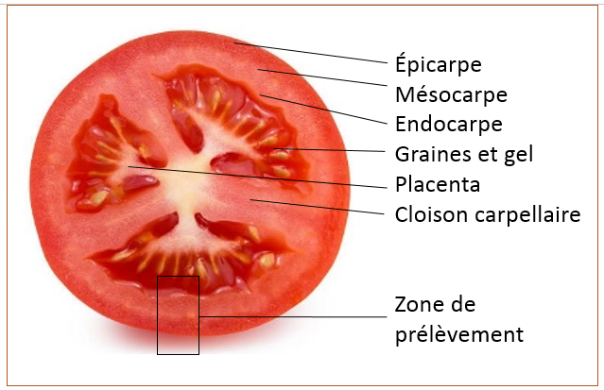
Application project: PROFER
Yellow & light blue: Fixe age fruits kinetics (12 & 26 days labelling)
Orange & dark blue: dynamic labelling kinetics from 8 to 19 days and et de 21 to 32 days.
Comparison « prediction model » vs. « experimental value » of the tomato proteins ½ life during fruit growth and maturation
Journée Club Jeune FPS – Bordeaux, 25-27/04/2022

Slide 42
Project status…
Reliable sample preparation with ¹⁵N metabolic labelling
Isotopes ratios:
  High peptide signal redundancy favor this approach
  But require strong data filtration and validation
LC-MS/MS instrument
  Q-Ex instrument signal is highly instable
  Signal improvement is required (new instrument investigated)
Strong Bioinformatics processing resources
On the way for realistic measurements with acceptable errors…
Journée Club Jeune FPS – Bordeaux, 25-27/04/2022

Slide 43
To conclude…
Low ¹⁵N metabolic labelling is compatible with:
  Peptide characterisation and protein identification
  Determination of the Protein Fold Change (MCQR)
Data post acquisition processing provides:
  Reliable experimental isotopic distributions
    Evaluate the ¹⁵N labelling rates
    Estimation of the Labelled Protein Fraction (LPF)
In progress:
  Improvement of the LPF accuracy
  R script package under development
Journée Club Jeune FPS – Bordeaux, 25-27/04/2022

Slide 44
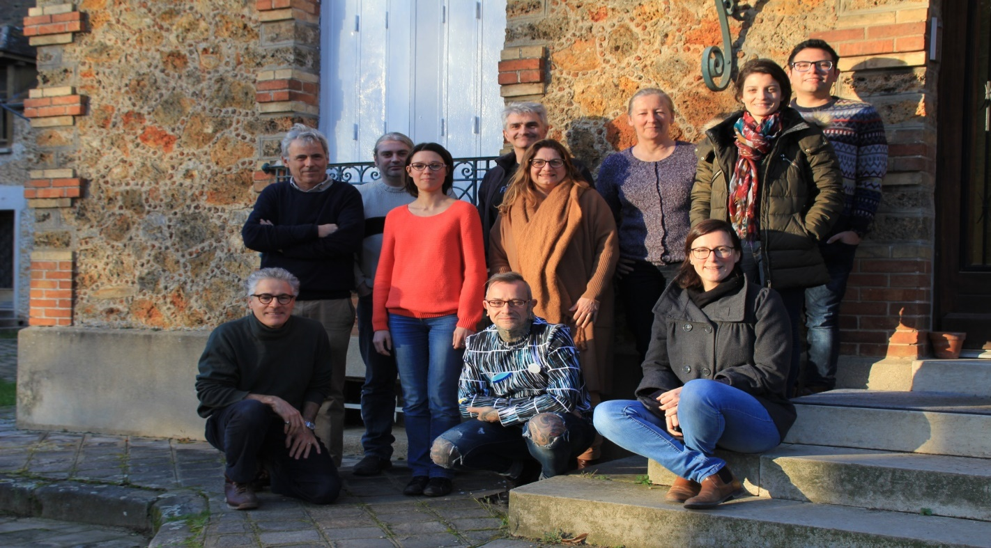
Acknowledgement's
Liam Le Goffic
Thomas Welfelé
Olivier Langella
Thierry Balliau
Filippo Rusconi,
Marlène Davanture,
Michel Zivy
Mélisande Blein-Nicolas
Collaboration with
C. Masclau-Daubresse & A. Marmagne
(IJPB, Versailles)
S. Colombié & Y. Gibon
(BFP, Bordeaux)
Journée Club Jeune FPS – Bordeaux, 25-27/04/2022

