Slide 1
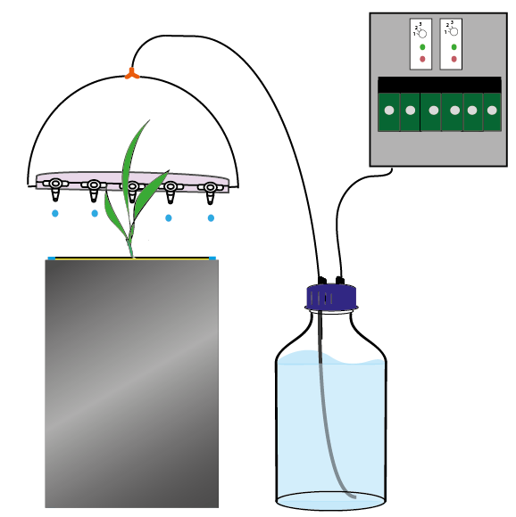
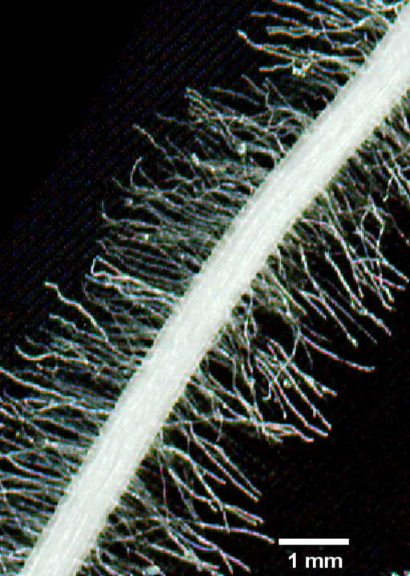
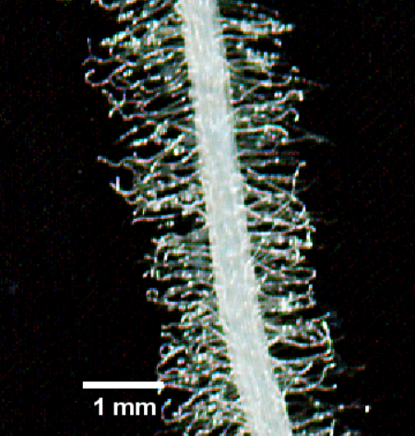
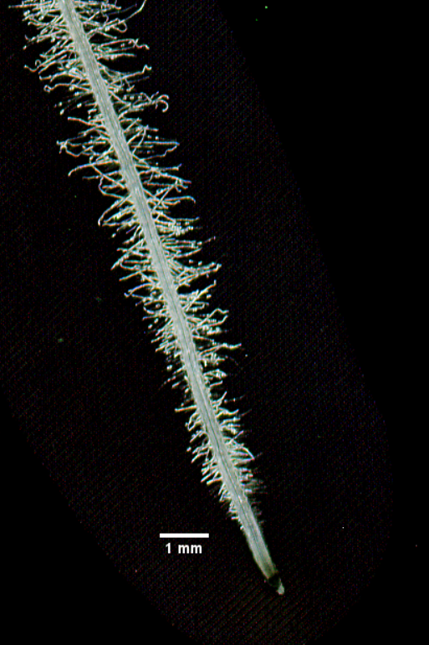
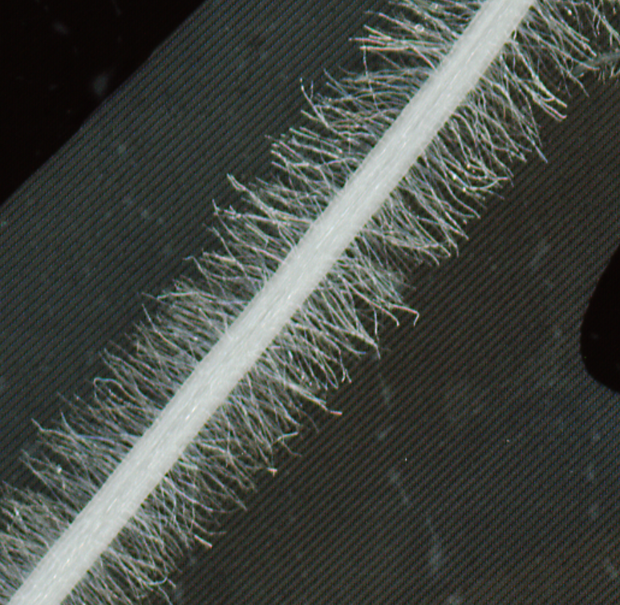
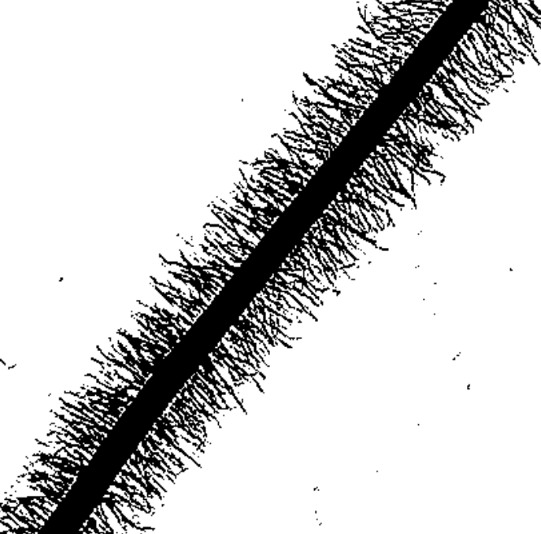
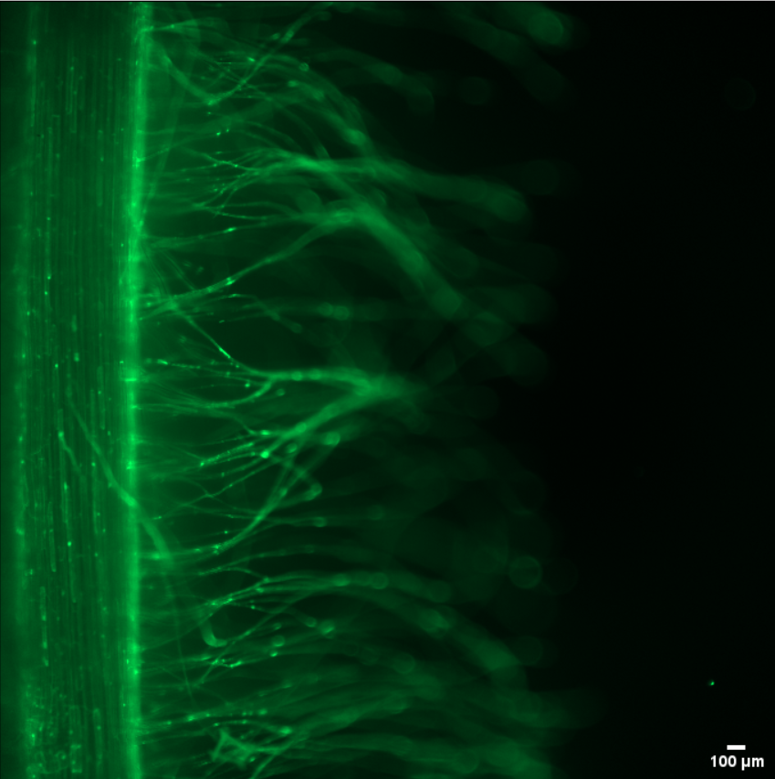
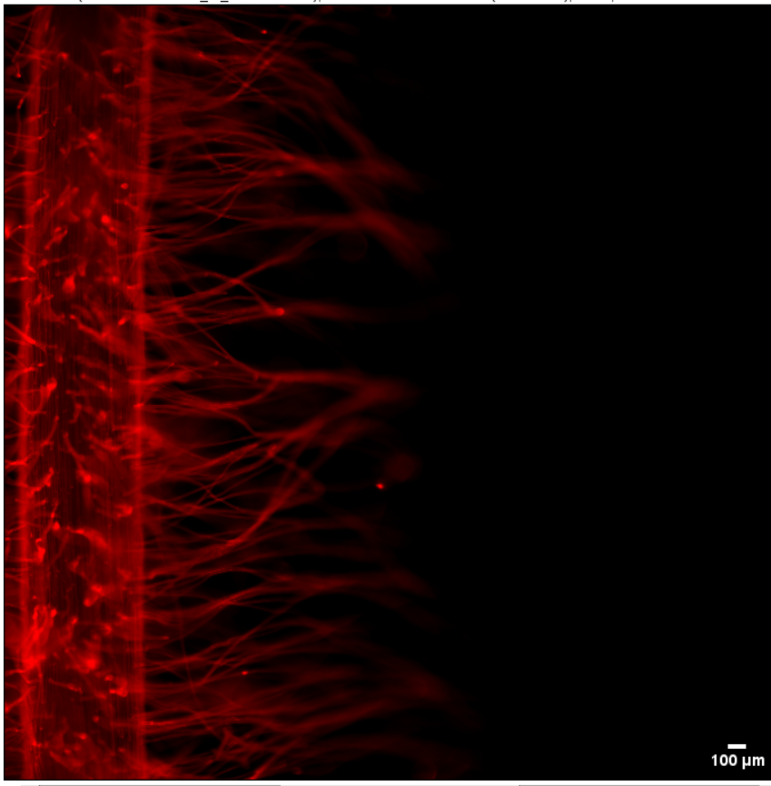
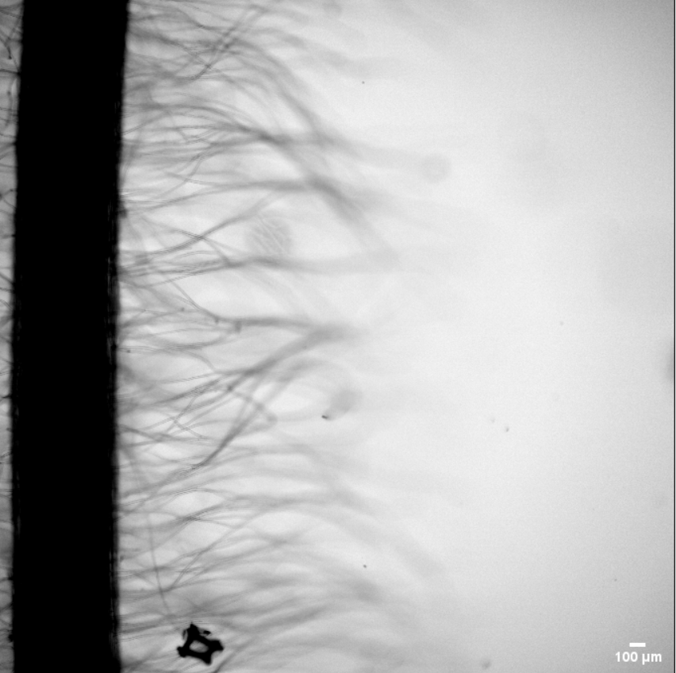
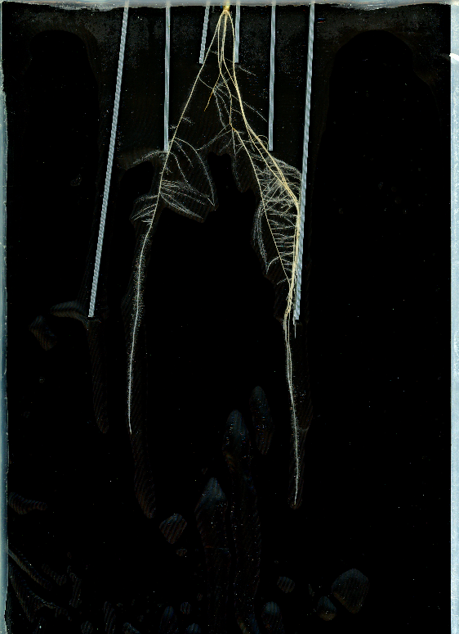
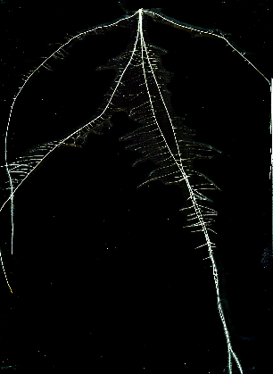
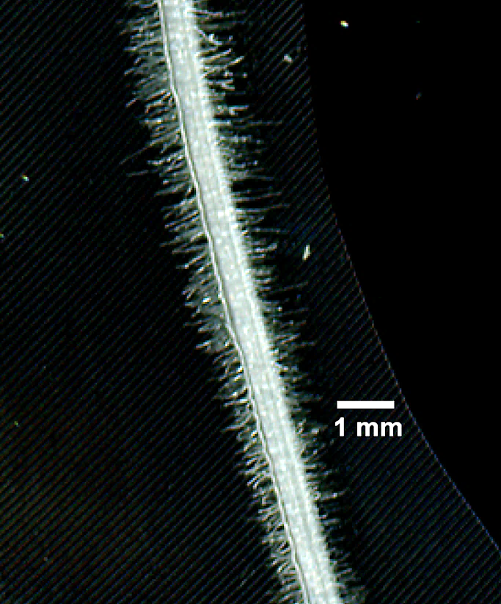
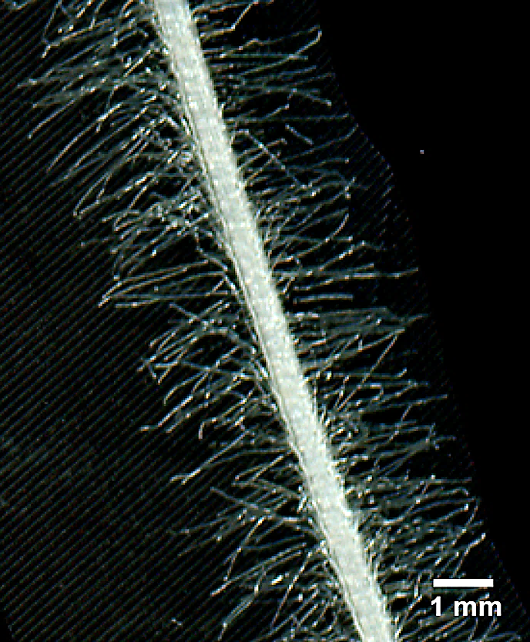




Plasticity of root and root hair development in response to nutrient deficiency among wheat genotypes
I. Madani¹, T. Rongsawat¹, A.A. Véry¹, H. Sentenac¹, J.B. Peltier¹
¹UMR B&PMP, CNRS-INRAE-Supagro-Univ Montpellier, 2 place Pierre Viala – 34060 Montpellier Cedex 2, France
²Montpellier Ressources Imagerie, BioCampus Montpellier, CNRS, INSERM, University of Montpellier
Introduction
Reducing the ecological costs of conventional agriculture, including fertilization and irrigation, is a major objective of research in plant science. High-throughput phenotyping of root traits as predictors of crop performance under limited water and nutrient availability are now available but these still often ignore root hairs (RHs), although these cells provide a major contribution to plant nutrient, water uptake and interactions with soil microbes. We developed a non-destructive procedure (based on a Rhizobox-type device) to phenotype wheat root hair development in whole root systems.
We used this system to phenotype the architectural traits of a landrace wheat variety Triticum turgidum ssp. durum cv. Oued Zenati and an ancestral wheat variety T. t. L. spp. dicoccum cv. Escandia and we performed an integrative analysis of the plasticity of root and root hair traits under low phosphorus availability
A rhizobox-type device providing high resolution images of root hairs ( Rh) on intact root systems
1- Root hair phenotyping system ( Rhizobox-like system)
2-Type of images obtained by the rhizobox
A Side view
4 (transparent: glass)
B Top view
C Irrigation device
Pressurized air
(0.6 bar )
A
A
B
5 (grey)
2 (black)
1 (yellow)
3 (blue)
4
Irrigation
controller
5
2
1
5
3
4
Solid polyurethane foam board (2) Black polyester fabric (3) U-shape aluminium sliding bar. (4) Glassplate (5) Polystyrene board (C) Watering system. Pressurized air (0.6 bar) moves the nutrient solution from a reservoir bottle to the rhizobox via a symmetrical circuit
Roots are scanned through transpalent glassplate
10 mm
Wheat seedling Oued Zenati grown for 14 days in a rhizobox and watered with complete hoagland solution.
Root and root hair image segmentation using the pixel-based trainable classifier Ilastik workflow.
Vital staining of root hair cells indicating that most cells were alive
Rhizobox for architectural traits phenotyping
3- Root and root hair images vital staining
4 - Differences in rhizobox occupancy between wheat genotypes
5 - Response to a physical constraint imposing vertical growth to seminal roots
A
B
C
A
Rhizobox width: 21 cm
B
C
A
B
C
D
central zone: 10 cm
*
***
(A) the FDA staining of RHs. (B) IP staining of RHs. (C) bright field image of RH. Pieces of fabric on which root regions harboring root hairs were present were carefully excised (without moving the root segment at the surface of the fabric to prevent root hair damages) and directly transferred into dual-labeling solution containing. Fluorescent di-acetate (FDA) and Propidium iodide (PI).Green staining is indicative of living cell. Red nuclei staining (white arrows) indicates dead cells.
+
Central
Lateral
Central
Lateral
Oued
Escandia
We introduced Plastic jumpers of different length in the rhizoboxes between the fabric and the glass plates to impose vertical growth for the seminal roots. (A) and (B) Representative images of the root system of a Oued and (C) and (D) of Escandia. (A) & (C) : control without plastic jumpers. (B) & (D): presence of plastic jumpers. Escandia showed a strong reorientation capacity toward a horizontal growth when the vertical constraint ceases.
Distal zones
Oued
Escandia
Procedure used to analyze rhizobox occupancy by the root system. The rhizobox area is vertically divided into a 10 cm wide "central" zone and 2 lateral zones (considered as a single zone of 11 cm width in total).
Integrative analysis of the plasticity of root and root hair traits reveal differences between the 2 wheat accessions in low phosphorus condition
6- Effect of Low P on root and shoot biomass and root and root hair surface area
7 -Effects of low P on root hair elongation and density
Conclusion and perspectives
A
B
*
C
**
Sem
C
A
a
B
a
The developed methodology allowed to reveal differences between root architectural traits of the two accessions, and their responses to phosphorus starvation.
Such analyses pave the way to comparison of wheat genotypes that recapitulate wheat domestication in different abiotic conditions (nutrient availability) and in presence or absence of PGPR bacteria.
*
***
Oued
LP
b
a
Lat
C
c
a
LP
a
a
C
LP
C
LP
C
LP
C
LP
C
LP
C
LP
Sem
C
a
a
Oued
Escandia
Oued
Escandia
Oued
Escandia
Escandia
LP
b
a
Pi shortage affected plant growth (biomass production), leading to a strong increase in the root to shoot biomass ratio in both accessions
Lat
C
c
b
LP
0
d
a
D
*
E
F
0.5
1
1.5
2
Root hair density
(RH pixel density in %)
*
*
*
***
Root hair sheath width (mm)
Total Root area (cm²)
Root hair area (cm²)
***
Ratio (%)
Pi deficiency increased both root hair length and root hair density. the most prominent effect being on root hair length.
C
LP
C
LP
C
LP
C
LP
C
LP
C
LP
A
B
Oued
Escandia
Oued
Escandia
Oued
Escandia
Acknowledgement:
Pi shortage resulted in an increase in total root area (root skeleton +RHs) mainly due to a large increase in RH area. The RH contribution to the increase in total root area upon Pi deficiency was especially significant in Escandia seedlings, the ratio of root hair area to total root area being increased by more than two times (from less than 15% to more than 30%) in this wheat accession upon Pi deficiency
This work was supported by the Algerian Ministry of High Education and Scientific Research through the funding of the PhD of Ikram MADANI
1 mm
Representative images of root segment with root hairs
in control condition (A) and Low P (B)

