Slide 1
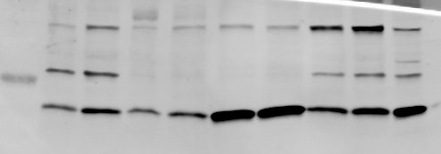

HNE differentiated
HEK-293 + PRAF2-V5
+ CFTR
HBE
CFBE41o-
MW kDa
WT#1
WT#2
F508del
3130delA
WT
F508del
WT
F508del
WT
PRAF2
15
55
Tubulin
4
3
PRAF2 / Tubulin
2
1
0
Supplementary Fig. 1. PRAF2 is expressed both in primary nasal epithelial cells from CF patients and controls and in cell lines.
Top. Fifty µg protein of the indicated cell extracts were separated on SDS-PAGE, blotted and probed with anti-PRAF2 or anti-tubulin (loading control) antibodies. The specificity of the PRAF2 antibody used in this experiment was reported previously (see Ref 11). Human nasal epithelial cells (HNE) from normal (WT) or homozygous CF patients with the indicated mutations were differentiated in vitro (as described in Methods). 3130delA: deletion of A at 3130 with frame shift. HBE: human bronchiolar epithelial cell lines expressing exogenous WT or F508del CFTR. CFBE41o- cells: a human bronchial epithelial cell line derived from a CF patient, homozygous for CFTR-F508del, expressing minimal amounts of the mutated channel. These cells were reconstituted with CFTR-WT. HEK-293 cells expressing exogenous WT or F508del CFTR and epitope-tagged PRAF2 (HEK-293 + PRAF2-V5 + CFTR) were used as positive control. Bottom. The level of total PRAF2 expression in the various extracts was compared after normalization with tubulin level.

Slide 2
Supplementary Fig. 2. CFTR CO-IP by endogenous PRAF2 in CFBE41o- cells
Whole cell lysates were prepared from parental CFBE41o- cells (expressing minimal concentrations of endogenous CFTR-F508del) or CFBE41o-CFTR-F508del expressing the exogenous mutant CFTR, and immunoprecipitated with a polyclonal PRAF2 antibody against endogenous PRAF2 (see Methods). Immunoprecipitated and total proteins are detected by anti-CFTR, anti-vinculin and anti-PRAF2 antibodies. IB: Immunoblot. Arrowhead indicates Band B (core-glycosylated CFTR-F508del).

Slide 3
a
b
Supplementary Fig. 3. PRAF2 retains both CFTR WT and CFTR F508del
(a) CFBE parental cells were transfected with the indicated plasmids and CFTR F508del was rescued by the treatment with VX-809. Whole cell lysates were separated by PAGE, blotted, and membranes were probed with anti-CFTR, anti-tubulin and anti-V5 antibodies. The ER-core glycosylated CFTR, referred to as band B, and the Golgi- glycosylated CFTR, referred to as band C, are indicated by the arrows. IB: Immunoblot. UT: untransfected (b) Quantification of band C; the % band C versus the total (B+C) was first determined for each condition. Mean±SEM; n=3; ****p<0.0001; **p=0.005; *p=0.016; ns=not significant; one way ANOVA followed by Sidak’s multiple comparison test.

Slide 4
a
CFTR-WT
R555K, LL435-436AA
CFTR-F508del
R555K, LL435-436AA
b
MW
kDa
CFTR-WT
CFTR-F508del
UT
IB
CFTR
vinculin
Band C
Band B
Supplementary Fig. 4. Targeting the ₅₅₃RXR₅₅₅ arginine-framed retention signal partially rescues CFTR-F508del in CFBE cells
a) CFBE41o- cells were transfected with plasmids for CFTRWT, CFTR-F508del or the indicated mutants. Cell lysates were processed for immunoblots and probed with anti-CFTR and anti vinculin (loading control) antibodies. b) Quantification of band C; the % band C versus the total (B+C) was determined for each condition. Mean±SEM; n=3; ****p<0.0001 one way ANOVA followed by Sidak’s multiple comparison test ns= not significant. UT: untransfected.

Slide 5
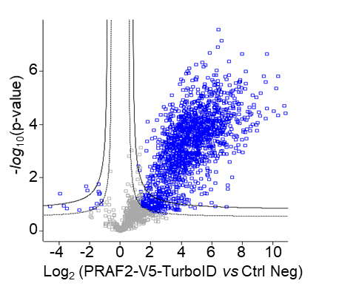
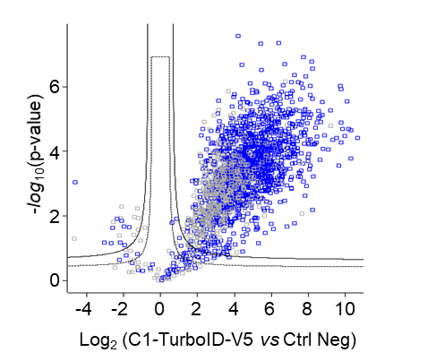
a
C1-TurboID-V5
PRAF2-V5-TurboID
C1-TurboID-V5
PRAF2-V5-TurboID
MW kDa
PRAF2-V5
MW kDa
PRAF2-V5
130-
130-
100-
100-
55-
55-
35-
35-
15-
15-
PRAF2-V5
C1-TurboID-V5
Anti-V5
Streptavidin-HRP
PRAF2-V5-TurboID
b
Enriched in PRAF2-V5-TurboID
Metabolism of RNA
Translation
Metabolism of proteins
Vesicle-mediated transport
Membrane trafficking
Infectious disease
0
10
20
30
40
50
60
70
-log (q value)
c
Enriched in C1-TurboID-V5
Metabolism of RNA
Metabolism of proteins
Translation
Infectious disease
Membrane trafficking
Vesicle-mediated transport
0
10
20
30
40
50
60
70
-log (q value)
Supplementary Fig. 5. Comparison of proteins enriched in the proximity assays with PRAF2-V5-TurboID and C1-TurboID-V5. a) Left panel: comparison of the expression level of the used constructs in HEK-293 cells; Middle panel: Streptavidin-HRP labeling of the cell lysates expressing the indicated constructs. Right panel: total number of protein labeled in each condition b,c) Volcano plot showing significantly enriched proteins in PRAF2-V5-TurboID (B, 1613 proteins in blue) and C1-TurboID-V5 (C, 1766 proteins) compared to untagged PRAF2 (Ctrl Neg). These proteins were enriched (reactome pathways) in the indicated “biological processes”. Shown are q-values, corresponding to p values corrected for multiple testing within each category.

Slide 6
Supplementary Fig. 6: Absence of VX-445 effect on BRET between GB1-Rluc and PRAF2-YFP. The GB1 subunit of the GABA_{B} receptor is retained in the ER by PRAF2 in the absence of the GB2 subunit. Previous studies demonstrated the proximity of these proteins in saturation BRET experiments [Doly S, Shirvani H, Gäta G, Meye FJ, Emerit MB, Enslen H, Achour L, Pardo-Lopez L, Yang SK, Armand V, Gardette R, Giros Bet al (2016) GABAB receptor cell surface export is controlled by an endoplasmic reticulum gatekeeper Mol Psychiatry 21: 480-490.] Preincubation of cells with VX-445 did not change significantly BRET_{max} and BRET₅₀ values (862±37 and 3.08±0.58, respectively, for control DMSO; 814±31 and 2.83±0.41respectively, for VX-445). The selectivity of VX-445 for CFTR confirms that VX-445 interacts with the transporter rather than with PRAF2.

Slide 7
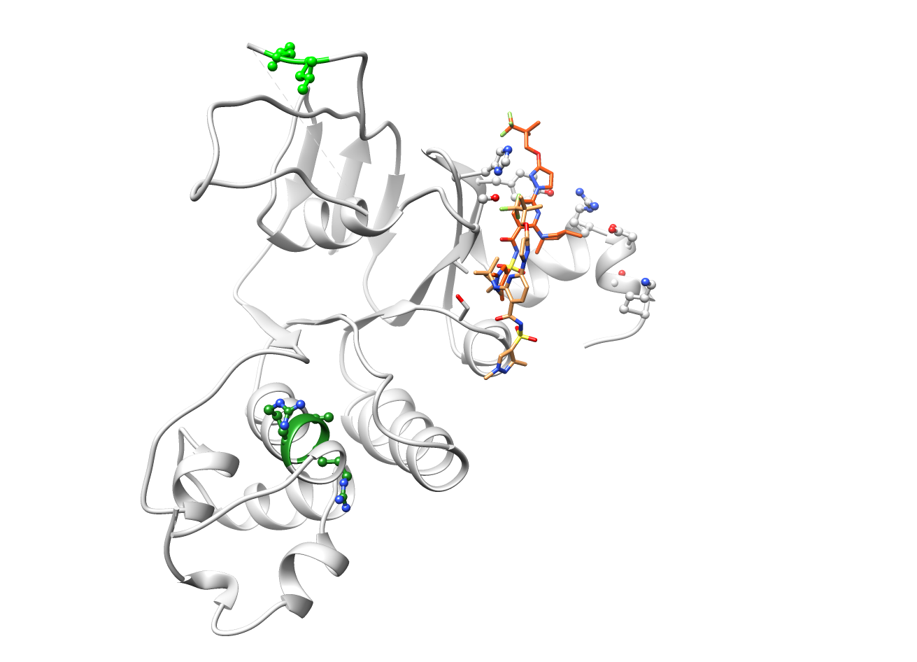
Supplementary Fig. 7: VX-445 binding site on NBD1 relatively to the RXR and LL motifs involved in the interaction with PRAF2.
The position of VX-445 within its proposed NBD1 binding site [Baatallah N, Elbahnsi A, Mornon JP, Chevalier B, Pranke I, Servel N, Zelli R, Décout JL, Edelman A, Sermet-Gaudelus I, Callebaut I, Hinzpeter A (2021) Pharmacological chaperones improve intra-domain stability and inter-domain assembly via distinct binding sites to rescue misfolded CFTR. Cell Mol Life Sci 78: 7813-7829] is shown. RXR and LL motifs are in green. These motifs are relatively distant from the drug binding site, suggesting a possible allosteric inhibiting effect of VX-445 on PRAF2 – NBD1 interaction.

