Slide 1
a
b
c
d
e
f
****
****
Figure 1

Slide 2
a
b
c
d
e
f
ER lumen
PRAF2-V5
Flag-C1-NBD1
Figure 2

Slide 3
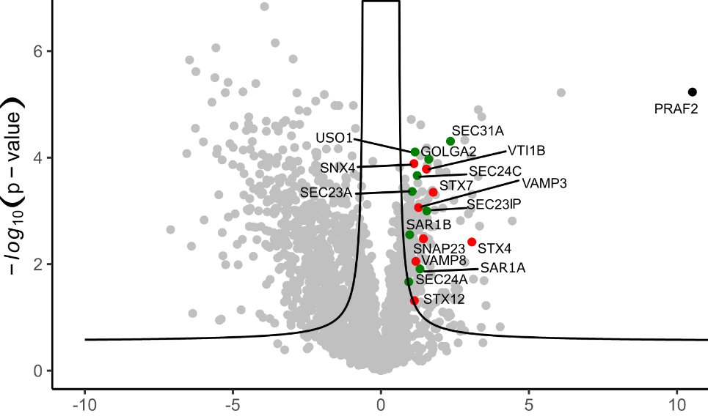
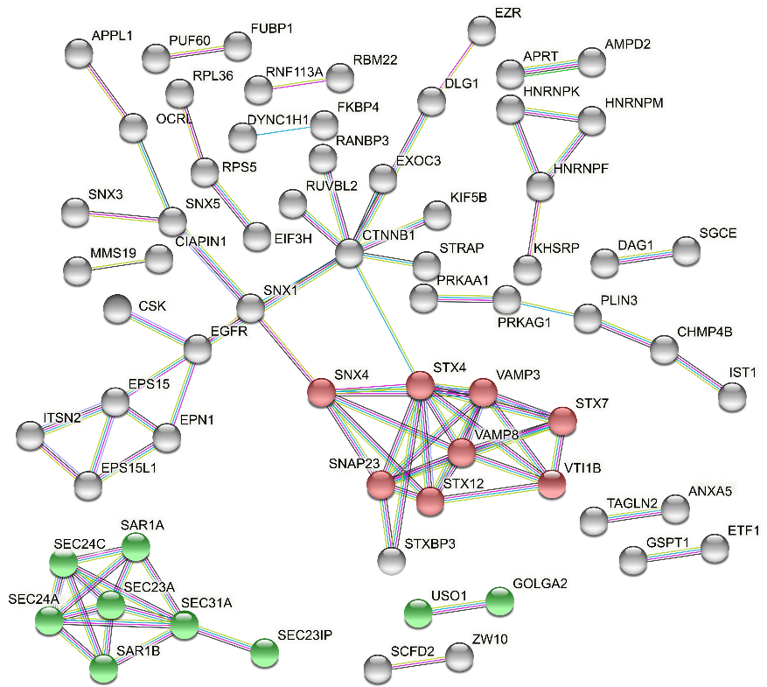
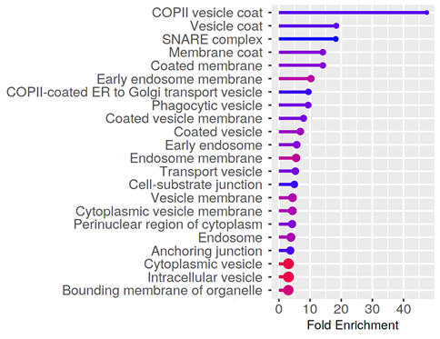
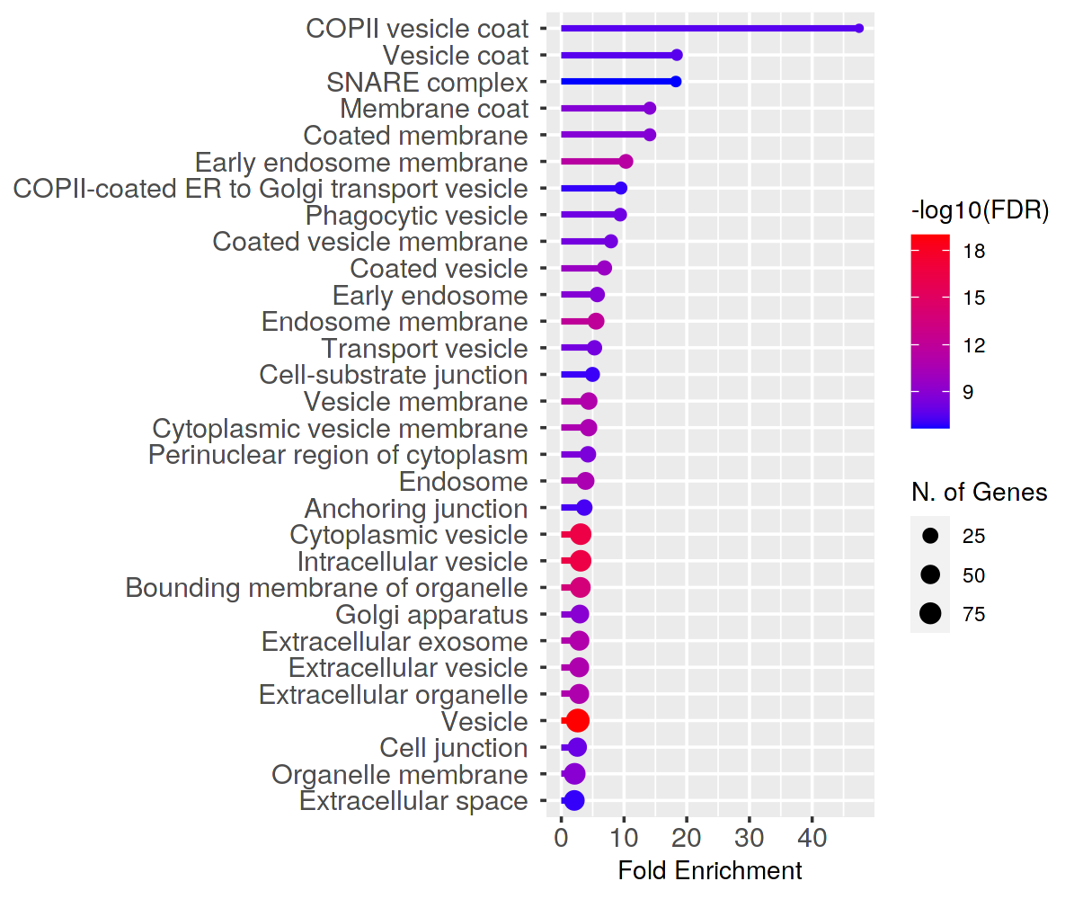
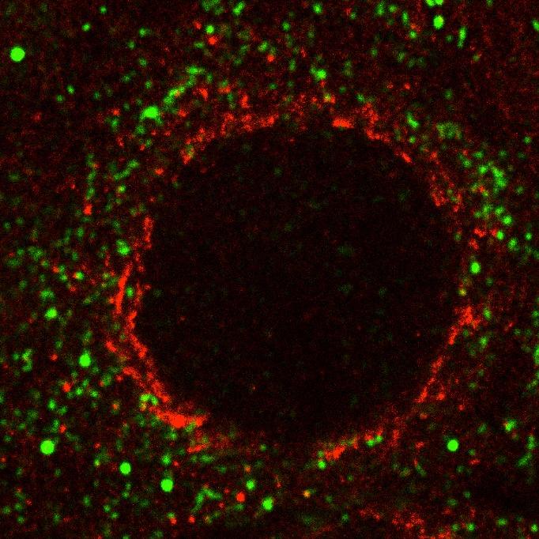
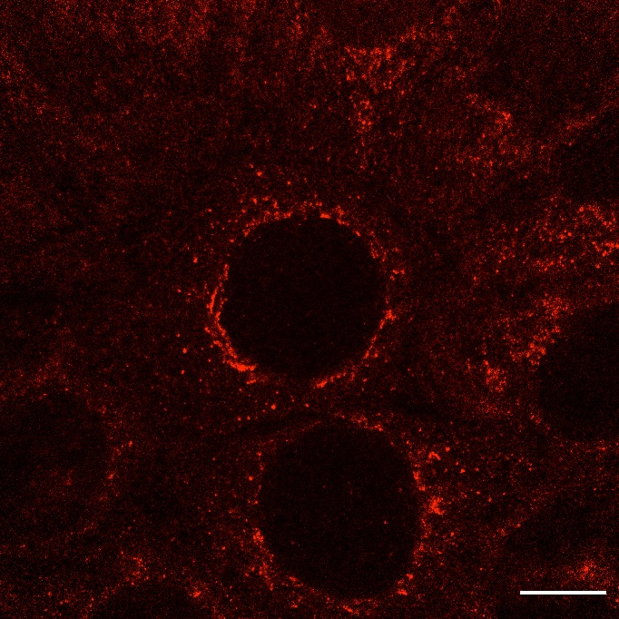
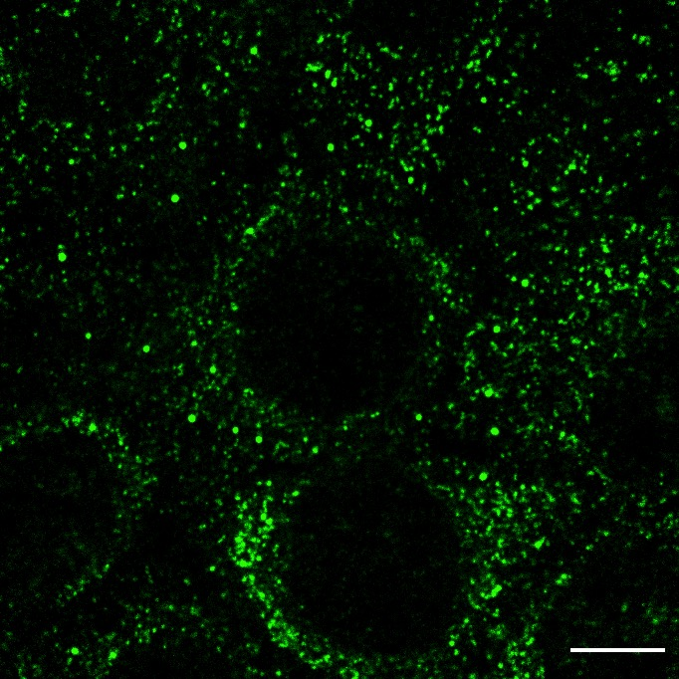
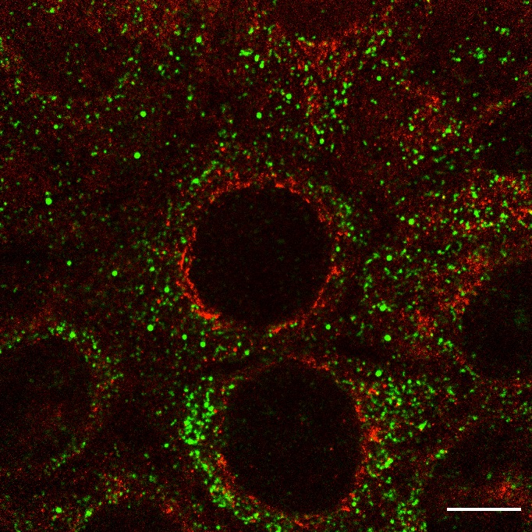
a
b
N-
TurboID
C1
V5
N-
V5
PRAF2
N-
PRAF2
V5
TurboID
nucleus
ER
ERES
Log₂ (PRAF2-V5-TurboID vs C1-TurboID-V5)
c
GO : Cellular Component
d
COPII vesicle coat
SNARE complex
COPII-coated ER to Golgi transport vesicle
e
PRAF2
Sec31
Merge
Figure 3

Slide 4
a
b
c
Figure 4

Slide 5
a
b
c
d
e
Figure 5

Slide 6
a
b
c
MW kDa
Figure 6

Slide 7
a
b
c
d
CFTR-WT
e
CFTR-F508del
Figure 7

