Slide 1

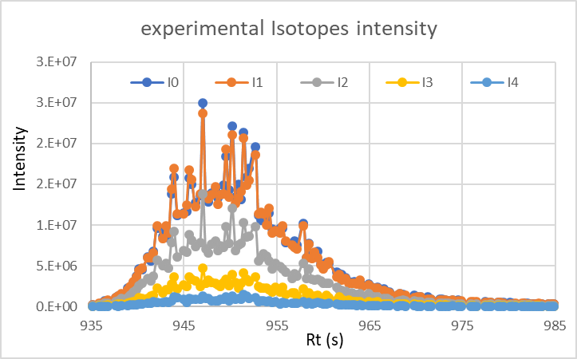
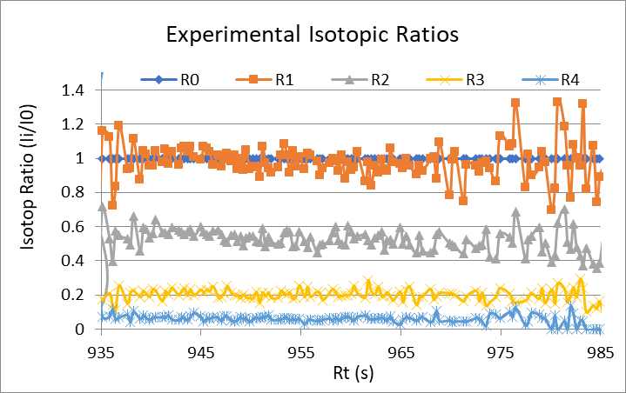
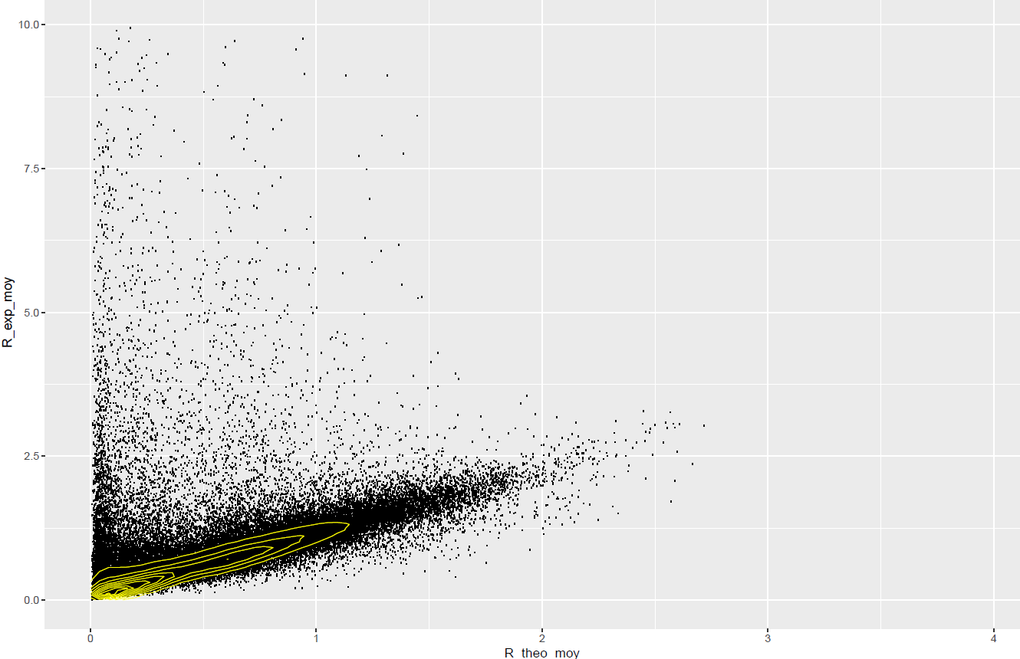
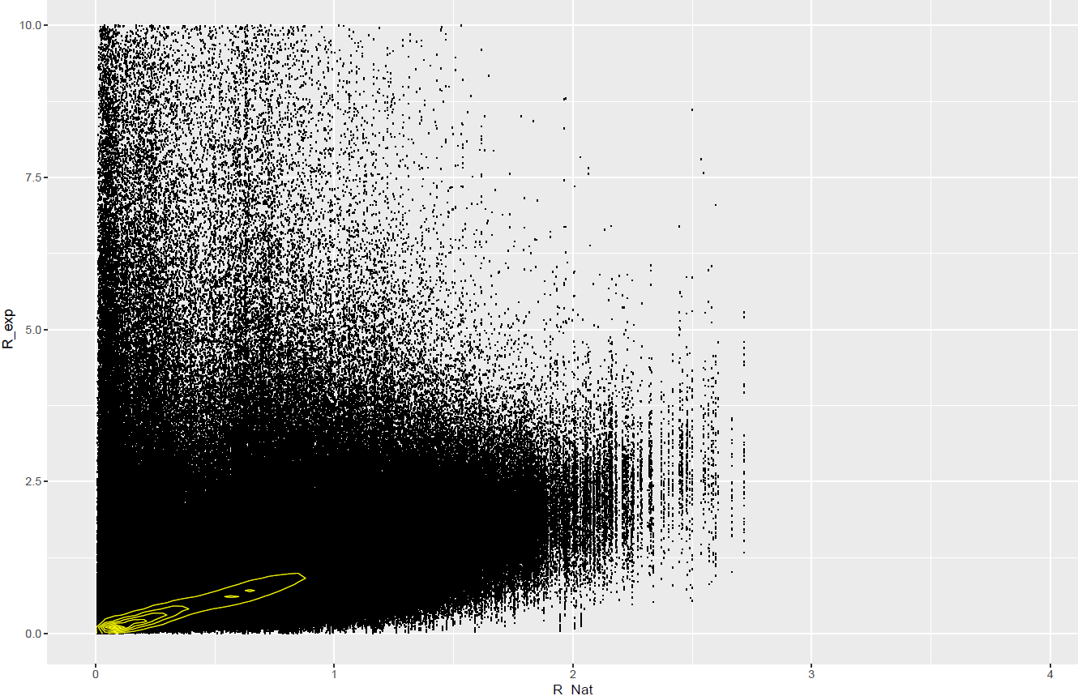
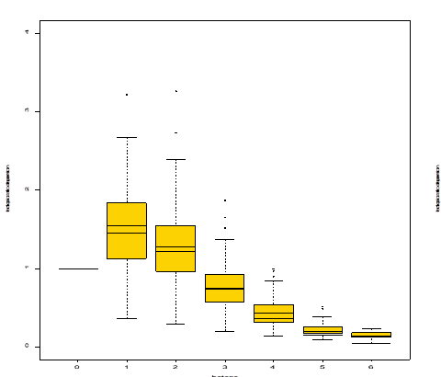
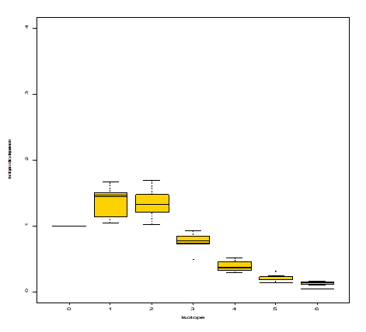
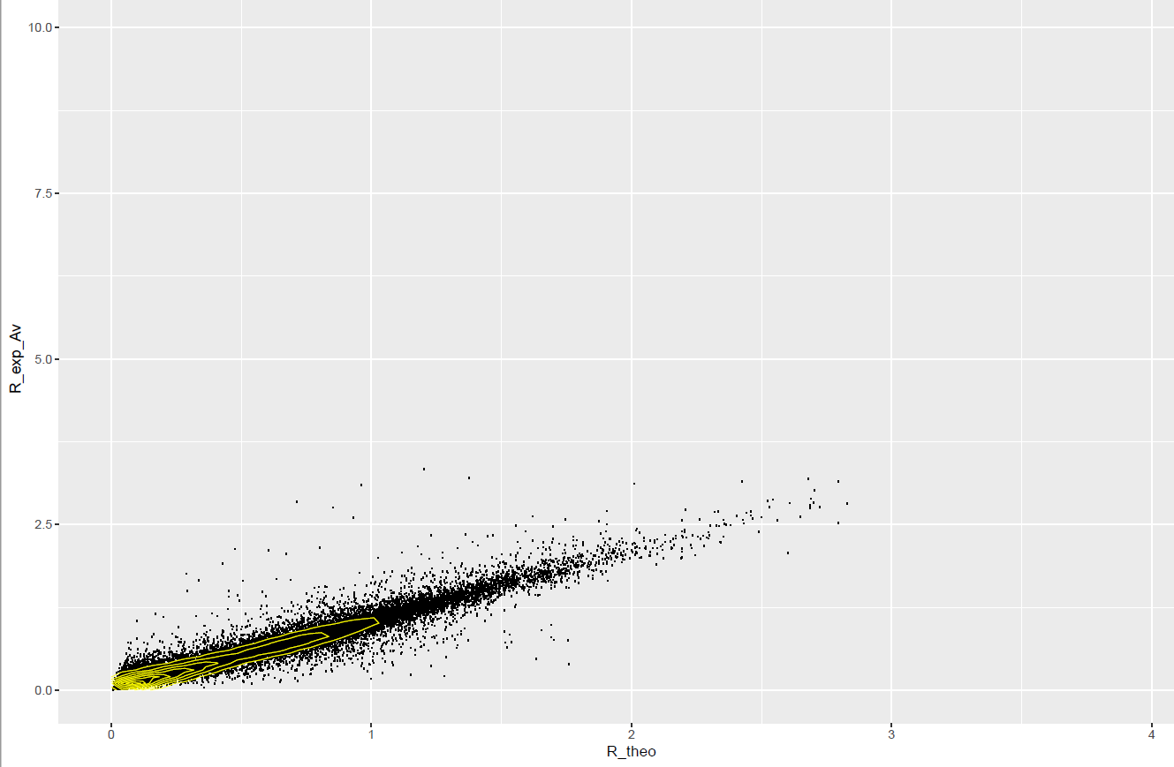
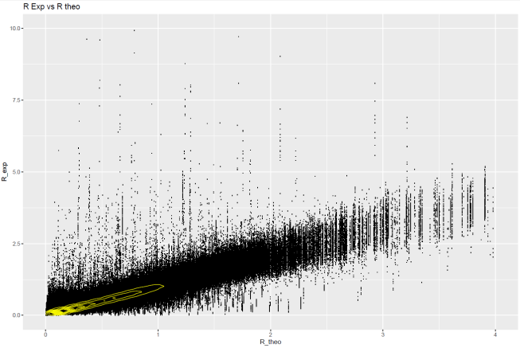
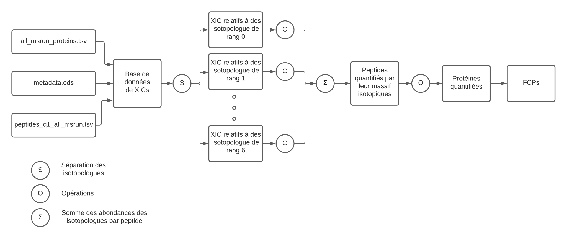
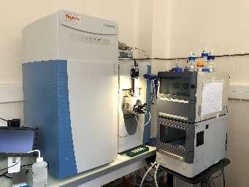
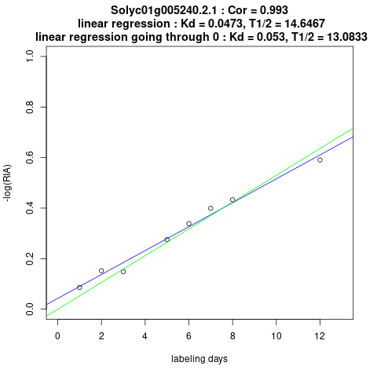



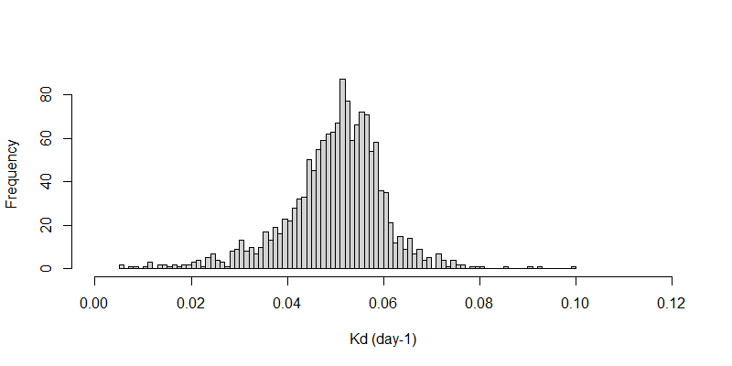
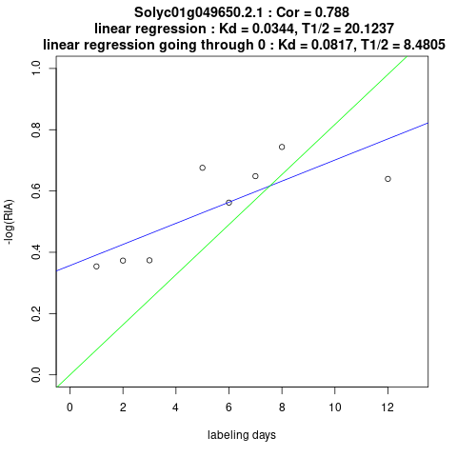
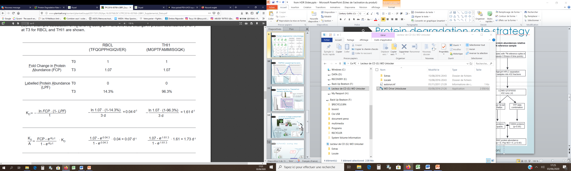






P163
Sub optimal 15N metabolic labelling in plant:
A new way to perform large scale protein turnovers determination using the peptides isotopic distribution
BIENVENUT W. V., LE GOFFIC L. , LANGELLA O., BALLIAU T., BLEIN-NICOLAS M.
GQE, IDEEV, CNRS, Gif sur Yvette, France
Abstract
Data processing
Proteostasis is defined as the processes required maintaining the equilibrium between protein synthesis and degradation. Tight regulations from gene transcription to post-translational proteins modifications of these processes are required in cell cycle and survival to balance cellular development and environmental stresses. It has been shown repeatedly that the abundance of proteins only moderately correlates with that of transcripts. While the determination of protein turnover using pulsed SILAC metabolic labelling is popular for large scale proteomics investigations. Although used with small mammals (e.g. mice), such approach remains difficult with whole organisms and almost impossible with autotroph species like plants. Alternatively, it has been proposed to use inorganic sources of 15N isotopes that could be metabolically incorporated to de novo synthetized amino acids but full 15N protein labelling is almost impossible due to the high amino acid recycling rate in plant.
Instead of reaching complete 14N/15N exchange as previously done by Millar et al.^{1,2}, we decide to perform a 15N metabolic pulse at very low incorporation yield (around 5 % 15N enrichment). This limited incorporation rate offers some advantages of which a limited increase of mass spectrometry signal complexity. Indeed, the 15N-labelled products moderately modify the peptide natural isotopic distribution and both labelled and unlabelled product appears as an overlapping isotopic distribution. Then, the recorded signal is extensively processed to filter out the outliers. Finally, the filtered signal is finally used to first perform label free protein quantitation which provide the “Protein Fold Change” (PFC) evolution over time. Second, the experimental peptide isotopic distribution is used to determine the apparent 15N labelling rate and the evolution of the 15N “Labelled Protein Fraction” (LPF) over the labelling time.
Thanks to our local bioinformatics developments including i2MassChroQ, MassChroQ and the MCQR package, we propose an approach of MS signal processing that make it possible to determine the fold change in protein (FCP) and the labelled protein fraction (LPF). Both values (FCP & LPF) are key elements and are required to estimate the turnover rate individually for each protein³ at the proteomic scale. Furthermore, this presentation highlights that accurate isotopic distribution measurement is possible and could be used from ordinary large-scale proteomics LC-MS/MS instruments to provide an interesting alternative to determine protein turnover determination at the proteome scale
Initial Ctrl
1 day labelling
3 days labelling
Ctrl after 10 days
6 days labelling
10 days labelling
Example of the evolution of the isotopic pattern during the ¹⁵N incorporation (low incorporation rate with 4.5% ¹⁵N enrichment) for the peptide AGVKEYKLTYYTPEYETK
Processing for LPF determination
Peptides isotopic
profiles extraction and isotopic ratios calculation (Python script)
i2MassChroQ
Exports of the PeptIDs list
26800 peptides
8755972 mass spectra
IsoSpec.py
Theoretical isotopic distribution calculation for different ¹⁵N rates (0-6%)
R² = 0.08
R² = 0.07
Non redundant Isotopic ratio (aggregated per nr peptide)
Highly redundant Individual isotopic ratios
Sample production, preparation and analysis
Estimation of the Labelled Protein Fraction
R₁^{Exp} : Experimental ratio of isotopolog 1 (I₁)
R₁^{15N}: Theoretical ratio of I₁ at the maximum ¹⁵N incorporation (6.075% measured by ICMS)
R₁^{Nat}: Theoretical ratio of I₁ for the natural ¹⁵N isotopic distribution (~ 0.364%)
Single peptide Ratios distribution example
Filtering peptide ratios
Tomato developmental stages
I₀
I₁
I₂
I₃
I₄
I₅
I₆
Out of range isotopic ratios
Based on peptide isotopic ratio distribution
Based on Inter-spectrum correlation
LPF =
R₁^{Exp} - R₁^{15N}
R₁^{Nat} - R₁^{15N}
I₀
I₁
I₂
I₃
I₄
I₅
I₆
2842304 mass spectra
Cellular division
Cellular expansion
Maturation
Ripening
12052 peptides
Epicarp
Tomato growth condition
Detailed protocol is available in reference 4:
- Photoperiod: 16h/8h (Day/Night) using natural light or additional LED light
- Hygrometry : 60-80%
- Temperature:
- Day: 23-28°C / Night: 16-19°C
- Feeding solution depending the developmental stage (Nutritive solution table)
Sample production
- Fixe developmental stage: 12 days after anthesis
- Labelling for different times: 1-12 days
- 3-6 fruits for each labelling time point from different plants
- Samples collected from the equatorial zone of the fruit and reduced to small pieces of 2x10 mm
- Liquid nitrogen frozen and stored at -80°C
- Stainless steel ball (10 mm) grinding for 1mn at 25 Hz
LPF validation
The Corr. Coef. (> 0.99), the slope (min = 0.8, Max = 1.2) and the intercept (min = -0.2, Max = 0.2) between Experimental and theoretical R_{i} (0 < i < 6) are used to filter the LPF calculated values.
LPF aggregation per protein
The individual LPF values are averaged per non-redundant proteins for each sample (labelling time) and retained only if the final value is related to 2 individual values at least.
R² = 0.97
R² = 0.96
Mesocarp
Endocarp
Seeds and gel
Placenta
Carpel septum
Processing for PFC determination
Sampling zone
Major modification of the MCQR package:
Using the whole isotopic cluster (I0 to I6) instead of the most intense one
Missing values handled at the sample level instead at the project level
Nutritive solutions:
XICs related to isotopolog 0
M
Feeding solution | Description | KNO₃ (mM) | K ₂ SO₄ (mM) | KH₂PO₄ (mM) | Ca(NO₃) ₂ (mM) | Ca(¹⁵NO₃) ₂ (mM) | MgSO₄ (mM) | Oligo Elements
Initial | Up to the 1st flower | 3.5 | 1 | 2 | 6 | - | 2 | X
End growth | Fruit development | 4 | 1.5 | 1.5 | 4 | - | 1.5 | X
Labelling | ¹⁵N labelling | 4 | 1.5 | 1.5 | 3.4 | 0.6 | 1.5 | X
XICs related to isotopolog 1
M
XICs database
Protein extraction:
Proteins were extracted by phenol extraction using a protocol described in reference (6) using 100mg of the tomato frozen powder previous prepared.
Protein digestion:
Proteins pellet was subject to reduction and alkylation with iodoacetamide before tryptic digestion in 50 mM ammonium bicarbonate. The resulting peptides were desalted by solid phase extraction using polymeric C₁₈ columns.
XICs related to isotopolog 6
S
Isotopologs spliting
M
M
Missing value replacement
Σ
Isotopolog intensity summation
Sample analysis and data processing for peptide/protein identification
Results
Protein Inference and
sequence redundancy filtering
Evolution of the peptide ¹⁵N rate (in %) during the different labelling times (from t0 to t11 days)
Kd are calculated using the equation proposed by li et al. (3) for the proteins with a FCP range in between ]-0.449, 0.449[across the labelling process. For the calculation, Kd is defined as 1 since no significant differences could be associated to this range.
Q-Exactive Raw files
The Kd could also be plotted as a function of the labelling time (graph on the right). Since FCP =1, the slope is equal to the Kd.
A validation of the Kd is based to a comparison of the
linear regression slope (Kd) to the linear model passing through 0 (best correlation hypothesis).
As an example, protein Solyc01g005240 with a Kd = 0.0473 day⁻¹ whereas protein Solyc01g049650 with a Kd = 0.0344 day⁻¹ is not retained due to the strong divergence between the 2 models.
Raw file mzML conversion with ProteoWizard 3.0
X!Tandem
List of identified
peptides and proteins
ITAG3.2_proteins20181206.fasta reference protein DB
RP-LC Q-Exactive analysis
i2MassChroQ tool
HPLC separation
nanoLC ultra 2D (Eksigent)
Biosphere C₁₈ pre-column (5um, 12 nm 360/100 um, 20 mm) and column (3um, 12 nm, 360/75 um, 300 mm)
Linear gradient from 5% to 70% buffer B in 75 min, 300nl/min
buffer A: 0.1% FA in water; buffer B: 0.1% FA in acetonitrile
Q-Exactive plus acquisition
Acquisition with Xcalibur™ v4.0 with (1) MS scan 350-1400 m/z range at 75000 resolution (2) MS/MS scan at 17500 resolution. Step 2 repeated for the eight most intense ions detected in step 1 with precursor charge step of 2⁺, 3⁺ and 4⁺, dynamic exclusion of 50 s
Evolution of the unlabelled protein fraction during the labelling times (from t0 to t11 days)
K_{D} distribution (1455 proteins)
Protein degradation and
synthesis constants calculation
Protein degradation rate constant (3)
Protein synthesis rate constant (3)
Conclusions
FCP: Fold Change in Protein
variation of the protein abundance during the experiment
Processing based on the MCQR package
LPF: Labelled Protein Fraction
Fraction of the ¹⁵N labelled peptide/protein out of all material
Processing based on the MassChroq and dedicated R scripts
Low ¹⁵N labelling (<6%) is compatible with standard LC-MS acquisition with low loss of efficiency for peptides/proteins characterisation.
Variations of the isotopic pattern provide relevant information for differential proteins quantitation
Kinetic constants for proteins synthesis and degradation could be determine with such approach
Collected data could be used directly for both LPF and FCP determination
Some improvement are required especially for data acquisition to improve:
  Signal stability and reproducibility
  Peptide separation (HPLC and/or ionic mobility)
To develop some scoring scheme able to:
  Strengthen the robustness of the LPF
  Validate/invalidate the final Kd/Ks calculation
Since all fruits are collected at 12 days (at the same developmental stage), we do not expect any difference in protein amount.
In such condition, which is equivalent to a « stationary phase » the PFC must be identical whatever the labelling time and then, Kd = Ks.
Acknowledgments
References
Many thanks to Sarah Naudin, Marie-Helène Andrieu, Sophie Colombié from the META team at the BFP for the production of the biological samples, Anne Marmagne, Cléline Masclaux-Daubresse from the SATURN team at the IJPB for the ICMS ¹⁵N measurement and their contribution to the development of this project.
The authors and the META team thank the BAP department of the INRAE for the PROOFER grant related to this project.
1) Salih, K. J. et al. Biochem J 2020, 477, 3019-3032.
2) Nelson, C. J. et al. Plant Physiol 2014, 166, 91-108.
3) Li, L. et al. Plant Cell 2017, 29, 207-228
4) Andrieu M.H. et al. NOV’AEE Numéro Régulier #05.juin 2022
5) Sénécaut N. Ph D. thesis manuscritpt; Université Paris Cité: 22 juin 2022
6) Belouah, I. et al. Data in brief 2020, 28, 105015

