Slide 1
‘Mother’s milk’: Is there a social reversal in breastfeeding practices along with economic development?
Elodie rossi (bordeaux school of economics)
Pierre levasseur (inrAE)
Matthieu clement (bordeaux school of economics)

Slide 2
Why not breastfeeding (BF) is a major issue?
Health consequences
    For children, via a greater exposure to infectious diseases, obesity and diabetes, and a reduction in cognitive and non-cognitive skills, even in rich countries (e.g. Belfield & Kelly, 2012; Girard et al., 2017).
    For mothers, by increasing risks of post-partum depression, ovarian and breast cancer, heart disease and type-2 diabetes (UNICEF, 2018).
    600,000 children and 100,000 women die each year due to inadequate BF behaviors worldwide (Walters et al., 2019).
Economic consequences
    Negative impacts on educational attainment and labor market outcomes in adulthood (e.g. Fletcher, 2010; Cesur et al., 2017), even in rich countries.
    Walters et al. (2019) estimated the global economic losses associated with not BF to be more than $340.3 billions (including costs linked to child and maternal mortality as well as cognitive losses), accounting for approximately 0.7% of global GNI.
Appropriate BF practices are well below the 2030 international targets of the WHO (40% vs. 70%).

Slide 3
Causes of the choice to not breastfeed
HOUSEHOLD WEALTH
Household-level determinants
Socioeconomic causes (Rippeyoung & Noonan, 2012, Volk & Franklin 2020, Sarki et al. 2019, Victora et al. 2016)
    Preference for the present: temporal trade-off between short-term opportunity cost and future health benefits
    Formula milk is used as signal of social distinction (since formula milk has a direct cost and is associated with progress)
    Lack of nutritional and health knowledge
    Maternal employment after birth
Country-level determinants
Environmental and cultural causes (Baker et al. 2016; Rollins et al. 2016, Neves et al. 2020)
    Low accessibility to safe water, and health and education services
    Development of the milk formula market (intensive marketing)
    Cultural constraints against BF (or against formula milk in some contexts, e.g. China)
    Lack of BF-friendly policy (e.g., maternity leaves), public health campaigns and regulation of the milk formula market
NATIONAL WEALTH

Slide 4
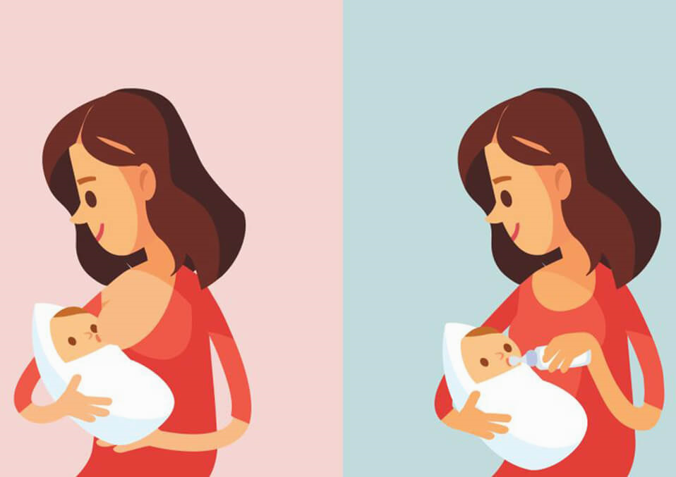
Literature review
A paradoxe between wealth and appropriate BF practices among high-income countries (e.g. Jones et al., 2011; Kohlhuber et al., 2008; Oakley et al., 2014; Sarki et al., 2019; Victora et al., 2016).
In developing countries, results are mixed. Further investigations are needed!
BF increases with household wealth
But decreases with national wealth

Slide 5
Research questions applied to developing countries
Household wealth
National wealth
How household wealth affects the trade-off between the choice to breastfeed or not?
    H1: Presence of within-country inequality

Slide 6
Research questions applied to developing countries
Household wealth
National wealth
How household wealth affects the trade-off between the choice to breastfeed or not?
    H1: Presence of within-country inequality
How national wealth affects this trade-off?
    H2: Presence of cross-country inequality

Slide 7
Research questions applied to developing countries
Household wealth
National wealth
How household wealth affects the trade-off between the choice to breastfeed or not?
    H1: Presence of within-country inequality
How national wealth affects this trade-off?
    H2: Presence of cross-country inequality
How national wealth moderates and changes the household wealth-BF association
    H3: Existence of a social reversal along with economic development
    While the richer household adopt healthier (physiological) behaviors, the poorest have higher access to formula milk

Slide 8
Data and indicators
We merged all the Demographic and Health Surveys (DHS) available for the Asian continent
    Our analyses rely on 37 DHS conducted in 16 countries b/w 1990 and 2017 (a sample of 2,445,656 young children)
    Asia concentrates mostly 40% of the global health and economic costs of inappropriate BF practices
We constructed:
  4 dummy indicators of adequate BF practices (according to the WHO & UNICEF)
    Exclusive BF (EBF) for the 6 first months
    Early initiation of BF (EIBF)
    Continued BF at one year (CBF1), 12-15months, and at two years (CBF2)
  2 household wealth scores allowing for comparison across DHS waves and countries (as proxy of SES)
    Using PCA and MCA approaches including 7 dummies of durables ownership (radio, TV, refrigerator, bicycle, motorcycle, car, and phone), 2 dummies of access to public facilities (water and electricity), and 3 dummies of housing conditions (number of sleeping rooms, quality of floor material, and toilet facility)
    Each score varies from 0 to 1
  3 indicators of national wealth at a given time (low vs. medium vs. high)
    Based on tercile of GNI per capita ($PPP 2017), tercile of GDP per capita ($PPP 2017), and tercile of HDI.

Slide 9
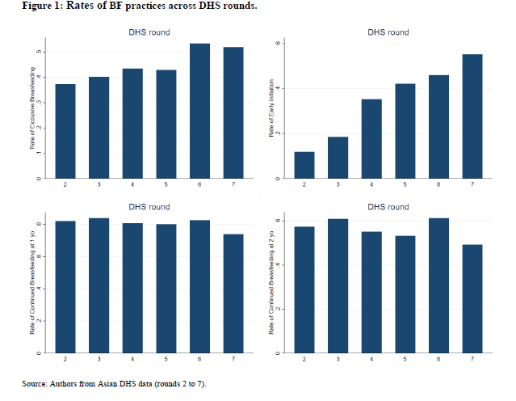
Descriptive: BF across time
→ Improvement of EBF & EIBF across time, but not for CBF

Slide 10
Descriptive: BF across national wealth
→ Improvement of EBF & EIBF across economic development, but not for CBF

Slide 11
Descriptive: BF across household & national wealth
→ A social convergence across national wealth

Slide 12
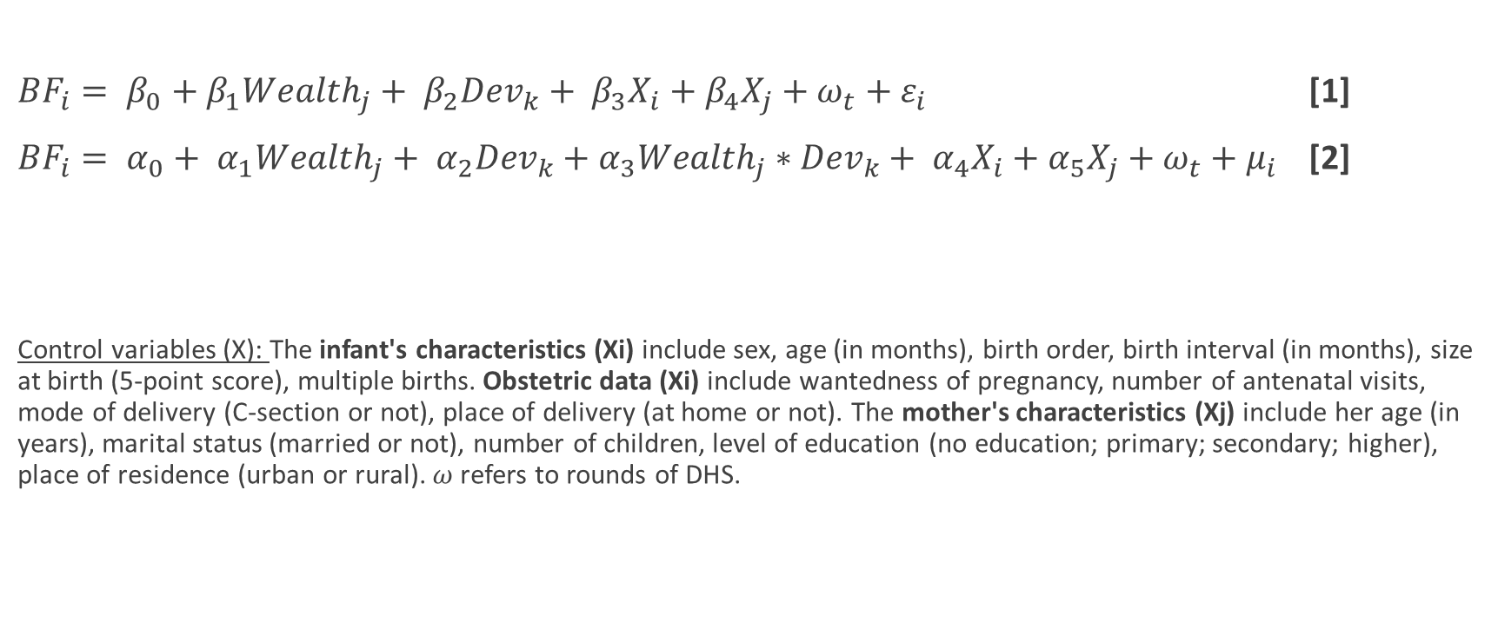
Econometric OLS models
${BF}_{i}= β_{0}+β_{1}{Wealth}_{j}+ β_{2}{Dev}_{k}+ β_{3}X_{i}+β_{4}X_{j}+ω_{t}+ε_{i}$ [1]
${BF}_{i}= α_{0}+ α_{1}{Wealth}_{j}+ α_{2}{Dev}_{k}+α_{3}{Wealth}_{j}∗{Dev}_{k}+ α_{4}X_{i}+α_{5}X_{j}+ω_{t}+μ_{i}$ [2]
Control variables (X): The infant's characteristics (Xi) include sex, age (in months), birth order, birth interval (in months), size at birth (5-point score), multiple births. Obstetric data (Xi) include wantedness of pregnancy, number of antenatal visits, mode of delivery (C-section or not), place of delivery (at home or not). The mother's characteristics (Xj) include her age (in years), marital status (married or not), number of children, level of education (no education; primary; secondary; higher), place of residence (urban or rural). $ω$refers to rounds of DHS.

Slide 13
→ Existence of within-country heterogeneity (appropriate BF practices are more common among the poorest)

Slide 14
→ Towards a social convergence of EBF and CBF2 in richer Asian countries (suggesting a future social reversal?)

Slide 15
OLS results
Dependent outcome: | Exclusive breastfeeding (dummy) |  |  | Early initiation (dummy) |  |  | Continued breasfteeding at 1 yo |  |  | Continued breasfteeding at 2 yo
 | Linear | Interacted |  | Linear | Interacted |  | Linear | Interacted |  | Linear | Interacted
Household wealth score | -0.144*** | -0.366*** |  | -0.097*** | -0.100*** |  | -0.137*** | -0.169*** |  | -0.164*** | -0.247***
 | (0.019) | (0.031) |  | (0.011) | (0.020) |  | (0.017) | (0.030) |  | (0.022) | (0.040)
Medium GNI per capita (dummy) | -0.017 | -0.088*** |  | 0.021** | 0.036*** |  | -0.019* | -0.022 |  | -0.030** | -0.015
 | (0.011) | (0.021) |  | (0.008) | (0.014) |  | (0.010) | (0.018) |  | (0.014) | (0.025)
High GNI per capita (dummy) | 0.039*** | -0.077*** |  | 0.064*** | 0.060*** |  | -0.002 | -0.020 |  | -0.038*** | -0.085***
 | (0.010) | (0.017) |  | (0.007) | (0.011) |  | (0.009) | (0.014) |  | (0.013) | (0.020)
Wealth*MediumGNI |  | 0.208*** |  |  | -0.046 |  |  | 0.008 |  |  | -0.048
 |  | (0.052) |  |  | (0.031) |  |  | (0.049) |  |  | (0.062)
Wealth*HighGNI |  | 0.336*** |  |  | 0.016 |  |  | 0.053 |  |  | 0.143***
 |  | (0.036) |  |  | (0.023) |  |  | (0.034) |  |  | (0.044)
Control variables | YES | YES |  | YES | YES |  | YES | YES |  | YES | YES
Observations | 34,452 | 34,452 |  | 133,506 | 133,506 |  | 25,449 | 25,449 |  | 21,890 | 21,890
R-squared | 0.086 | 0.088 |  | 0.084 | 0.084 |  | 0.080 | 0.080 |  | 0.118 | 0.119
Children age interval (in month) | [0-5] | [0-5] |  | [0-23] | [0-23] |  | [12-15] | [12-15] |  | [20-23] | [20-23]
Notes: Standard errors are clustered at the PSU-level. Robust standard errors are in parenthesis: *** p<0.01, ** p<0.05, * p<0.1.

Slide 16
→ Towards a social convergence across time

Slide 17
Robustness checks
Two IV regression models using two sets of instruments
    IV1: proportion of households equipped with clean and modern fuel for cooking (i.e., biogas, LPG, electricity, ethanol, or natural gas) compared to dirty traditional fuel (i.e., charcoal, wood, or other organic combustibles) at the PSU level, excluding household j (Kim et al., 2010; Barnes et al., 2013; Kpelitse et al., 2014; Bonnefond & Clément, 2014; Clément, 2017; Daran & Levasseur, 2022)
    IV2: the average height of mothers at the PSU level, excluding the household j (Case & Paxson, 2008)
Including confounding covariates: mother’s BMI (body mass index), mother’s employment (yes or no), and religion (Muslim, Christian, Hindu, Buddhist, and others)
Other measurements of household wealth (MCA approach) and national wealth (GDP/capita and HDI)
Approved

Slide 18
Robustness: IV regression I
Dependent outcome: | Exclusive breastfeeding (dummy) |  |  | Early initiation (dummy) |  |  | Continued breasfteeding at 1 yo |  |  | Continued breasfteeding at 2 yo
 | Linear | Interacted |  | Linear | Interacted |  | Linear | Interacted |  | Linear | Interacted
Household wealth score | -0.751*** | -1.219*** |  | -0.509*** | -0.776*** |  | -0.335*** | -0.499*** |  | -0.676*** | -0.782***
 | (0.089) | (0.148) |  | (0.047) | (0.071) |  | (0.074) | (0.118) |  | (0.095) | (0.162)
Medium GNI per capita (dummy) | -0.006 | -0.143*** |  | -0.007 | -0.126*** |  | -0.028** | -0.132*** |  | -0.006 | 0.081
 | (0.012) | (0.050) |  | (0.009) | (0.029) |  | (0.011) | (0.042) |  | (0.015) | (0.058)
High GNI per capita (dummy) | 0.016 | -0.205*** |  | 0.034*** | -0.091*** |  | -0.015 | -0.079** |  | -0.040*** | -0.103**
 | (0.012) | (0.042) |  | (0.009) | (0.024) |  | (0.011) | (0.034) |  | (0.014) | (0.046)
Wealth*MediumGNI/c |  | 0.391*** |  |  | 0.331*** |  |  | 0.312*** |  |  | -0.276
 |  | (0.140) |  |  | (0.077) |  |  | (0.121) |  |  | (0.171)
Wealth*HighGNI/c |  | 0.623*** |  |  | 0.340*** |  |  | 0.169** |  |  | 0.198*
 |  | (0.104) |  |  | (0.056) |  |  | (0.085) |  |  | (0.117)
Control variables | YES | YES |  | YES | YES |  | YES | YES |  | YES | YES
Number of instruments | 1 | 3 |  | 1 | 3 |  | 1 | 3 |  | 1 | 3
Instruments | Area clean cooking fuel use | Area clean cooking fuel use and its interactions with with medium GNI/c and high GNI/c |  | Area clean cooking fuel use | Area clean cooking fuel use and its interactions with with medium GNI/c and high GNI/c |  | Area clean cooking fuel use | Area clean cooking fuel use and its interactions with with medium GNI/c and high GNI/c |  | Area clean cooking fuel use | Area clean cooking fuel use and its interactions with with medium GNI/c and high GNI/c
Observations | 33,999 | 33,999 |  | 131,359 | 131,359 |  | 25,061 | 25,061 |  | 21,486 | 21,486
Children age interval (in month) | [0-5] | [0-5] |  | [0-23] | [0-23] |  | [12-15] | [12-15] |  | [20-23] | [20-23]

Slide 19
Robustness: IV regression II
Dependent outcome: | Exclusive breastfeeding (dummy) |  |  | Early initiation (dummy) |  |  | Continued breastfeeding at 1 yo (dummy) |  |  | Continued breastfeeding at 2 yo (dummy)
 | Linear | Interacted |  | Linear | Interacted |  | Linear | Interacted |  | Linear | Interacted
Household wealth score | -0.425*** | -1.325** |  | -0.575*** | -0.293 |  | -0.367*** | -0.203 |  | -1.165*** | -2.381***
 | (0.140) | (0.517) |  | (0.079) | (0.268) |  | (0.131) | (0.419) |  | (0.168) | (0.605)
Medium GNI per capita (dummy) | 0.025 | -0.097 |  | 0.056*** | 0.199** |  | -0.033 | -0.040 |  | -0.072*** | -0.341**
 | (0.021) | (0.153) |  | (0.014) | (0.082) |  | (0.021) | (0.125) |  | (0.026) | (0.168)
High GNI per capita (dummy) | 0.052*** | -0.322** |  | 0.078*** | 0.183** |  | -0.020 | 0.054 |  | -0.094*** | -0.572***
 | (0.019) | (0.161) |  | (0.012) | (0.085) |  | (0.019) | (0.129) |  | (0.024) | (0.178)
Wealth*MediumGNI/c |  | 0.471 |  |  | -0.480* |  |  | 0.011 |  |  | 1.003*
 |  | (0.524) |  |  | (0.283) |  |  | (0.427) |  |  | (0.601)
Wealth*HighGNI/c |  | 1.268** |  |  | -0.357 |  |  | -0.248 |  |  | 1.658***
 |  | (0.545) |  |  | (0.288) |  |  | (0.434) |  |  | (0.628)

Slide 20
Robustness: adding confoundings
Table S15: Alternative regressions including (less well-answered) additional covariates about mothers’ characteristics (working status. BMI, and religious affiliation).
Dependent outcome: | Exclusive breastfeeding (dummy) |  |  | Early initiation (dummy) |  |  | Continued breasfteeding at 1 yo |  |  | Continued breasfteeding at 2 yo
 | Linear | Interacted |  | Linear | Interacted |  | Linear | Interacted |  | Linear | Interacted
Household wealth score | -0.147*** | -0.595*** |  | -0.090*** | -0.126** |  | -0.100** | -0.222*** |  | -0.024 | -0.243***
 | (0.046) | (0.073) |  | (0.024) | (0.050) |  | (0.042) | (0.085) |  | (0.049) | (0.089)
Medium GNI per capita (dummy) | 0.173*** | 0.036 |  | 0.162*** | 0.163*** |  | -0.057 | -0.099** |  | -0.112*** | -0.208***
 | (0.039) | (0.048) |  | (0.023) | (0.028) |  | (0.036) | (0.040) |  | (0.043) | (0.046)
High GNI per capita (dummy) | -0.001 | -0.121*** |  | 0.069*** | 0.056** |  | -0.092*** | -0.125*** |  | -0.269*** | -0.319***
 | (0.035) | (0.042) |  | (0.021) | (0.025) |  | (0.034) | (0.038) |  | (0.040) | (0.044)
Wealth*MediumGNI |  | 0.670*** |  |  | -0.008 |  |  | 0.201* |  |  | 0.477***
 |  | (0.127) |  |  | (0.074) |  |  | (0.114) |  |  | (0.123)
Wealth*HighGNI |  | 0.535*** |  |  | 0.052 |  |  | 0.144 |  |  | 0.239**
 |  | (0.083) |  |  | (0.054) |  |  | (0.091) |  |  | (0.098)

Slide 21
Contributions & conclusions
This paper is the first:
    To empirically demonstrate from a large sample of developing countries the occurrence of a shift in the wealth-BF association across levels of economic development.
    To provide econometric evidence on this topic and to intend to address endogeneity issues.
We can speculate that the household wealth-BF relationship will become positive when developing Asian countries will reach higher levels of economic development
Important implication for BF-friendly public policies (a need to target the poorest households of developing countries).

Slide 22
Appendix

Slide 23
Robustness: IV regression I

