Slide 1
Facing climate challenges in coastal areas: the evolving nature of acceptability of adaptation.
The case study of a French subarctic archipelago.
Philippenko Xénia – BRGM, CNRS-LGP UMR 8591, Université de Paris 1 Panthéon-Sorbonne
Goeldner-Gianella Lydie – Université de Paris 1 Panthéon-Sorbonne
Le Cozannet Gonéri – BRGM
Grancher Delphine – CNRS-LGP UMR 8591
UGI Paris 2022 - 19th July

Slide 2
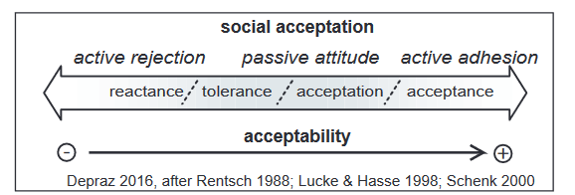
Research Context
Increasing coastal risks due to climate change
Cascading effects, varying levels of vulnerability
Adaptation is needed but faces numerous challenges
Social acceptability of adaptation is one of the issue
Acceptability : process during which a social group admits the existence of restrictions or modifications in its environment (Fournis and Fortin, 2015)
Depraz and Laslaz, 2017
this study present four dimensions of acceptability for a better management of adaptation
Notes:
Expliquer pourquoi acceptability = issue → dans un monde qui évolue rapidement à cause du CC, il faut s’adapter “rapidement”, donc accepter de nombreux changements dans son Environnement. Or pas tjs evident et cela peut freiner adaptation.
Has an impact on the success of adaptation
Depends on multiple factors : perceptions of adaptation solutions, trust in public actors, in governance decisions…
Can be analysed at various scales : global to local, from social changes to neighbourhood relations

Slide 3
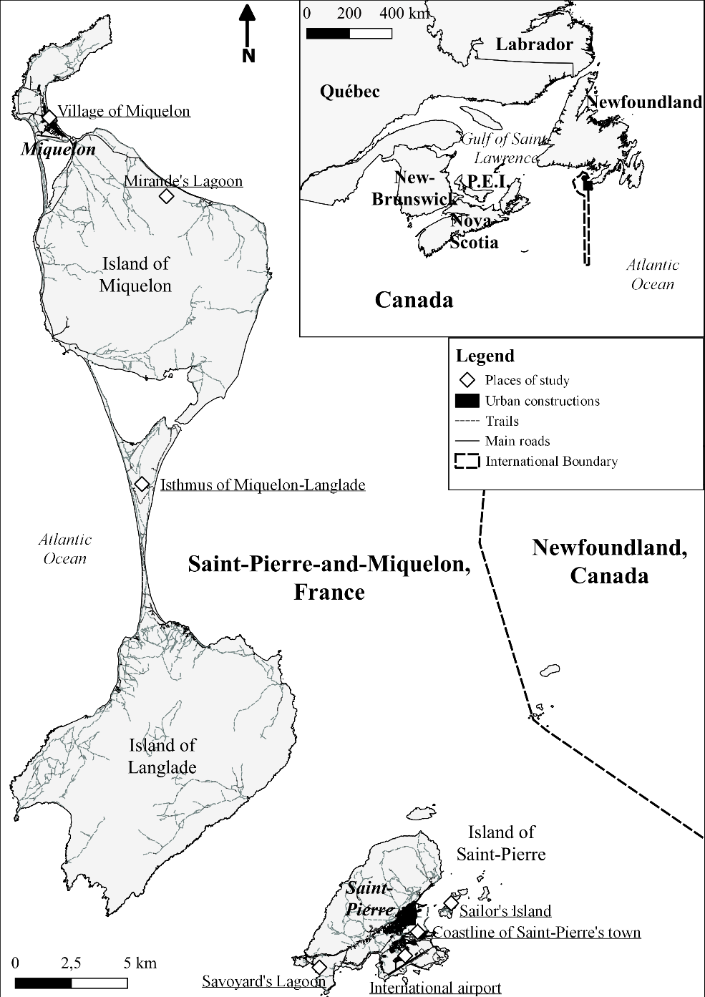
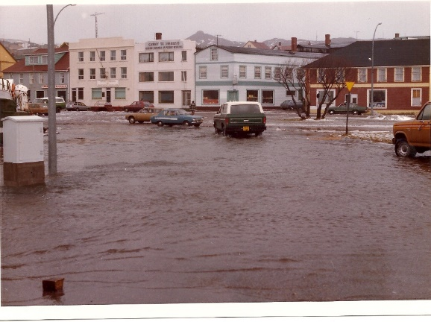
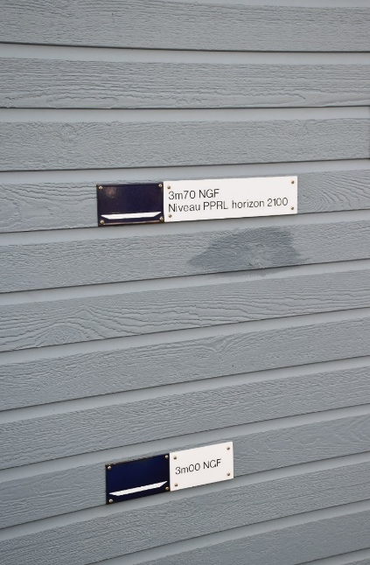
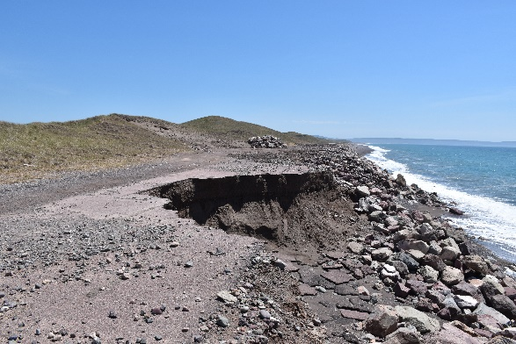
Place of study : Saint-Pierre-and-Miquelon
242 km² - 4 269 km of Paris - 25 km of Newfoundland
6 294 inhabitants = 25 hab/km²
240 m (highest point) – 28% of accumulation coastline
Coastal risks worsened by climate change
Seven local sites of study: on the map
Sea-level rise
Submersion
Erosion
1982
DTAM
Xénia Philippenko, 2018
2021
Philippenko et al., 2021
2018
Xénia Philippenko, 2021

Slide 4
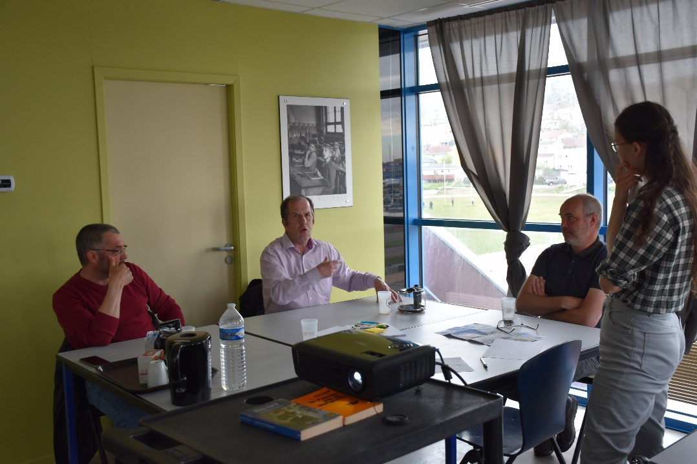
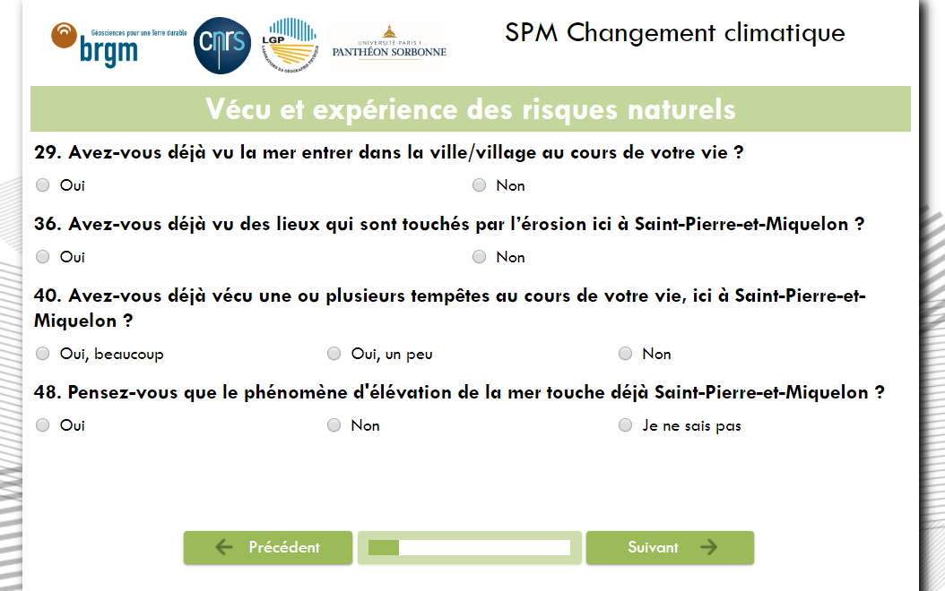
Methods
Doctoral research with various methods:
structured questionnaire : online and face-to-face, 289 people
13 focus groups from 3 to 15 people
Interviews : ~60 people
Observation and informal discussion

Slide 5
Psycho-social dimension
Miquelon – The role of experience and attachment
Psycho-social dimension
Better educated people = Better acceptance of restrictive solutions
Personal experience of coastal risks = influences acceptability of solutions
Strong attachment to the territory = barrier to adaptation → except Miquelon
more details in Philippenko and al., 2021 - 10.1016/j.ocecoaman.2021.105924
Source: France TV report on the damage caused by the storm of 28 November 2018.
2 storms in November 2018:
- impact on householders minds,
- climate change’s effects more tangible
Strong attachment to the village :
- At first, causes rejection of relocation
- After the storm, attachment leads to proactive attitude
Notes:
Détail des types de variables :
Socio-economic variables:
Age and gender
Social, cultural and economic capital
Psycho-social variables:
Emotions and personnal experience
Knowledge and cognitive abilities
Risk aversion
Environmental sensitivity :
Degree of environmental commitment
Relationship to space and the environment
Leisure activities in the area
Awareness, knowledge and culture of risk
Attachement to the territory:
Origin
Life span
Ownership

Slide 6
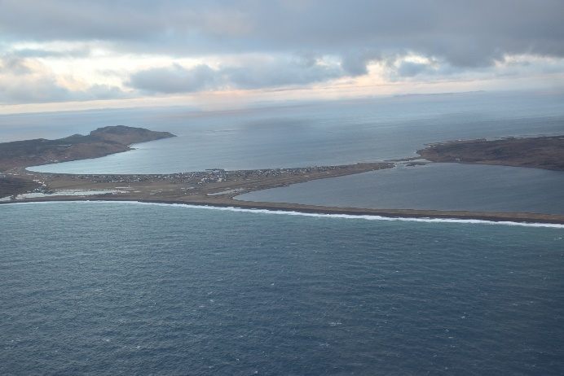
Spatial dimension
Miquelon – a village surrounded by water
soft solutions are better accepted in recreational areas
hard solutions are preferred where stakes and risks are high
Village located on an isthmus, surrounded by water → Greater exposure
Isthmus of Miquelon-Langlade:
Vegetation = 45%
Disappearance = 37%
Rockfills = 29%
Île-aux-Marins:
Abandon = 28%
Rockfills = 27%
Spatial dimension
Source: Xénia Philippenko, 2018.
Saint-Pierre’s coastline:
Enhance seawalls = 41%
Enhance houses, walls, docks = 25%
Relocate = 20%
Airport:
Rockfills = 32%
Enhance airport = 25%
No solution but relocation, due to spatial constraints → influences the acceptability
Acceptability:
Relocation = 89%
Rockfills = 44%
Seawalls = 30%
Notes:
Détail des types de variables :
Place’s issues:
Human
Economic
Heritage
Environmental
Scale of management:
Place
Territorial
Regional
National
International
Territorial constraints :
Geomorphology
Isolation/Connection
Territorial resources

Slide 7
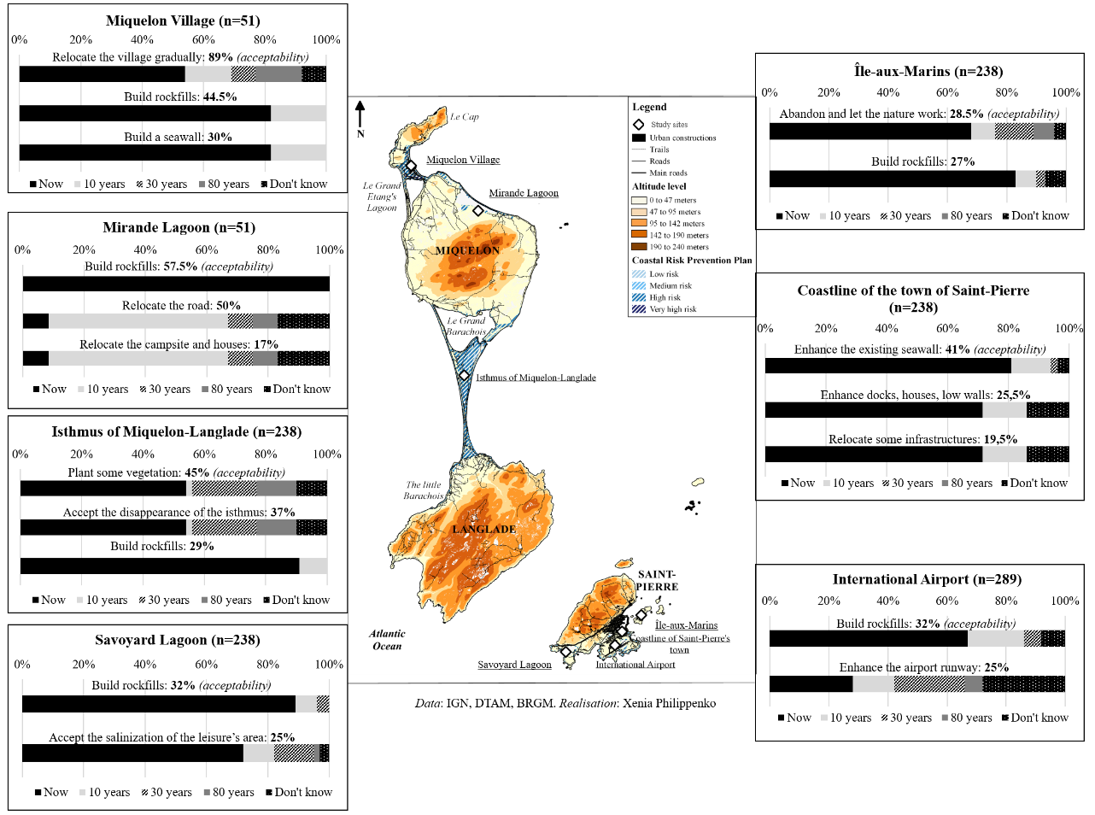
Temporal dimension
Miquelon
Source: Philippenko et al., 2021.
Acceptability evolved through time : active rejection, passive acceptation, active adhesion
Managed retreat is better accepted if gradually implemented
Source: Philippenko et al., 2021.
Temporal dimension
short term = a desired time scale for both nature-based solutions and hard protections.
Notes:
managed retreat is better accepted at long term, whereas the short term seems to be a desired time scale for both nature-based solutions and hard engineering protections.
Détail des variables:
Time frame:
Past
Present
Short term / Medium term / Long term
Relationship to scientific uncertainties :
Transmission and understanding
Consideration in adaptation choices
Relationship with socio-economic uncertainties
Tipping points :
Environmental
Socio-economic
Political, geopolitical

Slide 8
Socio-political dimension
Miquelon – the importance of the governance context
Verbatim
“Meetings today are useless. It's consultation, not participation. We want a stronger involvement of population”
Adaptation process
Information
Stakeholders and governance
- A complex institutional context, but cooperation between stakeholders
- Leading role of the village’s mayor
- Participation of population through workshops, surveys, etc
→ A positive dynamic to be consolidated: the relocation is seen as a territorial project
Scientists
Media
Elders
Itself
Internet
Prefecture
Source: Xénia Philippenko, 2021.
Socio-political dimension

Slide 9
Conclusion : acceptability as a challenge in SPM for coastal resilience
Acceptability is constantly evolving depending on :
Individual context
Space
Time
Governance context
→ Difficulty for managers of Saint-Pierre-and-Miquelon to integrate these elements in their strategies
It may either represents a barrier to adaptation (rockfills – isthmus of Miquelon-Langlade) or offers opportunities to strengthen the resilience of local societies (relocation - village of Miquelon)
Miquelon – towards managed retreat
Philippenko and al., 2021. Perceptions of climate change and adaptation: A subarctic archipelago perspective (Saint-Pierre-and-Miquelon, North America), Ocean and Coastal Management, 215-105924 - 10.1016/j.ocecoaman.2021.105924
https://theconversation.com/que-faire-face-a-la-montee-du-niveau-de-la-mer-lexemple-de-miquelon-village-en-cours-de-deplacement-177786

Slide 10
Thank you for your attention.
Merci de votre attention.
x.philippenko-crnokrak@brgm.fr
+33.663.26.35.29
Twitter :@XPhilippenko
UGI Paris 2022 - 19th July

