Slide 1
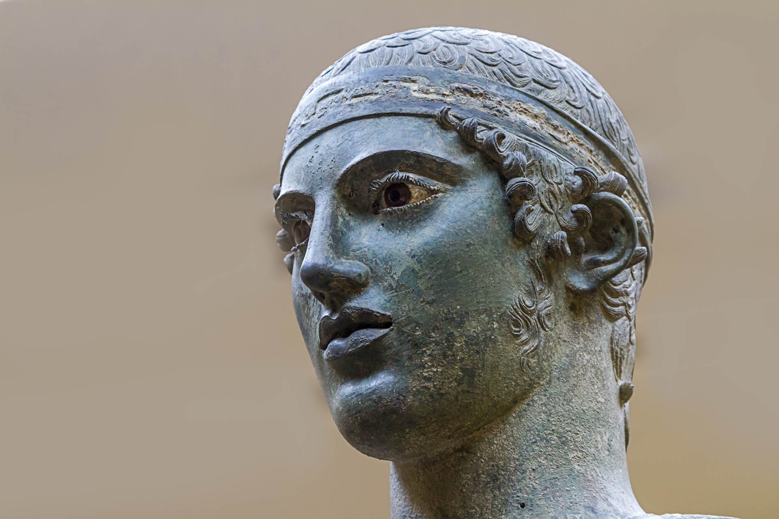



Postponed Relative Pronouns in Pindar
Nicolas BERTRAND
Université Côte d’Azur
BCL, CNRS

Slide 2
Introduction
What is that pronoun doing there?

Slide 3
Typical relative clauses in ancient Greek
Relative pronoun: inflected subordinator followed by the rest of the relative clause
Head: DP or pronoun, which can be:
external (preposed to the RC)
κωφὸς ἀνήρ τις, ὃς Ἡρακλεῖ στόμα μὴ περιβάλλει P. 9.87
“a man is mute who does not have Herakles on his lips”
external (postposed to the RC)
οἷσι δὲ Φερσεφόνα ποινὰν παλαιοῦ πένθεος
δέξεται, ἐς τὸν ὕπερθεν ἅλιον κείνων ἐνάτῳ ἔτεϊ
ἀνδιδοῖ ψυχὰς πάλιν fr. 133.1–3
“the ones for whom Persephona receives the payment of her ancient grief, she brings back again their souls to the sun above on the ninth year”
internal
§ ὅσαι τ’ εἰσὶν ἐπιχωρίων καλῶν ἔσοδοι | τετόλμακε. P. 5.116–117
“every opportunity there is for local excellence, he has dared to do”
null
ἐν δὲ πείρᾳ τέλος | διαφαίνεται ὧν τις ἐξοχώτερος γένηται N. 3.70–71
“in trial the accomplishment appears, of that in which one is the best”
Notes:
Typical relative clauses in Ancient Greek are straightforward from an Indoeuropean perspective

Slide 4
Puzzling relative clauses
οὐδ’ Ἀΐδας ἀκινήταν ἔχε ῥάβδον,
ᾇ κατάγει κοίλαν πρὸς ἄγυιαν
θνᾳσκόντων; O. 9.33–35
“nor did Hades keep his staff unmoved, with which he leads the mortal bodies down to the hollow city of the dead”
καὶ τὸ Μηδείας ἔπος ἀγκομίσαι
ἑβδόμᾳ καὶ σὺν δεκάτᾳ γενεᾷ Θήραιον, τό ποτε ζαμενής
παῖς ἀπέπνευσ' ἀθανάτου στόματος, δέσποινα Κόλχων. P. 4.9–11
“and to carry out the word of Medeia, at the 17th generation, [the word] spoken at Thera, which Aietas’ holy child once blew from her immortal mouth, the queen of the Colchians”
In both cases, the relative pronoun appears after material belonging to the relative clause.
Descriptively, I will call them postponed relative pronouns.
What is puzzling about them is that they are rare (12.3%): in run-of-the-mill relative clauses in ancient Greek, the pronoun must be initial in the clause.
βρότεα σώμαθ’
Αἰήτα

Slide 5
Why are postponed RPs problematic?
Relative pronouns are in the highest position in the clause structure.
No extraction nor raising to object (prolepsis)
Both would imply a movement through Spec,C_{h}P, which is impossible since it is already occupied by the RP.
No topicalization over the RP
Counterexamples imply topicalized phrases pertaining to the matrix clause:
νέωτα δ’ οὐδεὶς ὅστις οὐ δοκεῖ βροτῶν
Πλούτῳ τε κἀγαθοῖσιν ἵξεσθαι φίλος.
“but for the new year there is no one who does not expect among the mortals to become friend of Wealth and noble men.”
Semonides fr. 1 9–10 West
Faure 2021: 160 (fig. 1)
Notes:
οἱ μὲν ἡμέρην | μένουσιν ἐλθεῖν, οἱ δ' ἐτέων περιτροπάς: some wait for the next day to come, some for turn of the year. Furthermore, the phrase οὐδεὶς ὅστις οὐ is to be considered a fixed expression.

Slide 6
A Pindaric peculiarity?
The postponement of the RP is attested in verse:
7th–6th c. BCE
πό̣ρ̣νᾳ δ’ ὄ κέ τις δίδ̣[ῳ
ἴ]σα κἀ[ς] π̣ολ̣ίας κῦμ’ ἄλ[ο]ς ἐσ̣β[ά]λην. Alcaeus fr. 117b. 26–27 V.
“who makes a gift to a whore, it is as if he had thrown it in the wave of the salted sea.”
6th c. BCE
ἔρρε, θεοῖσίν τ’ ἐχθρὲ καὶ ἀνθρώποισιν ἄπιστε,
ψυχρὸν ὃς ἐν κόλπῳ ποικίλον εἶχες ὄφιν Theognis 601–602
“begone, you enemy of the gods and unfaithful to mankind, who kept the cold colorful snake in your lap!”
6th c. BCE
κληροπαληδ̣ὸν ὃς ἂν
πρᾶτος λάχῃ ἕκατι Μοιρᾶν Stesichorus fr. 222b
“who has his lot come out first in the drawing of lots, by the will of the Moirai”
Notes:
For Homer: partitive genitives don’t count (adverbial flavor), and neither do topicalizations
Prose : τίνες ἵππους ἐπίστανται κολάζειν ὀρθῶς; πότερον οἵπερ βελτίστους ποιοῦσιν ἢ ἄλλοι; — Οἵπερ βελτίστους. —Τί δέ; κύνας οὐχ οἳ βελτίστους ἐπίστανται ποιεῖν, οὗτοι καὶ κολάζειν ὀρθῶς ἐπίστανται; ([Plat.] Amat. 137c)

Slide 7
A Pindaric peculiarity?
5th c. BCE
ἢ τὰν μεγαλώνυ]μον Αἴγιναν, μεγ[ίστ]ου
Ζην]ὸ̣ς̣ [ἃ πλαθεῖσα λ]έ̣χει τέκεν ἥρω Bacchylides Ep. 9.55–56
“or the renown Aigina, who after approaching the bed of the Great Zeus bore a hero”
5th c. BCE
φίλοι, κακῶν μὲν ὅστις ἔμπειρος κυρεῖ, | ἐπίσταται… Aeschylus Pers. 598–9
“Friends, whoever has the experience of evil things, knows…”
5th c. BCE
Ὦ Ζεῦ, τὸν Οἴτης ἄτομον ὃς λειμῶν’ ἔχεις Sophocles Trach. 200
“O Zeus, who owns Oite’s unbreakable meadow”
5th c. BCE
τὰς δὲ δαιμόνων τύχας | ὅστις φέρει κάλλιστ’ ἀνὴρ οὗτος σοφός Euripides fr. 37
“any man who bears with utter nobility the fortunes sent by the gods, this man is wise”
Notes:
For Homer: partitive genitives don’t count (adverbial flavor), and neither do topicalizations
Prose : τίνες ἵππους ἐπίστανται κολάζειν ὀρθῶς; πότερον οἵπερ βελτίστους ποιοῦσιν ἢ ἄλλοι; — Οἵπερ βελτίστους. —Τί δέ; κύνας οὐχ οἳ βελτίστους ἐπίστανται ποιεῖν, οὗτοι καὶ κολάζειν ὀρθῶς ἐπίστανται; ([Plat.] Amat. 137c)

Slide 8
A Pindaric peculiarity?
It is not attested in Homer nor in prose. Some of the examples adduced in the literature must be explained otherwise:
Τίνες ἵππους ἐπίστανται κολάζειν ὀρθῶς; πότερον οἵπερ βελτίστους ποιοῦσιν ἢ ἄλλοι; — Οἵπερ βελτίστους. — Τί δέ; κύνας οὐχ οἳ βελτίστους ἐπίστανται ποιεῖν, οὗτοι καὶ κολάζειν ὀρθῶς ἐπίστανται; [Plat.] Amat. 137c
“Who knows how to correctly flatter the horses? The ones who make them better or other people? — The ones [who make them] better. — Now, as for the dogs, the ones who know how to make [them] better, is it not those who know how to flatter them correctly?”
→ Topicalization pertaining to the matrix clause, not the relative.
Ἀχαιῶν ὅστις ἄριστος [sc. ἐστιν] Hom. Il. 7.50
“whoever is the best among the Achaeans”
→ Partitive genitives are not a part of the relative per se.

Slide 9
What is there to explain?
1.
What licenses the postponement of the relative pronoun?
2.
Why is there variability regarding its position (initial vs. postponed)?

Slide 10
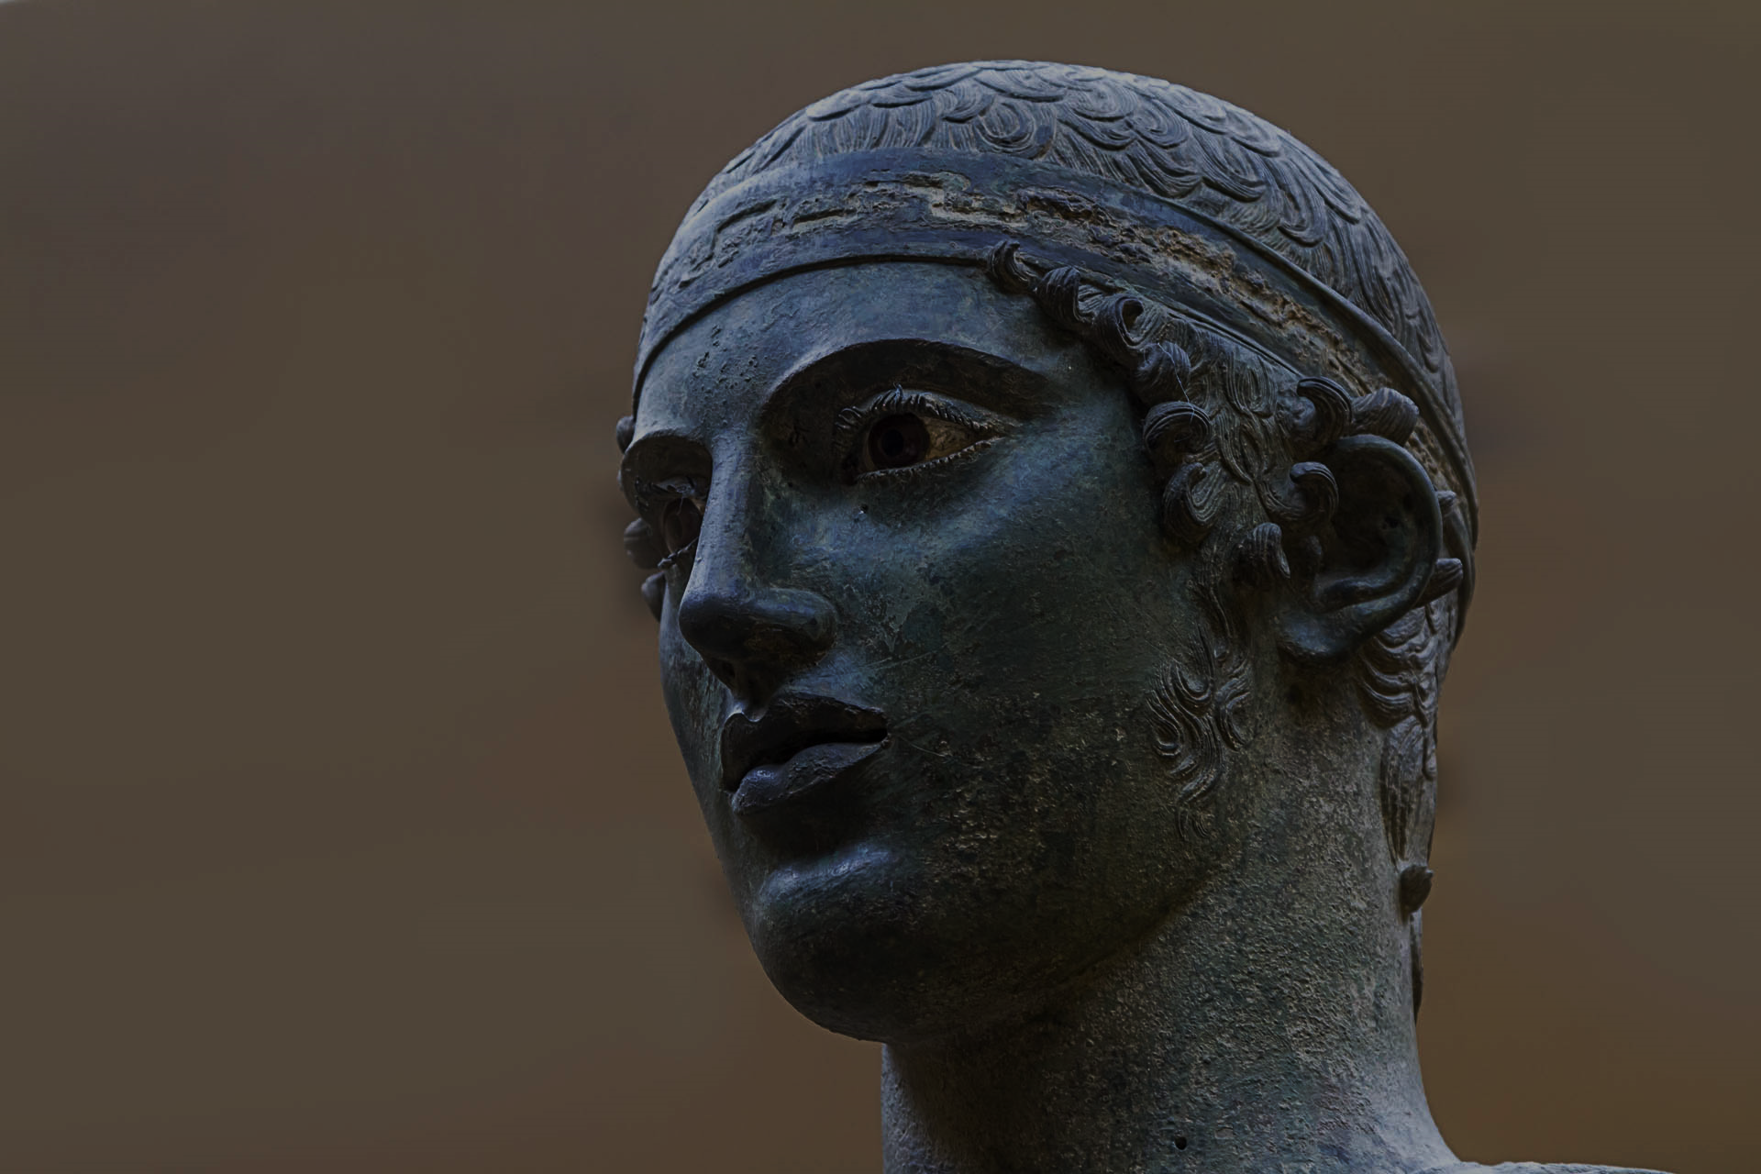
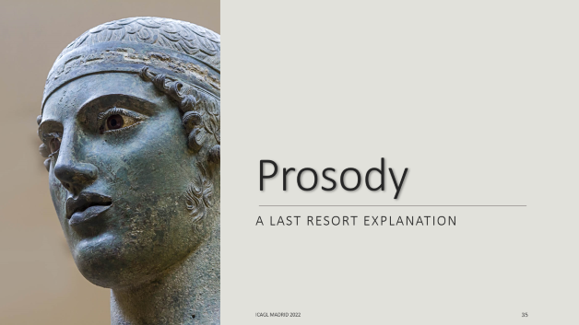
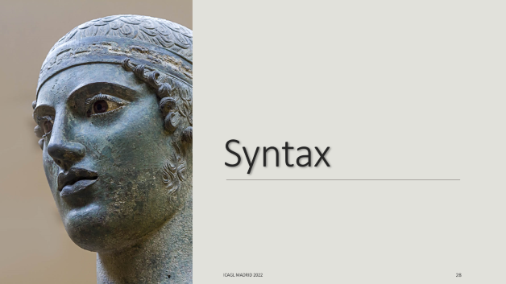



Slide 11
The data
An overview

Slide 12
The relative pronouns
As in Homer, the simple relative pronouns are the reflexes of two different PIE roots, both originally anaphoric-demonstrative pronouns:
ὅς, ἅ, ὅ (<*Hyo-) : the classical relative pronoun
Cognate with anaphoric ἰν, Sanskrit RP yáḥ, Avestan RP yō, Lat. anaphoric is, etc.
ὁ, ἁ, τό (<*so-, *to-) : identical with the definite article
Cognate with Sanskrit sá, sā, tád, Germanic þar, etc.
Some forms are a priori ambiguous (ἅ, οἱ, αἱ), but were counted as reflexes of *Hyo-. (Endingless masc. ὁ is demonstrably a philological chimaera (Probert 2005), and all instances were counted as reflexes of *so-.)
Both ὅς and ὁ can also be used as demonstrative-anaphoric pronouns in Pindar.
  Probert (2015) makes a good case for attributing anaphoric uses of ὅς to a form *so-s.
  Earlier literature (Des Places 1947, Hummel 1993) relies on the “movement of the sentence” to set them apart, but this leads to a fuzzy and subjective classification.
Stricter criterion: asyndeton secures a relative reading of the pronoun, whereas coordination leads to an anaphoric reading.
Notes:
Only once ὅ σφιν has a variant ὅς σφιν (P. 1.74) that is metrically possible: I followed Maehler’s text.

Slide 13
Repartition of forms
Singular |  | *so- | Init. | Post. | *Hyo- | Init. | Post.
Masculune | Nom. | ὅ | 7 | 1 | ὅς | 52 | 8
 | Acc. | τόν | 32 | 1 | ὅν | 18 | 1
 | Gen. | τοῦ | 2 | 0 | οὗ | 1 | 0
 | Dat. | τῷ | 6 | 0 | ᾧ | 3 | 1
Feminine | Nom. | ἁ |  |  | ἅ | 11 | 1
 | Acc. | τάν | 17 | 2 | ἅν | 6 | 2
 | Gen. | τᾶς | 6 | 0 | ἇς | 2 | 0
 | Dat. | τᾷ | 1 | 0 | ᾇ | 6 | 2
Neuter | Nom. | τό | 0 | 0 | ὅ
 | Acc. | τό | 4 | 1 | ὅ
 | Gen. | τοῦ | 1 | 0 | οὗ | 2 | 0
 | Dat. | τῷ | 1 | 0 | ᾧ | 1 | 0
Total |  | 82 | 77 | 5 | 117 | 102 | 15
Plural |  | *so- | Init. | Post. | *Hyo- | Init. | Post.
Masculune | Nom. | τοί | 5 | 1 | οἵ | 9 | 1
 | Acc. | τούς | 5 | 0 | οὕς | 1 | 0
 | Gen. | τῶν | 1 | 0 | ὧν | 7 | 0
 | Dat. | τοῖς | 3 | 0 | οἷς | 9 | 4
Feminine | Nom. | ταί | 1 | 0 | αἵ | 1 | 1
 | Acc. | τάς | 0 | 0 | ἅς | 3 | 2
 | Gen. | τᾶν | 1 | 0 | ἇν | 0 | 0
 | Dat. | ταῖς | 2 | 0 | αἷς | 2 | 0
Neuter | Nom. | τά | 2 | 0 | ἅ
 | Acc. | τά | 2 | 0 | ἅ
 | Gen. | τῶν | 7 | 1 | ὧν | 2 | 0
 | Dat. | τοῖς | 1 | 0 | οἷς | 1 | 0
Total |  | 32 | 30 | 2 | 43 | 35 | 8
Notes:
ἅ < *Hyeh₂ vs. ἁ < *seh₂
They only differ in their accent mark, but
ὅς : < *Hyos or *so-s?
Cf. instances of ὅ σφιν vl. ὅς σφιν
οἵ and αἵ ? But concurrent forms τοί and ταί
Note that neuter N-A ὅ (<*Hyo-) is never used, but τό is found instead (homophony with masc. ὁ)

Slide 14
The relative pronouns
Other complex relative pronouns are attested in Pindar, all based on the relative root *Hyo- :
  ὅστις: indefinite relative pronoun initial 18× postponed 0×
  ὅσπερ: specific relative pronoun initial 7× postponed 0×
  ὅστε: used when the relative clauses attributes a permanent initial 25× postponed 5×
  property to the head noun
  οἷος / ὁποῖος: relative pronoun of quality initial 15× postponed 3×
  ὅσ(σ)ος / ὁπόσ(σ)ος: relative pronoun of quantity initial 21× postponed 1×
Moreover, other roots are used as adverbial relatives:
  ἁνίκα: “when” initial 8× postponed 1×
  ἵνα: “where” initial 15× postponed 3×
  ἔνθα / ἔνθεν “where, whither” initial 11× postponed 1×

Slide 15
The relative pronouns
Since relative pronouns are also used as interrogative pronouns, I excluded from the corpus:
indirect interrogative clauses
exclamative clauses
comparative clauses

Slide 16
Other subordinators
ὅς-subordinators
Other
ὁπᾷ “to the point where”
ὁπότε / ὁπόταν “when, whenever”
ὅτε / ὅταν “when, whenever”
ὅτι “because”
οὕνεκα / oὕνεκεν “because”
ὄφρα “in order that”
ὡς “how”
ὅπως “how”
ὥσπερ “just as”
ὥστε “so as to”
εἰ “if”
εἴπερ “if indeed”
ἐπεί “after, when, as soon as; for”
ἐπειδή “since”
πρίν “before”
εὖτε “when, after”

Slide 18
Subordinator type
The most obvious difference in the rate of postponement is the subordinator:
the rate is highest with non-relative subordinators, which is expected since they do not occupy the Spec,C_{h}P.
it is roughly as expected with all relative pronouns based on the root *Hyo- (ὅς etc.)
the rate is lowest with ὁ < *so-: there seems to be a reluctance to postpone this pronoun, even though all examples are metrically secured.
P = 0.002

Slide 19

Crosslinguistic similarities
Language | Root | Restriction to poetry | Position | Optional
Latin | *kʷis | Yes | Clause-2nd | Yes
Tokharian | *kʷis | Yes | Clause-2nd In-situ | Yes
Oscan | *kʷis | No | ? | Yes
Hittite | *kʷis | No | Clause-2nd | Yes
Vedic | *Hyo- | Mostly | Preverbal In-situ | Yes
Except in Vedic, the relative pronoun is always a reflex of PIE *kʷis, cognate (or identical) with the indefinite pronoun.
Except in Oscan and Hittite, the postponement of the relative pronoun is a poetic feature of the language.
In Hittite, the current theory is that there is a connection between the semantics of the relative clause and the option of postponing the pronoun.
It has been claimed that in Tokharian and Vedic, the relative pronoun is in situ, or at least does not show wh-movement.

Slide 20
A look around
Crosslinguistic similarities

Slide 21
Latin and Tokharian
Arma virumque cano, Troiae qui primus ab oris
Italiam fato profugus Laviniaque venit
litora. Verg. Aeneid 1.1–3
“I sing the arms and the man, who from the Trojan borders first came to Italy, fleeing his fate, and to the shores of Lavinium”
yāmi speltke po āñmtsa | āñme ket tsälpātsi tākoy
make:opt.3sg effort:acc all self:perl wish:nom whose release.inf be.opt.3sg
PKAS7Ha4 verse 1b
“May he make effort wholeheartedly, whose wish may be to be released.”
käṣṣintse pūdñäktentse | patstsa kᵤse yamaṣäṃ kṣāttre
teacher:gen Buddha:gen Stūpa:perl who make:prs.3sg umbrella:acc PKAS7Ib4 verse 15d
“Of the teacher Buddha, who over [his] Stūpa makes the gift of an umbrella”
Both in Latin and Tokharian, this poetic feature is connected to the middle cesura in the line (Hackstein 2015).

Slide 22
Oscan
V. Aadirans V. eítiuvam paam vereiiaí Púmpaiianaí
Vibis.nom Aadirans.nom Vibis.gen money.acc.sg REL.acc.sg.fem vereia.dat.sg
Púmpaiianaí trístaamentud deded,
Pompeian.dat.sg will.abl.sg gave.3sg.perf
eísak eítiuvad V. Viínikiís Mr. […] trííbúm ekak
that.abl.sg money.abl.sg Vibis.nom Viínikiís.nom Maras.gen building.acc.sg this.acc.sg.fem
[…] úpsannam deded.
to-be-built.acc.sg.fem gave.3sg.perf
“The money which Vibis Aadirans son of Vibis gave to the Pompeian vereia in his will, with that money Vibis Viínikiís son of Maras […] gave this building to be built […].”

Slide 23
Hittite
nu ḫatrā-nun kuedaš KUR.KU]R-e-aš
conn write-1sg.pst which.dat.pl land-dat.pl
egir-an⸗wa⸗mu tiyatten
there⸗quot⸗1sg.dat-loc stand.imper
n⸗at⸗mu egir-an t[ī]ēr
conn⸗3pl.nom⸗1sg.dat-loc there stood.3pl KBo 6.29+ obv. ii 14-17
“the lands to which I wrote “Stand by me”, they stood by me”
nu 8 dumu.meš-uš uwadanzi munus-ni ⸗ššan kuiēš nāwi pānzi KUB 9.31 ii 9–10
then 8 boys-acc.pl bring.3pl woman-dat.sg⸗loc who.nom.pl not.yet go.3pl
“they bring 8 boys who have not yet gone to a woman”

Slide 24
Vedic
apā́m bílam áphitaṃ yád ā́sīd vṛtráṃ jaghanvā́ṃ ápa tád vavāra RV 1.32.11
“what opening of the waters [had been] covered, that he opened up [after] killing Vṛtra
The position of the relative pronoun here is always preverbal (Hock 1992).
Although in Vedic it does not appear in prose, but only in verse, the postponement of the relative pronoun later occurs in prose as well.

Slide 25
Semantics

Slide 26
Typology of relative clauses
AG relative clauses can be classified as restrictive, non-restrictive and maximalizing.
No statistically significant difference between initial and postponed RPs
Difference in the choice between ὁ and ὅς:
  ὅς is more frequent than expected with restrictive RCs
  ὁ is more frequent than expected with non-restrictive RCs and unattested with maximalizing RCs
This trend is in line with Homeric usage (Monteil 1963, Probert 2015), although Pindar allows for ὁ to appear in constructions where Homer only uses ὅς.
P < 0.001

Slide 27
Definiteness of the head
The definiteness of the head has been claimed to be the key in the optional postponement of the relative pronoun in Hittite.
In Pindar, it is not always sure if the head is definite or indefinite:
  no systematic use of the definite article in his dialect
  rhetorical stance of the poet (in a mythological allusion, is the audience supposed to know the referent of the NP?)
The definiteness of the antecedent NP has no influence whatsoever on the postponement of the RP.
P = 0.801

Slide 28
Syntax

Slide 29
Difference with regressive attraction
φυλακὰς δ’ ἃς εἴρεαι, ἥρως,
οὔ τις κεκριμένη ῥύεται στρατὸν οὐδὲ φυλάσσει. Hom. Il. 10. 416–17
“the guard-posts you’re asking about, hero, there’s no chosen one which guards the army or protects it”
The bare NP preceding the relative pronoun is best considered to be a part of the relative clause (Faure 2010) and regressive attraction should check 4 criteria (Probert 2015):
  Contiguity between NP and RP
  Restrictive or maximalizing relative clause
  No demonstrative
  No article
Surprisingly, regressive attraction (attractio inversa) is unattested in Pindar, while it is frequent from Homer onwards.

Slide 30
Case accessibility hierarchy
subject > direct object > indirect object > oblique > genitive > object of comparison
(Keenan and Comrie 1977)
Case accessibility does not play any role whatsoever in the postponement of the relative pronoun.
P = 0.889
Notes:
Negative proof that the movement involved in both constructions is the same: if the relative pronoun moved to a different landing site when it is postponed, a difference in those uses should be detectable.

Slide 31
Headedness of the RC
Ancient Greek relative clauses can be:
  1. postposed externally-headed | 2. preposed externally-headed | 3. internally-headed | 4. null-head
All those constructions allow for the postponement of the relative pronoun:
Κάδμοιο κούραις, ἔπαθον αἳ μεγάλα O. 2.23
“to the daughters of Cadmos, who suffered a lot”
τὰς δὲ δαιμόνων τύχας | ὅστις φέρει κάλλιστ’ ἀνὴρ οὗτος σοφός Euripides fr. 37
“any man who bears with utter nobility the fortunes sent by the gods, this man is wise”
ἐμοὶ δ’ ὁποίαν ἀρετάν | ἔδωκε Πότμος ἄναξ
εὖ οἶδ’ ὅτι χρόνος ἕρπων πεπρωμέναν τελέσει. N. 4.41–43
“which kind of virtue lord Potmos gave me, I know well, that time passing will achieve it as fated”
θανεῖν δ’ οἷσιν ἀνάγκα [scil. ἐστι], τά κέ τις ἀνώνυμον
γῆρας ἐν σκότῳ καθήμενος ἕψοι μάταν […]; O. 1.82–83
“for those who must die, why would anyone follow in vain an anonymous old age, sitting in obscurity?”
Notes:
No example of preposed externally-headed RC in Pindar, due to the small number of those overall.
The real surprise is ex. 3, the only instance of internally-headed relative clause with postponed pronoun: It has been claimed that in situ relative pronouns are unattested with internally-headed relative clauses. Note however that in this case, the RC might be analyzed as an IntC, with anacoluth and reanalysis in the course of the sentence (Pindar is fond of syntactic ambiguity), sc. “which kind of virtue lord Potmos gave me, I know well, that time passing will achieve it as fated”. Besides ἐμοί could be an ethic dative topicalized to the whole sentence , not the IO of ἔδωκε.

Slide 32
Headedness of the RC
Statistically, no difference is visible in the distribution of initial vs. postponed relative pronouns among those 4 categories.
The syntax of each type is different, so we would expect a difference in the ratio of postponed vs initial RPs if their position was due to syntax.
P = 0.858

Slide 33
Rel-in-situ?
One possible explanation for postponed relative pronouns would be to allow them to remain in their base position, as has been advocated for other languages (de Vries 2002, 2005; Hindi: Mahajan 2000, Tokharian B: Hearn 2017; Hittite: Sideltsev 2015).
Problems:
It doesn’t explain why the pronoun is always second in the relative clause (either after the first word or the first constituent).
It doesn’t explain why the negation and sentence clitics are blocked from raising higher than the relative pronoun.
It doesn’t explain why it is optional.

Slide 34
Information structure
TOPIC
οὐκέτι πρόσω
ἀβάταν ἅλα κιόνων ὑπὲρ Ἡρακλέος περᾶν εὐμαρές,
§ ἥρως θεὸς ἃς ἔθηκε ναυτιλίας ἐσχάτας
μάρτυρας κλυτάς· N. 3.21–23
“it is not easy to cross the trackless sea beyond the pillars of Herakles, which the hero-god set up as the famous witnesses of the limit of navigation”
FOCUS
ἐν τίν κ' ἐθέλοι, Γίγαντας ὃς ἐδάμασας, εὐτυχῶς | ναίειν N. 7.90–91
“under your protection, you who subdued the Giants, would he gladly live”
UNCLEAR
ὃς πάχει μάκει τε πεντηκόντορον ναῦν κράτει,
τέλεσεν ἃν πλαγαὶ σιδάρου. P. 4.245–246
“[a dragon] which in thickness and length surpassed a fifty-oar ship, that the blows of a hammer built”
Notes:
A last indication that the postponement of the RP is not syntactic in nature is that elements to the left of the pronoun don’t show any uniform informational feature.

Slide 35
Prosody
A last resort explanation

Slide 36
Contiguity
The element above the relative pronoun is located immediately before the pronoun in all 45 instances but one.
τὸ δὲ παθεῖν εὖ πρῶτον ἀ͜έθλων· εὖ δ’ ἀκούειν δευτέρα μοῖρ’· ἀμφοτέροισι δ’ ἀνήρ
ὃς ἂν ἐγκύρσῃ καὶ ἕλῃ, στέφανον ὕψιστον δέδεκται. P.1.99–100
“success is the best prize; good reputation is the second lot; with both of them, a man who gains and takes them, gets the highest crown”
Furthermore, only 11 occurrences have more than 1 lexical word before the pronoun, and never more than 1 constituent. As a rule, the relative pronoun is second in the relative clause, i.e. it is in the so-called Wackernagel position.
Inter-speaker variation between prosodic word treatment and phonologic word treatment is expected (cf. Huggard 2015 for Hittite, Goldstein 2015 for Greek).
Hypothesis: the relative pronoun can be postpositive in AG verse.
Notes:
ἀμφοτέροισι may be better construed as the topic of the matrix clause, rather than the left-detached object of ἐγκύρσῃ.

Slide 37
Domain interruption
The postponed relative pronoun can interrupt a syntactic domain.
ματρομάτωρ ἐμὰ Στυμφαλίς, εὐανθὴς Μετώπα,
§ πλάξιππον ἃ Θήβαν ἔτικτεν, O. 6.84–85
“my mother’s mother the woman of Stymphale, fair-flowered Metopa, who bore the rider Theba”
A case of hyperbaton?
μῆτιν δ' ἀλώπηξ, αἰετοῦ ἅ τ’ ἀναπιτναμένα ῥόμβον ἴσχει· I. 4.65
“in wisdom [he is] a fox, which forstalls the swoop of the eagle by falling on her back”
Only 5 cases similar to (2), versus 13 cases similar to (1).

Slide 38
Prosodic breaks
Avoidance of line-ends before a postponed relative pronoun: only 4 instances where it is line-initial.
τὰς δὲ Θεοξένου ἀκτῖνας πρὸς ὄσσων
μαρμαρυζοίσας δρακείς
ὃς μὴ πόθῳ κυμαίνεται, ἐξ ἀδάμαντος
ἢ σιδάρου κεχάλκευται μέλαιναν καρδίαν fr. 123.1–4
γλῶσσαν εὑρέτω κελαδῆτιν, Ὀρσοτριαίνα
ἵν’ ἐν ἀγῶνι βαρυκτύπου
θάλησε Κορινθίοις σελίνοις· N. 4.86–88
Αἰγυπτίαν Μένδητα, πὰρ κρημνὸν θαλάσσας
ἔσχατον Νείλου κέρας, αἰγιβάται
ὅθι τράγοι γυναιξὶ μίσγονται. fr. 201.1–3
οὐκ ἔμειν’ ἐλθεῖν τράπεζαν νυμφίαν,
οὐδὲ παμφώνων ἰαχὰν ὑμεναίων, ἅλικες
οἷα παρθένοι φιλέοισιν ἑταῖραι
ἑσπερίαις ὑποκουρίζεσθ' ἀοιδαῖς· P. 3.16–19
Participial clause
Local relatives
Nothing special

Slide 39
Prosodic breaks
Responsion in the Pindaric stanza allows to detect prosodic breaks within the line.
Score for word-ends: 1 for a lexical word-end, 0.5 for a clitic or appositive word-end, divided by the total number of responsions (expressed as a percentage).
Average word-end score difference between first word of the RC and postponed RP: 22.37%.
P < 0.001
P = 0.779

Slide 40
Complex relative pronouns ὅστις, ὅσπερ and ὅστε
Contrary to what is attested in other authors, in Pindar relative ὅστις and ὅσπερ are never postponed.
Statistically significant for ὅστις (undecidable for ὅσπερ).
Restriction on simplex relative pronouns (including οἷος and ὅσος)? But ὅστε is postponed 5× (20%).
Possible explanation: ὅστις and ὅσπερ were not analyzable anymore by Pindar’s time (at least by some speakers), whereas ὅστε was still felt as ὅς + “epic” τε.

Slide 41
Clitics and postpositives
When a clitic or postpositive with scope over the relative clause is present, it never precedes the relative pronoun.
χειρῶν ἄωτον Βλεψιάδαις ἐπίνικον,
ἕκτος οἷς ⸗ἤδη στέφανος περίκειται φυλλοφόρων ἀπ’ ἀγώνων. O. 8.75–76
“the finest victory of hands for the Blepsiads, whom the sixth garland now crowns because of their fights full of leavves”
οἷα Συρακοσίων ἀρχῷ δαμασθέντες πάθον,
ὠκυπόρων ἀπὸ ναῶν ὅ ⸗σφιν ἐν πόντῳ βάλεθ’ ἁλικίαν P. 1.73–74
“Such were their sufferings once they were vanquished by the leader of the Syracusans, who from their rapid ships flung their youths into the sea”
καὶ τὸ Μηδείας ἔπος ἀγκομίσαι
ἑβδόμᾳ καὶ σὺν δεκάτᾳ γενεᾷ Θήραιον, Αἰήτα τό ⸗ποτε ζαμενής
παῖς ἀπέπνευσ’ ἀθανάτου στόματος, δέσποινα Κόλχων.
“and to carry out the word of Medeia, at the 17th generation, [the word] spoken at Thera, which Aietas’ holy child once blew from her immortal mouth, the queen of the Colchians”
Notes:
In other words, a postponed RP always hosts any Wackernagel clitic present in the RC
Admittedly a very rare configuration (only 5×). Surpisingly, it is found only with *so-, and never with *Hyo- (unless P 1.74 ὅ σφιν is actually ὅς σφιν as in some codices)
Restriction to ὁ all the more suprising since postponed ὅς occures 7× more often than postponed ὁ.

Slide 42
Clitics and postpositives
ἐν ᾇ καὶ τὸν ἀδείμαντον Ἀλκμήνα τέκεν
παῖδα, θρασεῖαι τόν ⸗ποτε Γηρυόνα φρῖξαν κύνες I. 1.12–13
“in which Alcmena bore the dauntless son as well whom once Geryon’s bold dogs feared”
τρέω τοι πόλεμον
Διὸς Ἐννοσίδαν τε βαρ[ύ]κτυπον
§ χθόνα τοί ⸗ποτε καὶ στρατὸν ἀθρόον
πέμψαν κεραυνῷ τριόδοντί τε
ἐς τὸν βαθὺν Τάρταρον fr. 52d.40–44
“I flee away from the war of Zeus and loud-thundering Earthshaker, who once sent the earth and a compact army, with their lightning and trident, in the depths of the Tartaros”
Only 5×, and almost always with *so- (even if *Hyo- relative pronouns are 7× more frequent overall).
The count is different if we add all instances of ὅστε counted as ὅς ⸗τε (5×).
Notes:
In other words, a postponed RP always hosts any Wackernagel clitic present in the RC
Admittedly a very rare configuration (only 5×). Surpisingly, it is found only with *so-, and never with *Hyo- (unless P 1.74 ὅ σφιν is actually ὅς σφιν as in some codices)
Restriction to ὁ all the more suprising since postponed ὅς occures 7× more often than postponed ὁ.

Slide 43
Problems with a prosodic explanation
CLITICS AND NEGATIONS
Why can’t a clitic or a negation appear to the left of the relative? There is not enough data to answer this question, but a solution might be that there was an ordered clitic chain (as there is with postpositive particles)
OPTIONALITY
Clitics and postpositives are lexically determined: a word is either a full lexical word or a clitic/postpositive.

Slide 44
A diachronic explanation
In all other IE languages (except Vedic) where postponement of the RP is attested, the RP is a reflex of PIE *kʷis, homophonous with the indefinite (clitic) pronoun.
In AG, both relative pronouns are identical with anaphoric pronouns. Such pronouns are usually ratified topics, which are treated as postpositive in AG.
When they acquired a relative function, they might have kept this placement property as an archaism.
This property then extended to complex pronouns when they became unanalyzable.
This would explain both the restriction of this postponement to verse and its optionality.

Slide 45
Conclusion
Summing up

Slide 46
Dead-ends and a possible solution
In Pindar (and other verse authors), the relative pronoun comes sometimes second in the relative clause.
Relative clauses with a postponed pronoun do not differ from regular relative clauses:
  no difference in their semantics
  no difference in their syntax
The solution to the problem lies in prosody: the ability of the relative pronoun to be treated as a clitic or postpositive word. This explains:
  why the pronoun is always second in the clause;
  why it can interrupt syntactic domains;
  why there is fewer line-ends before the postponed relative pronoun than before the initial relative pronoun.
The optionality is probably a result of diachrony.

Slide 47
Thank you!
Nicolas BERTRAND
Université Côte d’Azur
BCL, CNRS

Slide 48
References
BERTRAND, N. 2010. L’ordre des mots chez Homère: structure informationnelle, localisation et progression du récit. Paris: Paris-Sorbonne PhD Thesis.
DE VRIES, M. 2005. “The Fall and Rise of Universals on Relativization.” Journal of Universal Language 6, 1–33.
DES PLACES, É. 1947. Le pronom chez Pindare: recherches philologiques et critiques (Études et commentaires). Paris: Klincksieck.
CINQUE, G. 2020. The Syntax of Relative Clauses: A Unified Analysis. Cambridge & New York: Cambridge University Press.
FAURE, R. 2010. Les subordonnées interrogatives dans la prose grecque classique. Paris: Paris-Sorbonne PhD Thesis.
—— 2021. The Syntax and Semantics of Wh-Clauses in Classical Greek : Relatives, Interrogatives, Exclamatives (The Language of Classical Literature 34). Leyde & Boston: E. J. Brill.
GOLDSTEIN, D. M. 2015. Classical Greek syntax : Wackernagel's Law in Herodotus (Brill's Studies in Indo-European Languages & Linguistics 16). Leiden & Boston: E. J. Brill.
HACKSTEIN, O. 2015. “The word-order patterns Troiae qui primus ab oris and summa cum dignitate in Latin and Tocharian.” Tocharian Texts in Context: International Conference on Tocharian Manuscripts and Silk Road Culture, Vienna, June 25-29th, 2013, ed. MALZAHN, M., PEYROT, M., FELLNER, H. & ILLÉS, T.-S.. Bremen: Hempen. 73–86.
HEARN, R. 2017. “Wh-questions in Hittite and Tocharian and implications for PIE reconstruction.” 36th Annual East Coast Indo-European Conference, Cornell University.
HOCK, H. H. 1992. “Some pecularities of Vedic-prose relative clauses.” Wiener Zeitschrift für die Kunde Südasiens / Vienna Journal of South Asian Studies in History and Philosophy of Science 36 : Proceedings of the VIIIth World Sanskrit Conference Vienna 1990, 19–29.
HUGGARD, M. G. C. 2015. Wh-words in Hittite : A Study in Syntax-Semantics and Syntax-Phonology Interfaces: University of California PhD Thesis.
HUMMEL, P. 1993. La syntaxe de Pindare (Bibliothèque de l’information grammaticale 24). Paris & Louvain: Peeters; Société pour l’information grammaticale.
—— 2001. “Polysyntaxe et polysémie dans la poésie de Pindare”. Quaderni urbinati di cultura classica 68 (2), 41–48.
MAHAJAN, A. 2000. “Relative Asymmetries and Hindi Correlatives.” The Syntax of Relative Clauses, ALEXIADOU, A., LAW, P. & WILDER, C., , Amsterdam & Philadelphia: John Benjamins Publishing Company. 201-229.
MONTEIL, P. 1963. La phrase relative en grec ancien: sa formation, son développement, sa structure, des origines à la fin du Vᵉ s. A. C. (Études et commentaires 47). Paris: Klincksieck.
PROBERT, P. 2015. Early Greek Relative Clauses. Oxford & New York: Oxford University Press.
SIDELTSEV, A. V. 2015. “Hittite clause architecture.” Revue d'assyriologie et d'archéologie orientale 109 (1), 79–112.

