Slide 1
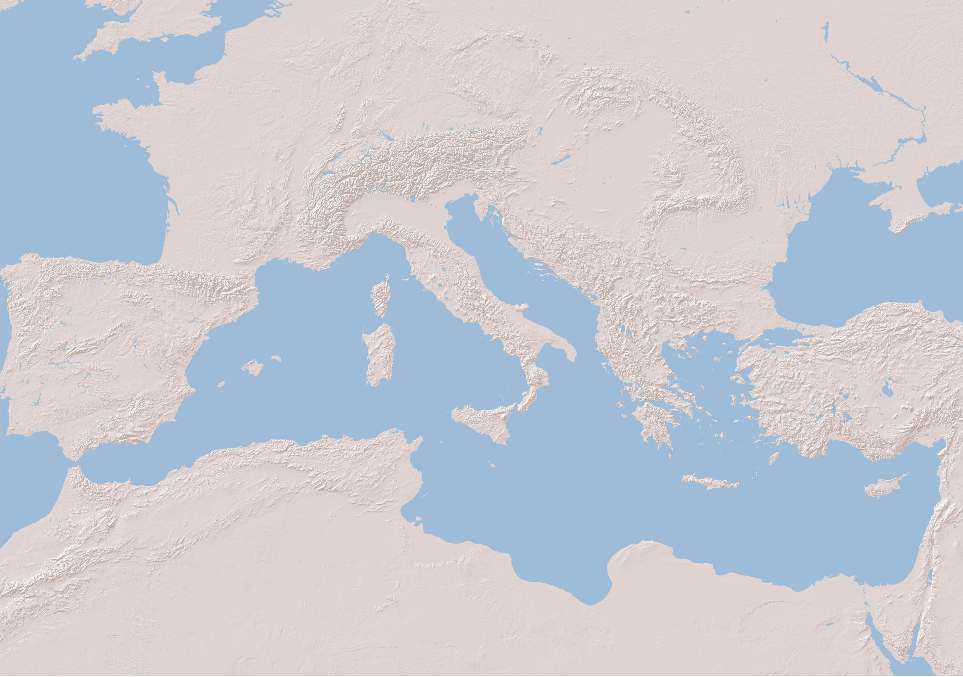


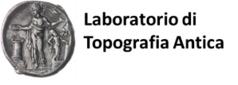




African Red Slip ware in Sicily during the Roman empire and the Late Antiquity : the region of Agrigento and Termini Imerese.
Session 162 | Culture contacts in the western Mediterranean sea during the Roman Age. Pottery as cultural marker between traffics and local productions
:
Fabrizio Ducati*
Claudio Capelli**
* Università degli Studi di Palermo; Aix Marseille Univ, CNRS, CCJ, Aix-en-Provence, France
** DISTAV, Università degli Studi di Genova

Slide 2
Session 162 | Culture contacts in the western Mediterranean sea during the Roman Age. Pottery as cultural marker between traffics and local productions
:
Topics
The integrated approach for the characterization of the African Red Slip ware workshops
African Red Slip ware in Sicily: the contribution of CASR project (2008-2016)
New data about African Red Slip ware: the surveys in Agrigento and Termini Imerese hinterland
The calcareous flanged bowls from Cignana: imitation or not?

Slide 3
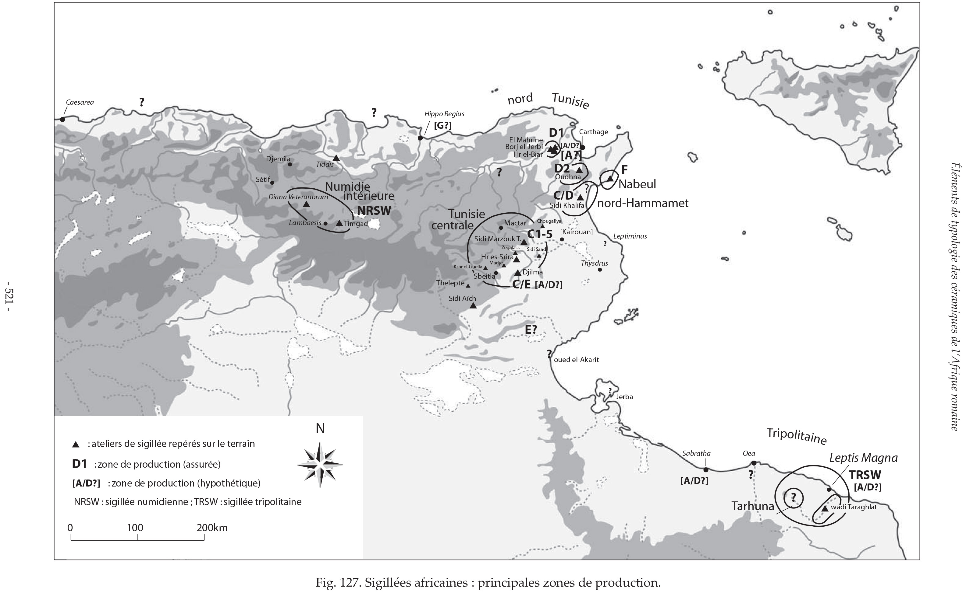
African Red Slip wares : workshops and production areas
From Bonifay 2016, p. 521, fig. 127

Slide 4
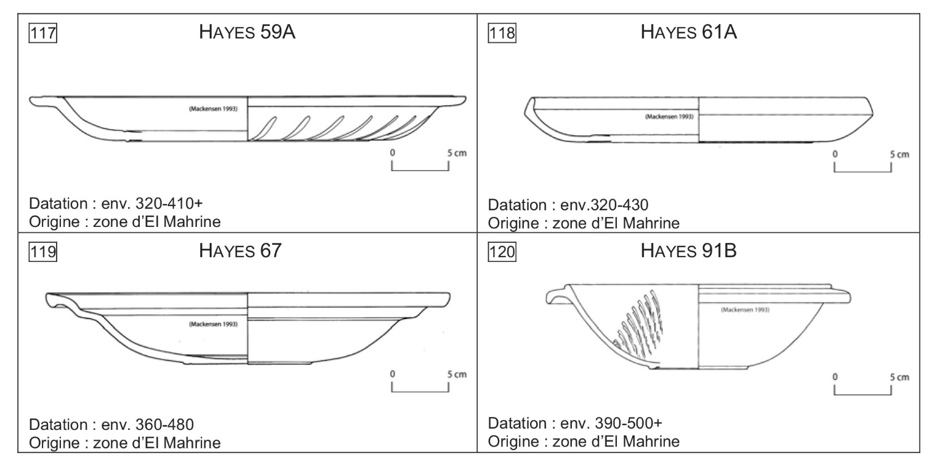
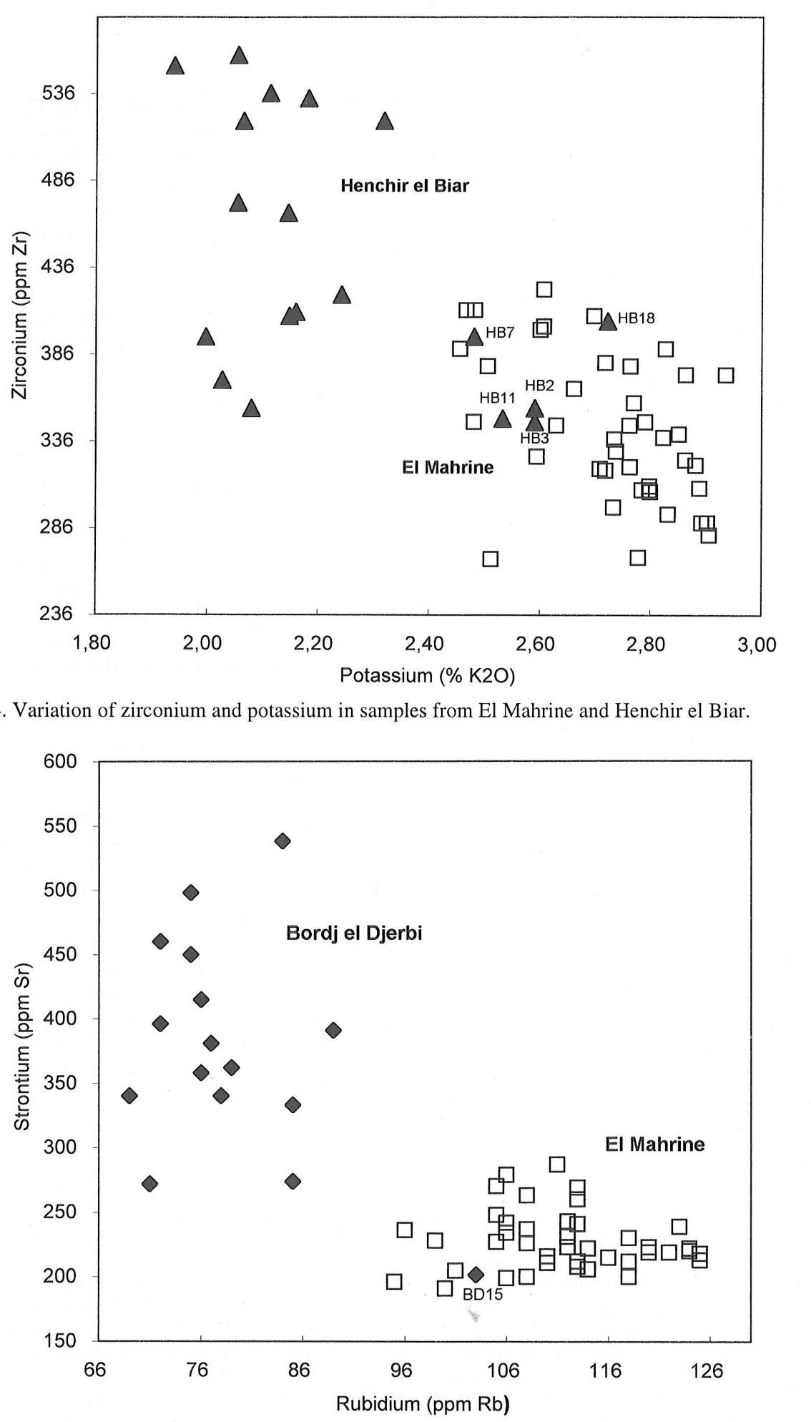
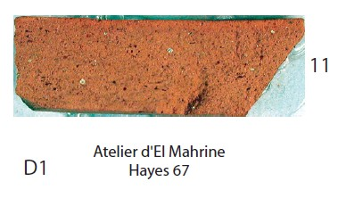
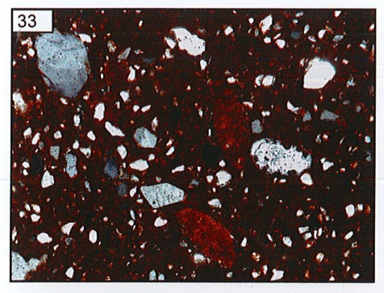
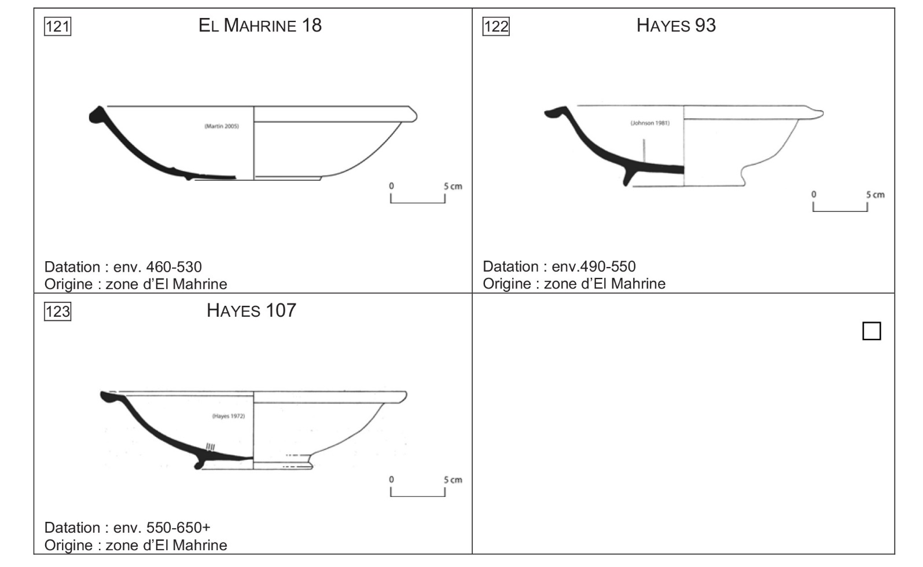

The integrated approach: archaeology and archaeometry
From Bonifay 2004, Pl II, n. 11.
From Bonifay 2016, pp. 557-558; Capelli et alii 2016, p. 384, fig. 81.
From Mackensen, Schneider 2002, fig. 14-15.

Slide 5
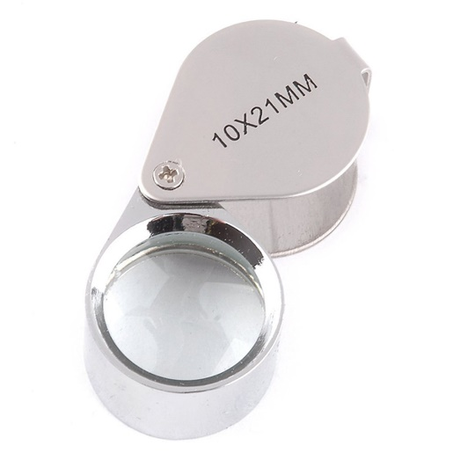
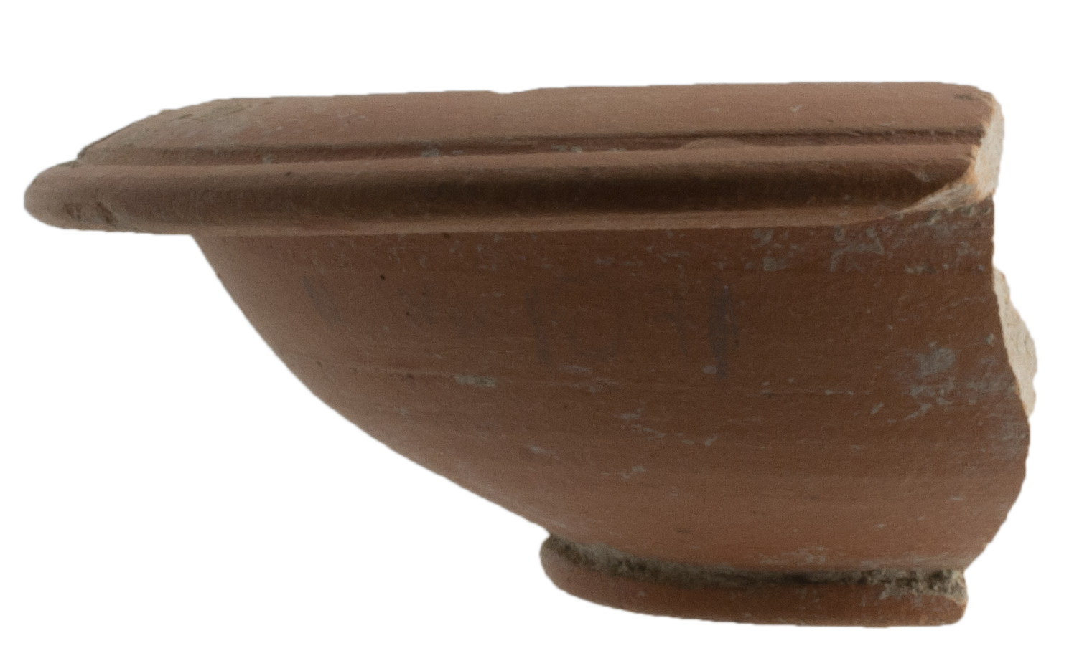
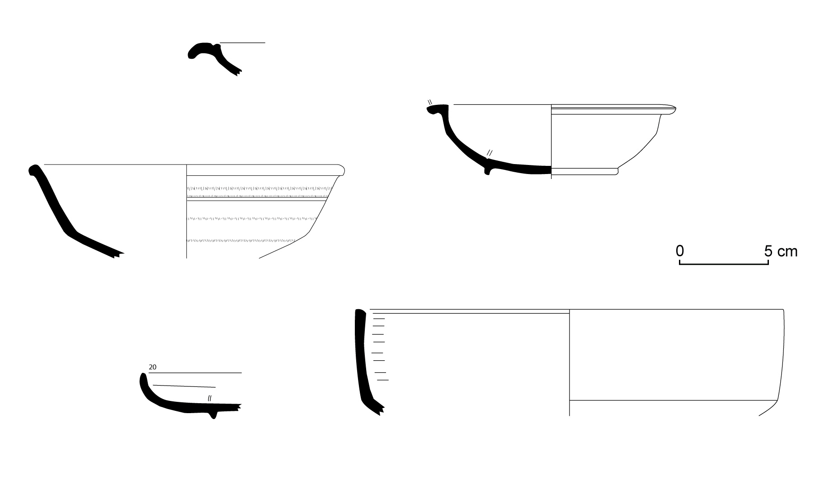
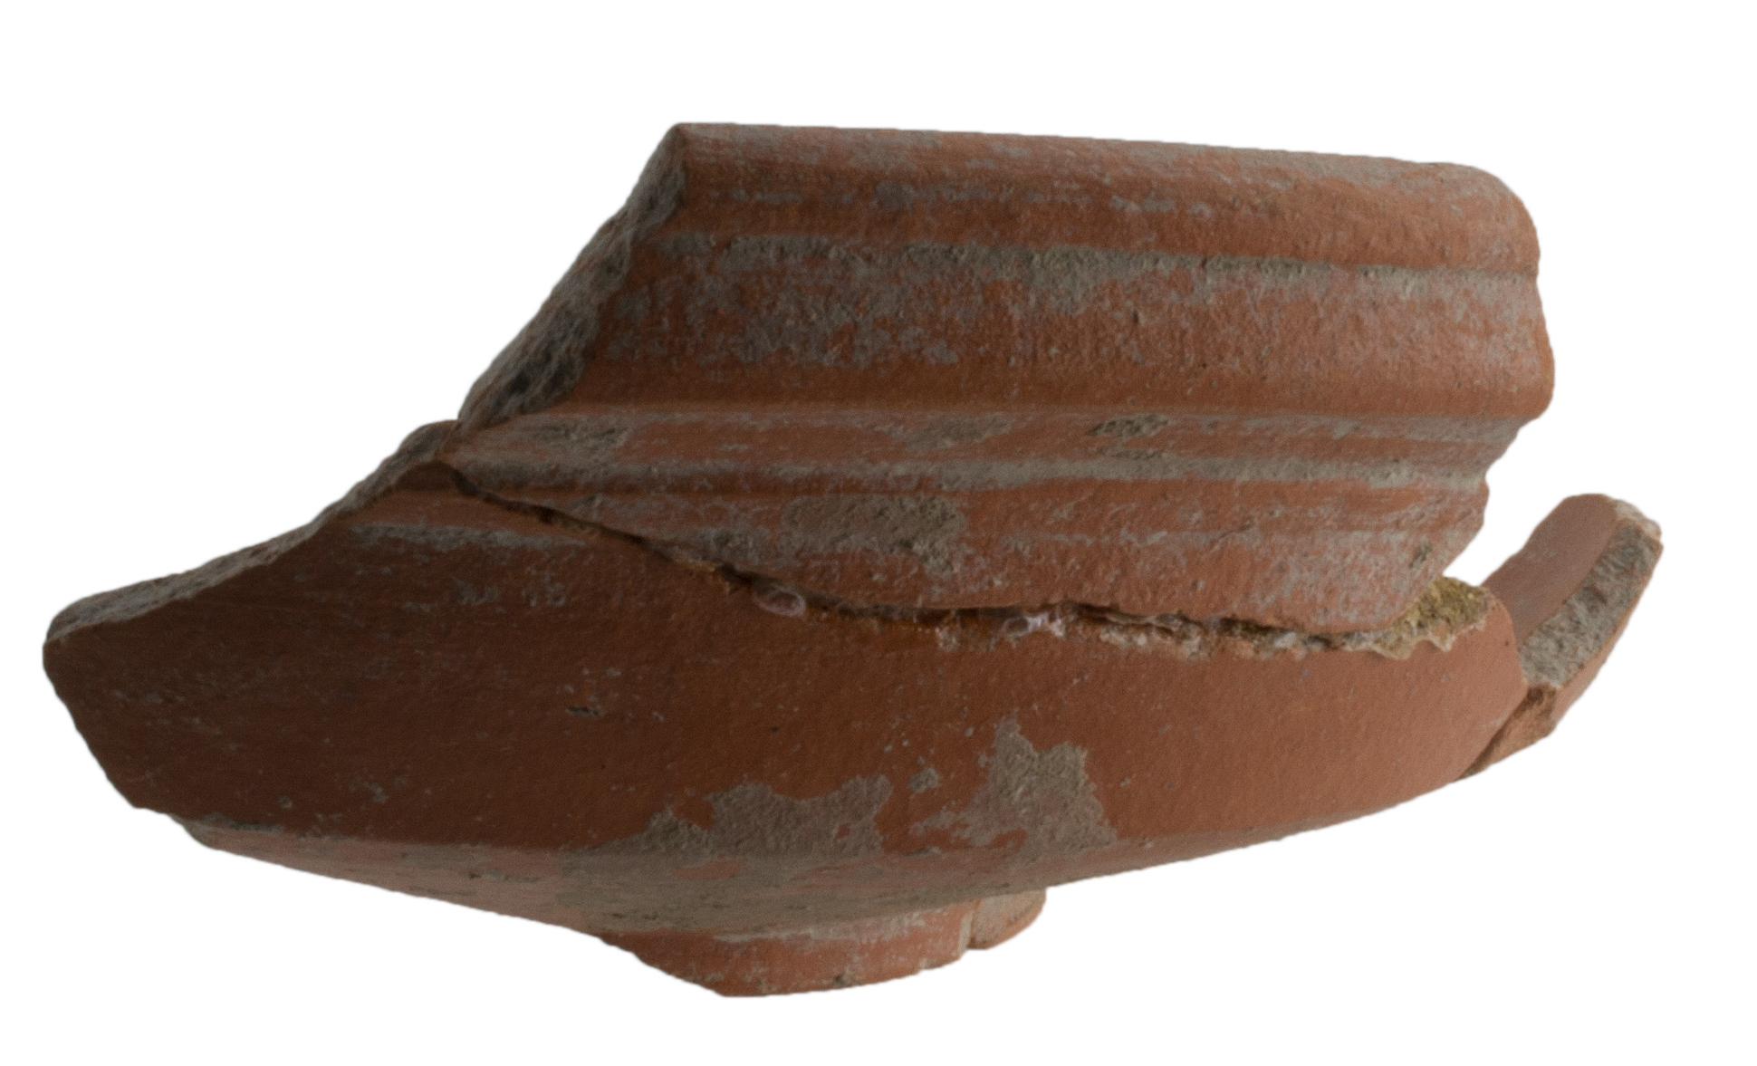

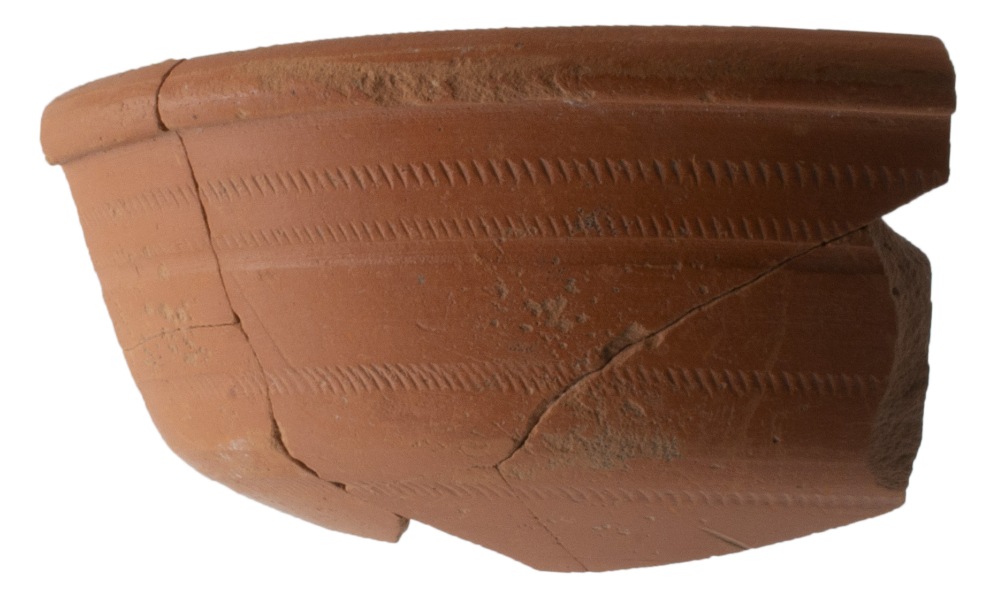
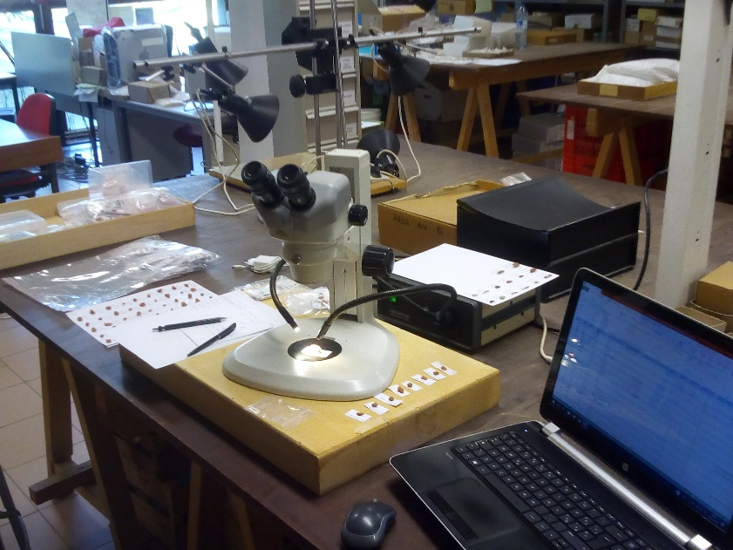
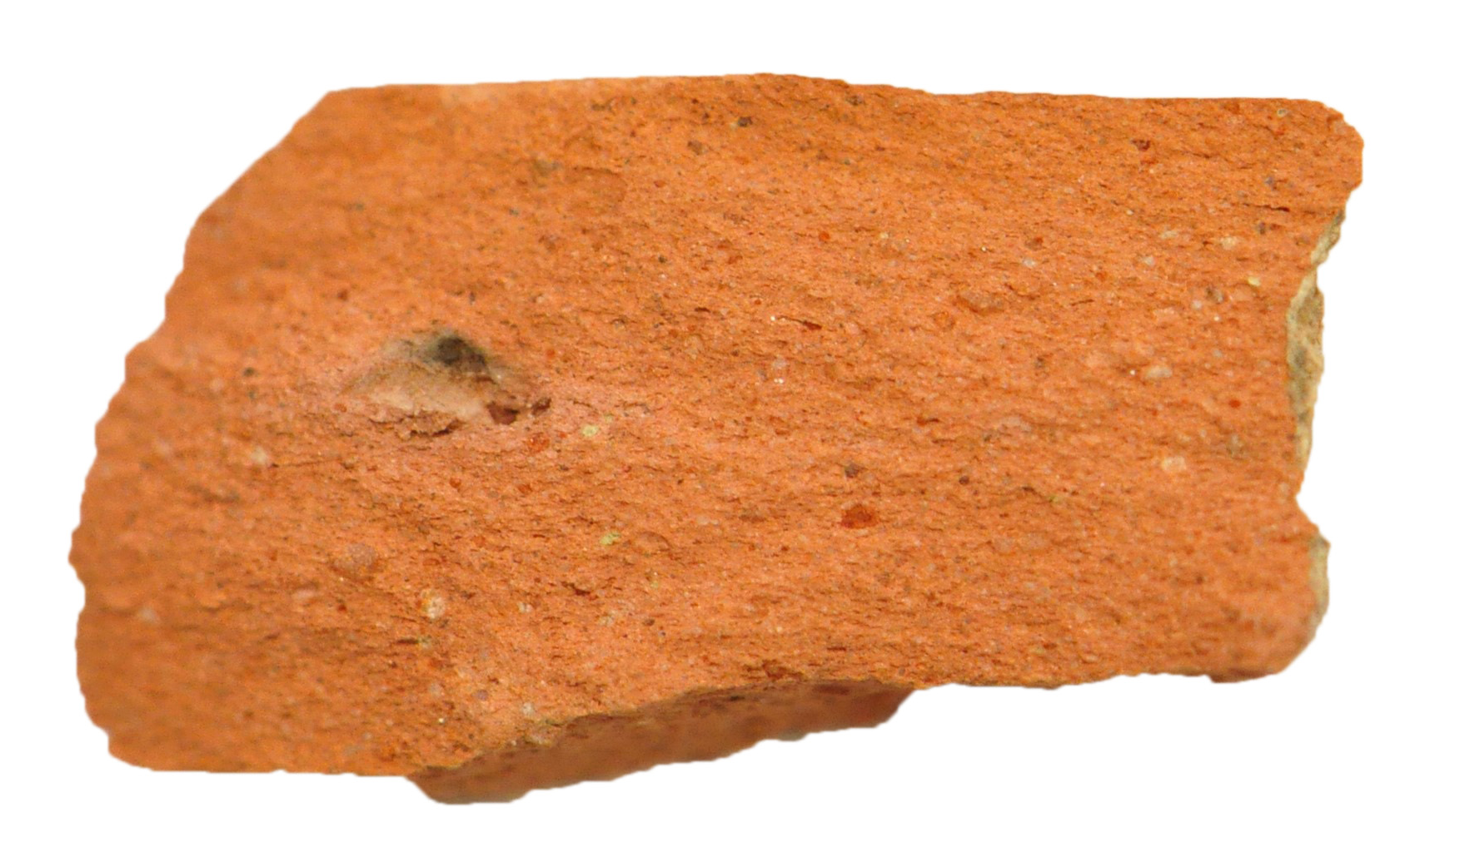
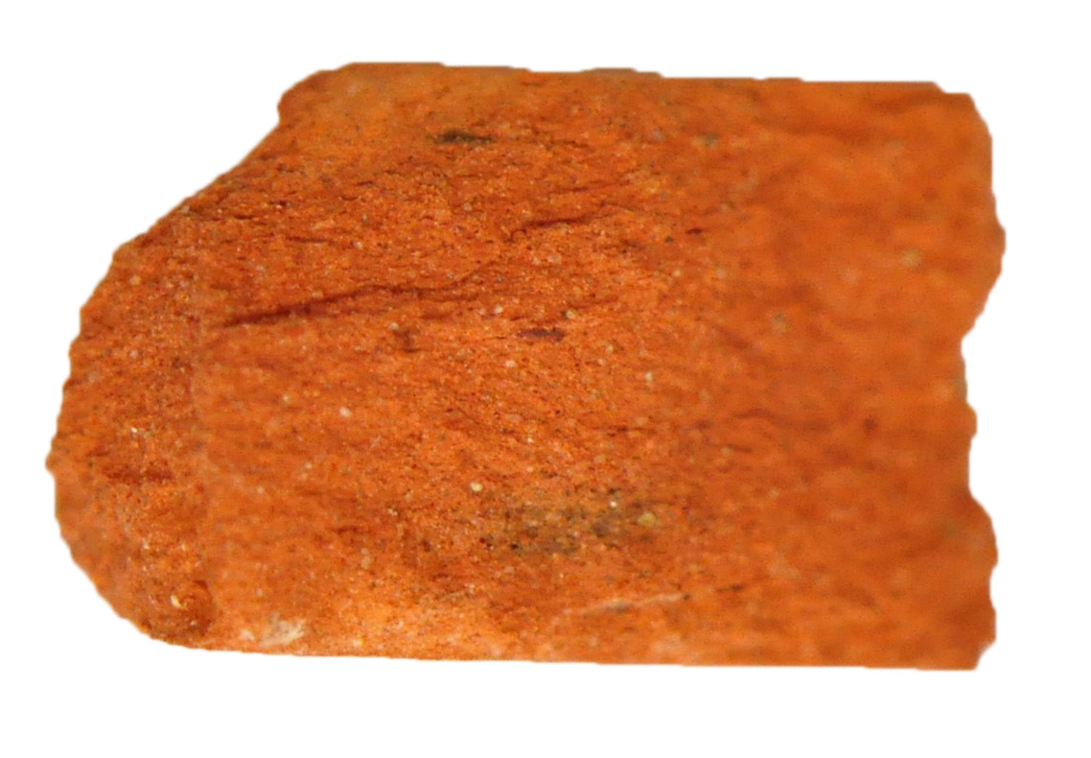
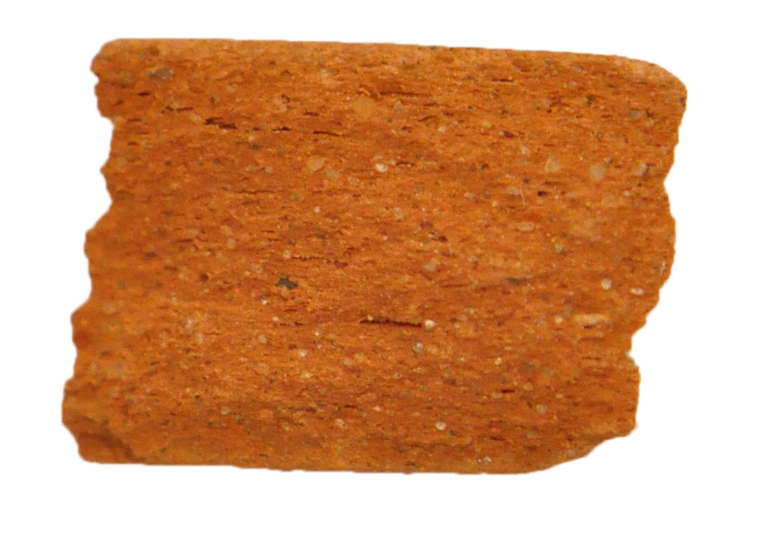
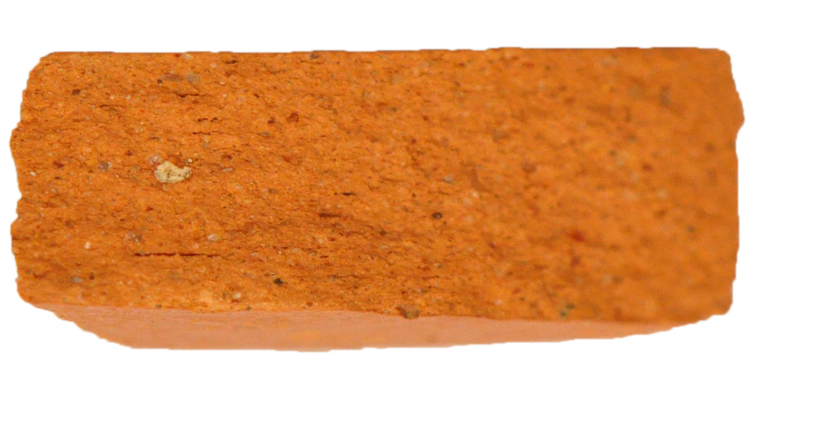
Working on consumption sites outside Africa
Hayes 2/3A, Hayes 6, Hayes 7, Hayes 15, Hayes 27
ARS A1
ARS D1
ARS C/D
ARS F

Slide 6
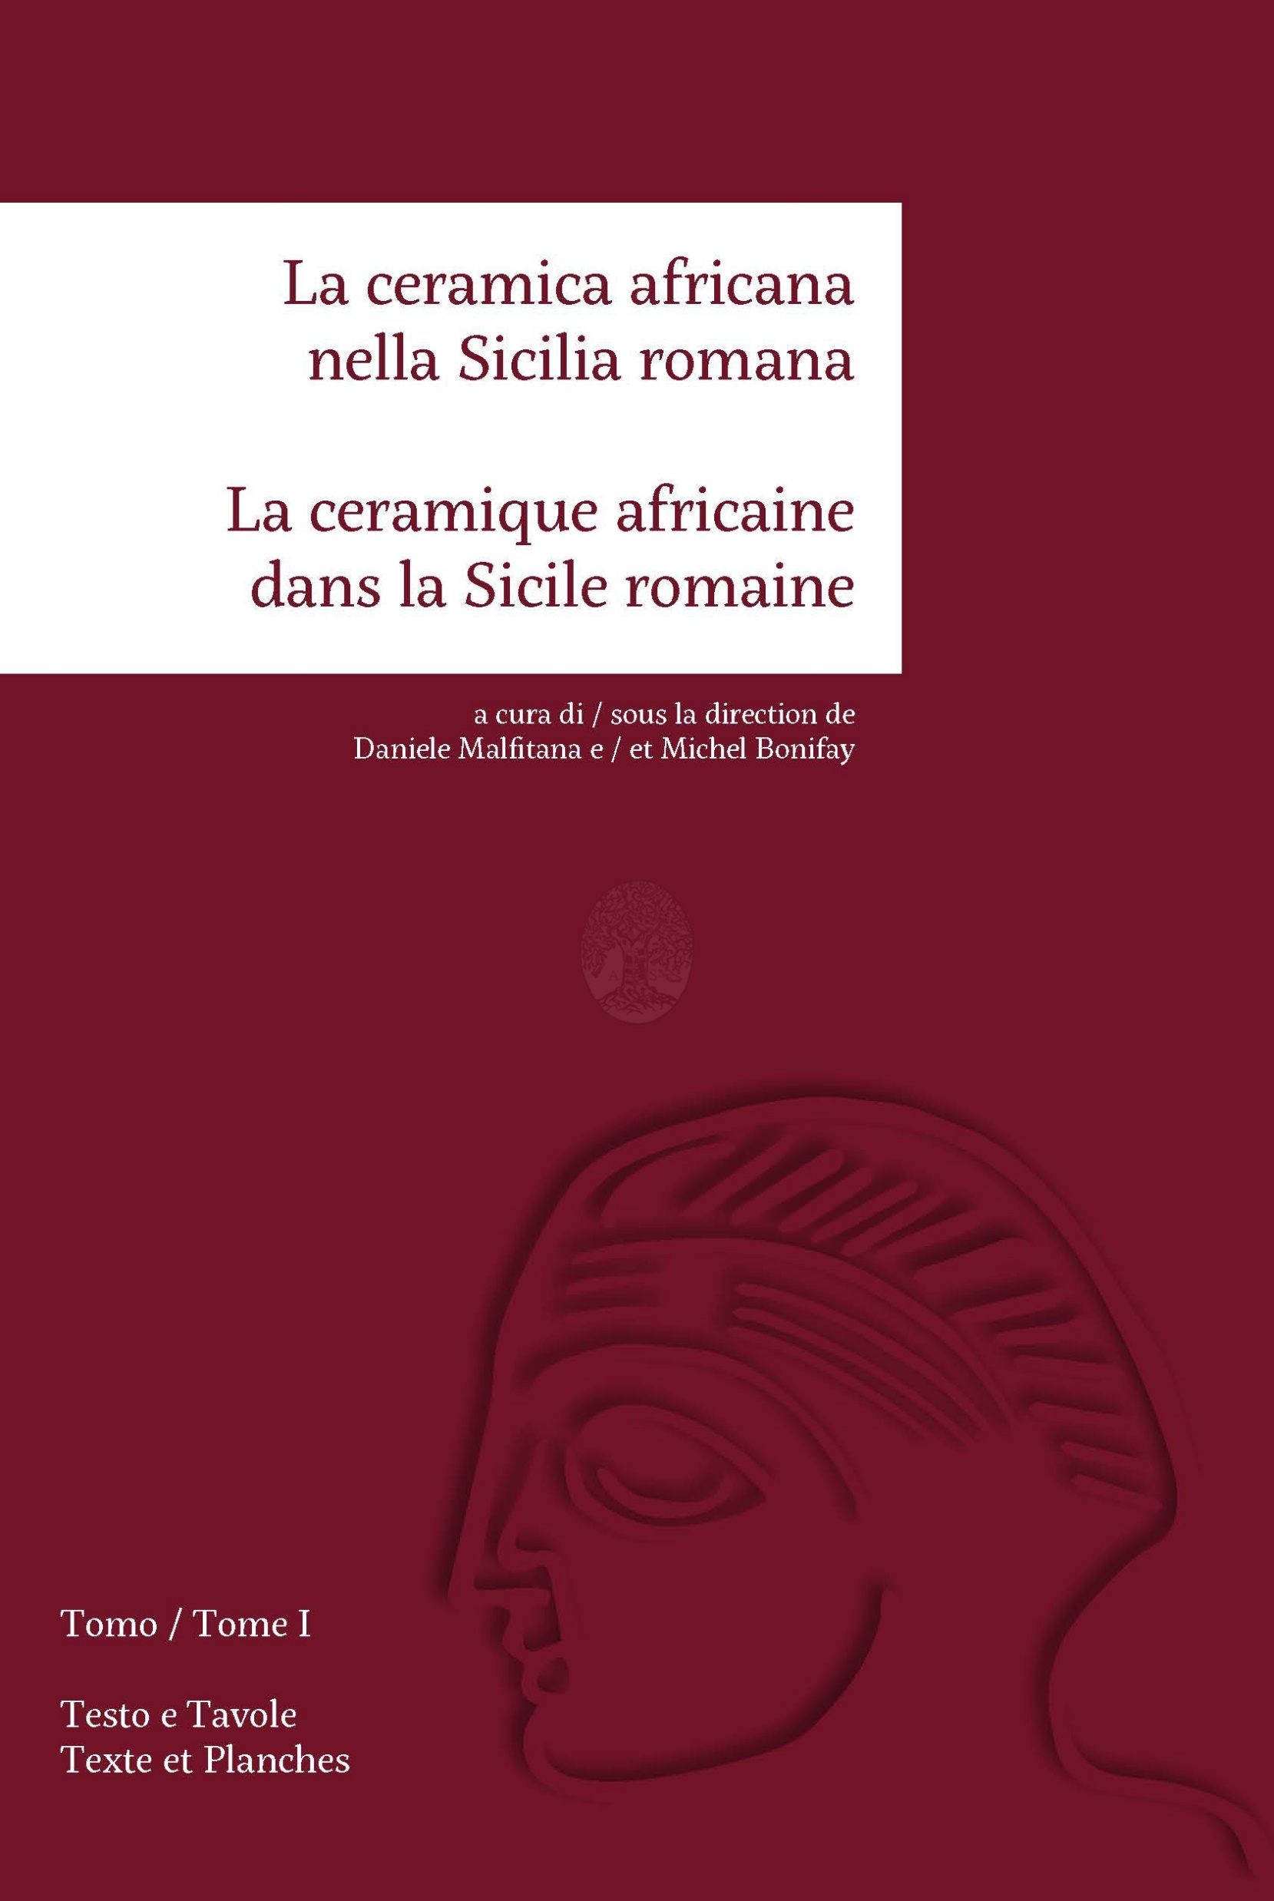
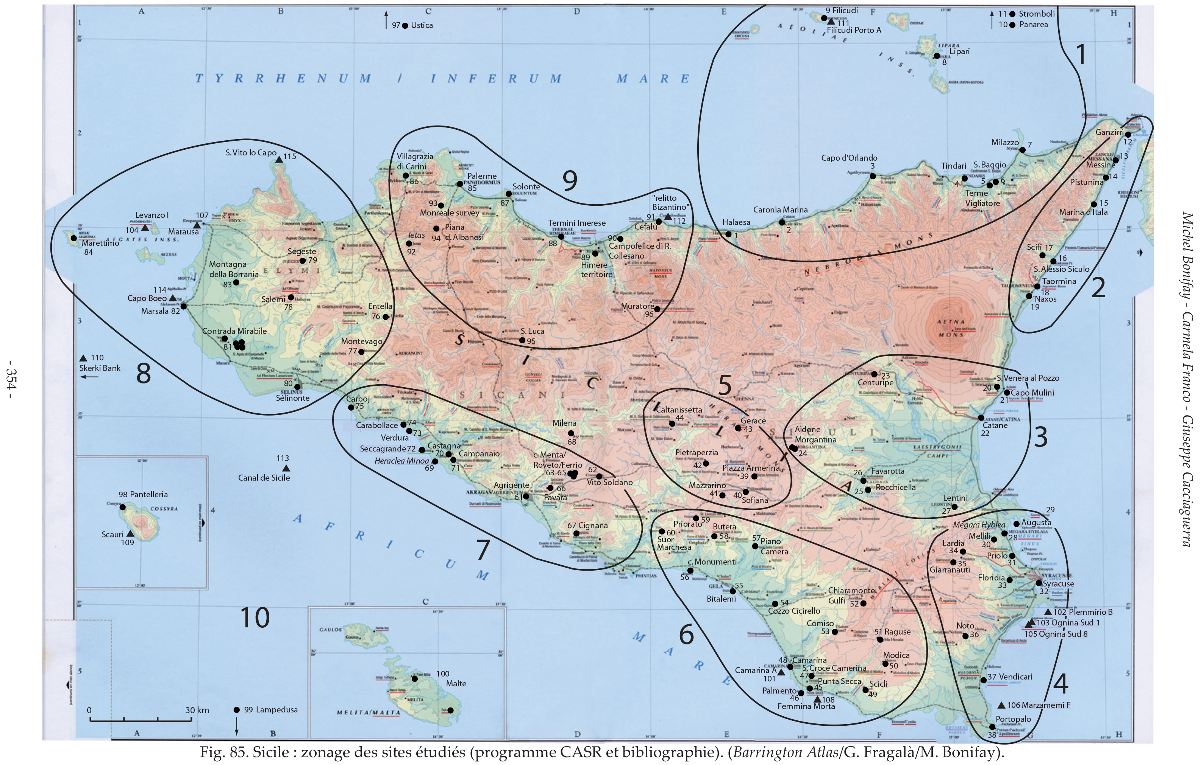
The CASR project (2008-2016) : La Ceramica Africana nella Sicilia Romana
From Bonifay et alii 2016, p. 354, fig. 85 : Sicilian sites analized durign the CASR project

Slide 7
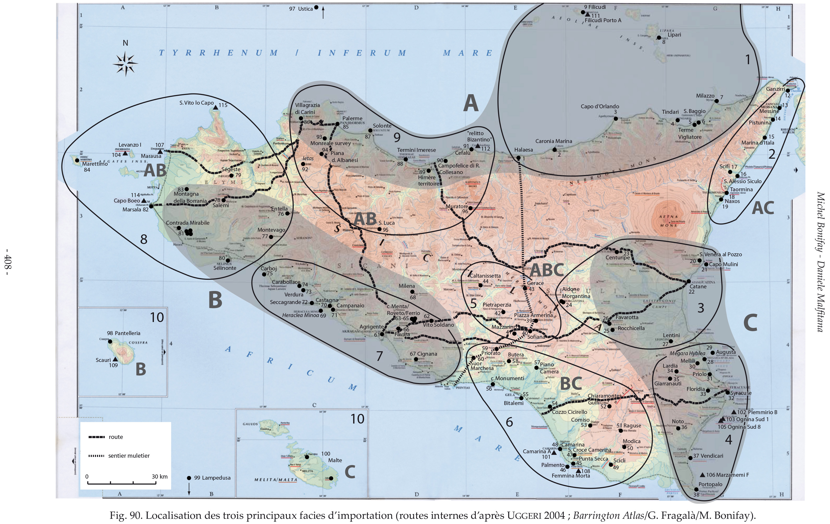
The CASR project (2008-2016) : La Ceramica Africana nella Sicilia Romana
Main workshops and production areas in Tunisia
From Bonifay, Malfitana 2016, p. 408, fig. 90. Main import facies

Slide 8
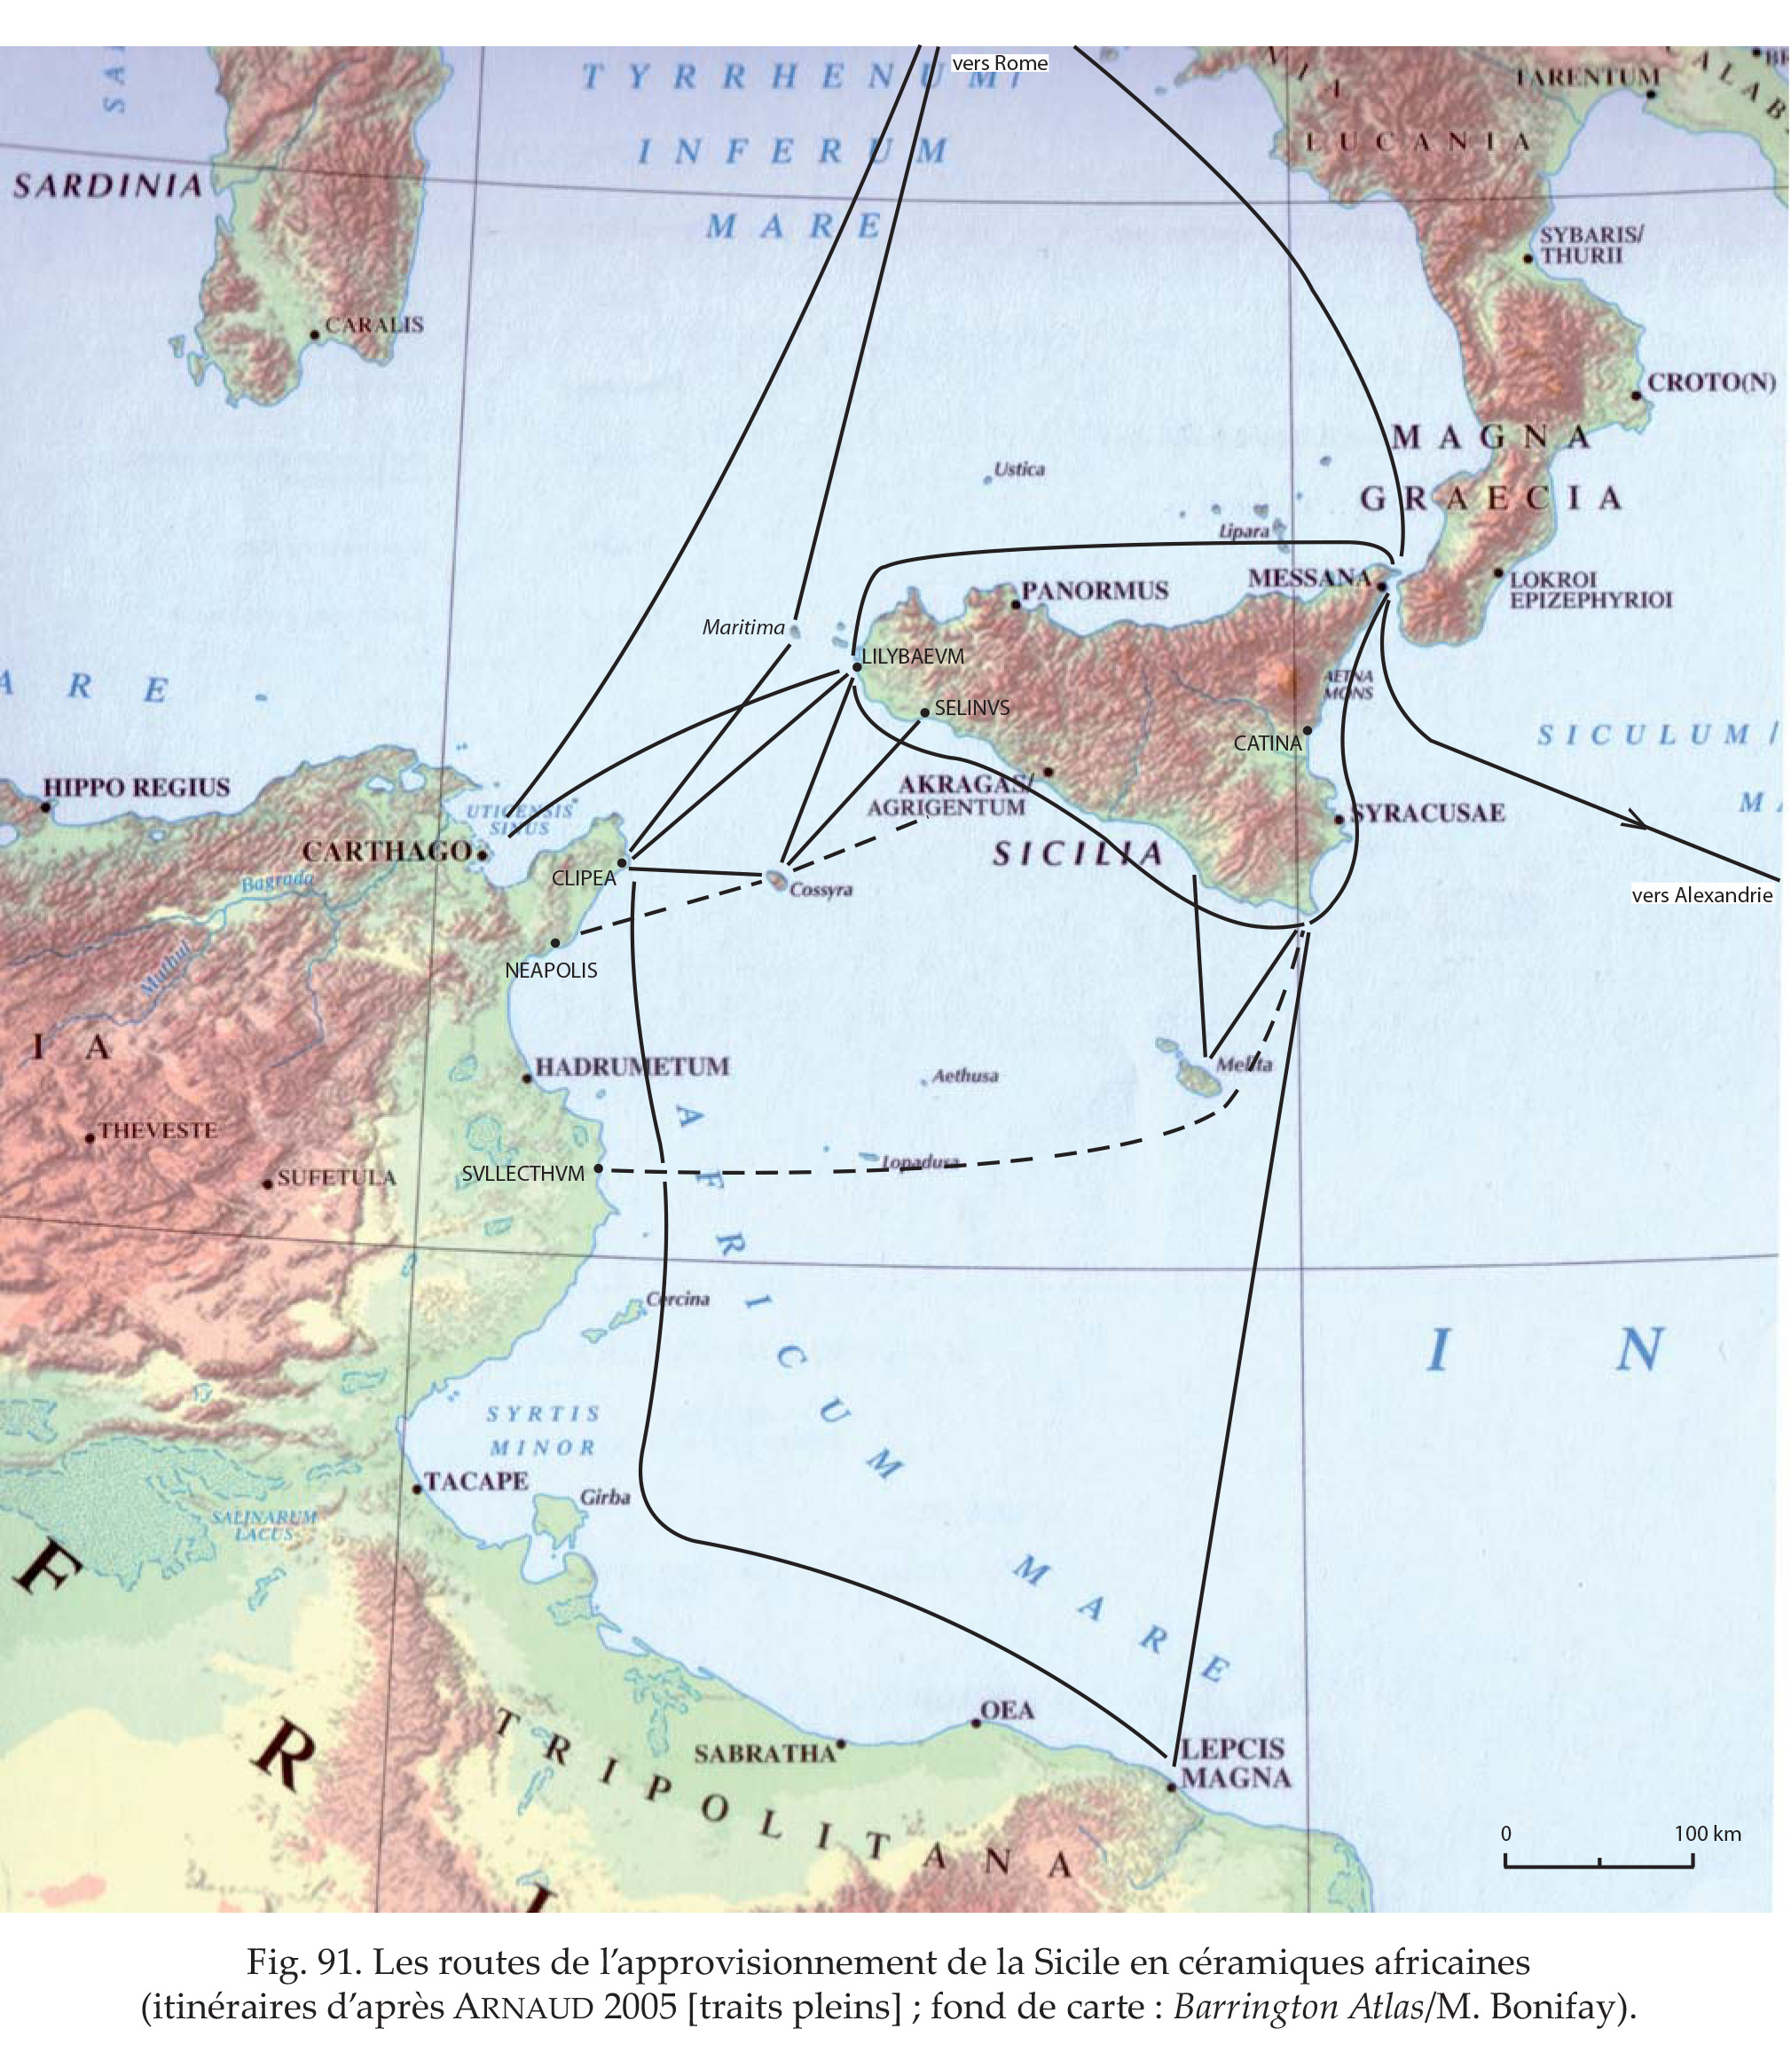
From Bonifay, Malfitana 2016, p. 412,fig. 91.
Routes that supplied Sicily with African potteries

Slide 9
African Red Slip ware from the region of Agrigento and Termini Imerese
Thermae Himerae surveys
Cignana surveys

Slide 10
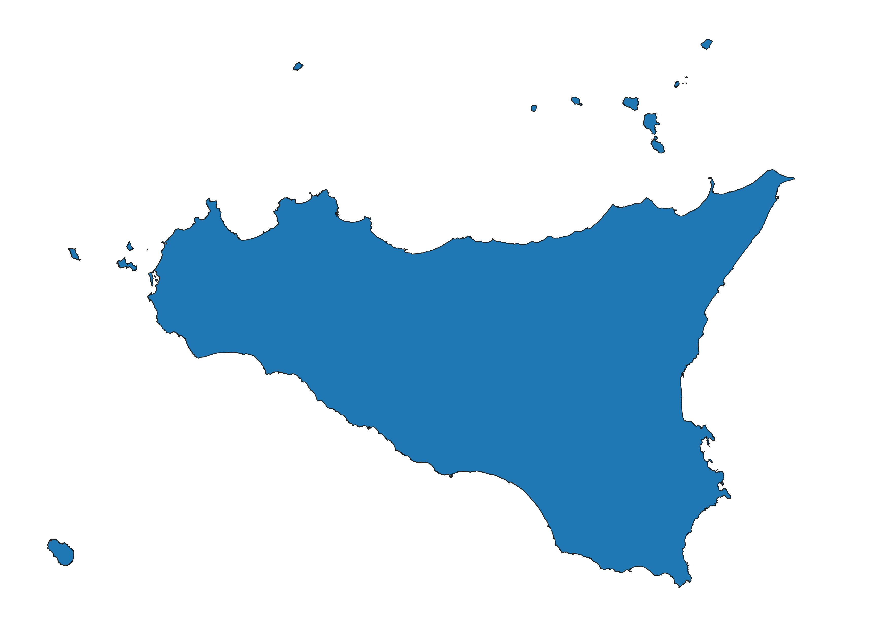
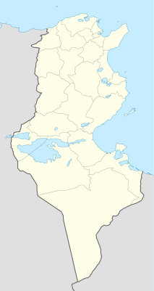
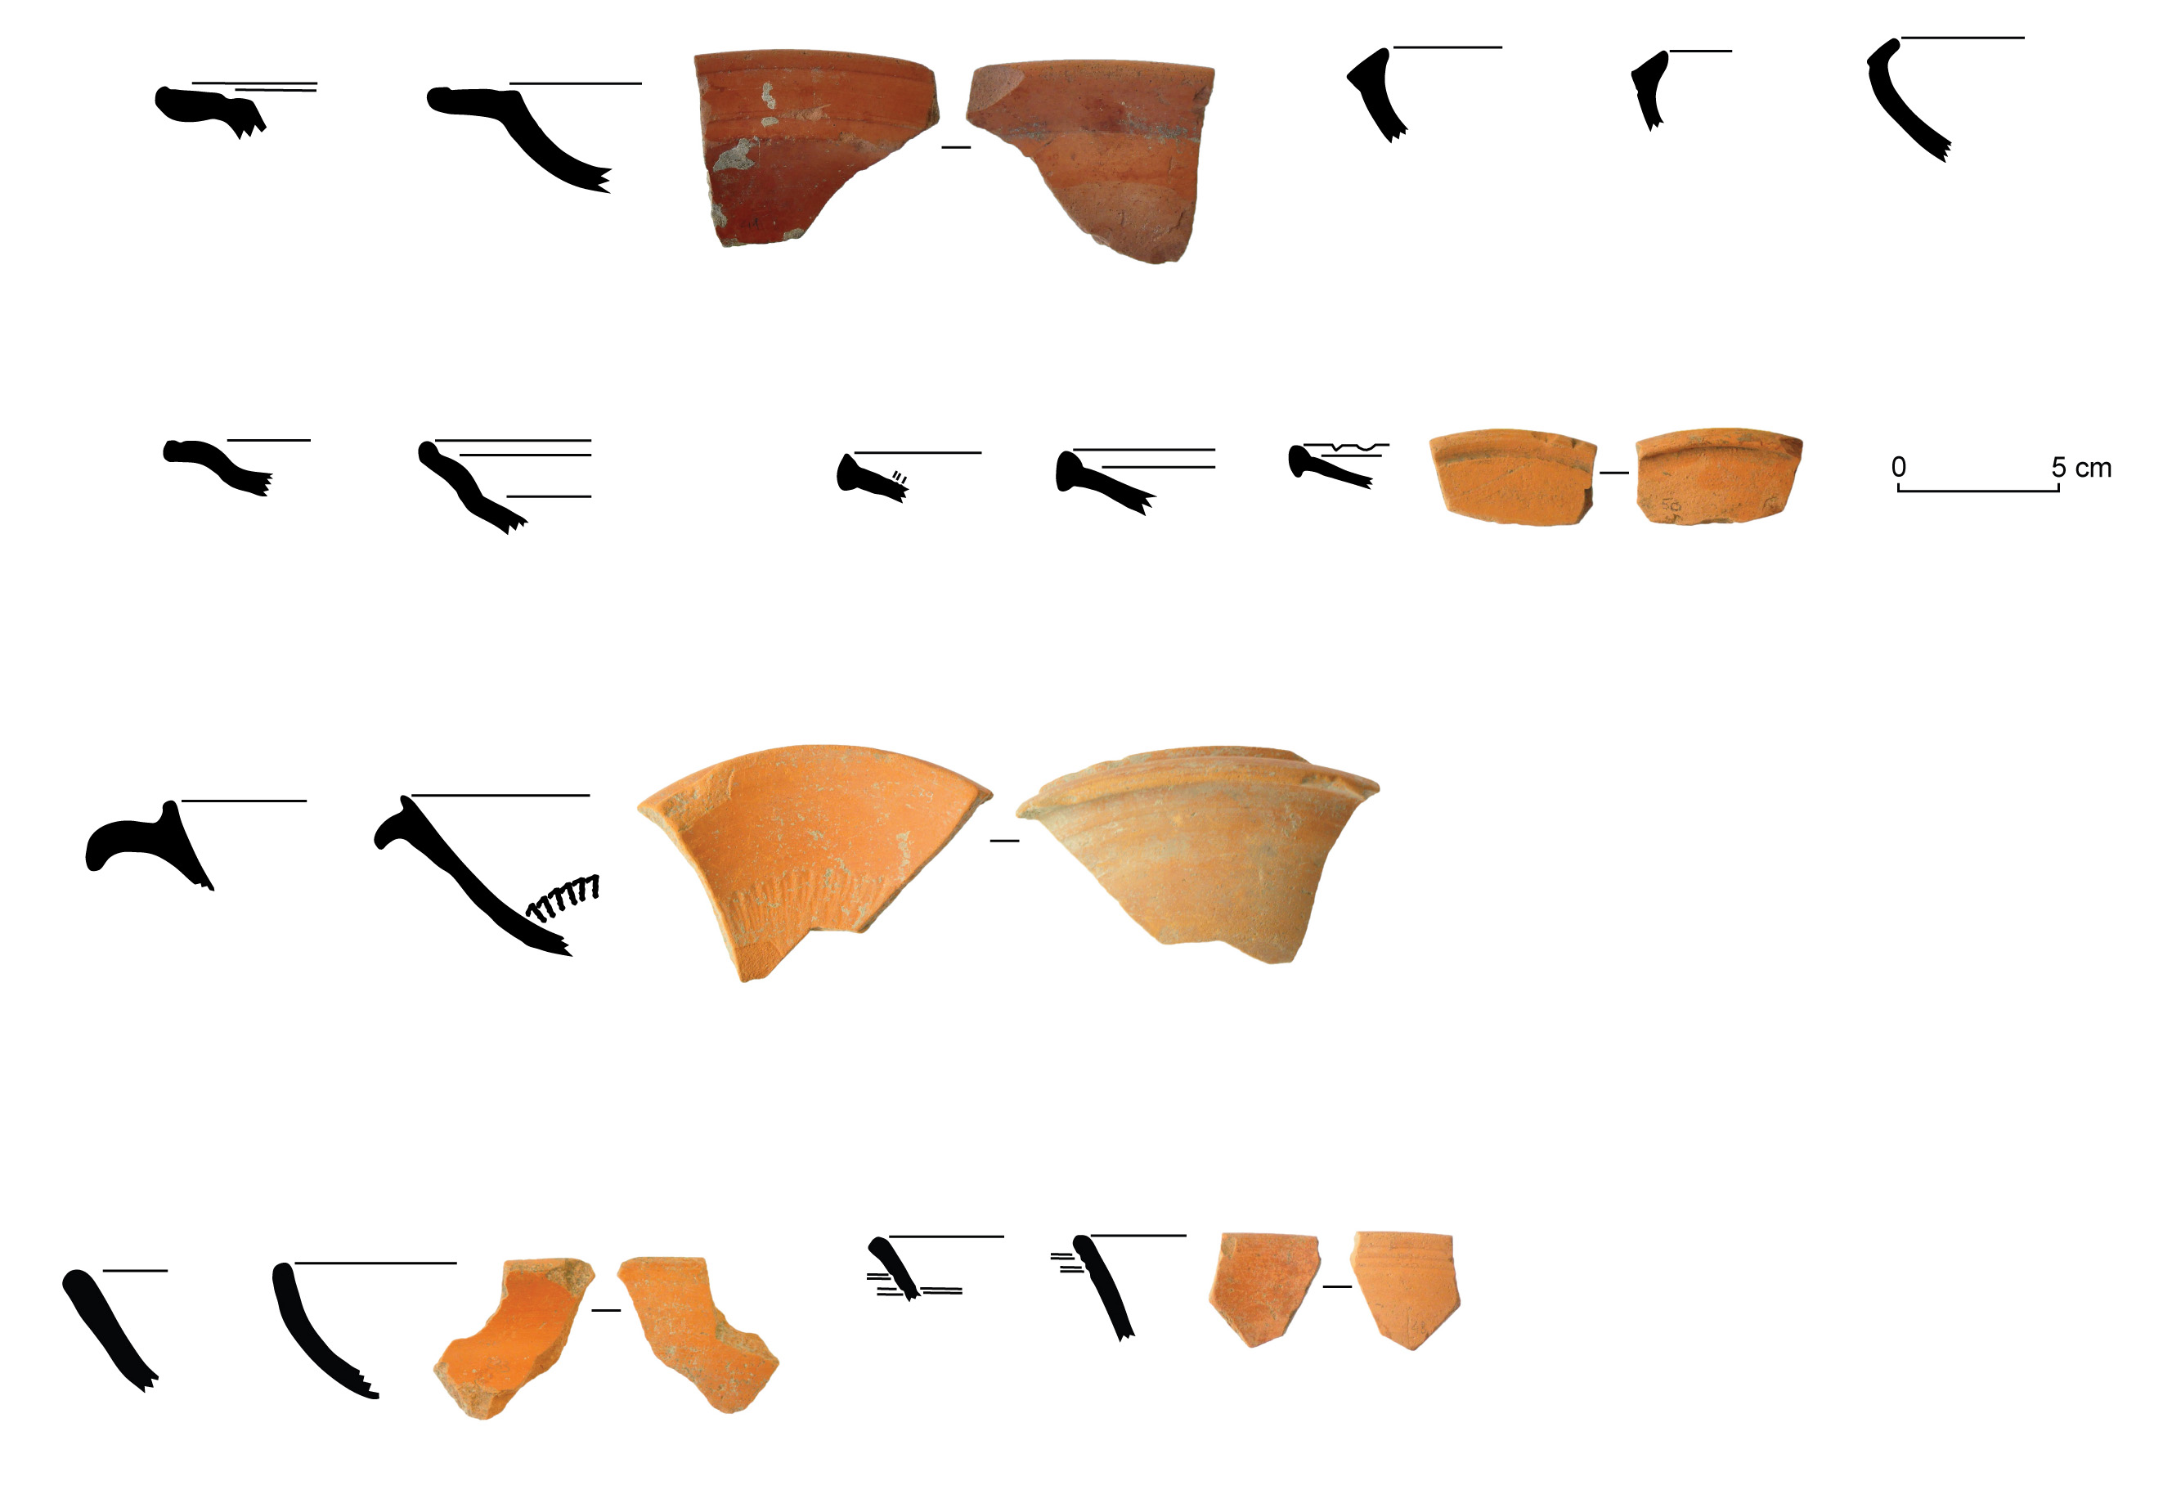
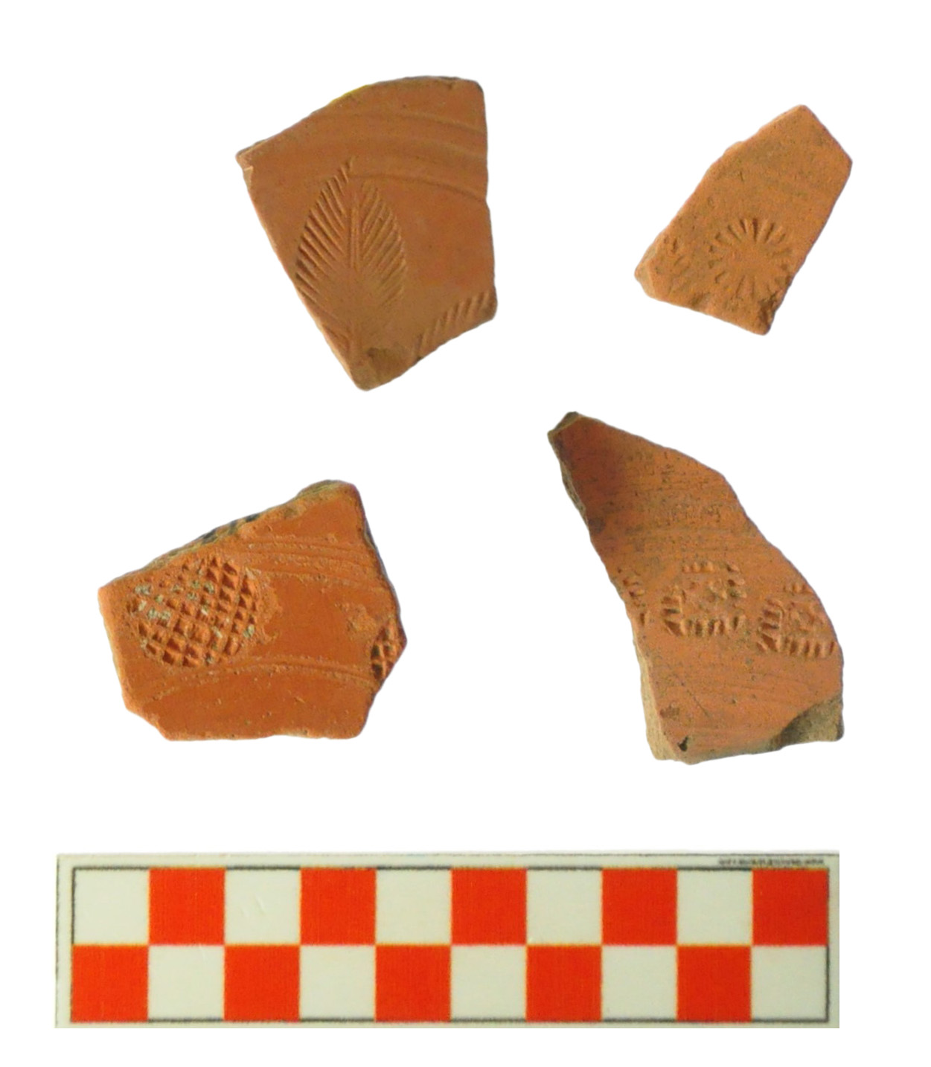
The surveys on Thermae Himerae hinterland
Hayes 59
Hayes 61A
Hayes 67
Hayes 73 and 76
ARS D1 from the region of El Mahrine
ARS D from the region of Carthage
Hayes 91B
Hayes 82 and 64
Hayes 80

Slide 11
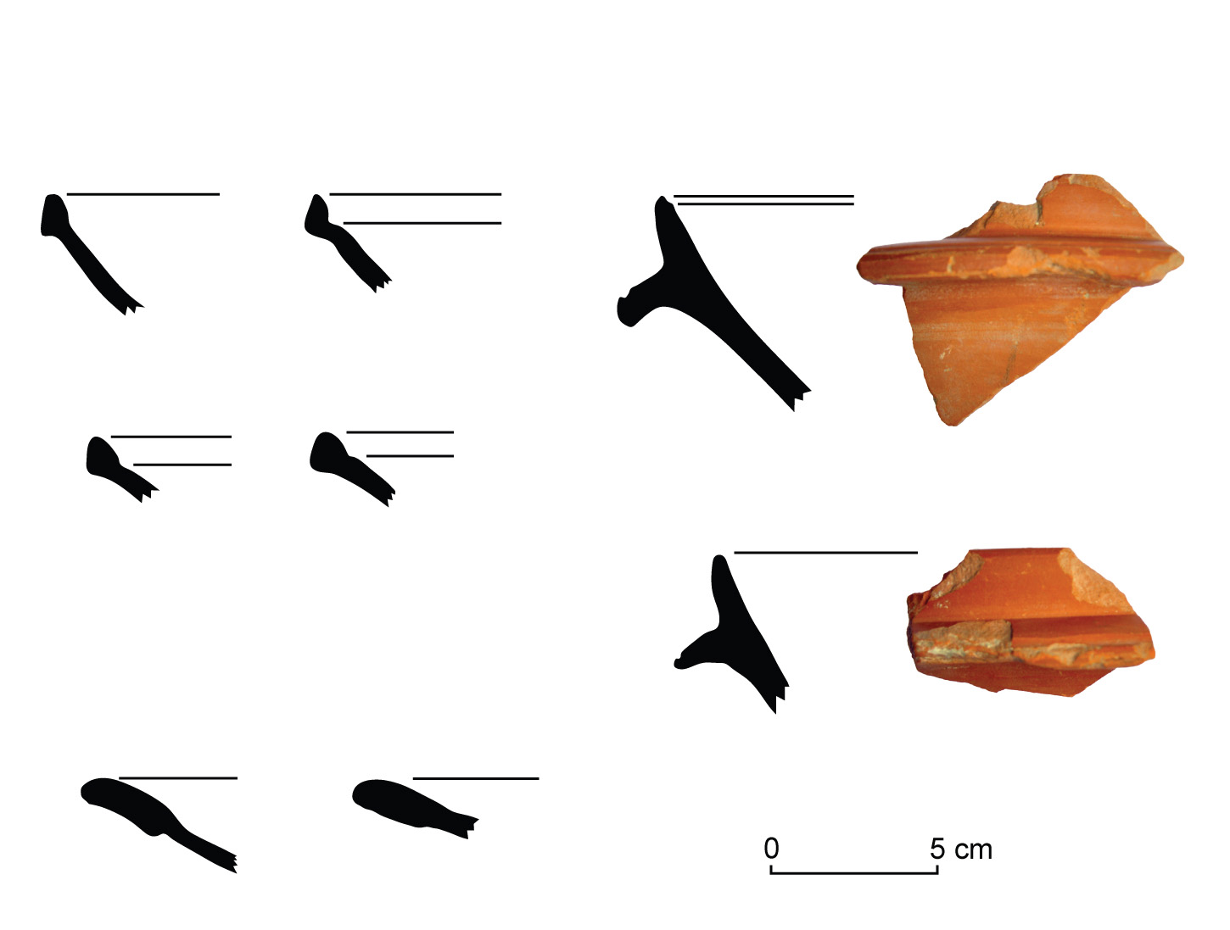
The surveys around the Roman Villa of Cignana :
20 Km South-East from Agrigento
ARS C/D
from Sidi Khalifa
Hayes 61B
Hayes 92 similis
Hayes 88
Style A(iii)

Slide 12
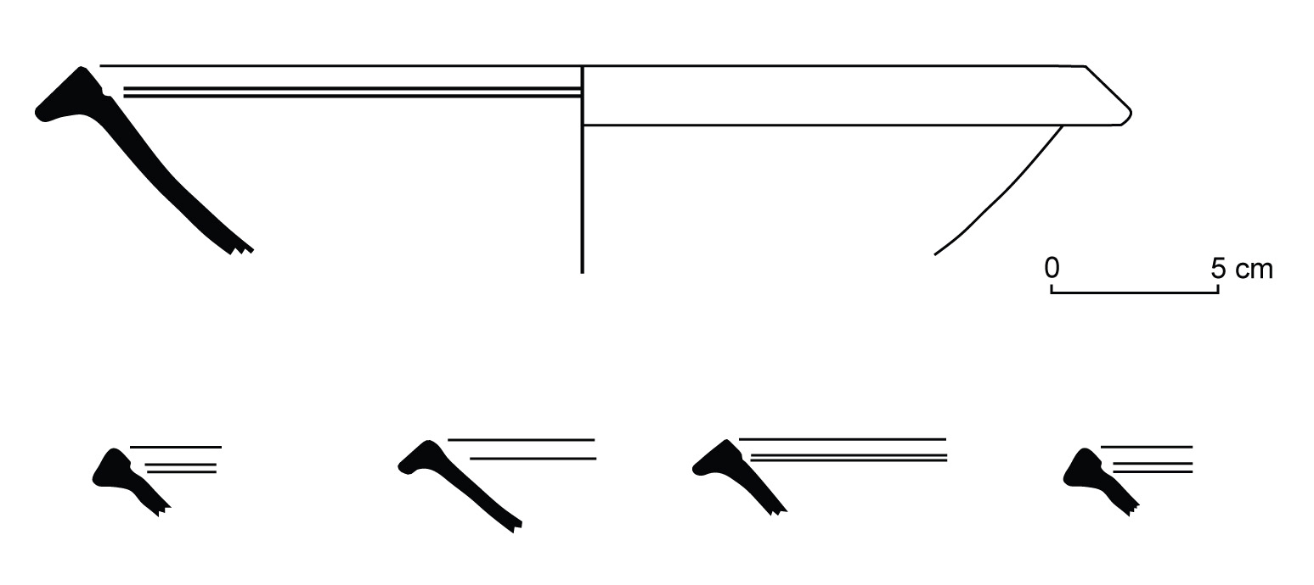
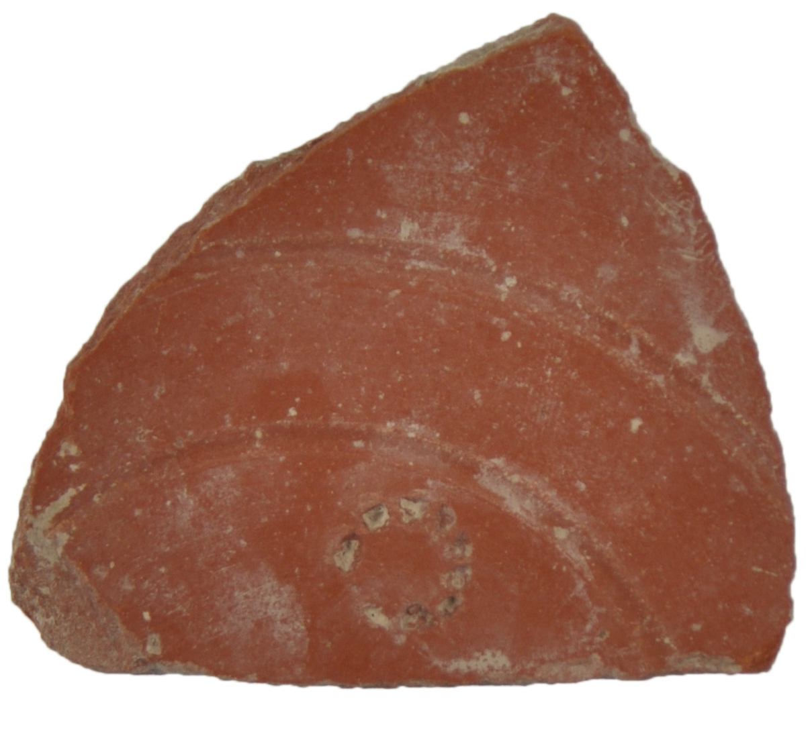
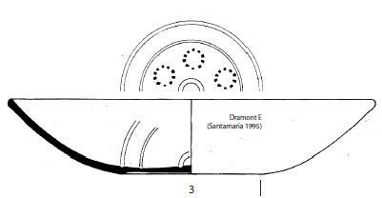
The surveys around the Roman Villa of Cignana :
20 Km South-East from Agrigento
ARS D: Hayes 61 C from
the North of the Gulf of Hammamet
ARS F: Hayes 50B, n° 61 from Nabeul
ARS D2: Hayes 103 or 104 (?)
decored in style E (ii), from Atelier X
From Bonifay 2004, fig. 105

Slide 13
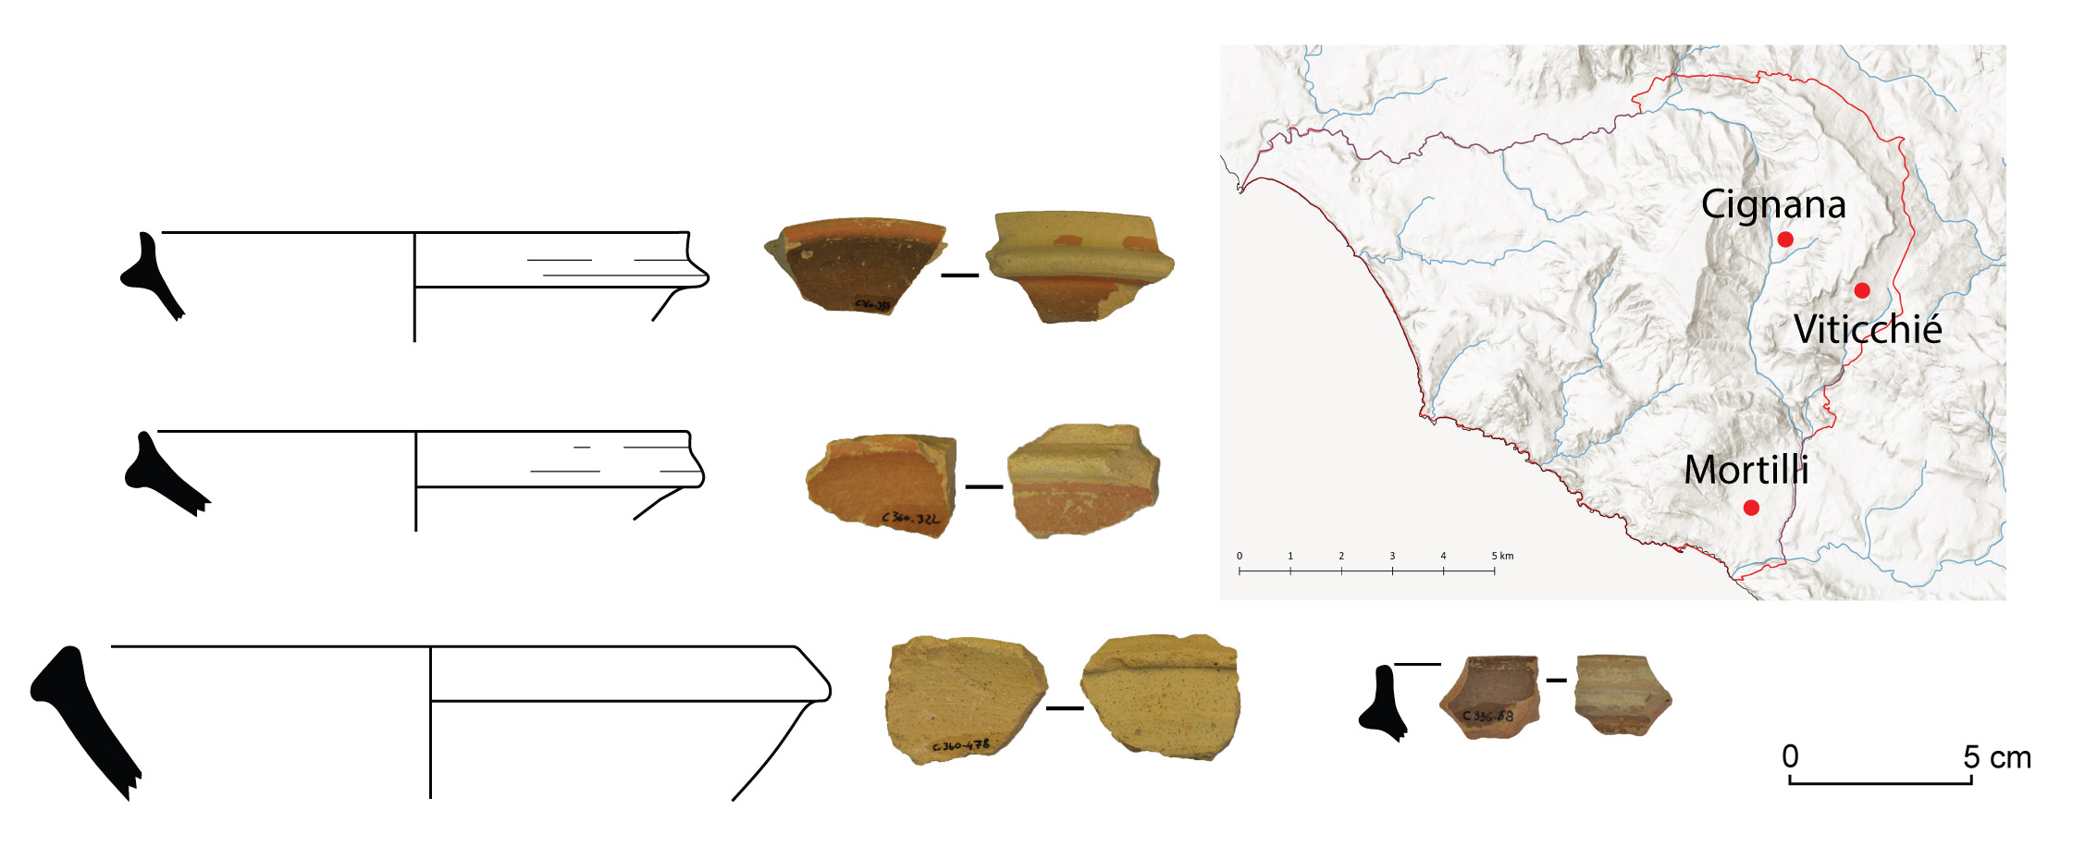
Flanged bowls from Cignana surveys
Sites that delivered flanged bowls
Small flanged bowls with calcareous matrix and iron-rich slip, on the inner and outer side.

Slide 14
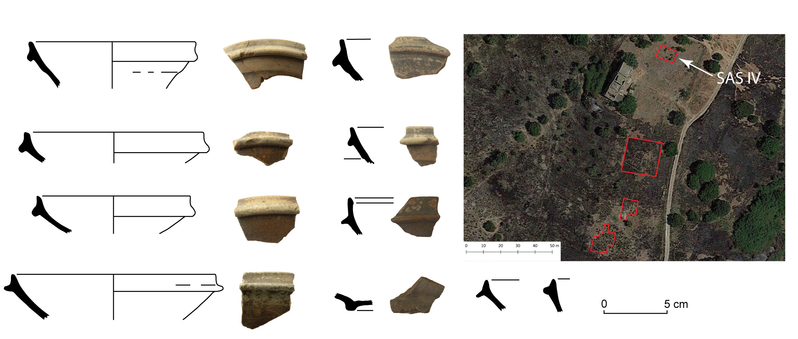
Flanged bowls from Cignana excavation (2006): SAS IV
The area of the Late Antique village
Thanks to Maria Serena Rizzo (Parco Archeologico della Valle dei Templi), supervisor Cignana excavation.

Slide 15
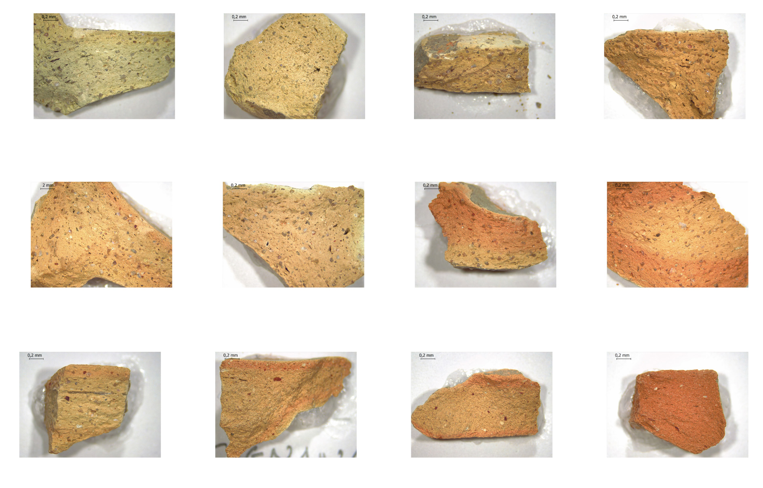

Slide 16
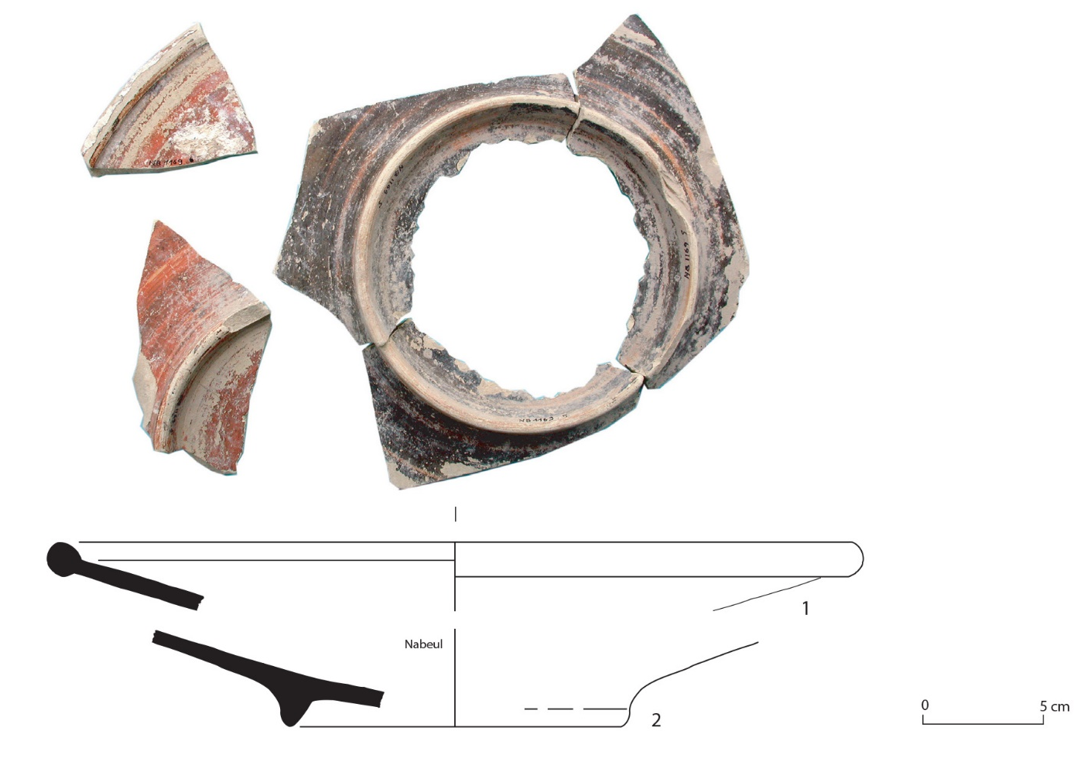
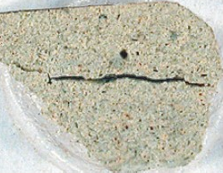
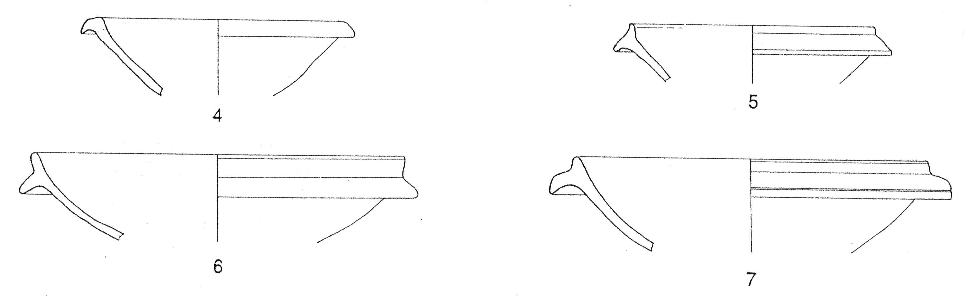
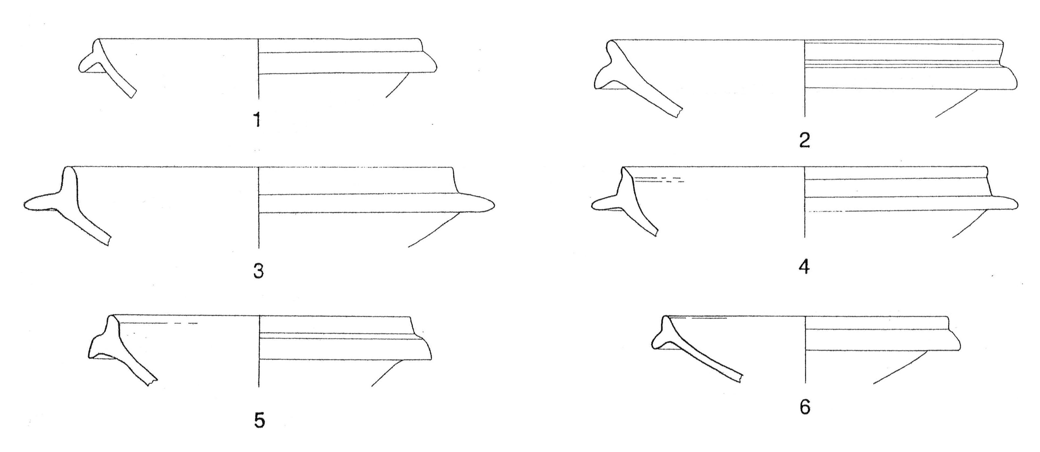
Dérivée de sigillée brune à pâte blanche
Ceramica romana a vernice rossa
From the Domus of Gaudenzio in Rome
From Bonifay 2004, Pl. II, n. 20
Hayes 105 from Nabeul.
End VII – beginning VIII century (?).
From Bonifay 2004, fig. 111
From Fontana 1988, fig. 5-6

Slide 17
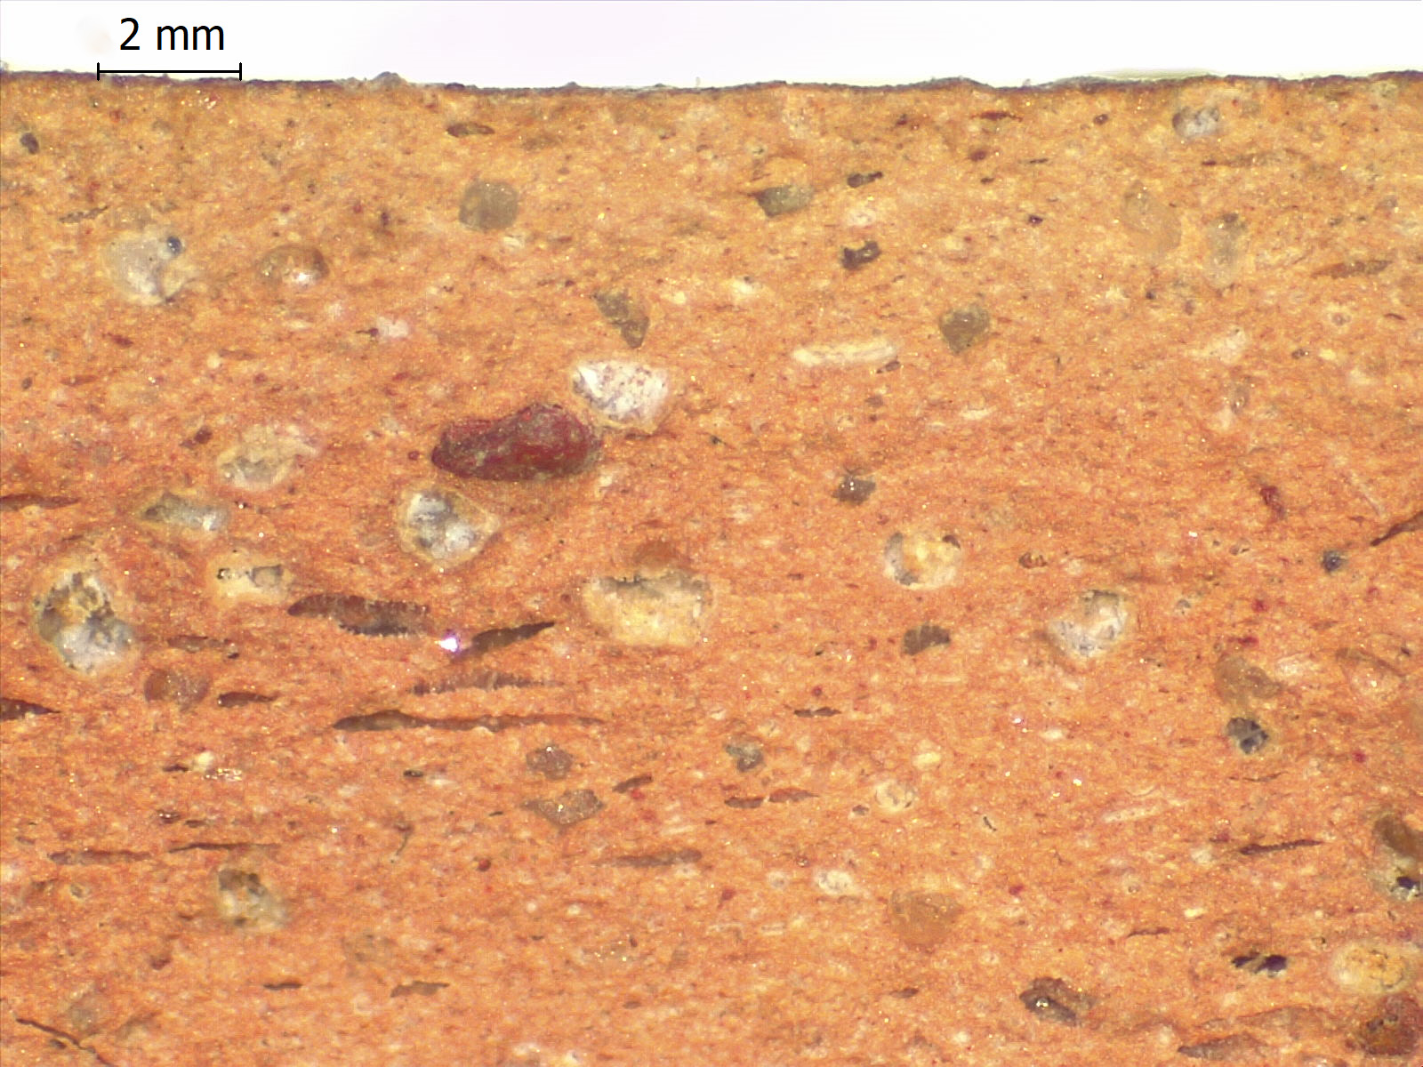
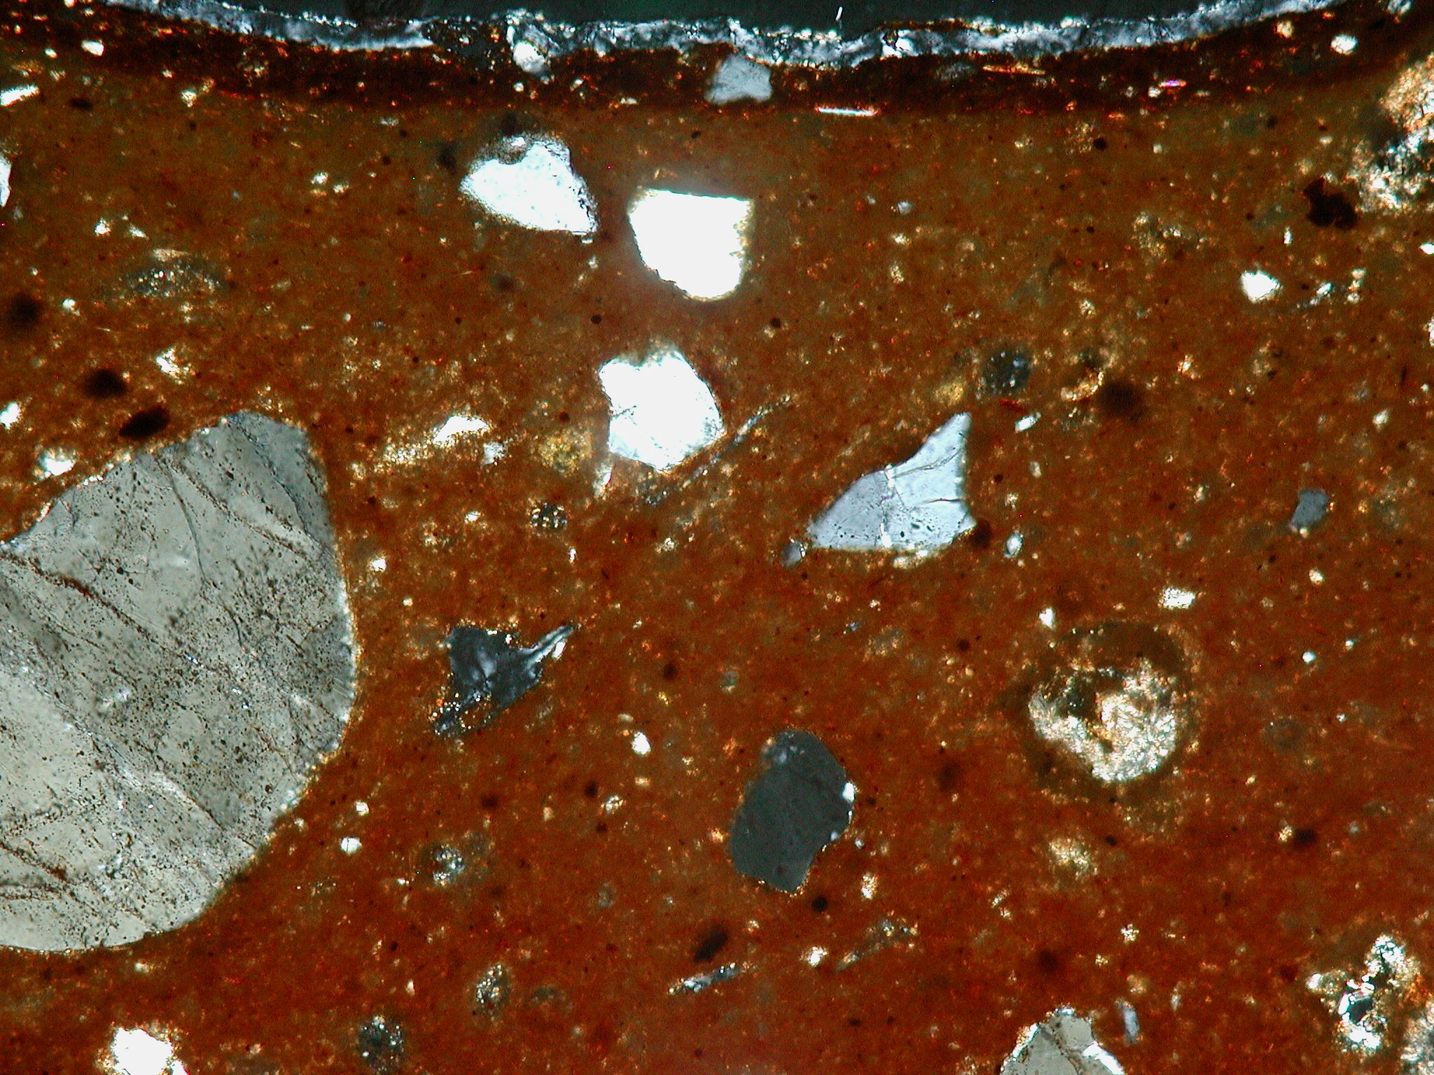
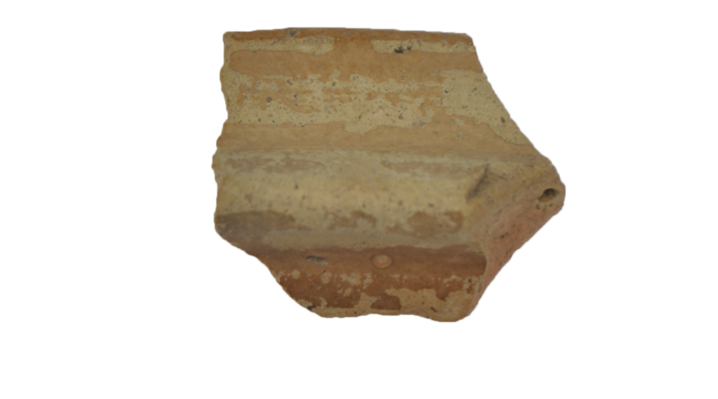
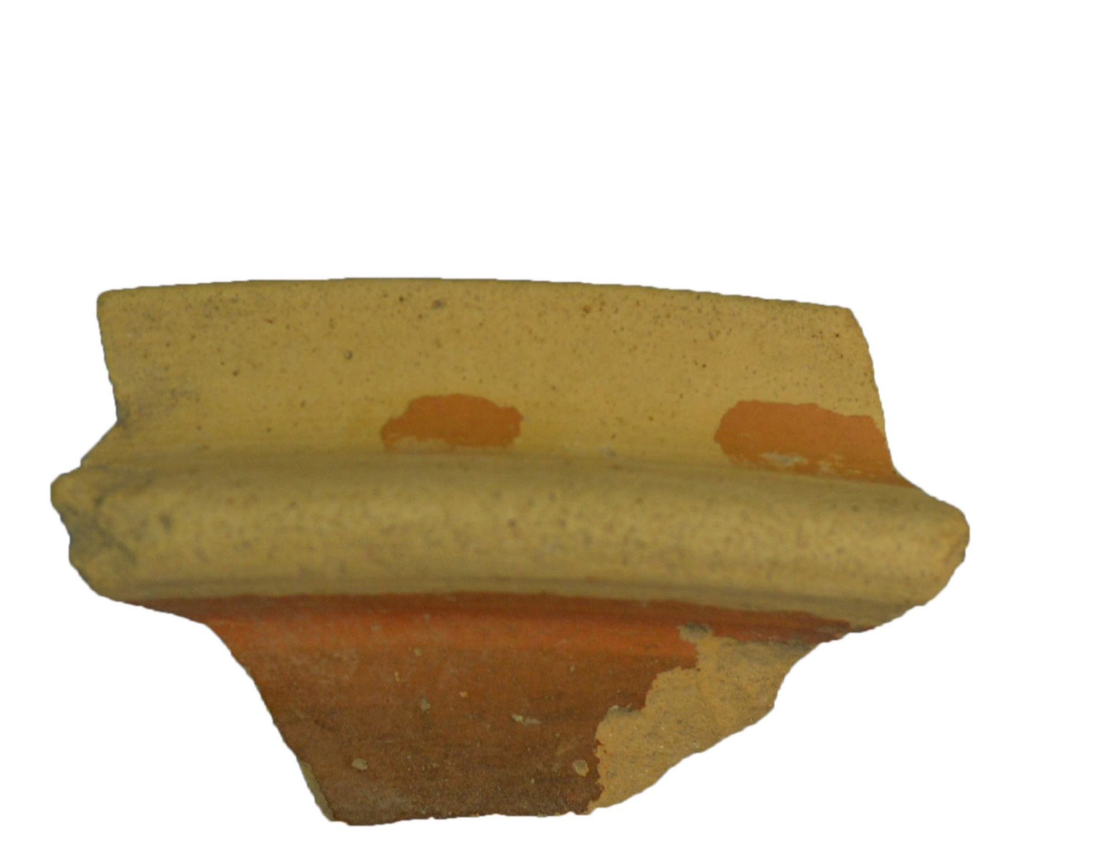
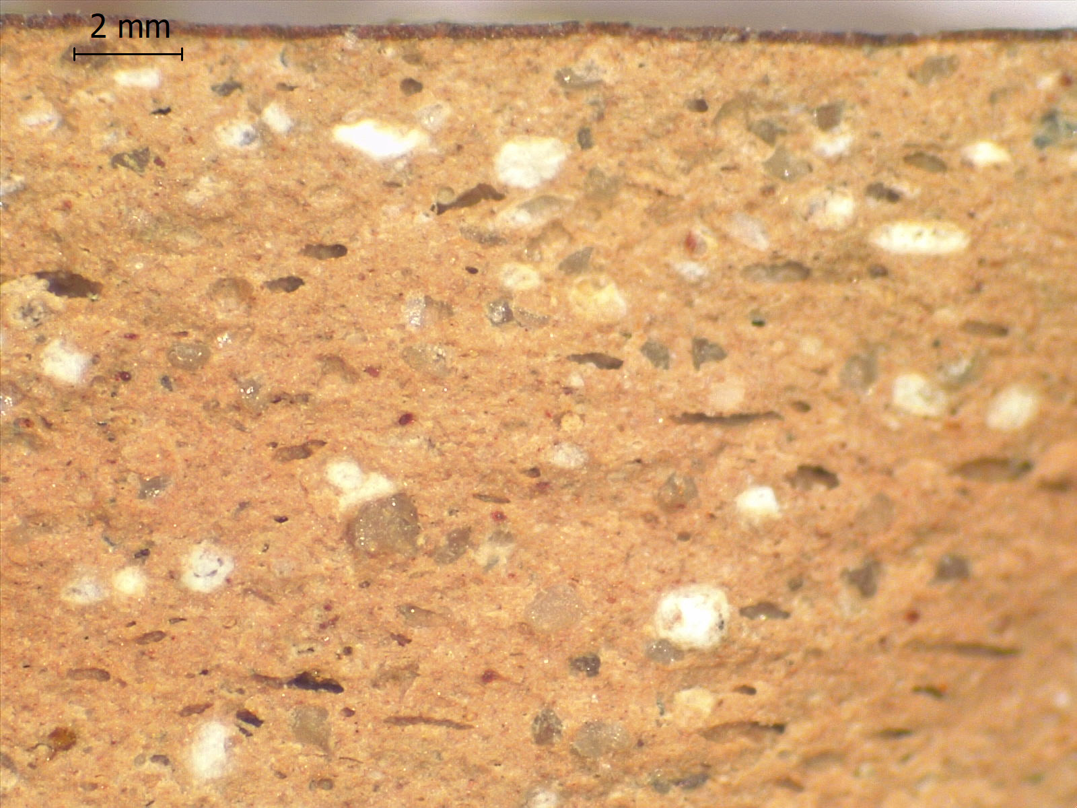
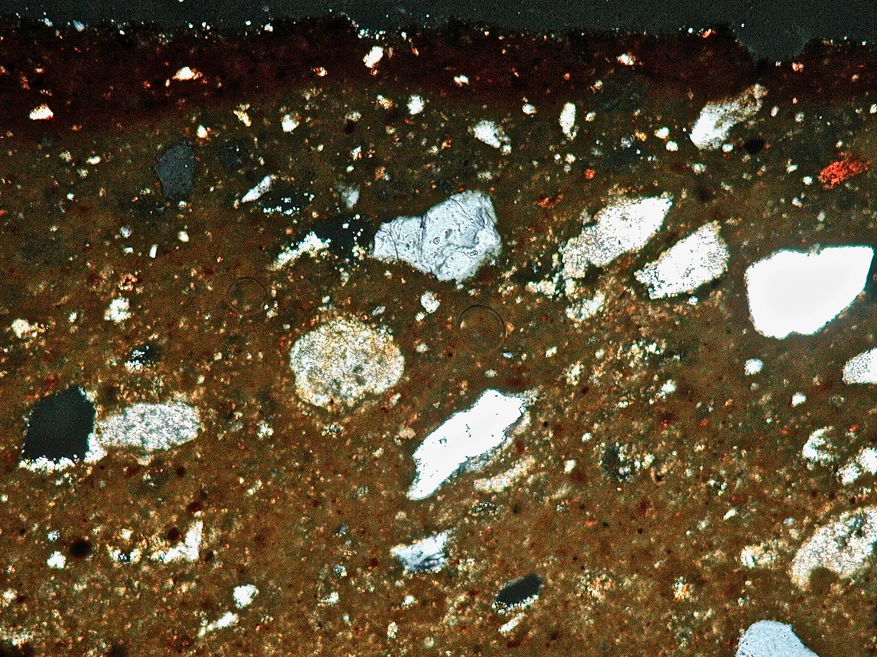
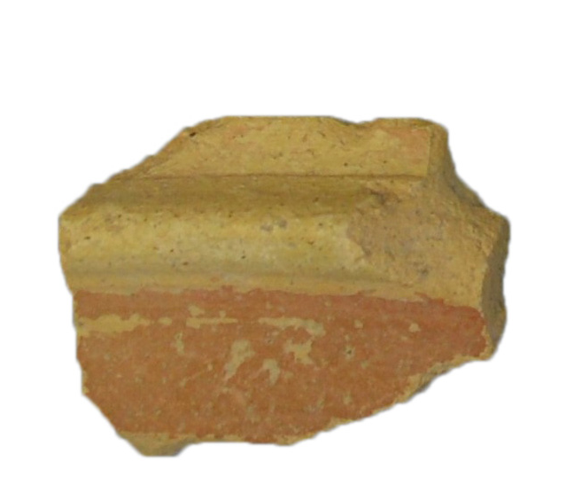
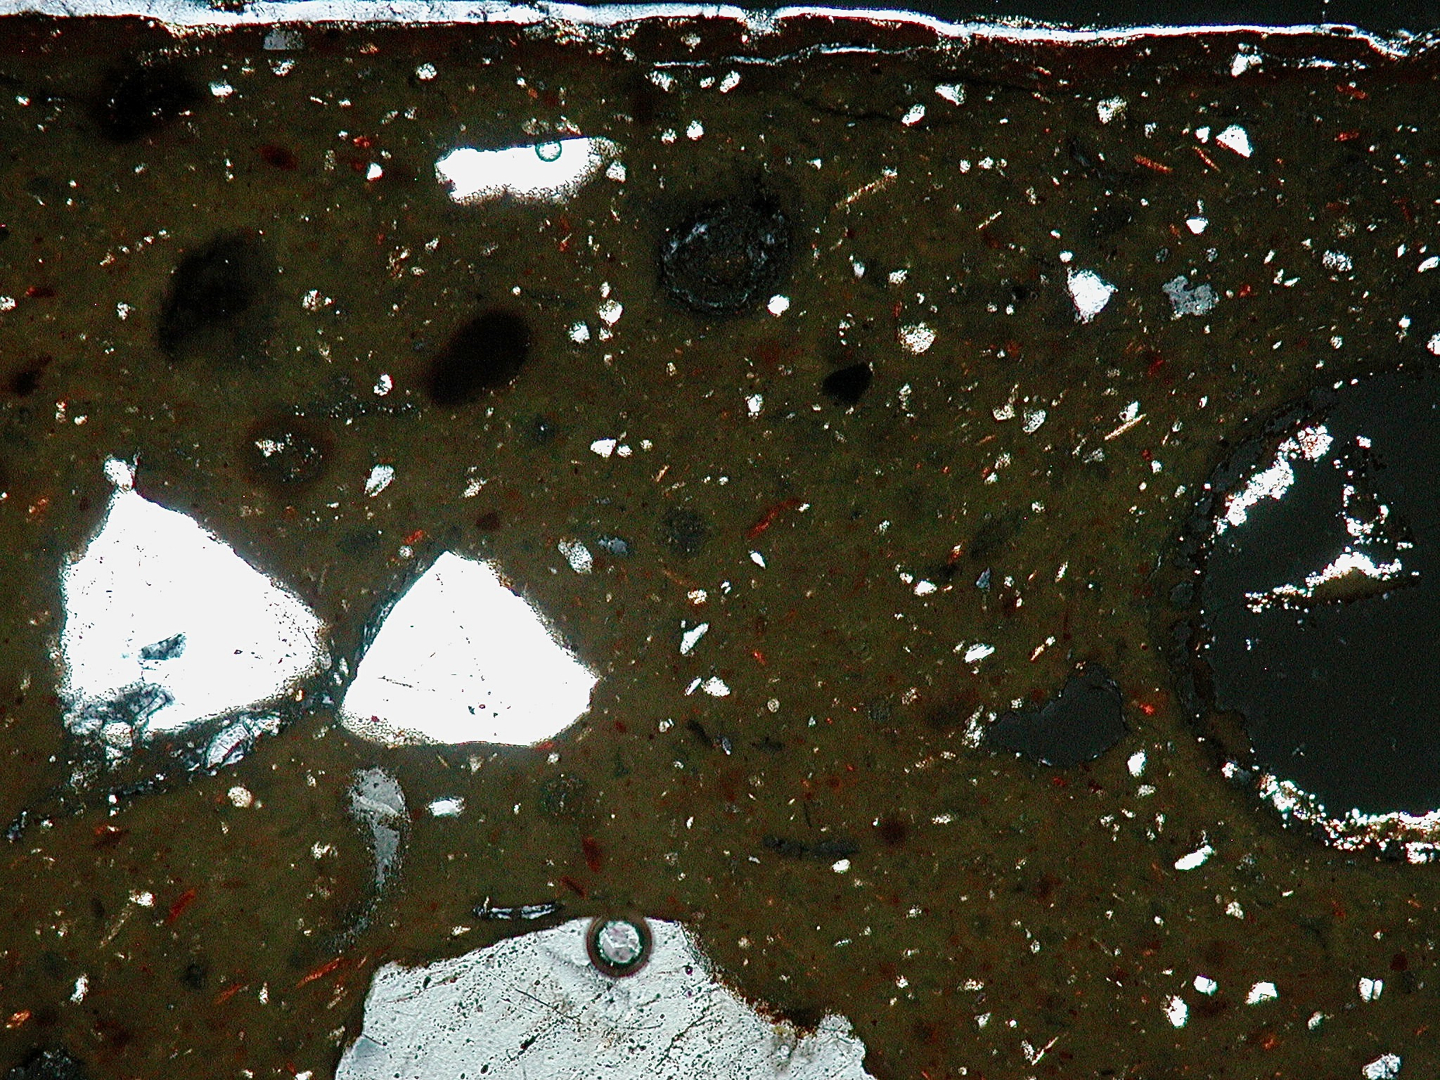
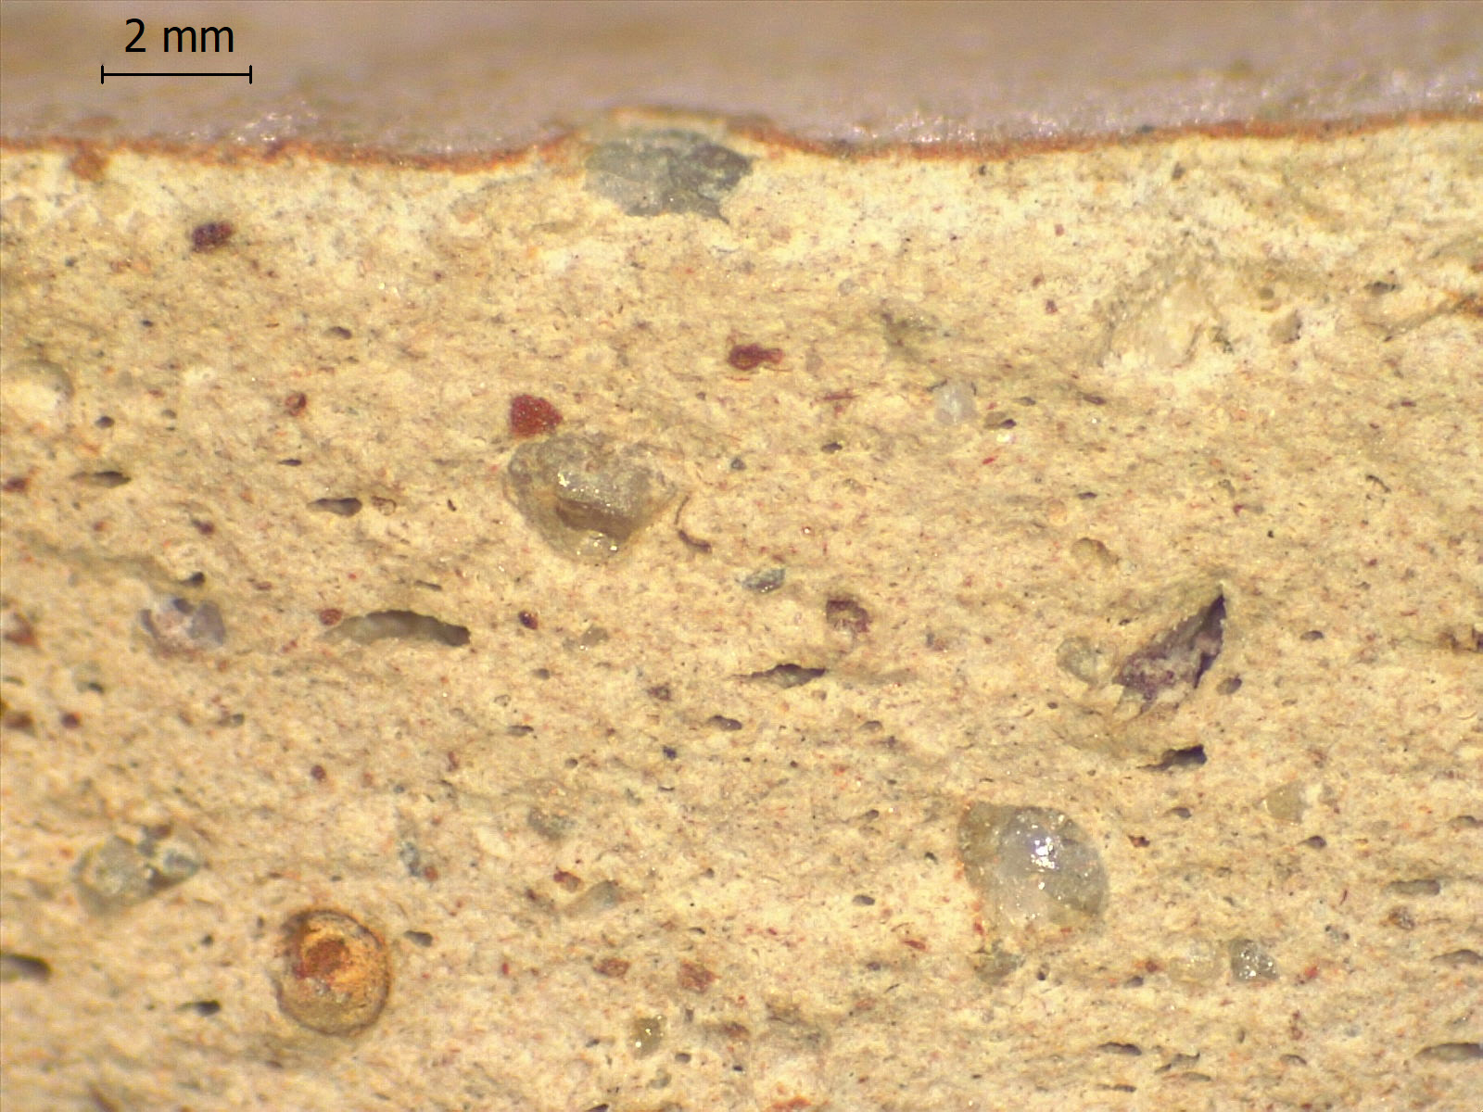
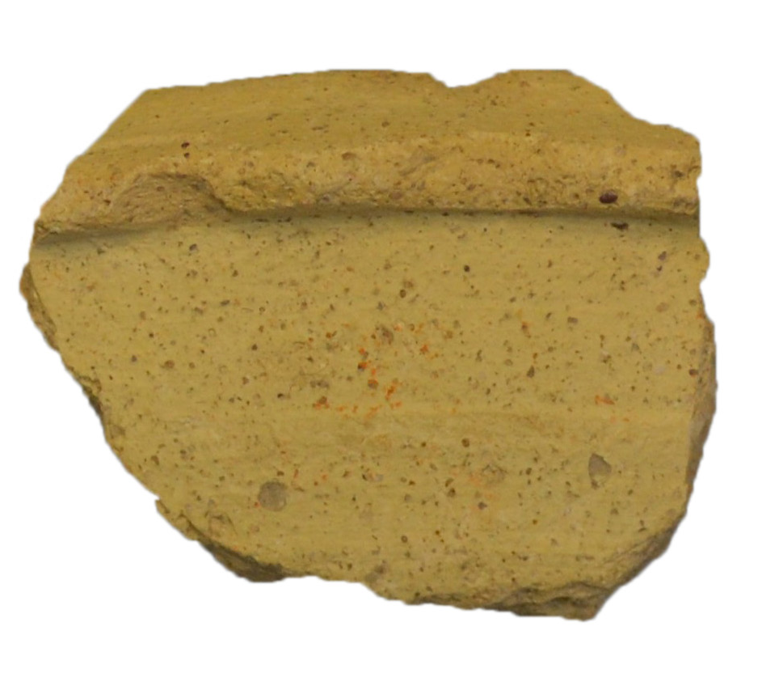
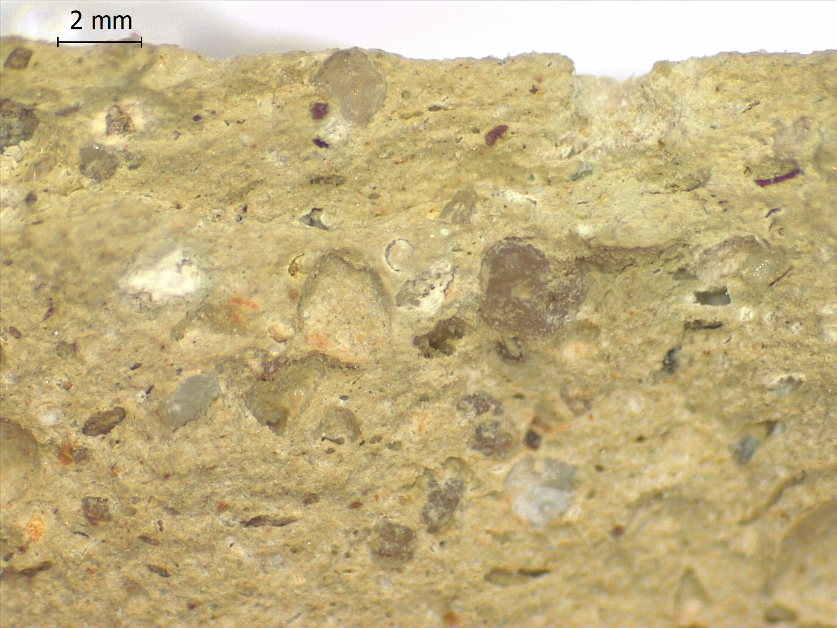
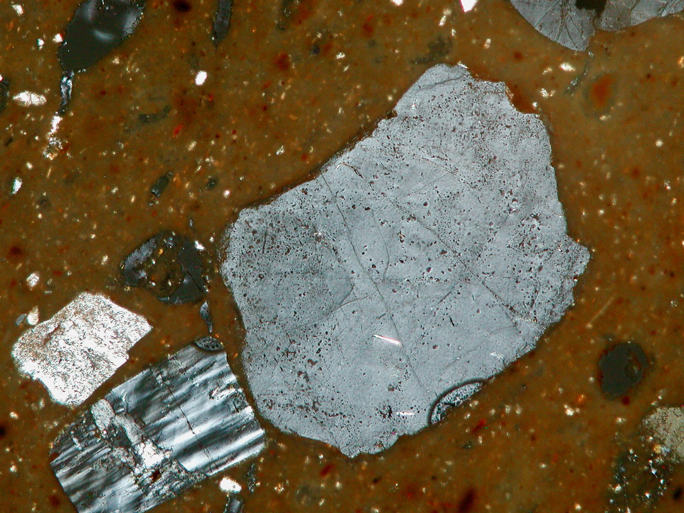
Flanged bowls from Cignana surveys
336.68
Unknown origin, Tunisia excluded (Algeria??)
360.355
360.322
Possible origins: North-West Tunisia, Algeria, South Spain, Sicily (?)
Analysis and micro-photos CP by C. Capelli
360.478

Slide 18
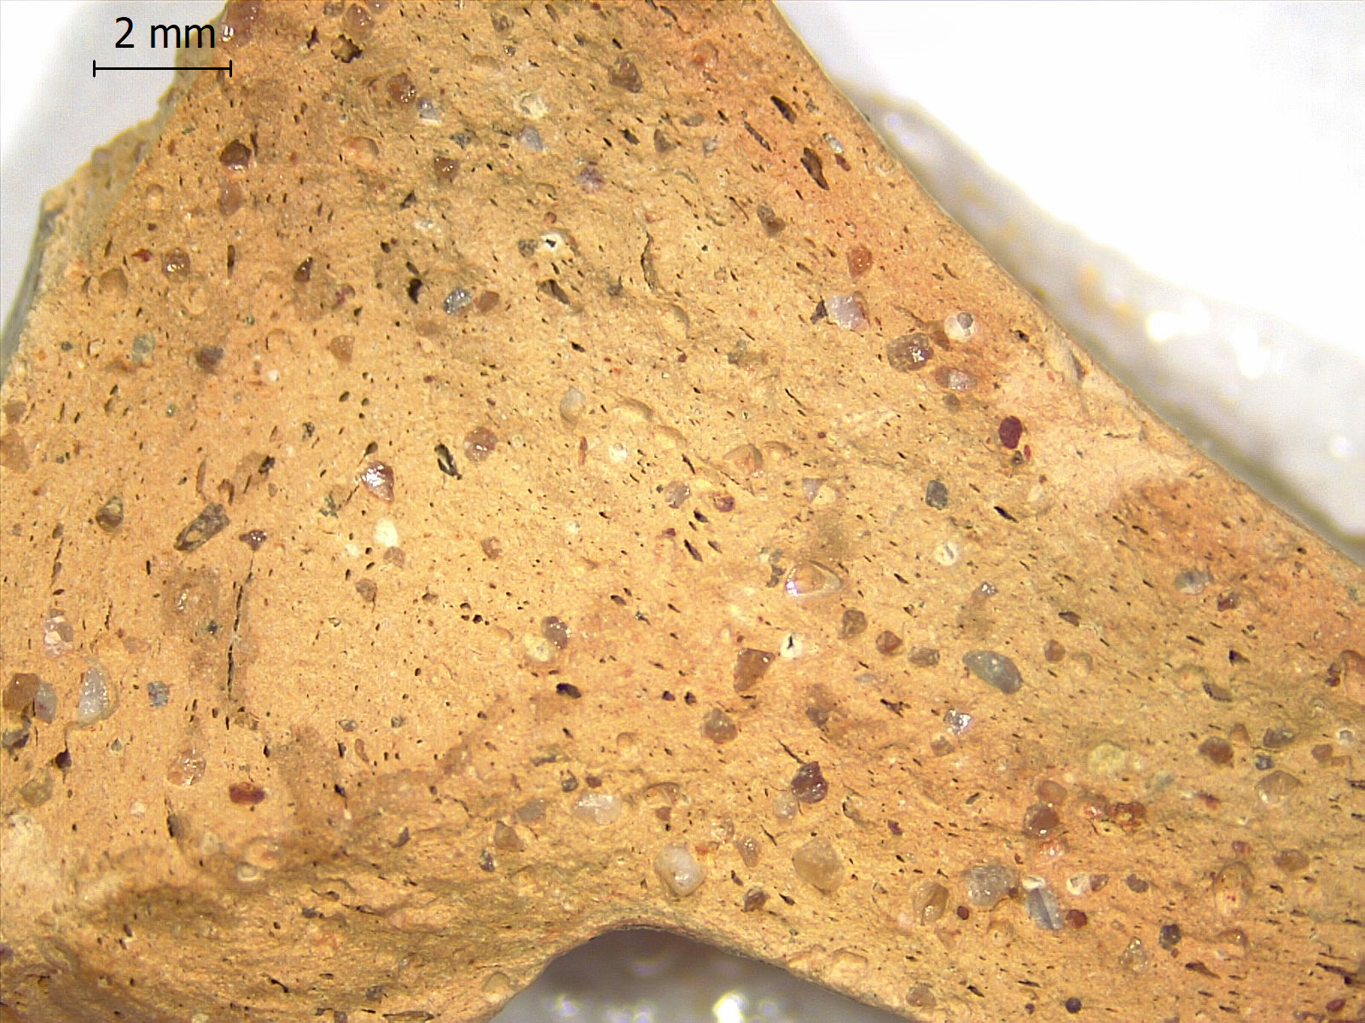


The same sherd was firstly published by Rizzo, Zambito 2012
CASR n° 262 [SIC 515] : Flanged bowl from Cignana (Site 67). Origin not from Africa. Maybe central-south Sicily
From Capelli et alii 2016, p. 350, fig. 83

Slide 19


Imitations of African Red Slip ware
Imitations of ARS A and C
Imitations of ARS D
From Bonifay 2014, fig. 5. Main zones imitating ARS
From Bonifay 2014, figg. 6-7.

Slide 20


Flanged bowls produced in Africa between the 6th and the end of the 7th century
Fine wares
Common wares
Types derived from Hayes 91 (?)
Type Carthage Class 2
From Bonifay 2004, fig. 111 and 138

Slide 21


Flanged bowls produced in Africa between the 6th and the end of the 7th century
Common wares
Late byzantine types with stamped decoration
Late byzantine types with painted decoration
Other late byzantine types
From Bonifay 2004, fig. 141

Slide 22
Thank you!
Session 162 | Culture contacts in the western Mediterranean sea during the Roman Age. Pottery as cultural marker between traffics and local productions
Fabrizio Ducati : fabrizio.ducati90@gmail.com
Claudio Capelli : capelli@dipteris.unige.it

Slide 23
Session 162 | Culture contacts in the western Mediterranean sea during the Roman Age. Pottery as cultural marker between traffics and local productions
Bonifay 2004 | M. Bonifay, Etudes sur la céramique romaine tardive d’Afrique, BAR IS-1301, Oxford 2004.
Bonifay 2014 | M. Bonifay, Céramique africaine et imitations : où, quand, pourquoi?, in R. Morais, A. Fernández, M. J. Sousa (ed.), As produçôes cerâmicas de imitaçâo na Hispania, monografias ex officina hispana II, Tomo I, Madrid 2014, 75-91.
Bonifay 2016 | M. Bonifay, Annexe 1. Éléments de typologie des céramiques de l’Afrique romaine, in Malfitana, Bonifay 2016, pp. 507-573.
Bonifay, Malfitana 2016 | M. Bonifay, D. Malfitana, L’apport de la documentation sicilienne à l’étude du commerce de l’Afrique romaine, in Malfitana, Bonifay 2016, pp. 403-439,
Bonifay et alii 2016 | M. Bonifay, C. Franco, G. Cacciaguerra, Analyse micro-régionale de la diffusion des céramiques africaines en Sicile, in Malfitana, Bonifay 2016, pp. 353-401.
Capelli et alii 2016 | C. Capelli, M. Bonifay, C. Franco, C. Huguet, V. Leitch, T. Mukai, Étude archéologique et archéométrique intégrée, in Malfitana, Bonifay 2016, pp. 273-351,
Fontana 1988 | S. Fontana, Le “imitazioni” della sigillata africana e le ceramiche da mensa italiche tardo-antiche, in L. Saguì (a cura di), Ceramica in Italia : VI-VII secolo. Atti del Convegno in onore di John W. Hayes (Roma, 11-13 maggio 1995), vol. I-II, Firenze 1998, pp. 83-100.

Slide 24
Session 162 | Culture contacts in the western Mediterranean sea during the Roman Age. Pottery as cultural marker between traffics and local productions
Mackensen, Schneider 2002 | M. Mackensen, G. Schneider, Production centres of African red slip ware (3rd-7th c.) in northern and central Tunisia: archaeological provenance and reference groups based on chemical analysis, in JRA 15, 2002, pp. 121-15.
Malfitana, Bonifay 2016 | D. Malfitana, M. Bonifay (a cura di), La ceramica africana nella Sicilia romana / La céramique africaine dans la Sicile romaine, I-II, Catania 2016.
Rizzo, Zambito 2012 | M.S. Rizzo, L. Zambito, La cultura materiale di un villaggio di età bizantina nella Sicilia centromeridionale: apporti dall’Oriente e dall’Africa a Cignana (Naro, Agrigento), in AfrRom XIX, Sassari 2010, Roma 2012, pp. 3051-3064.

