Slide 1





Real-time observer from stochastic reduced order model
M Ladvig, A M Picard, V Resseguier,
D Heitz, E Mémin, B Chapron

Slide 2
Content
Context : observer for unsteady aerodynamism
Physics, data & reduced order model (ROM)
Simulation, measurements & data assimilation
Reduced order model under location uncertainty
Results
2

Slide 3
PART I
Context :
Observer for unsteady aerodynamism

Slide 4
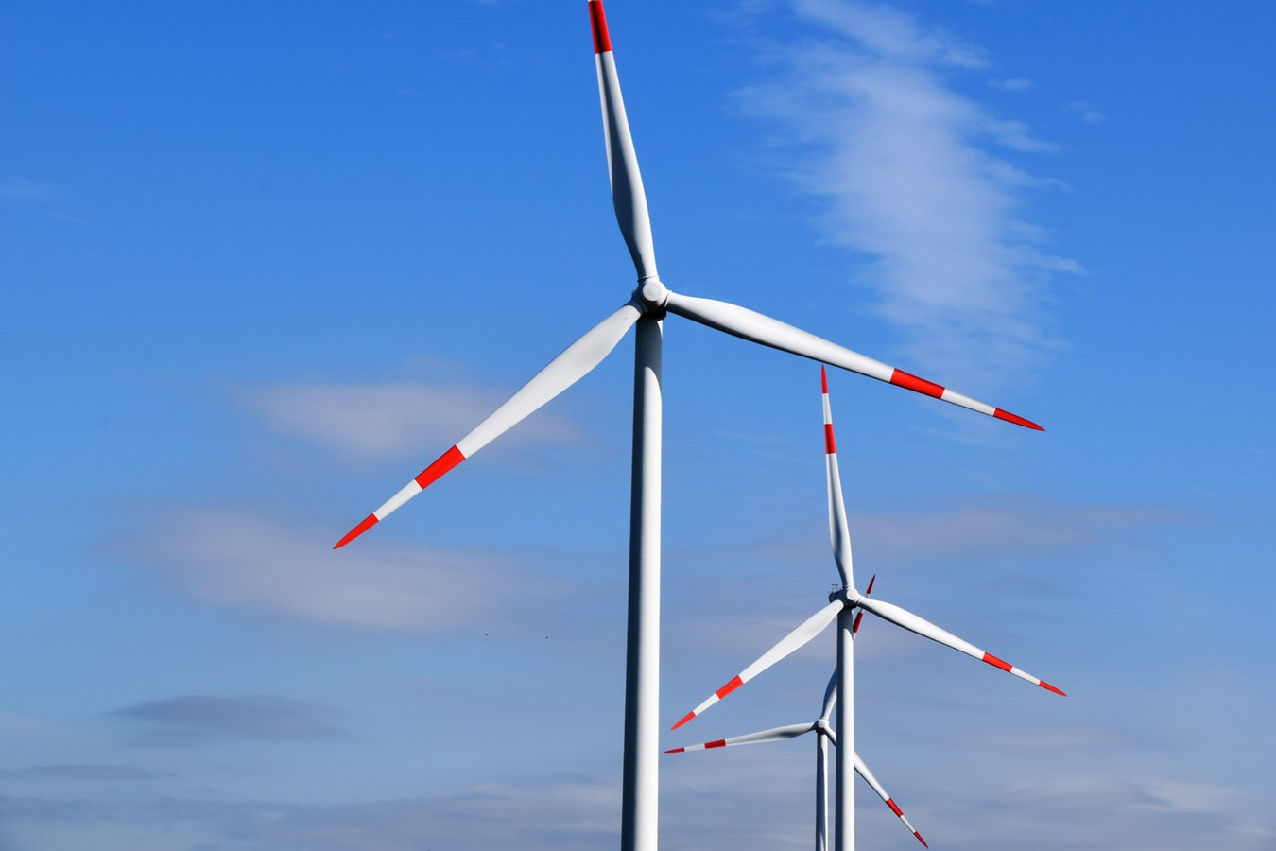
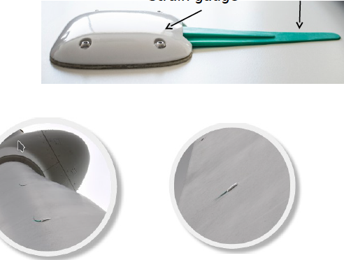
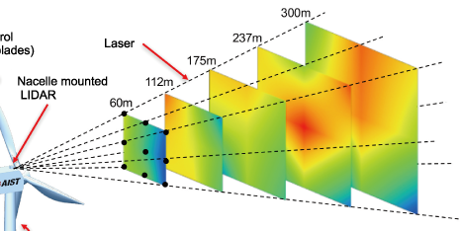
application
  Estimate and predict unsteady aerodynamism -- in real-time –
  for better active control loops
  Lower wind turbine maintenance costs
  Longer wind turbine life cycle
Wind fluctuations
Estimation and prediction:
Air flow
Lift, drag, AoA
…
Controller
Blade pitch
Fluidic actuators
…
Simple model
Observer
Wind
turbine
blade
Wind turbine sensors
Damages
Simple model
E-penon
LIDAR
Which simple model? How to combine model & measurements?
4

Slide 5
PART II
Physics, data
& reduced order model

Slide 6




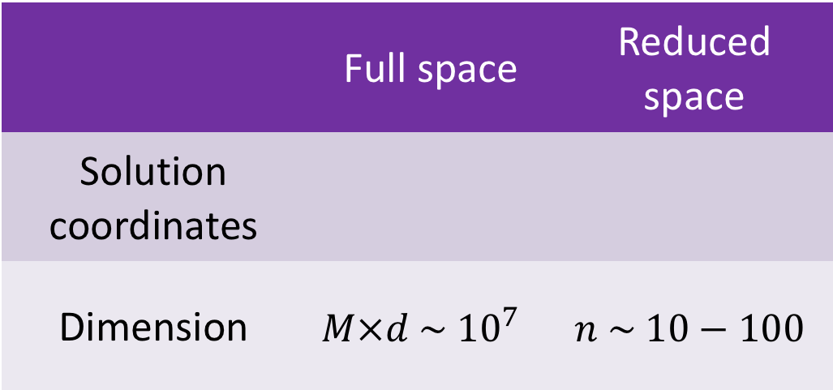
Reduced order model (ROM)
Parameters
(if any)
Solution of an PDE with the form:
Time
Space
 | Full space | Reduced space
Solution coordinates
Dimension | $$M×d \sim {10}^{7}$$ | $$n \sim 10−100$$
Order of magnitude examples in CFD
6

Slide 7





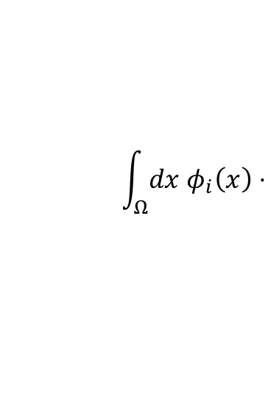
POD-Galerkin
Principal Component Analysis (PCA) on a dataset to reduce the dimensionality:
Snapshots
Spatial modes
Off-line
simulations
PCA
Approximation:
Resolved modes
Projection of the “physics”
onto the spatial modes :
→ ROM for very fast simulation of temporal modes
$$\int_{Ω}{dx φ_{i}\left(x\right)⋅}$$
( Physical equation (e.g. Navier-Stokes))

Slide 8
PART III
Simulation, measurements
& data assimilation

Slide 9






Combining simulations and measurements
Data assimilation
( particle filtering
with tempering & mutation )
Numerical
Simulation
(ROM)
  → erroneous
On-line
measurements
  → incomplete
  → possibly noisy
More accurate
estimation
globally in space
$$p\left(x | y\right)∝p\left(y | x\right)p(x)$$
Need for uncertainty / errors quantification
Random dynamics
$$p(x_{t+1}|x_{t})$$
$$p(x)$$
$$p(y|x)$$
$$3 m.s^{−1}$$
$$5 m.s^{−1}$$
Velocity
9

Slide 10
Part IV
Reduced order models under location uncertainty

Slide 11
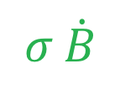
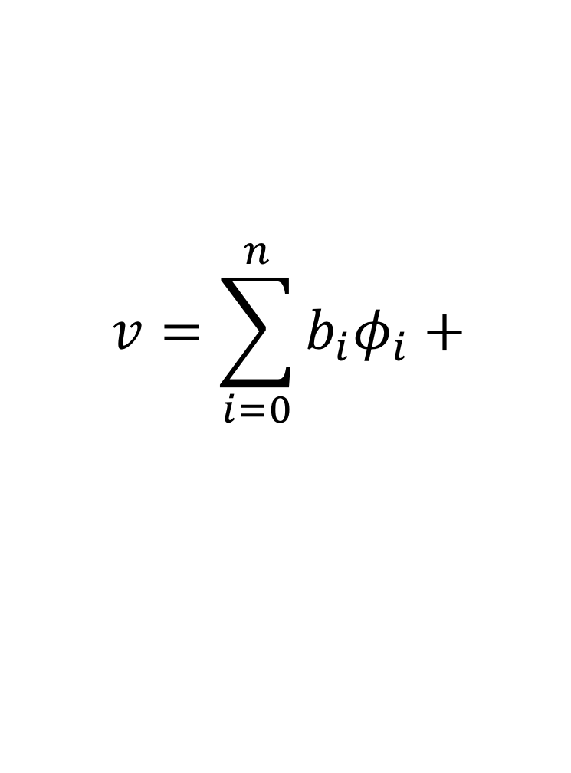
location uncertainty models (LUM)
Assumed
time-uncorrelated
Resolved modes
Randomized
Navier-Stokes model
__________________
Good closure
Good model error quantification
for data assimilation
$$v=\sum_{i=0}^{n}{b_{i}φ_{i}}+$$
Randomized
ROM
Residual
$$σ \dot{B}$$
LUM
SALT
Crisan et al., 2017
Gay-Balmaz & Holm 2017
Cotter and al. 2018 a, b
Cotter and al. 2019
Memin, 2014
Resseguier et al. 2017 a, b, c, d Cai et al. 2017
Chapron et al. 2018
Yang & Memin 2019
Mikulevicius & Rozovskii, 2004
Flandoli, 2011
Holm, 2015
Holm and Tyranowski, 2016
Arnaudon et al. 2017
References :
Cotter and al. 2017 Resseguier et al. 2019 a, b

Slide 12
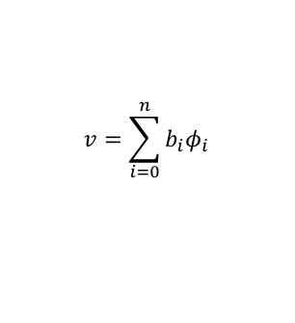

Summary
Off-line : Building ROM
On-line :
Simualtion & data assimialtion
Physics
(Navier-Stokes)
DNS code
Data
assimilation
(particle filtering)
Measurements
Data
Stochastic
ROM
Temporal modes
Flow
Randomized
Physics
(LUM)
Stochastic
ROM
$$v=\sum_{i=0}^{n}{b_{i}φ_{i}}$$
$$b_{i}$$

Slide 13
Part V
Results :
UQ &
Fast Observer
of the flow

Slide 14
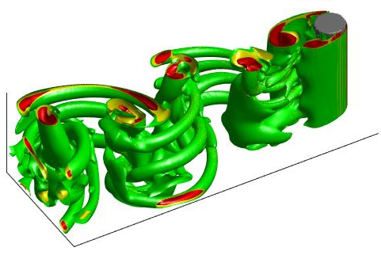
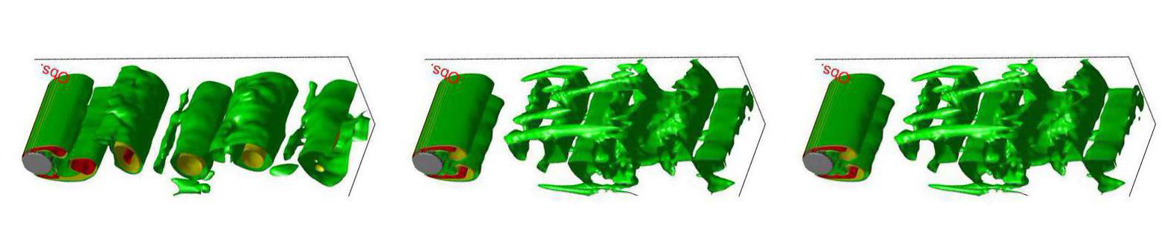
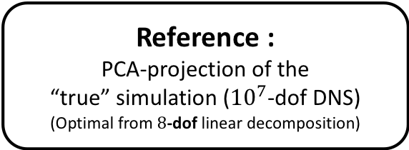
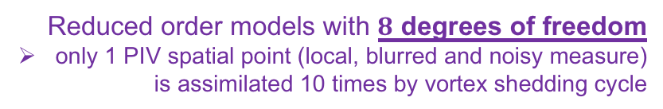
Numerical results :
3D Wake at Reynolds 300
Reduced order models with $8$ degrees of freedom
only 1 PIV spatial point (local, blurred and noisy measure)
is assimilated 10 times by vortex shedding cycle
Reference :
PCA-projection of the
“true” simulation (${10}^{7}$-dof DNS)
(Optimal from $8$-dof linear decomposition)
Our method :
POD-Galerkin with Navier-Stokes
under location uncertainty (LUM)
State-of-art :
POD-Galerkin with Navier-Stokes + optimally tuned eddy viscosity & additive noise
Inflow
Q-criterion
Inflow
Q-criterion
Inflow
Q-criterion

Slide 15
CONCLUSION
valentin.resseguier@scalian.com

Slide 16
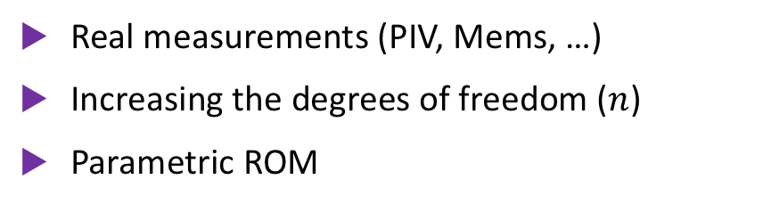
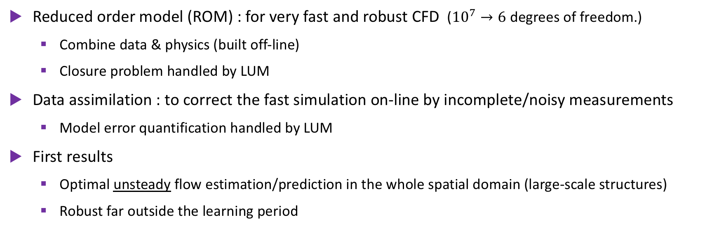
Conclusion
Reduced order model (ROM) : for very fast and robust CFD (${10}^{7}→6$ degrees of freedom.)
  Combine data & physics (built off-line)
  Closure problem handled by LUM
Data assimilation : to correct the fast simulation on-line by incomplete/noisy measurements
  Model error quantification handled by LUM
First results
  Optimal unsteady flow estimation/prediction in the whole spatial domain (large-scale structures)
  Robust far outside the learning period
  Now implemented in OpenFOAM / ITHACA-FV
Next steps
Real measurements (PIV, Mems, …)
Increasing the degrees of freedom ($n$)
Parametric ROM
Increasing Reynolds
(reduced DNS → reduced LES)
valentin.resseguier@scalian.com

Slide 17
Bonus slides
valentin.resseguier@scalian.com

Slide 18


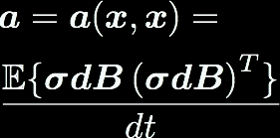

Model under location uncertainty,
The tracer Advection example
Diffusion
Advection
$$\frac{DΘ}{Dt}=0$$
Large scales:
Small scales:
Variance
tensor:
Drift
correction
Multiplicative
random
forcing
Balanced
energy
exchanges
18

Slide 19

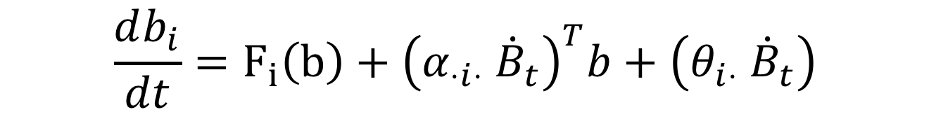



Reduced models under location uncertainty:
Galerkin projection gives SDEs for resolved modes
(stochastic Navier-Stokes)
n x M
M x 1
n x 1
1 x M
M x 1
$$\frac{db_{i}}{dt}=F_{i}\left(b\right)+{\left(α_{⋅i⋅}\dot{{ B}_{t}}\right)}^{T}b+\left(θ_{i⋅}\dot{{ B}_{t}}\right)$$
Large scales:
Small scales:
Variance
tensor:
multiplicative noise
additive noise
Correlations to estimate
2nd order polynomial:
coefficients given by physics,
and
$α_{pi⋅}α_{qj⋅}, α_{pi⋅}θ_{j⋅}, θ_{i⋅}θ_{j⋅}$
$$a=\overline{σ\dot{B}{\left(σ\dot{B}\right)}^{T}}τ$$

Slide 20
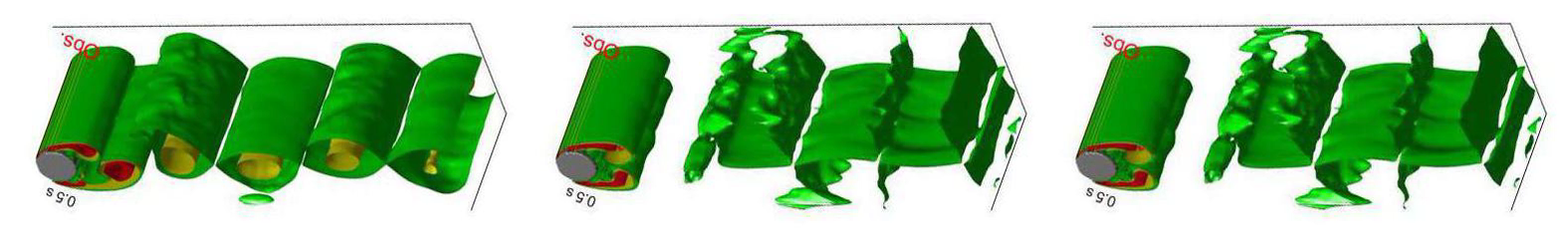

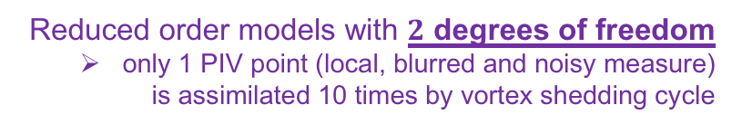
Numerical results :
3D Wake at Reynolds 300
Reduced order models with $2$ degrees of freedom
only 1 PIV point (local, blurred and noisy measure)
is assimilated 10 times by vortex shedding cycle
Reference :
PCA-projection of the
“true” simulation (${10}^{7}$-dof DNS)
(Optimal from $2$-dof linear decomposition)
Our method :
POD-Galerkin with Navier-Stokes
under location uncertainty (LUM)
State-of-art :
POD-Galerkin with Navier-Stokes + optimally tuned eddy viscosity & additive noise
Inflow
Q-criterion
Inflow
Q-criterion
Inflow
Q-criterion

Slide 21

Numerical results :
3D Wake at Reynolds 300
Reduced order models with $n$ degrees of freedom
only 1 PIV spatial point (local, blurred and noisy measure)
is assimilated 10 times by vortex shedding cycle
n=2
n=4
n=8

