Slide 1
Towards a Better Understanding of Open Source Hardware Design Reuse in Company-Community Collaboration
Amer EZOJI, Romain PINQUIE, Jean François BOUJUT
Univ. Grenoble Alpes, CNRS, Grenoble INP*, G-SCOP, 38000 Grenoble, France
* Institute of Engineering Univ. Grenoble Alpes
The 10th International Joint Conference on
Mechanics, Design Engineering and Advanced Manufacturing (JCM 2020)
2-4 June 2020
Aix-en-Provence, France
Acknowledgment: The work reported in this paper was completed as part of the OPEN!NEXT project, which has received funding from the European Union’s Horizon 2020 research and innovation programme under grant agreement No.869984. This paper reflects only the authors' views and the European Commission is not responsible for any use that may be made of the information it contains.
Notes:
Hello every one, My name is Amer Ezoji, I am post-doctoral at G-SCOP laboratory in Grenoble. My presentation entitled: Towards a Better Understanding of Open Source Hardware Design Reuse in Company- Community Collaboration. is part of H2020 project called Open! Next.

Slide 2
Outlines
Introduction to the Horizon 2020 Open!Next project
Review of design reuse practices
Review of design reuse practices in company
Review of design reuse practices in community
3. Design reuse in company-community collaboration
The necessary conditions for collaborative design
Do companies and communities meets the necessary conditions for collaborative design?
4. Conclusion and ongoing works
Notes:
First of all, let me introduce you the OpenNext project

Slide 3
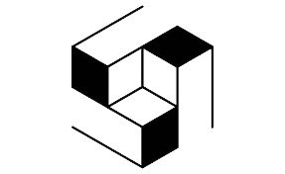
Horizon 2020 Open!Next Project
SME’s
Practice Partners
WP2 – Company-Community Collaboration
 | Task 1. Develop a maturity model for company-community collaboration
 | Task 2. Creating a design process facilitation dashboard
 | Task 3. Facilitating documentation for design reuse
Research Institutes
https://opennext.eu/
Notes:
The OPEN!NEXT project is dedicated to develop methods and tools to foster company-community collaboration. OPEN!NEXT is made up of 19 partners from seven European countries and it has different partners such as research and practice partners and SMEs. Moreover, it has six work package. e are working on WP2: company- community collaboration. In WP2, we are responsible for the task entitled "facilitating documentation for design reuse".
(SMEs have little resource to create and prototype new concepts and could benefit from the potential resources in terms of machines and skills of open source communities. On the other hand, communities of developer can benefit from collaboration with SMEs to create a more sustainable business model and expand their activity beyond simple hobbyists.)

Slide 4
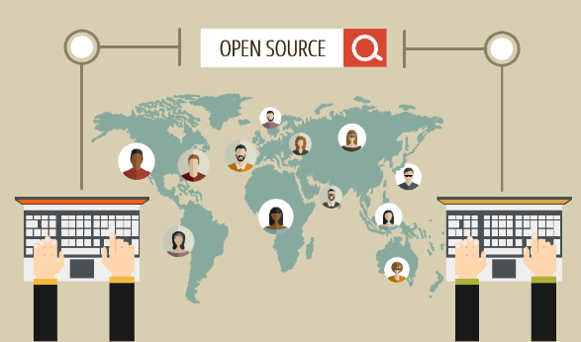
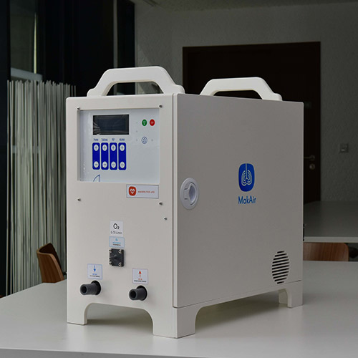
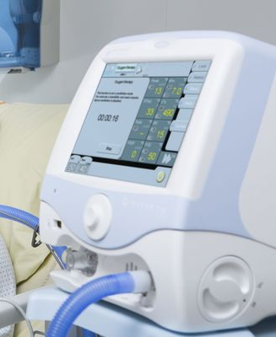
Design Reuse for Company-Community Collaboration
Community
Company
Why a Company-Community Collaboration is Challenged by Existing Methods & Tools of Design Reuse ?
https://makair.life/
Notes:
Open source hardware is a relatively recent phenomenon that takes its roots in the open source software development. Like open source software, open source hardware promotes a sharing approach based on the consideration that sharing bits of designs allows a globally more efficient development process and empower people with development capabilities they do not have with traditional industrial approaches. This phenomenon is becoming more and more popular in the developed countries through the hackers or makers movements.
Design reuse is an activity that consists in re-using all or part of an existing design, in order to fulfill a new set of requirements in a new context.
If we consider this ventilator as a product, there are two alternatives to design and manufacture the product.
The first one is the classical industrial approach where a company or a group of companies design, produce and sell the product. The design is private and often protected by a patent.
The second approach is community-based and in that case the design is made public and shared on a open-source hardware platform. The design is made publicly available so that anyone can freely study, modify, distribute, make, and make business out of it. OSH falls into the category of open source innovation and one of the major benefits is to provide the designers with the ability to reuse solutions, build upon them better designs and consequently save time and efforts. Companies have a long practice of design reuse. The question we deal with in this paper is: Why a Company-Community Collaboration is Challenged by Existing Methods & Tools of Design Reuse ?

Slide 5
Outlines
Introduction to the Horizon 2020 Open!Next project
Review of design reuse practices
Review of design reuse practices in company
Review of design reuse practices in community
3. Design reuse in company-community collaboration
The necessary conditions for collaborative design
Do companies and communities meets the necessary conditions for collaborative design?
4. Conclusion and ongoing works
Notes:
Now we will review existing design reuse practices in company and community

Slide 6
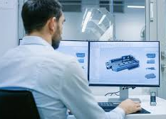
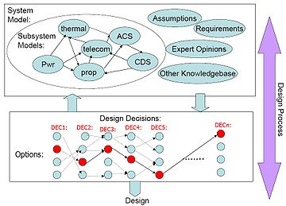
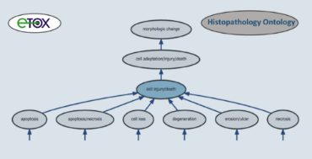
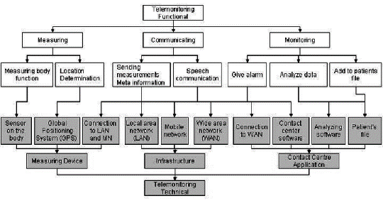
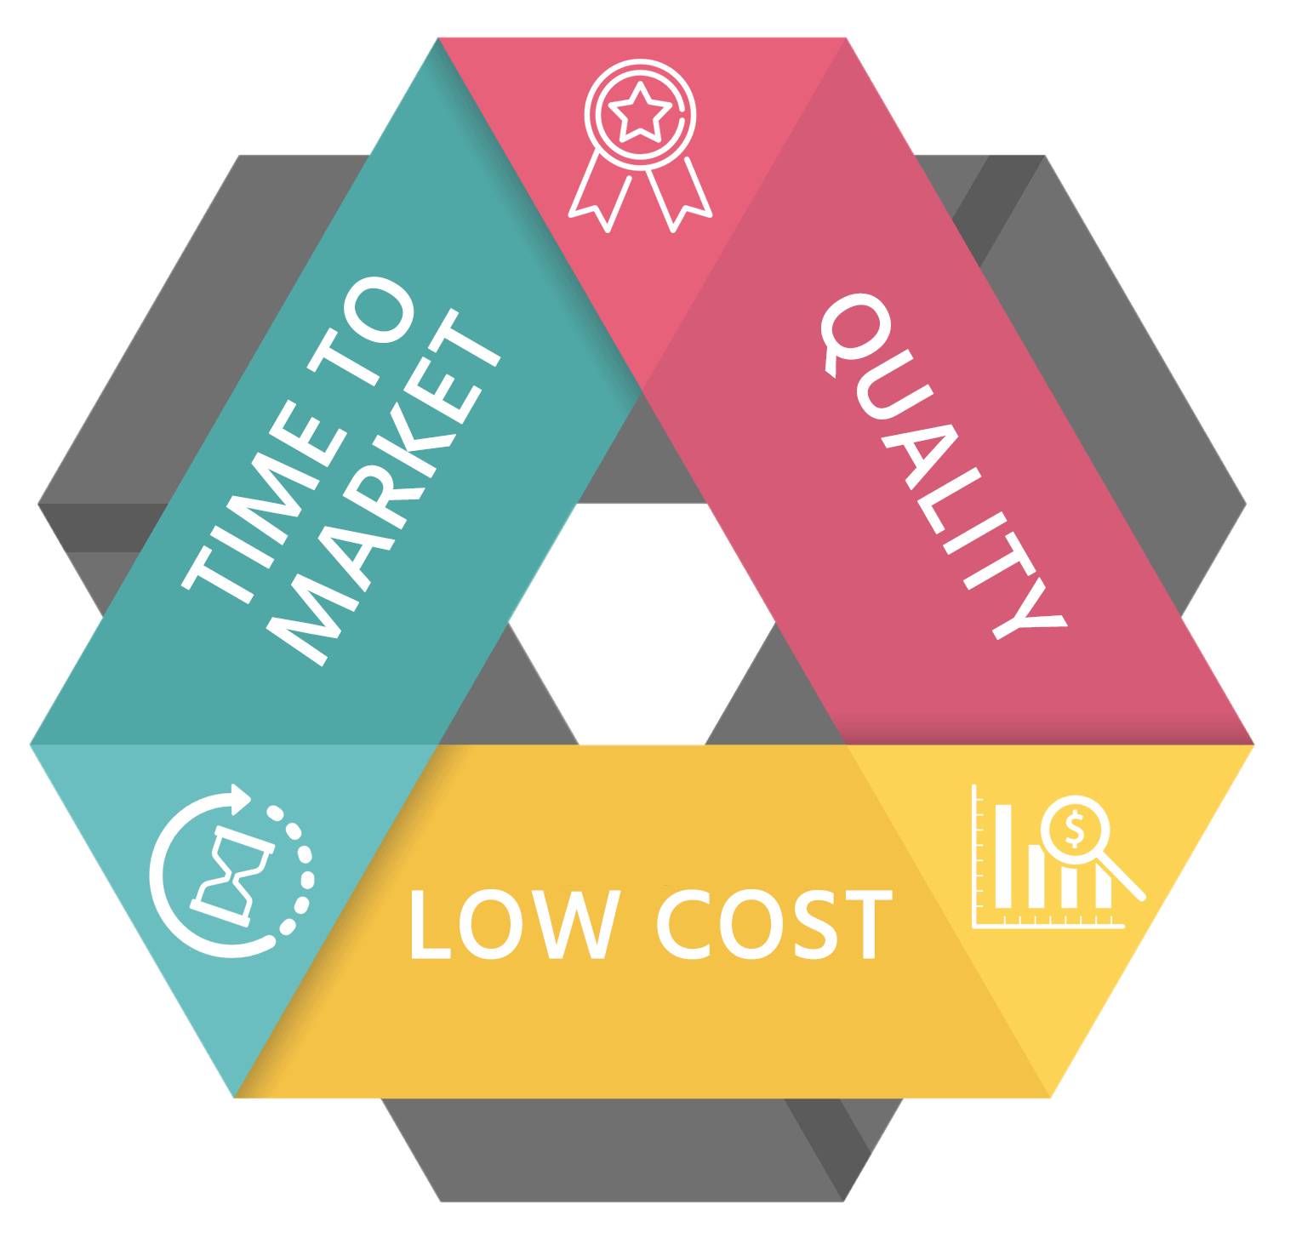
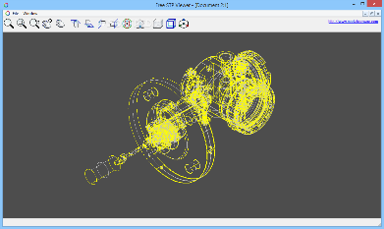
Design Reuse in Company
Who?
How?
Why?
Design reuse in community
Design engineers [16]
Design rationale (text annotations, …) [7,11]
Organize design data (ontology, database, PLM/PDM, library) [9,14]
Reducing costs and time to market [16]
Modular product architecture [12]
Information retrieval (search engine, data mining) [12]
Maximizing customer satisfaction [13, 15]
Data exchange format (step, fmi, …) [12]
Improving quality [13, 15]
Notes:
We first look at how the scientific literature were dealing with this question of Design Reuse. The review the current methods and technologies for supporting design reuse in companies led to the following findings:
We concentrate one three main dimensions: Who is reusing designs, why do people reuse designs and how do they reuse designs?
First question is: Who in a company wants to reuse the design? According to the stat of the art, up to 70% of design engineers use past design knowledge to solve new design problems and minimize the resources and efforts
Second question: Why do someone would reuse a design? There are different motivations for companies to reuse a design such as reducing the costs and time-to-market, maximizing customer satisfaction by finishing the design task in a shorter time and improving quality by reusing an existing design and therefore minimizing the risk of failure. Mainly the motivations are in terms of quality, time and effort (reuse what is working well).
Third question: How do people reuse designs? The first technique aims at using a design rationale techniques to capture the reasons that led to a design decision. The second technique consists in organizing the design data such as ontologies, management of data using information systems such as PDM/PLM software in order to allow an efficient retrieval of the information. Third technique consists of developing intelligent retrieval approach with information retrieval techniques such as search engines or data mining. Forth technique in computer-aided design environment is to use data exchange formats such as STEP or STL and develop modular product architecture approaches.

Slide 7
Design Reuse in Community
Who?
How?
Why?
Design reuse in community
5 personas according to 23 interviews in the previous project “OPEN”:
Who?
How?
Why?
Design reuse in community
 | Participant in OSD projects | Inventive creator | Entrepreneur and OSP project founder | Community manager & visionary | Maker & Geek
Motivation to create | Fun | Create own product | Ideological | Collective challenge | Teaching and learning
 | Teaching and learning | Problem solving | Teaching and learning | Ideological | Fun
 | Collective challenge | Collective challenge | Empowerment through technology | Empowerment through technology | Collective challenge
Vision | Create own product | Have an impact | Have an impact | Create an alternative system | Create own product
 | Educate | Create own product | Create an alternative system | Have an impact (by making a difference) | Educate
 | Fun | Fun | Educate | Create own product | Fun
Motivation for openness | Sharing | Innovation PD | Access to expertise | Social impact | Sharing
 | Access to expertise | Access to expertise | Innovation / product development | Innovation / product development | Access to expertise
 | Social impact | Social impact | Social impact | Sharing | Innovation/product development
Notes:
In this part, I rely on design a previous study made within the framework of the “OPEN” project, where the researchers made qualitative analysis of 23 interviews and that led to the creation of 5 personas. These personas are archetypes of the typical OSH participants. We have 1) The participant in open source development (OSD) projects 2) The inventive creator 3) The entrepreneur and open source process (OSP) founder 4) The Community manager & Visionary 5) The maker & Geek .
To the question Who in a community are the most likely to reuse designs? We found that among the 5 personas, the Maker & Geek, the participant in OSD projects and potentially the inventive creator are the main stakeholders for design reuse. The maker/Geek because he actually develops and tests the solutions and the inventive creator because he reuses parts of existing designs to assemble building blocks to create a product.
Then, Why a community should reuse designs? A member who is involved in a community-based and open source product development process shares some fundamental motivations. The analysis of the interviews reveal the those motivations:
CAT 1: problem solving, empowerment through technology, collective challenge, ideological, fun, teaching and learning.
CAT 2: sharing, innovation, access to expertise, social impact.
CAT 3: have fun, educate, make money, have in impact, create our own product, and create an alternative system.

Slide 8
Design Reuse in Community
Who?
How?
Why?
Design reuse in community
Access the sources
Understand the sources
Duplicate the sources
Reuse with or without modification
Find similar project
Notes:
Design reuse is not duplicating an existing design. Design reuse in a community-based open source hardware design is a process.

Slide 9
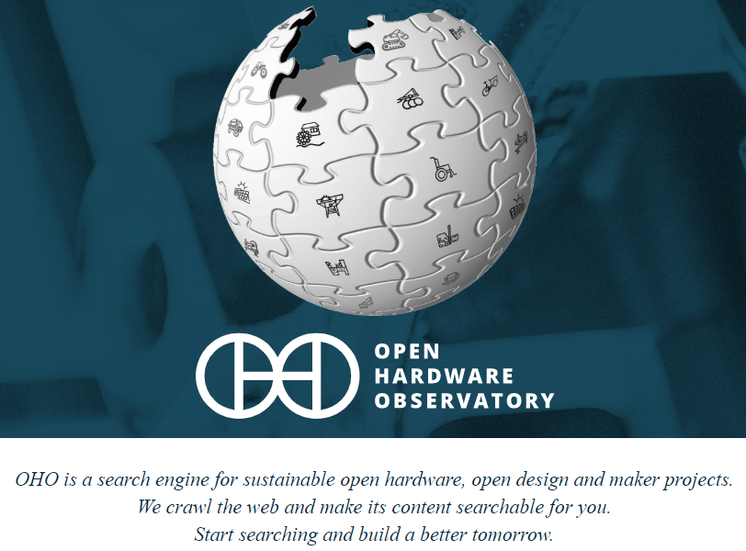
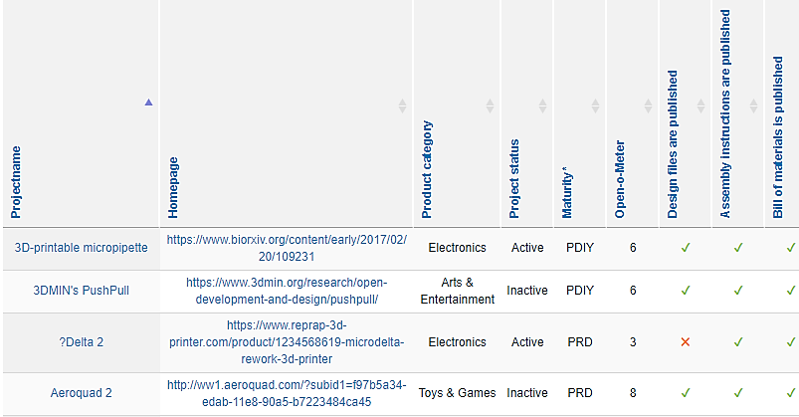
Design Reuse in Community
Who?
How?
Why?
Design reuse in community
Find similar project
Access the sources
Understand the sources
Duplicate the sources
Reuse with or without modification
https://oho.wiki/
Notes:
To the question “How” does a community facilitate the reuse of design? Finding a similar project is mostly the first step achieved by the OSH. This is why some initiatives are launched to propose wikis, web sites, search engines that allow to publicize existing designs. For example Open source Hardware Observatory is a search engine for sustainable open hardware, open design and maker projects.

Slide 10
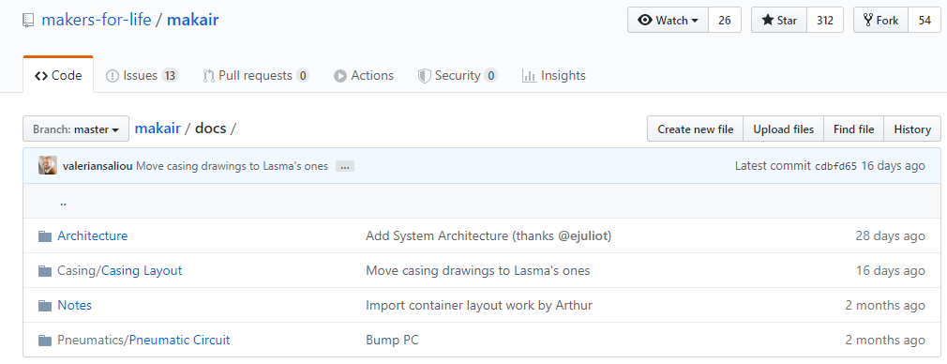
Design Reuse in Community
Who?
How?
Why?
Design reuse in community
Find similar project
Access the sources
Understand the sources
Duplicate the sources
Reuse with or without modification
https://github.com/makers-for-life/makair/
Notes:
Once a maker has identified a similar project, the second activity of a basic open source hardware design reuse process consists in accessing to the sources of the design. Makers usually share their designs using online repositories such as GitHub or Wikifactory.

Slide 11
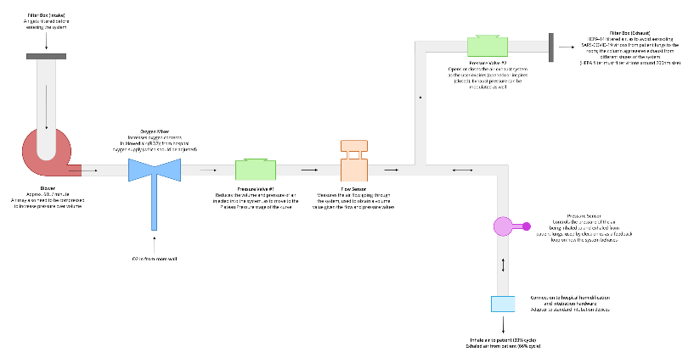
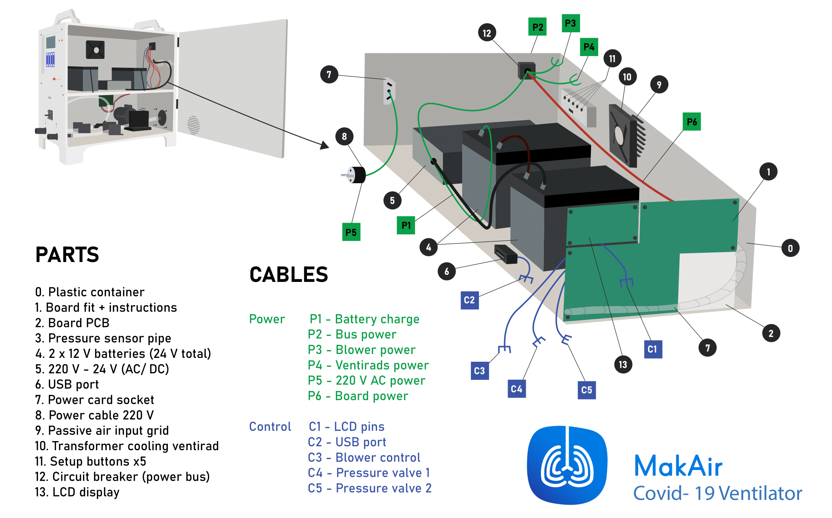
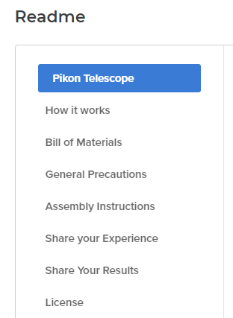
Design Reuse in Community
Who?
How?
Why?
Design reuse in community
Find similar project
Access the sources
Understand the sources
Duplicate the sources
Reuse with or without modification
Notes:
Getting the sources is a necessary but not sufficient condition for design reuse. Indeed, as a maker, I will need to customize the existing design to my own requirements. This is the reason why, I should be able to understand the sources. Web-based platforms provide communication capabilities for commenting design decisions and rationals such as change history, issues tracking, comments, or bill of materials and drawings.

Slide 12
Design Reuse in Community
Who?
How?
Why?
Design reuse in community
Find similar project
Access the sources
Understand the sources
Duplicate the sources
Reuse with or without modification
Notes:
The fourth activity of the design reuse corresponds to the duplication of the sources on a new repository, this capability is known as “Forking”.

Slide 13
Design Reuse in Community
Who?
How?
Why?
Design reuse in community
Kind of viral propagation
Find similar project
Access the sources
Understand the sources
Duplicate the sources
Reuse with or without modification
Find similar project
Access the sources
Understand the sources
Duplicate the sources
Reuse with or without modification
Find similar project
Access the sources
Understand the sources
Duplicate the sources
Reuse with or without modification
Notes:
Finally, the maker can reuse with or without prior modification the sources on his own repository before sharing his own new version of the open source hardware with the rest of the community.

Slide 14
Outlines
Introduction to the Horizon 2020 Open!Next project
Review of design reuse practices
Review of design reuse practices in company
Review of design reuse practices in community
3. Design reuse in company-community collaboration
The necessary conditions for collaborative design
Do companies and communities meets the necessary conditions for collaborative design?
4. Conclusion and ongoing works
Notes:
If look at design reuse in company-community collaboration

Slide 15
Necessary conditions for collaborative design
Necessary (but not sufficient) conditions for collaborative design [1,8]:
C1. Stakeholders must share a common language and understanding of the design content and process
Community
Who?
Participant in OSD projects
Inventive creator
Entrepreneur and OSP project founder
Community manager & visionary
Maker & Geek
Why?
Mechanisms such as forums, fork, …
Web-based repositories
Index of OSH projects
How?
CAT 3: have fun, educate, …
CAT 2: sharing, innovation, …
CAT 1: problem solving, fun, …
Company
Who?
Why?
How?
Design engineers
Reducing costs and time
Maximizing customer satisfaction
Improving the quality
Design rationale (text annotation,…)
Organize design data (ontology, database,…)
Information retrieval (search engine, …)
Data exchange format (step, fmi, …)
Modular product architecture
Notes:
Communities and companies have actors with an engineering background who share a common technical language and understanding of a design.

Slide 16
Necessary conditions for collaborative design
Necessary (but not sufficient) conditions for collaborative design [1,8]:
C2. Stakeholders must share common goals
Community
Who?
Participant in OSD projects
Inventive creator
Entrepreneur and OSP project founder
Community manager & visionary
Maker & Geek
Why?
Mechanisms such as forums, fork, …
Web-based repositories
Index of OSH projects
How?
CAT 3: have fun, educate, …
CAT 2: sharing, innovation, …
CAT 1: problem solving, fun, …
Company
Who?
Why?
How?
Design engineers
Reducing costs and time
Maximizing customer satisfaction
Improving the quality
Design rationale (text annotation,…)
Organize design data (ontology, database,…)
Information retrieval (search engine, …)
Data exchange format (step, fmi, …)
Modular product architecture
Notes:
Companies and communities mainly share different goals. Companies look for quality and customer satisfation while reducing costs and time-to-market, whereas makers are motivated by solving problems, having fun, and sharing knowledge. But if we dig into the motivations, we notice that both - companies and communities - share some common goals such as reducing design errors and fostering creativity.

Slide 17
Necessary conditions for collaborative design
Necessary (but not sufficient) conditions for collaborative design [1,8]:
C3. Stakeholders must share common technologies
Community
Who?
Participant in OSD projects
Inventive creator
Entrepreneur and OSP project founder
Community manager & visionary
Maker & Geek
Why?
Mechanisms such as forums, fork, …
Web-based repositories
Index of OSH projects
How?
CAT 3: have fun, educate, …
CAT 2: sharing, innovation, …
CAT 1: problem solving, fun, …
Company
Who?
Why?
How?
Design engineers
Reducing costs and time
Maximizing customer satisfaction
Improving the quality
Design rationale (text annotation,…)
Organize design data (ontology, database,…)
Information retrieval (search engine, …)
Data exchange format (step, fmi, …)
Modular product architecture
Notes:
From a technology point of view, the review of the litterature and the analysis of open source hardware design practices shows that companies and communities use different design methods and tools. Companies use heavy information systems and laborious documentation practices, whereas communities prefer to use web-based plateforms for their openness and flexibility.

Slide 18
Outlines
Introduction to the Horizon 2020 Open!Next project
Review of design reuse practices
Review of design reuse practices in company
Review of design reuse practices in community
3. Design reuse in company-community collaboration
The necessary conditions for collaborative design
Do companies and communities meets the necessary conditions for collaborative design?
4. Conclusion and ongoing works

Slide 19
Conclusion and ongoing work
Conclusion
A company-community collaboration is mainly challenged by a lack of common methods and tools for the collaborative design of open source hardware products. Even if actors share common engineering knowledge and goals, this technological misalignment makes the reuse of existing designs difficult from both sides.
Ongoing work
Analysis of 20 interviews for identifying the main problems and needs for OSH design reuse
Derivation of needs into technical requirements for a new method and/or tool for OSH design reuse
Notes:
How can we improve the current situation ? Shall we concentrate our efforts on a new design rational approach? Or maybe shall we come up with a new data exchange format? Or perhaps the problem is the lack of a standardized design documentation. To rationally decide how to facilitate design reuse for a better company-community collaboration, we have interviewed X makers and companies from different parts of the world. We are currently analyzing the transcriptions of these interviews to identify the problems and needs in terms of OSH design reuse that will help us to specify technical requirements for a new method and/or tool for OSH design reuse.

Slide 20
Towards a Better Understanding of Open Source Hardware Design Reuse in Company-Community Collaboration
Amer EZOJI, Romain PINQUIE, Jean François BOUJUT
Univ. Grenoble Alpes, CNRS, Grenoble INP*, G-SCOP, 38000 Grenoble, France
* Institute of Engineering Univ. Grenoble Alpes
The 10th International Joint Conference on
Mechanics, Design Engineering and Advanced Manufacturing (JCM 2020)
2-4 June 2020
Aix-en-Provence, France
Acknowledgment: The work reported in this paper was completed as part of the OPEN!NEXT project, which has received funding from the European Union’s Horizon 2020 research and innovation programme under grant agreement No.869984. This paper reflects only the authors' views and the European Commission is not responsible for any use that may be made of the information it contains.

Slide 21
References
1. Achten, H.H., 2002. Requirements for collaborative design in architecture.
2. Aksulu, A. and Wade, M.R., 2010. A comprehensive review and synthesis of open sourcevresearch. Journal of the Association for Information Systems, 11(11), p.6.
3. Balka, K., 2011. Open source product development: the meaning and relevance of openness. Springer Science & Business Media.
4. Bonvoisin, J. and Boujut, J.F., 2015. Open design platforms for open source product development: current state and requirements. In DS 80-8 Proceedings of the 20th International Con- ference on Engineering Design (ICED 15) Vol 8: Innovation and Creativity, Milan, Italy, 27- 30.07. 15 (pp. 011-020).
5. Bonvoisin, J., Buchert, T., Preidel, M. and Stark, R.G., 2018. How participative is open source hardware? Insights from online repository mining. Design Science, 4.
6. Brissaud, D. and Garro, O. (1998) Conception distribuée, émergence. In: Tollenaere, M. (ed.), Conception de Produits Mécaniques : Méthodes, Modèles et Outils. Hermès Sciences, pp 105-114.
7. Hisarciklilar, O. and Boujut, J.F., 2009. A Speech Act Theory-based information model to support design communication through annotations. Computers in Industry, 60(7), pp.510- 519.
8. Kleinsmann, M.S., 2006. Understanding collaborative design.
9. Levandowski, C., Bokinge, M., Malmqvist, J. and Johannesson, H., 2012, July. PLM as Support for Global Design Reuse–Long Term Benefits and Immediate Drawbacks. In IFIP Inter- national Conference on Product Lifecycle Management (pp. 488-500). Springer, Berlin, Hei- delberg.
10. Levine, S.S. and Prietula, M.J., 2014. Open collaboration for innovation: Principles and per- formance. Organization Science, 25(5), pp.1414-1433.
11. Matta, N. and Ducellier, G., 2014. How to learn from design project knowledge. Internation- al Journal of Knowledge and Learning, 9(1-2), pp.164-177.
12. Meehan, J.S., Duffy, A.H. and Whitfield, R.I., 2007. SupportingDesign for Re-use'with mo- dular design. Concurrent Engineering, 15(2), pp.141-155.
13. Pakkanen, J., Huhtala, P., Juuti, T. and Lehtonen, T., 2016. Achieving benefits with design reuse in manufacturing industry. Procedia CIRP, 50, pp.8-13.
14. Rezgui, Y., Boddy, S., Wetherill, M. and Cooper, G., 2011. Past, present and future of infor- mation and knowledge sharing in the construction industry: Towards semantic service-based e-construction?. Computer-Aided Design, 43(5), pp.502-515.
15. Sanghee, K. and Bracewell Rob, H., 2007. Improving design reuse using context. Guidelines for a Decision Support Method Adapted to NPD Processes.
16. Sivaloganathan, S. and Shahin, T.M.M., 1999. Design reuse: an overview. Proceedings of the Institution of Mechanical Engineers, Part B: Journal of Engineering Manufacture, 213(7), pp.641-654.

