Slide 1
The emergence of intersex as a protected category in international law
Sexual Orientation and Gender Identity in International Law
24 July - 2 August
Benjamin Moron-Puech
Université Panthéon-Assas, Paris
NGO GISS | Alter Corpus
b.moronpuech@u-paris2.fr

Slide 2
Overview
I. Introduction
II. The emergence of intersex in international law
III. The protection granted to intersex in international law

Slide 3

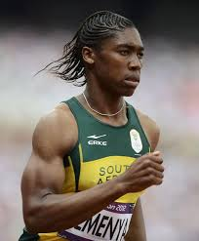
I. Introduction
Caster, an intersex runner
Sibel, an intersex sex worker held in Turkey

Slide 4
I. Introduction
A. What does intersex means?
B. What concrete problems intersex are facing?
C. Intersex and international law?

Slide 5
I. Introduction
A. What does intersex means?
B. What concrete problems intersex are facing?
C. Intersex and international law?

Slide 6
A. What does “intersex” means?
1. Definitions…
2. …And controversies!

Slide 7
1. Definitions
  Who are positively intersex people? :
  “Intersex people are born with physical sex characteristics that don’t fit medical and social norms for female or male bodies”
  OII Australia <https://oii.org.au/18106/what-is-intersex/>
  “Intersex people are born with sex characteristics (including genitals, gonads and chromosome patterns) that do not fit typical binary notions of male or female bodies”
  OHCHR, Fact Sheet, Intersex, 2015 <https://unfe.org/system/unfe-65-Intersex_Factsheet_ENGLISH.pdf>

Slide 8
Who are not intersex people?
“It is to be distinguished from transsexuality, a phenomenon where someone has an evident sex, but feels as if he or she belongs to the other sex and is therefore ready to undergo a medical intervention altering his or her natural sex.”
“[Intersex] is a naturally occurring variation in humans and not a medical condition.”
Council of Europe, Resolution 1952 (2013), Children’s right to physical integrity, explanatory memorendum, § 4.9.
Notes:
Corporal minority vs Gender minority

Slide 9
2. Controversies
According to the council of Europe (resolution 1952 [2013]), “[Intersex] is a naturally occurring variation in humans and not a medical condition”
Doctors disagree !
  Consensus statement on management of intersex disorders (2005)
  WHO, International classification of disease (ICD)
    “Terms such as intersex […] are particularly controversial. These terms are perceived as potentially pejorative by patients, and can be confusing to practitioners and parents alike.
    The term “disorders of sex development” (DSD) is proposed, as defined by congenital conditions in which development of chromosomal, gonadal, or anatomical sex is atypical.””
Notes:
The same goes for the Austrian Constitutional court who stated on 30 June 2018 that “Intersexuality in the sense used here is thus a variant of the development of sex, which, as such, must be recognized and, in particular, is not an expression of pathological development”

Slide 10
ICD-10: intersex = psychological and physical “disorder”
  Ch. 5: Mental and behavioural disorders”
  “Gender dysphoria […] with a disorder of sex development”
  Ch. 17: Congenital malformations, deformations and chromosomal abnormalities => Congenital malformations of genital organs
  Q56.0 Hermaphroditism, not elsewhere classified
  Q56.1 Male pseudohermaphroditism, not elsewhere classified
  Q56.2 Female pseudohermaphroditism, not elsewhere classified
ICD-11: intersex = only physical “disorder”
  Ch. 17 Conditions related to sexual health (Ch. 17)
  “Gender incongruence” and no mention of intersex
  Ch. 20: Developmental anomalies => L2DA Malformative DSD
  LC1A1 Ovotesticular disorder of sex development
  LC1A2 46,XY gonadal dysgenesis
  LC73 Chimaera 46, XX, 46, XY, etc.”
International Working Group on Intersex Depathologization (IDepath)
Notes:
Diagnostic and Statistical Manual of Mental Disorder DSM
International Classification of Diseases

Slide 11
B. What concrete problems intersex are facing?
Health issues
  Eugenics
  “Normalizing” treatment
  Access to daily care
Segregated place and activities
  Sports
  Prisons
  School
Privacy and family issues
  Pathologization of their identity and stigma
  Identity documents (compulsory and limited sex/gender markers)
  Access to sexual and reproductive rights

Slide 12
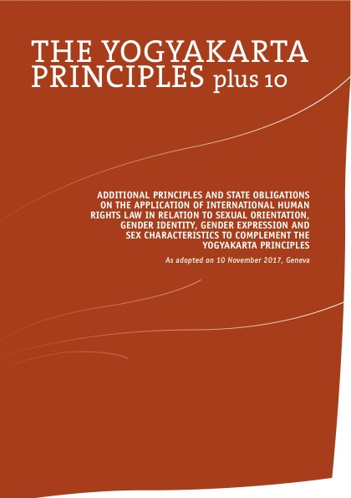
C. Intersex and international law?
How are States addressing those problems?
  Most States encourage discrimination against intersex by promoting a binary conception of society
  Most States don’t react much to intersex human rights violations
That’s why international law can be a useful tool !
Not only hard law, but also soft law
Transnational norms can also be useful :
    In the opinion of the Court, the positive obligation to allow that [3d gender recognition] request arises from Article 8 ECHR in combination with the Yogyakarta Principles
    NL, Limburg District Court, 25 May 2018

Slide 13
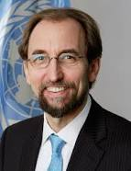
II. The emergence of intersex in international law
“When I started as High Commissioner a year ago, I knew little about intersex people. I don’t think I was alone in this: it reflects a general lack of awareness.
Too many people assume, without really thinking about it, that everyone can be fitted into two distinct and mutually exclusive categories: male or female.”
Opening Remarks at the Expert meeting on ending human rights violations against intersex persons, 15 September 2015
http://www.ohchr.org/EN/NewsEvents/Pages/DisplayNews.aspx?NewsID=16431
Zeid Ra'ad Al Hussein United Nations
High Commissioner for Human Rights
(2014-2018)

Slide 14
II. The emergence of intersex in international law
A. When did it emerge?
B. Where (in what instruments) did it emerge?

Slide 15
A. When did it emerge?
Chronological indicators
Before 2009
2009-2010
2011-2014
2015-today
No occurrence of intersex as a protected category in international law
First occurrence of intersex
Gathering intersex issues with others
First documents addressing intersex issues alone

Slide 16
Before 2009
Intersex is not a human rights issue in international law
2001, CoE, ECHR, Goodwin v United Kingdom
  “While it also remains the case that a transsexual cannot acquire all the biological characteristics of the assigned sex, the Court notes that with increasingly sophisticated surgery and types of hormonal treatments, the principal unchanging biological aspect of gender identity is the chromosomal element. It is known however that chromosomal anomalies may arise naturally (for example, in cases of intersex conditions where the biological criteria at birth are not congruent) and in those cases, some persons have to be assigned to one sex or the other as seems most appropriate in the circumstances of the individual case.”
Yogyakarta principle, 2006, preamble (transnational law)
  “AWARE that historically people have experienced these human rights violations because they are or are perceived to be lesbian, gay or bisexual, because of their consensual sexual conduct with persons of the same gender or because they are or are perceived to be transsexual, transgender or intersex
Notes:
The courts say this to justify not giving to much importance to chromosomal factors

Slide 17
2009-2010 Intersex starts to be a human rights issue
European Union
Council of Europe
United Nations Organization

Slide 18
European Union
Fundamental Right Agency, Homophobia and Discrimination on Grounds of Sexual Orientation and Gender Identity in the EU Member States, Part II – The social situation, 2009
  “20. Member States should ensure all rights to informed consent are respected in regard to procedures on intersex children. Medical associations should ensure that their members are fully informed on current trends in ethics, therapy and care for intersexual persons.”
But:
  In the Summary of findings, trends, challenges and promising practices, no signs of intersex…
  In the 2010 update of this studies : “The position of intersex people is not specifically addressed in this report.”

Slide 19
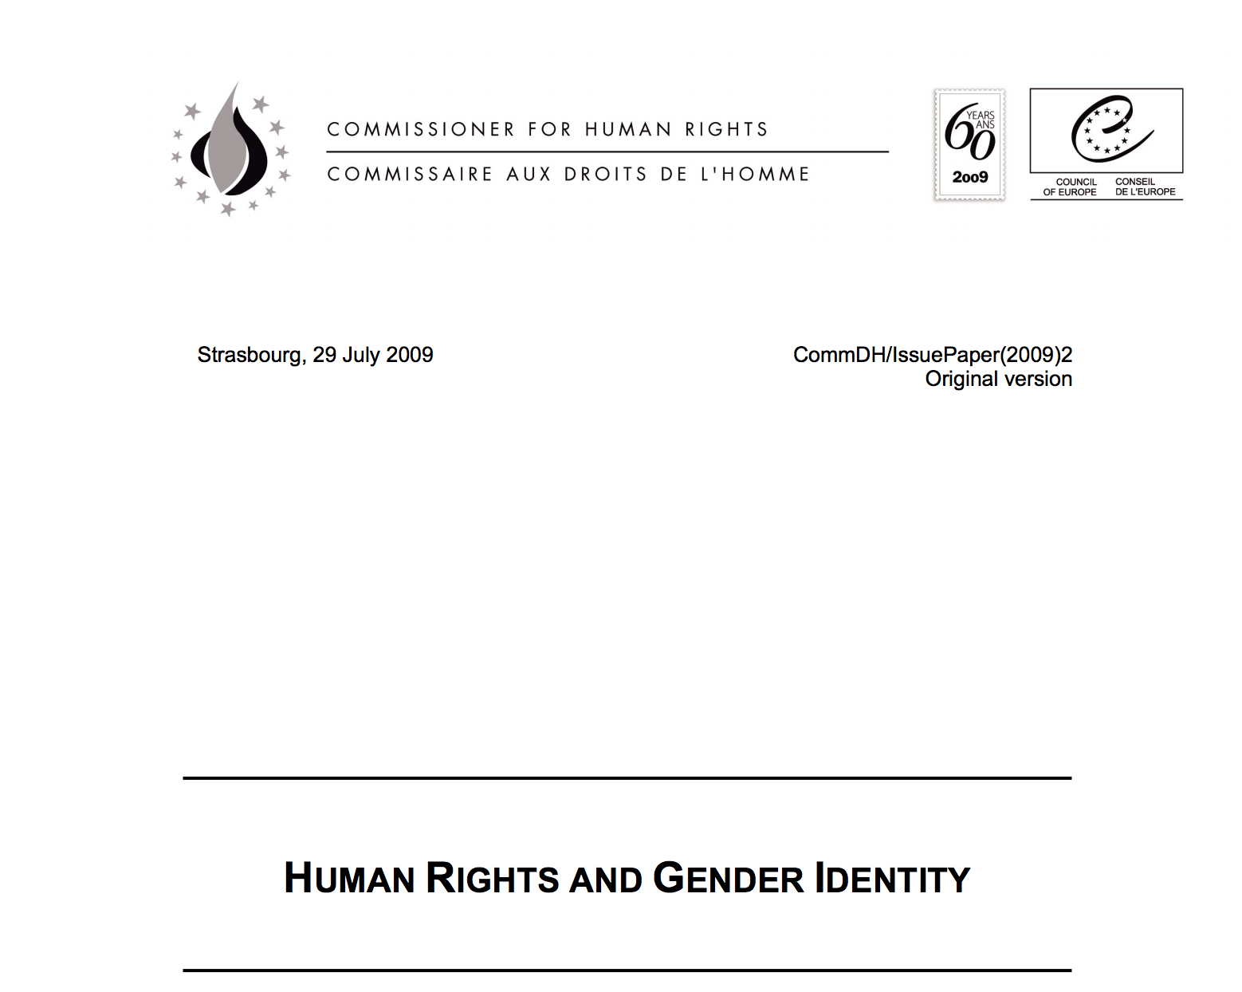
Council of Europe
Commissioner for Human Rights. Issue paper on human rights and gender identity, 2009, p. 3 (introduction)
  “a relatively small number of people experience problems with being a member of the sex recorded at birth. This can also be so for intersex persons whose bodies incorporate both or certain aspects of both male and female physiology, and at times their genital anatomy”
    But
      No other mention of intersex in that document
      No mention of intersex in the PACE’s resolution 1728 (2010), Discrimination on the basis of sexual orientation and gender identity

Slide 20

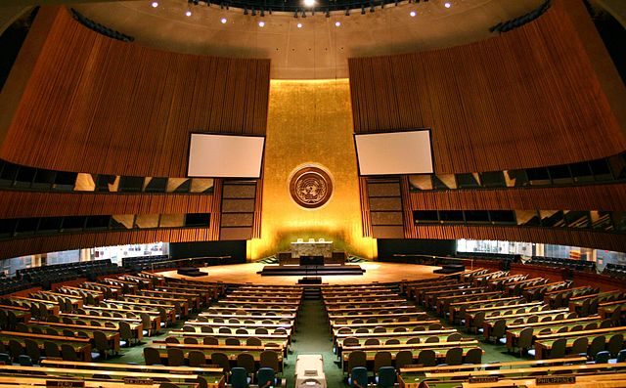
United Nations Organization
Committee on Economic, Social and Cultural Rights, General Comment n° 20, E/C.12/GC/20, 2009, n° 32
  “Other status” as recognized in article 2, paragraph 2, includes sexual orientation. In addition, gender identity is recognized as among the prohibited grounds of discrimination; for example, persons who are transgender, transsexual or intersex often face serious human rights violations, such as harassment in schools or in the workplace.
General assembly, Report of the Special Rapporteur on the right of everyone to the enjoyment of the highest attainable standard of physical and mental health, A/64/272, 2009, para. 49
  “Health-care providers should strive to postpone non-emergency invasive and irreversible interventions until the child is sufficiently mature to provide informed consent. [Footnote 67 : This is particularly problematic in the case of intersex genital surgery, which is a painful and high-risk procedure with no proven medical benefits]
But: no serious developments in these reports on intersex issues

Slide 21
2011-2014
Gathering intersex issue with others
European Union
Council of Europe
United Nations Organization

Slide 22
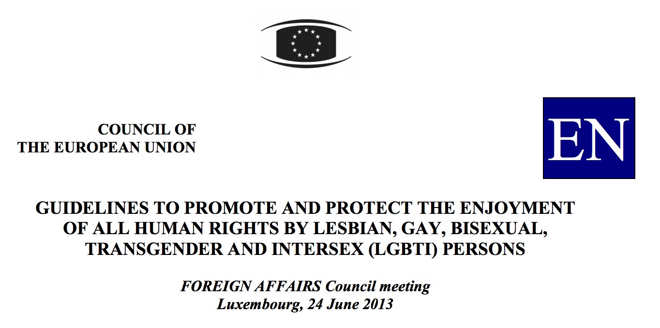
European Union
Council of the European Union,
Guidelines to promote and protect the
enjoyment of all human rights by lesbian,
gay, bisexual, transgender and intersex
(LGBTI) persons, June 2013,
  Annex 2 : Elements for analysis/checklist of the situation regarding LGBTI human rights issues: […]
  4.4 Are there procedures in place to recognise a transgender or intersex person’s gender identity in official documents?
  4.5 Can a transgender or intersex person enjoy all of the rights of her/his new reassigned gender?

Slide 23

Council of Europe
Parliamentary Assembly, Children’s right to physical integrity, Resolution 1952 (2013), October 2013
  “7. The Assembly therefore calls on member States to:
  7.5.3. undertake further research to increase knowledge about the specific situation of intersex people, ensure that no-one is subjected to unnecessary medical or surgical treatment that is cosmetic rather than vital for health during infancy or childhood, guarantee bodily integrity, autonomy and self-determination to persons concerned, and provide families with intersex children with adequate counselling and support;

Slide 24

United Nations Organization
Committee on Economic, Social and Cultural Rights, Consideration of reports submitted by Germany, E/C.12/DEU/CO/5, July 2011, §26
  “The Committee urges the State party to step up measures, legislative or otherwise, on the identity and the health of transsexual and inter-sex (sic) persons with a view to ensuring that they are no longer discriminated against and that their personal integrity and sexual and reproductive health rights are respected. The Committee calls on the State party to fully consult transsexual and inter-sexed persons for this purpose.”
Human Rights Council, Report of the Special Rapporteur on torture and other cruel, inhuman or degrading treatment or punishment, A/HRC/22/53, Feb. 2013, para. 88
  “§3. Lesbian, gay, bisexual, transgender and intersex persons
  The Special Rapporteur calls upon all States to repeal any law allowing intrusive and irreversible treatments, including forced genital normalizing surgery, involuntary sterilization, unethical experimentation, medical display, “reparative therapies” or “conversion therapies”, when enforced or administered without the free and informed consent of the person concerned.”

Slide 25
2011-2014
Gathering intersex issue with others
The limits of merging intersex issues with other minorities
  It gives a partial view of intersex issue (see European Union guidelines)
  Intersex are still invisible
    CoE, Parliamentary Assembly, Resolution 1945 (2013) Putting an end to coerced sterilisations and castrations : not a word on intersex issues…
  It can be counterproductive
    CoE, Committee of Ministers, Reply to Recommendation 2023 (2013) on “Children’s right to physical integrity” :
      “The Committee of Ministers notes that protection for children against the risks of non-medically justified operations and interventions is provided by existing international instruments. […] The Committee considers that, for the present, further standard-setting work is not required.”

Slide 26

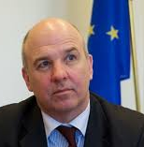
2015-today: First documents addressing intersex issues alone
Reports
  European Union, Fundamental Rights Agency,
  The fundamental rights situation of intersex people,
  FRA Focus, April 2015
  Council of Europe, Commissioner for Human Rights, Human rights and intersex people, Issue paper, 12 May 2015
  United Nations Organization, High Commissioner for Human Rights, Intersex, Fact sheet, September 2015

Slide 27

2015-today: First documents addressing intersex issues alone
  Parliamentary resolution
  CoE, Parliamentary assembly, Promoting the human rights of and eliminating discrimination against intersex people, resolution 2191 (2017)
  EU, European Parliament, The rights of intersex people, resolution, 14 February 2019

Slide 28
2015-today: First documents addressing intersex issues alone
What are the consequences?
  Better awareness of Intersex issues
      EU, Fundamental Rights Agency, Current migration situation in the EU: LGBTI asylum seekers, March 2017
      “This report uses the term LGBTI throughout, even though the measure or policy in place may only concern some categories of persons included in this group. Virtually no information could be collected on intersex asylum seekers.”
  Development of a new concept: sex characteristics
    CoE, Commissioner on human rights (2015) : “Sex characteristics should be included as a specific ground in equal treatment and hate crime legislation”
    European Parliament “[d]eplores the lack of recognition of sex characteristics” in EU member States (2019 resolution)

Slide 29

B. Where did it emerge?
1st stage: limited support
Concluding observations on the States periodic reports
  CEDAW: Germany (2009), Costa Rica (2011),
  CAT: Germany (2011), Switzerland, Austria, Denmark, Hong-Kong, China (2015)
  CESCR: Germany (2011)
  CRC: Switzerland, Chile (2015),
  CRPD: Germany (2015),
Reports by externals or special rapporteurs
  2013, E. Schneider for the SOGI Unit of the CoE, An insight into respect for the rights of trans and intersex children in Europe
  2009, Special Rapporteur on the right of everyone to the enjoyment of the highest attainable standard of physical and mental health, Right of everyone to the enjoyment of the highest attainable standard of physical and mental health A/64/272
  2013, Special Rapporteur on torture and other cruel, inhuman or degrading treatment or punishment, A/HRC/22/53
http://stop.genitalmutilation.org
http://zwischengeschlecht.org/
Notes:
36 UN reprimand

Slide 30
B. Where did it emerge?
2nd stage: active support
Reports by international organizations
  December 2013, European Parliament, Committee on Civil Liberties, Justice and Home Affairs, ("Lunacek report"), Report on the EU Roadmap against homophobia and discrimination on grounds of sexual orientation and gender identity
  May 2014, OHCHR, UN Women, UNAIDS, UNDP, UNFPA, UNICEF and World Health organization, Eliminating forced, coercive and otherwise involuntary sterilization.
  April 2015, Fundamental Right Agency, The fundamental rights situation of intersex people
  May 2015, Human Rights Council, Discrimination and violence against individuals based on their sexual orientation and gender identity, Report of the Office of the United Nations High Commissioner for Human Rights, A/HRC/29/23
  May 2015, Council of Europe Commissioner for Human Rights, Human rights and intersex people. Issue Paper
  November 2015, Inter-American Commission on Human Rights, Violencia contra Personas Lesbianas, Gay, Bisexuales, Trans e Intersex en América

Slide 31
B. Where did it emerge?
2nd stage: active support
Reports by international organizations
Supporting or organizing NGO meetings and events
  March 2014, Human Rights Council, Side Events to the The 25th Session, Intersex People and Human Rights: Violations, Voices and Visions
  August 2015, Commissioner for Human Rights (CoE), Opening of the European Intersex Forum in Douarnenez (France)
  September 2015, OHCHR (UN), Expert meeting on ending human rights violations against intersex persons
  September 2015, European Parliament, LGBTI Intergroup Session, Human rights of intersex people
  November 2017, African Commission on Human and People’s Rights, Side event on the protection and promotion of the human rights of Intersex people

Slide 32
B. Where did it emerge?
2nd stage: active support
Reports by international organizations
Supporting or organizing NGO meetings and events
Parliamentary work
  October 2013, Parliamentary Assembly (CoE), Resolution 1952 (2013) and Recommendation 2023 (2013), Children's right to physical integrity
  February 2017, European Parliament (EU), Promoting gender equality in mental health and clinical research, § 61
  October 2017, Parliamentary Assembly (CoE), Resolution 2191 (2017), Promoting the human rights of and eliminating discrimination against intersex people
  February 2019, European Parliament (EU), The rights of intersex people

Slide 33
B. Where did it emerge?
2nd stage: active support
Reports by international organizations
Supporting or organizing NGO meetings and events
Parliamentary work
Joint statement
  May 2014, Eliminating forced, coercive and otherwise involuntary sterilization, UN interagency statement
  13 May 2015, Discriminated and made vulnerable: Young LGBT and intersex people need recognition and protection of their rights International Day against Homophobia, Biphobia and Transphobia
  26 October 2016, End violence and harmful medical practices on intersex children and adults, UN and regional experts urge
Notes:
2014 : OHCHR, UN Women, UNAIDS, UNDP, UNFPA, UNICEF and WHO
2015 : Committee on the Rights of the Child, group of UN human rights experts, Inter-American Commission on Human Rights, Special Rapporteur on Human Rights Defenders of the African Commission on Human and Peoples’ Rights, Commissioner for Human Rights of the Council of Europe, Discriminated and made vulnerable: Young LGBT and intersex people need recognition and protection of their rights International Day against Homophobia, Biphobia and Transphobiahttp://www.ohchr.org/EN/NewsEvents/Pages/DisplayNews.aspx?NewsID=15941&LangID=E
2016 : UN Committee against Torture, UN Committee on the Rights of the Child (CRC), UN Committee on the Rights of People with Disabilities (CRPD), Subcommittee on Prevention of Torture and other Cruel, Inhuman or Degrading Treatment or Punishment (SPT), group of UN, Special Representative of the UN Secretary-General on Violence against Children Ms. Marta Santos Pais, African Commission on Human and Peoples' Rights, Chairperson of the Committee for the Prevention of Torture in Africa, Commissioner for Human Rights (Coe), Inter-American Commission on Human Rights

Slide 34
III. The protection granted to intersex in international law

Slide 35
III. The protection granted to intersex in international law
A. Overview of the different international norms protecting intersex
B. Insight on the norms related to the normalizing surgeries
C. Dead angles?

Slide 36
A. Overview of the different international norms protecting intersex
1. Hard law : general provision as in the ICCPR
    Art. 7: “No one shall be subjected to torture or to cruel, inhuman or degrading treatment or punishment. In particular, no one shall be subjected without his free consent to medical or scientific experimentation”;
    Art. 16: “Everyone shall have the right to recognition everywhere as a person before the law.”
    Art. 18: “No one shall be subject to coercion which would impair his freedom to have or to adopt a […] belief of his choice.”
    Art. 24: “Every child shall have, without any discrimination as to race, colour, sex, language, religion, national or social origin, property or birth, the right to such measures of protection as are required by his status as a minor, on the part of his family, society and the State.”
    Art. 26: “All persons are equal before the law and are entitled without any discrimination to the equal protection of the law. ”

Slide 37
A. Overview of the different international norms protecting intersex
2. Soft law: specific provisions produced by international organizations
  Intersex’ bodily integrity and self determination
  Access to counseling, support and medical records
  Educating professionals working with intersex and raising general awareness
  Investigation, access to justice redress and compensation for intersex victims
  Fight against discrimination based on sex characteristics
  Participation of intersex NGO in intersex policies and studies
  Protecting intersex’ rights regarding their gender identity (including depathologisation)
  Funding intersex studies and intersex NGO’s
  (Yogyakarta plus 10 principles)
Notes:
+ Yogyakarta plus 10 :
Principle 31: the right to legal recognition
Principe 32: the right to body and mental integrity
Principe 37: the right to truth

Slide 38
B. Insight on the norms related to normalizing surgeries
2009
2011
2011
“Member States should ensure all rights to informed consent are respected in regard to procedures on intersex children.”
“Health-care providers should strive to postpone non-emergency invasive and irreversible interventions”
“The Committee urges the State party to step up measures […] on […] the health […] of inter-sex persons with a view to ensuring […] that their personal integrity […] and reproductive health rights are respected.”
“The Committee recommends that the State party: (a) Ensure the effective application of legal and medical standards following the best practices of granting informed consent to medical and surgical treatment of intersex people, including full information, orally and in writing, on the suggested ; […] (d) Properly inform patients and their parents of the consequences of unnecessary surgical and other medical interventions for intersex people.”
FRA, Homophobia and discrimination on Grounds of SOGI in the EU Member States
UN, Special Rapporteur on the right of everyone to the enjoyment of the highest attainable standard of physical and mental health
UN, CECSCR, Consideration of reports submitted by Germany
Committee against Torture, Concluding observations, Germany
Notes:
Committee on Economic, Social and Cultural Rights

Slide 39
B. Insight on the norms related to normalizing surgeries
2013
2014
2015
(April)
“The Special Rapporteur calls upon all States to repeal any law allowing intrusive and irreversible treatments, including forced genital normalizing surgery […] when enforced or administered without the free and informed consent of the person concerned. He also calls upon them to outlaw forced or coerced sterilization in all circumstances”
UN, Human Rights Council, Report of the Special Rapporteur on torture and other cruel, inhuman or degrading treatment or punishmen
“Suggestions: […] In the absence of medical necessity, when the physical well-being of a person with an intersex condition is in danger, if possible, postpone treatment that results in sterilization until the person is sufficiently mature to participate in informed decision-making and consent.”
OHCHR, UN Women, UNAIDS, UNDP, UNFPA, UNICEF & WHO, Eliminating forced, coercive and otherwise involuntary sterilization,
“EU Member States should avoid ‘sex-normalising’ medical treatments on intersex people without their free and informed consent”
FRA, The fundamental rights situation of intersex people
Notes:
Committee on Economic, Social and Cultural Rights

Slide 40
B. Insight on the norms related to normalizing surgeries
2015
(May)
2016
2017
(Feb)
2017
(Oct.)
“The High Commissioner recommends that States address violence by: […] (h) Prohibiting medically unnecessary procedures on intersex children
OHCHR, Discrimination and violence against individuals based on their sexual orientation and gender identity
“States must, as a matter of urgency, prohibit medically unnecessary surgery and procedures on intersex children”
Joint Statement on Intersex Awareness day, End violence and harmful medical practices on intersex children and adults
Calls on the Member States to prevent, ban and prosecute […] genital mutilation affecting intersex persons
European Parliament, Resolution on promoting gender equality in mental health and clinical research
“the Assembly calls on Council of Europe member States to […] prohibit medically unnecessary sex-“normalizing” surgery, sterilization and other treatments practiced on intersex children without their informed consent”
CoE, Parliamentary Assembly, resolution 2191 (2017), Promoting the human rights of and eliminating discrimination against intersex people
Notes:
Committee on Economic, Social and Cultural Rights

Slide 41
B. Insight on the norms related to normalizing surgeries
Summary of the evolution

Slide 42
B. Insight on the norms related to normalizing surgeries
Summary of the evolution
2009
2011
2013
2014
2015
2016
2017
“should strive to postpone non-emergency invasive and irreversible interventions”
“ensuring […] their personal integrity […] and reproductive health rights”
“Properly inform patients and their parents”
“calls upon all States to repeal any law allowing intrusive and irreversible treatments, including forced genital normalizing surgery”
“if possible, postpone treatment that results in sterilization”
“States should avoid ‘sex-normalising’ medical treatments”
“recommends [p]rohibiting medically unnecessary procedures ”
“States must, as a matter of urgency, prohibit medically unnecessary surgery”
“calls to prevent, ban and prosecute […] genital mutilation affecting intersex persons”
“Calls to prohibit medically unnecessary sex-“normalizing” surgery”
Notes:
Before 2015: recommandation of avoidance and non promotion
After 2015: recommandation of prohibition and prosecution
Torture next?

Slide 43
C. Dead angles?
Vulnerable group of intersex
  Migrants
  Detained persons
  Fetus
Unaddressed questions related to binary sexed rule
  Prison, toilets, sports (though: A/HRC/40/L.10/Rev.1)
  Marriage, medically assisted reproduction
Notes:
A/HRC/40/L.10/Rev.1: “Expresses concern that discriminatory regulations, rules and practices that may require women and girl athletes with differences of sex development”

