Slide 1




Projet financé avec le concours de l’Union Européenne avec le Fonds Européen de Développement Régional
ICEP Plymouth 2019
Coastal flood management: when ‘natural’ risks are seen as less dangerous?
Raquel Bertoldo, Séverin Guignard, Pierre Dias, Alexandra Lindenmann
Notes:
I’m presenting you here a qualitative study that is part of an interdisciplinary project.
We were mainly interested in better understanding how people in southern France, in the mediterranean coast understand coastal risks. When I say people I mean not stakeholders, just common people right?
There have been some pretty spectacular winter storms over the last decade; institutions have surelly responded. But local people, have they adapted? Changed what they perceive as threatening? Or on the contrary, they believe it might be negligeable regarding other things….

Slide 2
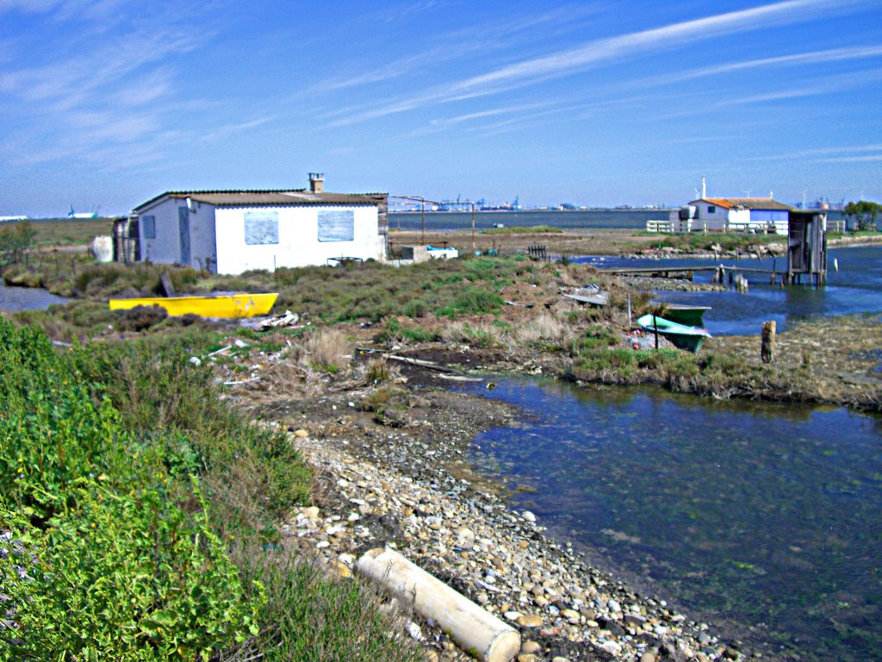
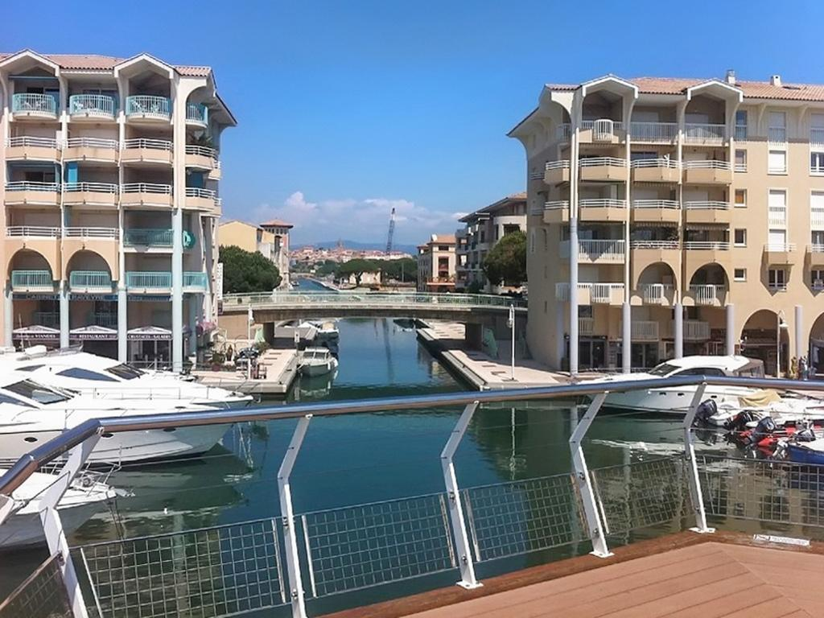
How natural is a natural risk?
Port Saint Louis du Rhône
Fréjus (Port)
Notes:
Out fieldwork was done in two localities that were chosen by our geography colleages in relation to their exposition to coastal floodings. We chose two places that are comparable in this regard, BUT that are pretty different.
On your left you have PSL. A relativelly new municipality for french standards, just over a 100 years. It was once a fourishing port but it as soon abandoned by another neighbouring town – Fos sur mer – that could receive larger ships. Since then this lost place at hte doors of the Camargue national park is home to tight knit community of local families. They have there this tradition of ‘cabanons’ that is a small house (a shed) used to hunt and fish. these sheds are usually in areas highly exposed to flooding. So we can imagine these peolpe know what flooding is.
This place here feels (and actually is) a parking lot for yachts. The percentage of summer residences is very important (during the winter the city is empty) and retired peolpe also (people who want to finally live by the sea, etc). These people very rarelly were capable to describe events where a coastal or even a flood took place.

Slide 3
Possible differences
Place attachment
“propensity of human beings and other animals to seek out the place where they were born or find a place in which they feel comfortable and secure” (Hidalgo & Hernández, 2001, p. 274).
Place attachment + risk perception
Inconsistent findings in relation to different types of natural risks (Bonaiuto et al., 2016) → both positive and negative relationships between place attachment and risk perception make sense in a given context.
Legal changes have endeavoured to improve natural risk management nationally and across the EU (e.g. EU Flood Directive). Still legal innovations are often met with local resistance (Castro & Mouro, 2016)
Notes:
place attachment as an emotional bound that drives an individual to preserve an association with a given place (Hidalgo & Hernández, 2001). Or, “it is the propensity of human beings and other animals to seek out the place where they were born or find a place in which they feel comfortable and secure” (p. 274).
The problem arises when this frugal and resourceful places are presented as representing a threat (Breakwell, 2001). When this happens, and the communities are not in the capacity to respond to the threat, a resistance in how the threat is locally perceived has been described

Slide 4
Port Saint Louis du Rhône
Fréjus
PSL and Fréjus are both exposed to comparable flooding risks. The two southern France localities differ in economic activity, demographic composition and income.
Study goal
How local dwellers of these two southern France communities (1) understand the risks presented by their immediate environment and (2) act in the perspective of mitigating these risks?
Social representations theory: local meaning making of scientific ideas (Moscovici, 2001), also in relation to the environment (Castro, 2006)
II. The events that are represented might however be more or less ‘visible’ if they are (Kasperson et al., 1988)
Socially amplified
Socially attenuated

Slide 5
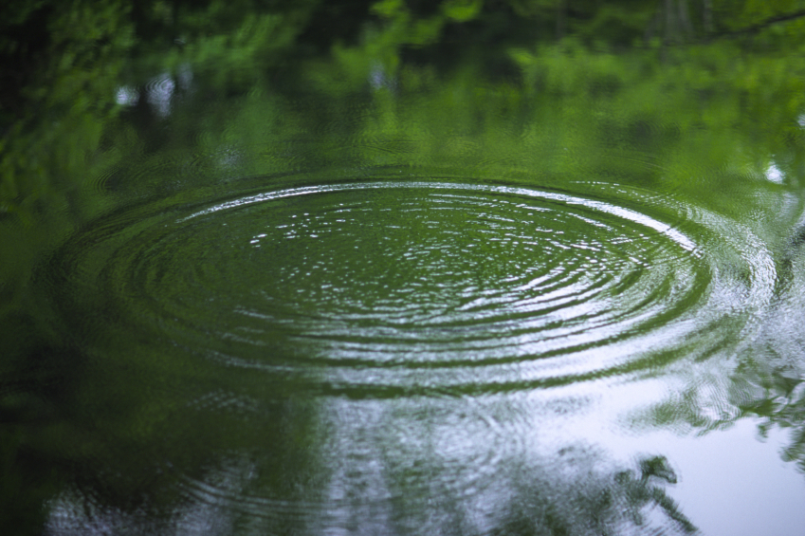
Amplification signals (Burgess, 2012)
Projection of harm into the future
Associated risks (e.g. pollution)
Blame and responsibility
Attenuating signals
‘act of god’
Anecdotes
Economic impact

Slide 6
Method
Forty in-depth semi-directive interviews with local dwellers (20 in PSL and 20 in Fréjus)
Interview length: between 40 minutes and 1h30
Interview guide sections
  Community description
  Past natural events
  How coastal floods were/are dealt with?
  Source of information
  Perceived vulnerability and intention to leave
Interviews were transcribed and content analysed. The analytical approach mixed theory driven aspects – Bertoldo et al. (submitted) – and content driven aspects.
Notes:
This analysis will focus the content driven aspects that have been identified after a tourough reading of the material.

Slide 7
Categories
People living in these two localities described in different terms their exposure to coastal floods as:
‘Natural’ risks → here coastal risks are described in nostalgic terms. Risk exposure is characterised as part of simpler everyday lives lived in the rhythms of nature. Nobody is held accountable.
Manageable risks → here coastal risks are described in catastrophic terms. Risk management here is described in technical terms that shields this sphere from public debate and participation. Local authorities are here described as directly accountable for reducing risk exposure.
Notes:
Numerous content have emerged, but for this presentation I chose to focus on the clear distinction between people who share a local culture of observing nature with peolpe who must try to figure out a way to conceive it.

Slide 8
Coastal floods as NATURAL risks
“We learn here to live with nature since childhood - we are used to it”
Man PSL 65 yo
[about the sheds] “That's why I say that is the art of living in PSL: the sheds are flooded regularly and despite everything we live well because we do not overconsume”
Woman PSL 65 yo
“You go elsewhere, it's all flooded. And you go around the cabanon (shed) and... you wonder it's impossible! But the old ones when they did it back then, I do not know how they did it, but they were not stupid in the end because they had no bull[bulldozer]”
Man PSL 67 yo
“People are smarter now, but before the old ones, they were tough because here you did not have to work to live. Everything was available in abundance”
"I tend to say that often the Rhone us is our god”
Man PSL 70 ans
Lost paradise, romantic view of ‘nature’
Local memory
No responsibilities
Notes:
Animist character of nature.
We are born into it; we were used to this, and local people still nurture this art de vivre in communion with the environment.
This comparaison is made by locals with older times. But it is also used by people that are not natives and compare this place with elsewhere.

Slide 9
Coastal floods as a MANAGEABLE risk
“it seems that they have become aware that it is necessary to maintain [the dikes]. But the maintenance of the dikes, uh, it's the ... there are responsibilities and people have to assume their responsibilities, that's it.” (man, 70, PSL)
“So, it is an outside company that manages the pumps, which manages the ... if there is a problem it is ... it must work. It might be struggling, but it must work. If it does not work, it's them, the people in charge [who are to blame] It's our homes that are at stake” (man, 16, PSL)
“They have to stop building in flood plains, that's clear. I think that since then, there have been some who understood that we should not build in a flood plain” (woman, 15, Fréjus)
Well, the risks are often human […]. But there, all that one builds and all the zones which were natural which become waterproofed, it is zones which bring water, which bring risks of flood, etc. (man, 77 yo, Fréjus)
Notes:
If it is manageable → there is always the possibility to do a good or a bad job.
Here the risk is described as something that was created from the more intensive occupation of the sea front. AND something that we can succed or totally fail and be responsible for this.
more important as we project it into the future.

Slide 10
Coastal floods as a MANAGEABLE risk
“But can we build a hotel there? We do not think this should be authorized... first it is a public space, it will privatize the beach” (man, 68 yo, Fréjus)
“Building permits, building plans, all that is very important. If the mayor decides that we must build higher, we build higher, that's all” (man, 68 yo, Fréjus)
Polarization, debate
Clear responsibility → of the public OR the administration
Projection of harm into the future

Slide 11
Discussion
In places where coastal floods are part of everyday life, they are part of a local know how, a local way of live.
  Possible limit to local legal change: the ‘Asterix’ spirit “we know better”
  attenuated risks (immanent representations [Harré, 1998])
In more densely populated coastal areas, with a large amount of retired people from elsewhere, local to make sense of coastal threats and to find accountable instances
  Amplified risks (transcendent representations)
  Politically polarized
Context for legal innovations in coastal areas → improve local debate and participation for future adaptation plans

Slide 12
Projet financé avec le concours de l’Union Européenne avec le Fonds Européen de Développement Régional
ICEP Plymouth 2019
Coastal flood management: when ‘natural’ risks are seen as less dangerous?
THANK YOU!
raquel.bohn-bertoldo@univ-amu.fr

