Slide 1
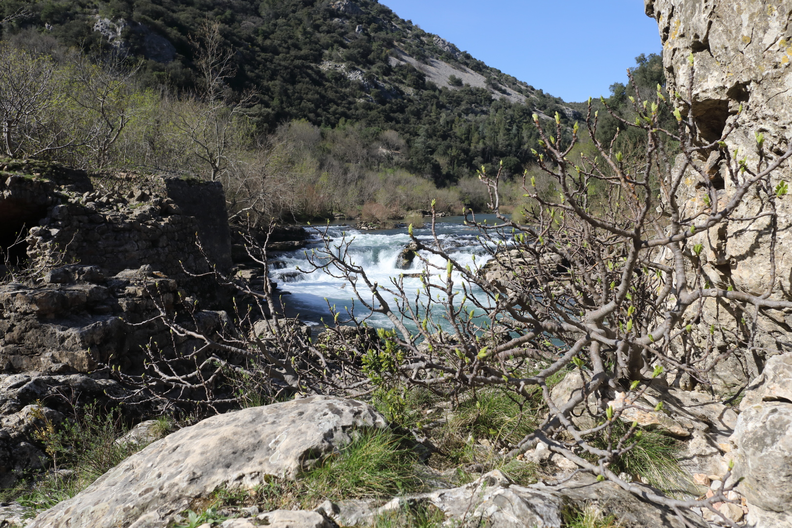
Ficus carica and its pollination
Finn Kjellberg and Annick Lesne
Creative Commons Licence CC-BY
Notes:
Photographic credit: F. Kjellberg except when stated otherwise.

Slide 2
wild Ficus carica
Ficus carica typically grows on rocks
2 meters
Notes:
Wild Ficus carica on the rocky bank of river Hérault, March 2020, St-Guilhem-le-désert, France

Slide 3
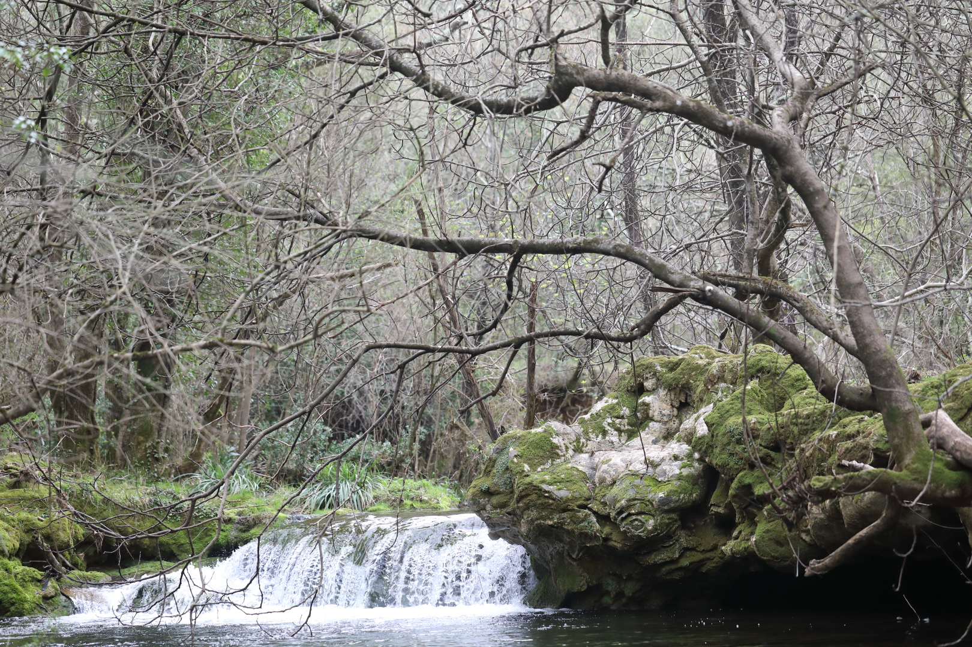
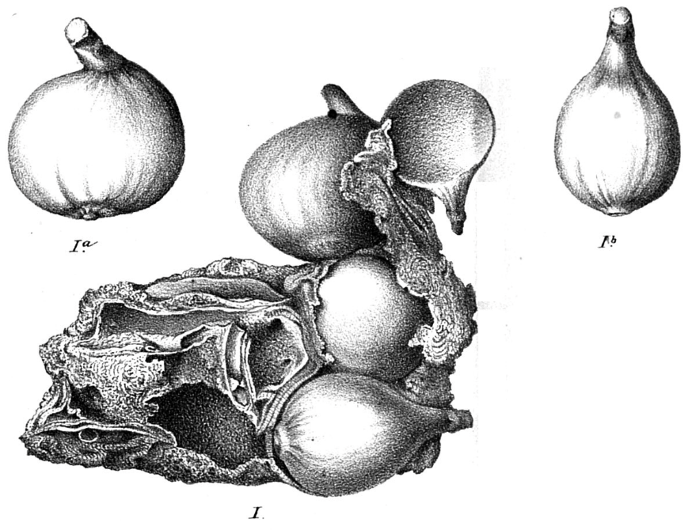
wild Ficus carica
fig tree
Ongoing tufa deposition
Hérault, France
UPMC Paris, France
I: original tufa concretion
Ia and Ib, Ficus carica fossil figs isolated from I Hérault, France >60.000 years BP
G. Planchon 1864, Paris, France
Notes:
River Buèges, March 2020, St Jean de Buèges, France
Fig trees grow on rocks on the riverbank.
The formation of tufa concretions is rapid given the high concentration of carbonate minerals in the water, so that fossilization of soft tissues (e.g. figs) can occur.
These fossil figs, as well as fossil leaves, demonstrate the presence of wild Ficus carica in this region of Europe more than 60 000 years ago.
G. Planchon thesis dissertation (defended at the Faculté des Sciences de Paris) is now available at UPMC (Paris 6), Sorbonne Université
http://jubilotheque.upmc.fr/ead.html?id=TH_000102_001#!{"content":["TH_000102_001_e0000024",false,""]}

Slide 4
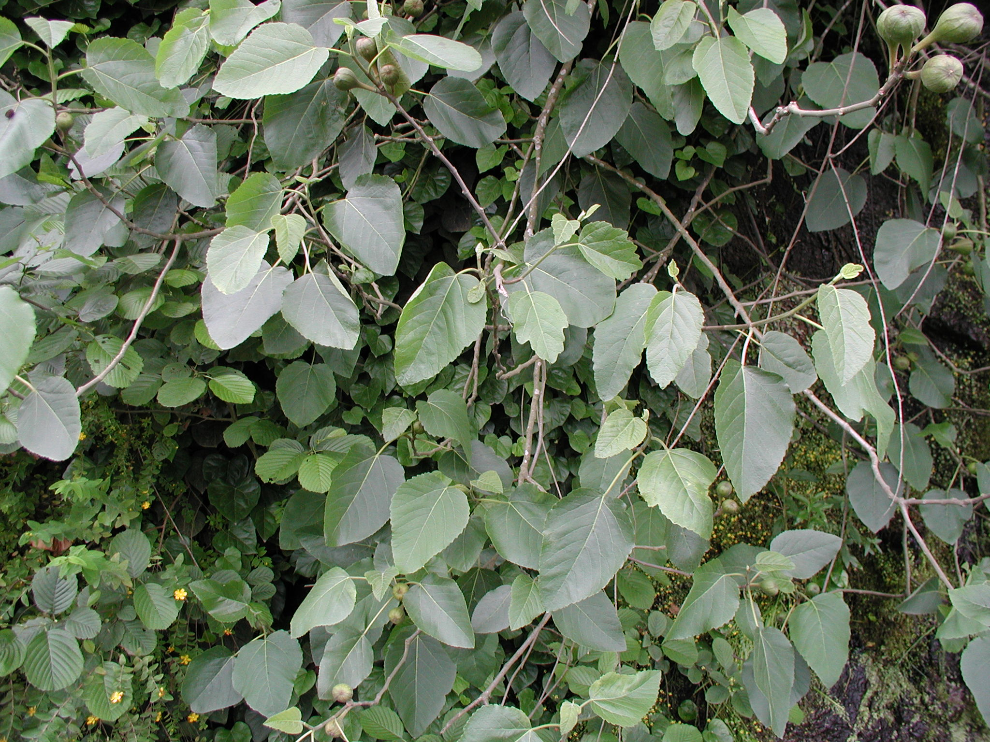
wild Ficus carica
Ficus carica (form Ficus colchica Grossh.)
This is morphologically the most divergent form of Ficus carica
Black Sea coast, Turkey

Slide 5
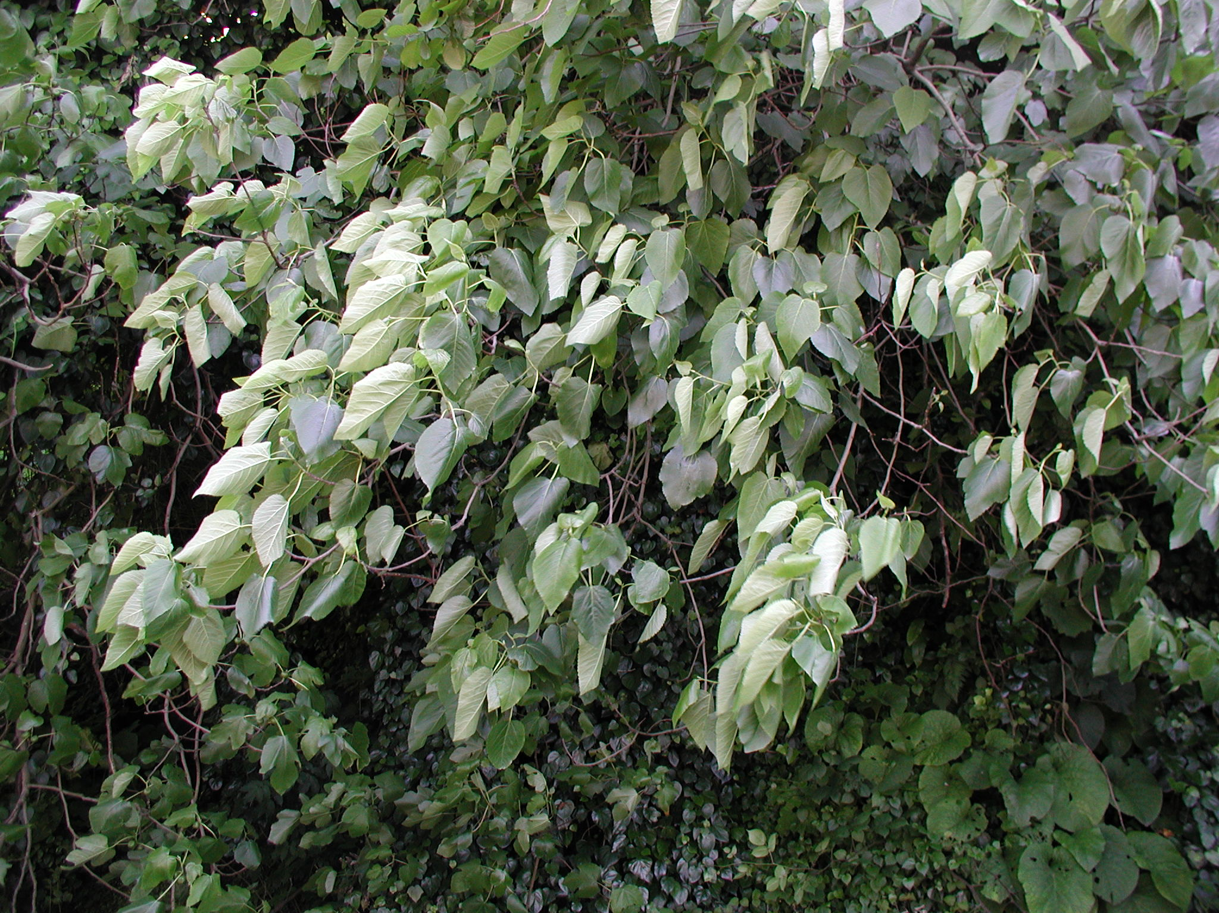
wild Ficus carica
Ficus carica (form Ficus colchica Grossh.)
Note the gracile branches and flexible leaves
Black Sea coast, Turkey
Notes:
This form belongs to Ficus carica (Khadari and Kjellberg, unpublished data).
However, the branches and leaves of this phenotype are quite different from the more common forms of F. carica growing around the Mediterranean basin.

Slide 6
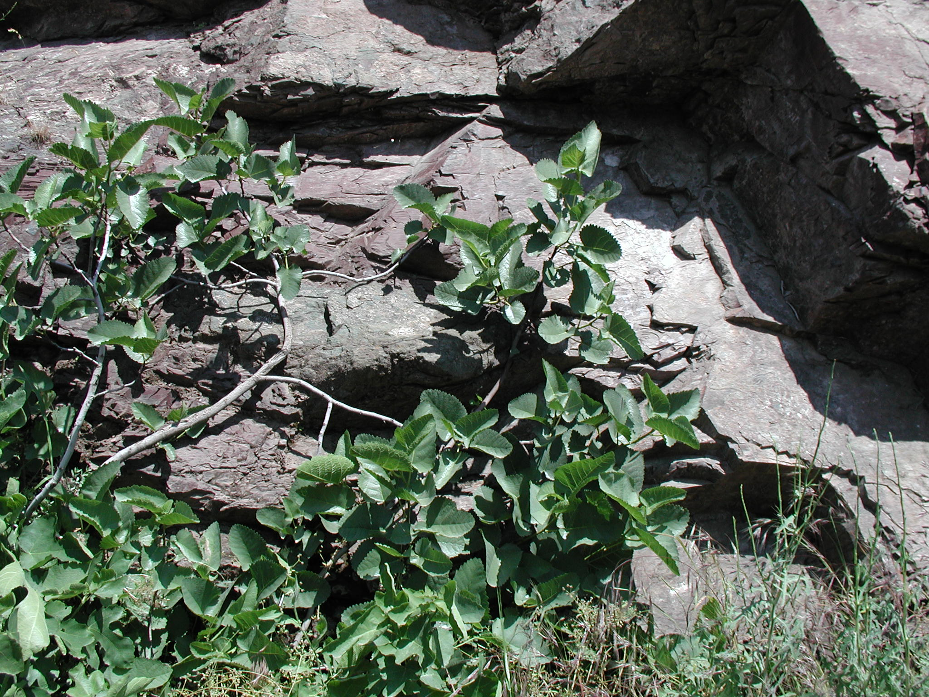
Ficus palmata
Adıyaman Province, Turkey
Ficus palmata is the sole species closely related to F. carica It is distributed from Ethiopia to India and Nepal
Notes:
This is the plant described under the name Ficus carica subspecies rupestris.

Slide 7
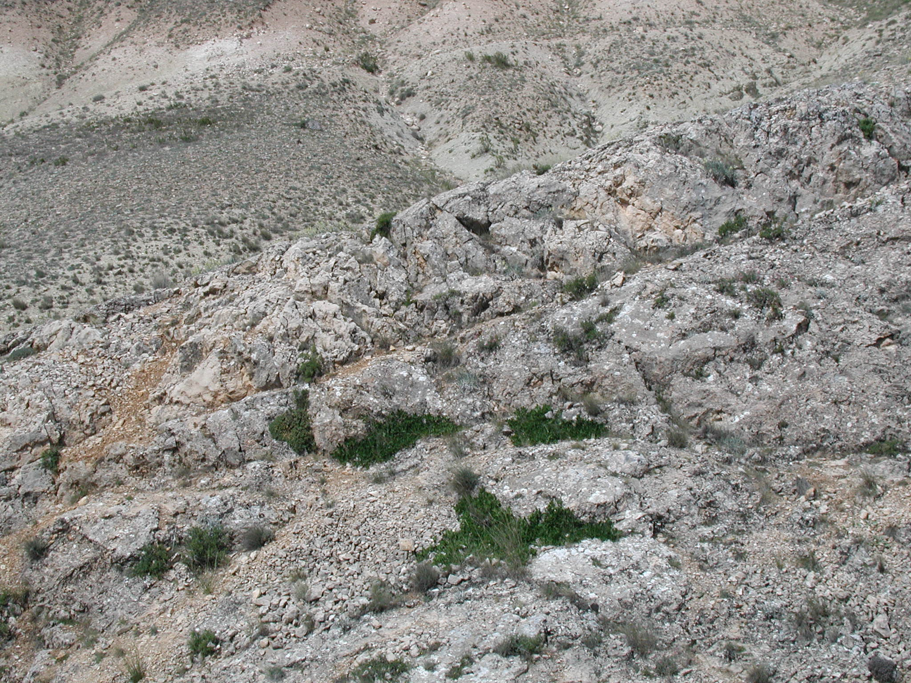
Ficus palmata
Adıyaman Province, Turkey
fig trees
2 meters

Slide 8
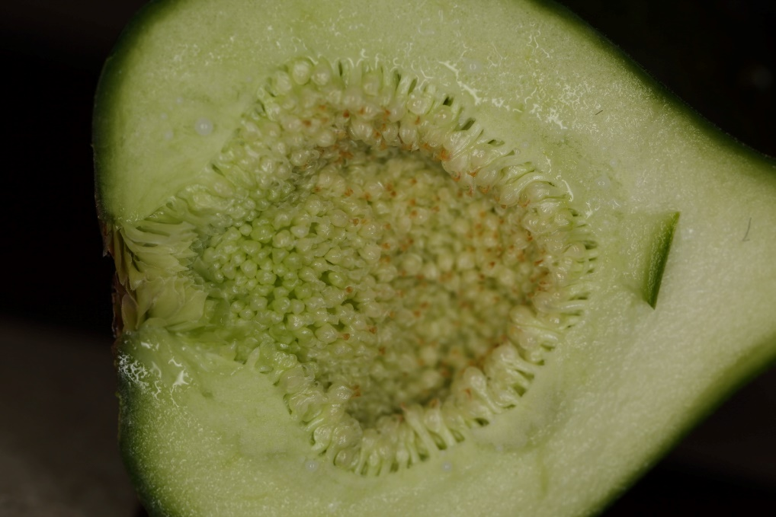
wild Ficus carica
ostiole
immature
male flowers
female flowers
A fig is an urnshaped receptacle. It is closed by an ostiole, the inside is lined by uniovulate female flowers, and male flowers
Notes:
In Ficus carica, male flowers pimordia are present in all fig buds, but do not fully develop in figs that have not overwintered as buds on the tree. In figs on female trees that have overwintered as buds, the male flower zone is apparent, but the flowers do not contain pollen. Such sterile male flowers are called neuter flowers.

Slide 9
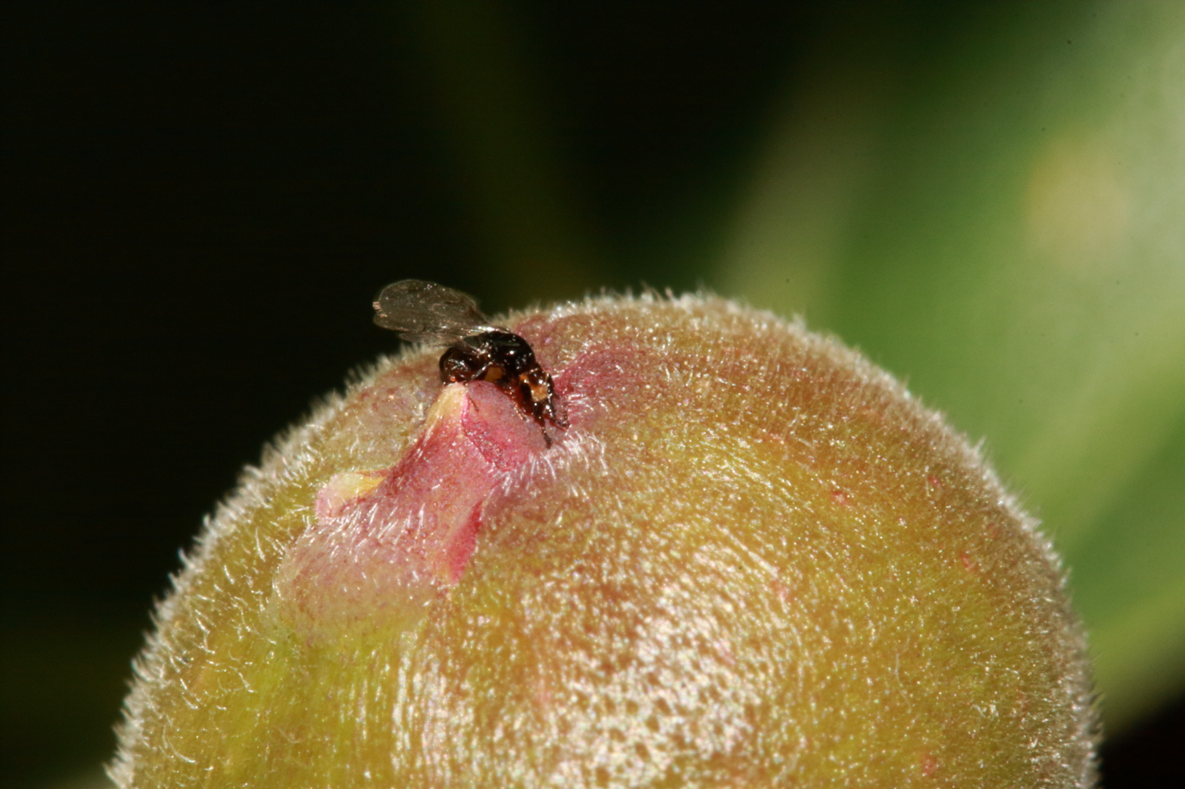
wild Ficus carica
pollen loaded female Blastophaga psenes
ostiole
Figs are exclusively pollinated by Blastophaga psenes wasps that enter the fig through the ostiole to oviposit

Slide 10
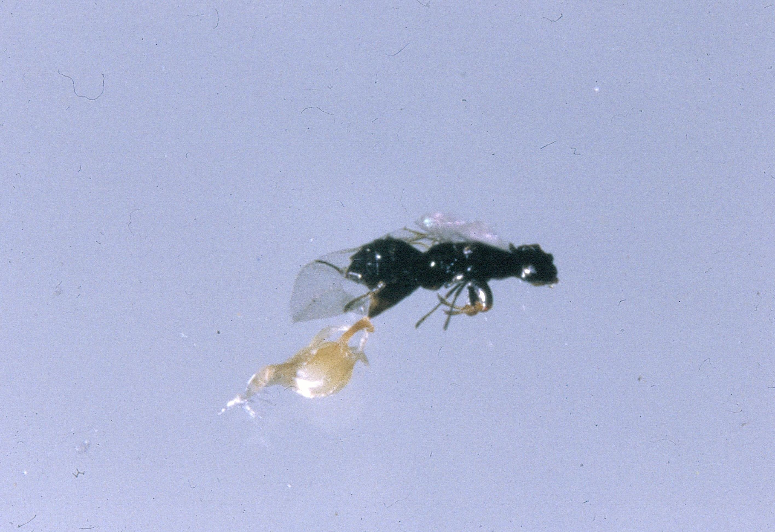
wild Ficus carica
ovipositing female Blastophaga psenes
flower ovule
flower style
Within the fig: Blastophaga psenes oviposits in female flowers, transforming them into galls. The ovipositor is inserted through the style of the flower. The egg is laid in the ovule, between the inner integument and the nucellus
Photo G. Valdeyron
Notes:
The ovipositing female injects a drop of liquid from the reservoir of its venom gland while ovipositing. This triggers the swelling of inner integument tissues at the opposite side of the nucellus, which is followed by the swelling of nucellus cells.

Slide 11
Ficus carica is a functionally dioecious species
- Female trees have long styled female flowers that do not host wasp larvae; their figs produce seeds and no pollen
- Male trees have short styled female flowers that host wasp larvae and only very few seeds; their figs produce wasps (pollen vectors) and pollen, i.e. they are functionally male

Slide 12
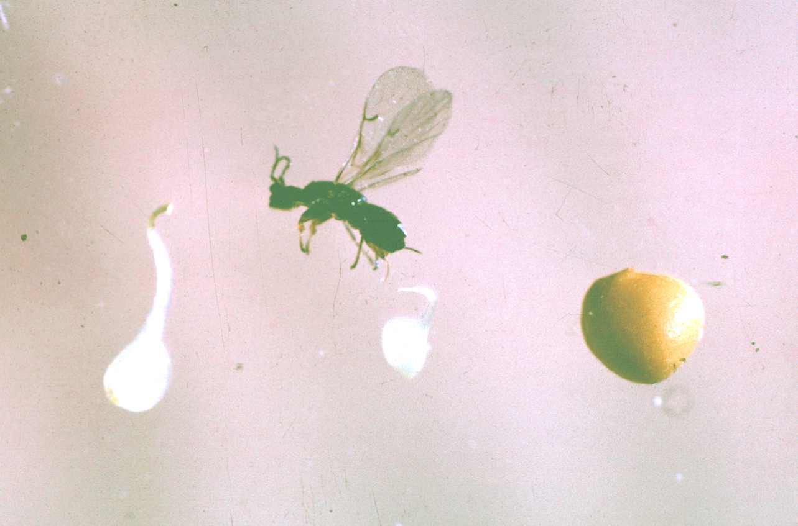
wild Ficus carica
long-styled flower:
turns into seed
ovipositor
seed
short-styled flower:
turns into gall containing wasp larva
In long styled flowers the ovipositor does not reach the ovule, no egg is laid, the flower gives a seed. In short styled flowers an egg is laid and the ovule is transformed into a gall.
Photo G. Valdeyron

Slide 13
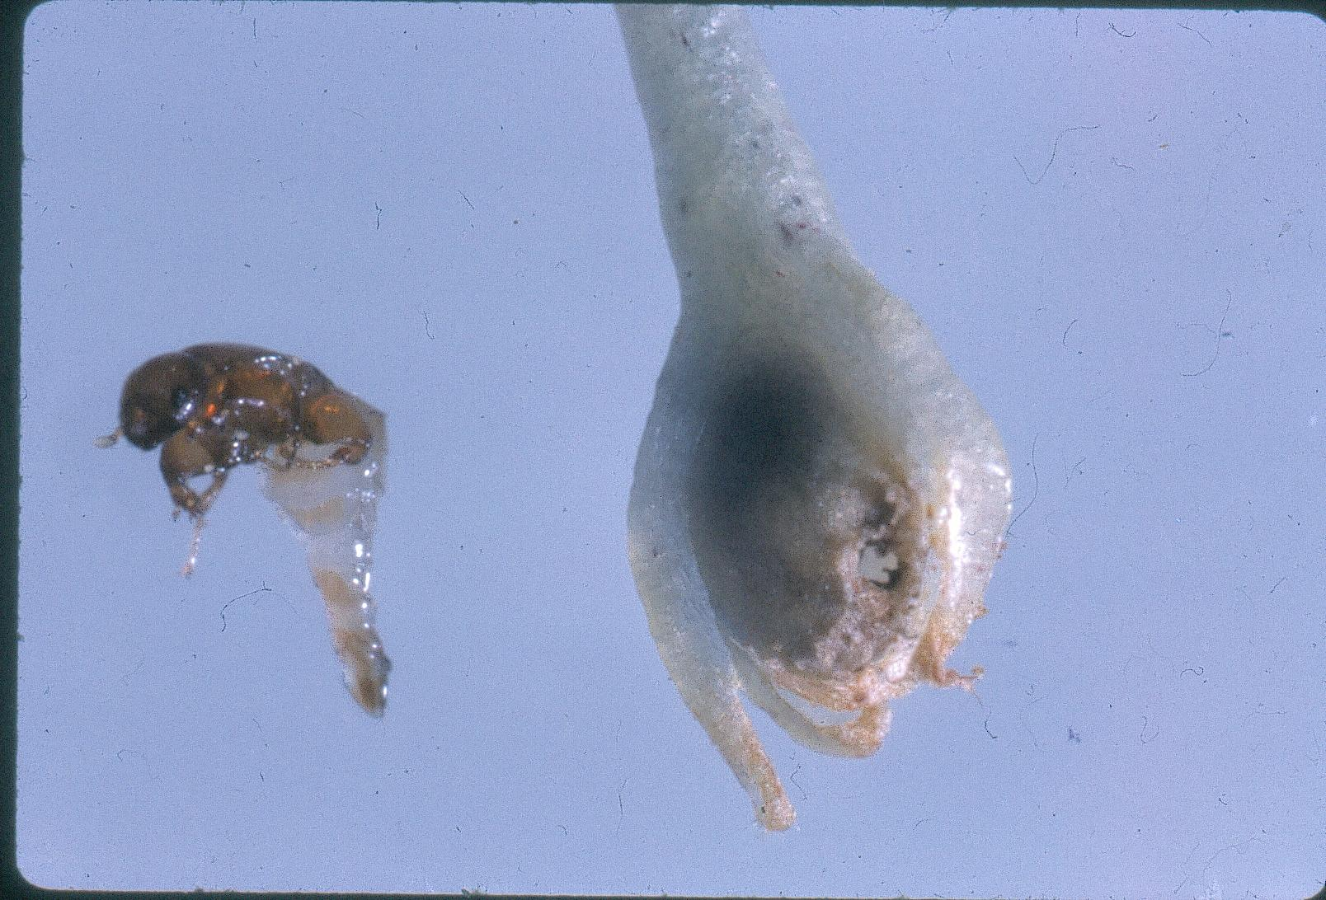
wild Ficus carica
galled female flower with mating hole
mated female in gall
male Blastophaga psenes
Male tree: males mate females still enclosed in their natal gall
Photo G. Valdeyron

Slide 14
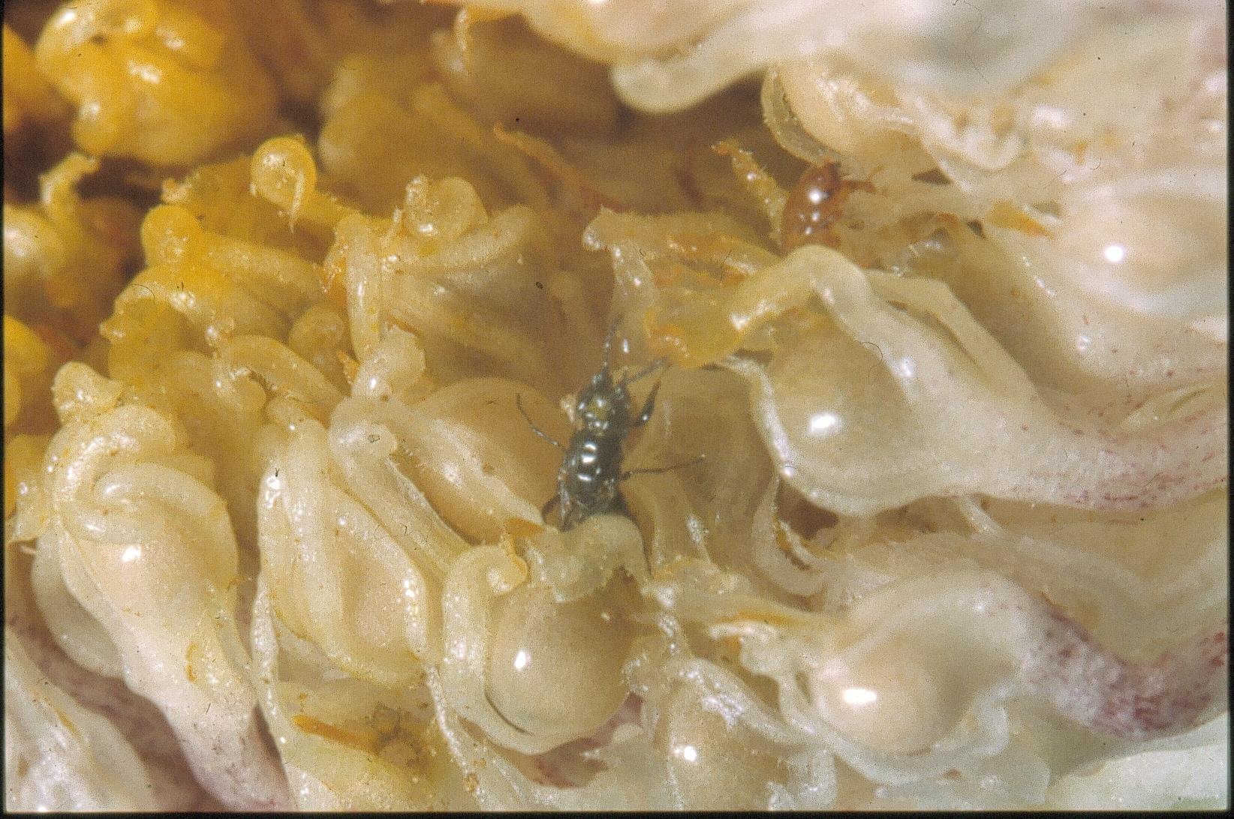
wild Ficus carica
male Blastophaga searching for galls
containing females
galled female flower
Male tree: mated female Blastophaga emerging into the fig cavity from a galled female flower
Notes:
Mated female wasps wait, protected, in their galls, until the moment of emergence from the fig (afternoon in April, morning in July).

Slide 15
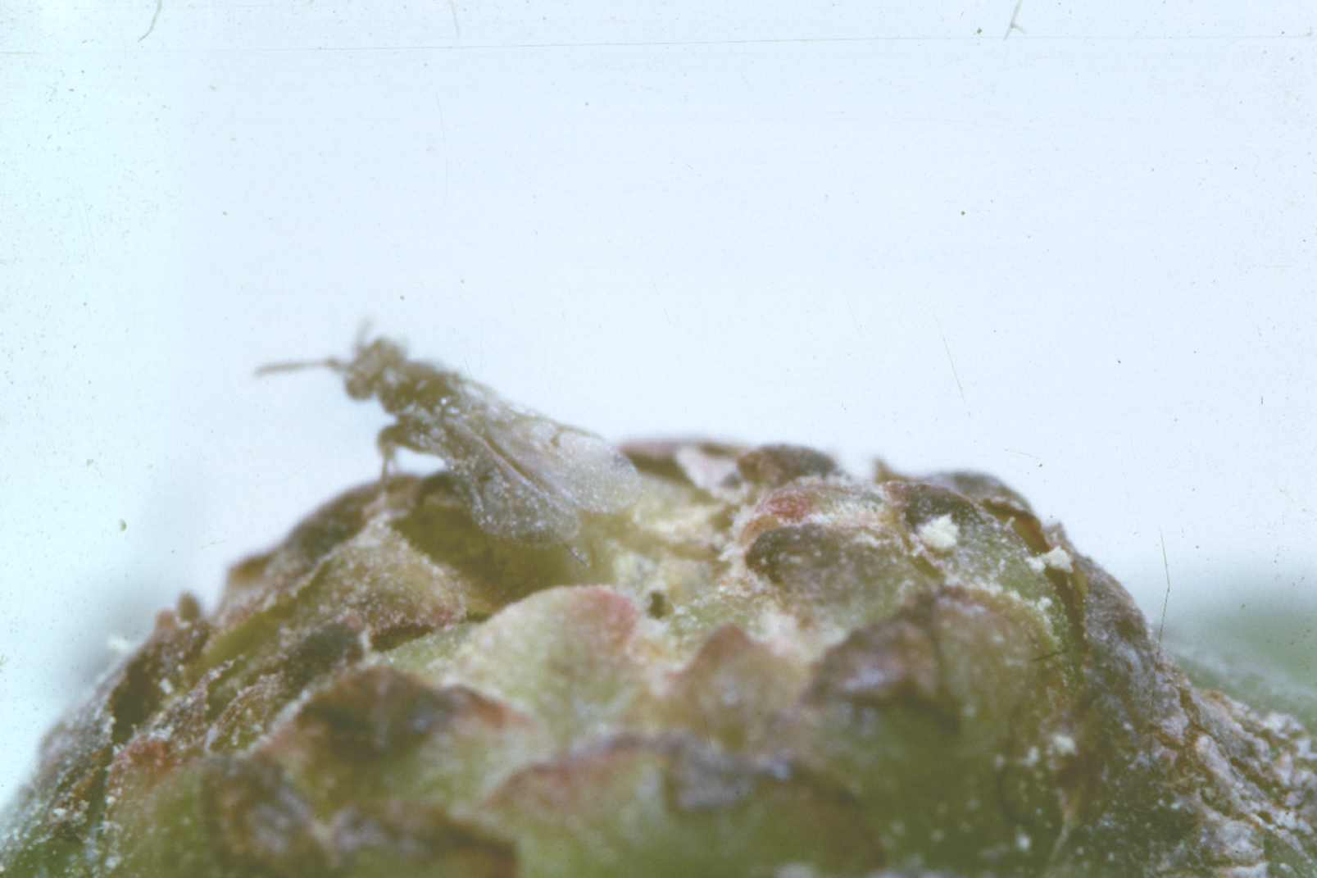
wild Ficus carica
pollen
Male tree: wasp emerging from the fig cavity through the ostiole
It got abundantly dusted with pollen while emerging
Pollen is largely wasted
The wasp will leave in search of a receptive fig to enter during its short survival outside figs (about 1 day).
Photo G. Valdeyron
Notes:
receptive: the stage of fig development when the stigmas of the female flowers allow pollen germination and the ovules are ready for fertilization.

Slide 16
wild Ficus carica
The year-round cycle of wild Ficus carica in Montpellier, France

Slide 17
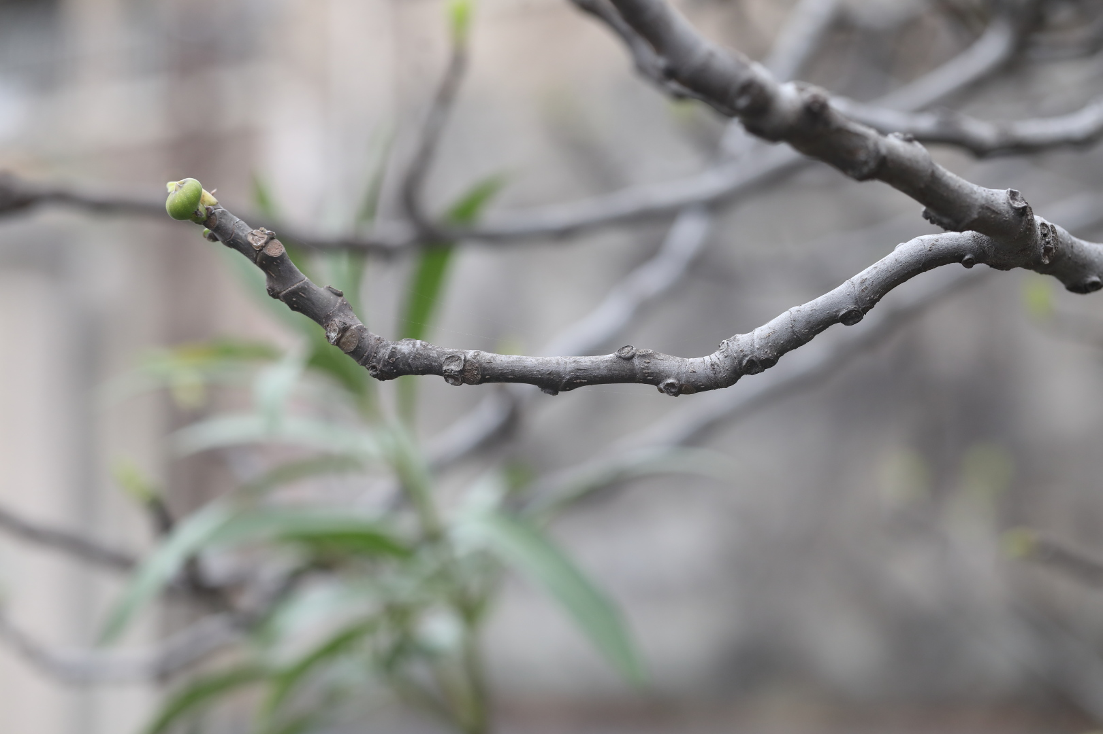
Reading a fig branch, in early spring, year N
fig that overwintered as a bud initiated year N-1
scar after a fig that developped directly
on the growth of year N-1
scar after the stipules
that enveloped the terminal bud
scar after a fig that developped
at the axil of the leaf
vegetative bud
scar after a leaf
shoot of year N-3
shoot of the year N-1
shoot of year N-2
shortened internodes corresponding to the resting (August year N-3 to March, year N-2) terminal bud
shortened internodes corresponding to the resting (August year N-2 to March, year N-1) terminal bud
Notes:
On male and female trees, fig buds appear progressively on the shoot of the year, first at the base of the shoot and then progressively along the shoot, on female trees while the shoot is growing, on male trees once the shoot has stopped growing. Fig buds appear in June-July on female trees and late July-August on male trees. As fig buds appear progressively along the shoot (the latest at the end of the shoot), bud position reflects the timing of its development. Some will develop into figs before winter (almost all figs on female trees, overwintering figs on male trees). On male trees, many of the late fig buds will overwinter as buds and develop into figs next spring.
The timing of their development and the fate/function of the corresponding figs depend on climatic conditions and wasp visitation.
As a rule, (wild) figs unvisited by the end of their period of receptivity abort.
Peculiar features may appear when the tree is pruned or when the shoot does not stop growing in July due to unusual climatic conditions.

Slide 18
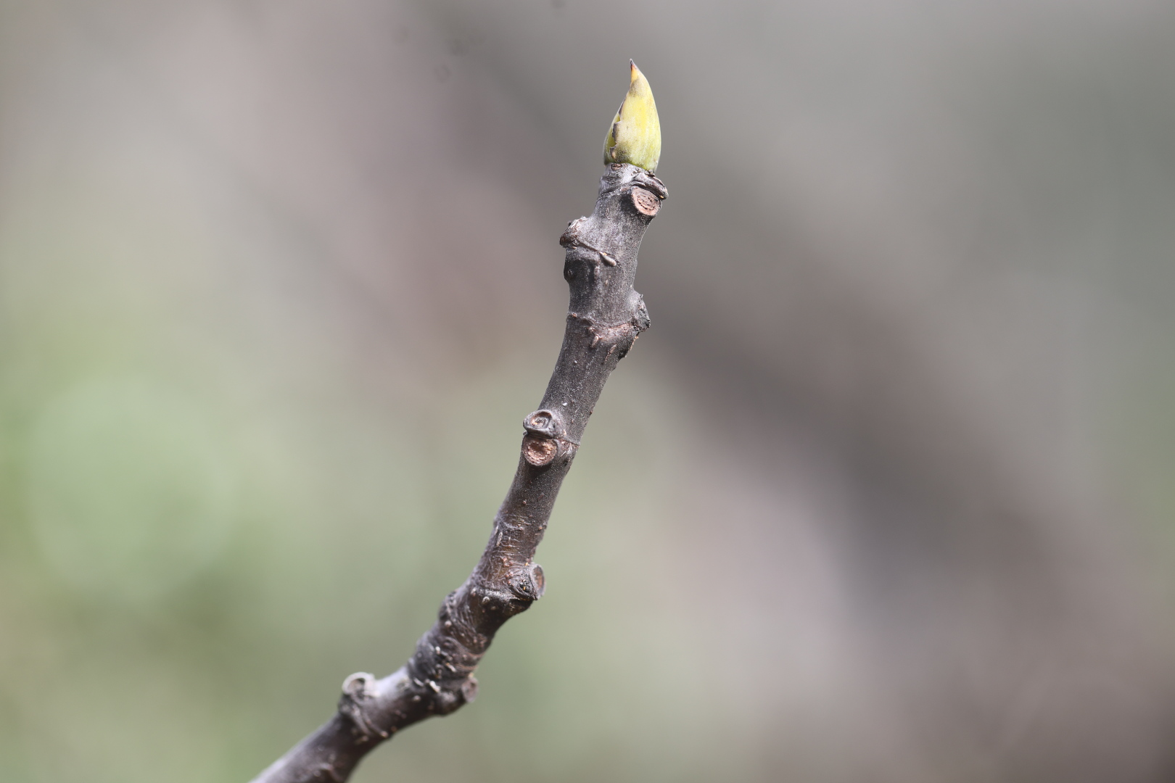
wild Ficus carica
scars after figs that ripened in August-September
scars after leaf petioles
Fig buds appear on the shoot of the year and develop directly into figs receptive in June-July and ripe in August-September
winter: female tree
Notes:
Some late-appearing fig buds at the end of the shoots will overwinter, then start developing next spring. On wild female trees they rapidly abort, before becoming receptive

Slide 19
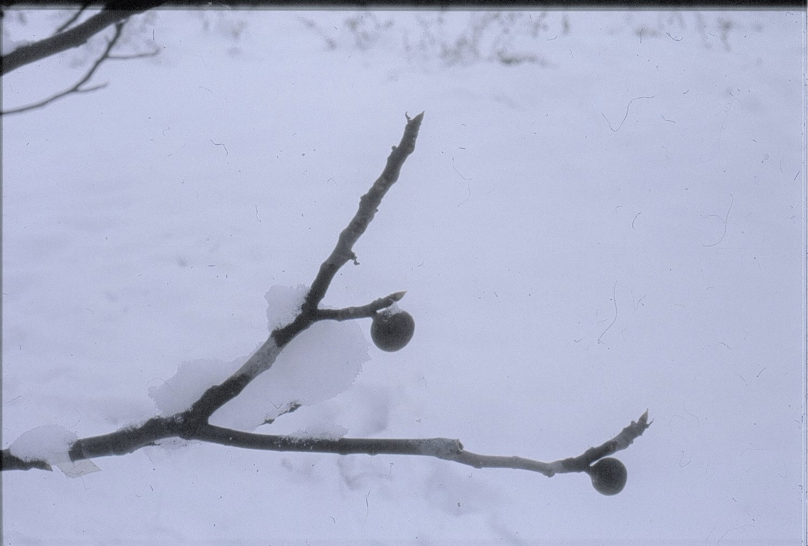
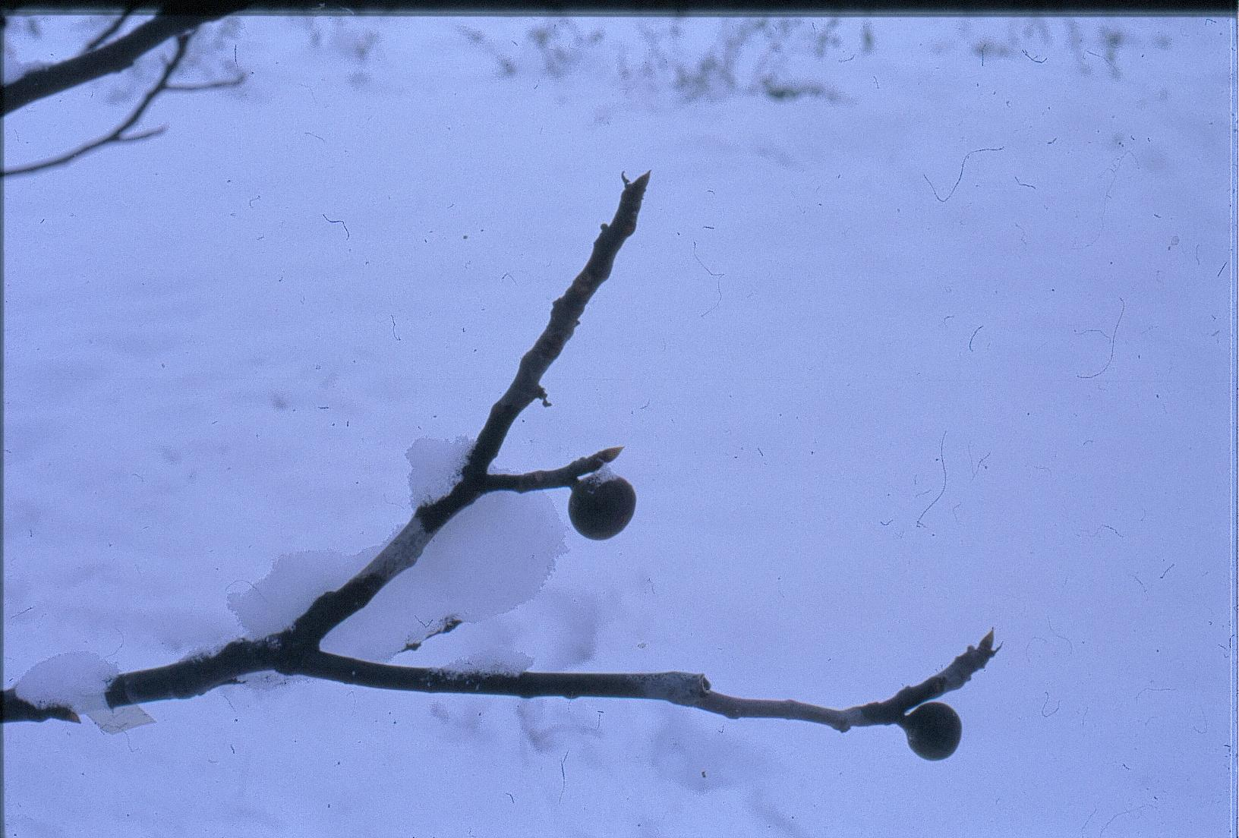
wild Ficus carica
fig bud from previous growth season, it will resume its development in spring
figs that developped directly from fig buds on the shoot of the year and containing last larval stage Blastophaga
winter: male tree
fig bud
Notes:
All fig buds appear on the shoot of the year. The basal ones develop directly and become receptive in late July-August while the distal ones only become receptive next April.

Slide 20
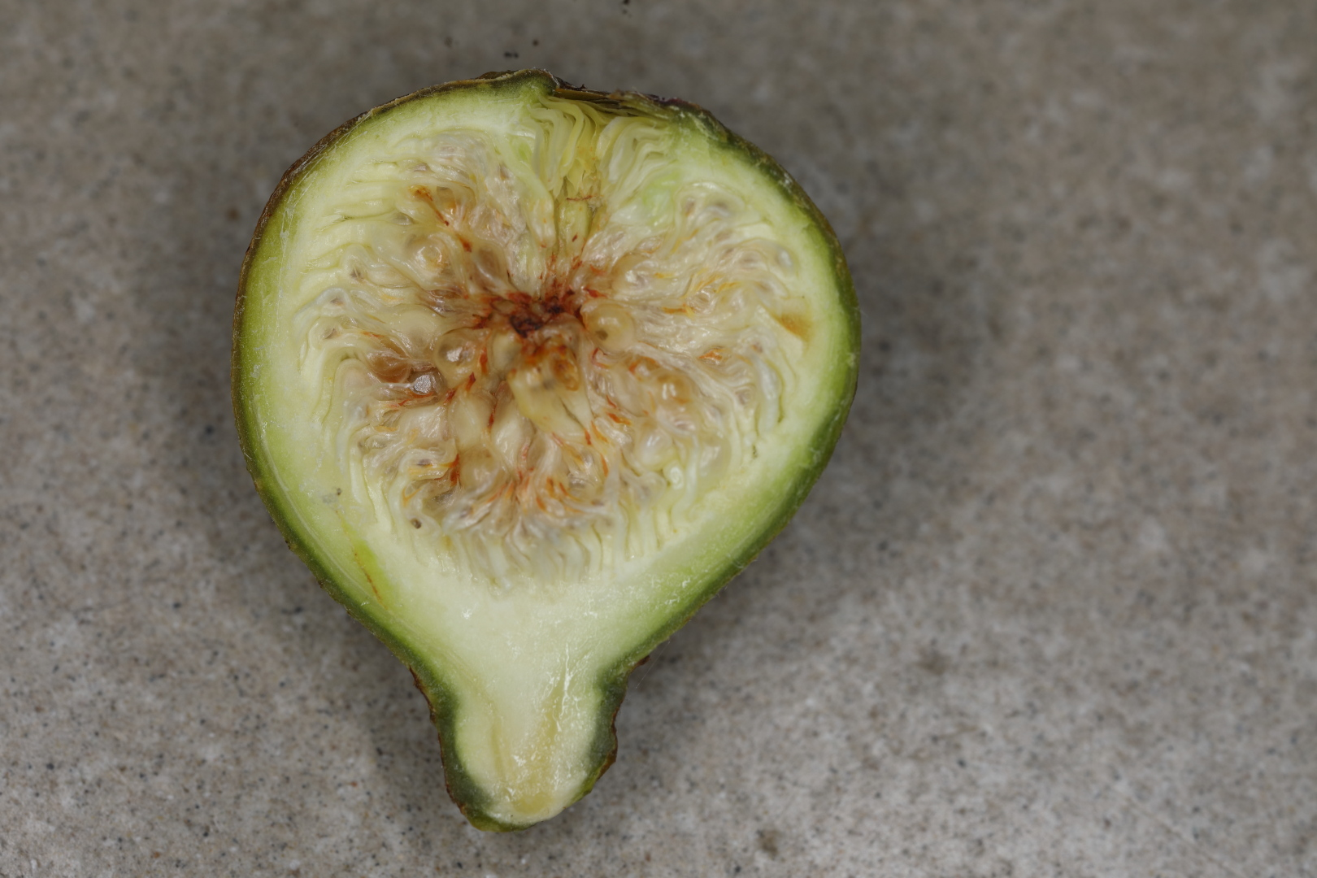
wild Ficus carica
gall containing a wasp larva
female flowers have short styles, contain insect larvae and only very few seeds
winter: male tree

Slide 21
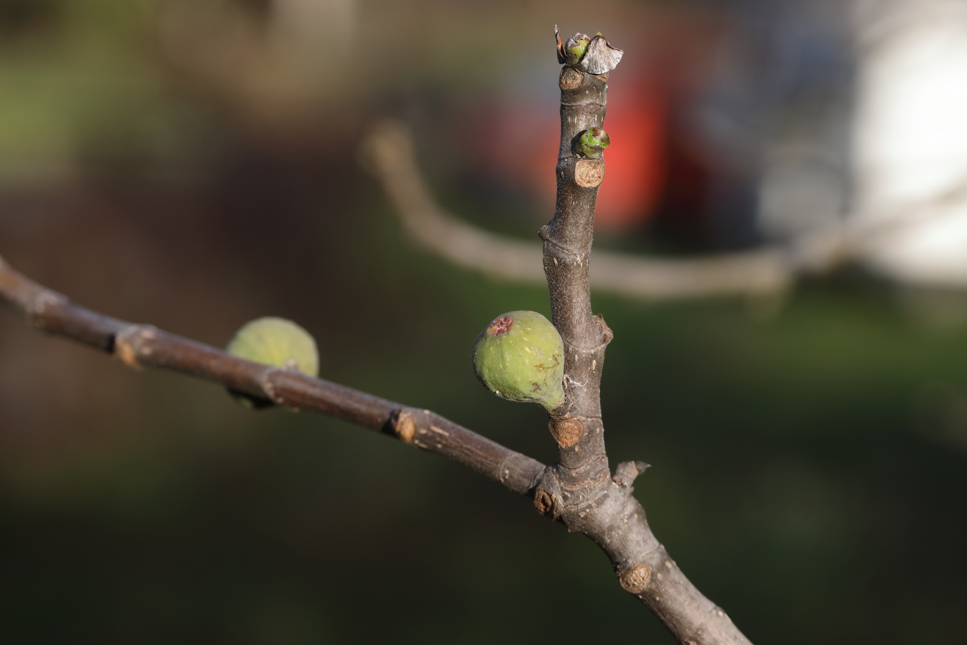
wild Ficus carica
fig bud
scars after aborted
unvisited figs that became receptive previous summer when wasps were no longer available
previous-summer fig containing wasp larvae
end of winter: male tree
Fig buds appear progressively along the shoot of the year from July to September
Their fate depends on wasp visitation at their receptivity and climatic conditions
Notes:
The shoot of the year grows from April to July. Fig buds appear progressively at the axils of the leaves during summer. The earliest fig buds, at the base of the shoot, are visited by wasps emerging from polliniferous figs in late July and may contain some seeds. In Montpellier the development of wasp larvae within these figs will be stopped at the last larval stage by the onset of colder temperatures in autumn. The figs will finalize their development next spring. The next figs to become receptive during summer abort as no wasps are available. Under warmer climates, wasps may emerge from the basal figs before autumn and may colonize figs that become receptive in late August or September. In that situation wasps will overwinter in these later figs. Hence the typical fruiting phenology of male Ficus carica may sustain 2 or 3 yearly generations of wasps depending on local climatic conditions. Male flowers in figs that have not overwintered as fig buds remain small and do not finalize their development.

Slide 22
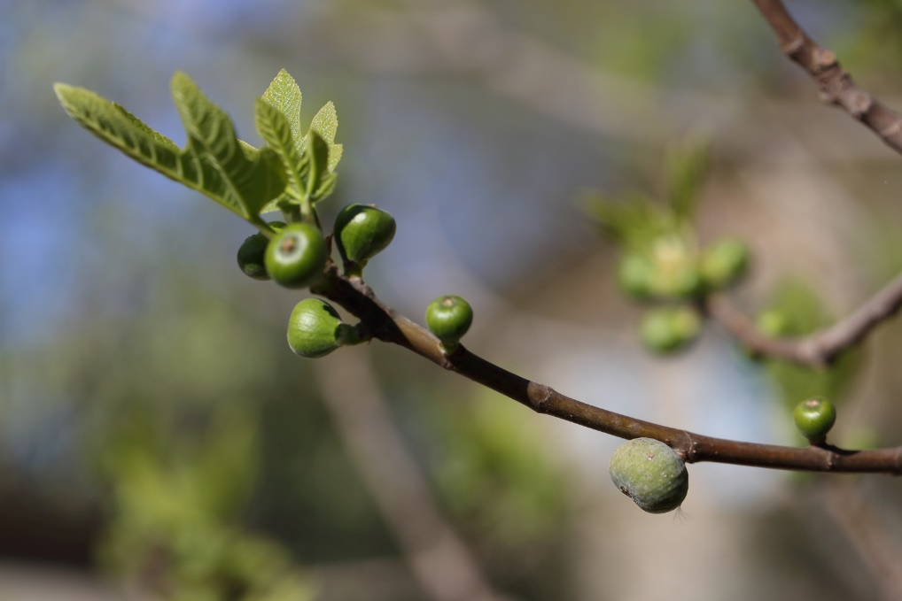
wild Ficus carica
receptive figs
(attractive to wasps)
fig in which the wasps overwintered
April: male tree, wasps are ready to emerge from the overwintering figs to visit receptive figs on male trees
Notes:
At that moment, there are no receptive figs on female trees and the overwintering figs on male trees contain no pollen.

Slide 23
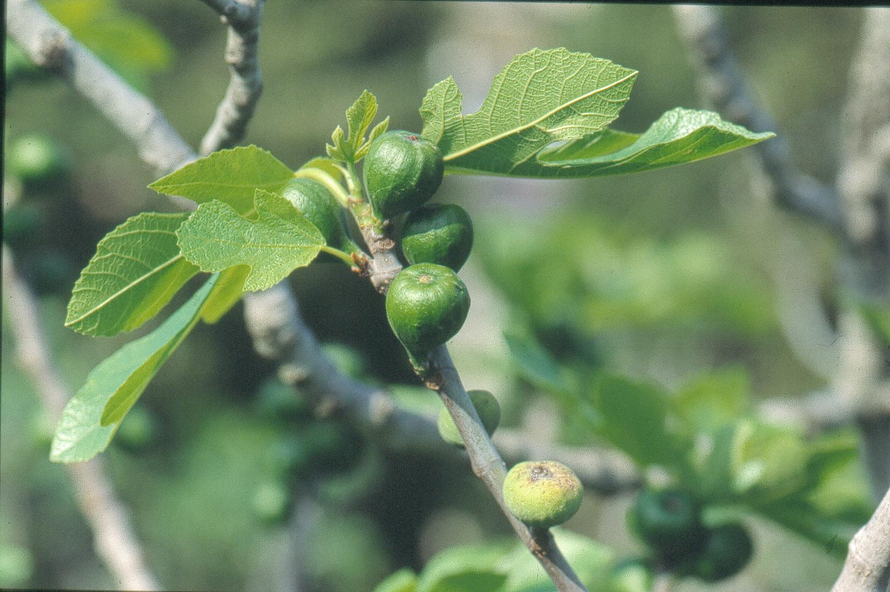
Ficus carica sauvage
receptive figs
(attractive to wasps)
fig in which the wasps overwintered
April: male tree, wasps are ready to emerge
from the overwintering figs to visit the receptive,
future polliniferous figs
The receptive figs have grown large, waiting for Blastophaga to visit them
Notes:
The physiological stage of overwintering fig buds is synchronized at the end of winter. The subsequent development of these buds into receptive figs depends on a sum of degree-days. The ripening of the overwintering figs and wasp emergence are under the control of wasp development into adults. The wasps overwinter as quiescent last-stage larvae. There is no diapause, so that high temperatures for a sufficient duration will trigger wasp metamorphosis and emergence. As the physiological mechanisms controlling fig receptivity and wasp emergence are different, the matching of the two processes lacks precision. This lack of precision is compensated by the figs being capable of remaining receptive for several weeks.

Slide 24
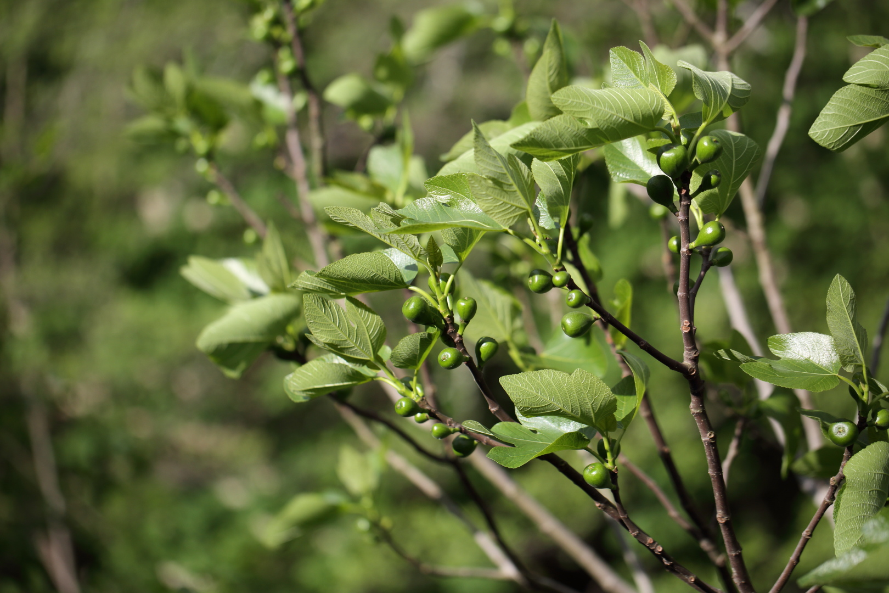
wild Ficus carica
receptive figs (attractive to wasps)
April: male tree without overwintering figs
The receptive figs have grown large, still waiting for Blastophaga from another male tree to visit them
Notes:
Some male genotypes produce no or almost no overwintering figs. As a consequence, they produce more receptive figs in April. These latter figs will ensure female tree pollination and hence reproductive success of the plant. However, they depend on other male trees for the visitation of their polliniferous figs. Depending on local circumstances, this may be a good choice or a risky bet.

Slide 25
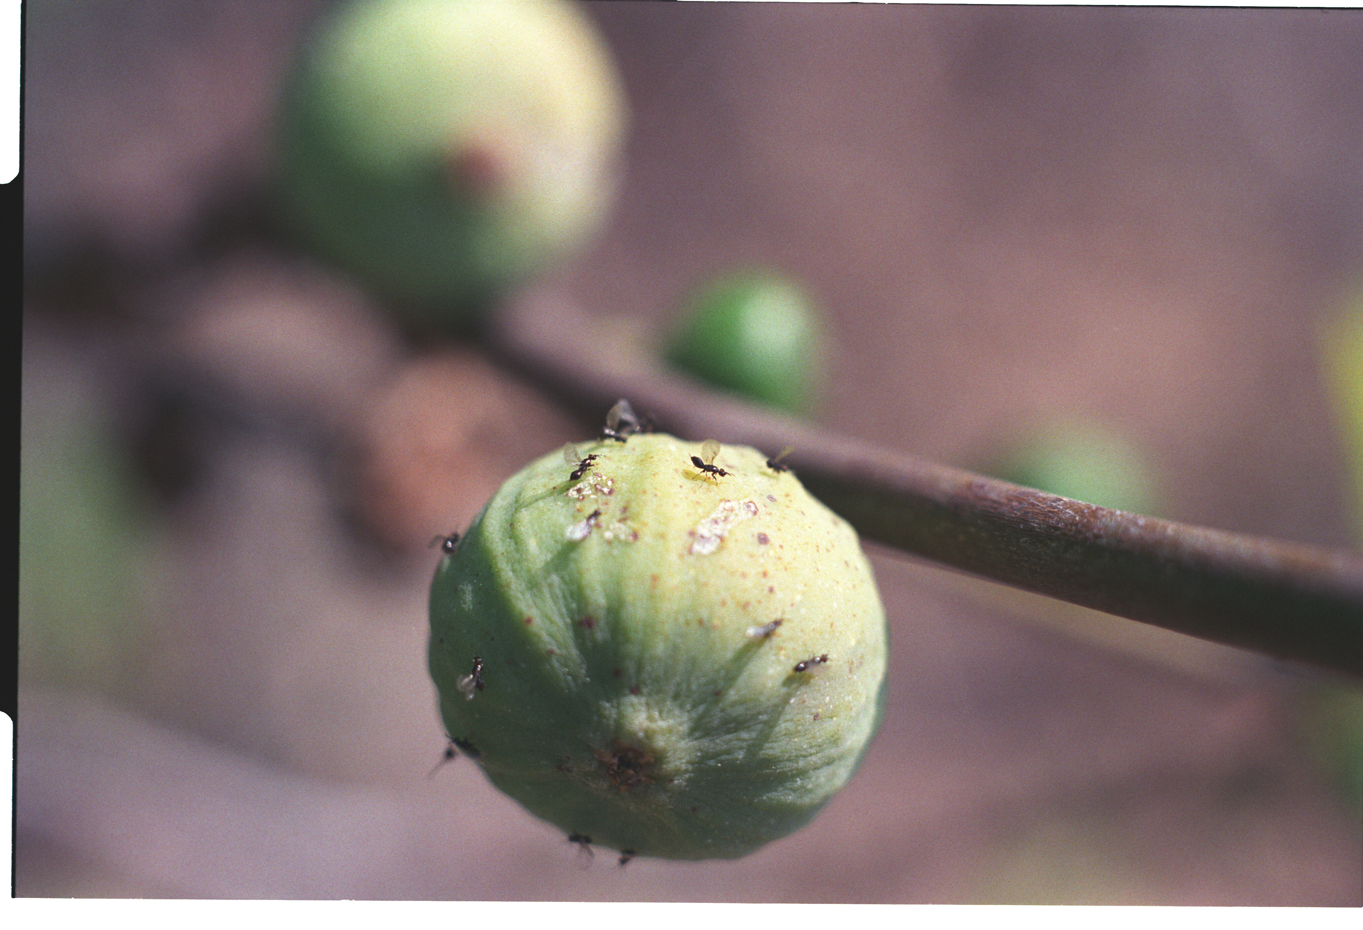
wild Ficus carica
April: male tree, wasps that have just emerged through the ostiole from the fig in which they overwintered.
The wasps are not dusted with pollen as these figs produce no pollen
ostiole

Slide 26
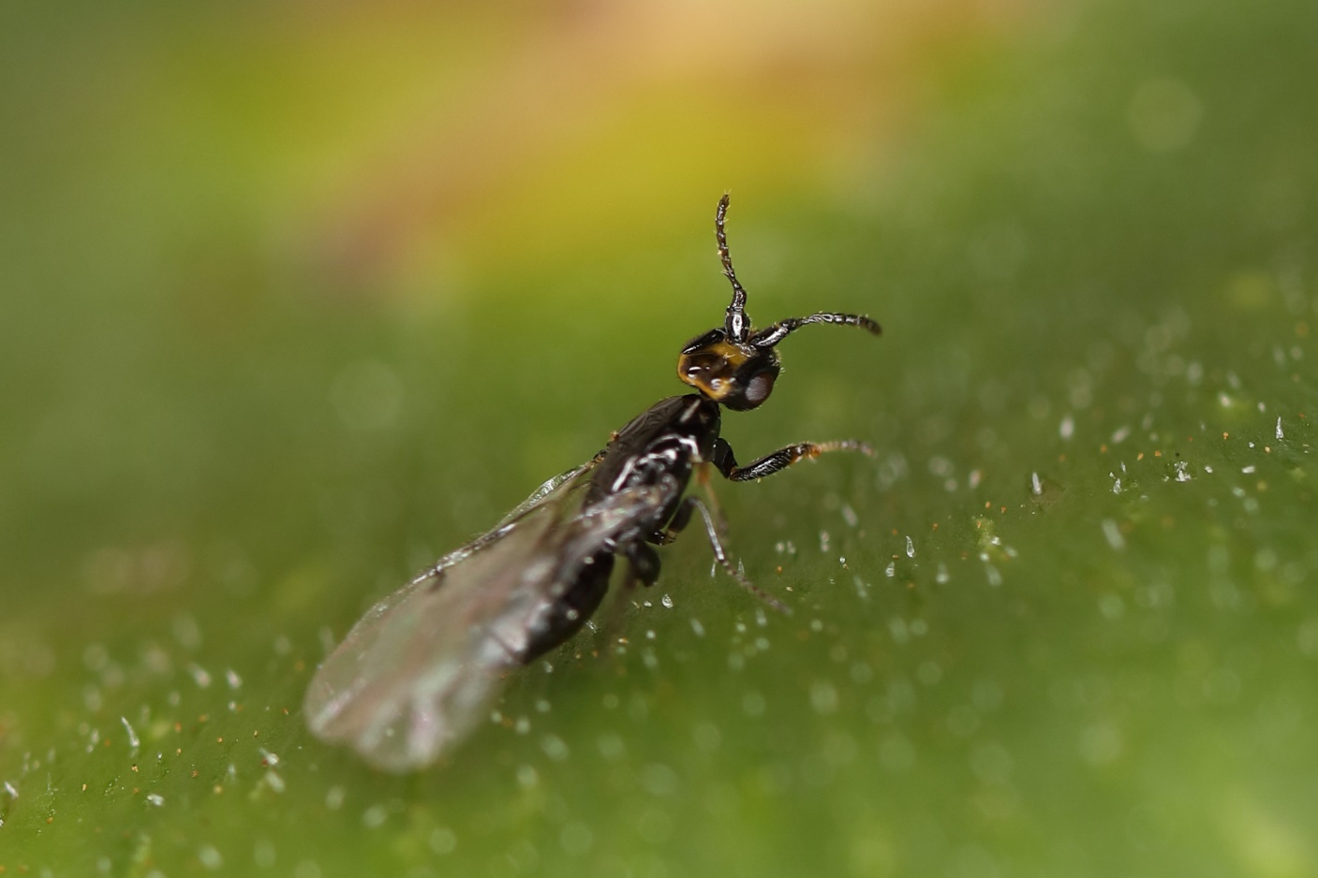
wild Ficus carica
April: male tree, a newborn female Blastophaga psenes has reached a receptive fig

Slide 27
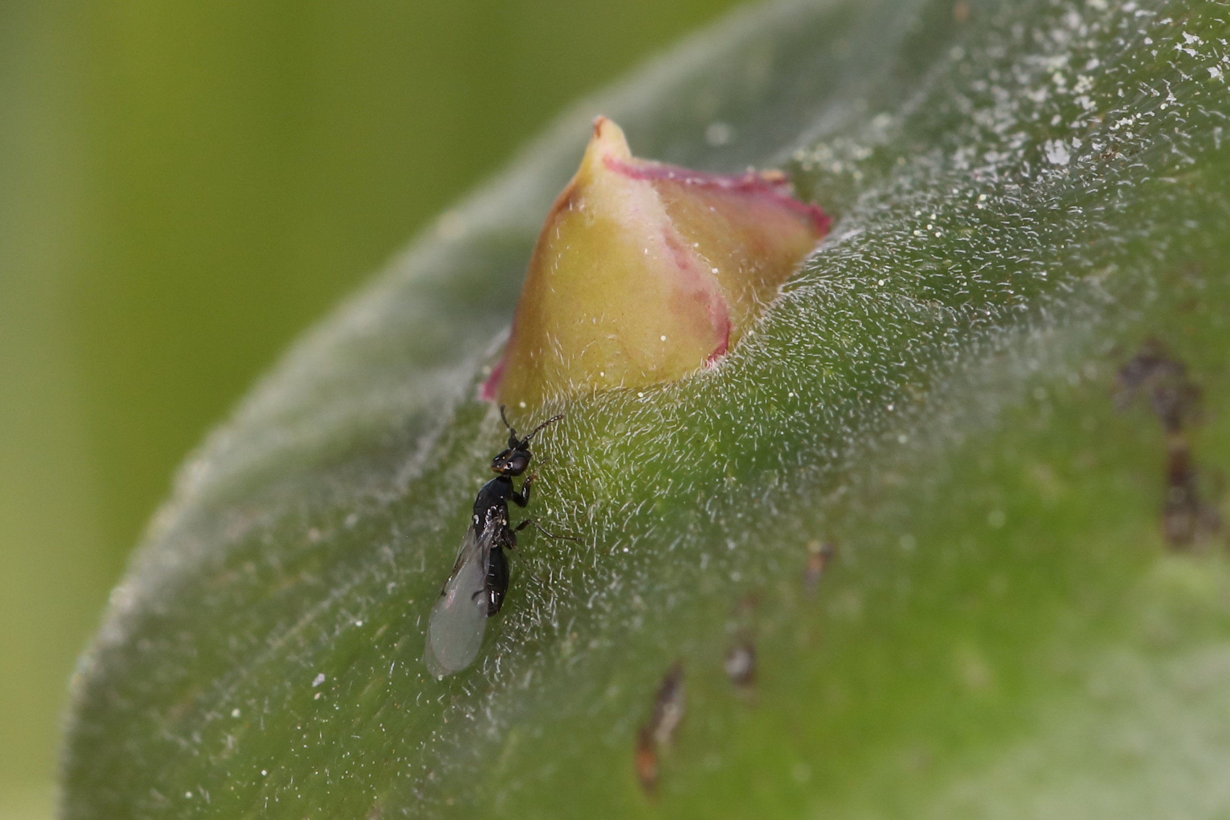
wild Ficus carica
ostiole
April: male tree, a female Blastophaga psenes close to the ostiole on a receptive fig

Slide 28
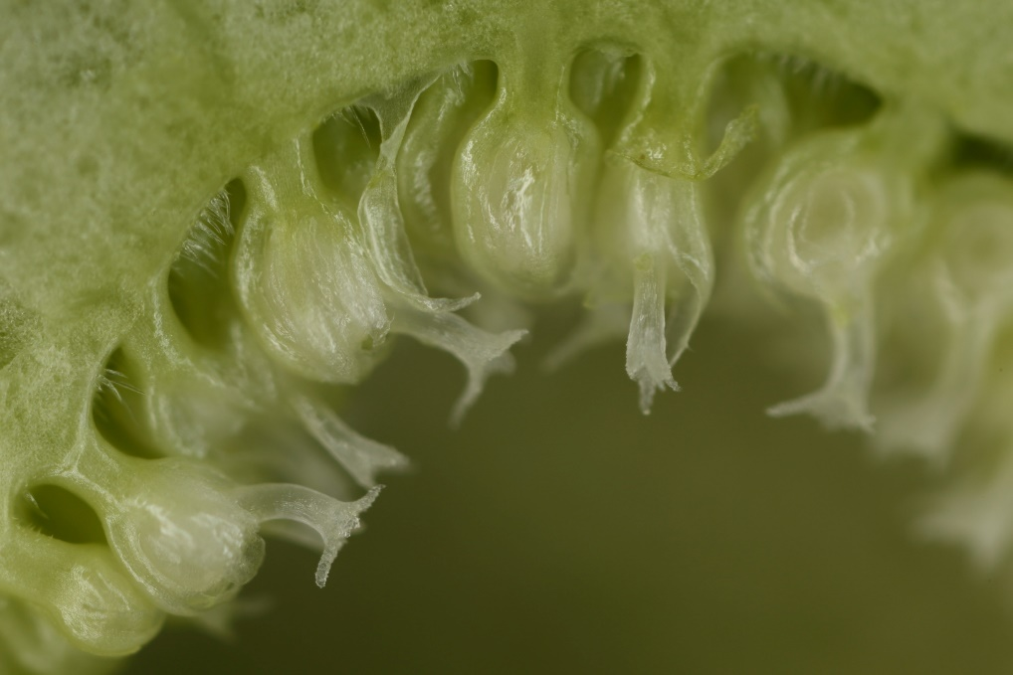
wild Ficus carica
April: male tree, inside a receptive fig
The styles are short allowing wasp oviposition
flower ovule
flower style
flower stigma

Slide 29
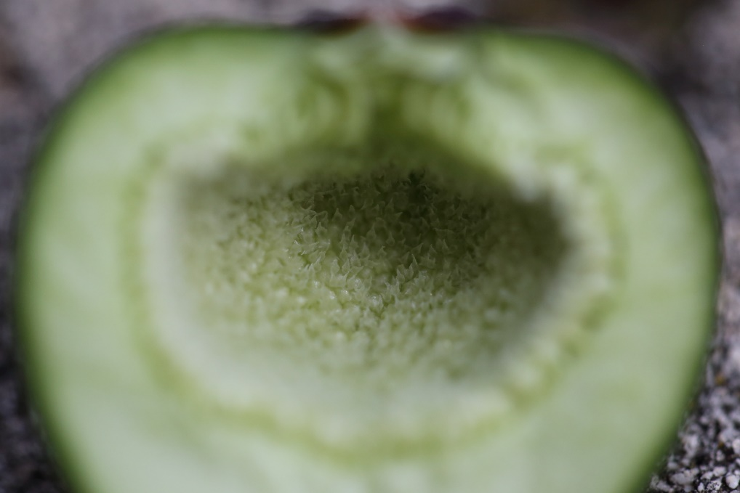
wild Ficus carica
April: male tree, receptive fig
The stigmas form a platform within the fig on which the wasps will walk

Slide 30
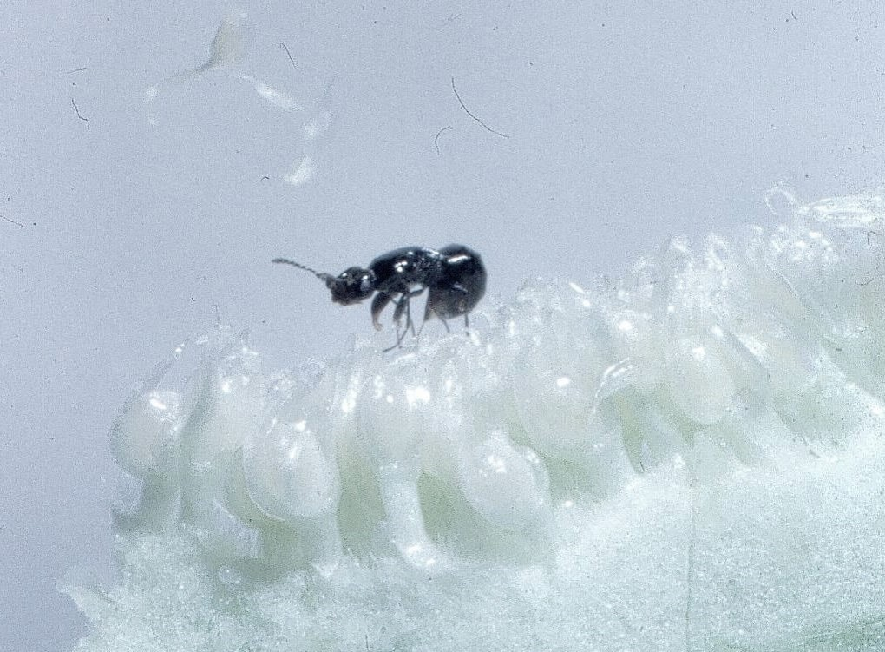
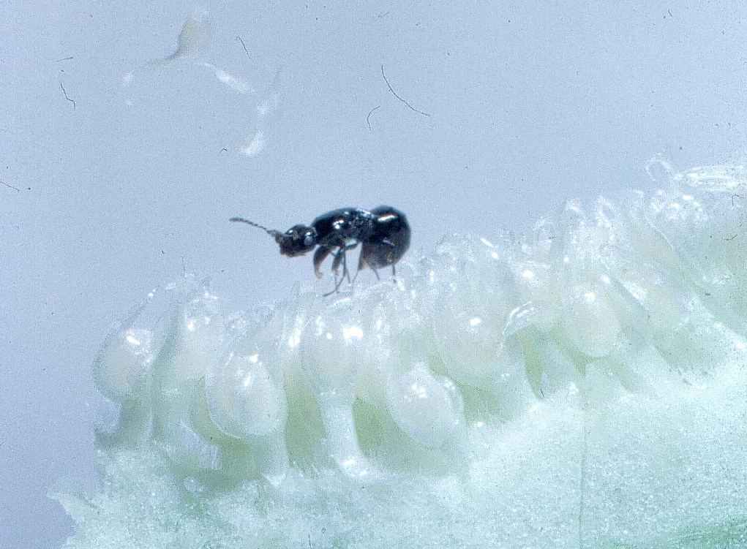
wild Ficus carica
April: male tree, Blastophaga ovipositing in a receptive fig
Photo G. Valdeyron

Slide 31
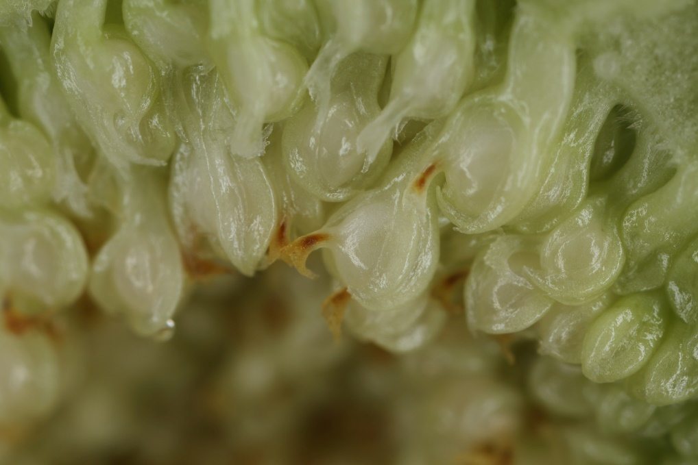
wild Ficus carica
no ovipositor insertion
elongating flower pedicel
swelling galled ovule containing a pollinator egg
flower style with brown trace of ovipositor insertion
April: male tree, shortly after wasp oviposition
After oviposition into a flower the style turns brown, the pedicel elongates and the ovule begins to swell turning into a gall
Notes:
The ovipositing female injects a drop of liquid from the reservoir of its venom gland while ovipositing. This triggers the rapid swelling of the ovule and elongation of the pedicel which moves the galled ovule away from the fig wall, out of reach of parasite oviposition through the wall, see next slide. On hatching, the Blastophaga larva will migrate to the embryo sac, and develop feeding on endosperm. This endosperm is diploid, developping parthenogenetically as no pollen is available at that time of year to ensure the double fertilisation. Its development is probably triggered by the larva.

Slide 32
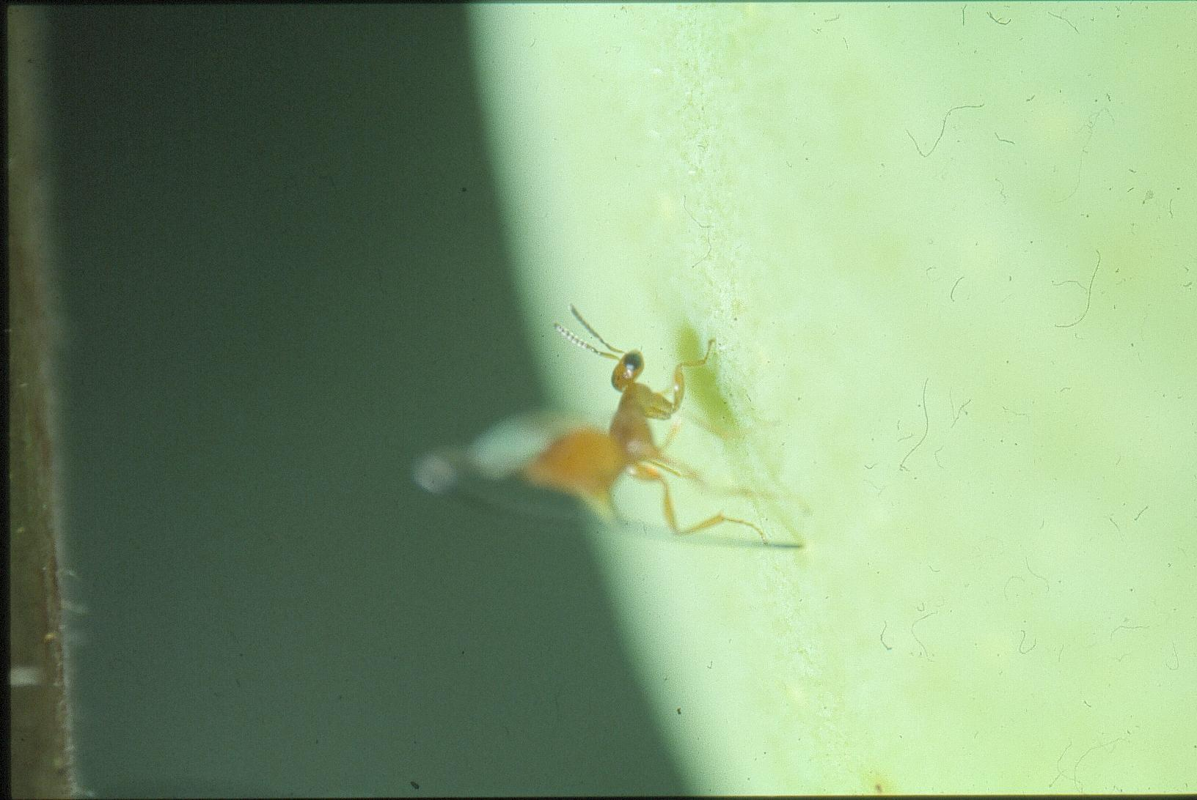
wild Ficus carica
April: male tree, Philotrypesis caricae - a cleptoparasite of Blastophaga psenes - ovipositing into a fig recently entered by Blastophaga

Slide 33
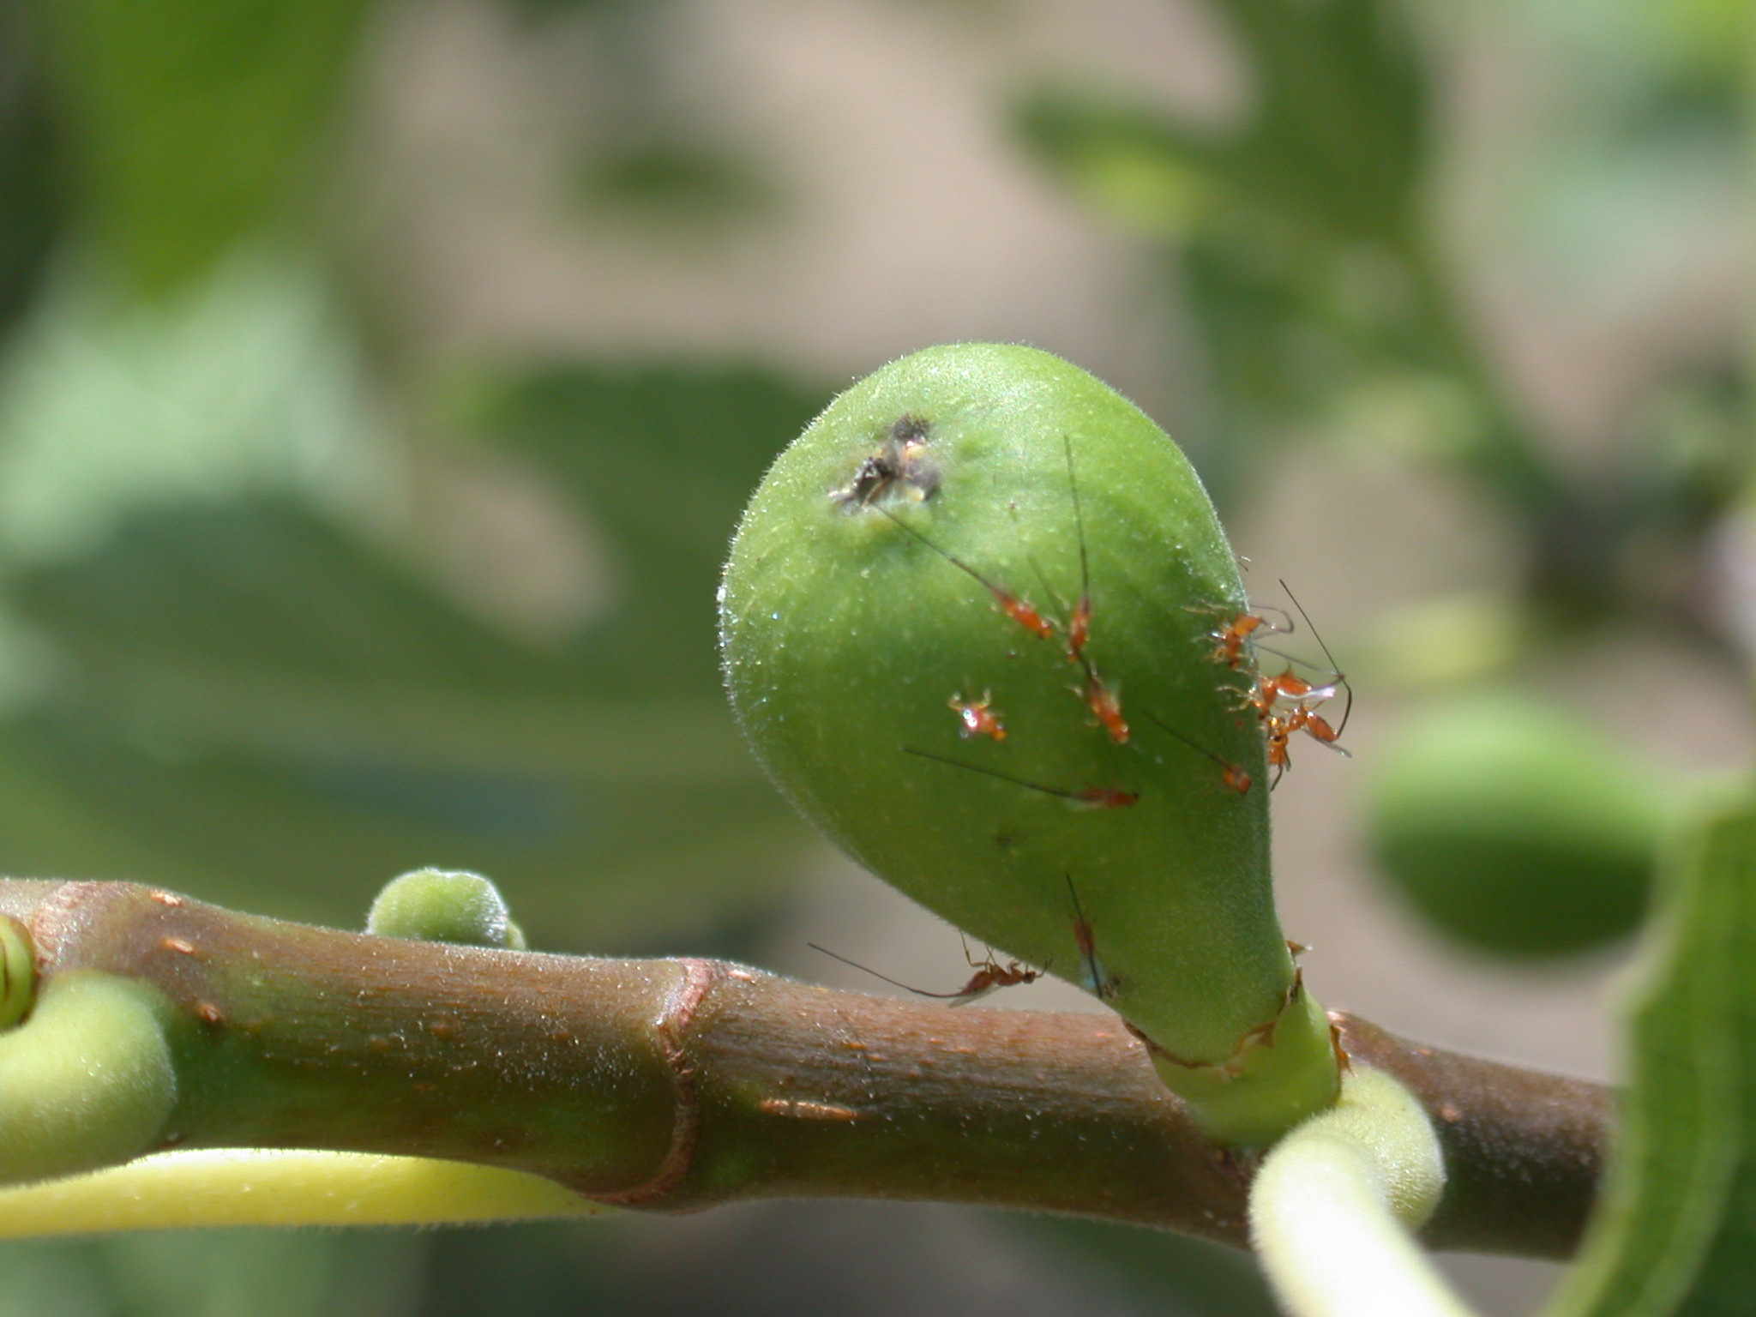
wild Ficus carica
Photo B. Schatz
April: male tree, Philotrypesis caricae ovipositing into a fig recently entered by Blastophaga

Slide 34
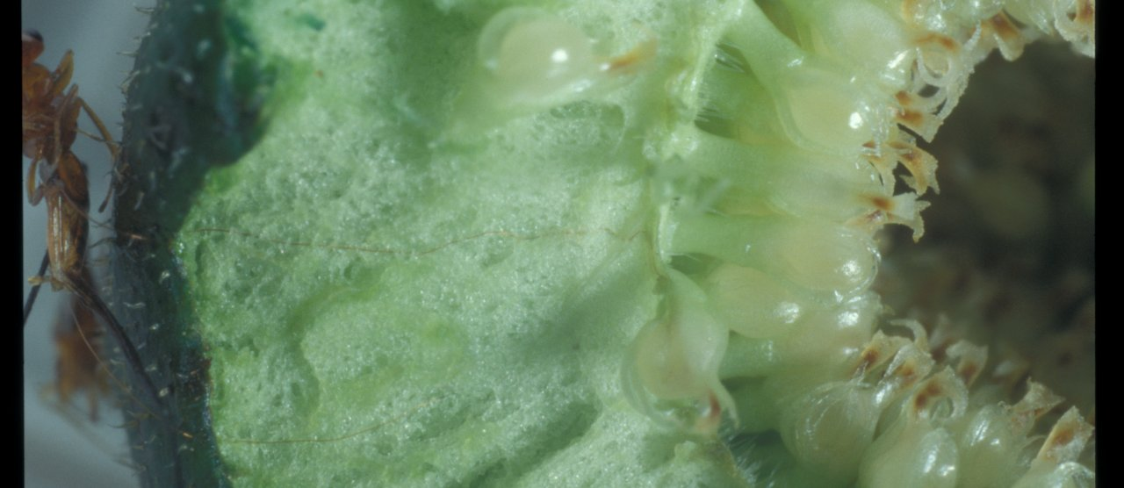
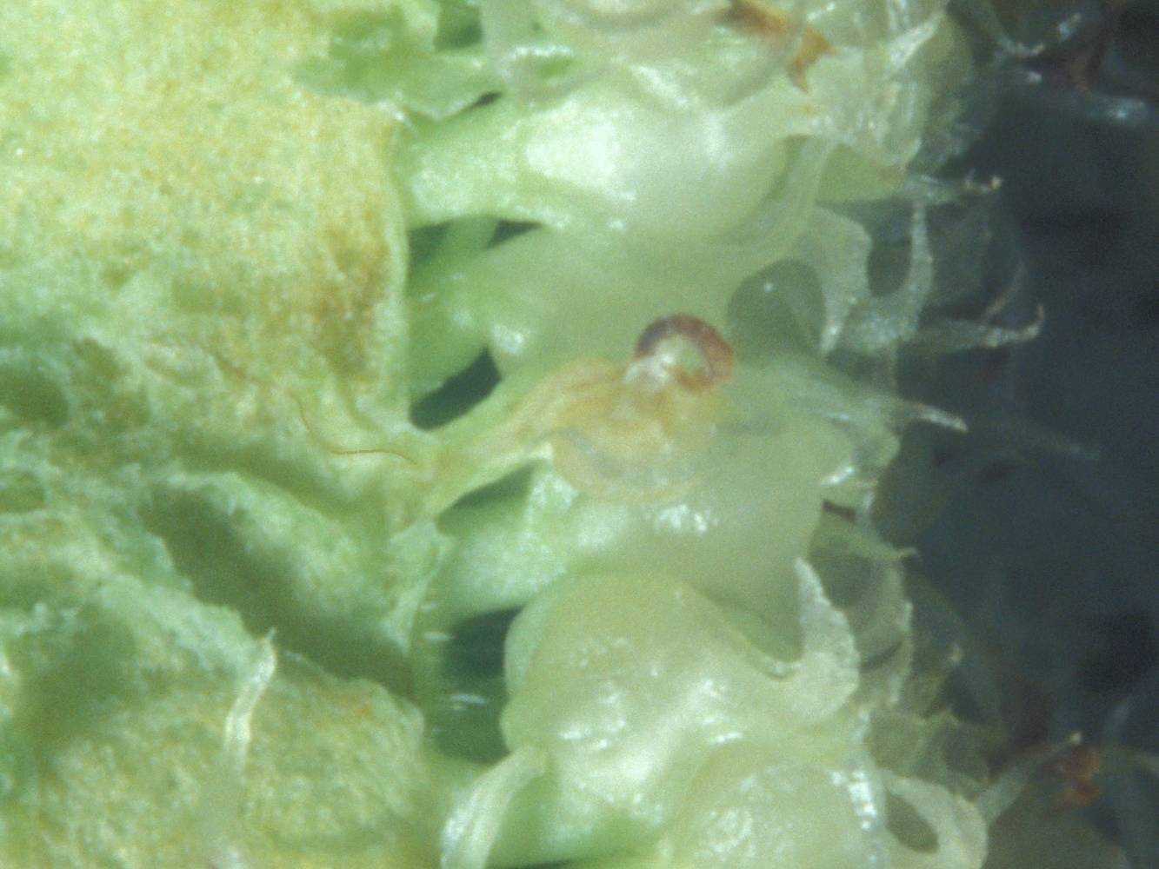
wild Ficus carica
Philotrypesis ovipositors
April: male tree
ovipositor of Philotrypesis inserted through the fig wall and entering the flower through the pedicel: the egg is laid beside the Blastophaga egg between the inner integument and the nucellus
Notes:
The Philotypesis larva develops within the galled flower, feeding on the endosperm initiated by the Blastophaga. The Blastophaga larva starves to death.

Slide 35
wild Ficus carica
immature
male flowers
galled female flowers
April: male tree, fig a few days after oviposition
There are many male flowers

Slide 36
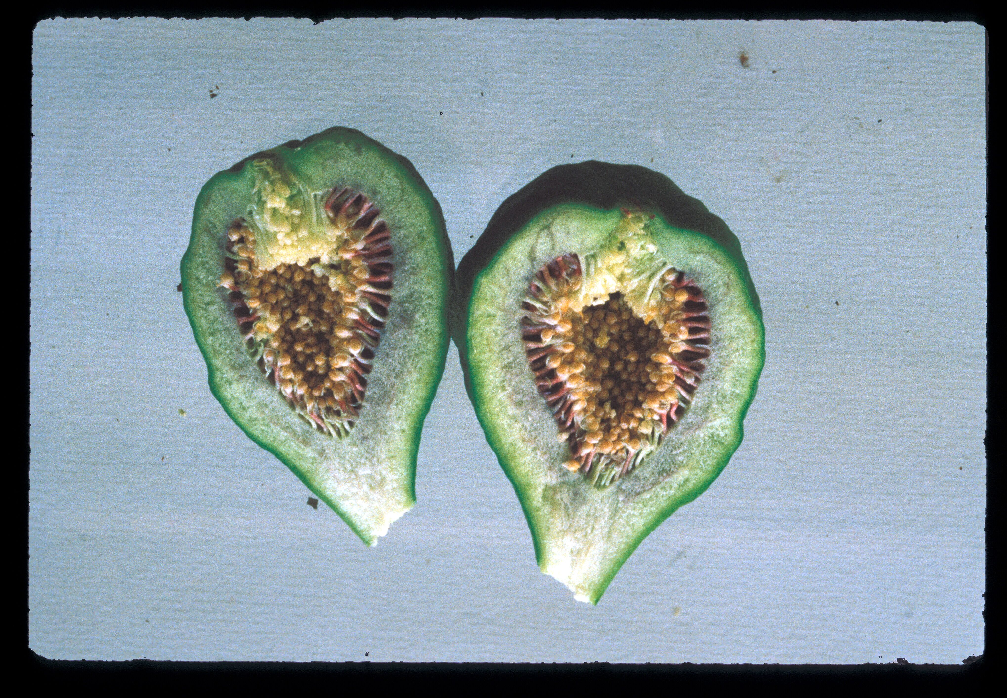
wild Ficus carica
ostiole
male flowers with pollen
galled female flowers
June: male tree, the female flowers have turned into galls each hosting a wasp larva
Male flowers with pollen are conspicuous

Slide 37
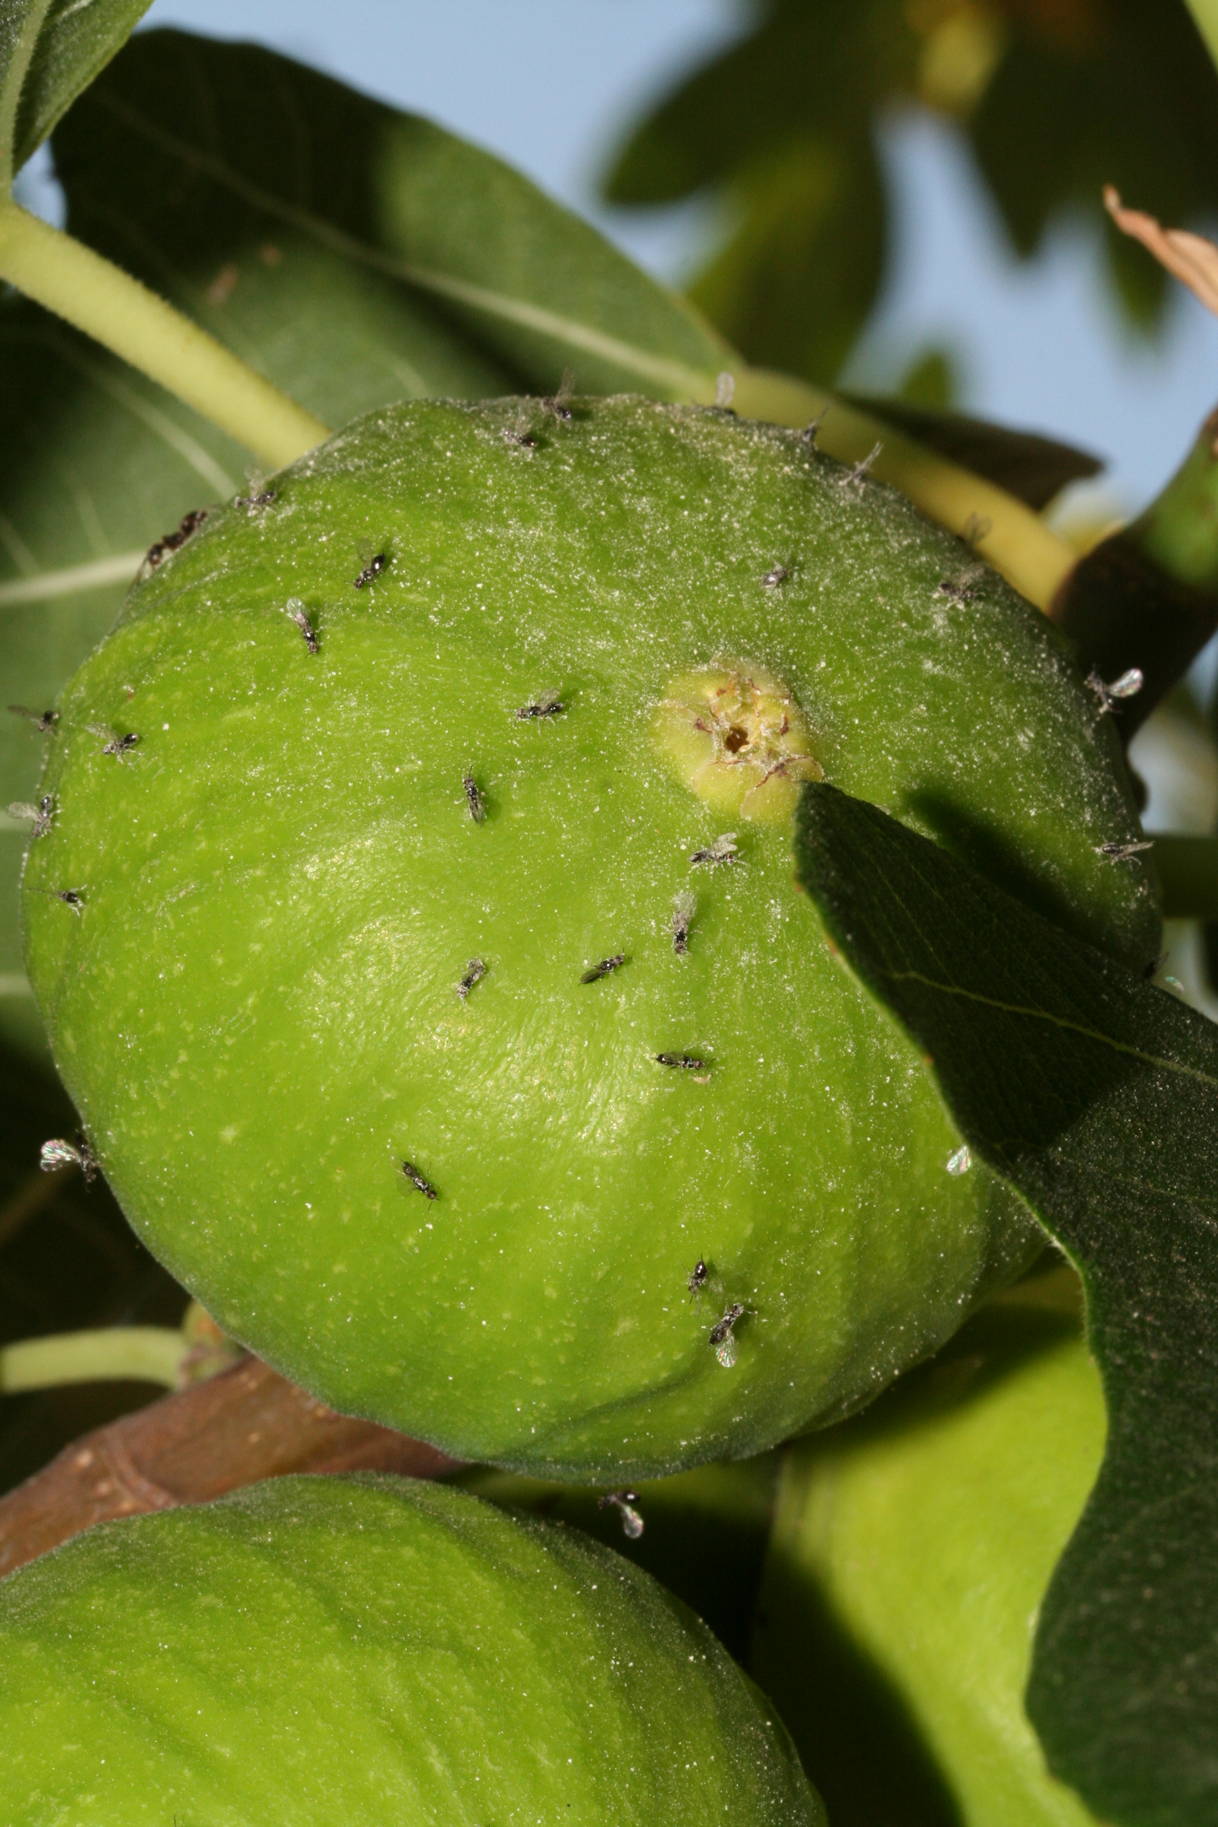
wild Ficus carica
open ostiole
June-July: male tree, Blastophaga emerging through the ostiole from a polliniferous fig, covered with pollen before cleaning themselves
Some pollen remains caught in the intersegment pleura

Slide 38
wild Ficus carica
open ostiole
June-July: male tree, Blastophaga emerging from a polliniferous fig

Slide 39
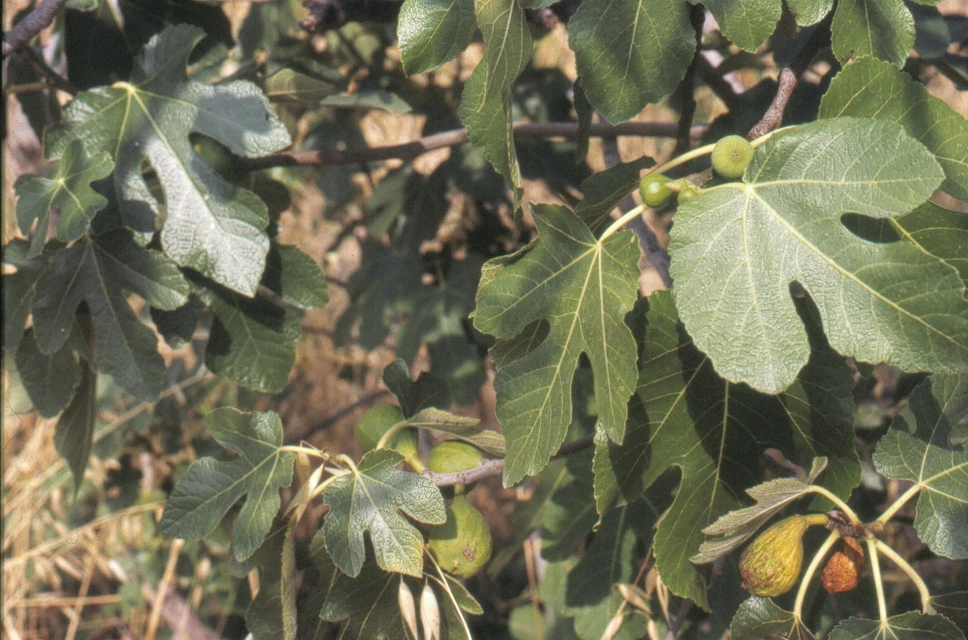
Two wild Ficus carica
Female tree: a recently pollinated fig
two receptive figs
June-July
At that period, there are no receptive figs on male trees
The wasps can only go from male figs to figs on female trees
Male tree: polliniferous figs at the stage of Blastophaga emergence

Slide 40
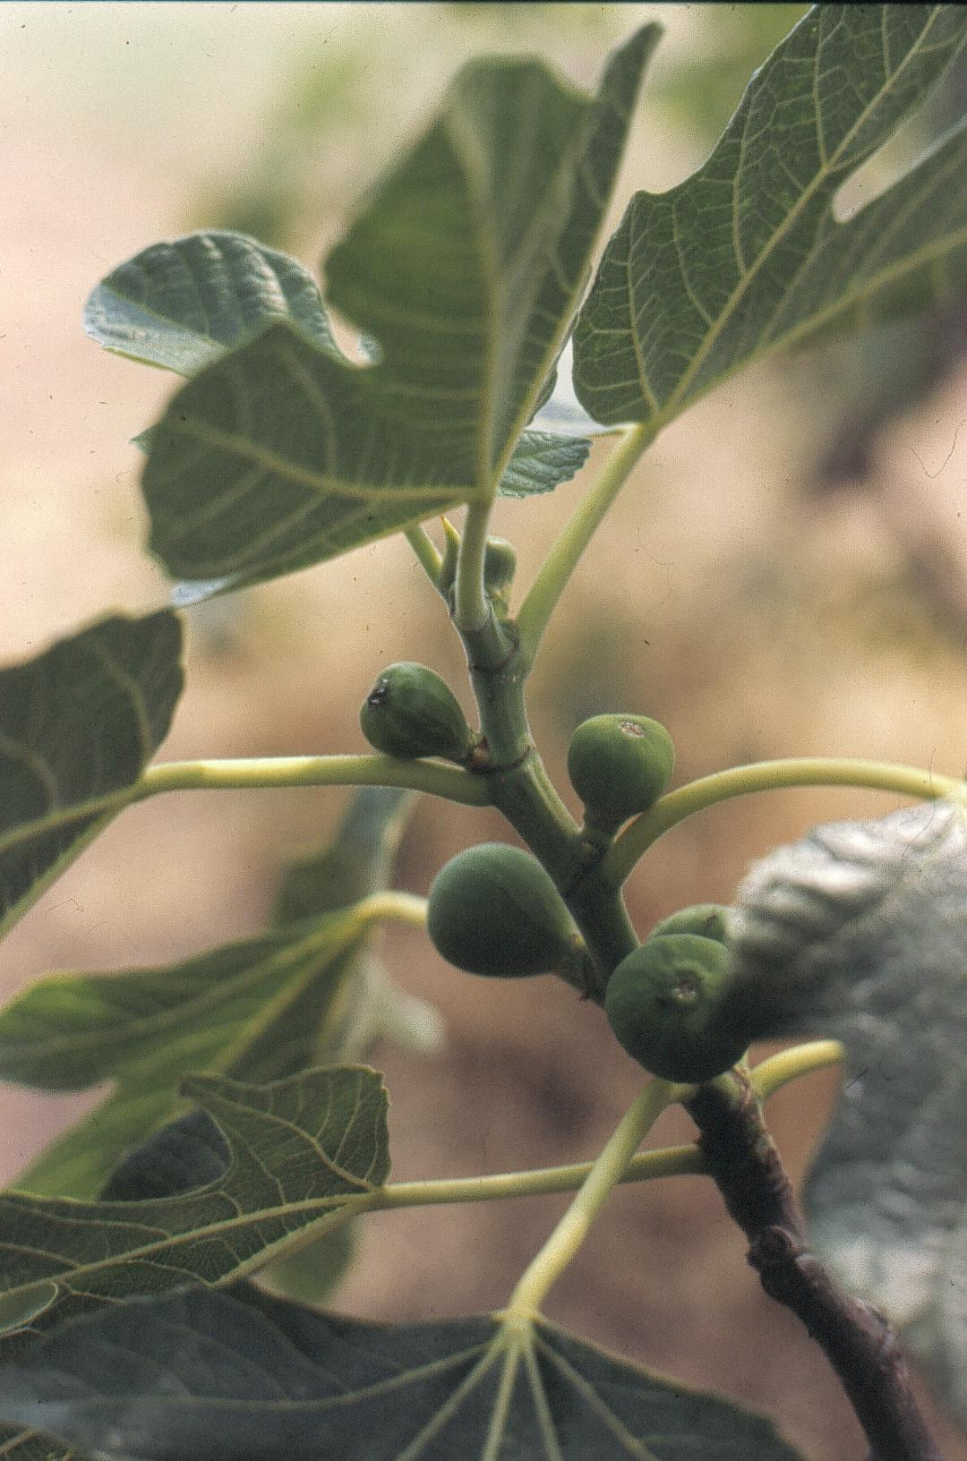
wild Ficus carica
pre-receptive fig
wasps trying to enter fig
very recently pollinated figs
June-July: female tree

Slide 41
wild Ficus carica
July: female tree, pollen-bearing wasp trying to enter a fig

Slide 42
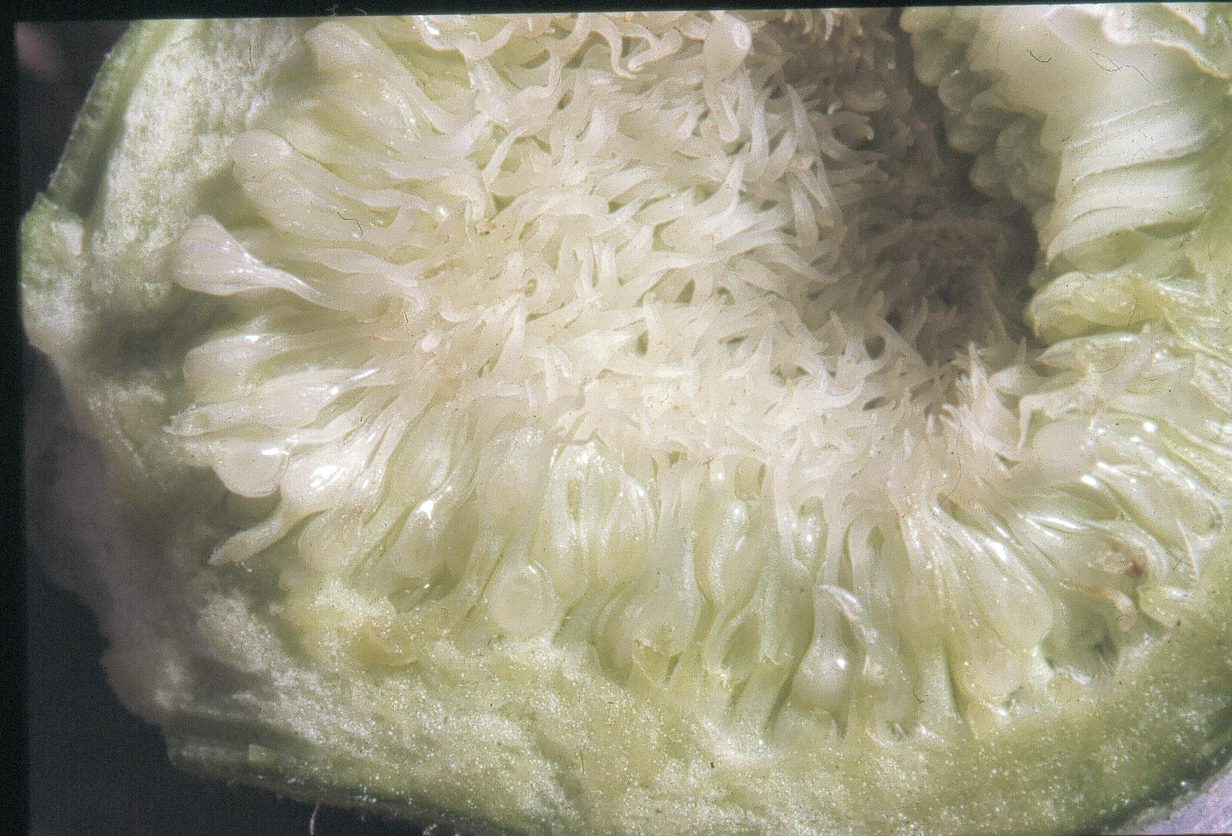
wild Ficus carica
elongate stigmas that will brush the body of the wasp, collecting pollen and ensuring seed set
July: female tree, receptive fig

Slide 43
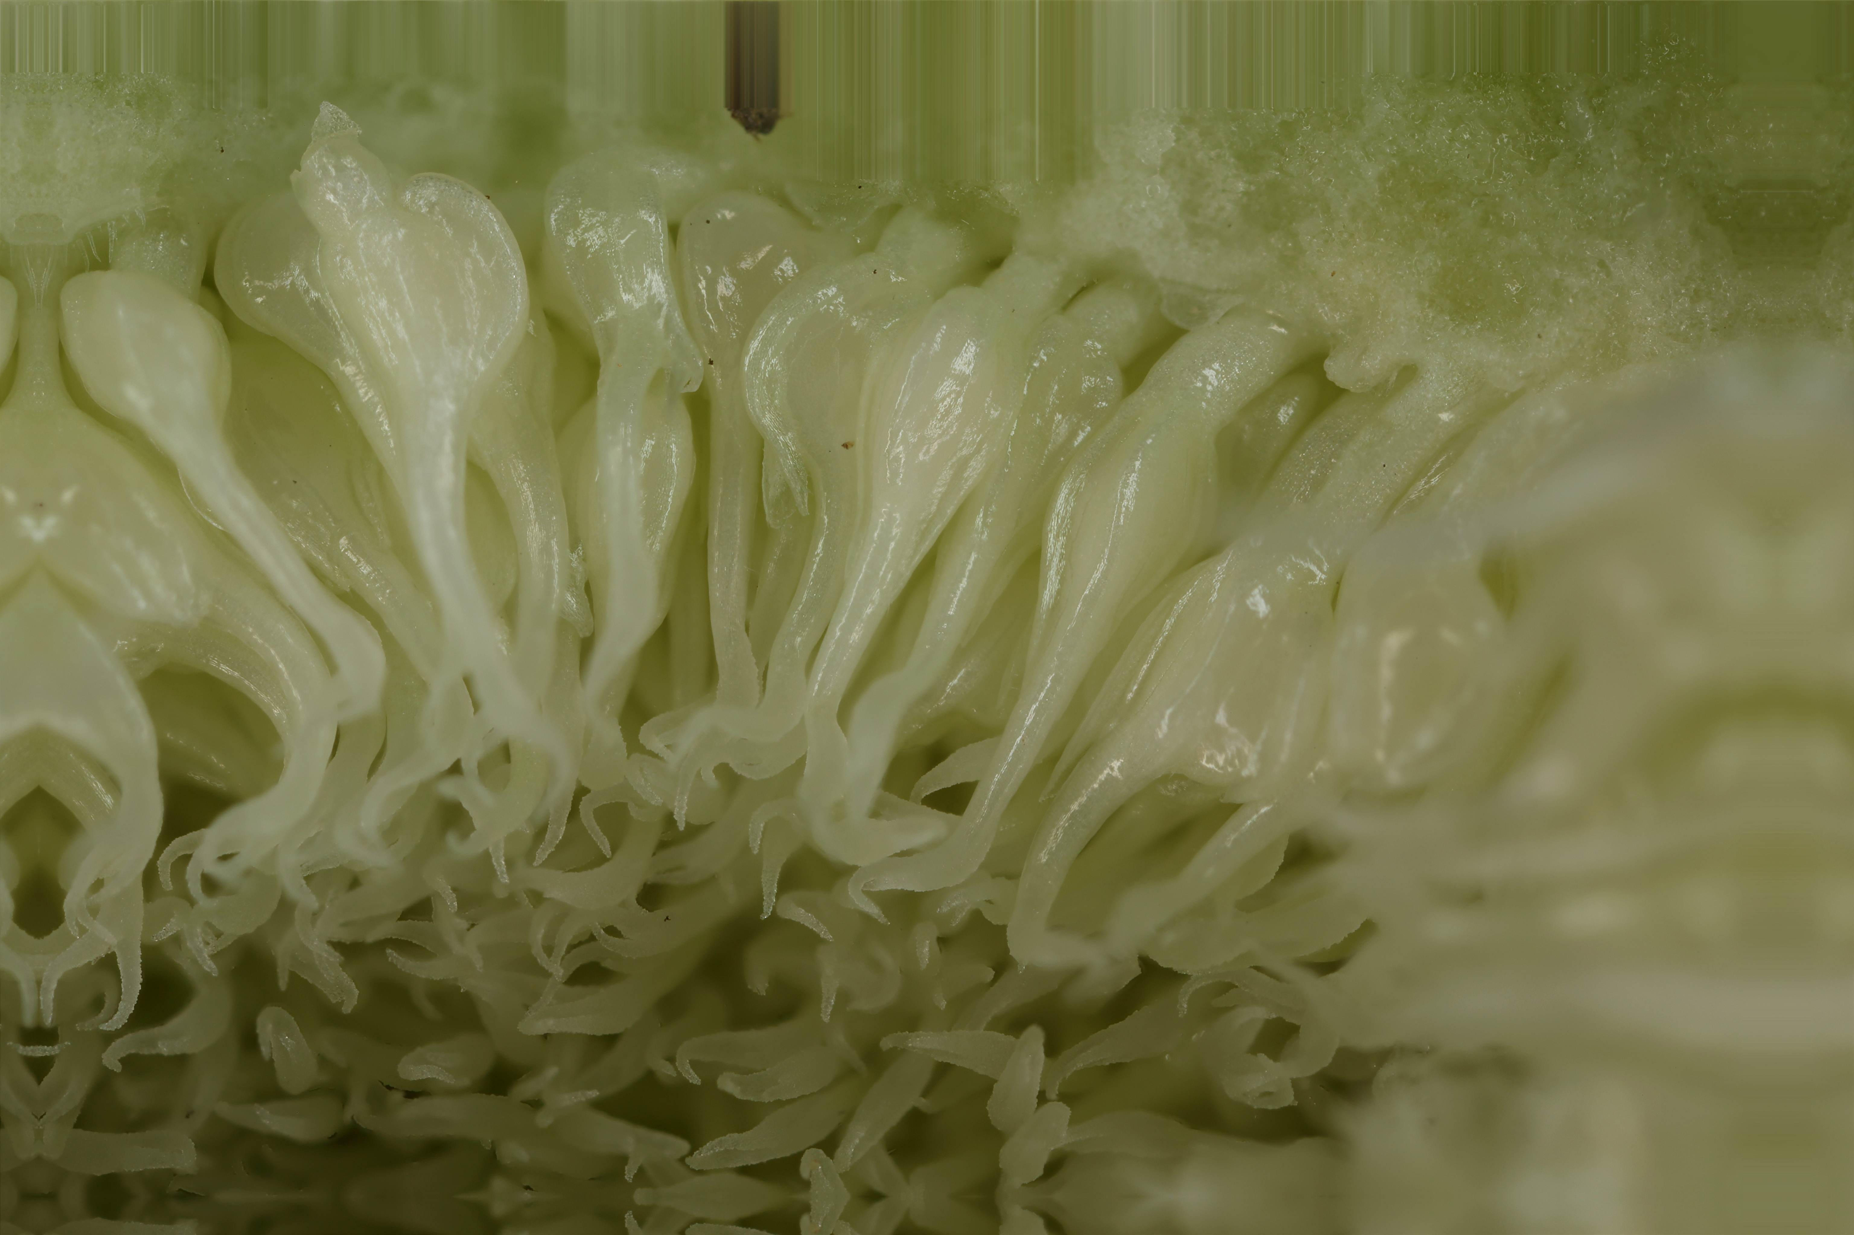
wild Ficus carica
flower ovule
long style, the wasp cannot oviposit
elongate stigmas with papillae on which pollen will stick
July: female tree, receptive fig

Slide 44
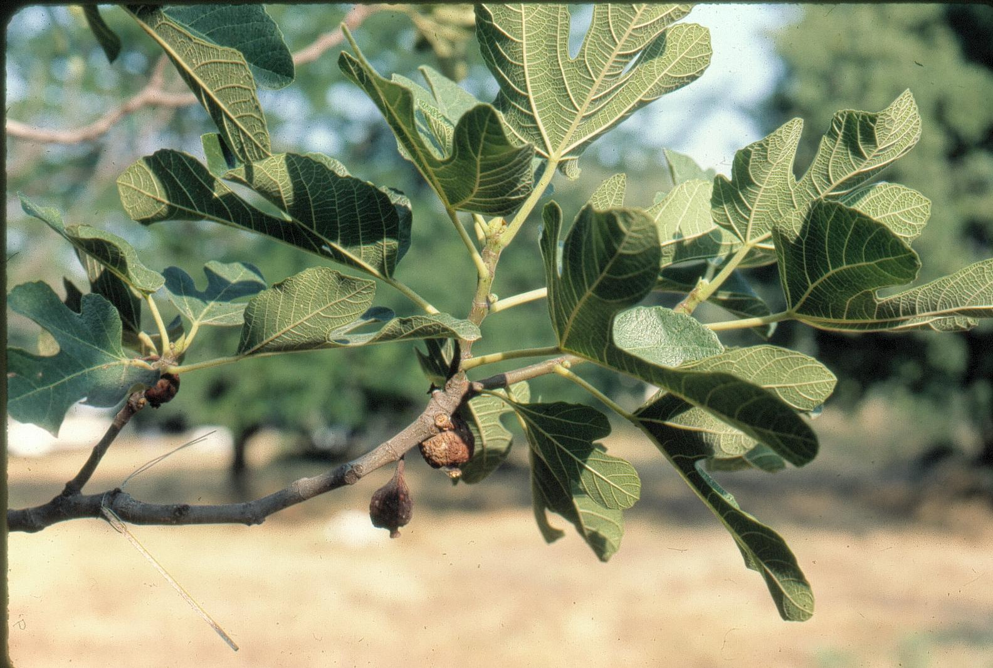
wild Ficus carica
figs from which the wasps have already emerged
young fig buds
Late July: male tree, the very earliest young figs are visited by the wasps emerging from the very latest polliniferous figs. This sensitive point in the yearly cycle of the wasps is present throughout the wild range of Ficus carica

Slide 45
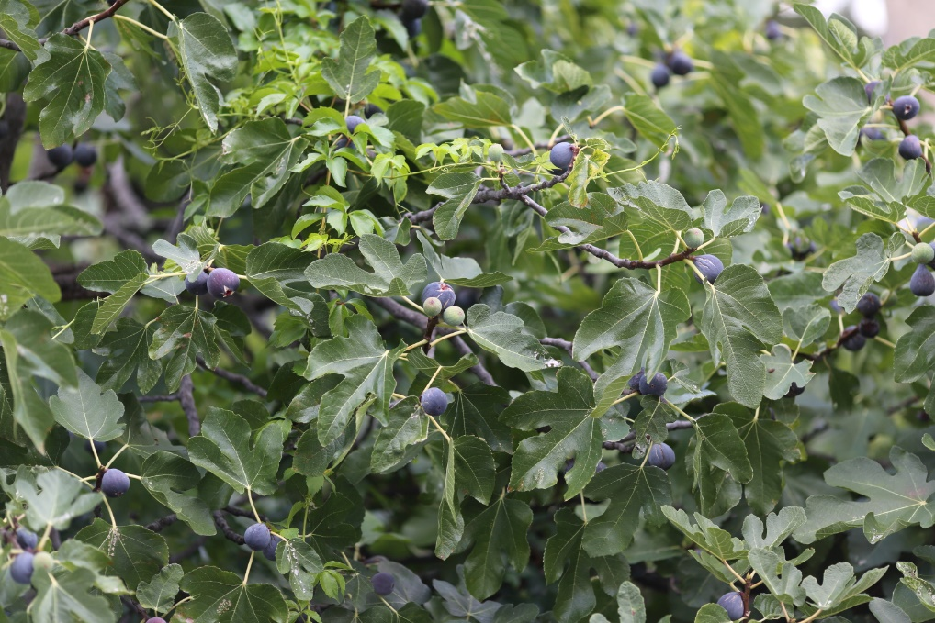
wild Ficus carica
September: female tree, ripe seed-containing figs

Slide 46
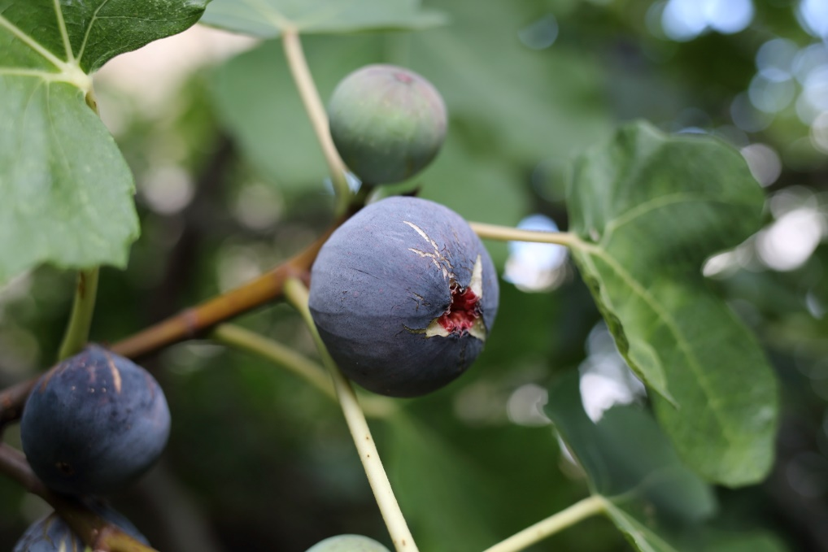
wild Ficus carica
September: female tree, ripe seed-containing figs
The climacteric ripening involves nutriment transfer, ethylene production and respiratory peak
Ripening can be artificially sped up by depositing a drip of olive oil on the ostiole
Notes:
olive oil releases ethylene

Slide 47
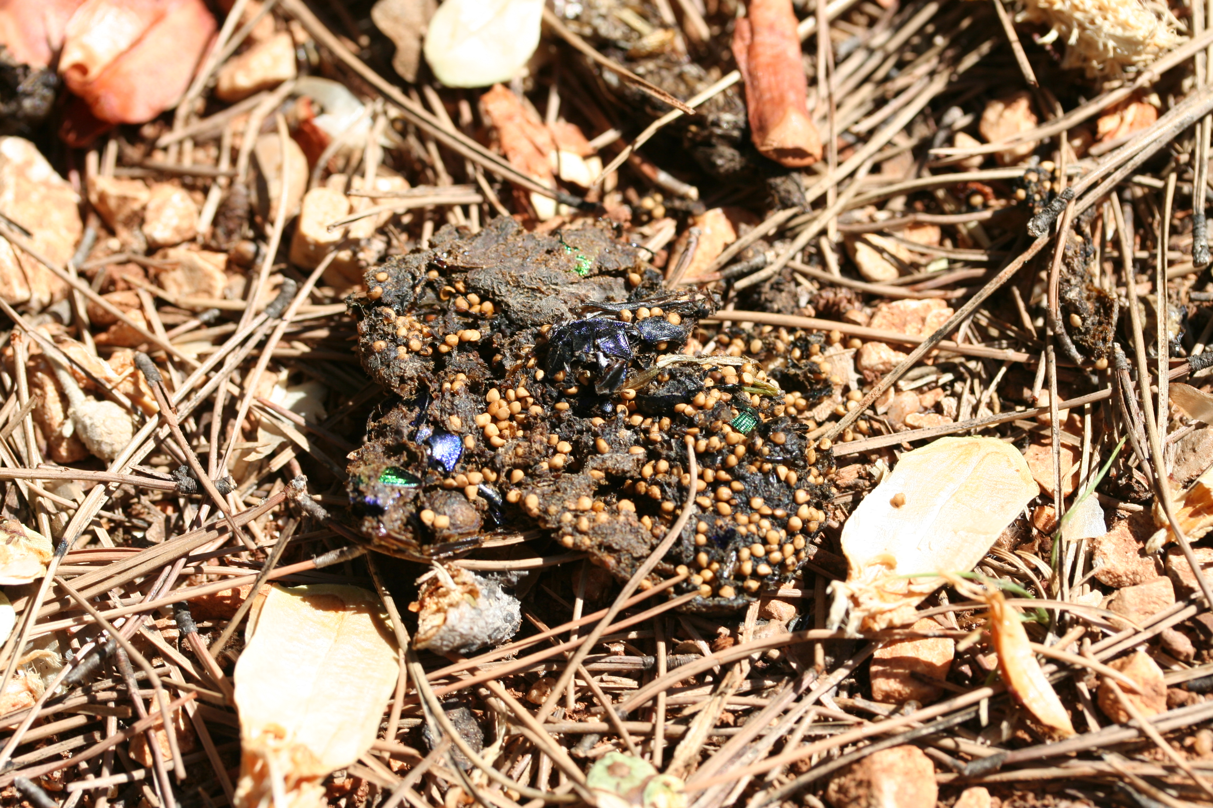
wild Ficus carica
September: fig seed dispersal by a mammal

Slide 48
wild Ficus carica, in man-made habitat
fig tree
Valleraugue, Hérault, France

Slide 49
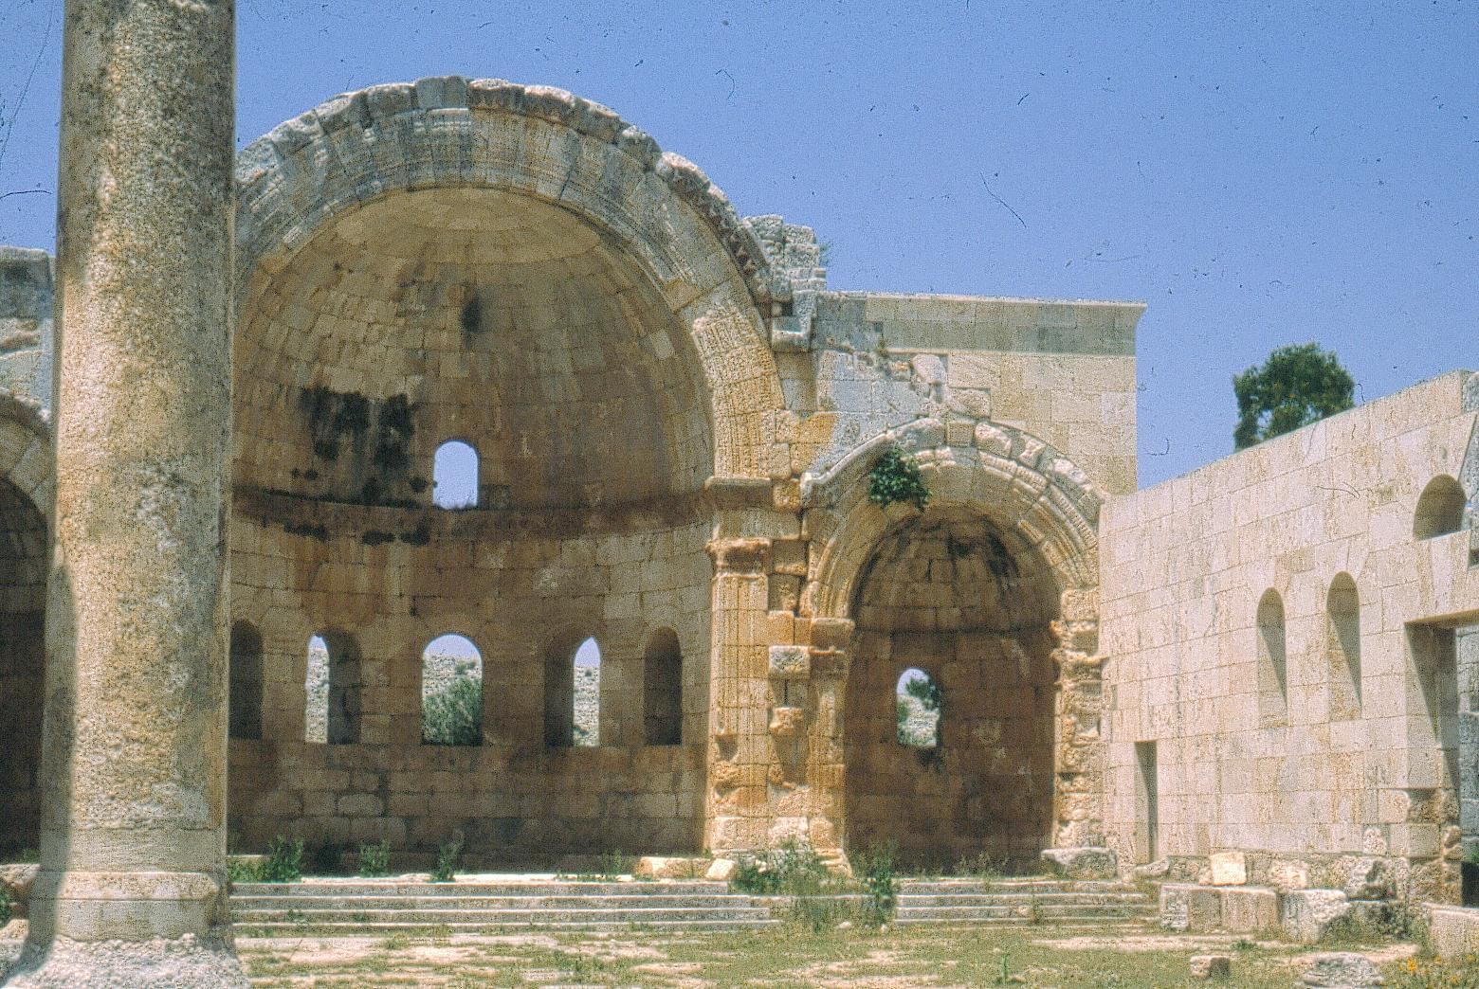
wild Ficus carica, in man-made habitat
fig tree
Church of Saint Simeon the Stylite, Syria

Slide 50
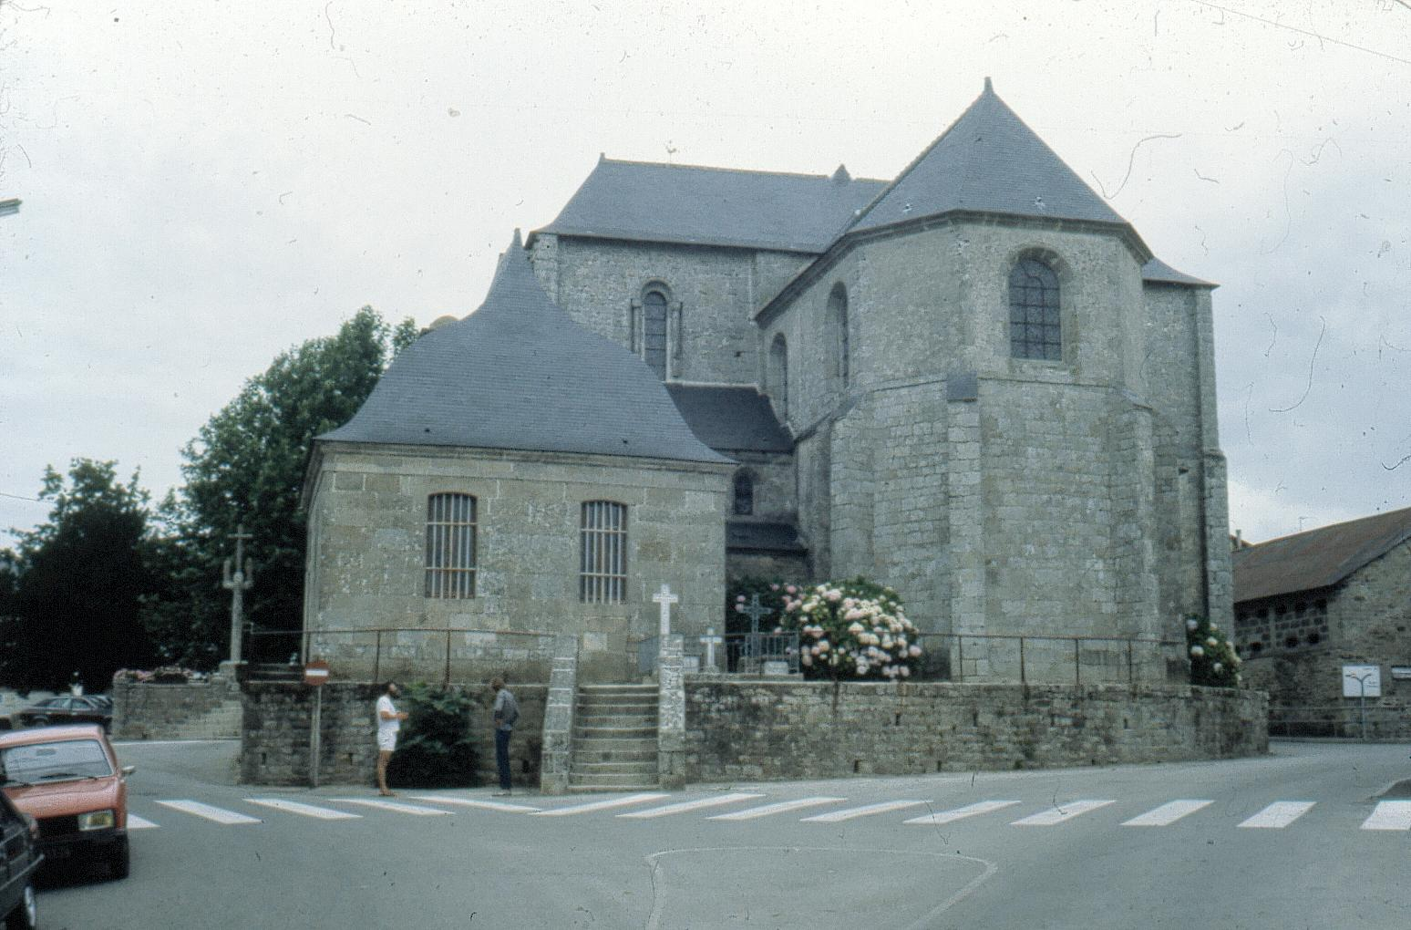
wild Ficus carica, in man-made habitat
Wild-germinated Ficus carica, outside the range of the pollinator,
Britany, France
Photo G. Valdeyron

Slide 51
Fig cultivation and domestication

Slide 52
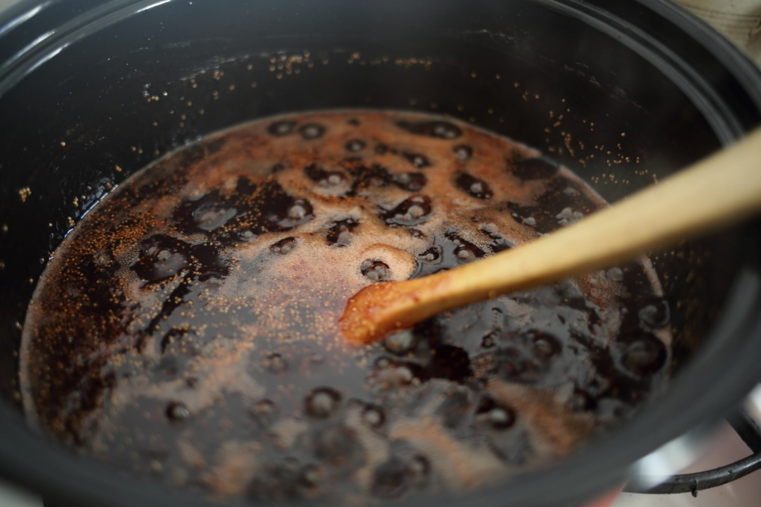
From wild to cultivated
Wild figs are as good as domesticated ones

Slide 53
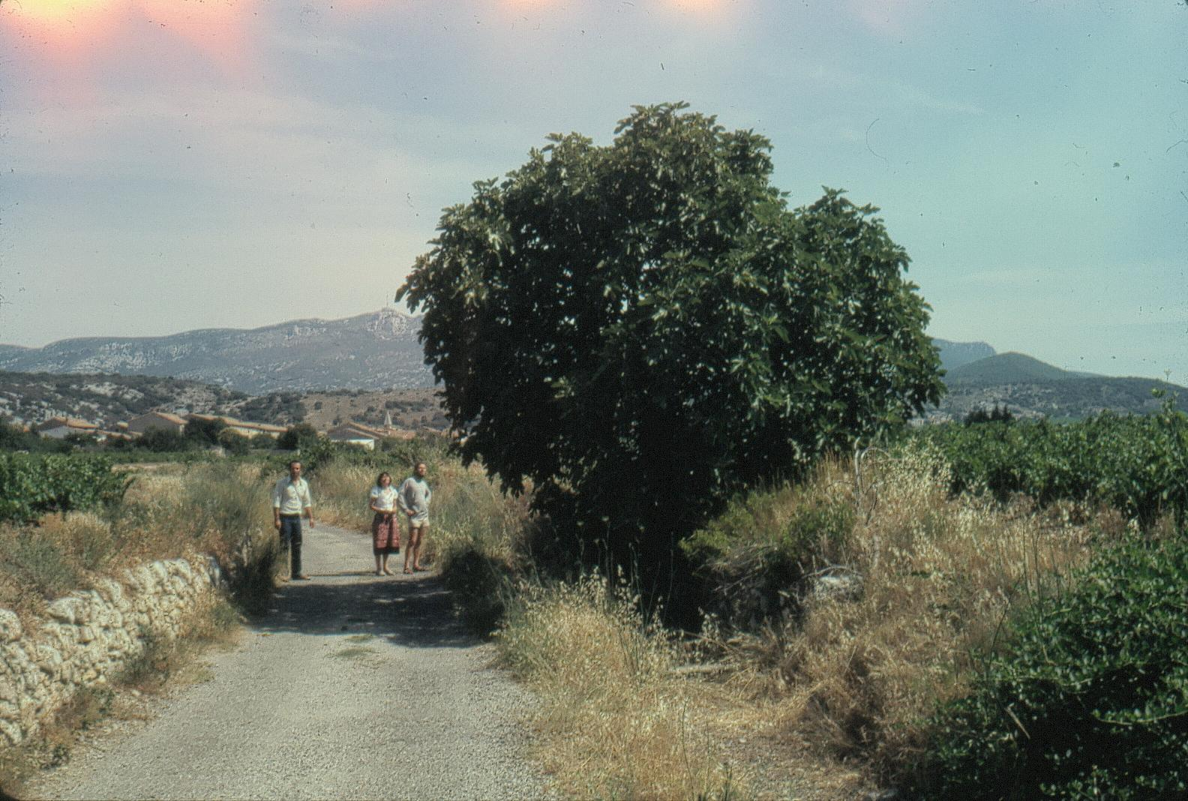
fig cultivation
cultivated wild-germinated fig tree
Montpeyroux, Hérault, France
Photo G. Valdeyron

Slide 54
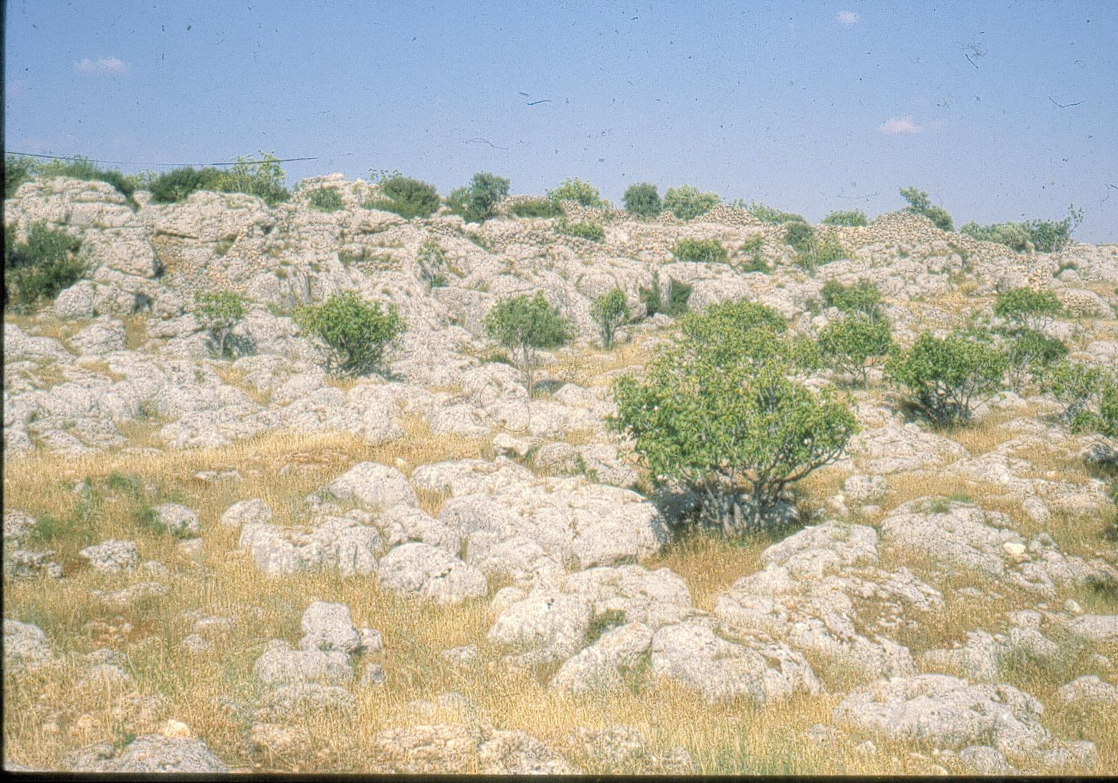
fig cultivation
Fig plantation, Syria

Slide 55
fig cultivation
Fig plantation,
Meander valley, Turkey

Slide 56
fig cultivation
Figs of the cultivars producing the best dry figs abort if not pollinated
How is pollination achieved in large fig plantations?
Turkey, Meander valley

Slide 57
fig cultivation
June: female tree, receptive figs of the second crop (= the crop present on wild female trees), requiring pollination
This phenotype is very similar to typical wild female trees
Turkey, Meander valley

Slide 58
fig cultivation
Fig plantation for dry fig production with caprifig trees (male trees) planted upwind of the female trees so wasps are blown towards the receptive figs
Idlib governorate, Syria
Photo G. Valdeyron

Slide 59
fig cultivation
female tree
fresh profichi
older profichi
June: caprification=profichi (polliniferous figs of male trees) are suspended in female trees to ensure pollination
Greece, Kalamata
Notes:
Renewing profichi throughout the period when figs are receptive on female trees ensures the production of numerous second crop figs.
On the opposite, if profichi are only suspended when the basal figs are receptive, then fewer figs develop to maturity but they will be larger.

Slide 60
fig cultivation
June: tying profichi (polliniferous figs from male trees) together to suspend in female trees. Kalamata, Greece
profichi

Slide 61
fig cultivation
female tree
fresh profichi
older profichi
June: weeding is neglected, but caprification is still performed
With caprification many female trees can be pollinated with figs from few distant caprifig trees
Greece, Kalamata

Slide 62
fig cultivation
second crop receptive figs
a pair of profichi tied together
June: caprification of female tree for dried fig production
Idlib governorate, Syria

Slide 63
fig cultivation
Preparing profichi for caprification in a village of dried fig producers, Meander valley, Turkey

Slide 64
fig cultivation
A village specialized in profichi cultivation for sale at the market in the city Meander valley, Turkey
the day’s unsold profichi

Slide 65
fig cultivation
profichi
receptive figs
June: caprifig cultivar from a village specialised in profichi production
Pollinator reproduction is facilitated by the early development of the next generation of figs on the shoot of the year.
Meander valley, Turkey

Slide 66
fig cultivation
A caprifig cultivar from the Meander valley
On this phenotype wasps visit figs on the same tree instead of ensuring pollen transfer to female trees, and the reproduction of the male tree
This phenotype is counterselected in the wild
numerous wasps attracted to a receptive fig on the same tree
just emerged wasp on natal fig
June: caprifig cultivar with early receptive figs selected in the villages specialised in profichi production, Meander valley, Turkey

Slide 67
fig cultivation
under insular conditions, overwintering figs containing wasps may lack in spring: wasps are brought from the continent
profichi
mamme (=overwintering fig on male tree) picked on the continent and used to ensure wasp colonization of profichi figs
Photo G. Valdeyron
June: caprification of male trees, Tunisia, Kerkennah Islands

Slide 68
fig cultivation
diseases spread by pollinating wasps
Fusarium growing in a mamme fig
California, USA
Photo Themis Michailides UC Davis

Slide 69
fig cultivation
diseases spread by pollinating wasps
Fusarium moniliforme on Blastophaga
California, USA
Photo Themis Michailides UC Davis

Slide 70
fig cultivation
diseases spread by pollinating wasps
second crop figs, Endosepsis caused by Fusarium
Photo Themis Michailides UC Davis

Slide 71
fig cultivation
diseases spread by pollinating wasps
Smut Endosepsis Alternaria rot
Aspergillus niger Fusarium spp. Alternaria, Ulocladium
Aspergillus japonicus
Aspergillus carbonarius
Photo Themis Michailides UC Davis

Slide 72
fig cultivation
controlling diseases spread by pollinating wasps
a caprifig plantation, preparation to collect mamme for sanitation
California, USA
Photo Themis Michailides UC Davis

Slide 73
fig cultivation
profichi collected in specialised orchard, before sanitation
California, USA
Photo Themis Michailides UC Davis

Slide 74
fig cultivation
Profichi collected in specialized orchard before sanitation
California, USA
Photo Themis Michailides UC Davis

Slide 75
fig cultivation
sanitation with fungicide of profichi figs split open, just before wasp emergence
California
Photo Themis Michailides UC Davis

Slide 76
fig cultivation
sanitation of profichi figs split open
California
Photo Themis Michailides UC Davis
Packaging of profichi sanitised just before wasp emergence, ready for use in caprification

Slide 77
fig cultivation
second crop figs (typical crop present in wild female trees) on the shoot of the year
First crop fig (equivalent of profichi on female trees) on the shoot of previous year
June: female tree, biferous cultivar (=2 crops, the typical one of wild female trees, and the one corresponding to the generation of profichi figs, only present in cultivars )
Mamme figs do not produce pollen so that first crop figs are never pollinated
First crop figs develop without pollination, they are parthenocarpic
The second crop is also parthenocarpic in some cultivars

Slide 78
fig cultivation
shoot of the previous summer
scars after second crop figs
first crop fig buds
shoot of previous summer
Winter: female tree, biferous cultivar

Slide 79
fig cultivation
Receptive female fig, first crop
First crop figs are larger and have a thicker wall, the flowers are less densely packed and the styles are shorter than in second crop figs
The overwintering first crop fig bud presented differentiated flower primordia
Morphological differences with second crop figs are induced during winter

Slide 80
fig cultivation
Receptive female fig, first crop
The stigmas will never be pollinated as mamme do not produce pollen
First crop figs artificially pollinated with preserved pollen produce seeds

Slide 81
fig cultivation
buds that will give ripe first crop figs next August
at the northern limit:
second crop figs that will never ripen
March, Normandy, France

Slide 82
fig cultivation
Croisic, a caprifig cultivar cultivated outside the range the fig wasp
It produces edible figs
Britany, France
Photo G. Valdeyron

Slide 83
Other-fig cultivation
Jelly fig
(Ficus pumila var awkeotsang)
Taiwan

