Slide 1
Structural evolutions in Zr alloys during oxidation at high temperature and subsequent cooling
ICNMNE, London, January 19 and 20th, 2017
R. GUILLOU ^{1*}; M. LE SAUX ¹; J.C. BRACHET ¹; T. GUILBERT ¹; E. ROUESNE ¹, D. MENUT ²; C. TOFFOLON-MASCLET ¹; D. THIAUDIERE ²
*Corresponding author: raphaelle.guillou@cea.fr
¹ DEN-Service de Recherches Métallurgiques Appliquées (SRMA), CEA, Université Paris-Saclay, F-91191, Gif-sur-Yvette, France
² Synchrotron SOLEIL, Gif-sur-Yvette, France

Slide 2
outline
Background of the study : Fuel cladding tube and LOCA
Objectives of the study
X-ray diffraction
Dilatometry
Conclusions

Slide 3
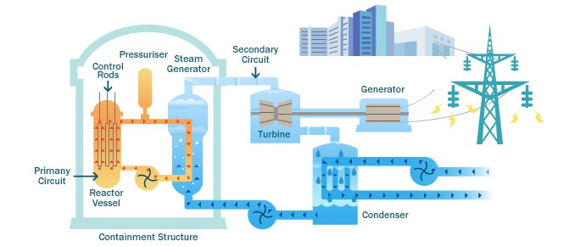
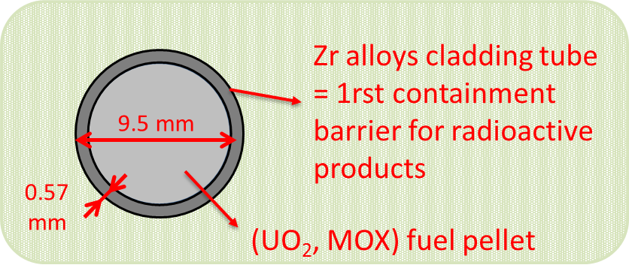
Background of the study: Fuel cladding tube
Pressurized Water Reactor

Slide 4
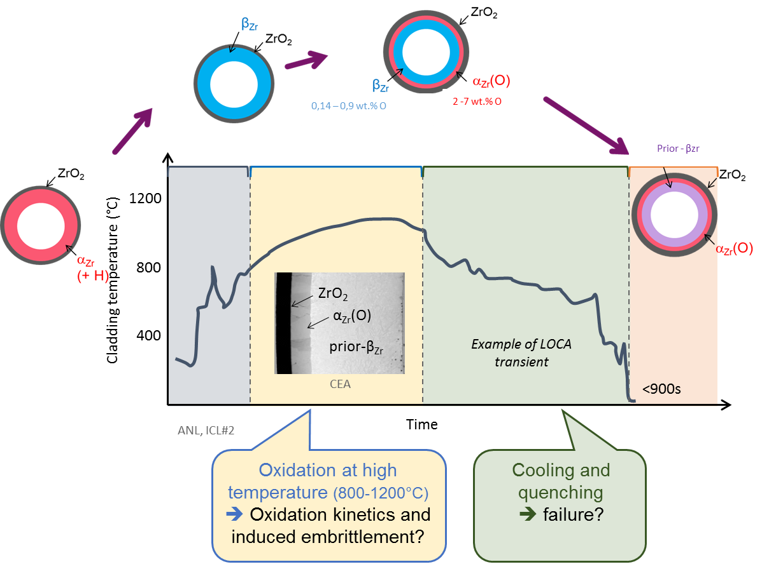
Background of the study: Loss Of Coolant Accident (LOCA)
Formation of a breach in the primary circuit, pressure drop
Loss of water in the primary circuit, vaporization of water…

Slide 5
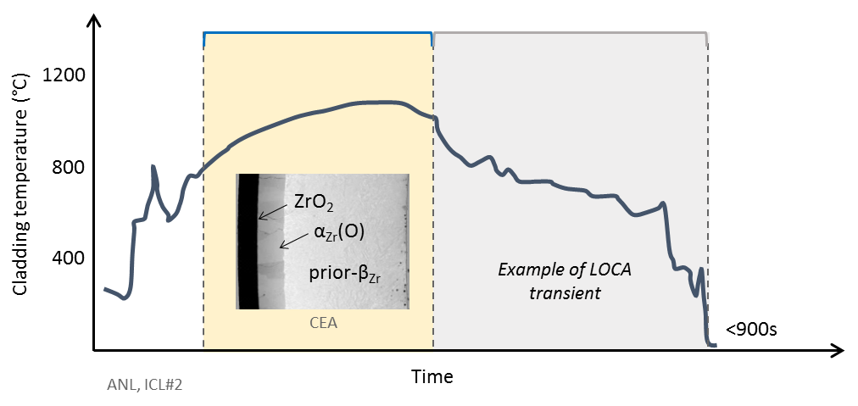
Objectives of the study
Why?
During oxidation: internal stresses may result from the formation of the oxide layer, the diffusion of oxygen into the underlying metal, the β_{Zr} to α_{Zr}(O) phase transformation → potential effect on the oxide structure and the oxidation kinetics of the material
During cooling: internal stresses are due to differences between the thermal expansion coefficients of the various phases / layers, phase transformations of the metal and the oxide... These stresses may result in the failure of the oxidized cladding during quenching.

Slide 6
Objectives of the study
Why?
During oxidation: internal stresses may result from the formation of the oxide layer, the diffusion of oxygen into the underlying metal, the β_{Zr} to α_{Zr}(O) phase transformation → potential effect on the oxide structure and the oxidation kinetics of the material
During cooling: internal stresses are due to differences between the thermal expansion coefficients of the various phases / layers, phase transformations of the metal and the oxide... These stresses may result in the failure of the oxidized cladding during quenching.

Slide 7
Objectives of the study
How?
In-situ high temperature oxidation and cooling experiments on Zr alloys samples
Synchrotron X-Ray Diffraction (XRD) experiments on the DiffAbs beamline of the SOLEIL synchrotron
+
Dilatometry experiments at CEA Saclay
The aim of these coupled experiments is to determine, at two different scales (microscopic for XRD and macroscopic for dilatometry), strains and then internal stresses developed during the oxidation at high temperature and subsequent cooling.

Slide 8
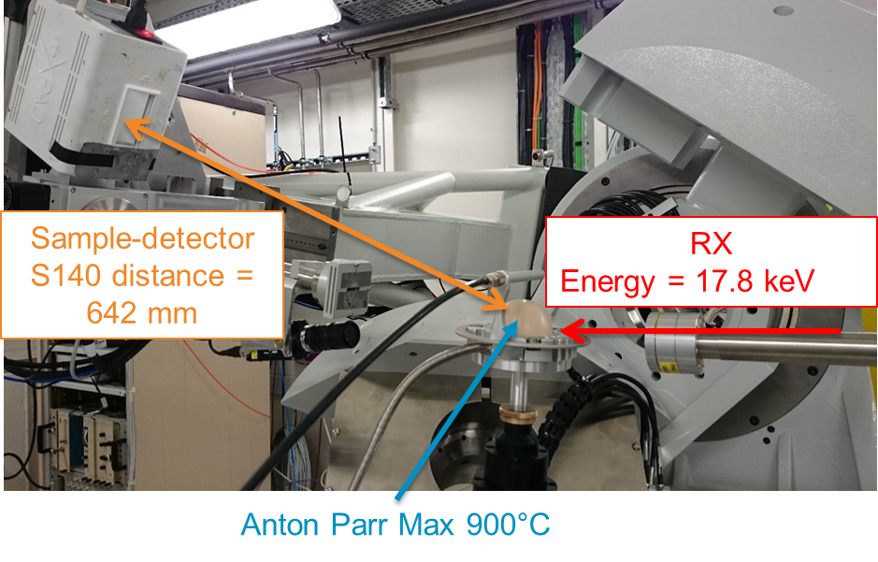
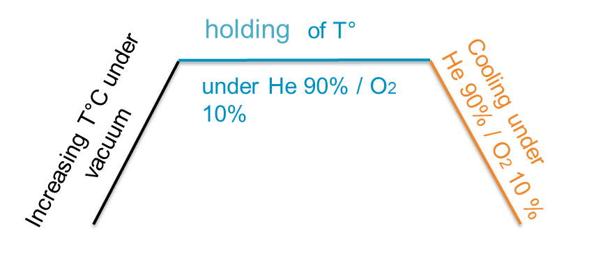
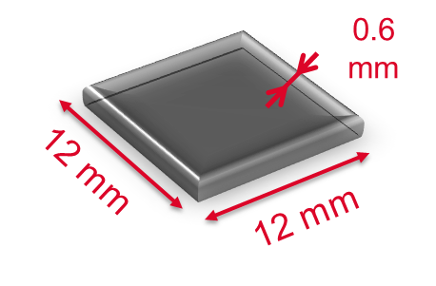
X-ray diffraction
XRD under Synchrotron radiation in-situ during oxidation and subsequent cooling
Experiments performed on Zy-4 sheet samples on the DiffAbs beamline of the SOLEIL synchrotron (France) → heating with a Anton Paar DHS 900 domed hot stage
Target oxide layer thickness at the end of the oxidation → 10µm
Penetration of the X-Ray ≈ 100µm
Oxidant mixture : 90 % He / 10% O2
3 temperatures studied: 700 / 800 / 900°C

Slide 9
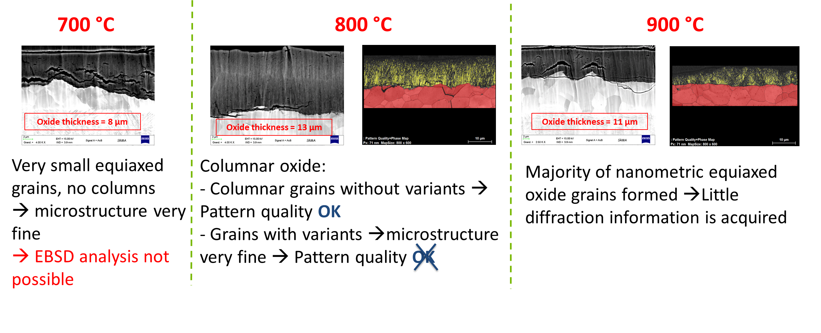
X-ray diffraction
Microstructure analyses after cooling by SEM and EBSD techniques → microstructure and crystallographic texture

Slide 10
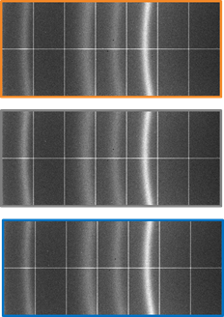
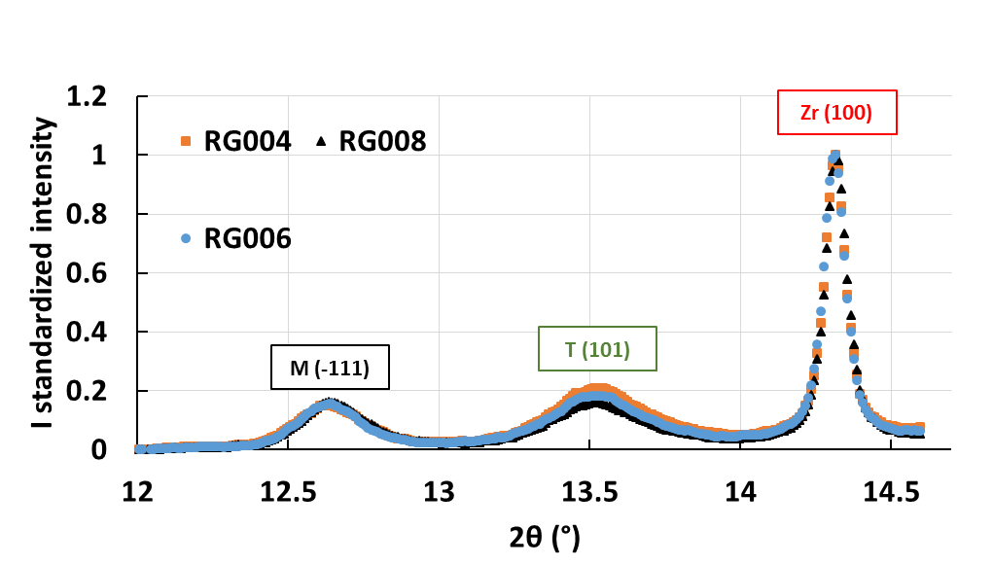
X-ray diffraction
Structural evolutions analysis by XRD
During heating at 550°C
At 550°C : a thin oxide layer is detected and both ZrO2 monoclinic and tetragonal phases are present

Slide 11
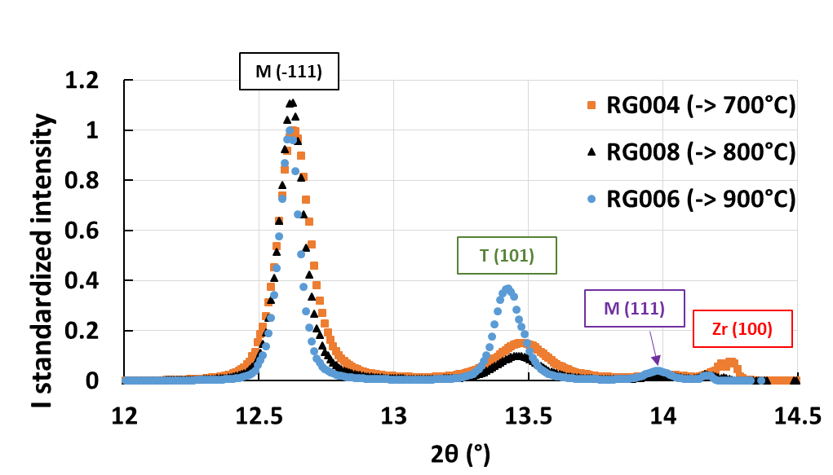
X-ray diffraction
Structural evolutions analysis by XRD
At the end of oxidation at 700, 800 et 900°C
Metallurgical evolutions of the metallic substrate (disappearance of the diffraction peak) + increasing of the ZrO2 tetragonal phase proportion when the oxidation temperature increases

Slide 12
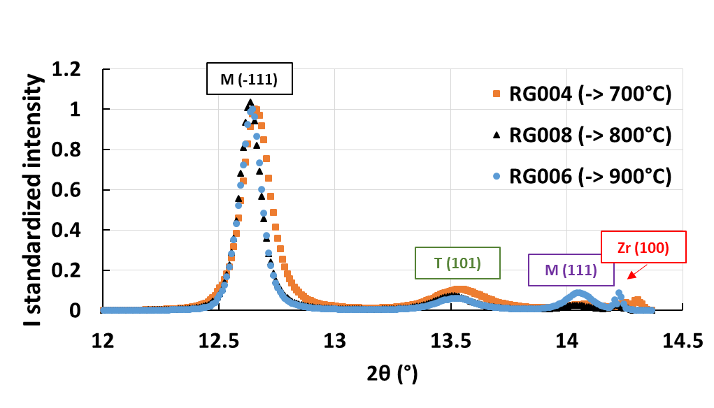
X-ray diffraction
Structural evolutions analysis by XRD
At the end of cooling (300°C)
During cooling: ZrO2 tetragonal phase transforms into monoclinic phase. For the 900°C case, this transformation is accompanied by the apparition of the (111) diffraction peak of the monoclinic phase

Slide 13
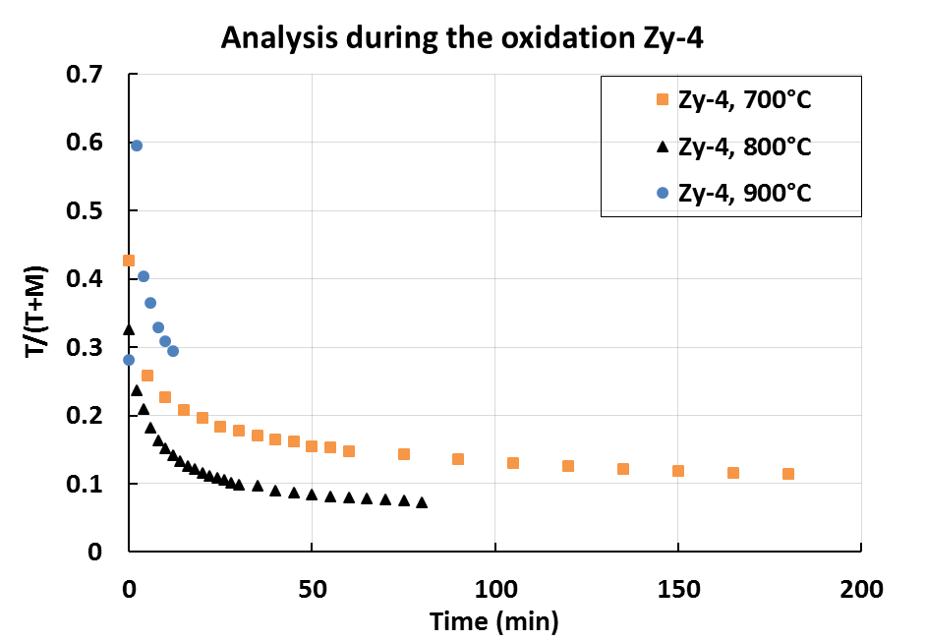
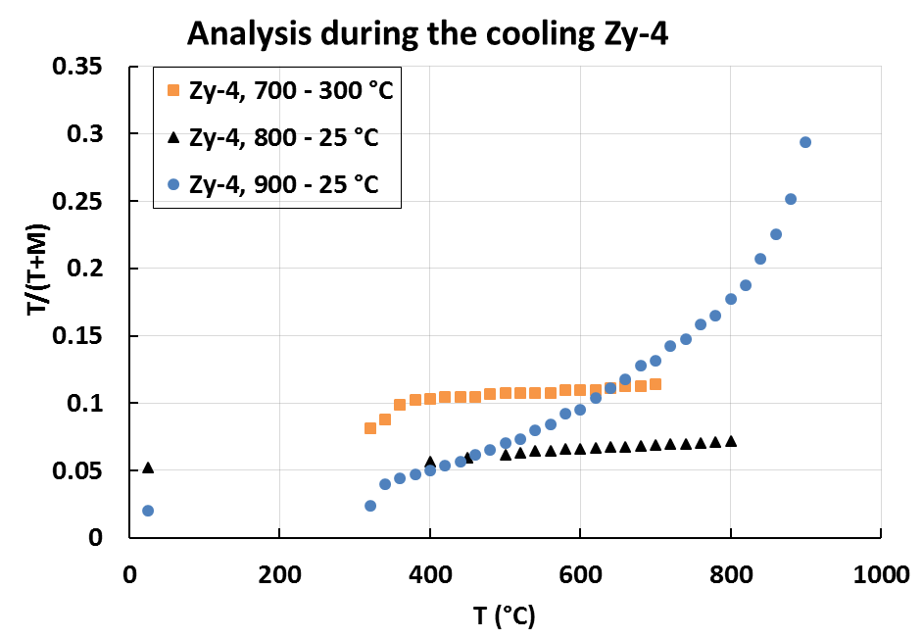
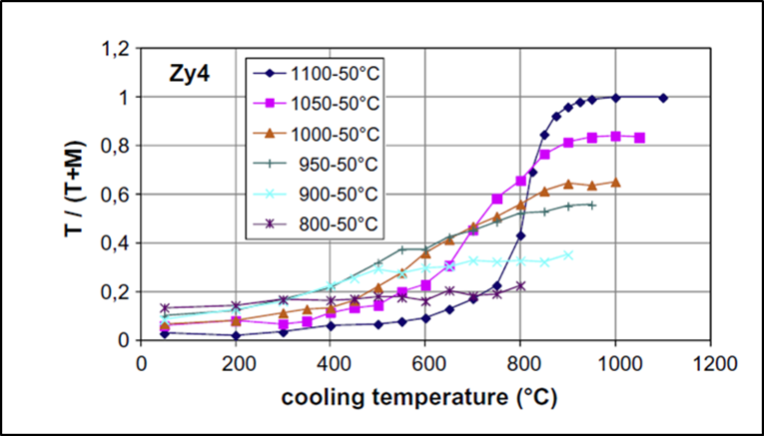
X-ray diffraction
Structural evolutions analysis bythanks to XRD technique
Synchrotron XRD
X-Ray penetration ≈ 100µm
During oxidation: decrease by 30% of the ZrO2 tetragonal phase volume fraction
During cooling:
For an oxide formed at 900°C: transformation into the ZrO2 monoclinic phase of most of the tetragonal phase
For oxides formed at 700 and 800 °C: smoother transformation
→ In agreement with literature
Laboratory XRD
X-Ray penetration ≈ 5µm

Slide 14
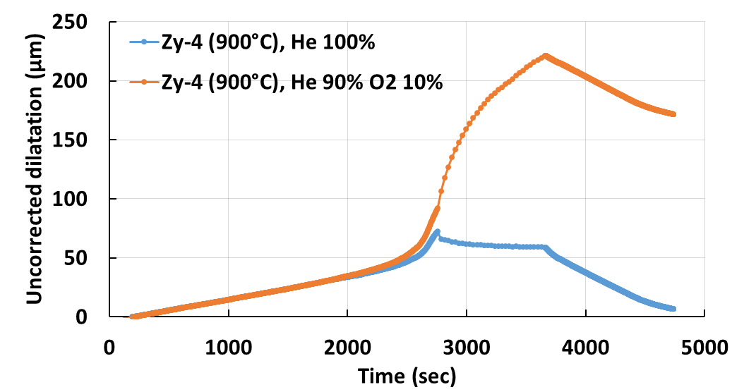
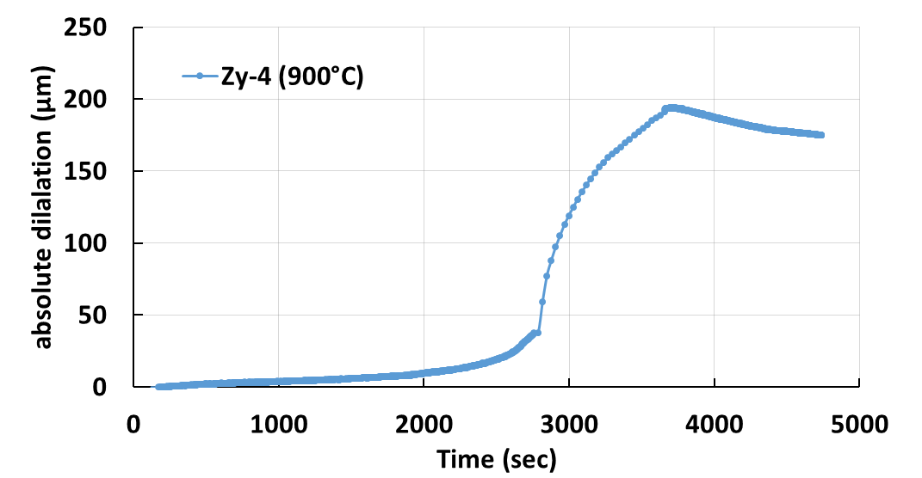
Dilatometry
Dilatometry in-situ oxidation experiment
Experiments done on Zy-4 sheet samples in a dilatometer DT1000 (CEA Saclay) with 100% He and 90 % He / 10% O2 mixture atmospheres
Principle of the technique
In-situ measurement of the sample length variation
Length variation obtained under neutral atmosphere (resulting from thermal strain and phase transformation of the metal)
substracted
from the one measured under the oxidizing atmosphere
→ Strain due to oxidation?

Slide 15
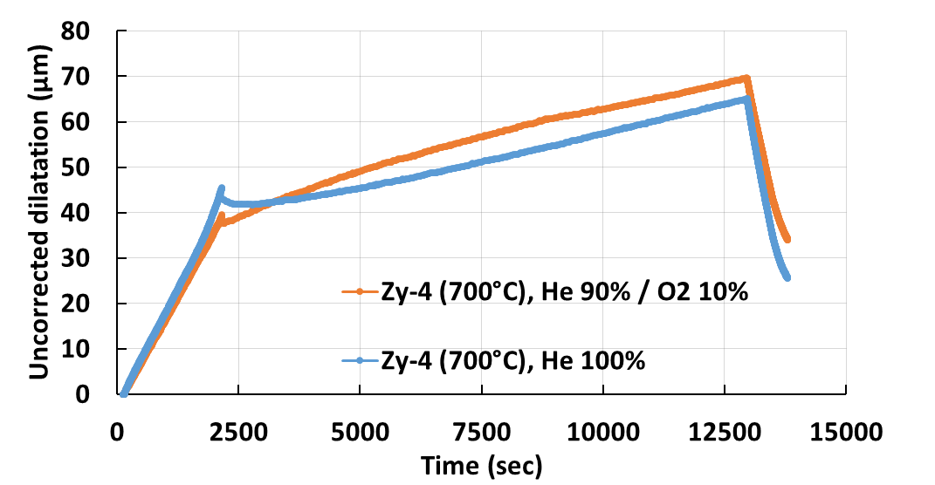
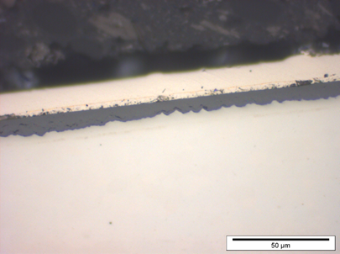
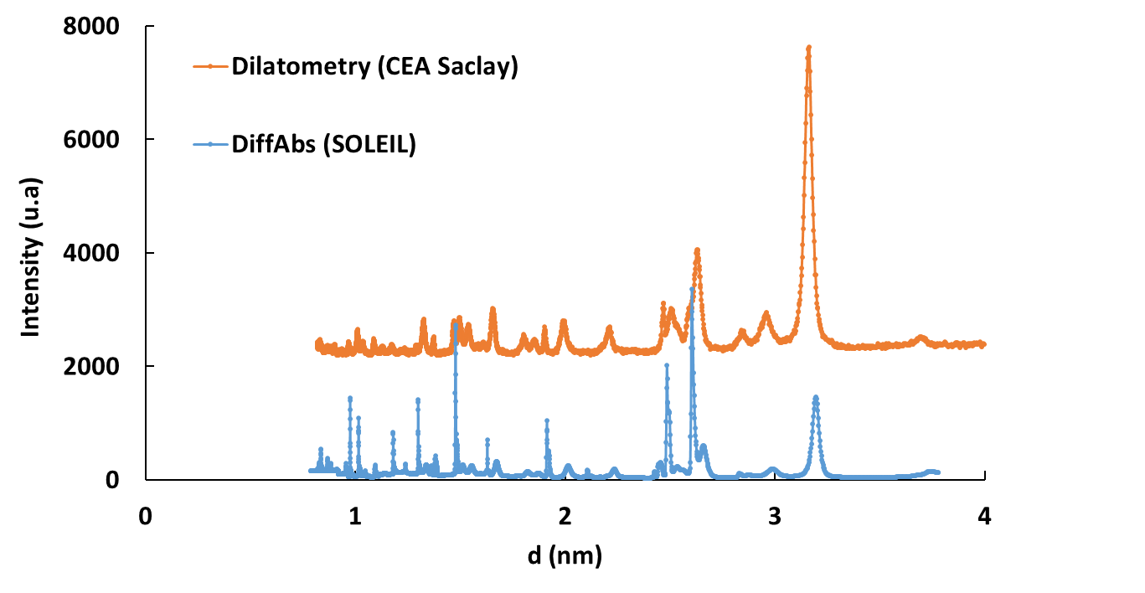
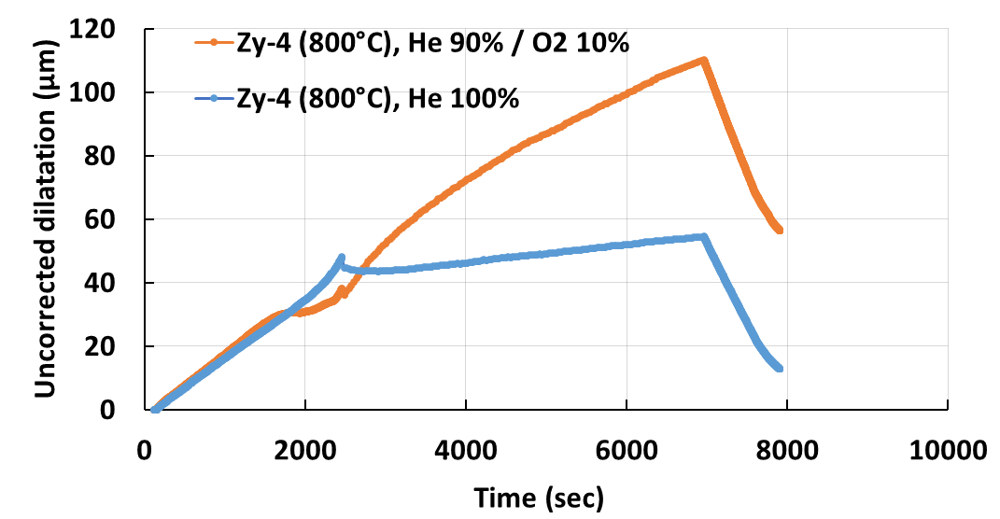
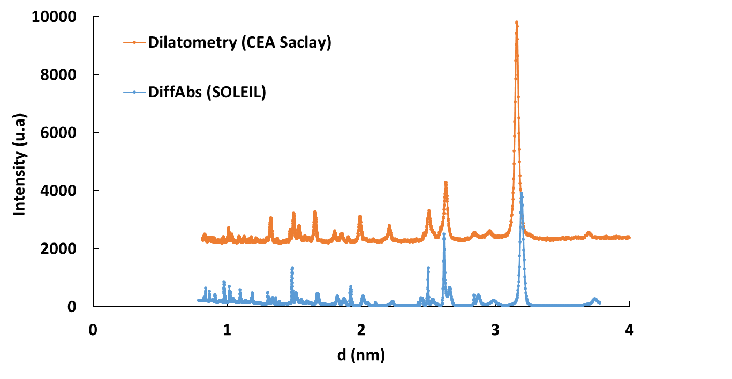
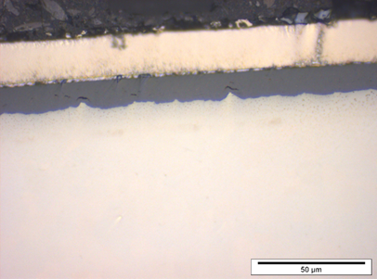
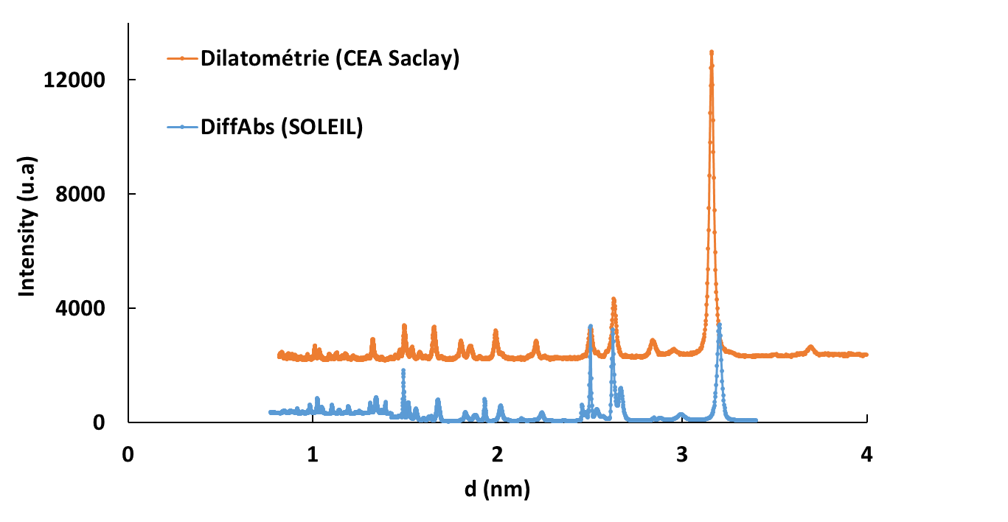
Dilatometry
700°C
eZrO2 ≈ 8 µm
800°C
eZrO2 ≈ 12 µm
900°C
eZrO2 ≈ 15 µm
The oxide layers obtained have characteristics close to those formed during synchrotron XRD experiments (thickness, morphology and phases at room temperature)

Slide 16
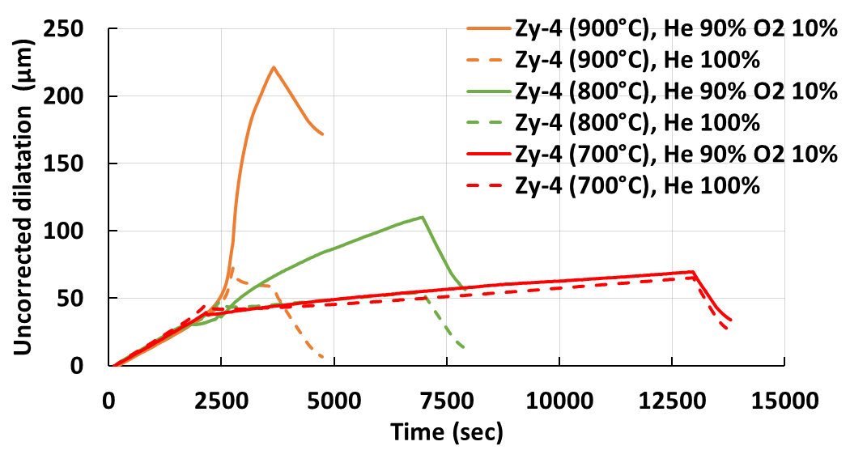
Dilatometry
Oxidation at high T ° → significant strains
→ internal stresses that have developed
Dilatation at 700°C < 800°C < 900°C

Slide 17
Conclusions
Realization of the first in-situ high temperature oxidation experiments under synchrotron X-Ray Diffraction (XRD) on Zircaloy-4 sheet samples: For the 3 studied temperatures (700, 800, 900°C) good control of the temperature and oxidation atmosphere (90 % He / 10% O2) → Desired oxide layer thickness obtained.
XRD analyses have shown metallic substrate evolutions (grain size increase and phase and texture changes), oxide layer growth and evolution (monoclinic and tetragonal phases) during oxidation and ZrO2 tetragonal phase transformation into the monoclinic phase during cooling.
Highlight of the significant influence of the oxidation temperature on the ZrO2 tetragonal phase volume fraction during oxidation and after cooling
Measurement by dilatometry of the deformation of Zircaloy-4 sheet samples in-situ during oxidation at 700, 800 and 900°C (conditions similar to those of the synchrotron XRD experiments) and cooling → Oxidation induces significant macroscopic strains associated with internal stresses

Slide 18
Thank you for your attention

