Slide 1



Future MTR capabilities :
Jules Horowitz Reactor
Jean-François VILLARD, Gilles BIGNAN
French alternative energies and atomic energy commission
Nuclear Energy Division – Reactor Studies Department
Cadarache – F-13108 St Paul Lez Durance, France
Joint ICTP/IAEA Workshop “Research Reactors for Development of Materials and Fuels for Innovative Nuclear Energy Systems”
6-10 November 2017, ICTP - Trieste, Italy

Slide 2
Future MTR capabilities : Jules Horowitz Reactor
Summary
Context and objectives of the JHR
General figures of the JHR
Experimental capabilities of the JHR
The key-role of innovative instrumentation for the JHR
JHR consortium and collaborations
PAGE 2

Slide 3
1. Context and objectives of the JHR

Slide 4
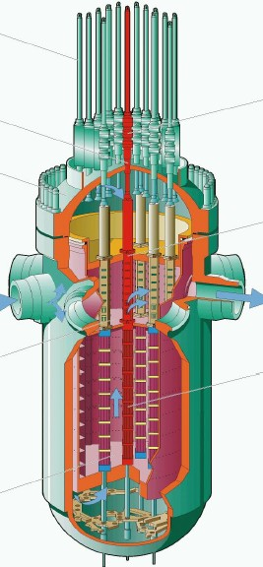

1. Context and objectives of the JHR
In-pile testing in support of the nuclear Industry
Just for France, 58 NPPs means more than 10 000 fuel assemblies under irradiation at a time…
The fuel has to be carefully designed, with enough Safety Analysis Design Margins
+ new fuel managements
+ new LWR standards…
→ need to generate additional margins
  Improve Modeling, Calculation tools and Testing
  Improve Safety Analysis design Methods
  Improve Fuel Product
In-pile data required !

Slide 5
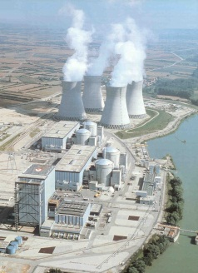
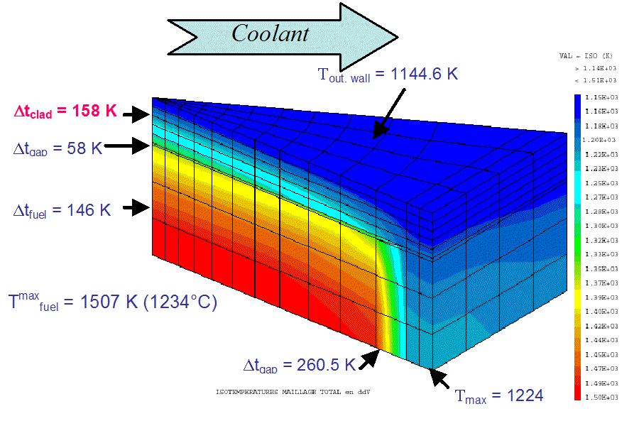
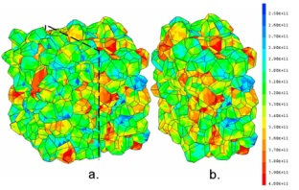
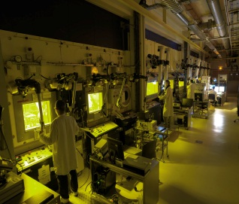
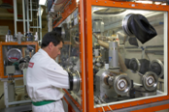
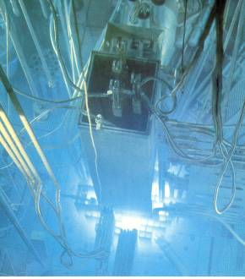
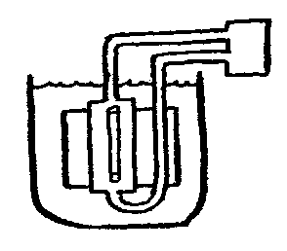
1. Context and objectives of the JHR
The Key-Role of Material Testing Reactors
for Fuel and Material qualification under irradiation
CODES
Validation
QUALIFICATION
Documents
BASIS RESEARCH
&
NUMERICAL SIMULATION
DESIGN
EXPERIMENTAL DATA
EXPERTISE
CEA
MANUFACTURING
REFABRICATION
CHARACTERIZATION
POST IRRADIATION
EXAMINATIONS
SINGLE EFFECT
EXPERIMENTS
Hot lab. for PIE
Hot Lab.
BEHAVIOUR UNDER IRRADIATION
Material Test Reactor
Situation in France :
OSIRIS MTR shutdown 2015

Slide 6
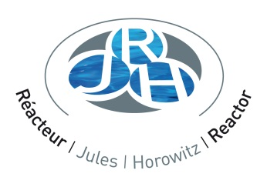
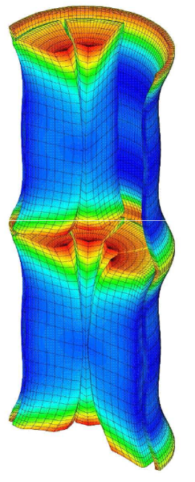
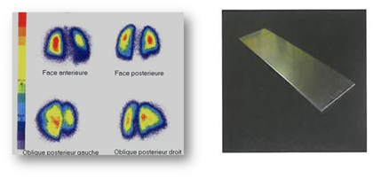
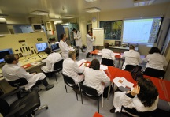
1. Context and objectives of the JHR
Jules Horowitz Reactor
main objectives
R&D in support to nuclear Industry
  Safety and Plant life time management (ageing & new plants)
  Fuel behavior validation in incidental and accidental situation
  Assess innovations and related safety for future NPPs
Radio-isotopes supply for medical application
  ⁹⁹Mo production
    JHR will supply 25% of the European demand
    (today about 8 millions protocols/year)
    + Up to 50% upon specific request
A key tool to support expertise
  Training new generations (JHR simulator, secondees program)
  Maintaining a national expertise staff and credibility for public acceptance
  Assessing safety requirements evolution and international regulation harmonization
Notes:
The Main Objectives of JHR
1] Support to nuclear industry, Regulators and R&D institutes
2] MOLI Production for Medical applications
3] Support Expertise: a key objective for the European Commission explaining their involvment in the consortium to maintain Epertise in Europe

Slide 7
2. General figures of the JHR

Slide 8
2. General figures of the JHR
Circuits (thermohydraulic,
chemistry, purification,…)
In-pile test device
MTR allows to reproduce on
a small scale, real power plant
conditions and in some cases,
more severe conditions for :
  Material screening (comparison of materials tested under representative conditions)
  Material characterisation (behaviour of one material in a wide range of operating conditions, up to off-normal and severe conditions)
  Fuel element qualification (test of one or several fuel rods)
PAGE 8

Slide 9
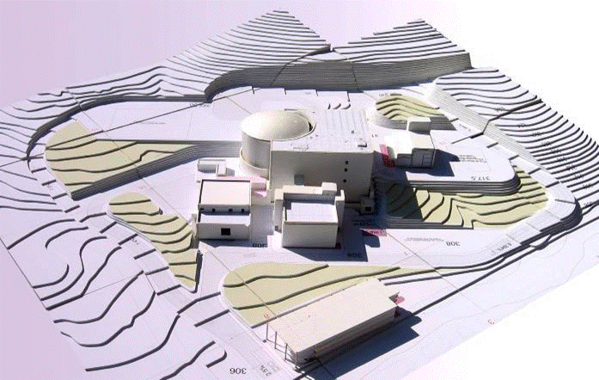
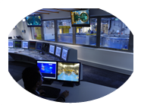
General layout of the JHR site
2. General figures of the JHR
Nuclear Auxiliary Building
Laboratories
Control room
Hot cells
(NDE + handling)
Storage pools (NDE)
Reactor Building
Reactor pool
(DD, NDE)
Experimental
rooms
Warehouse and
cold workshop
Cooling systems
Changing rooms +
power supply
Offices
PAGE 9

Slide 10
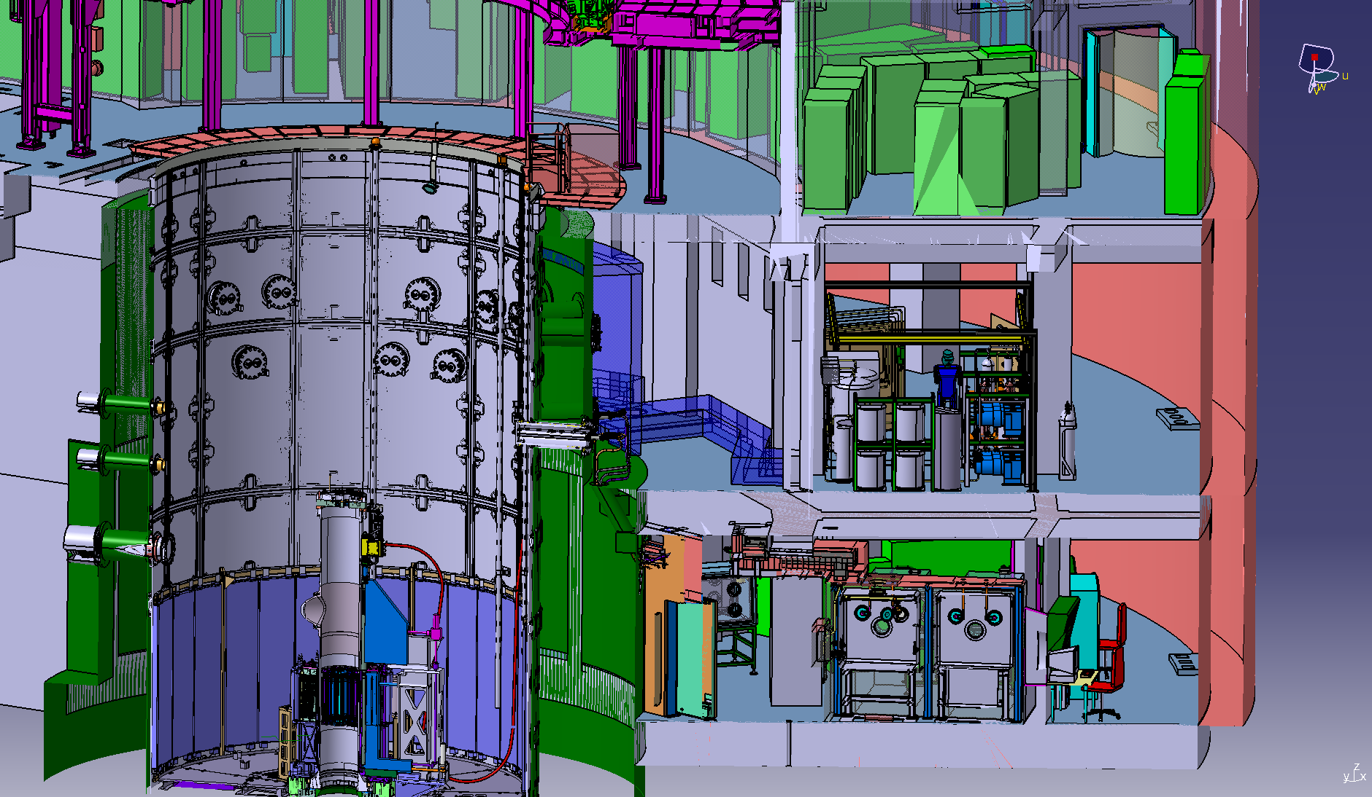
2. General figures of the JHR
Reactor building
I&C rooms for loop + test device
piping penetration
Connection lines
Cubicle ; Control of Thy conditions and water treatment
Reactor vessel
Core
Test device
FP laboratory
dedicated to on-line FP measurement
PAGE 10

Slide 11
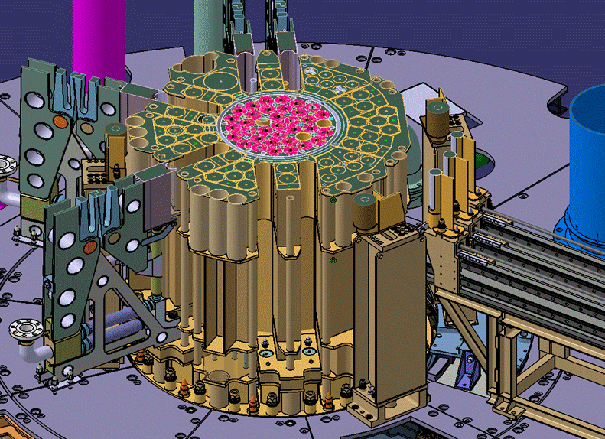
2. General figures of the JHR
The core is under moderated:
→High fast neutron flux in the core
→High thermal neutron flux in the reflector
~20 simultaneous
In reflector
experiments
In core
Up to 5.5 10
14
n/cm
²
Up to 5.5 10
14
n/cm
.s > 1
MeV
²
.s
Up to 10
15
n/cm
²
~20 fixed positions
.s > 0.1
MeV
(
100mm ; 1 position
200mm)
7 Small locations (
F
~ 32 mm)
and 6 displacement systems
3 Large locations (
F
~
80 mm)
Fuel studies: up to
Fuel experiment
600 W/cm with a
(fast neutron flux
–
GEN IV)
1%
235
U PWR rod
Material ageing
Material ageing
(up to 16
dpa/y
)
(low ageing rate)
GEN II & III + GEN IV
Displacement systems:
•
Adjust the fissile power
•
Study transients
1/Lethargy
Core Designed for UMo
Al fuel
Start
-
up with U
Si
-
3
2
Al fuel
70 MWth / 100 MWth
25 to 30 days cycle length
PAGE 11
6
-
7 days shutdown

Slide 12
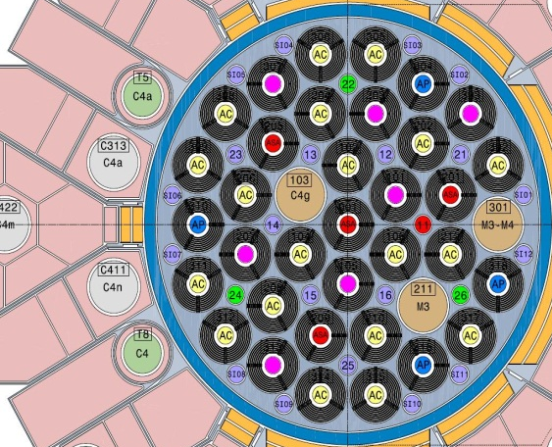
2. General figures of the JHR
Neutron spectra
In core and in reflector
In reflector (moving system)
Thermal flux
Fast flux
A large range of neutron fluxes and spectra
(and possible adaptation with « neutron filters »)
PAGE 12

Slide 13
3. Experimental capabilities of the JHR

Slide 14
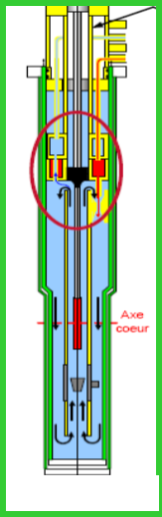
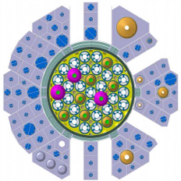
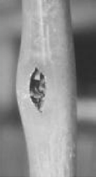
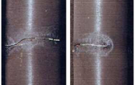

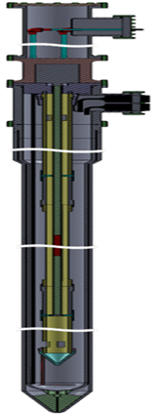
Hosting experimental systems (dedicated to LWR fuel testing)
3. Experimental capabilities of the JHR
LORELEI fuel testing under accidental conditions (LOCA)
ADELINE
For fuel testing under
off-normal conditions
Power transient,
post clad failure fuel behavior,
Lift-off experiment…
Source Term (FP releases)
Rod thermal-mechanical behaviour
Ballooning and clad burst (fuel relocation)
Corrosion at high temperature
Quenching and post-quench behaviour
MADISON
For fuel testing under nominal conditions
Available at JHR start-up
Available at JHR start-up
PAGE 14

Slide 15
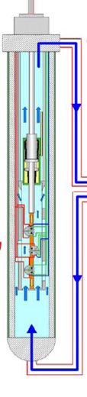
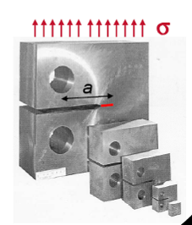

3. Experimental capabilities of the JHR
Hosting experimental systems (dedicated to LWR material testing)
OCCITANE
For pressure vessel steel testing
CALIPSO, MICA
For material testing
under high dpa
and accurate temperature control
(+ mechanical loading)
MICA Available at JHR start-up
- Irradiated material behaviour
tensile tests, resilience test (Charpy), crack propagation tests …..
Behaviour of Thermal affected zones
CLOE Corrosion loop
for “Zr alloy Corrosion” and “Irradiation Assisted Stress Corrosion Cracking”
29 octobre 2017
PAGE 15

Slide 16

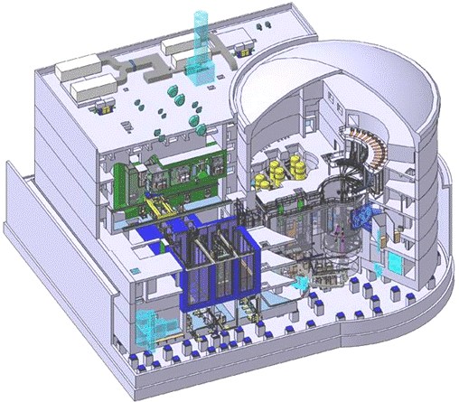
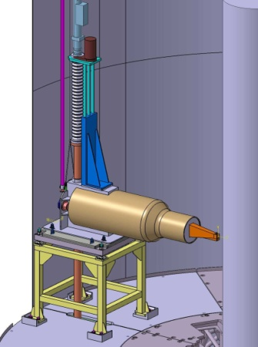
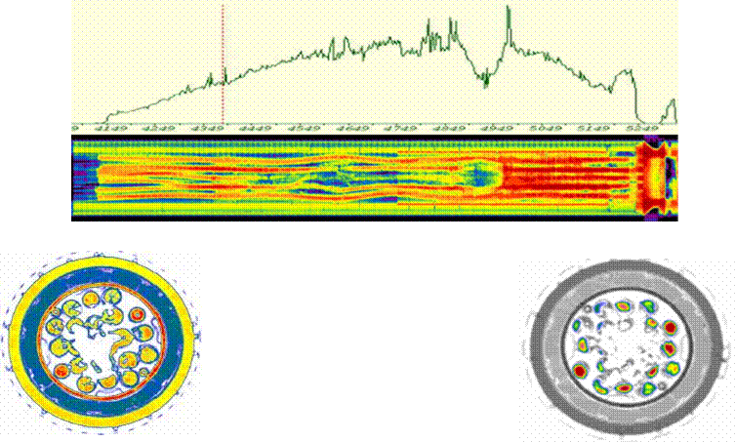
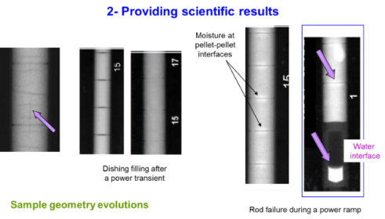
Non Destructive Examination (NDE) Benches
3. Experimental capabilities of the JHR
Test device
examination in pools
Sample examination
in hot cells
Neutron imaging system in reactor pool
Gamma and X-Ray tomography systems
Multipurpose test benches
Coupled X-ray & γ bench in reactor pool
Coupled X-ray & γ bench in storage pool
Neutron Imaging System
Coupled Gamma &X-ray bench
  Initial checks of the experimental loading
  Adjustment of the experimental protocol
  On-site NDE tests after the irradiation phase

Slide 17
4. JHR consortium and collaborations

Slide 18








4. JHR consortium and collaborations
JHR Consortium : economical model for investment & operation
  CEA = Owner & nuclear operator with all liabilities
  JHR Members owner of Guaranteed Access Rights
    (in proportion of their financial commitment to the construction)
  A Member can use totally or partly his access rights for implementing proprietary programs with full property of results and/or for participating to the Joint International Programs open to non-members
  Open to new member entrance until JHR completion
JHR Consortium current partnership: Research centers & Industrial companies
IAEC
Associated Partnership: JAEA
PAGE 18

Slide 19
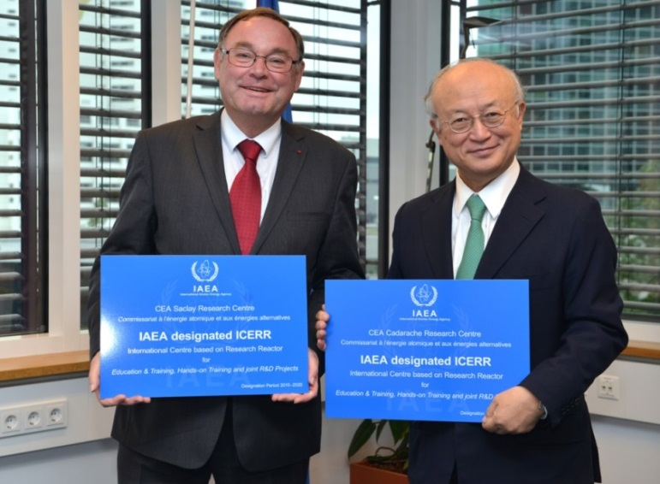

4. JHR consortium and collaborations
THE JHR AND ANCILLARY FACILITIES AS AN “ICERR”
  Objectives of the CEA-ICERR (IAEA Terms of Ref):
  Create international scientific networks
  Make available CEA facilities and experience to affiliates
  Lead innovative joint programs with shared results
  Enhance utilization of Research Reactors
  Host international scientists / engineers (visiting scientists, operators…)
  Provide “hands on” nuclear education “in the field”
Since CEA designation in September 2015, 6 Member States from the IAEA have signed an Agreement with CEA
  Strong CEA intention to welcome Junior and/or Senior Scientists, Nuclear Engineers, Operators, Safety Managers… within JHR teams for various topics (R&D programs, Hands-on training on equipment…)
PAGE 19

Slide 20
5. Status of the reactor construction

Slide 21
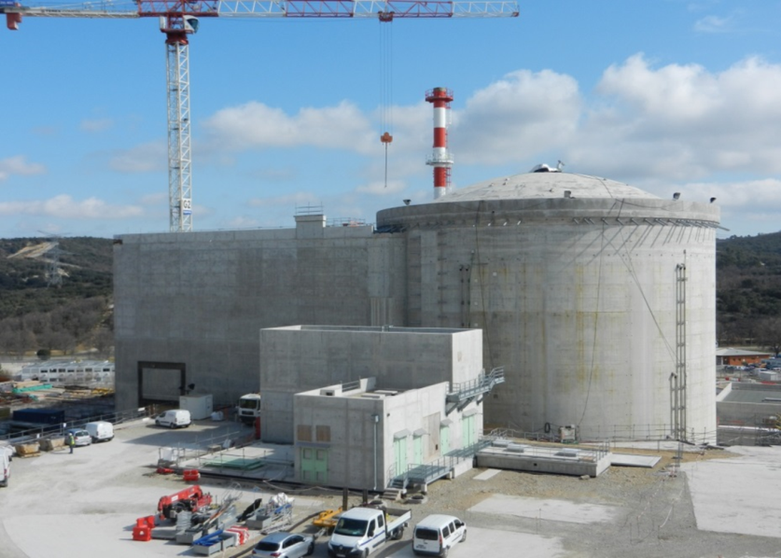
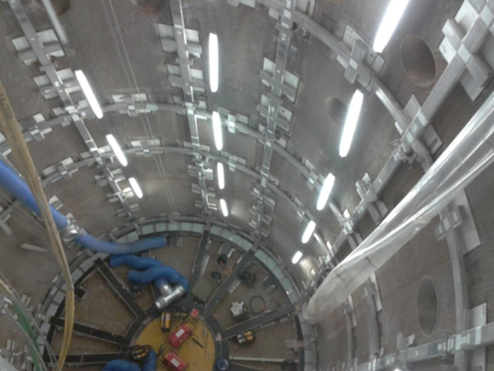
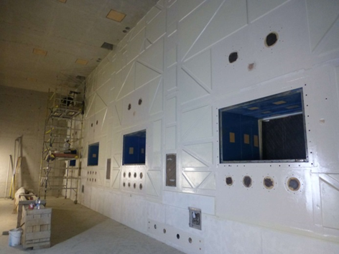
5. Status of the reactor construction
Civil work of Reactor Building and Auxiliary Unit Building nearly completed
Preparation for pool liner setting-up
Delivery of Hot Cells
end of 2016
(Czech partners)

Slide 22
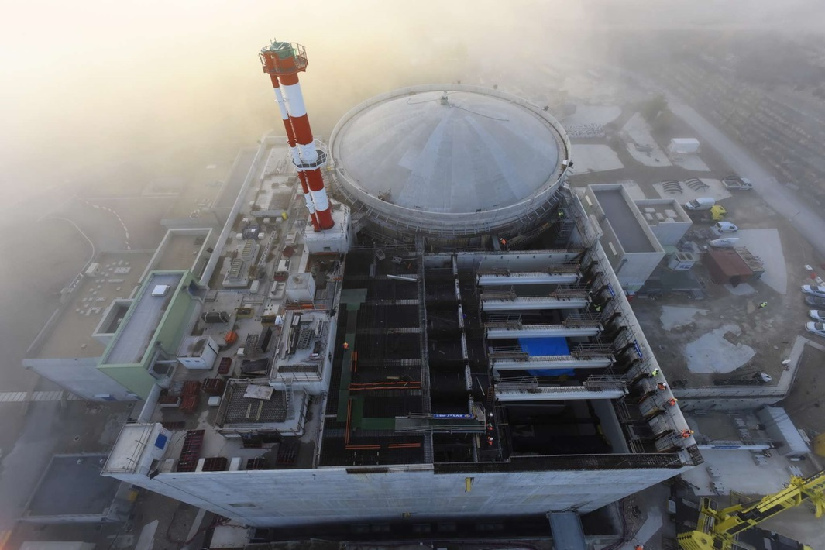
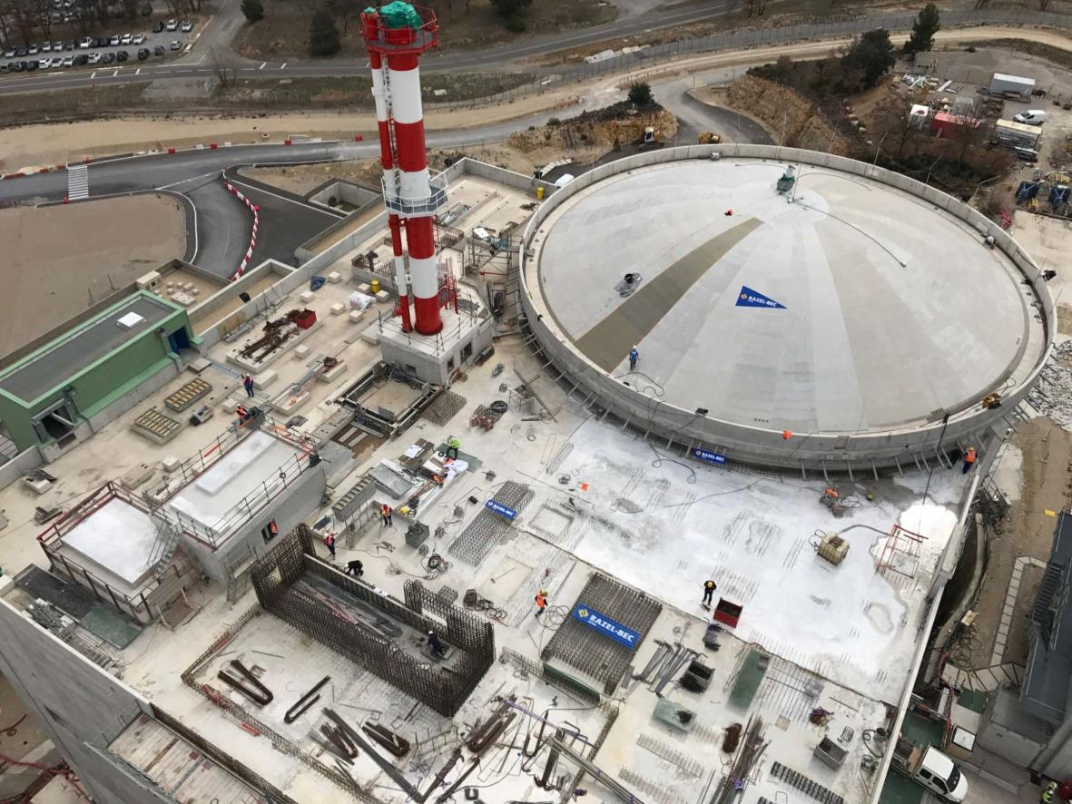
5. Status of the reactor construction
March 2017 : NUCLEAR UNIT CLOSURE
March 2017
December 2016
PAGE 22

Slide 23
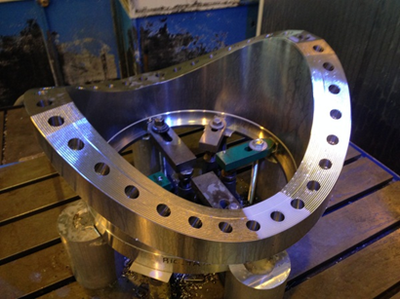
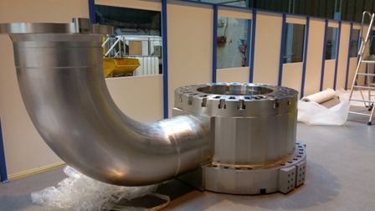
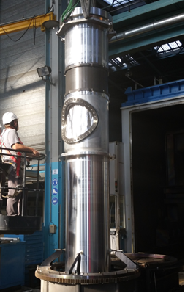
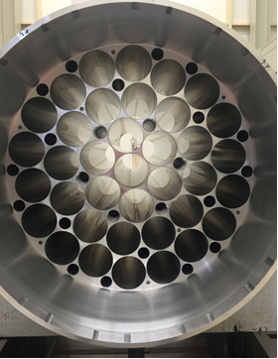
5. Status of the reactor construction
Core components
Main water box with primary system connection
Horse saddle flange
Last welding on the vessel
Electron beam welding
Rack for fuel elements
Heat Exchangers (Spanish partner)

Slide 24
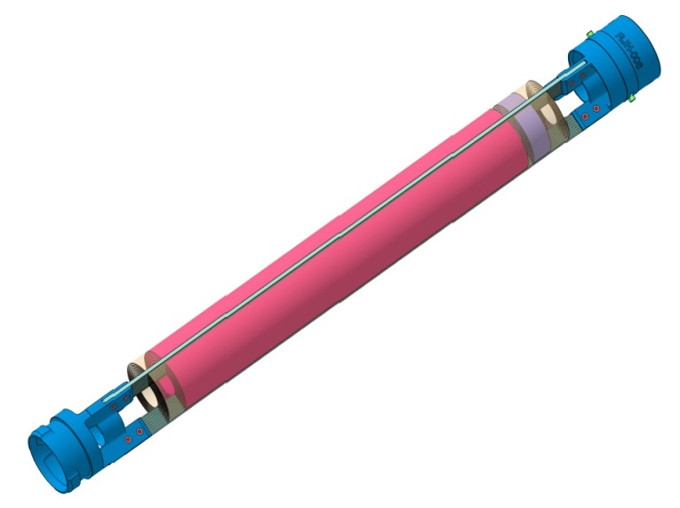
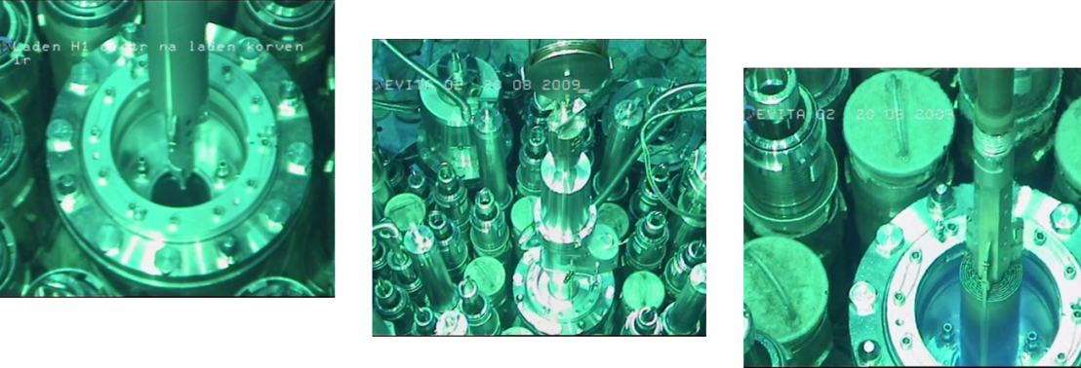
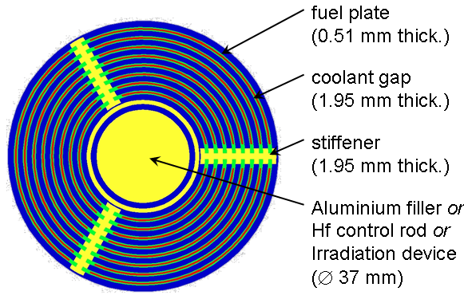
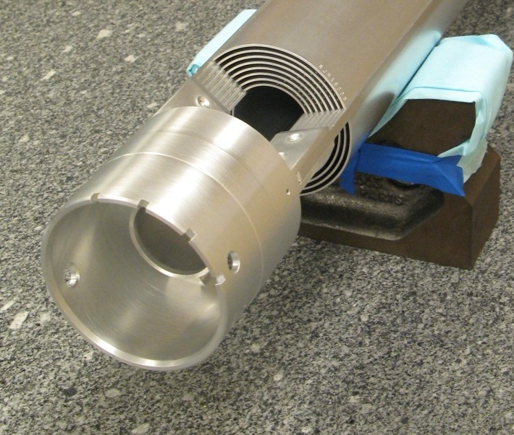
5. Status of the reactor construction
JHR Fuel qualification
(EVITA Program performed in BR2)
PAGE 24

Slide 25
6. The key-role of innovative instrumentation for the JHR

Slide 26
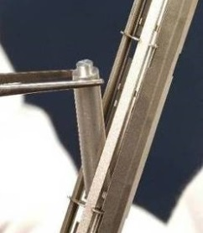
6. The key-role of innovative instrumentation for the JHR
Illustration of measurement needs for material testing
In-pile measurements are essential to:
Monitor the experiments
Objectives of irradiation tests :
Assess / verify / increase the precision of
behavior laws under irradiation
Studied property
(ex : fragility, cracking, corrosion, conductivity, etc.)
Influence parameter
(temperature, physicochemical conditions, etc.)
Integrated flux / dose
damages
→ All these parameters must be accurately measured !
Watch safety parameters
= check that some specified parameters stay in their acceptable range
(e.g. : temperature, pressure, etc.)
PAGE 26

Slide 27
6. The key-role of innovative instrumentation for the JHR
Main stakes for in-pile instrumentation
Radiation measurements
Physical parameter measurements
Reduction of uncertainties in experimental conditions
- Neutrons / gamma flux
- Neutron spectrum
- Neutron dose
Better characterization of thermo-hydraulic conditions
→ temperature field / fluid flows
Better knowledge of nuclear heating
→ design of experimental devices
Major stakes for JHR
Highly instrumented experiments
« Cook and look » →
Online measurement of experimental parameters
Material behavior
New materials, better representativeness
- Temperature
- Deformations (creep…)
Fuel improvement and qualification
- Fission gas release
- Pellet-cladding interaction
- Accidental conditions (LOCA)
Advanced in-pile instrumentation is necessary to answer needs coming from advanced simulation then enhance the quality of the future JHR experiments
PAGE 27

Slide 28
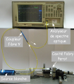


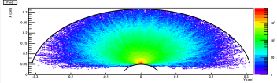
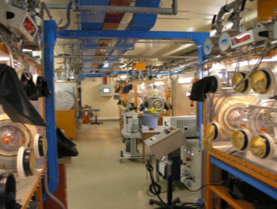
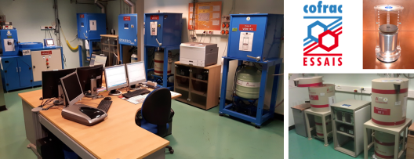
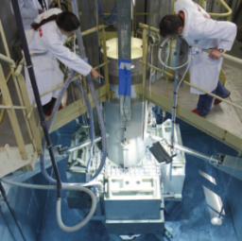
6. The key-role of innovative instrumentation for the JHR
Material resources and facilities
Development and test resources
Signal analysis laboratory
CEA-Tech Saclay
Optics laboratory
CEA Saclay
Metrology platform
CEA Cadarache
Sensor modelling platform
CEA Cadarache
Acoustics laboratory
IES Montpellier
Calorimetry laboratory
Aix-Marseille University
Manufacturing resources
Fission chamber manufacturing workshop
CEA Cadarache
MADERE dosimetry platform
CEA Cadarache
In-pile test resources
OSIRIS and ISIS reactors
CEA Saclay
BR2 and BR1 reactors (SCK•CEN Mol)
TRIGA reactor (JSI Ljubljana)
MARIA reactor (NCBJ Świerk)
ATR reactor (INL Idaho Falls)
MIT reactor (MIT Boston)…
MINERVE reactor
CEA Cadarache
Implementation (RJH)
CEA Cadarache
PAGE 28

Slide 29














4. JHR consortium and collaborations
Current collaborations for in-core instrumentation
In-pile optical measurements
Acoustic imagery
Activation dosimetry
Radiation and heating measurements
Low activity measurements
calibration,
inter-comparisons,
X spectrometry
SiC sensors
ZPR Instrumentation
LDCI
Acoustics
Nuclear heating
Neutron and gamma measurements
Neutron measurement and analysis
JSI
MTR Instrumentation
(LVDT, Corrosion)
MTR Instrumentation (optics, ultrasounds, fission chambers…)
PAGE 29

Slide 30

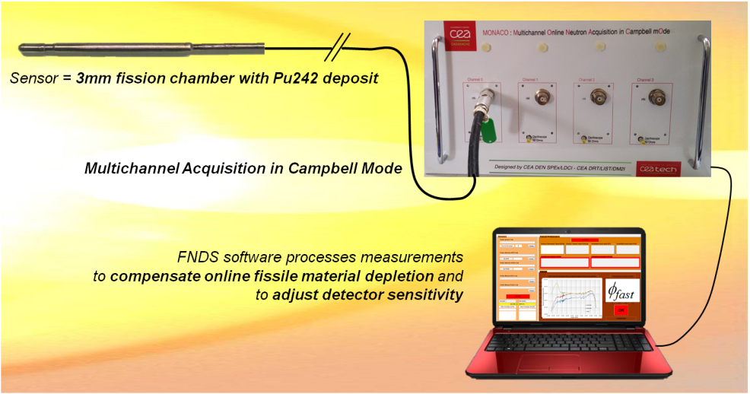
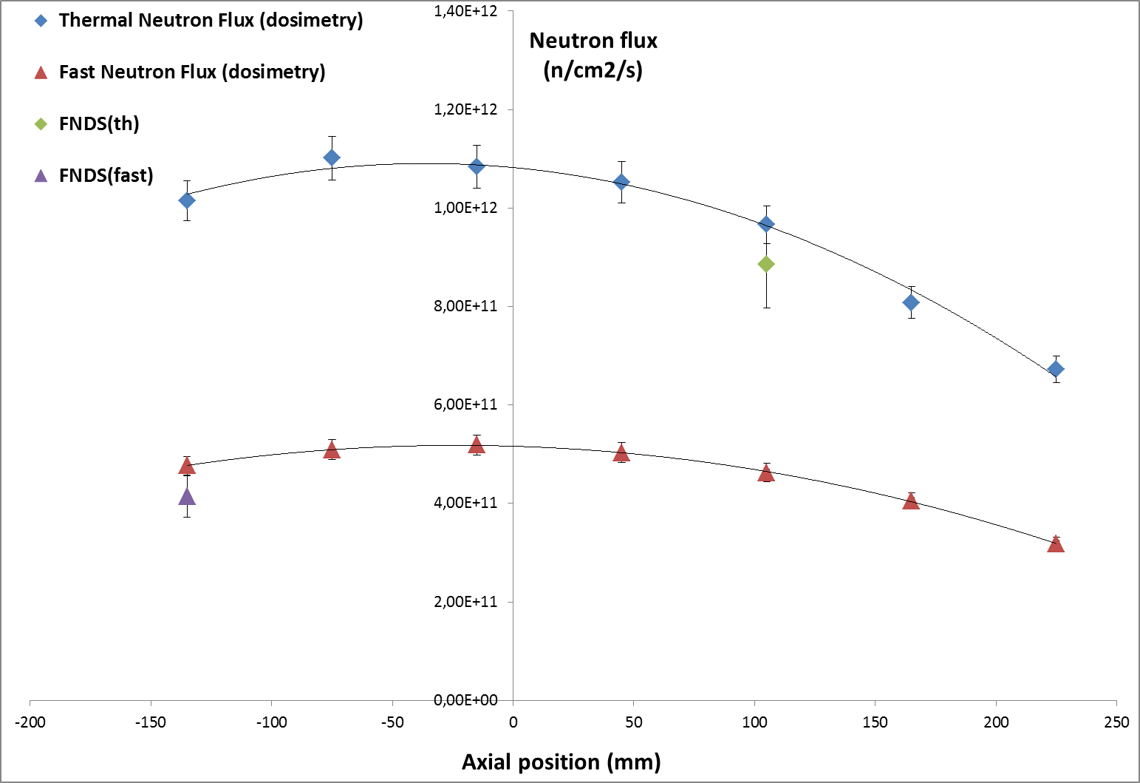
6. The key-role of innovative instrumentation for the JHR
Fast Neutron Detection System
FNDS is the first and unique acquisition system able to provide an online measurement of the fast neutron flux (E>1MeV) in typical MTR conditions
FNDS has been validated in 2015 after successive tests at the Belgium BR2 reactor and at the French ISIS reactor (FNDS signal was compared to reference thermal and fast neutron flux measurements using activation dosimeters)
→ FNDS proved its ability to measure online both thermal and fast neutron flux (consistency with activation dosimetry is better than 5%).
PAGE 30

Slide 31




6. The key-role of innovative instrumentation for the JHR
Fission gas analysis : Acoustic measurements
10-year development
Online measurement of the molar mass of the gas inside the fuel rod (→ fraction of released fission gas)
Operated successfully on a high burn-up MOX fuel rod in the REMORA-3 experiment (OSIRIS) & Excellent accuracy of the measurement (vs post-irrad. Meas.)
PAGE 31
PAGE 31

Slide 32


6. The key-role of innovative instrumentation for the JHR
MELODIE: Mechanical Loading Device for Irradiation Experiments
  Technical goals
  Study of LWR cladding irradiation creep
  Hoop stress 120 MPa, biaxiality ratio 0 to 1
  Biaxial online control of the stress
  Biaxial online measurement of the creep
  Why
  New technology for future instrumented experiments in the JHR
  Anisotropic material calls for complex experiments
  Cladding life is multiaxial because of the combination of FGR and PCMI
  First irradiation in Osiris performed in 2015 was very promising: optimization of the device is going-on
Creep rate @ 60 Mpa ≈ 4 µm/day
Creep rate @ 110 Mpa ≈ 8 µm/day
PAGE 32

Slide 33
Future MTR capabilities : Jules Horowitz Reactor
General conclusion
Material Testing Reactors remains key-tools in R&D support for nuclear power industry
Research Reactors are now more “costly machines” than in the past…
Considering the increasing complexity of the experiments (due to enhanced requirements from simulation) the use of international platform (as will be JHR) is recommended
Innovative in-core instrumentation is a key for the quality and attractiveness of future MTR experimental programs, together with Post-Irradiation Analysis capabilities
PAGE 33

Slide 34
Nuclear Energy Division
Reactor Studies Department
Experimental Physics Section
Instrumentation Sensors and Dosimetry Laboratory
French alternative energies and atomic energy commission
Cadarache | F-13108 Saint-Paul-lez-Durance | France
T. +33 (0)4 42 25 79 62 | F. +33 (0)4 42 25 78 76
Etablissement public à caractère industriel et commercial
RCS Paris B 775 685 019

