Slide 1



In-core Instrumentation for MTR Experiments
Jean-François VILLARD
French alternative energies and atomic energy commission
Nuclear Energy Division – Reactor Studies Department
Cadarache – F-13108 St Paul Lez Durance, France
Joint ICTP/IAEA Workshop “Research Reactors for Development of Materials and Fuels for Innovative Nuclear Energy Systems”
6-10 November 2017, ICTP - Trieste, Italy

Slide 2
In-core Instrumentation for MTR Experiments
Summary
General requirements
Conditions of measurement
Examples of in-core instrumentation :
3.1. Neutron and gamma flux
3.2. Temperature
3.3. Prospect : fiber optics
4. Review of MTR instrumentation around the World
PAGE 2

Slide 3
1. General requirements

Slide 4
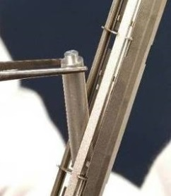
1. General requirements
Illustration of measurement needs for material testing
In-core measurements are essential to:
Monitor the experiments
Objectives of irradiation tests :
Assess / verify / increase the precision of
behavior laws under irradiation
Studied property
(ex : fragility, cracking, corrosion, conductivity, etc.)
Influence parameter
(temperature, physicochemical conditions, etc.)
Integrated flux / dose
damages
→ All these parameters must be accurately measured !
Watch safety parameters
= check that some specified parameters stay in their acceptable range
(e.g. : temperature, pressure, etc.)
PAGE 4

Slide 5
1. General requirements
Main stakes for in-core instrumentation
Radiation measurements
Physical parameter measurements
Reduction of uncertainties in experimental conditions
- Neutrons / gamma flux
- Neutron spectrum
- Neutron dose
Better characterization of thermo-hydraulic conditions
→ temperature field / fluid flows
Better knowledge of nuclear heating
→ design of experimental devices
Highly instrumented experiments
« Cook and look » →
Online measurement of experimental parameters
Material behavior
New materials, better representativeness
- Temperature
- Deformations (creep…)
Fuel improvement and qualification
- Fission gas release
- Pellet-cladding interaction
- Accidental conditions (LOCA)
PAGE 5

Slide 6
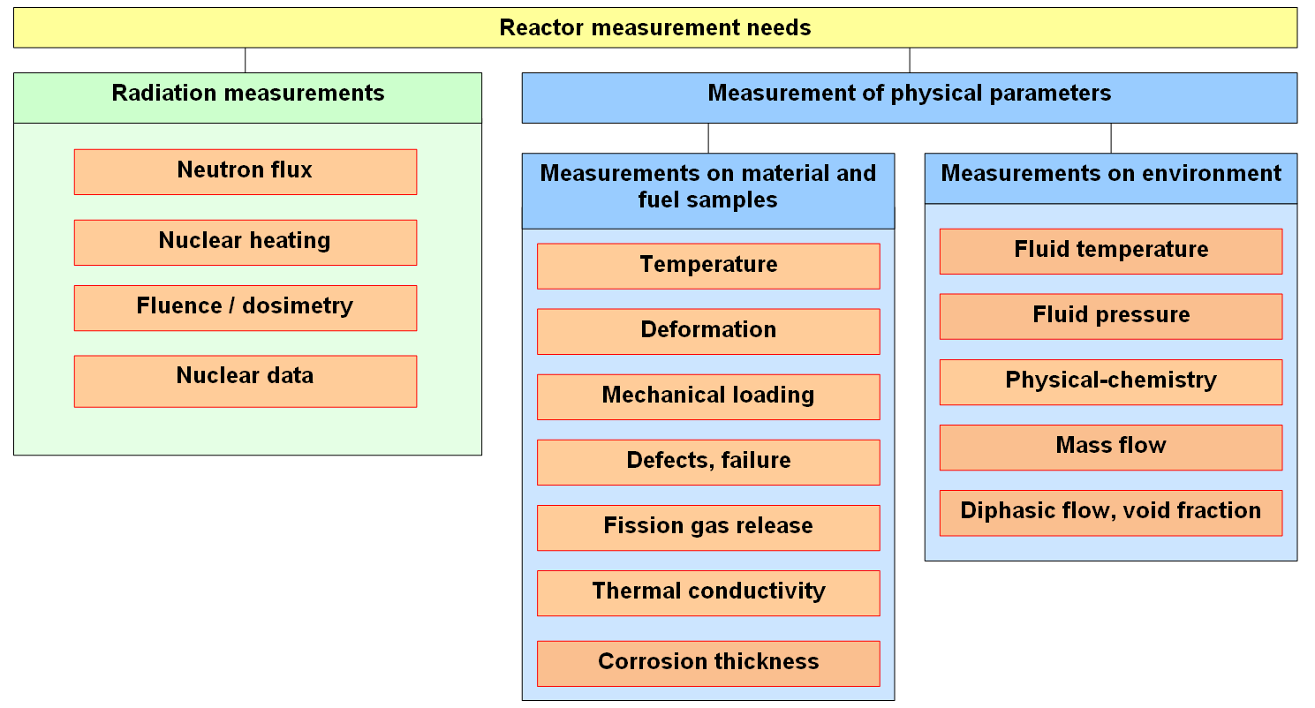
1. General requirements
Main reactor measurement needs and R&D programs
PAGE 6

Slide 7
1. General requirements
Ways to develop and qualify in-core instrumentation are changing
Yesterday:
Engineering approach
Mainly empirical characterization
Limited field of validation
Today:
Physician approach
Development and qualification of instrumentation modeling
Improvement in related nuclear data
Tomorrow:
Extended field of validation
Advanced signal analysis
PAGE 7

Slide 8
2. Conditions of measurement a. Physicochemical environment b. Effects of radiations c. Operational issues

Slide 9
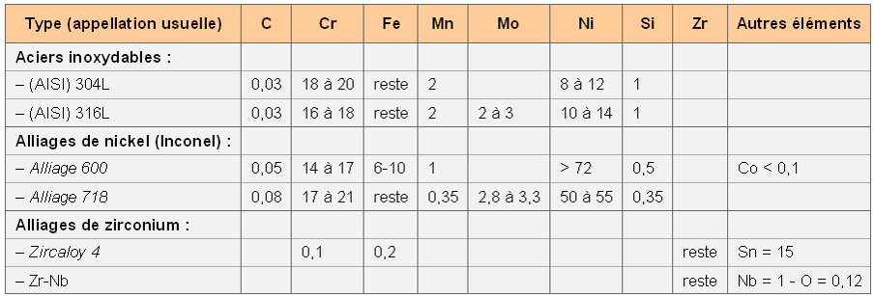
2. Conditions of measurement
a. Physicochemical environment
Physicochemical environment of in-core instrumentation
High temperature:
→ LWR conditions : 300-400°C continuous (up to 1200-1800°C in transients)
→ SFR conditions : 400-500°C continuous
→ HTR-VHTR conditions, materials for fusion : 800-1200°C continuous
Various media:
→ Pressurized water (+ bore and lithium)
→ Liquid metals (NaK, Na…)
→ High-temperature gas
Typical alloys used for in-core components
Type
Stainless steels
AISI 304 L
AISI 316 L
Nickel alloys (Inconel)
Alloy 600
Alloy 718
Zirconium alloys
Zircaloy 4
Zr-Nb
Others

Slide 10
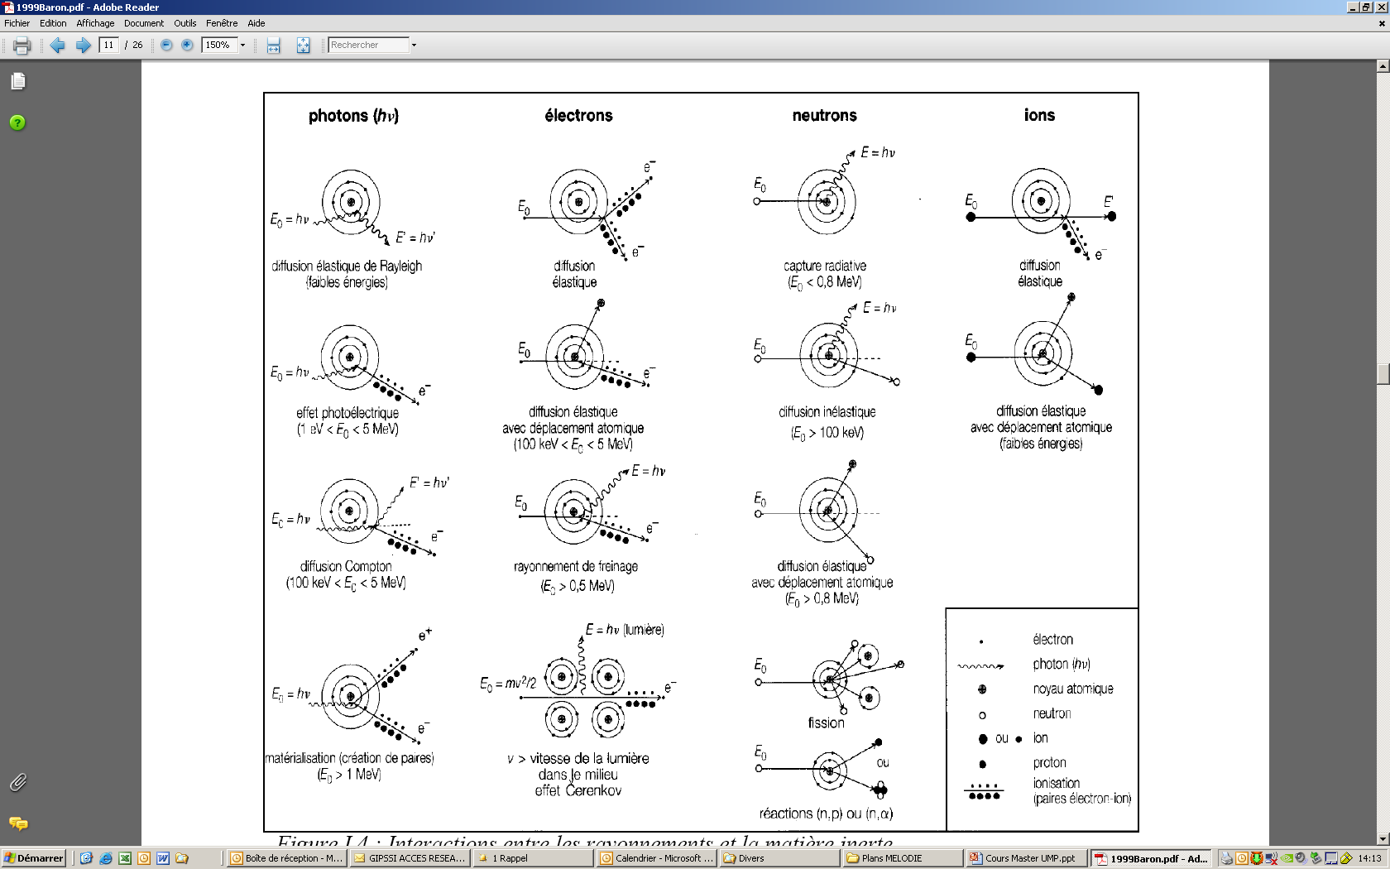
2. Conditions of measurement
b. Effects of radiations
Main effects of nuclear radiations on sensors
→ transmutations : composition changes
→ damages :
- alteration of electric insulators
- wires breaking
- change in mechanical properties
→ noise current (Compton and photoelectric effects)
→ heating
→ Precautions :
choice of materials
    form (metals, oxides, ceramics…)
    elements → nuclear properties
remove sensor from high-radiation areas when possible
in-situ calibration

Slide 11
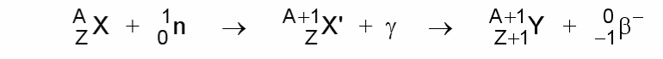
2. Conditions of measurement
b. Effects of radiations
Effects of transmutation on in-core sensors
Due to neutron capture
the material X disappears under irradiation : N(t) = N₀ e^{- σφt}
Illustration : effect on thermocouples
Change in wire composition
→ change in thermoelectric response = drift of the signal
Materials of standard thermo-elements | Si | Al | Cr | Mo | Ni | Pt | Mg | W | Re | Rh | Ir
(barn) neutron cross-section of the main isotope | 0,08 | 0,23 | 0,73 | 2,5 | 4,2 | 10 | 13,5 | 19,2 | 86 | 150 | 460

Slide 12
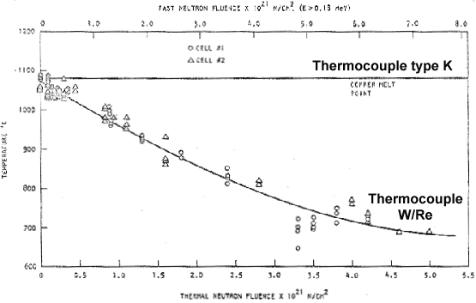
2. Conditions of measurement
b. Effects of radiations
Effects of transmutation on in-core sensors
Illustration : effect on thermocouples
Important effect on high-temperature thermocouples (W/Re, Pt/Rd…)
W → Re + Os (σ = 19 barn)
Re → Os (σ = 86 barn)
Rh → Pd (σ = 146 barn)
Drift of thermocouple signal under MTR irradiation
Type of thermocouple | Drift in MTR due to irradiation
K (Ni-Cr / Ni-Al) | Not significant
C (W-Re5% / W-Re26%) | -1°C / 2.10¹⁹ n/cm² (-0,9 °C / day)
S (Pt-Rh10% / Pt) | -1°C / 1,4.10¹⁹ n/cm² (-1,2 °C / day)

Slide 13
2. Conditions of measurement
c. Operational issues
Operational issues
High reliability (impossible maintenance on irradiated sensors)
High accuracy (higher scientific requirements. Example : in-core deformations must be measured with ~ µm accuracy)
Miniaturization (very narrow experimental devices : a few millimeters available for instrumentation)
Large distance between sensor and electronics (tens of meters)

Slide 14
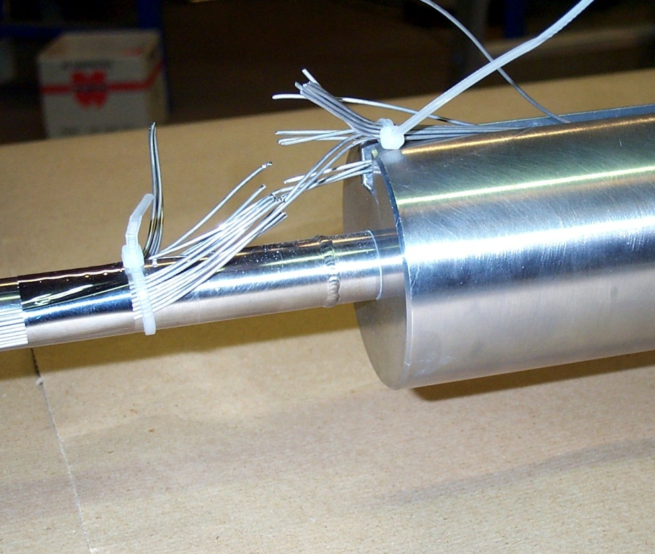
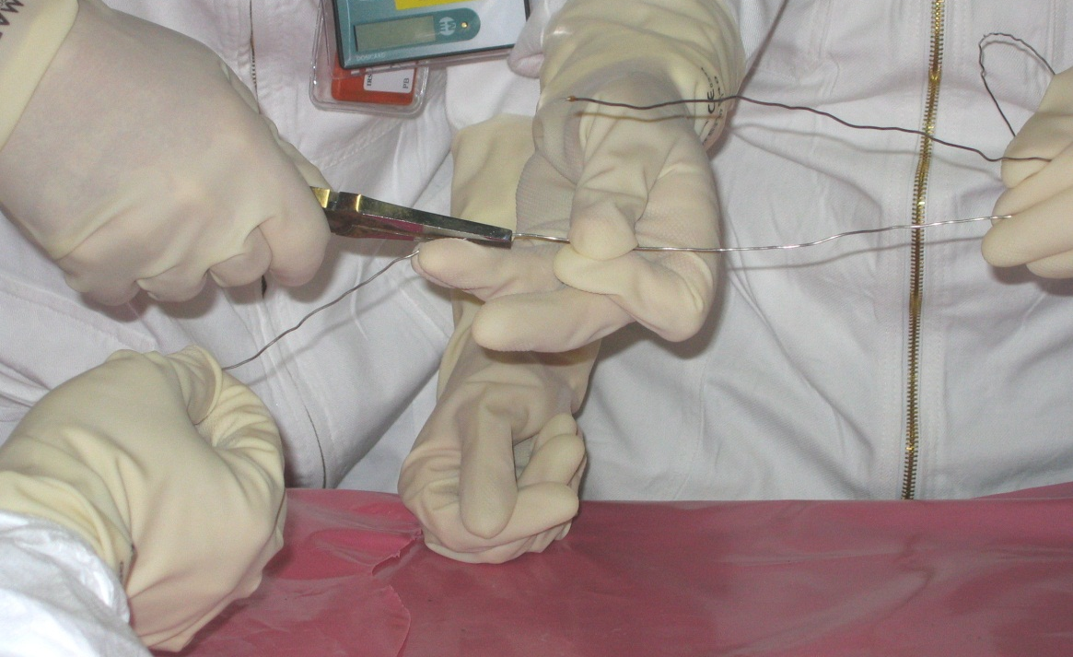
2. Conditions of measurement
c. Operational issues
Operational issues
Fragile instrumentation in difficult conditions of implementation
Repairing a mineral insulated cable
Damaged cables

Slide 15
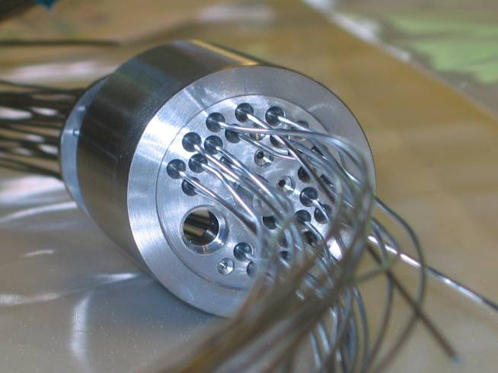
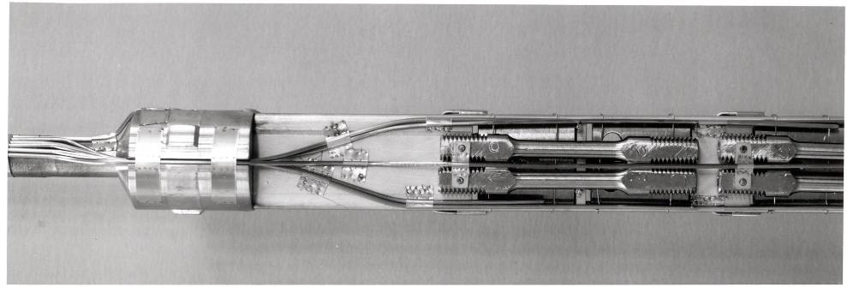
2. Conditions of measurement
Summary of in-core measurement conditions
High accuracy required to meet scientific and technical needs
High constraints related to reactor conditions:
  constraints due to irradiation (high neutron and gamma flux: material damages, composition changes, parasitic signal, etc.),
  constraints due to physicochemical conditions in experiments (high temperature, pressurized water, liquid metals, etc.),
  constraints due to integration (miniaturized sensors because of small size devices, long distance between sensors and electronics, etc.),
  constraints due to operation (high reliability requirements because of difficult or impossible maintenance or replacement of irradiated instrumentation).
Innovation is necessary !
PAGE 15

Slide 16
3. Examples of in-core instrumentation
3.1. Neutron and gamma flux

Slide 17
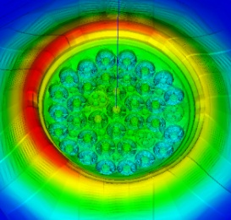
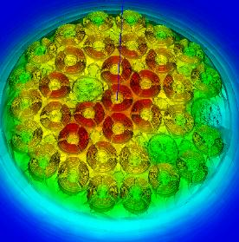
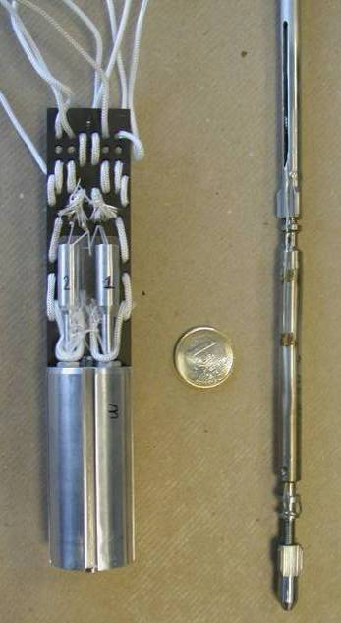
3. Examples of in-core instrumentation
3.1. Neutron and gamma flux
Neutron and gamma measurements
Objectives :
  To measure and reduce the uncertainties on:
  Thermal and fast neutron flux
  Gamma flux and nuclear heating
State-of-the-art :
Neutron flux:
  Activation foil dosimeters and wires (post-irradiation analysis) + Unfolding techniques
  Fission chambers for thermal and fast neutron
  Self Powered Neutron Detectors
Gamma flux:
  Ionization chamber
  Self Powered Gamma Detector (with Bi emitter)
Nuclear heating:
  Calorimeter (Gamma Thermometer and Differential Calorimeter)
Developments :
  Simulation tools for FC and SPND signal
  Dosimetry for epithermal flux
PAGE 17

Slide 18
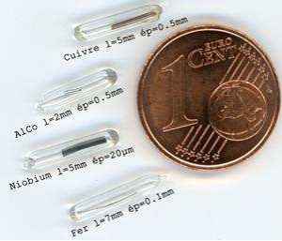
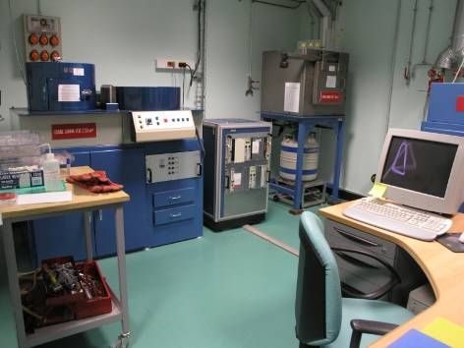
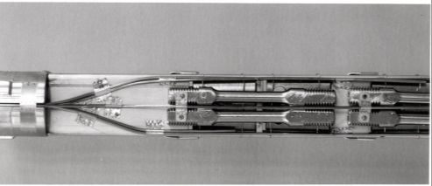
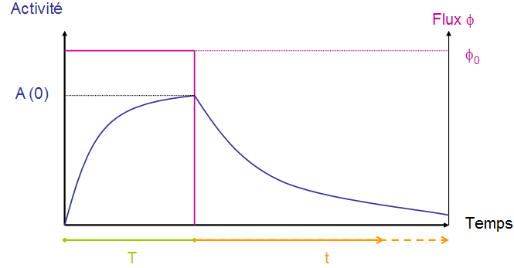
3. Examples of in-core instrumentation
3.1. Neutron and gamma flux
Activation dosimetry
= measurement of the radioactive activity of an irradiated material sample (dosimeter)
  Reference measurement for neutron flux and fluence
  High accuracy
  Selection of the neutron energy domain (thermal, epithermal, fast…)
  But post-irradiation analysis (no online measurement)
Dosimeters
Transportation
Irradiation
Activity measurement (spectrometry γ or X)
Irradiation history
geometry model
Cross section
Activity
Pic area
Reaction rate, fluence…
A(t) = Φ₀ . N₁ . σ₁ . (1- e^{-λ.T}) . e^{-λ.t}

Slide 19
3. Examples of in-core instrumentation
3.1. Neutron and gamma flux
Activation dosimetry
Short-life materials for dosimeters
Dosimeter
Reaction
Daughter
days
years
hours
hours
Spectrum energy area covered (MeV)
Dosimeter
Reaction
α
Daughter
days
hours
days
hours
hours
hours
Spectrum energy area covered (MeV)

Slide 20
3. Examples of in-core instrumentation
3.1. Neutron and gamma flux
Activation dosimetry
Long-life materials for dosimeters

Slide 21
3. Examples of in-core instrumentation
3.1. Neutron and gamma flux
Activation dosimetry
Illustration of dosimeter implementation : neutron fluence monitoring for material testing experiments
Dosimeter location
PAGE 21

Slide 22
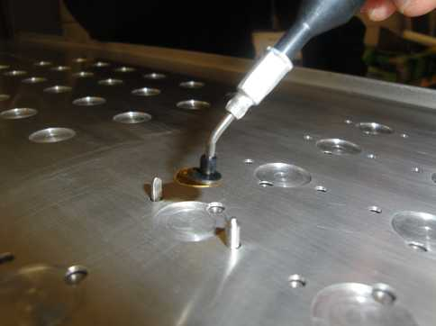
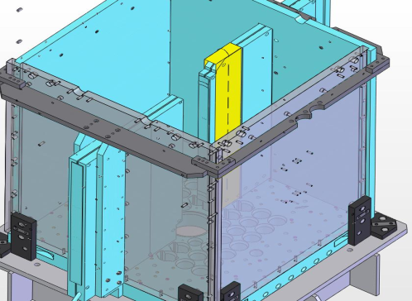

3. Examples of in-core instrumentation
3.1. Neutron and gamma flux
Activation dosimetry
Illustration of dosimeter implementation : flux mapping
PAGE 22

Slide 23
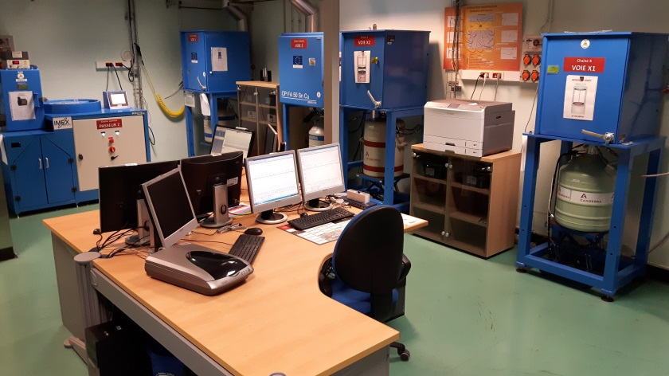
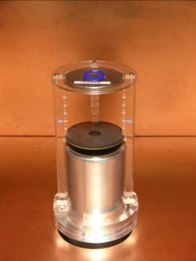
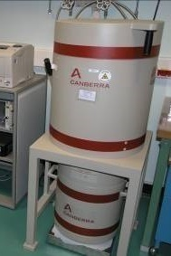
3. Examples of in-core instrumentation
3.1. Neutron and gamma flux
Activation dosimetry
Illustration of measurement facility : MADERE Platform at CEA Cadarache
    Performs reactor dosimetry measurements for research reactors and for the Surveillance Program of French PWRs
    → Measurement of γ and X activity of solid samples
    → Range : 0.1 Bq to 10⁸ Bq / dosimeter
    → Uncertainties : 1% à 5% (k=1)
PAGE 23

Slide 24
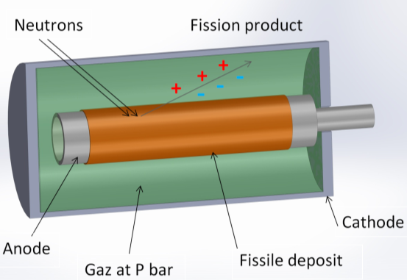
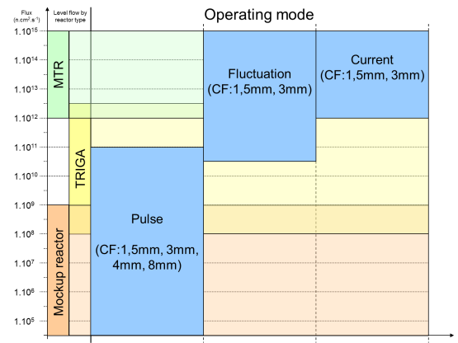
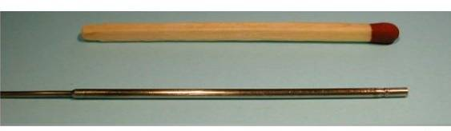
3. Examples of in-core instrumentation
3.1. Neutron and gamma flux
Fission chambers
Measurement of the current generated by fission reactions in a fissile material deposited on an electrode
An effective detector for measuring neutron flux
High linearity signal (10 decades)
Real-time online measurement
A modular detector
Choice of fissile isotope and mass deposit
Adaptation of technological parameters:
geometry, nature and pressure of gas...
A multi-information signal
Three operating modes depending on flux range
Neutron / gamma effective discrimination
PAGE 24

Slide 25
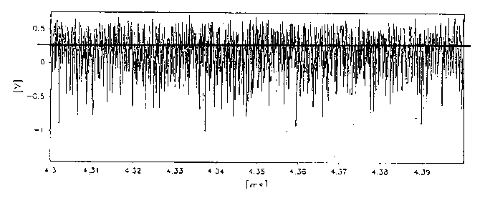
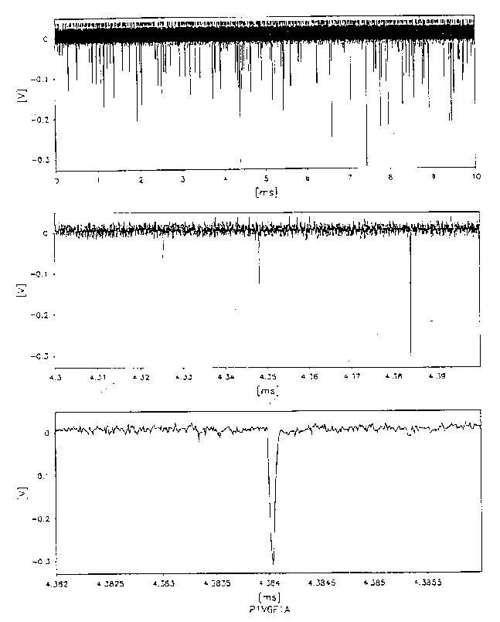
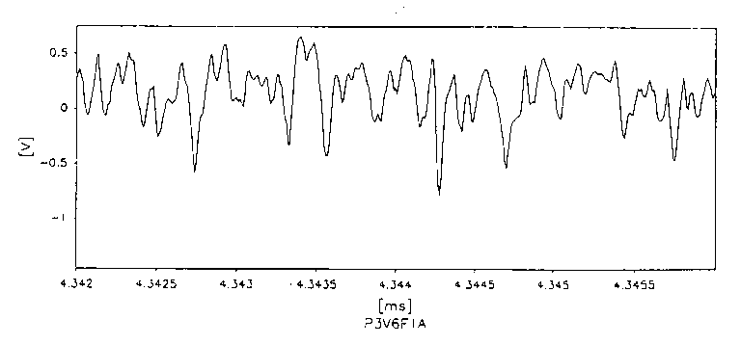
3. Examples of in-core instrumentation
3.1. Neutron and gamma flux
Fission chambers
Count rate
Current mode
> 5.10¹⁰ n.cm⁻².s⁻¹
threshold
Campbell mode (MSV)
V² = KNQ²
V² : variance
Q : mean charge per event (Qγ < Qn)
N : mean event rate
→ γ rejection
Pulse mode
γ suppression
Campbell mode reduces γ contribution by a factor of 50% / 0.6% = 83 for ²⁴²Pu FC
and 10.5% / 0.4% = 26 for ²³⁵U FC
PAGE 25

Slide 26
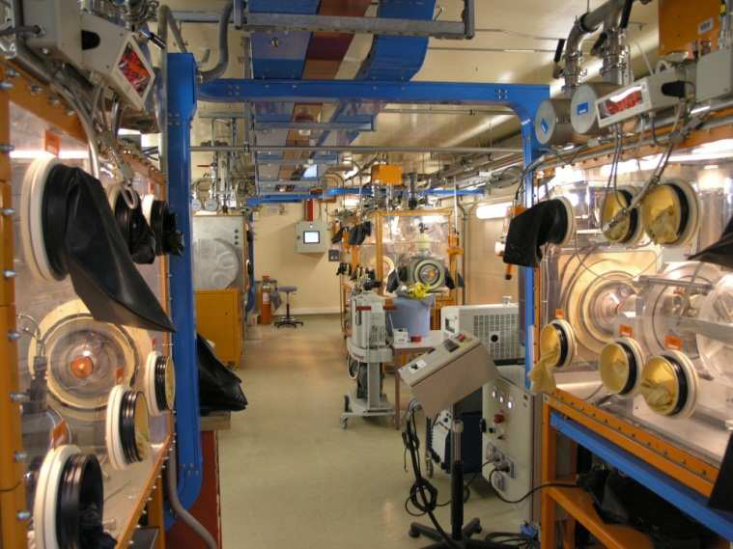
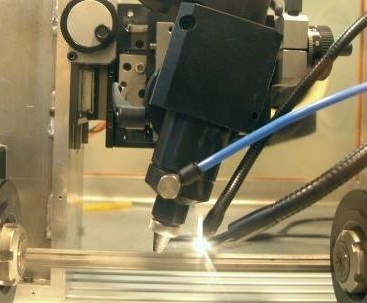
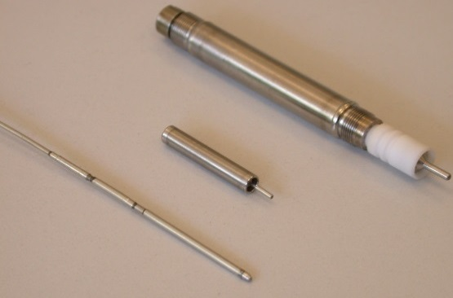
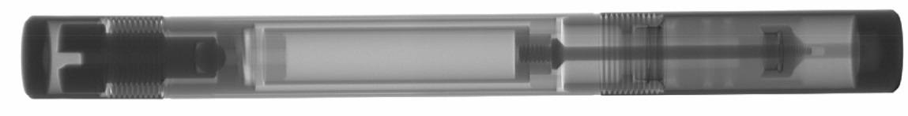
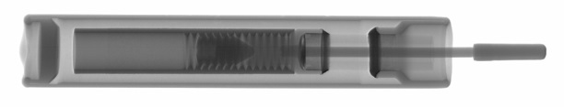
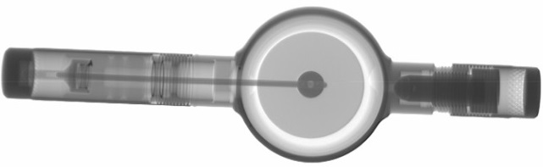

3. Examples of in-core instrumentation
3.1. Neutron and gamma flux
Fission chambers
Fission chamber manufacturing workshop at CEA Cadarache
  → Manufacturing specific fission chambers with various possible fissile deposits (mass/composition) : U, Pu, Th, Np, Am, Cm… and specific designs
  → Imagery and controls (RX)
PAGE 26

Slide 27
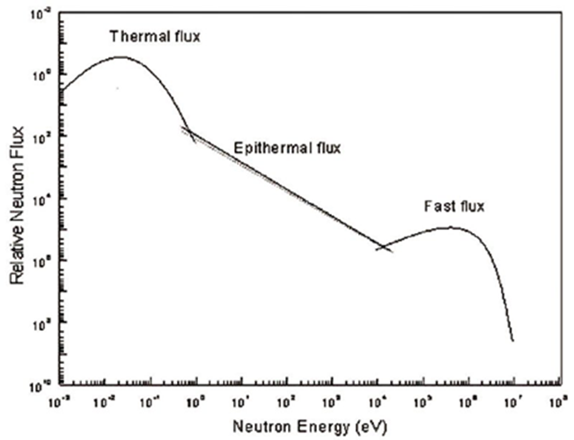
3. Examples of in-core instrumentation
3.1. Neutron and gamma flux
Application of fission chambers :
Fast Neutron Flux Measurement
Objective : Online measurement of the fast neutron flux (E>1 MeV) in typical Material Testing Reactor conditions : high neutron flux (10¹⁵ n.cm⁻².s⁻¹) generally dominated by thermal neutrons + high gamma flux
Principle : use of a specific fission chamber (²⁴²Pu) and specific acquisition and software
Parasitic reactions
Range of interest
Reaction of interest ²⁴²Pu fission
PAGE 27

Slide 28

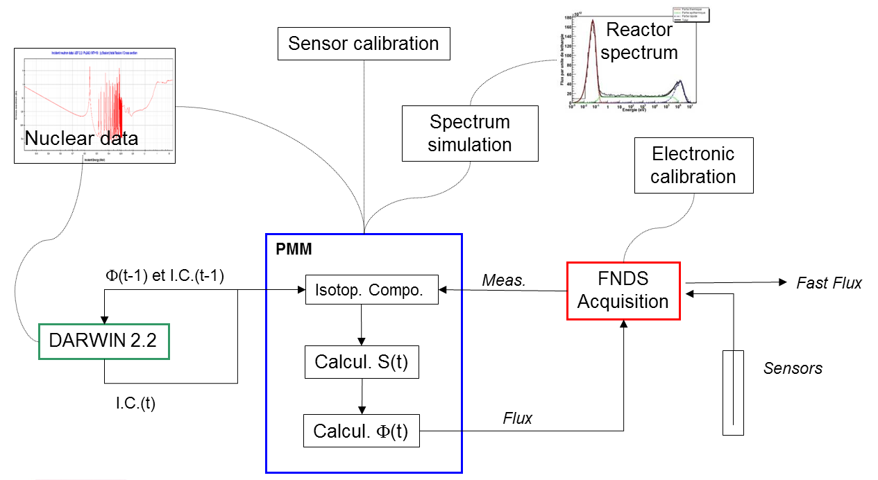
3. Examples of in-core instrumentation
3.1. Neutron and gamma flux
Application of fission chambers :
Fast Neutron Flux Measurement
2 patents
PAGE 28

Slide 29
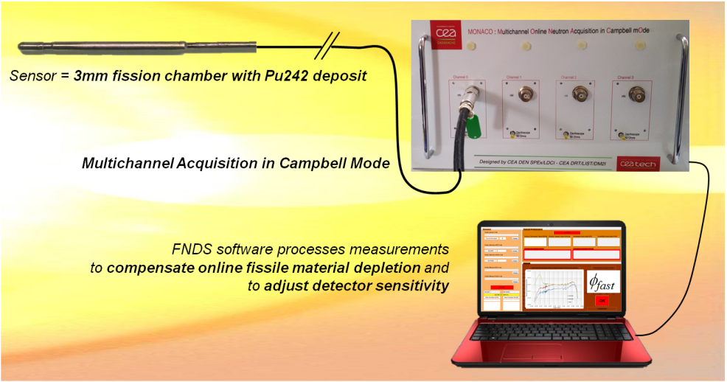
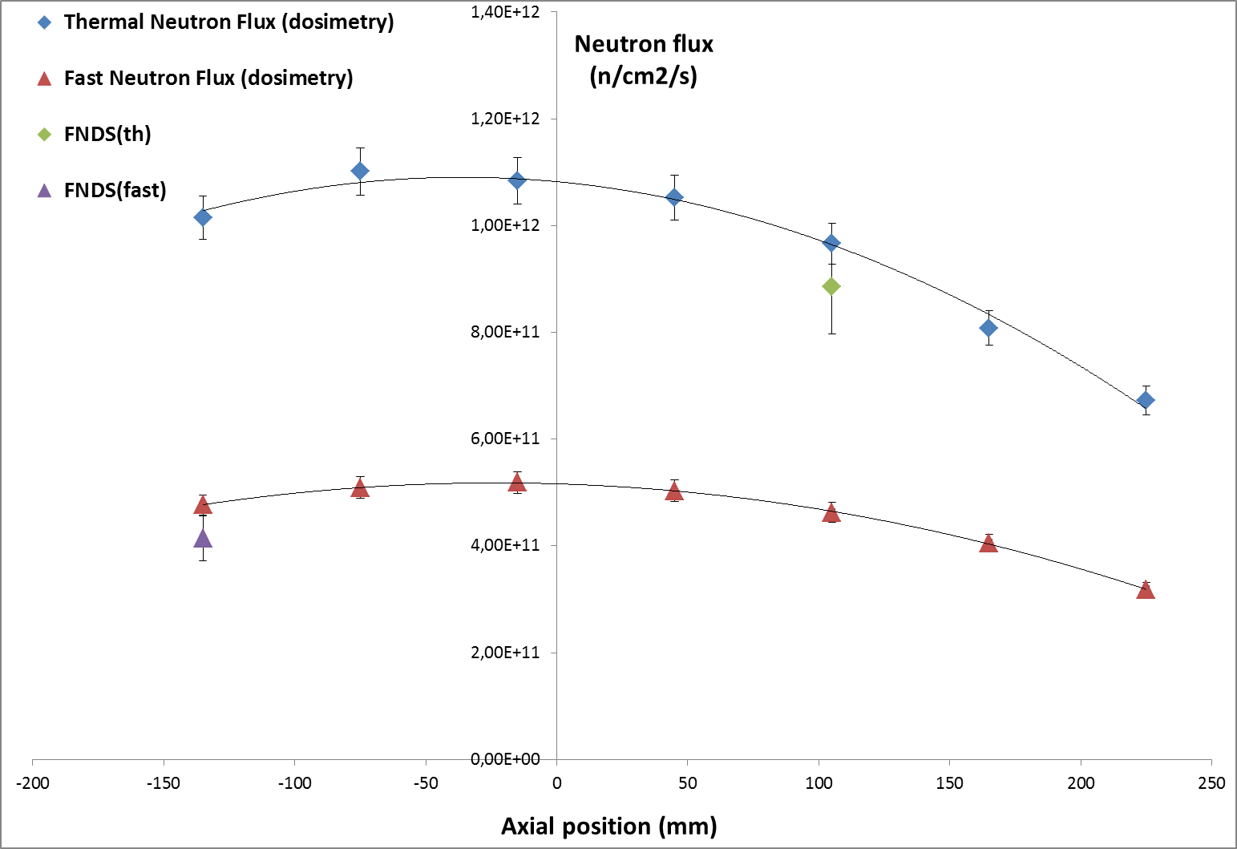
3. Examples of in-core instrumentation
3.1. Neutron and gamma flux
Application of fission chambers :
Fast Neutron Flux Measurement
FNDS is the first and unique acquisition system able to provide an online measurement of the fast neutron flux (E>1MeV) in typical MTR conditions
FNDS has been validated in 2015 after successive tests at the Belgium BR2 reactor and at the French ISIS reactor (FNDS signal was compared to reference thermal and fast neutron flux measurements using activation dosimeters)
→ FNDS proved its ability to measure online both thermal and fast neutron flux (consistency with activation dosimetry is better than 5%).
PAGE 29

Slide 30

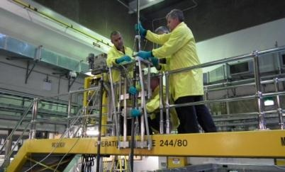
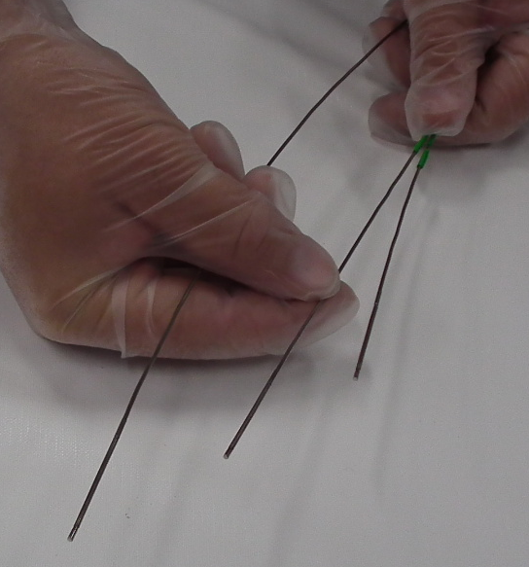
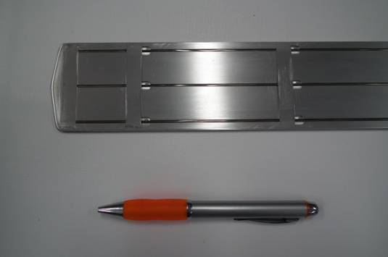
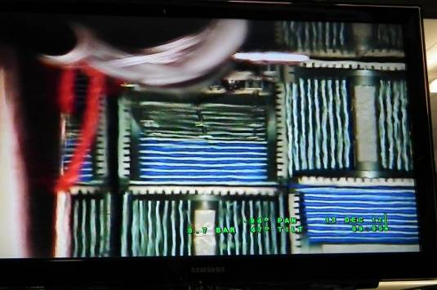
3. Examples of in-core instrumentation
3.1. Neutron and gamma flux
Application of fission chambers :
Neutron profile measurements between fuel plates in OPAL reactor (2013)
  3 x Ø1.5mm Fission Chambers
  Dedicated Experimental Rig:
  2mm thick aluminium plate attached to a 16 meter long pole
      Correct and repeatable positioning
      Precise manoeuvring within the core
  OPAL Reactor operated at stabilized power 100 kW
Ø1,5 mm Fission Chambers
for three simultaneous neutron profiles
Experimental rig
Insertion between fuel plates
PAGE 30

Slide 31
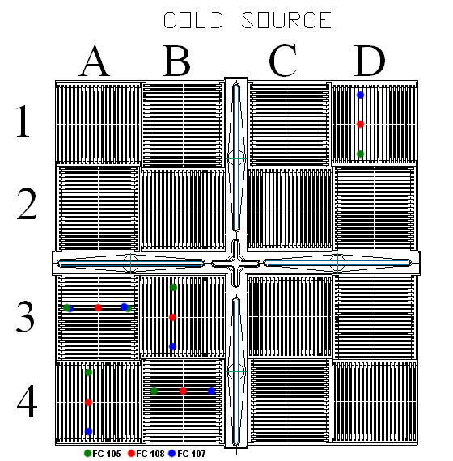
3. Examples of in-core instrumentation
3.1. Neutron and gamma flux
Application of fission chambers :
Neutron profile measurements between fuel plates in OPAL reactor (2013)
  400 measurement points
  Thorough investigation of 5 / 16 fuel assemblies:
      One complete quadrant
      One fresh fuel assembly in another quadrant
  Good agreement with expected neutron flux shapes
Measurement Locations
PAGE 31

Slide 32
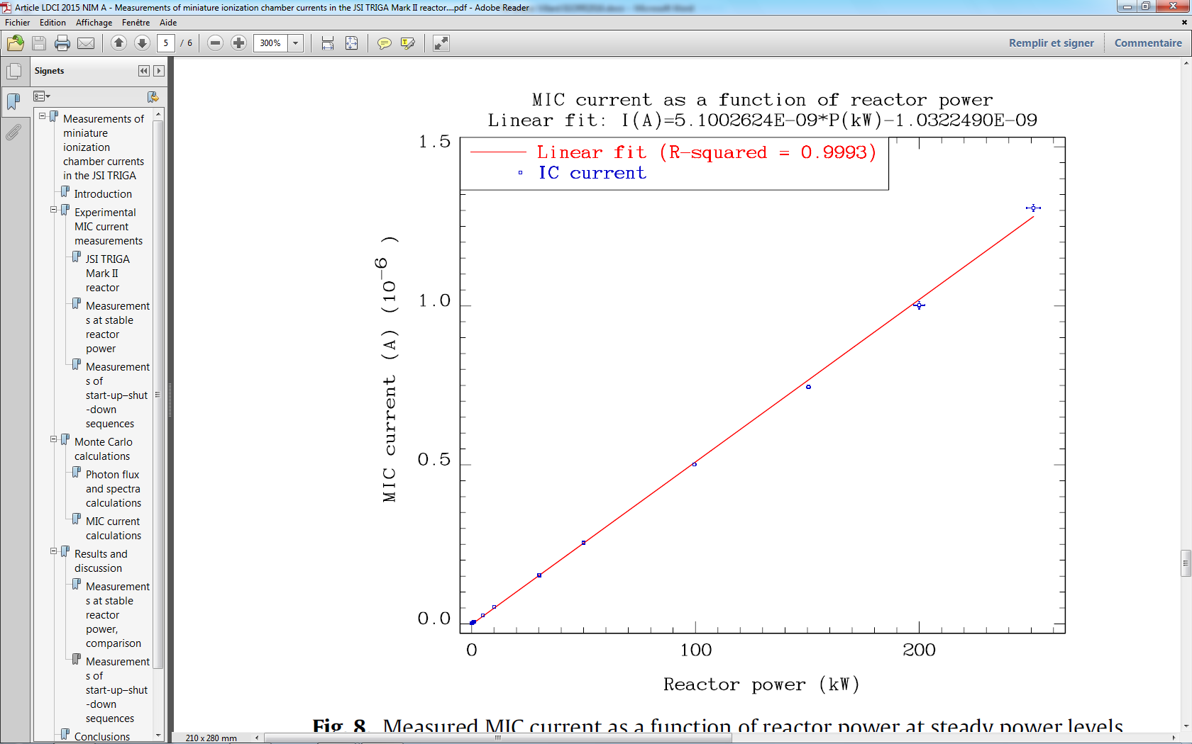
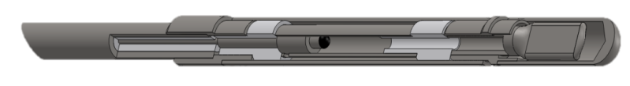
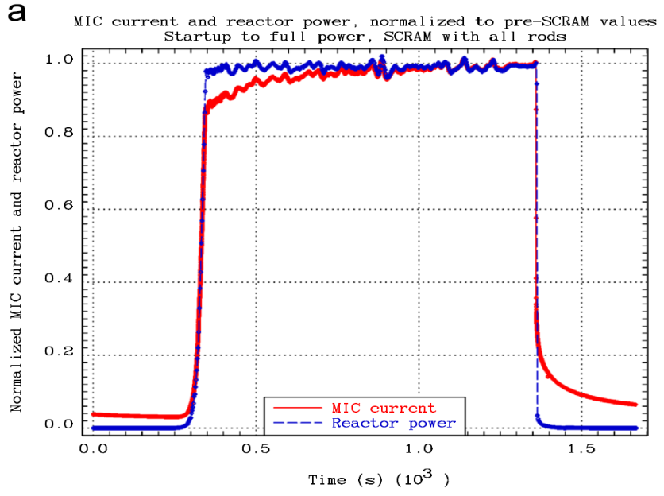
3. Examples of in-core instrumentation
3.1. Neutron and gamma flux
Miniaturized Ionization Chamber
        Pure gamma selectivity
        Large flux range and good linearity
        (up to a few 10¹⁴ γ.cm⁻².s⁻¹)
        Small dimensions (3mm diameter)
        No burn up effect
→ online and real-time evaluation of gamma flux over a wide range of flux level.
→ monitoring reactor power / following reactor SCRAMs (reactor shutdown with rapid insertions of control rods).
PAGE 32

Slide 33
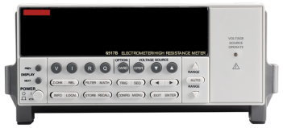
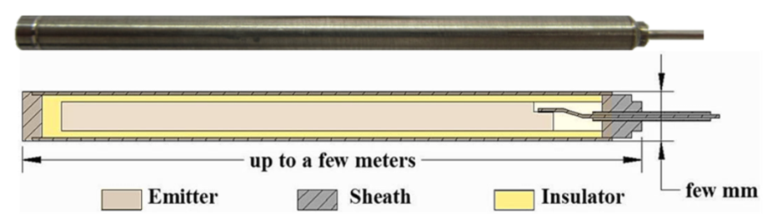
3. Examples of in-core instrumentation
3.1. Neutron and gamma flux
Self-powered neutron detectors (SPND)
  On line neutron or gamma flux measurement/monitoring
  Robust design and small dimensions
  Relatively easy implementation
  Acceptable cost
Basic Principle :
  Collection of electrons (or β⁻) created from nuclear interactions with materials
  (= self-generated current)
+
=
PAGE 33

Slide 34
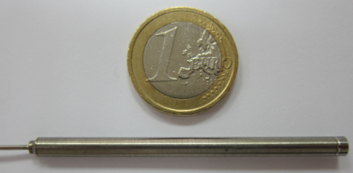
3. Examples of in-core instrumentation
3.1. Neutron and gamma flux
Self-powered neutron detectors (SPND)
Main Characteristics :
  Usual emitter materials: Ag, Rh, Co, V, Pt, Hf… Gd, Bi (gamma)
  Typical direct current for 2.10¹⁴ n.cm⁻².s⁻¹: Ag ~ 0,8 mA , Rh ~ 1,6 mA
  Saturation time: from 30 ms to 30 min
  Depletion for 2.10¹⁴ n.cm⁻².s⁻¹: Ag ~ 3%/20 days, Rh ~ 5%/20 days
  Not a selective sensor : thermal and epithermal neutron sensitivity (+ gamma)
  Usual geometries:
Sensitive length from 1 to 10 cm
Overall diameter from 1,5 to 4 mm
Typical cable length from 10 to 20 m
Usual insulator material: MgO ou Al₂O₃
Precautions :
  Emitter depletion to be calculated at all time for (n,β⁻) detectors (irradiation history is necessary)
  Possible weak signal → measurement precautions ( < 1 nA for low reactor power)
  Correction factors (cable, gamma contribution,...) to be mastered
  Output signal is integral; processing not straightforward
  → A multistep Monte Carlo calculation model has been developed and qualified for SPND signal analysis
PAGE 34

Slide 35
3. Examples of in-core instrumentation
3.2. Temperature

Slide 36
3. Examples of in-core instrumentation
3.2. Temperature
Temperature measurements
Objectives :
  Online measurement of materials or fuels temperature
  Typical range : 200-400°C (PWR materials) up to 1200°C (fuel)
  1000-1600°C for transient / study of incidental conditions
State-of-the-art :
  MIMS thermocouples : type K, N, C
  Expansion thermometers (LVDT)
  Melt wires, paint spots and SiC monitors (post-irradiation analysis)
Developments :
  High-temperature doped Mo/Nb alloy thermocouples
  In-situ calibration of thermocouples :
    Noise thermometry
    High-temperature fixed-point μ-cell
  Ultrasonic sensors
  Infrared pyrometer
  Distributed temperature measurements with Optical Fibers
PAGE 36

Slide 37
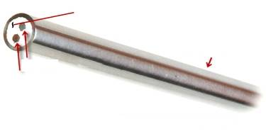
3. Examples of in-core instrumentation
3.2. Temperature
Thermocouples
Principle : Seebeck effect
An electromotive force is generated in an open circuit made of 2 different conducting materials, when their junctions are at different temperatures
Characteristics of in-core thermocouples :
Couples :
type K or type N (up to 1100 °C depending on wire diameter)
type C (fuel centerline temperature, for short irradiation time)
Sheath : Stainless steel (304L, 316L, 347)
Insulator : Al₂O₃, MgO, HfO₂
Standard sheath diam. : 1 mm
Standard wire diam. : ~ 0,2 mm
Hot junction insulated from sheath
Length : tens of meters
Mineral insulation
Metallic sheath
Thermoelectric wires
PAGE 37

Slide 38

3. Examples of in-core instrumentation
3.2. Temperature
Thermocouples
Examples of implantation in MTR experiments
ERABLE sample holder
Tensile test specimens
CT specimens
Thermocouples

Slide 39



3. Examples of in-core instrumentation
3.2. Temperature
Thermocouples
Examples of implantation in MTR experiments
CARDINAL sample holder
Thermocouples
Location of specimens
for creep or growth study

Slide 40


3. Examples of in-core instrumentation
3.2. Temperature
Thermocouples
Examples of implantation in MTR experiments
for fuel centreline temperature measurements
Drilled pellets

Slide 41

3. Examples of in-core instrumentation
3.2. Temperature
Irradiation device structure
Expansion thermometer
Fuel rod head plug
Plenum spring
Measures the expansion of a metallic rod
+ robust
+ suitable for very high temperatures
integrated temperature
very intrusive
Fuel rod
Tungsten rod (dia. 1,5mm)
Fuel rod bottom plug
Core support
Magnetic core
Elongation sensor (LVDT)

Slide 42


3. Examples of in-core instrumentation
3.2. Temperature
Ultrasonic sensors
Measures the acoustic wave velocity in a metallic rod or wire
Notches → wave reflection (echoes)
    Detection of acoustic wave velocity changes between notches
→ High-temperature measurements (> 2000°C)
→ Distributed measurements

Slide 43

3. Examples of in-core instrumentation
3.2. Temperature
Melt wires
Based on the detection of wire melting
→ Easy implementation (no cable)
But - post-irradiation measurement
- only indicates that melting temperature has been reached

Slide 44
3. Examples of in-core instrumentation
3.3. Prospect : fiber optics

Slide 45




3. Examples of in-core instrumentation
3.3. Fiber optics
Recent results : new fibers can survive in-core
Example : COSI experiment (OSIRIS reactor, France – 2006)
Irradiation of 12 recently developed optical fibers
Location of the tested fibers
emission
reception
92 days of reactor operation
Dose > 1E20 n_{fast}/cm⁻²
> 16 GGy

Slide 46


3. Examples of in-core instrumentation
3.3. Fiber optics
Recent results : new fibers can survive in-core
Some results from COSI experiment
Favorable spectral region in the 800-1200 nm range
RIA measured losses < 10 dB → suitable multimode and single mode fibers exist for in-core applications
Better choose measurement systems that do not rely on light intensity
→ interferometry (Fabry-Perot, Bragg gratings…)

Slide 47




3. Examples of in-core instrumentation
3.3. Fiber optics
Example of fiber-based in-core sensor : optical extensometer
Nuclear-grade elongation Fabry-Perrot type sensors
Adaptation to high T (400°C), with HT resistant fiber (Cuball, Al, Au coating)
Better sensor-sample sealing
Increased accuracy (1µm/100µm) and temperature compensation
→ Low drift at high temperature and high flux
PAGE 47

Slide 48



3. Examples of in-core instrumentation
3.3. Fiber optics
In-core optical measurements
Fabry-Perot sensor is now in a phase of industrial transfer
Other developments : Bragg Grating sensors
= distributed measurements of temperature / deformation
Unstressed fiber
stressed fiber
Spectral shift
Wavelengh
Bragg gratings
On-going tests at the MITR
Scheduled tests at the ATR and BR2
PAGE 48

Slide 49
4. Review of MTR instrumentation around the World

Slide 50

4. Review of MTR instrumentation around the World

Slide 51

4. Review of MTR instrumentation around the World

Slide 52

4. Review of MTR instrumentation around the World

Slide 53
Nuclear Energy Division
Reactor Studies Department
Experimental Physics Section
Instrumentation Sensors and Dosimetry Laboratory
French alternative energies and atomic energy commission
Cadarache | F-13108 Saint-Paul-lez-Durance | France
T. +33 (0)4 42 25 79 62 | F. +33 (0)4 42 25 78 76
Etablissement public à caractère industriel et commercial
RCS Paris B 775 685 019

