Slide 1
Eigenvalue Problems in Three-dimensional Random Media Andrea Zoia, Coline Larmier, Fausto Malvagi CEA/Saclay
ICTT2017 Monterey|
Andrea ZOIA| DEN/DANS/DM2S/SERMA/LTSD
October 16-20th 2017

Slide 2
Outline
Eigenvalue problems in random media
Stochastic tessellations
Analysis of fuel assemblies
Perspectives

Slide 3
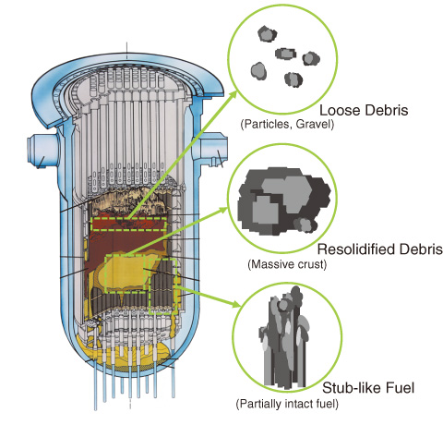
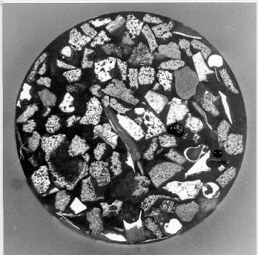
CONTEXT AND MOTIVATIONS
Analysis of re-criticality probability following severe core accidents
Fuel degradation:
melting and solidification
random configurations
TMI corium sample

Slide 4
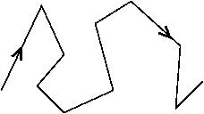
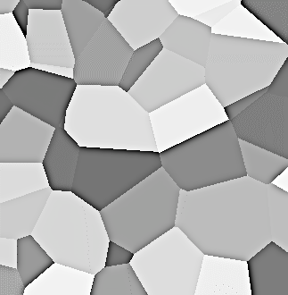
NEUTRON TRANSPORT IN « RANDOM » MEDIA
The randomness of a medium is measured w.r.t. neutron transport
Define :
λ = 1 / Σ = neutron mean free path
Λ = typical disorder size (correlation length) :
average size of homogeneous regions
λ
Λ
Three possible regimes :
Macroscopically heterogeneous medium
(homogeneous « by blocks »)
Λ
Λ << λ
Λ ≈ λ
Λ >> λ
Microscopically
homogeneous medium
(« atomic mix »)
Microscopically heterogeneous medium
Disorder can be described by probabilistic models

Slide 5
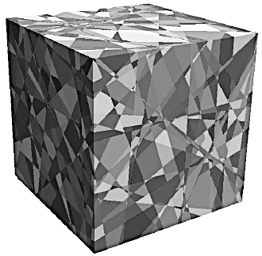
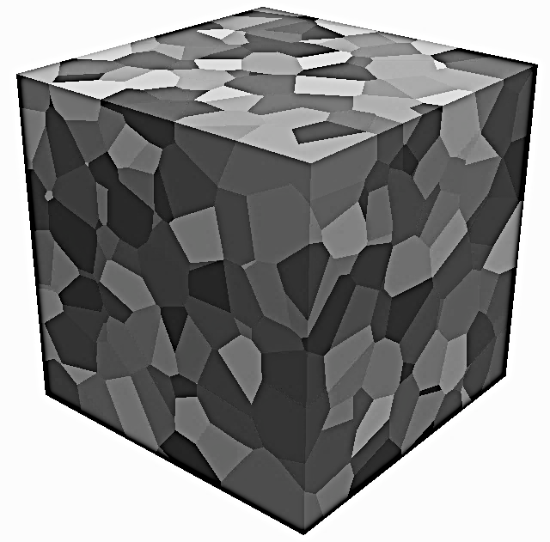
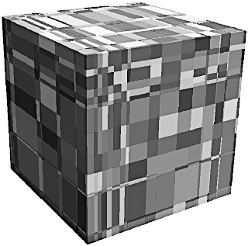
STOCHASTIC TESSELLATIONS FOR CRITICALITY PROBLEMS
Stochastic tessellations [Miles, Santalo] are a convenient model for disorder
Idea: partition a d-dimensional region according to a given probability law
Poisson tessellations
Random hyper-planes
Markov property
Voronoi tessellations
Poisson point process
Voronoi diagrams
Box tessellations
Poisson point process
Parallel hyper-planes

Slide 6
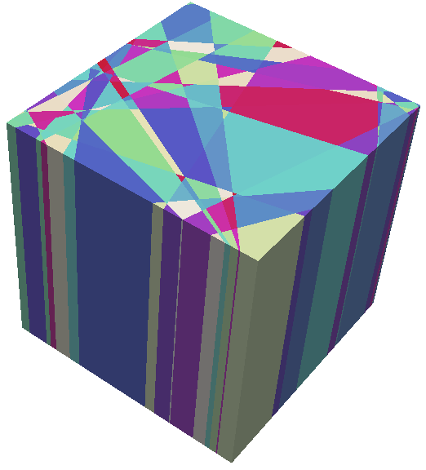
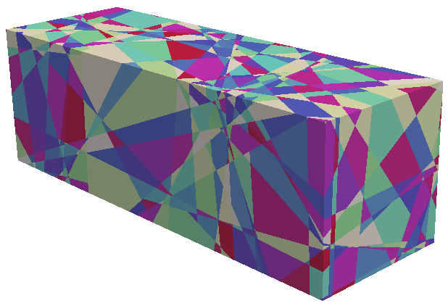
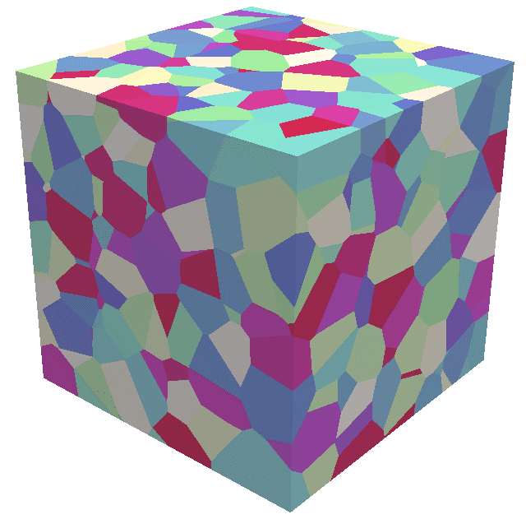
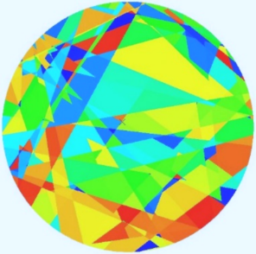
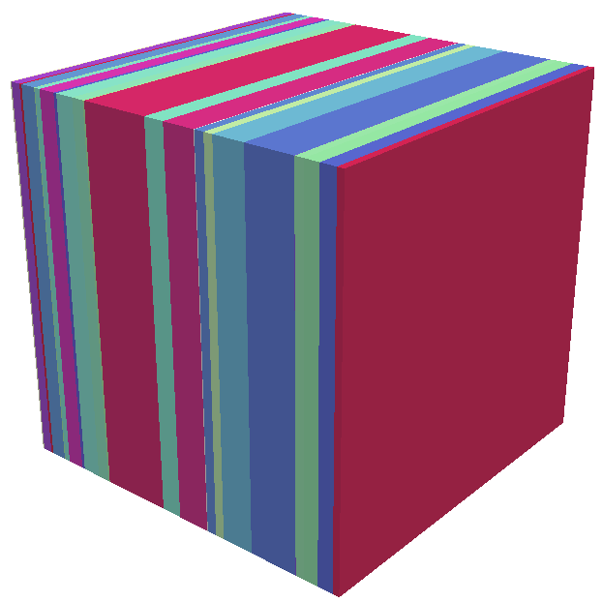
NUMERICAL TOOLS
Poisson (Markovian) tessellations in eigenvalue problems:
Analytical results via perturbation theory [Pomraning; Williams]
Numerical simulations for 1d configurations (slab or rod)
We have developed a c++ code to generate random tessellations
Several geometrical forms: d-parallelepipeds, cones, spheres, cylinders, …
Dimensions: 1d (rod or slab); 2d (flat or extruded); 3d
Several mixing statistics: Poisson (Markov), Voronoi, Box
Interface for the Monte Carlo transport code TRIPOLI-4

Slide 7
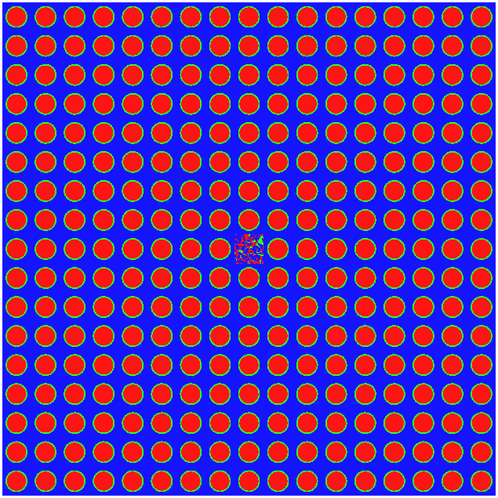
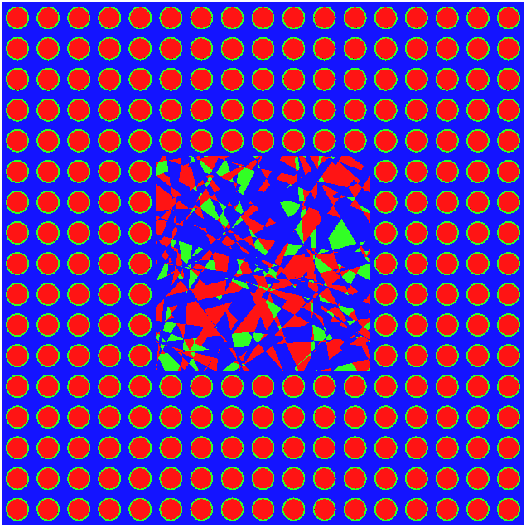
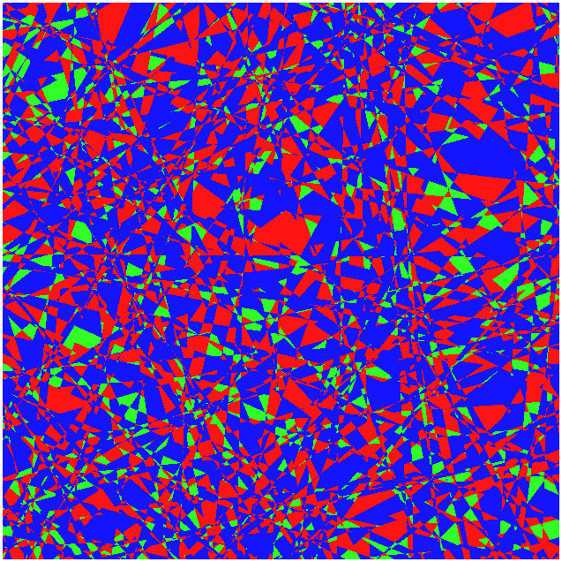
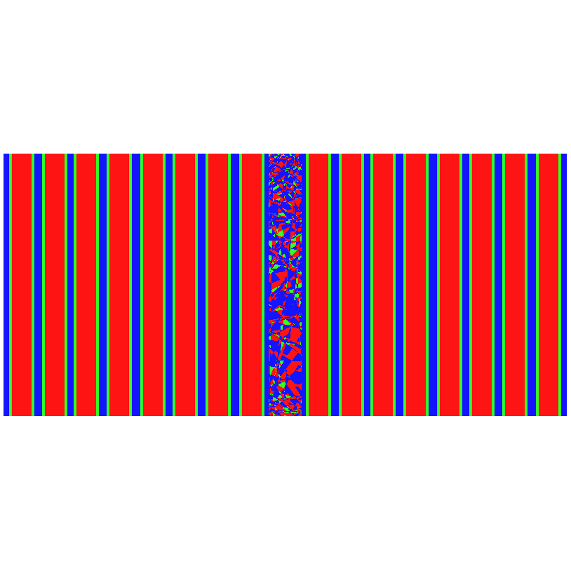
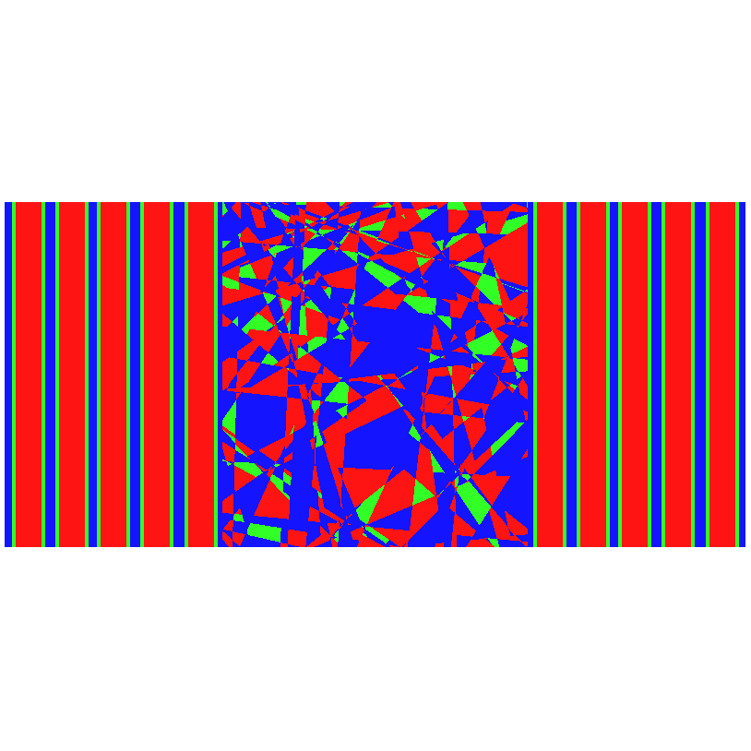
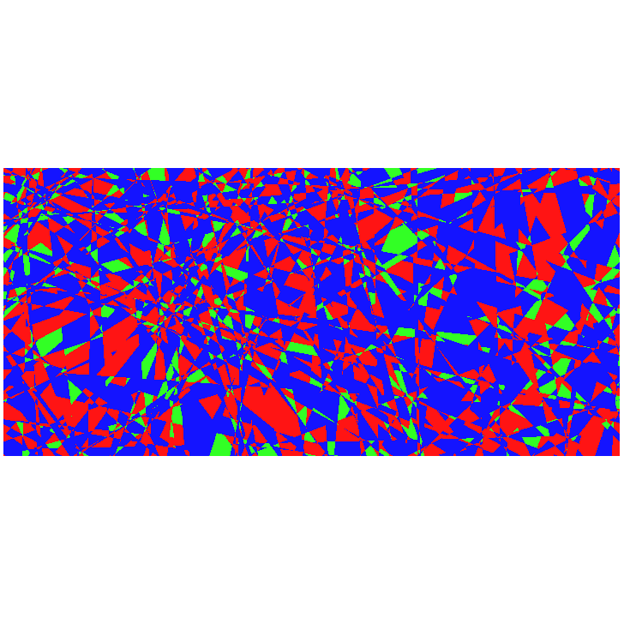
CRITICALITY BENCHMARK: DAMAGED 17x17 FUEL ASSEMBLY
1x1 portion
7x7 portion
17x17 portion
y
x
z
x
Compositions:
(ternary mixing,
respecting volume fractions p)
Fuel: UOX/MOX : 35%
Cladding : 10%
δ = 1.21 cm
Moderator: H₂O : 55%

Slide 8
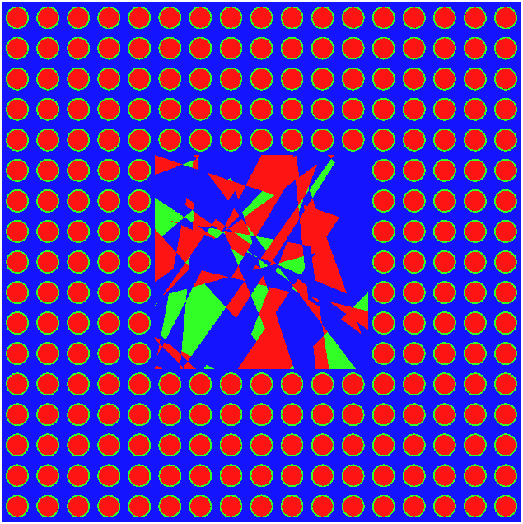
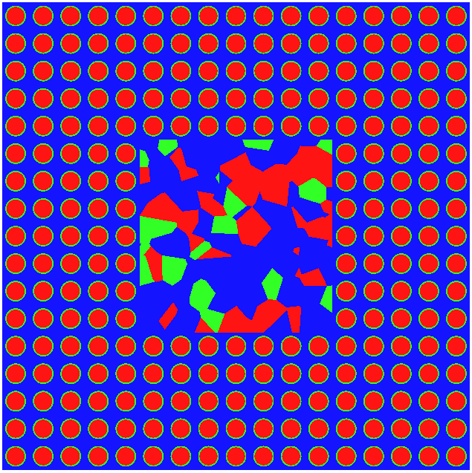
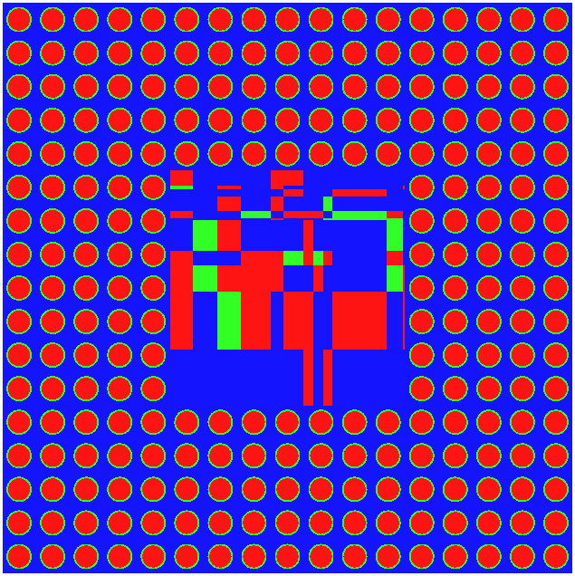
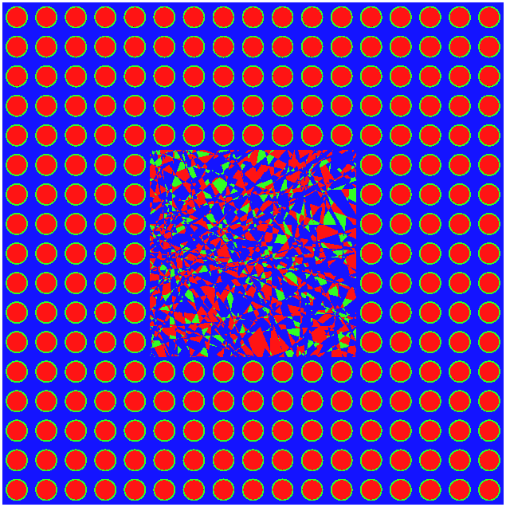
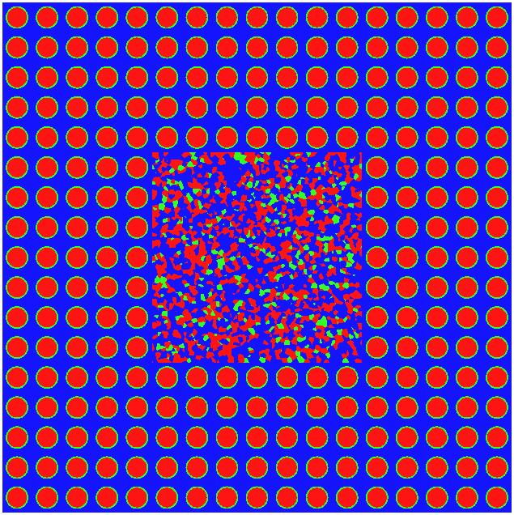
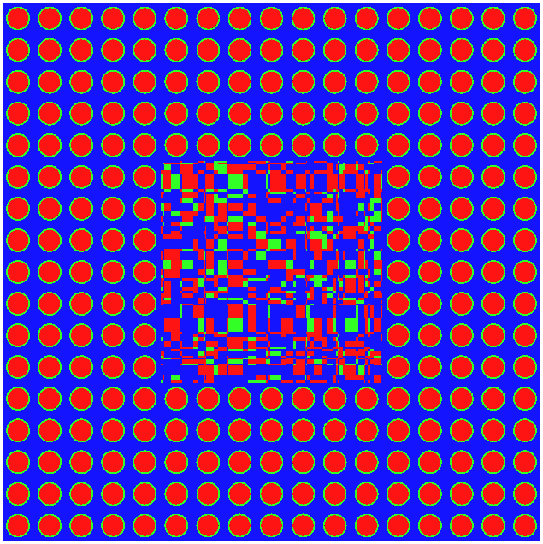
BENCHMARK PARAMETERS
Poisson tessellation
Voronoi tessellation
Box tessellation
Large Λ
Correlation length Λ
Small Λ

Slide 9
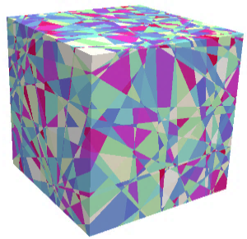
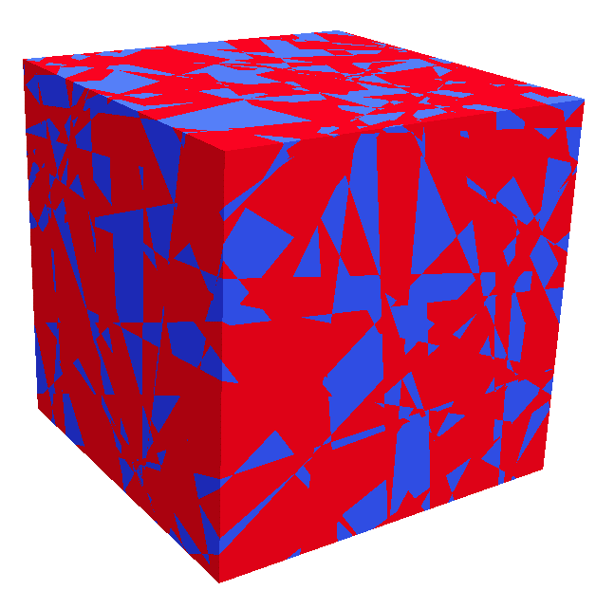
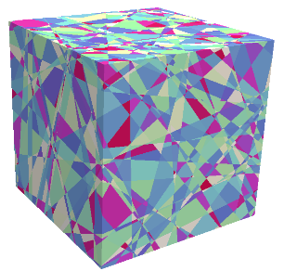
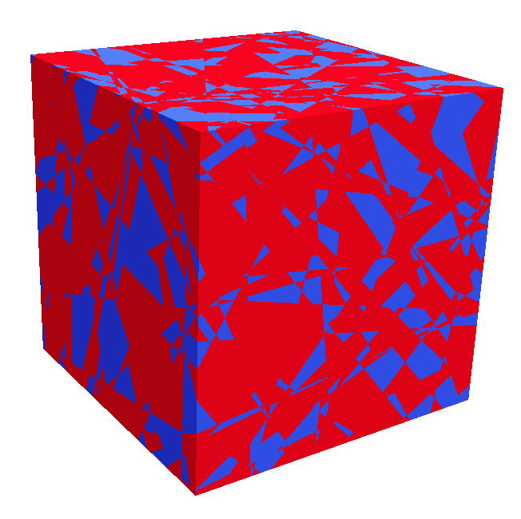
REFERENCE SOLUTIONS BY MONTE CARLO METHODS
Mixing statistics model
TRIPOLI-4
Criticality simulation
…
…
…
Tessellation
generator
M realizations
of stochastic tessellations
Solving the eigenvalue problem
Ensemble averages
Colouring
(volumic fraction p)
…
…
…
Parameters
p and Λ
TRIPOLI-4
Criticality simulation

Slide 10
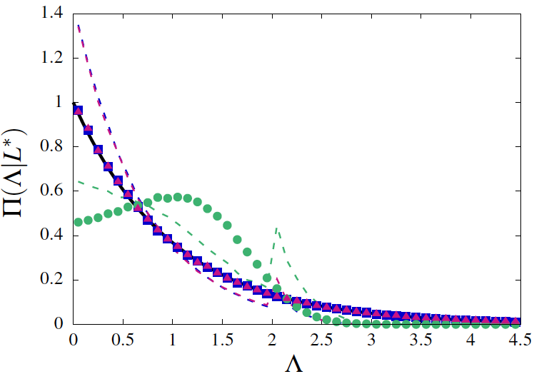
Model calibration: chord length
Setting the mixing statistics parameters so that they all have the
same average chord length <Λ> for a typical polyhedral cell
Blue: Poisson
Magenta: Box
Green: Voronoi
P(Λ)

Slide 11
Model calibration: polyhedral features
When imposing the same average chord length <Λ>, we have:
Volume
Surface
Faces
Poisson
Voronoi
Box

Slide 12
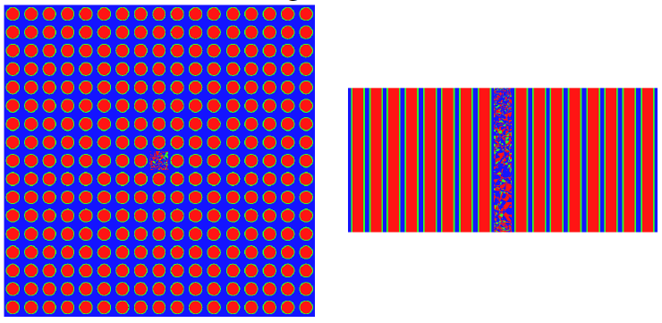
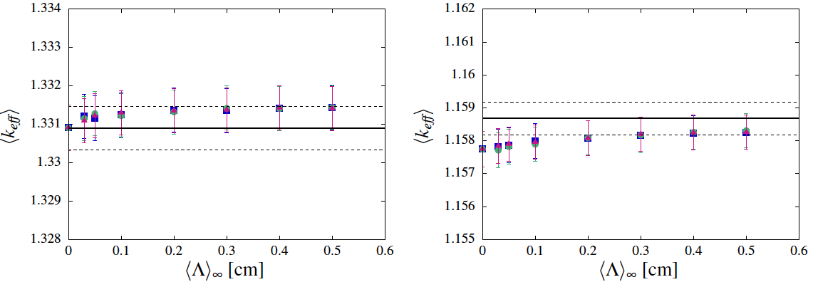
Average k_{eff}, 1x1 damaged fuel portion
Blue: Poisson
Magenta: Box
Green: Voronoi
Black: intact assembly
UOX
MOX

Slide 13
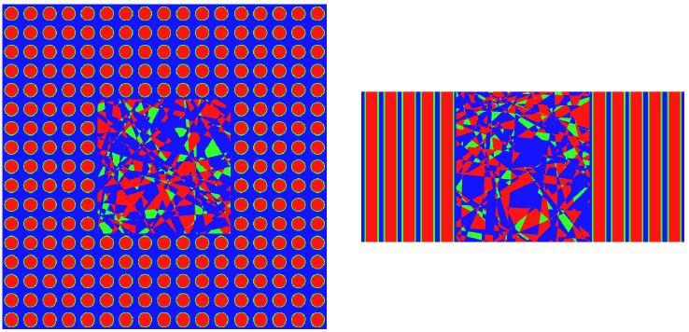
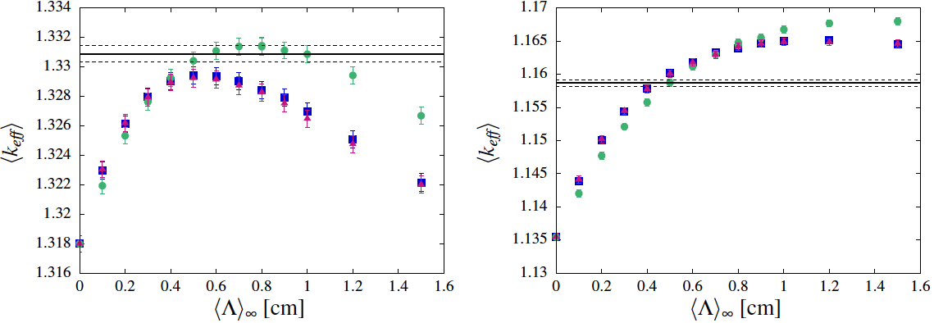
Average k_{eff}, 7x7 damaged fuel portion
Blue: Poisson
Magenta: Box
Green: Voronoi
Black: intact assembly
UOX
MOX

Slide 14
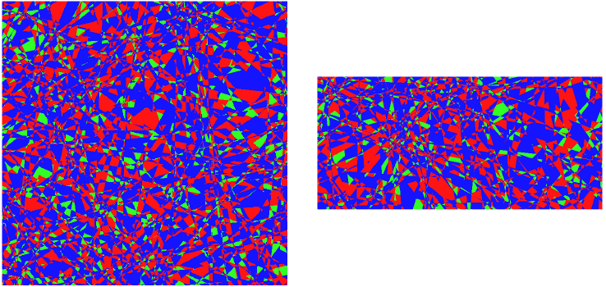
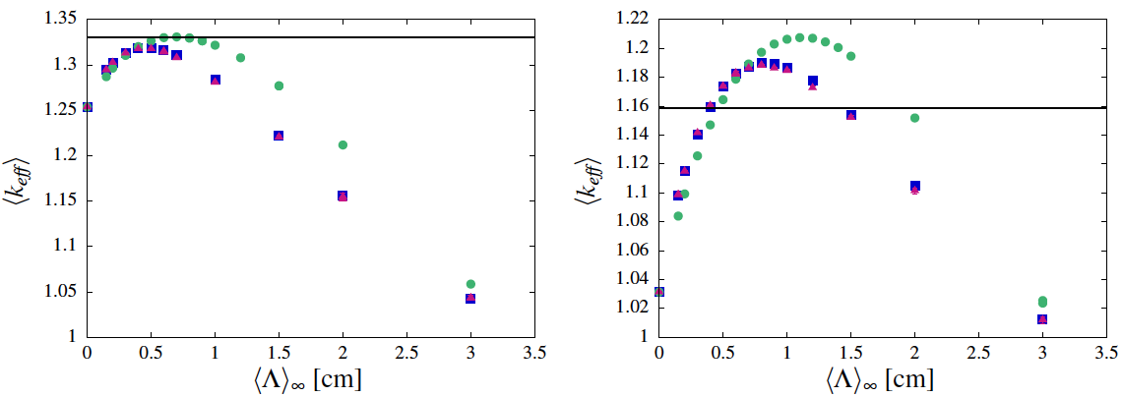
Average k_{eff}, 17x17 damaged fuel portion
Blue: Poisson
Magenta: Box
Green: Voronoi
Black: intact assembly
UOX
MOX

Slide 15
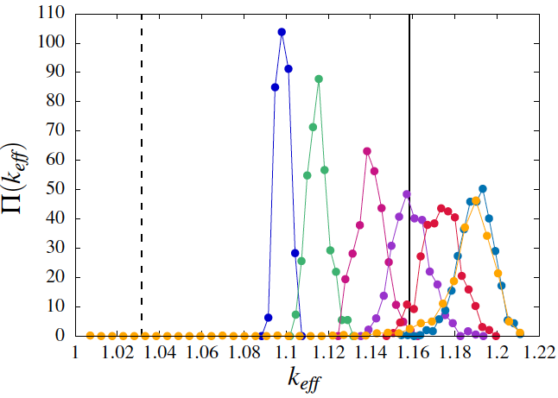
Distribution of K_{eff} as a function of <Λ>
MOX assembly with 17x17 damaged portion, with Poisson tessellation
Λ

Slide 16
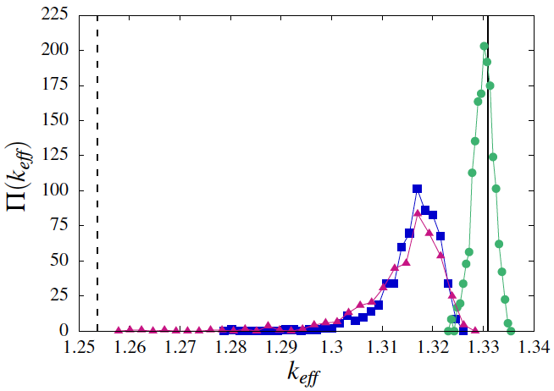
Distribution of K_{eff} as a function of Models
UOX assembly with 17x17 damaged portion
Blue: Poisson
Magenta: Box
Green: Voronoi

Slide 17
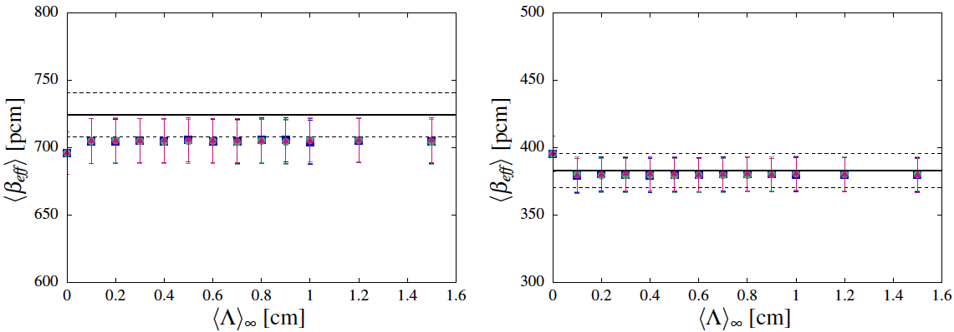
Average β_{eff}, 7x7 damaged fuel portion
Blue: Poisson
Magenta: Box
Green: Voronoi
Black: intact assembly
UOX
MOX

Slide 18
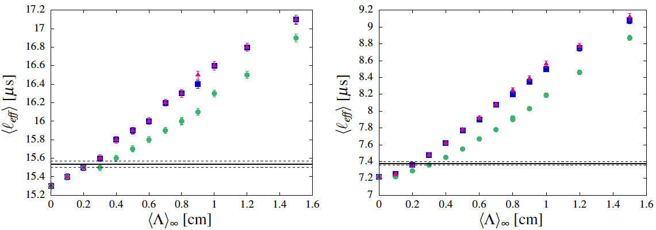
Average Λ_{eff}, 7x7 damaged fuel portion
Blue: Poisson
Magenta: Box
Green: Voronoi
Black: intact assembly
UOX
MOX

Slide 19
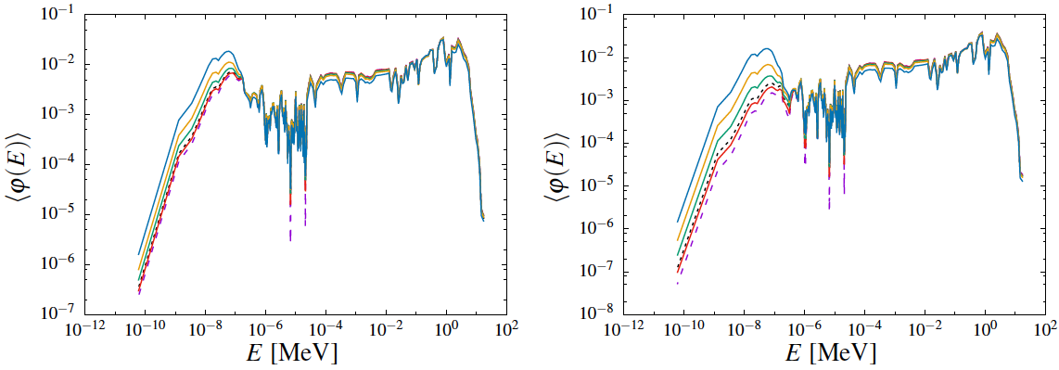
Flux Spectra, 17x17 damaged fuel portion
Poisson mixing statistics
Black dashed line: intact fuel pins
Purple dashed line: atomic mix
Λ
Λ
UOX
MOX

Slide 20
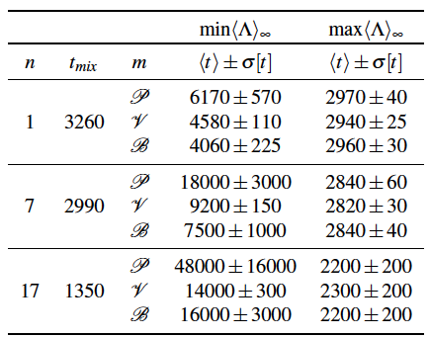
Simulation time [s]

Slide 21
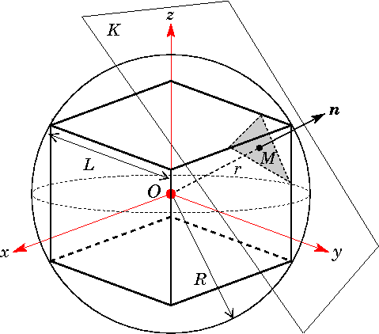
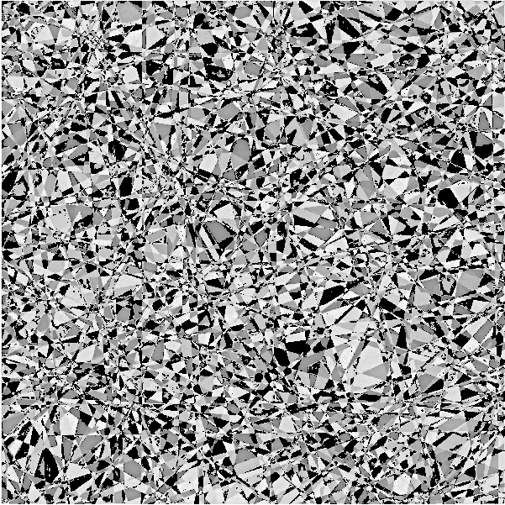
INCLUDING ANISOTROPY IN POISSON TESSELLATIONS
Angular distribution H(n)
Isotropic tessellations:
Anisotropic tessellations:
Strongly peaked H(n)
Example: material stratification

Slide 22
Thanks for your attention
References
C. Larmier, A. Zoia, F. Malvagi, E. Dumonteil, A. Mazzolo, Neutron multiplication in random media: Reactivity and kinetics parameters, Ann. Nucl. Energy 111, 391-406 (2018)
C. Larmier, A. Zoia, F. Malvagi, E. Dumonteil, A. Mazzolo, Monte Carlo particle transport in random media: the effects of mixing statistics. JQSRT 196, 270-286 (2017)
C. Larmier, François-Xavier Hugot, F. Malvagi, A. Mazzolo, A. Zoia, Benchmark solutions for transport in d-dimensional Markovian binary mixtures, JQSRT 189, 133-148 (2017)
C. Larmier, E. Dumonteil, F. Malvagi, A. Mazzolo, A. Zoia, Finite size effects and percolation properties of Poisson geometries, Phys. Rev. E 94, 012130 (2016)

Slide 23
DEN/DANS DM2S SERMA
Commissariat à l’énergie atomique et aux énergies alternatives
Centre de Saclay | 91191 Gif-sur-Yvette Cedex
T. +33 (0)1 69 08 62 75 | Secr :+33 (0)1 69 08 39 61
Etablissement public à caractère industriel et commercial | RCS Paris B 775 685 019

