Slide 1
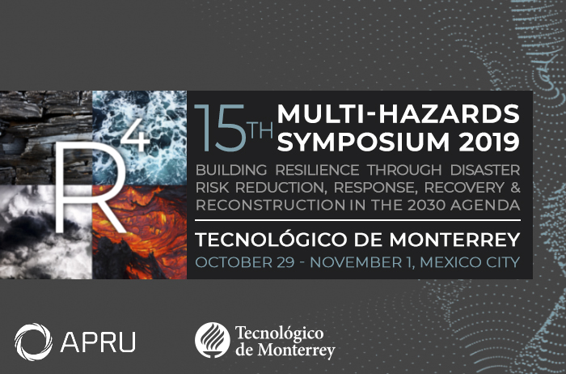

Slide 2
Authors - TEAM
ORTIZ HARO, David
LACLEMENCE, Patrick
MOREL SENATORE, Audrey
DELATOUR, Guillaume
BABIN, Michael

Slide 3
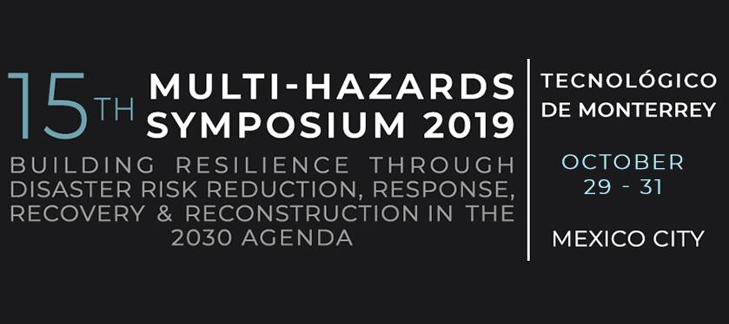
Collective Behaviors in crisis situations
Image Source: https://rpp.pe/mundo/desastres-naturales/ecuador-extiende-30-dias-mas-el-estado-de-excepcion-por-terremoto-noticia-971952

Slide 4
questions
What is known about citizens behaviors during crisis situations?
Are the old paradigms in the area still applicable nowadays?
What elements allow behavior to be performed in a more constructive way for facing crisis?
Which of those aspects allow communities develop their actions in an altruistic way?

Slide 5
Context
Image Source: https://www.unisdr.org/we/inform/disaster-statistics

Slide 6
The crowds

Slide 7
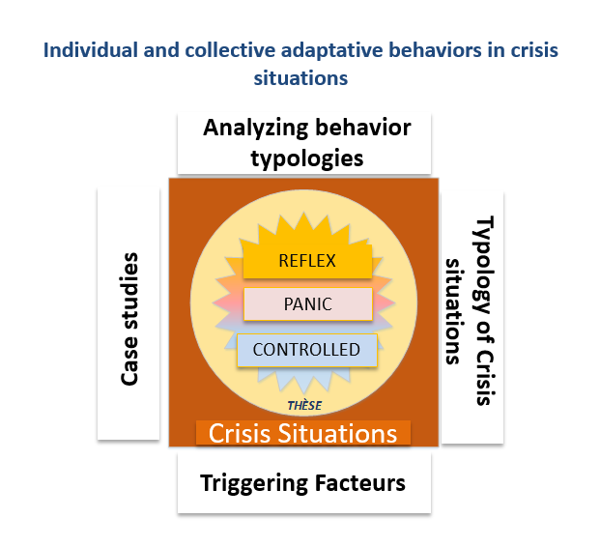
Human behaviors
Graphique qui contient une adaptation de la typologie de comportements de Provitolo et Dubos-Paillard (2015) appliqué à l’objet d’étude de cette thèse.
L’article peut être consulté sur le site internet: https://journals.openedition.org/cybergeo/27150

Slide 8
Human behaviors

Slide 9
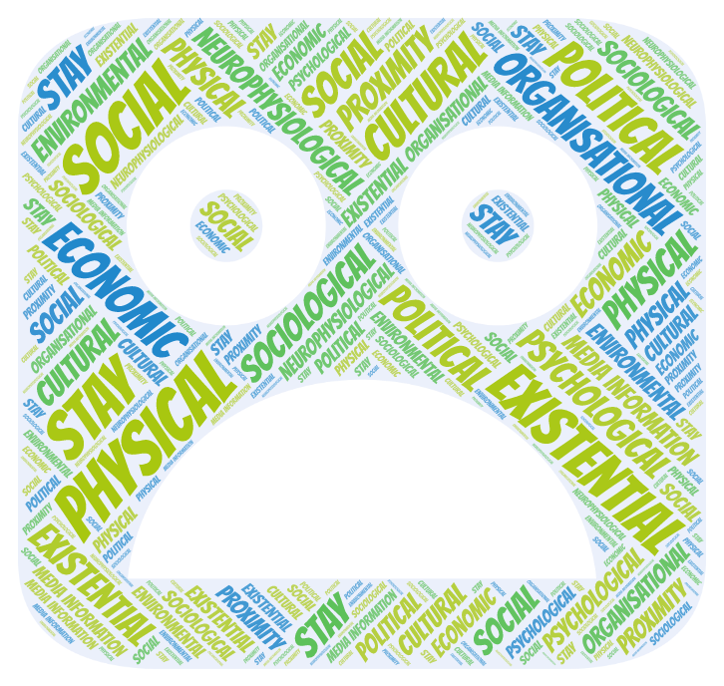
Factors that influence our behavior
SOCIAL LINKS
&
VALUES
EMPATHY
SOLIDARITY
ALTRUISM
=
DIGNITY

Slide 10
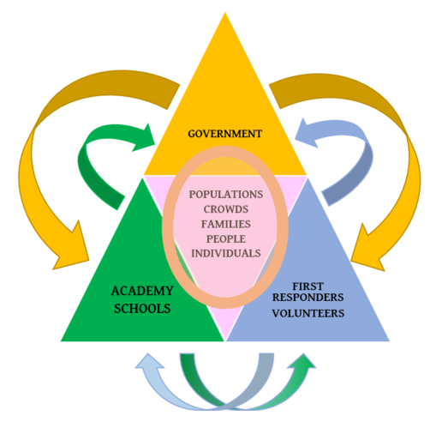
Three pillars to protect populations

Slide 11
Social cognition and integrative studies - HYPOTHESES
Source: http://www.cubadebate.cu/noticias/2016/04/18/continuan-labores-de-rescate-en-ecuador-tras-fuerte-sismo-fotos-y-video/#.XZ27YShLiUk

Slide 12
Thank you
Source: https://www.bing.com/images/search?view=detailV2&ccid=rhJB%2fwbj&id=615859821DAAB14C1891CE59C0F225432615BEC8&thid=OIP.rhJB_wbjvhl5cPotdS10pAHaKZ&mediaurl=http%3a%2f%2fpre12.deviantart.net%2fbf76%2fth%2fpre%2fi%2f2011%2f161%2fe%2f6%2fsolidarity_by_benheine-du3bog.jpg&exph=1059&expw=754&q=solidarity&simid=608016498980686326&selectedIndex=47&ajaxhist=0

